Slide 1
FINAL PROJECT
FORECASTING
COMPETITIVE FOOTBALL
Pre-Match & In-Play Prediction from Raw Event Data
NOSRATI
YAZDANI
Instructor: Sattar Hashemi
Machine Learning Course · Department of Computer Science
DEFENSE-READY DECK
Notes:
Opening: We built three football forecasting deliverables from raw StatsBomb event data: pre-match outcome classification, pre-match goal-margin regression, and in-play prediction. The key point of this defense is not a single accuracy number; it is whether the pipeline is leakage-safe and whether performance survives future-season testing.

Slide 2
01 · OVERVIEW
Project at a glance
Three deliverables, one leakage-aware data foundation.
138
536,328
111
1,998
3
raw matches
events
pre-match examples
in-play snapshots
future-season tests
Model 1 · Outcome Classification
Model 2 · Goal-Margin Regression
Model 3 · In-Play Prediction
One vector per match → calibrated probabilities for Home / Draw / Away.
Headline scoring: RPS, plus Log Loss, Brier, ECE and balanced accuracy.
Same pre-match history → signed home-minus-away goal margin.
Measured with MAE, RMSE, R² and correlation.
18 snapshots per match (5, 10, …, 90 minutes) → updated outcome probabilities and expected margin.
Defense principle
Every number in this presentation is tied to a specific test season and data scope. We do not present accuracy as a universal constant.
Notes:
Use this slide to frame the project. Mention the exact scale: 138 raw matches; after requiring enough historical matches, 111 pre-match examples remain; each produces 18 snapshots, so 1,998 live examples. Emphasize that the grading brief asks for all three tasks and probability quality, not accuracy alone.

Slide 3
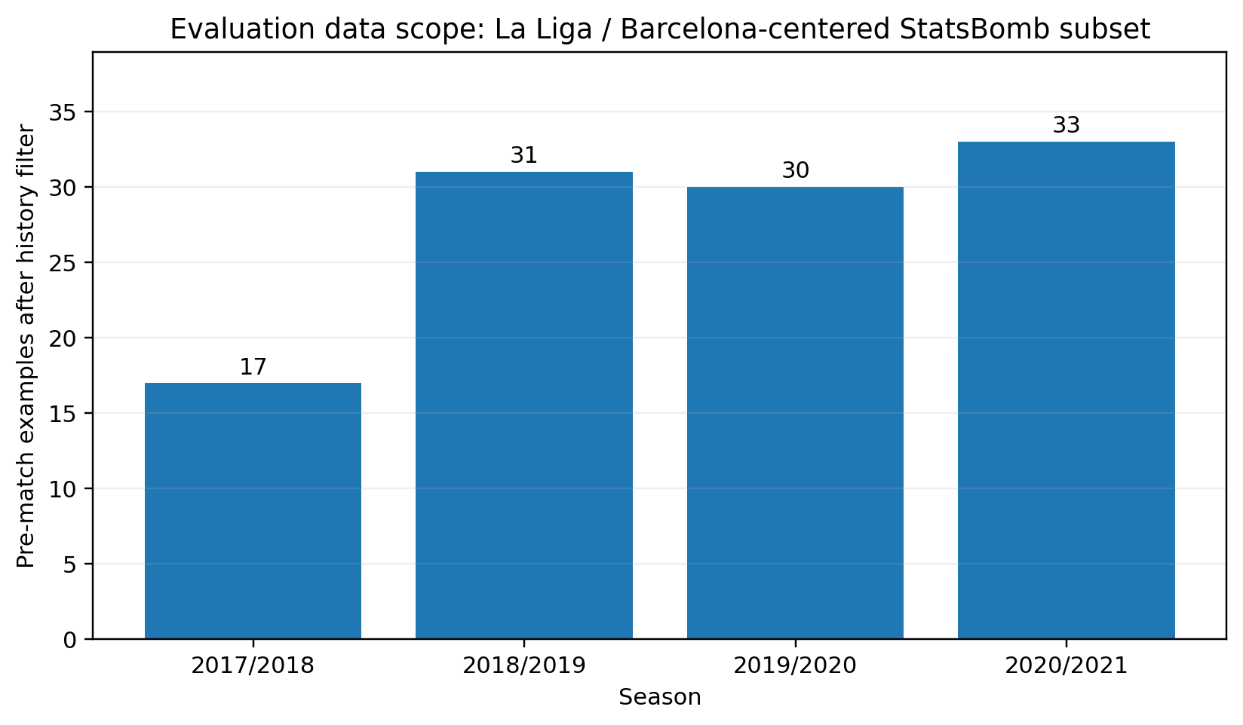
02 · DATA
What data did we actually evaluate?
This scope must be stated before quoting any accuracy.
Competition & seasons
La Liga · 2017/18, 2018/19, 2019/20, 2020/21
Important sampling fact
The available StatsBomb matches in these seasons are Barcelona-centered. Every retained modeling match includes Barcelona as home or away.
360 coverage
35 of 138 raw matches have 360 frames (25.4%). Final engineered features are primarily event-stream features, not full-coverage 360 inputs.
Modeling examples after rolling-history filtering.
Correct claim
“La Liga / Barcelona-centered StatsBomb subset” — not “all La Liga” and not “all leagues.”
Notes:
This is a critical answer if asked “which league and which period?” Say: La Liga seasons 2017/18 through 2020/21, but the StatsBomb open-data availability in this run is Barcelona-centered. Therefore the evaluation is not a full-season league sample and external generalization is limited.

Slide 4
03 · PIPELINE
End-to-end pipeline & leakage boundaries
Two feature pipelines share one chronological match-level split.
Raw JSON
Integration
Temporal split
Features
Models
Evaluation
matches · events
lineups · 360
keys · identities
labels · cleaning
season-ahead
match-level
pre-match
+ in-play
C · R · L
calibration
RPS · Log Loss
MAE · ECE · SHAP
Leakage defenses implemented in code
Pre-match boundary
Live time-t boundary
Match-level grouping
Rolling history uses shift(1): the target match is excluded from its own form features.
assert_time_t_cut(): no event after the snapshot minute can contribute.
All 18 snapshots from one match inherit the same train/test side.
PASS · pre-match history before kick-off
PASS · event timestamp ≤ snapshot time
PASS · GMM sampling only on training
Why it matters
A high score is scientifically meaningless if future information leaked into the features. Our validation claims begin with these boundaries.
Notes:
Explain leakage in plain language. Pre-match: all rolling aggregates are shifted before rolling, so the current match cannot affect its own features. In-play: snapshots only use events with timestamp at or before t. And snapshots are split by parent match, not row-by-row. Resampling is restricted to training data.

Slide 5
04 · FEATURES
Feature engineering: every group had to earn its place
11 pre-match + 3 live-state features — selected on future-season development RPS, not by “search and add”.
PRE-MATCH
IN-PLAY
Core form · KEEP
Game state · KEEP
11
6 domain anchors: 5-match points, goals for/against, shots, xG for/against. Dev mean RPS = 0.1606.
Final live contract adds only: snapshot minute, current score difference, and home man advantage.
final pre-match features
Style & territory · KEEP
Cumulative event quality · REJECT
+5: passes, completed passes, pressures, final-third carries, event share. RPS 0.1458; ΔRPS = −0.0147.
Development gain = 0.00011 RPS — below the 0.0005 live-feature threshold.
14
final live features
Context / efficiency · REJECT
Recent momentum · REJECT
Context gain only 0.0007 (<0.001). Efficiency worsened RPS by 0.0013; short-form by 0.0014; defense/set-piece by 0.0096.
Development gain = 0.00016 RPS — below threshold. Extra live counts added latency/variance without enough value.
Leakage & market guardrail
All features are shifted before kick-off / cut at time t. Bookmaker odds are excluded from model inputs so the market remains an independent baseline.
Momentum · REJECT
Decision rule
42.3% mean missingness (>30% pre-screen threshold). We did not let sparse trends enter model selection.
Pre-screen missingness → future-season ablation → keep only measurable gain; odds remain baseline-only.
Notes:
Answer the feature question by grouping, not reciting 100+ columns. Pre-match categories: form, xG/shots, passing/pressure/territory, discipline, efficiency, rest/context, momentum and home-away differences. In-play adds score state, man advantage, cumulative event statistics, recent 5-minute windows, live differences and the pre-match prior.

Slide 6
05 · MARKET
Market baseline: fixed, tagged and evaluated
Football-Data date/team alias matching is fixed; model and market scores use the exact same match identities.
111/111
100%
33
−0.0116
odds-tagged modeling rows
coverage across 4 seasons
shared final-test matches
RPS delta · model − market
What is actually compared
2020/21 · identical 33 matches
De-vig: q = 1/odds, then p = q / Σq.
Coverage by season: 17/17 · 31/31 · 30/30 · 33/33.
Odds are baseline-only — never used as model features in this experiment.
Logistic: RPS 0.1732 · Log Loss 0.889 · ECE 0.121 · Accuracy 63.6%
Market: RPS 0.1848 · Log Loss 0.913 · ECE 0.159 · Accuracy 63.6%
Defense-safe wording
“On this 33-match Barcelona-centered test, our RPS is 0.0116 lower than the de-vigged market (≈6.3%). That is one small held-out subset, not a universal market-beating claim.”
Notes:
Do not say the model beat bookmakers. Say exactly: the code includes odds_tagged and de-vigged H/D/A market probabilities, but the saved run has 0% successful odds tagging. Therefore those fields are unusable and there is no scientifically valid market comparison in the submitted outputs.

Slide 7
06 · VALIDATION
Validation: predict → observe → update
Model/feature choices use earlier future-season folds; final 2020/21 is scored game-by-game with no future labels.
DEVELOPMENT FOLD 1
FUTURE VALIDATION
Feature/model selection
2017/18 → validate 2018/19
31 matches · model selection only
Only the two development folds decide features, learner family and calibration. 2020/21 is untouched until final scoring.
DEVELOPMENT FOLD 2
FUTURE VALIDATION
Snapshot grouping
2017/18 + 2018/19 → validate 2019/20
30 matches · cadence / ablation only
All 18 snapshots of a match stay with the parent match. No same-match leakage across train/test; live features use events ≤ t.
FINAL INITIAL TRAIN
2020/21 PREQUENTIAL TEST
Cadence sensitivity · 2019/20
2018/19 + 2019/20 = 61 matches
33 predictions · refit after each FT result
RPS: every4 0.1364 · every2 0.1383 · every1 0.1391 · never 0.1413. Final protocol = every match; ECE 0.0957.
What “average test result” means
Every final metric averages predictions made before each match, after updating only with results that were already known. It is not one model trained once on a whole test season.
Notes:
The main validation answer: three chronological one-season-ahead outer tests. Hyperparameters and calibration are learned only from the training season. For live data, split by match, not by snapshot. One nuance: feature construction can use earlier completed games within the test season for a later test match, because that information is legitimately available at prediction time; model parameters are still frozen.

Slide 8
07 · EVALUATION
How do we know the model is “good”?
No single metric is enough for probabilistic forecasting.
1 · Future-season performance
2 · Proper probability scores
3 · Calibration
Evaluate on unseen future seasons, not a random row split.
RPS, Log Loss and Brier penalize overconfident wrong probabilities.
ECE + reliability diagrams check whether 70% predictions occur about 70% of the time.
4 · Class-aware metrics
5 · Baselines
6 · Failure analysis
Balanced accuracy, per-class precision/recall/F1 reduce majority-class illusion.
Dummy prior is the sanity floor. A valid market baseline is required once odds tagging works.
SHAP + worst predictions explain how the model fails, not just how often.
A model can have higher accuracy and worse probabilities
For a forecasting product, calibration and proper scoring rules matter because the output is a probability distribution, not only an arg-max class label.
Notes:
If asked “how do you know it is good now?”, say: I do not infer quality from accuracy alone. I require held-out future-season performance, comparison to a dummy prior, proper scoring rules, calibration, class-aware metrics and error analysis. The market baseline is not currently available because odds tagging is 0%, so I cannot use it as evidence.

Slide 9
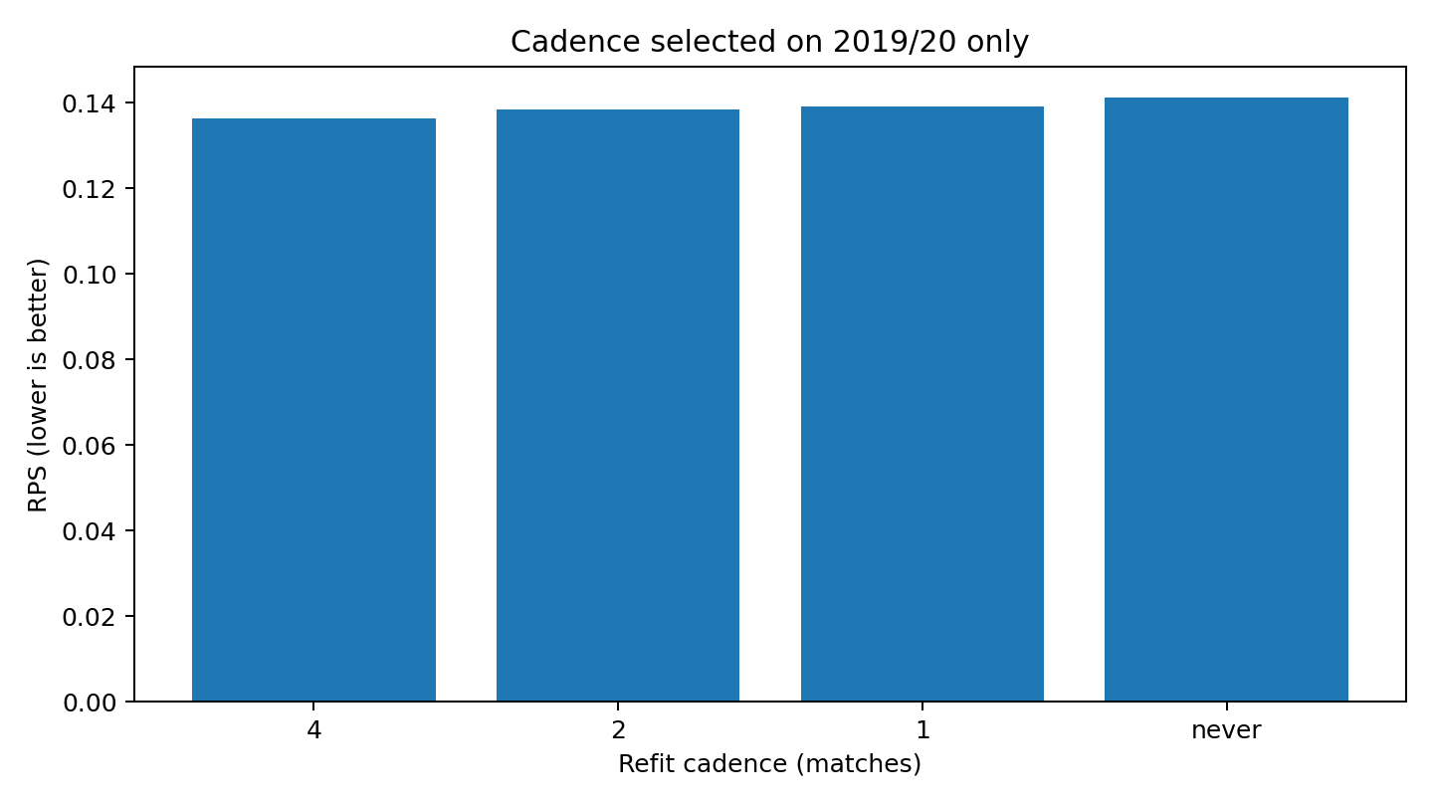
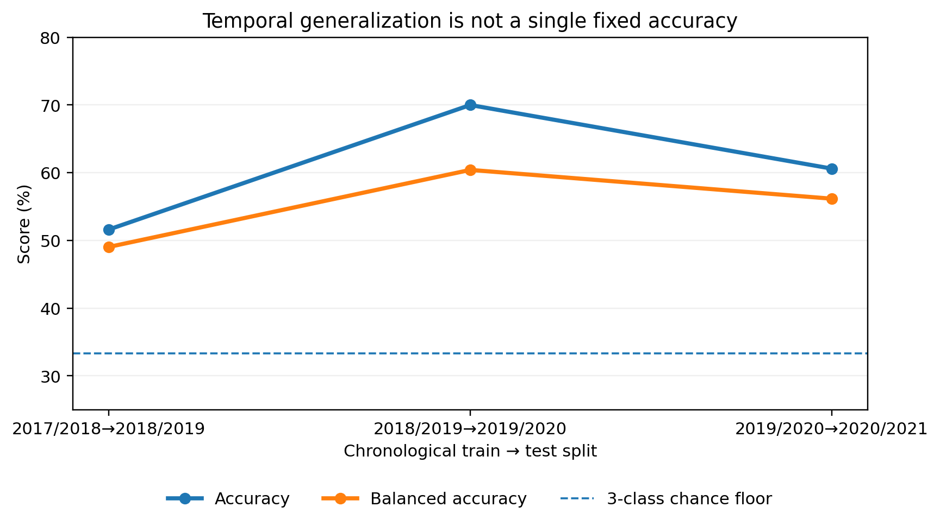
08 · UPDATE CADENCE
Why update after every match?
Cadence was studied on 2019/20 before final testing; final protocol follows the week-to-week deployment reality.
0.1391
every match · ECE 0.0957
0.1364
every 4 matches · best dev RPS
0.1413
never refit · ECE 0.1305
Decision, not a magic number
2019/20 cadence sensitivity — RPS lower is better.
We deploy every-match updates because the previous label is available, ECE stays <0.10, and RPS is within 0.0027 of the development optimum. The trade-off is reported, not hidden.
Notes:
This directly answers the “2016 vs 2019” type question. A number from one held-out season belongs to that season. The same SVC family scored 51.6%, 70.0% and 60.6% accuracy on the three future seasons. That variation is evidence of temporal distribution shift.

Slide 10
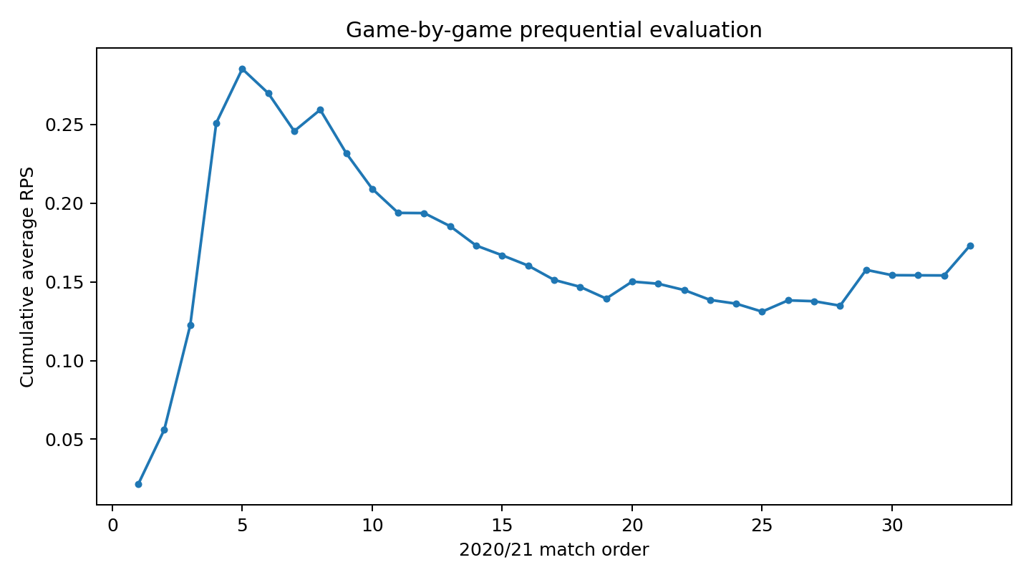
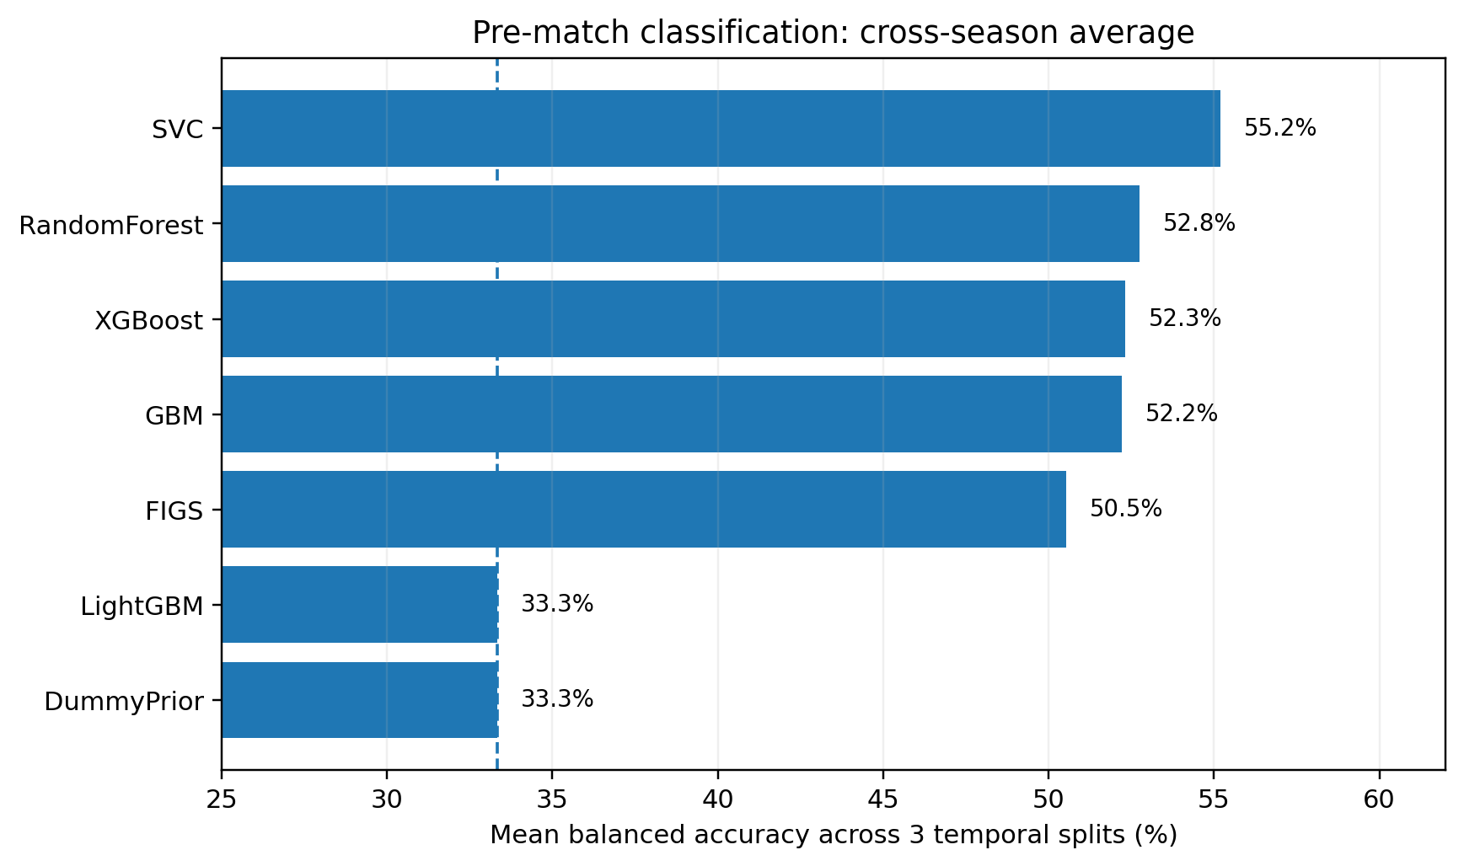
09 · RESULTS
Pre-match classification: selected model & final test
Learner family selected only on development folds; 2020/21 = 33-match every-game walk-forward.
Development selection
Mean RPS: Logistic 0.1458 · Random Forest 0.1550 · SVC 0.1588 · GBM 0.1650 · FIGS 0.2182
Final 2020/21 · n = 33
Logistic: Acc 63.6% · Bal 51.8% · RPS 0.1732 · Log Loss 0.889 · ECE 0.121
Market: Acc 63.6% · Bal 51.8% · RPS 0.1848 · Log Loss 0.913 · ECE 0.159
Why Logistic won here
Small Barcelona-centered N + 11 relative features favor regularization. Tree models added variance and did not improve future-season RPS.
Cumulative average RPS after each 2020/21 prediction.
Takeaway
Same top-1 accuracy as the market on the exact 33 matches, but better RPS, Log Loss and ECE. Scope remains small.
Notes:
For the final held-out 2020/21 subset, uncalibrated GBM reached 63.6% accuracy with RPS 0.161 on 33 matches. Always attach the scope: trained on 2019/20, tested on the Barcelona-centered 2020/21 subset. Across all three splits, SVC has the strongest mean balanced accuracy among the uncalibrated fixed variants shown.

Slide 11
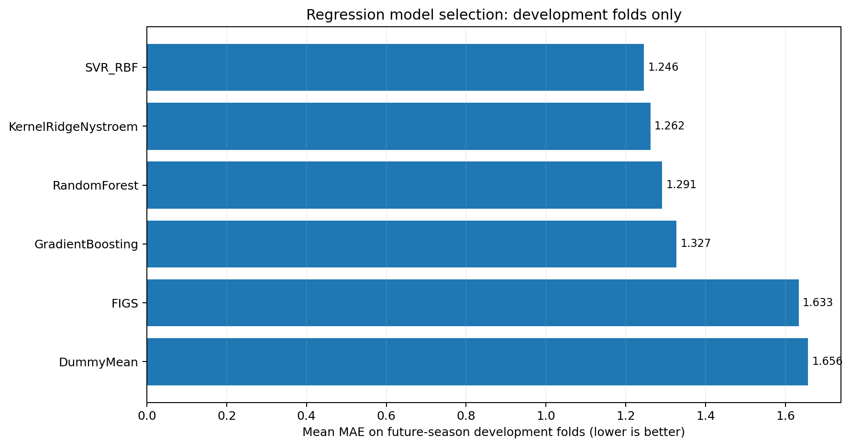
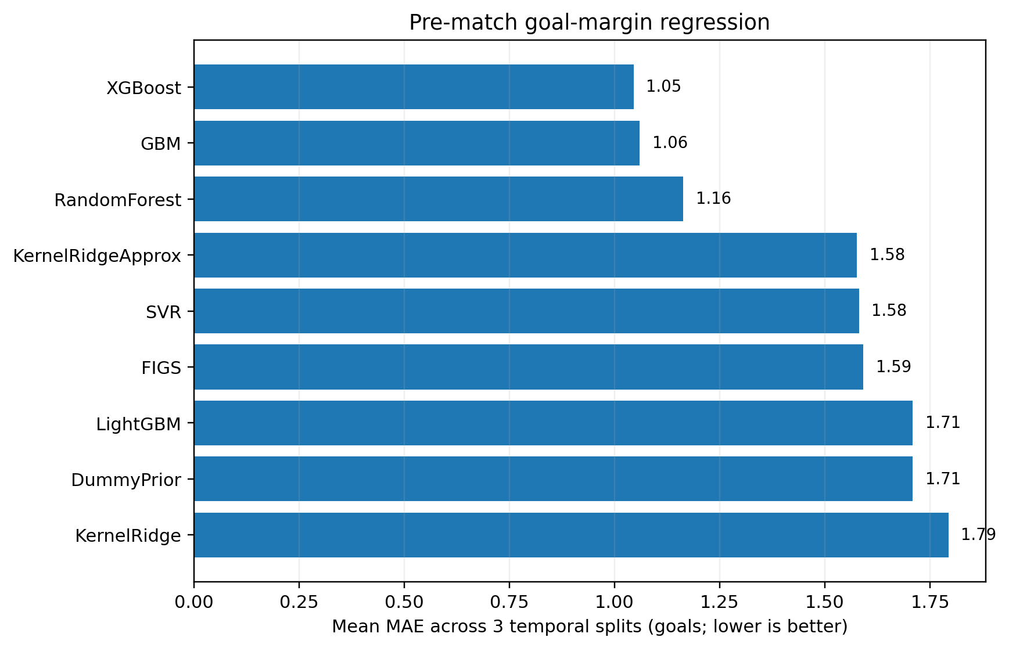
10 · RESULTS
Pre-match goal-margin regression
SVR_RBF minimizes development MAE; final reporting uses the harder game-by-game protocol.
Development selection
SVR 1.246 · Kernel Ridge 1.262 · Random Forest 1.291 · GBM 1.327 · FIGS 1.633 · Dummy 1.656
Final 2020/21 · every-match update
SVR_RBF: MAE 1.566 · RMSE 1.885 · correlation 0.523 on 33 prequential predictions.
Interpretation
We report the harder prequential number instead of cherry-picking the old static 0.452 MAE result. Regression remains a clear improvement target.
Mean MAE across the two future-season development folds.
Notes:
Regression is strongest with XGBoost/GBM across the three chronological splits: mean MAE about 1.05–1.06 goals. The final 2020/21 split looks much better — GBM MAE 0.452 — but because the test set is only 33 matches, present it as a split-specific result, not universal performance.

Slide 12
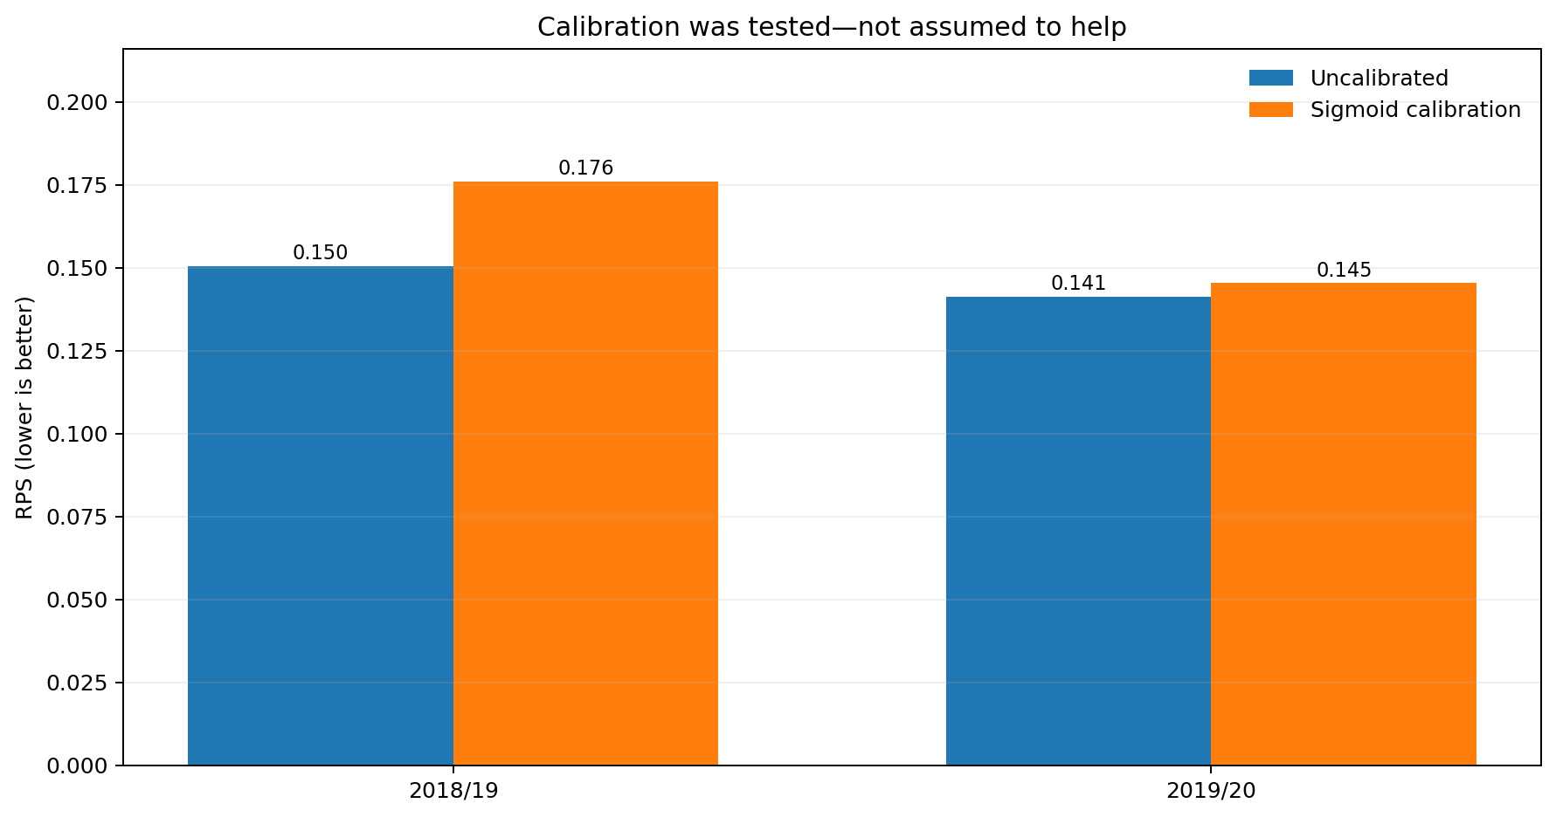
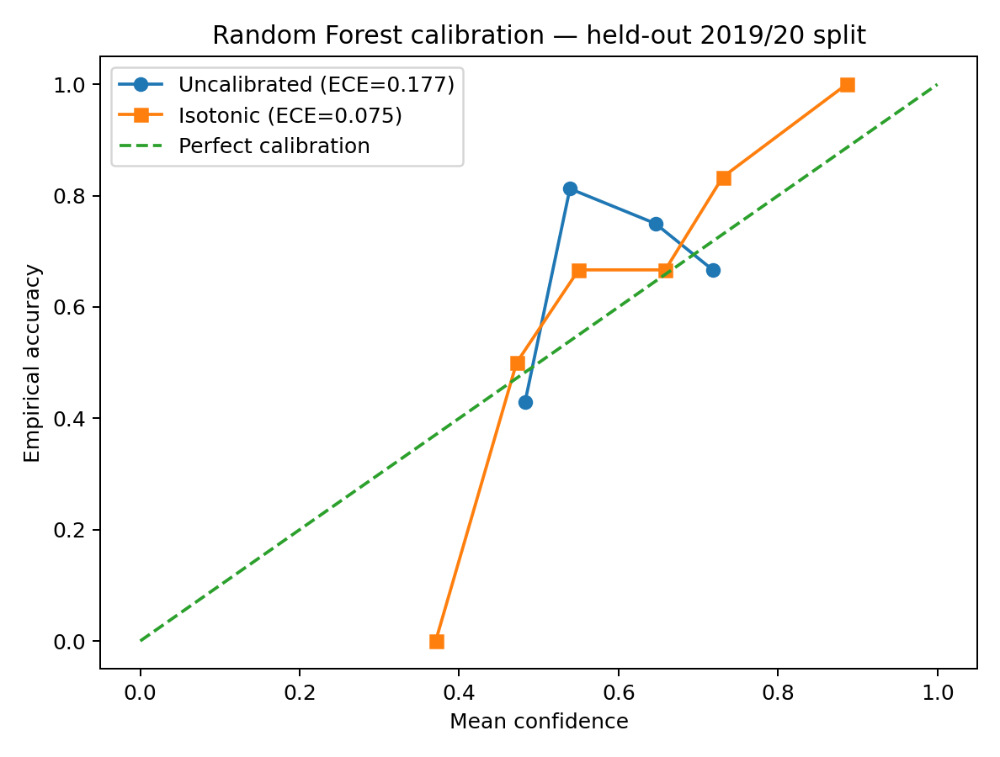
11 · CALIBRATION
Calibration: measured, not assumed
For the selected Logistic model, sigmoid calibration made development RPS/ECE worse.
0.1504
0.1759
RPS uncal · 2018/19
RPS sigmoid · worse
0.1413
0.1453
RPS uncal · 2019/20
RPS sigmoid · worse
0.1305
0.2200
ECE uncal · 2019/20
ECE sigmoid · worse
Final decision
Uncalibrated vs sigmoid on future-season development folds.
Keep the uncalibrated Logistic for the final walk-forward. Calibration is still evaluated and reported; it is not applied just to satisfy a checkbox.
Notes:
Use this as an example, not a universal claim. On split 2, Random Forest isotonic calibration improved ECE from about 0.177 to 0.075, RPS from 0.157 to 0.127 and Log Loss from 0.858 to 0.717. But small samples make isotonic unstable on some other splits, so calibration must be inspected separately by season.

Slide 13
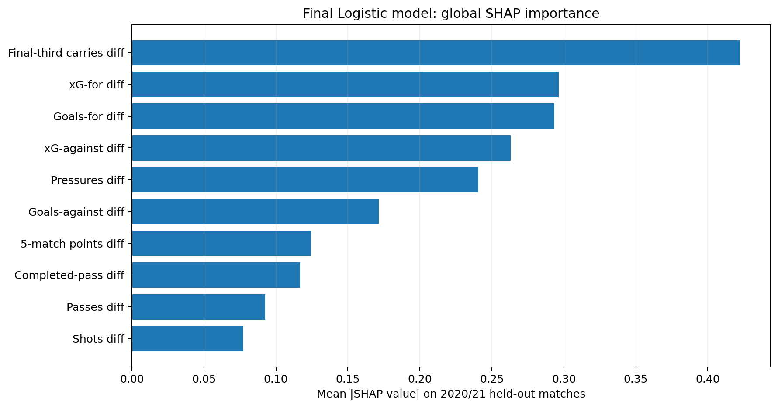
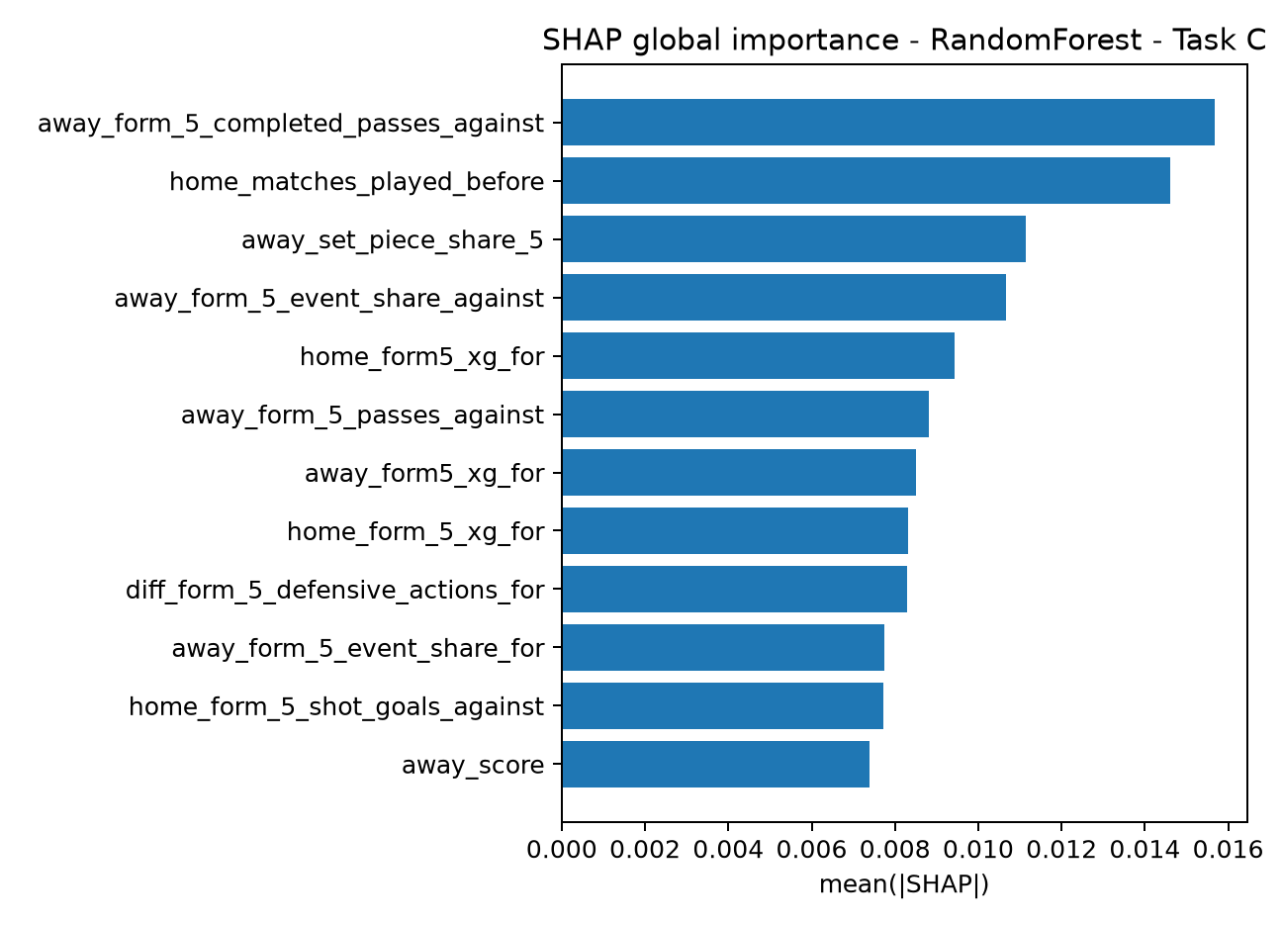
12 · EXPLAINABILITY
Explainability: show the actual final model
Global and local SHAP use the deployment Logistic, while FIGS provides explicit rule-level interpretability.
Global explanation
Largest mean |SHAP| drivers: final-third carries, xG for, goals for, xG against and pressures — all home-minus-away rolling contrasts.
Local explanation
phase2_final.ipynb shows the 10 worst predictions; the API returns top SHAP contributions for each requested snapshot.
Live explanation
The same 14-feature live contract is explained online; score difference / man advantage can take over as match evidence arrives.
Scientific caution
Final Logistic global mean |SHAP| on the 2020/21 held-out matches.
SHAP explains model contribution, not causality. FIGS rules are easier to narrate, but FIGS was not the best predictive model.
Notes:
SHAP is required because a forecasting model must be explainable. Global SHAP ranks overall feature impact. Local explanations help with worst-case post-mortems. In-play timelines are intended to show how attribution changes through a match. Do not interpret SHAP causally.

Slide 14
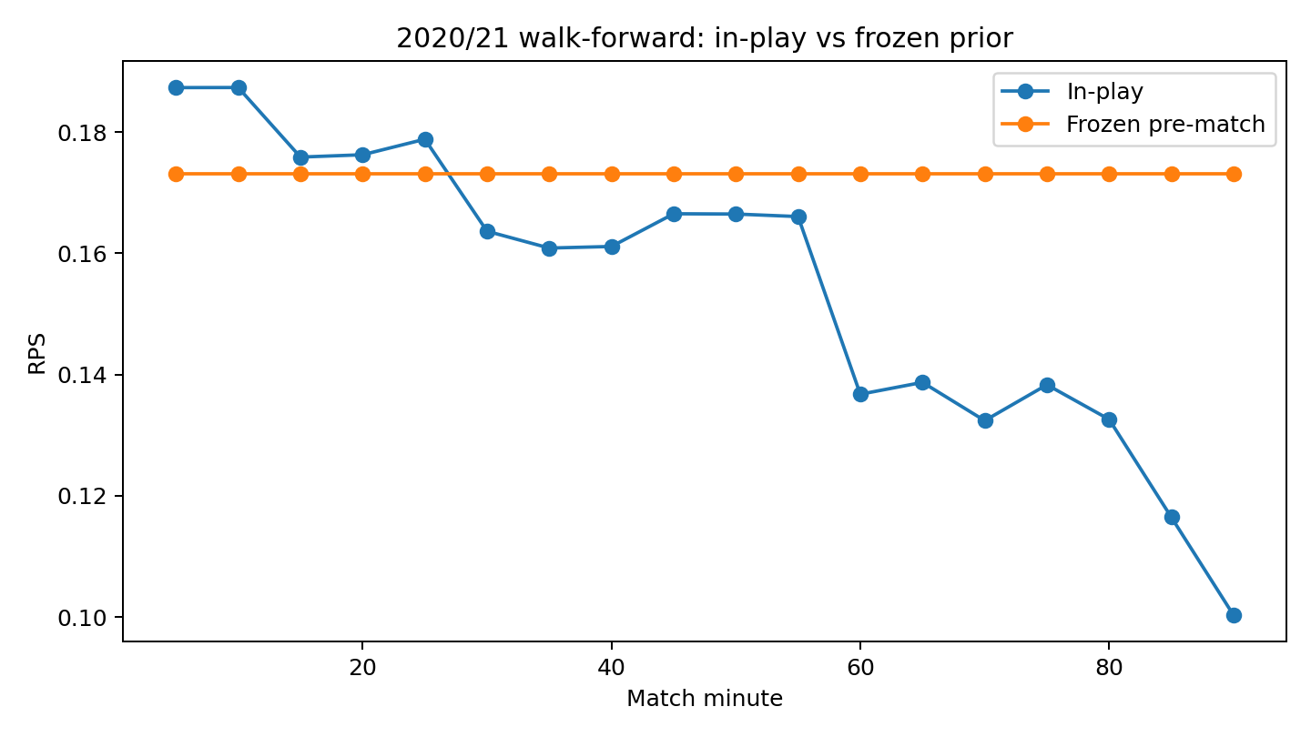
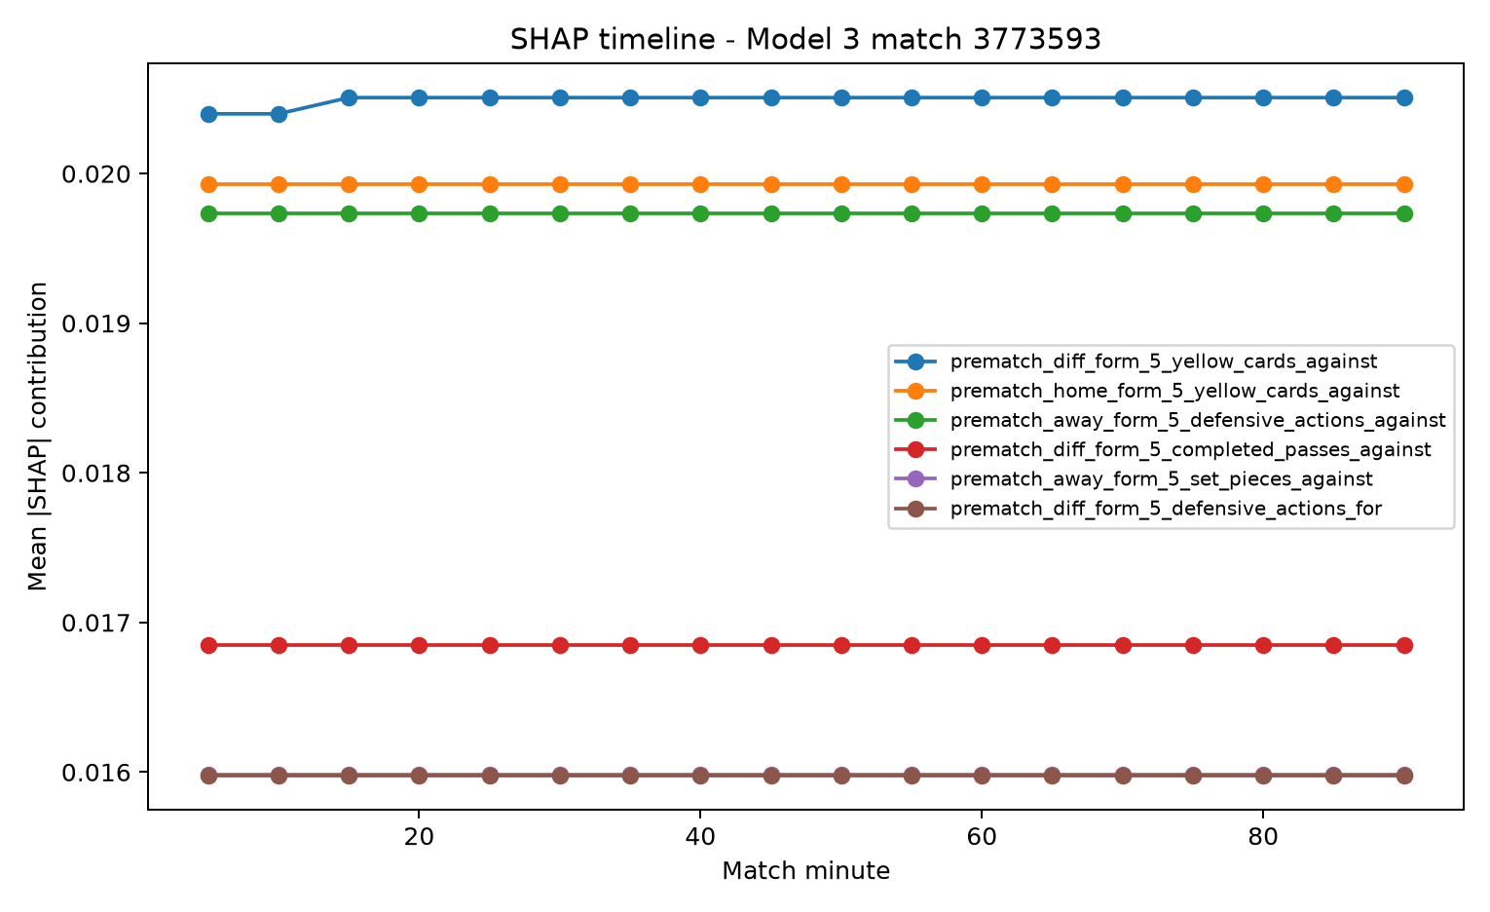
13 · IN-PLAY
Model 3: live information earns value over time
Final 2020/21 uses 18 five-minute snapshots per match and refits only after each match finishes.
Final every-match prequential · 33 matches
5 min
RPS 0.1873 vs frozen 0.1732 · early live signal is worse
30 min
RPS 0.1636 · improvement 0.0095 · accuracy 66.7%
60 min
RPS 0.1368 · improvement 0.0364 · accuracy 72.7% · MAE 1.194
90 min
RPS 0.1003 · improvement 0.0728 · accuracy 69.7% · MAE 0.905
2020/21 walk-forward: live RPS vs frozen pre-match prior.
Honest result
The live stream does not help immediately. It becomes useful around 15–30 minutes and improves strongly later; we keep the early negative result visible.
Notes:
Model 3 is evaluated on 18 snapshots per match. The best cross-season RPS variants are around 0.171 for SVC calibration variants. The saved SHAP timeline is relatively flat, which is a limitation: it suggests the pre-match signal still dominates and the live feature contribution needs stronger or more diverse training data.

Slide 15
14 · METHODS
Real-data final workflow + interpretable FIGS
Synthetic methods remain comparisons only; the final training path uses zero generated rows.
Synthetic sampling · comparison only
FIGS · actual model shown
Interpretability vs prediction quality
TA request applied: final workflow uses real matches only (synthetic rows = 0). GMM/SMOTE/ADASYN remain controlled training-fold experiments, not final data generation.
From-scratch classifier: 7 splits · 10 explicit rules. Final 2020/21: Acc 57.6% · Bal 53.2% · RPS 0.2111 · ECE 0.208.
Example H rule: carries diff > −31.95 AND pressures diff > −82 → +0.440 contribution.
FIGS is retained because its additive rules can be narrated live. It is not called “best”: Logistic has substantially lower development and final RPS.
Pre-match imbalance experiment · mean balanced accuracy
Imbalance conclusion
ClassWeight
52.6%
Class weighting was strongest in the earlier imbalance comparison (~52.6% mean balanced accuracy). Final real-data model uses no synthetic oversampling; negative results remain reported.
ADASYN
52.5%
Vanilla
49.4%
GMMSampling
47.2%
BorderlineSMOTE
46.0%
SMOTE
46.0%
DummyPrior
33.3%
Notes:
Be honest about negative results. The custom GMM oversampler is implemented and leakage-safe, but it did not outperform simple class weighting in the saved cross-season experiment. Class weighting averaged about 52.6% balanced accuracy; GMM sampling about 47.2%. The first split is very small, and ADASYN could not run there.

Slide 16
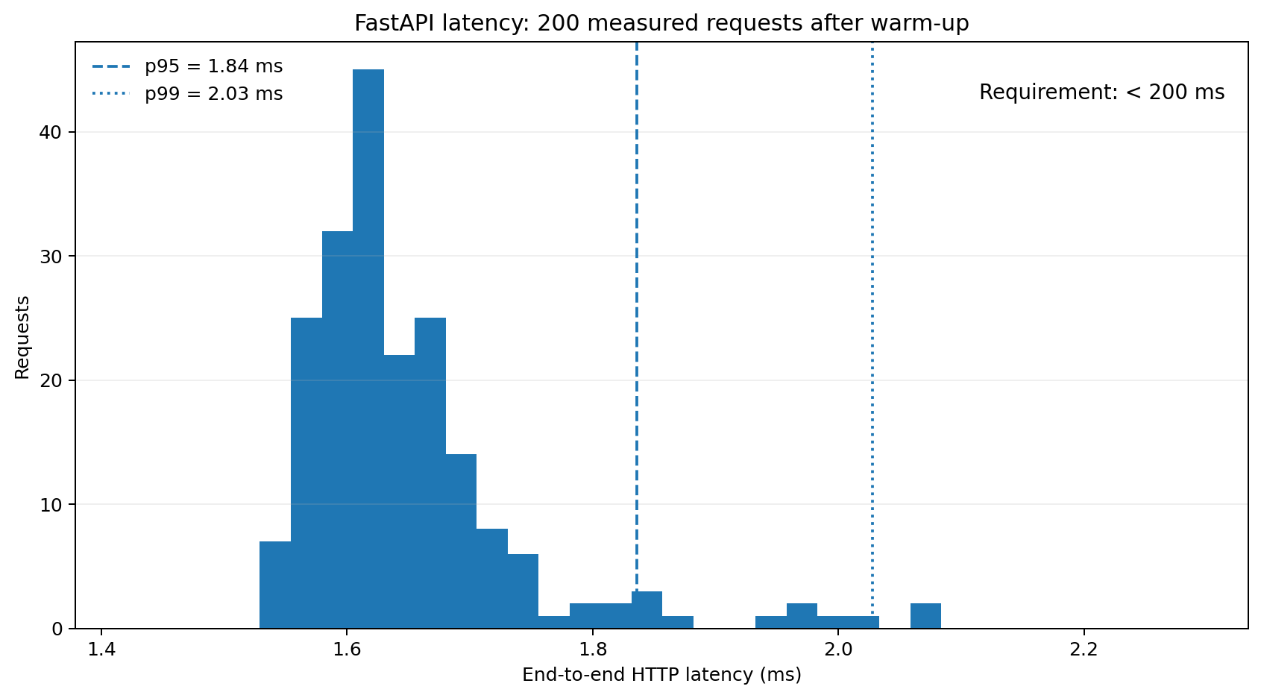
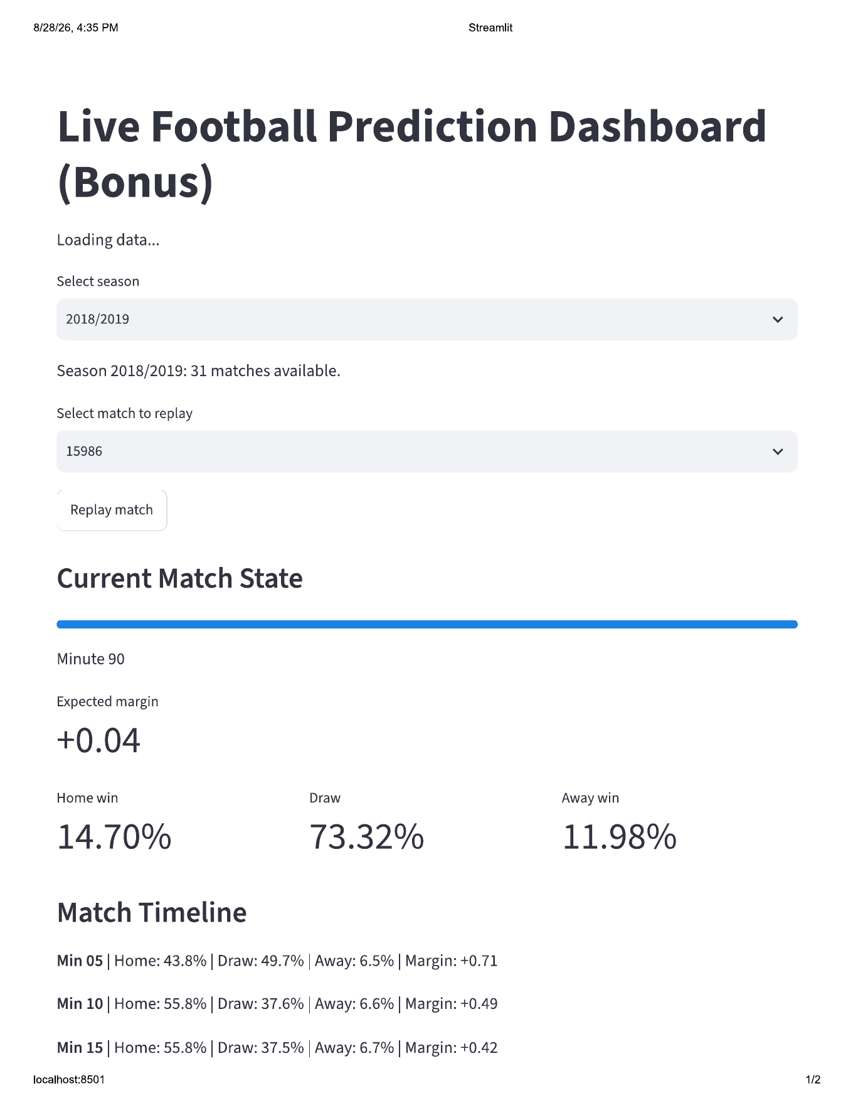
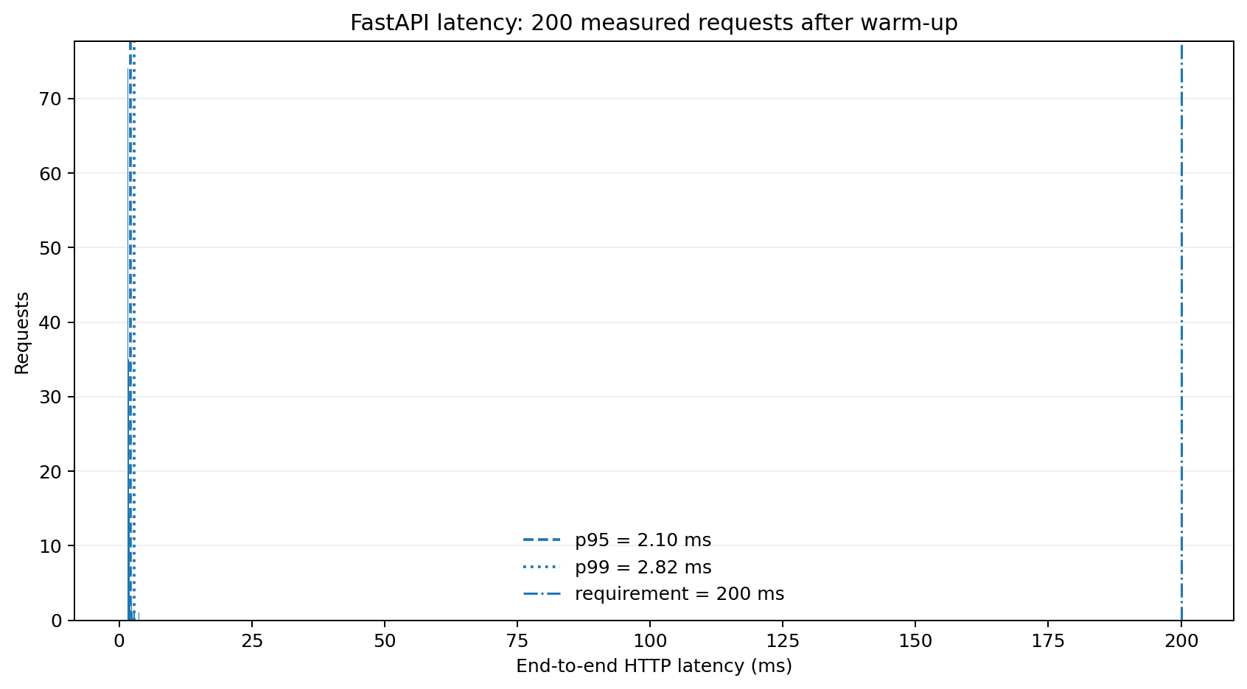
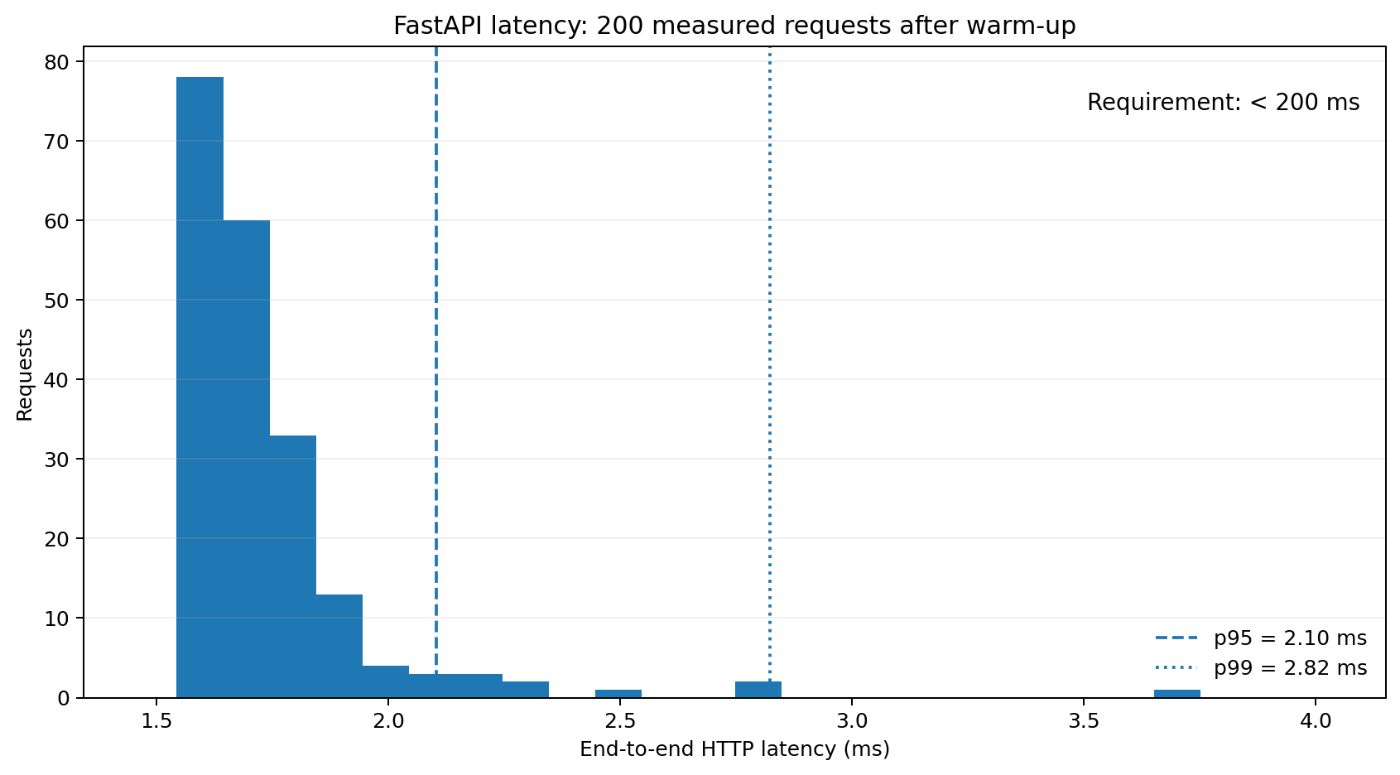
15 · BONUS
Live prediction service: <200 ms achieved with evidence
Same frozen Phase2 feature contract; models and SHAP explainers load once, and real feature vectors are cached before requests.
FastAPI service
11 pre-match / 14 in-play features · 111 + 1,998 vectors cached · Logistic + SVR loaded once · SHAP explainer preloaded.
Correctness check
12/12 offline-vs-API cases PASS. Maximum probability difference = 0; maximum expected-margin difference = 0.
HTTP latency benchmark
200 measured requests after warm-up · 200 successes · 0 errors · p50 ≈ 1.8 ms · p95 ≈ 2.1 ms · p99 ≈ 2.7 ms · max ≈ 3.4 ms.
200 measured requests after warm-up · 200 successes · 0 errors · p50 ≈ 1.6 ms · p95 ≈ 1.8 ms · p99 ≈ 2.0 ms · max ≈ 2.1 ms.
Requirement met
Measured uvicorn HTTP latency distribution from 200 real requests after warm-up.
p95 and p99 are far below the 200 ms target on this demo machine; raw request timings and summary reports are saved in bonus/outputs.
Notes:
The bonus artifact shows a working-looking Streamlit replay, including updated probabilities and margin at successive 5-minute states. The code includes latency benchmarking, but the provided outputs do not include a successful latency benchmark, so do not claim the under-200-millisecond requirement.

Slide 17
16 · LIMITATIONS
What is validated — and what remains limited
The strongest defense is to attach every claim to its exact data and protocol.
VALIDATED IN THIS RUN
NOT YET VALIDATED
End-to-end real-data pipeline runs with leakage assertions.
Feature/model choices use future-season development folds only.
Final 2020/21 uses 33 game-by-game predictions with refit after each match.
Odds coverage is 111/111 and market comparison uses identical final matches.
API correctness is 12/12 and p95/p99 latency is <200 ms.
Generalization to full La Liga, other teams, leagues or eras.
A claim of consistent market superiority across independent large test seasons.
Stable calibration under every small-sample regime.
Whether richer live event groups help once the dataset is expanded beyond Barcelona-centered coverage.
#1 limitation
#2 limitation
#3 limitation
First development training set has only 17 modeling matches.
Dataset is Barcelona-centered, not a full-league sample.
Market advantage is one 33-match final test: RPS 0.1732 vs 0.1848. It must be replicated on broader seasons.
Notes:
Internal validity is supported by chronological testing and leakage assertions. External validity is limited: small sample, Barcelona-centered data, and missing odds tags. For stronger validation, expand to full-league seasons and use a growing-window design, for example train 2017/18 through 2019/20 and test 2020/21.

Slide 18
17 · DEFENSE Q&A
Likely examiner questions · part 1
Keep these answers short, scoped and defensible.
Q · What features did you use?
Q · What market features did you add?
Pre-match: 6 core-form + 5 style contrasts. Style stayed because it improved dev RPS by 0.0147; context/efficiency/short-form/set-piece groups failed thresholds. Live adds only minute, score difference and man advantage: 14 total.
111/111 rows are odds-tagged. Odds are de-vigged into H/D/A probabilities and kept baseline-only. On the same 33 final matches: model RPS 0.1732 vs market 0.1848.
Q · What did you do for validation?
Q · How do you know the model is good?
Two future-season development folds choose features/models. Final 2020/21 starts from 61 earlier matches, predicts one game, observes its result, refits, then predicts the next — 33 times.
Future/prequential testing + exact market baseline + RPS/Log Loss/ECE + regression MAE/RMSE + in-play-vs-frozen curves + SHAP + API correctness/latency.
A useful sentence to memorize
“A defensible football forecast is a probability made with information available at that time, tested forward in time, and compared on the same matches as its baseline.”
Notes:
Practice these answers as 20–30 second responses. Start with the headline, then one supporting detail. Do not drown the examiner in feature names or model names unless asked for more.

Slide 19
18 · DEFENSE Q&A
Likely examiner questions · part 2
The most important issue is attaching every number to its test data.
Q · These final numbers belong to which data?
Q · Why refit every match — why not every two weeks?
Final test = 33 Barcelona-centered La Liga matches in 2020/21. Initial training = 61 matches from 2018/19 + 2019/20; the model is updated after every observed final result.
We tested cadence on 2019/20: every4 RPS 0.1364, every2 0.1383, every1 0.1391, never 0.1413. We choose every-match for operational freshness and ECE <0.10, while reporting that every4 had slightly better RPS.
Q · Are the results validate-able?
Q · What would you improve next?
Internally yes for this held-out sequence: leakage checks, identical odds matches, game-by-game scoring, and API/offline equality are all explicit. External validity remains limited by sample size and team diversity.
Expand to full-league/multi-team seasons; repeat the market comparison on multiple independent years; revisit rejected live groups only if they clear a pre-declared gain threshold; retest calibration with larger N.
Never say
Never say “our model beats the market.” Say: “On the exact 33-match 2020/21 held-out subset, Logistic had lower RPS/ECE than the de-vigged market; broader replication is still required.”
Notes:
This is the exact answer to the examiner’s likely validation challenge. The number is always conditional on the test season and sample. Internal validity means the pipeline can be checked and rerun on held-out seasons without leakage. External validity requires broader data.

Slide 20
19 · CONCLUSION
What we can defend confidently
The project now answers the “why this decision?” questions with measured ablations, forward tests and production evidence.
1 · Pipeline
2 · Validation
3 · Results
Real StatsBomb events + Football-Data odds. 111 modeling rows are odds-tagged. Final contracts: 11 pre-match features and 14 live features; synthetic final rows = 0.
Two development future-season folds + final 33-match prequential 2020/21 test. Predict → observe → refit after each match; all snapshots remain match-grouped.
Pre-match RPS 0.1732 vs market 0.1848. At minute 90, live RPS 0.1003 vs frozen 0.1732. API p95 ≈ 1.8 ms with 12/12 correctness cases.
Most defensible headline
“On the exact 33-match 2020/21 subset, regularized Logistic improves RPS and ECE versus the de-vigged market; live predictions improve as match information accumulates; the API meets the 200 ms target. Scope remains Barcelona-centered.”
NOSRATI · YAZDANI
Instructor: Sattar Hashemi
THANK YOU
Notes:
Closing: The main achievement is a complete, leakage-aware, reproducible pipeline with three model tasks and real future-season evaluation. The main limitations are also clear: small Barcelona-centered sample and zero successful odds tags in the saved run. That honesty makes the validation argument stronger, not weaker.

Slide 21
APPENDIX
References & reproducibility
Backup slide for methodology questions.
StatsBomb / Hudl StatsBomb — StatsBomb Open Data.
Football-Data.co.uk — historical football results and betting odds data.
Tan, Y. S., Singh, C., Nasseri, K., et al. — Fast Interpretable Greedy-Tree Sums (FIGS), 2022 preprint.
Lundberg, S. M. & Lee, S. I. — A Unified Approach to Interpreting Model Predictions (SHAP).
Chen, T. & Guestrin, C. — XGBoost: A Scalable Tree Boosting System.
Ke, G. et al. — LightGBM: A Highly Efficient Gradient Boosting Decision Tree.
Course project specification — Forecasting Competitive Football: Pre-Match & In-Play Prediction from Raw Event Data.
Reproducibility
Paper sign-off caveat
Seed = 42. Run phase1/phase1_final.ipynb → phase2/phase2_final.ipynb → bonus/bonus_final.ipynb. requirements.txt is pinned; each notebook was executed end-to-end and saved with outputs.
Exact TA-approved P1/P2 paper bibliography and sign-off metadata are not present in the supplied archive; verify against the papers used in class.
Notes:
Use only if asked about citations or reproducibility. The exact course-approved paper references should be checked against your class paper choices because the uploaded archive does not contain the approval/sign-off PDFs.

