Slide 1
FINAL PROJECT
FORECASTING
COMPETITIVE FOOTBALL
Pre-Match & In-Play Prediction from Raw Event Data
NOSRATI
YAZDANI
Instructor: Sattar Hashemi
Machine Learning Course · Department of Computer Science
DEFENSE-READY DECK
Notes:
Opening: We built three football forecasting deliverables from raw StatsBomb event data: pre-match outcome classification, pre-match goal-margin regression, and in-play prediction. The key point of this defense is not a single accuracy number; it is whether the pipeline is leakage-safe and whether performance survives future-season testing.

Slide 2
01 · OVERVIEW
Project at a glance
Three deliverables, one leakage-aware data foundation.
138
536,328
111
1,998
3
raw matches
events
pre-match examples
in-play snapshots
future-season tests
Model 1 · Outcome Classification
Model 2 · Goal-Margin Regression
Model 3 · In-Play Prediction
One vector per match → calibrated probabilities for Home / Draw / Away.
Headline scoring: RPS, plus Log Loss, Brier, ECE and balanced accuracy.
Same pre-match history → signed home-minus-away goal margin.
Measured with MAE, RMSE, R² and correlation.
18 snapshots per match (5, 10, …, 90 minutes) → updated outcome probabilities and expected margin.
Defense principle
Every number in this presentation is tied to a specific test season and data scope. We do not present accuracy as a universal constant.
Notes:
Use this slide to frame the project. Mention the exact scale: 138 raw matches; after requiring enough historical matches, 111 pre-match examples remain; each produces 18 snapshots, so 1,998 live examples. Emphasize that the grading brief asks for all three tasks and probability quality, not accuracy alone.

Slide 3
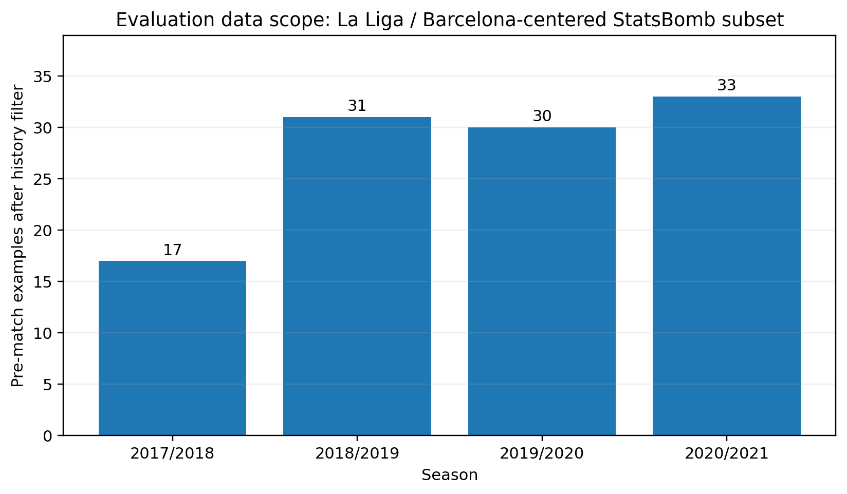
02 · DATA
What data did we actually evaluate?
This scope must be stated before quoting any accuracy.
Competition & seasons
La Liga · 2017/18, 2018/19, 2019/20, 2020/21
Important sampling fact
The available StatsBomb matches in these seasons are Barcelona-centered. Every retained modeling match includes Barcelona as home or away.
360 coverage
35 of 138 raw matches have 360 frames (25.4%). Final engineered features are primarily event-stream features, not full-coverage 360 inputs.
Modeling examples after rolling-history filtering.
Correct claim
“La Liga / Barcelona-centered StatsBomb subset” — not “all La Liga” and not “all leagues.”
Notes:
This is a critical answer if asked “which league and which period?” Say: La Liga seasons 2017/18 through 2020/21, but the StatsBomb open-data availability in this run is Barcelona-centered. Therefore the evaluation is not a full-season league sample and external generalization is limited.

Slide 4
03 · PIPELINE
End-to-end pipeline & leakage boundaries
Two feature pipelines share one chronological match-level split.
Raw JSON
Integration
Temporal split
Features
Models
Evaluation
matches · events
lineups · 360
keys · identities
labels · cleaning
season-ahead
match-level
pre-match
+ in-play
C · R · L
calibration
RPS · Log Loss
MAE · ECE · SHAP
Leakage defenses implemented in code
Pre-match boundary
Live time-t boundary
Match-level grouping
Rolling history uses shift(1): the target match is excluded from its own form features.
assert_time_t_cut(): no event after the snapshot minute can contribute.
All 18 snapshots from one match inherit the same train/test side.
PASS · pre-match history before kick-off
PASS · event timestamp ≤ snapshot time
PASS · GMM sampling only on training
Why it matters
A high score is scientifically meaningless if future information leaked into the features. Our validation claims begin with these boundaries.
Notes:
Explain leakage in plain language. Pre-match: all rolling aggregates are shifted before rolling, so the current match cannot affect its own features. In-play: snapshots only use events with timestamp at or before t. And snapshots are split by parent match, not row-by-row. Resampling is restricted to training data.

Slide 5
04 · FEATURES
What features did we use?
119 football/history numeric pre-match features + 4 market-related fields in the saved selector.
PRE-MATCH
IN-PLAY
Form & strength
Game state
123
Rolling 5- and 3-match points, goals for/against, shots, xG, and home-away differences.
Snapshot minute, home/away goals, score difference and man advantage.
pre-match numeric columns
Style & territory
Cumulative live
Passes/completions, pressures, final-third carries, set pieces, defensive actions, event share.
Shots, xG, passes, pressures, defensive actions, final-third carries, set pieces, red cards.
185
in-play numeric columns
Context & efficiency
Recent 5-minute window
Rest days, prior matches, home/away win rates, shot conversion, possession proxy, pressure rate.
Recent shots, pressures, events and per-minute rates for shots, pressures and passes.
Feature count caveat
The 123 pre-match numeric columns include 4 market fields. Because odds tagging failed in the saved run, those four fields contain no usable market signal.
Momentum
Relative signal
Last-5 minus previous-5 trends for points, goals and xG.
Home-away differences + live shot/pressure momentum + pre-match prior.
Notes:
Answer the feature question by grouping, not reciting 100+ columns. Pre-match categories: form, xG/shots, passing/pressure/territory, discipline, efficiency, rest/context, momentum and home-away differences. In-play adds score state, man advantage, cumulative event statistics, recent 5-minute windows, live differences and the pre-match prior.

Slide 6
05 · MARKET
Market features: implemented — but not validated in the saved run
This is the most important limitation to state honestly.
4
0%
0
NO
market-related fields
valid odds tagging
MarketOdds result rows
market-beating claim
What the pipeline adds
What happened in this saved run
odds_tagged
market_p_H · market_p_D · market_p_A
The intended market probabilities are de-vigged 1X2 bookmaker probabilities from Football-Data.co.uk.
All 111 modeling rows have odds_tagged = false. The saved odds coverage report is 0%, and no MarketOdds baseline appears in Phase 2 results.
Defense-safe wording
“Market integration exists at pipeline level, but this run has zero valid odds tags. I therefore do not claim a market comparison. The correct next step is to fix date/team alias matching and rerun every classifier on the identical tagged test matches.”
Notes:
Do not say the model beat bookmakers. Say exactly: the code includes odds_tagged and de-vigged H/D/A market probabilities, but the saved run has 0% successful odds tagging. Therefore those fields are unusable and there is no scientifically valid market comparison in the submitted outputs.

Slide 7
06 · VALIDATION
How did we validate?
Outer future-season holdouts + training-only tuning/calibration.
Split 1 · TRAIN
TEST · FUTURE
Inside training only
2017/2018
17 matches · 306 snapshots
2018/2019
31 matches · 558 snapshots
RandomizedSearchCV with 3-fold CV. Calibration also uses 3-fold training-only CV.
Split 2 · TRAIN
TEST · FUTURE
Snapshot grouping
2018/2019
31 matches · 558 snapshots
2019/2020
30 matches · 540 snapshots
Parent match sets the split → no minute-30 snapshot in train and minute-60 of same match in test.
Split 3 · TRAIN
TEST · FUTURE
Resampling boundary
2019/2020
30 matches · 540 snapshots
2020/2021
33 matches · 594 snapshots
SMOTE-family and GMM resampling are restricted to training data / folds.
One nuance
Within a held-out season, a later match may use earlier matches from that same season as historical features because those earlier results are genuinely known at its kick-off. The model is not refit on the test season.
Notes:
The main validation answer: three chronological one-season-ahead outer tests. Hyperparameters and calibration are learned only from the training season. For live data, split by match, not by snapshot. One nuance: feature construction can use earlier completed games within the test season for a later test match, because that information is legitimately available at prediction time; model parameters are still frozen.

Slide 8
07 · EVALUATION
How do we know the model is “good”?
No single metric is enough for probabilistic forecasting.
1 · Future-season performance
2 · Proper probability scores
3 · Calibration
Evaluate on unseen future seasons, not a random row split.
RPS, Log Loss and Brier penalize overconfident wrong probabilities.
ECE + reliability diagrams check whether 70% predictions occur about 70% of the time.
4 · Class-aware metrics
5 · Baselines
6 · Failure analysis
Balanced accuracy, per-class precision/recall/F1 reduce majority-class illusion.
Dummy prior is the sanity floor. A valid market baseline is required once odds tagging works.
SHAP + worst predictions explain how the model fails, not just how often.
A model can have higher accuracy and worse probabilities
For a forecasting product, calibration and proper scoring rules matter because the output is a probability distribution, not only an arg-max class label.
Notes:
If asked “how do you know it is good now?”, say: I do not infer quality from accuracy alone. I require held-out future-season performance, comparison to a dummy prior, proper scoring rules, calibration, class-aware metrics and error analysis. The market baseline is not currently available because odds tagging is 0%, so I cannot use it as evidence.

Slide 9
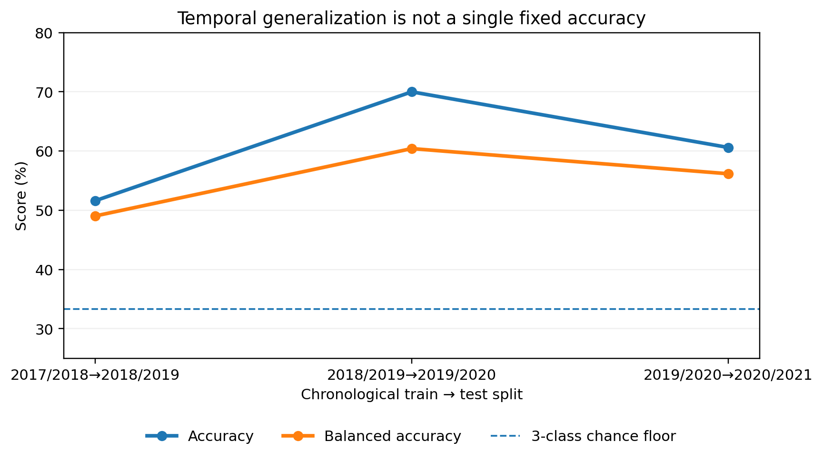
08 · GENERALIZATION
A 64% season does not guarantee 64% later
The same SVC changed substantially across three future seasons.
51.6%
2018/19 test accuracy
70.0%
2019/20 test accuracy
60.6%
2020/21 test accuracy
Answer to the examiner
Uncalibrated SVC across the three outer chronological splits.
Performance is season-dependent. Cross-season range/average is the credible claim — not one universal percentage.
Notes:
This directly answers the “2016 vs 2019” type question. A number from one held-out season belongs to that season. The same SVC family scored 51.6%, 70.0% and 60.6% accuracy on the three future seasons. That variation is evidence of temporal distribution shift.

Slide 10
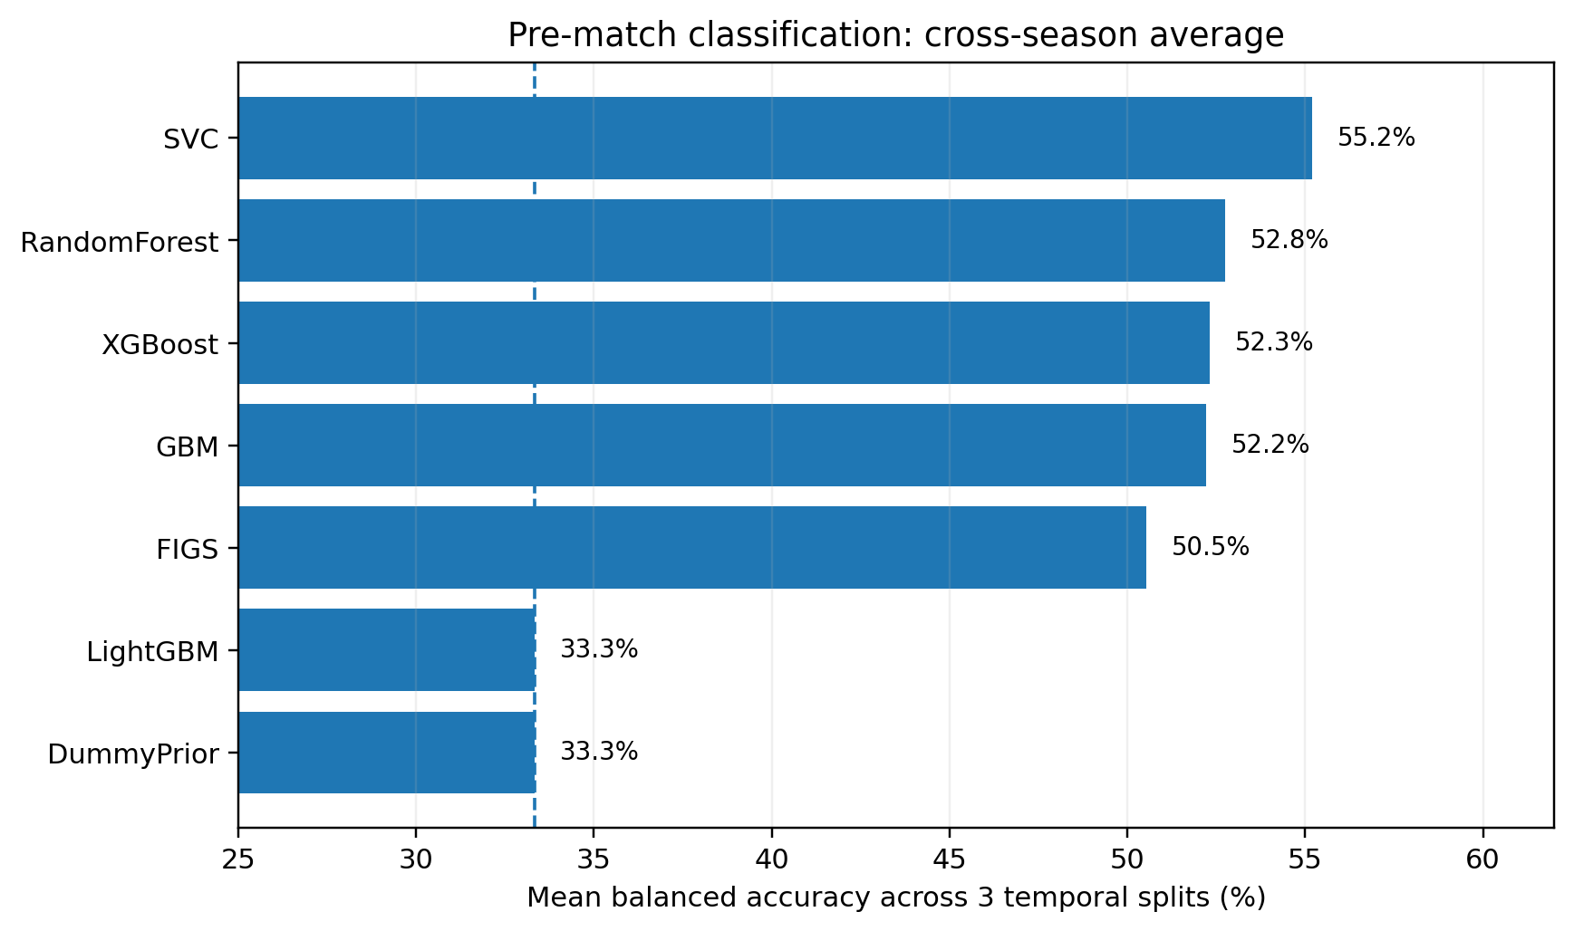
09 · RESULTS
Pre-match classification results
Cross-season stability first; final-season headline second.
Cross-season view
SVC: 55.2% mean balanced accuracy
Random Forest: 52.8%
XGBoost: 52.3%
GBM: 52.2%
Held-out 2020/21 · n = 33
GBM accuracy: 63.6%
Balanced accuracy: 58.7%
RPS: 0.161 · Log Loss: 0.828 · ECE: 0.177
What not to say
Do not call 63.6% “the accuracy of the model.” It is GBM on one specific held-out season/subset.
Mean balanced accuracy across three future-season tests; uncalibrated variants.
Takeaway
No universal winner; season-to-season stability and probability quality matter.
Notes:
For the final held-out 2020/21 subset, uncalibrated GBM reached 63.6% accuracy with RPS 0.161 on 33 matches. Always attach the scope: trained on 2019/20, tested on the Barcelona-centered 2020/21 subset. Across all three splits, SVC has the strongest mean balanced accuracy among the uncalibrated fixed variants shown.

Slide 11
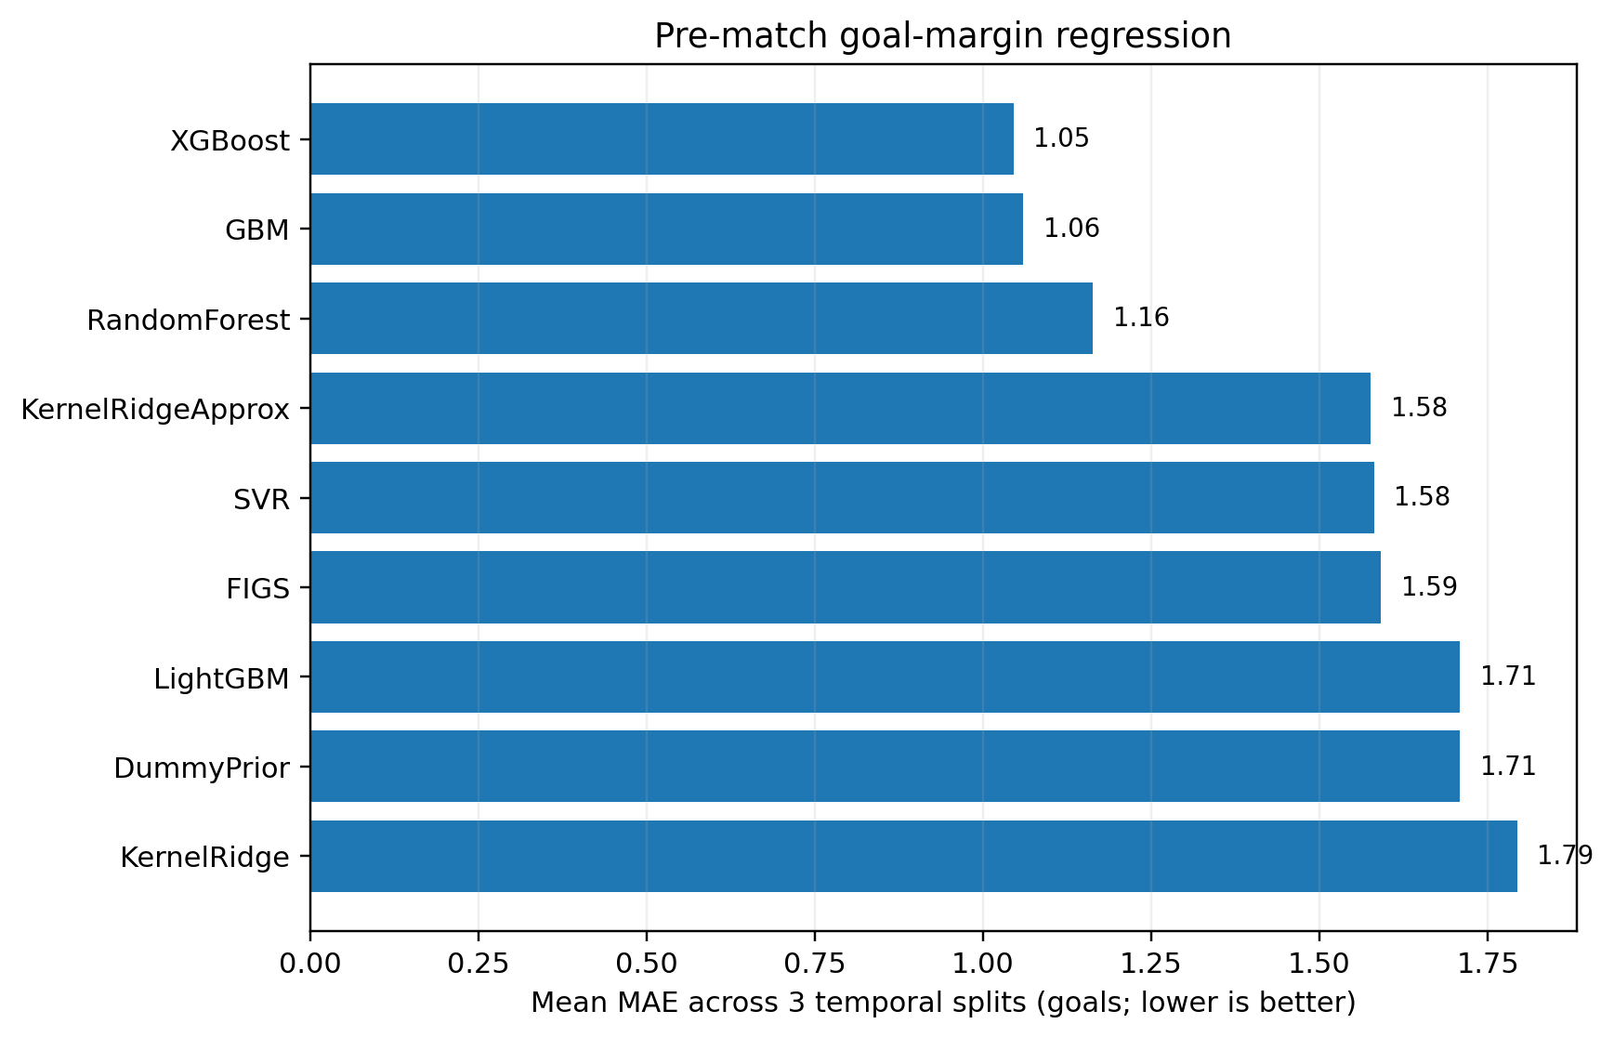
10 · RESULTS
Pre-match goal-margin regression
Tree boosting is strongest on average; the final split is easier than earlier splits.
Cross-season average
XGBoost MAE ≈ 1.05 goals
GBM MAE ≈ 1.06
Random Forest MAE ≈ 1.16
Held-out 2020/21
GBM MAE: 0.452
RMSE: 0.679
R²: 0.905
Correlation: 0.953
Interpretation
That excellent final-split score is based on only 33 matches and is not representative of all seasons by itself.
Mean absolute error across the three chronological test seasons.
Notes:
Regression is strongest with XGBoost/GBM across the three chronological splits: mean MAE about 1.05–1.06 goals. The final 2020/21 split looks much better — GBM MAE 0.452 — but because the test set is only 33 matches, present it as a split-specific result, not universal performance.

Slide 12
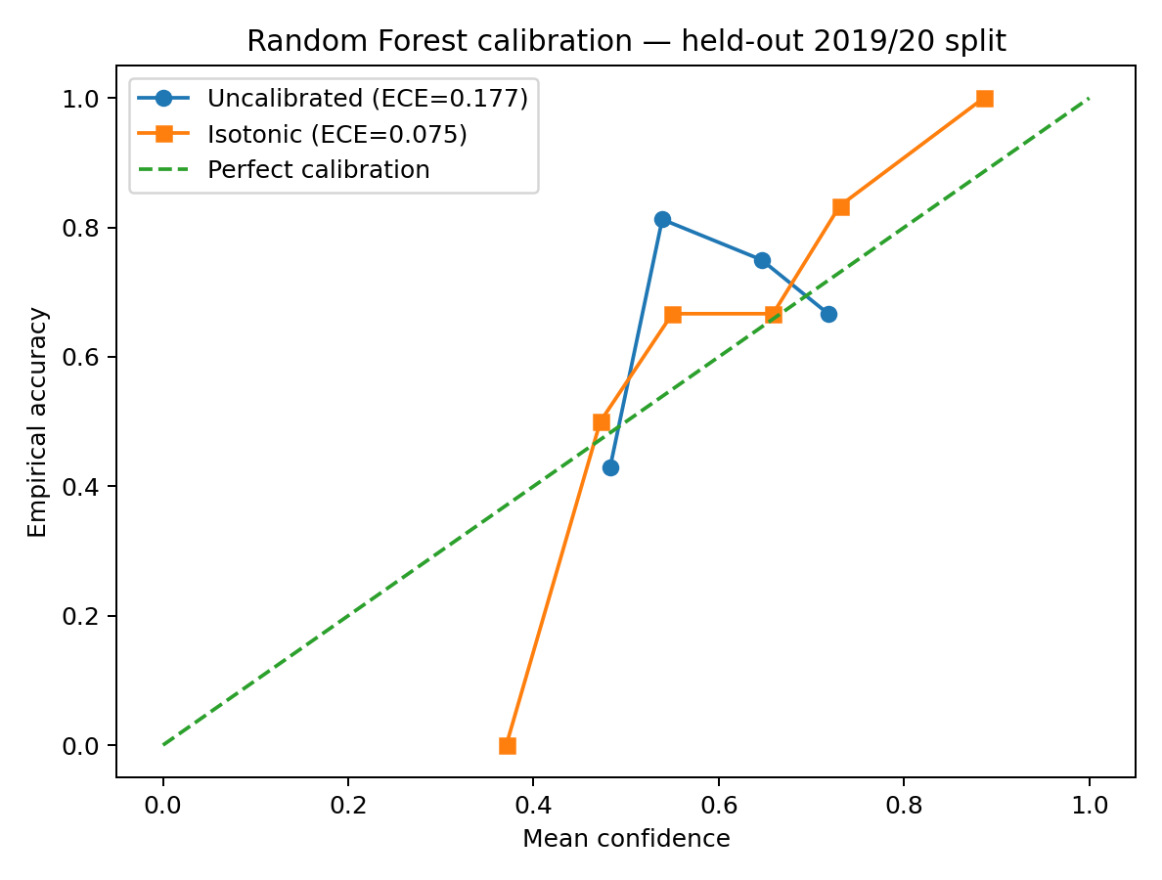
11 · CALIBRATION
Probability quality: calibration matters
Random Forest example on the held-out 2019/20 split.
0.177
0.075
ECE before
ECE isotonic
0.157
0.127
RPS before
RPS isotonic
0.858
0.717
Log Loss before
Log Loss isotonic
Important caveat
Regenerated from saved Random Forest prediction CSVs (uncalibrated vs isotonic).
Isotonic is not consistently stable across every split because sample sizes are small. Report calibration per season.
Notes:
Use this as an example, not a universal claim. On split 2, Random Forest isotonic calibration improved ECE from about 0.177 to 0.075, RPS from 0.157 to 0.127 and Log Loss from 0.858 to 0.717. But small samples make isotonic unstable on some other splits, so calibration must be inspected separately by season.

Slide 13
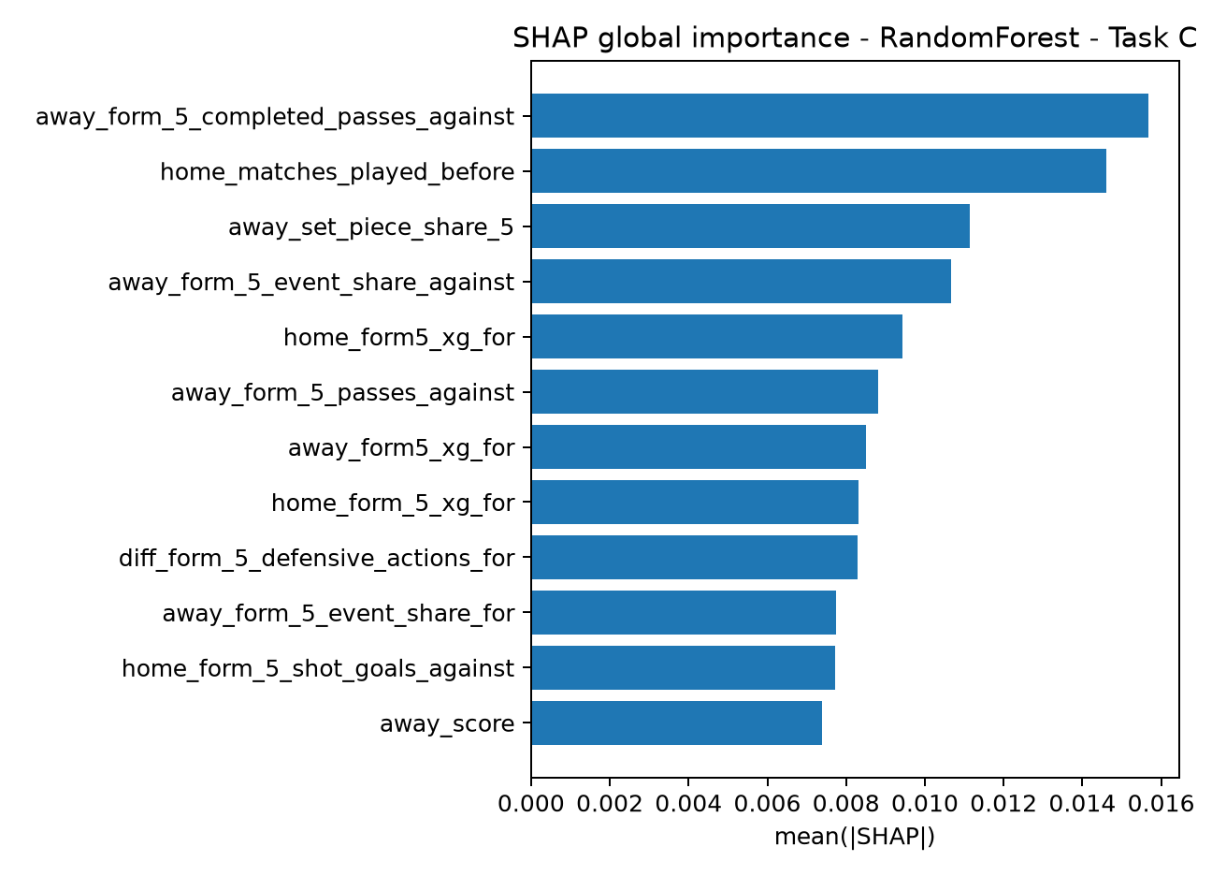
12 · EXPLAINABILITY
What is the model using?
SHAP turns aggregate scores into auditable feature contributions.
Global explanation
Ranks which engineered features matter most across predictions.
Local explanation
Waterfall/force-style analyses are used on worst predictions to explain confident mistakes.
Live explanation
In-play SHAP timeline tracks how feature contributions evolve at each 5-minute snapshot.
Scientific caution
Existing project output: global SHAP importance for pre-match Random Forest, split 2.
SHAP is diagnostic, not causal. A feature can drive a prediction without being the causal reason for the football outcome.
Notes:
SHAP is required because a forecasting model must be explainable. Global SHAP ranks overall feature impact. Local explanations help with worst-case post-mortems. In-play timelines are intended to show how attribution changes through a match. Do not interpret SHAP causally.

Slide 14
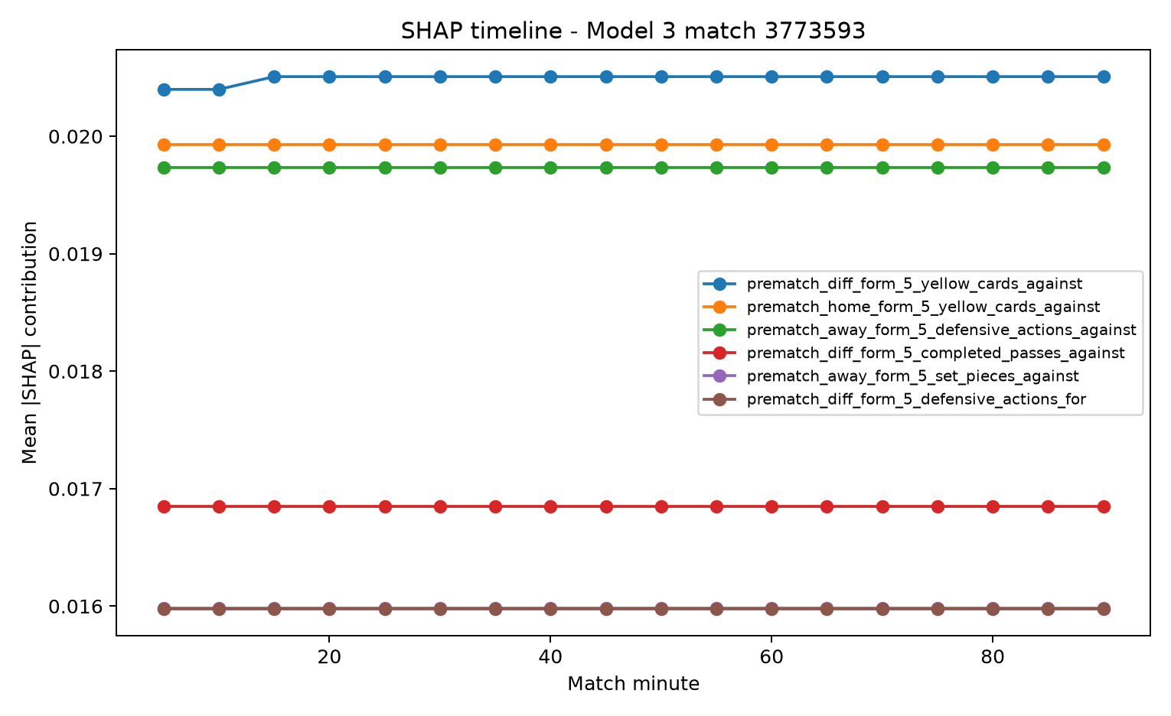
13 · IN-PLAY
Model 3: live prediction is the hardest task
5-minute snapshots combine pre-match history with the current match state.
Cross-season mean · best RPS variants
SVC · sigmoid
Acc 62.5% · Bal 55.1%
RPS 0.171 · ECE 0.120
SVC · isotonic
Acc 64.9% · Bal 58.3%
RPS 0.171 · ECE 0.092
RandomForest · sigmoid
Acc 59.3% · Bal 51.0%
RPS 0.175 · ECE 0.132
RandomForest · isotonic
Acc 54.2% · Bal 47.4%
RPS 0.185 · ECE 0.154
Existing project output: in-play SHAP timeline.
Current limitation
The saved SHAP timeline shows relatively small attribution movement. The live signal needs more diverse matches before claiming production-level robustness.
Notes:
Model 3 is evaluated on 18 snapshots per match. The best cross-season RPS variants are around 0.171 for SVC calibration variants. The saved SHAP timeline is relatively flat, which is a limitation: it suggests the pre-match signal still dominates and the live feature contribution needs stronger or more diverse training data.

Slide 15
14 · METHODS
Imbalance handling & paper-style implementations
We compare resampling, class weighting, and a from-scratch interpretable model.
GMM-based oversampling · from scratch
FIGS · from scratch
Paper documentation caveat
• Standardizes training features
• Selects Gaussian-mixture components using internal development likelihood
• Samples synthetic minority examples
• Restricted to training data
Fast Interpretable Greedy-Tree Sums implementation for both classification and regression — not just a black-box library call.
The archive contains implementations/results, but not the approved P1/P2 PDFs or TA sign-off metadata. Verify the exact course-approved citations.
Pre-match imbalance experiment · mean balanced accuracy
Interpretation
ClassWeight
52.6%
Class weighting is strongest on average in this small-sample experiment (≈52.6% balanced accuracy). GMM sampling is not the winner here; that is an honest negative result. ADASYN also failed on the smallest split, which is another small-data warning.
ADASYN
52.5%
Vanilla
49.4%
GMMSampling
47.2%
BorderlineSMOTE
46.0%
SMOTE
46.0%
DummyPrior
33.3%
Notes:
Be honest about negative results. The custom GMM oversampler is implemented and leakage-safe, but it did not outperform simple class weighting in the saved cross-season experiment. Class weighting averaged about 52.6% balanced accuracy; GMM sampling about 47.2%. The first split is very small, and ADASYN could not run there.

Slide 16
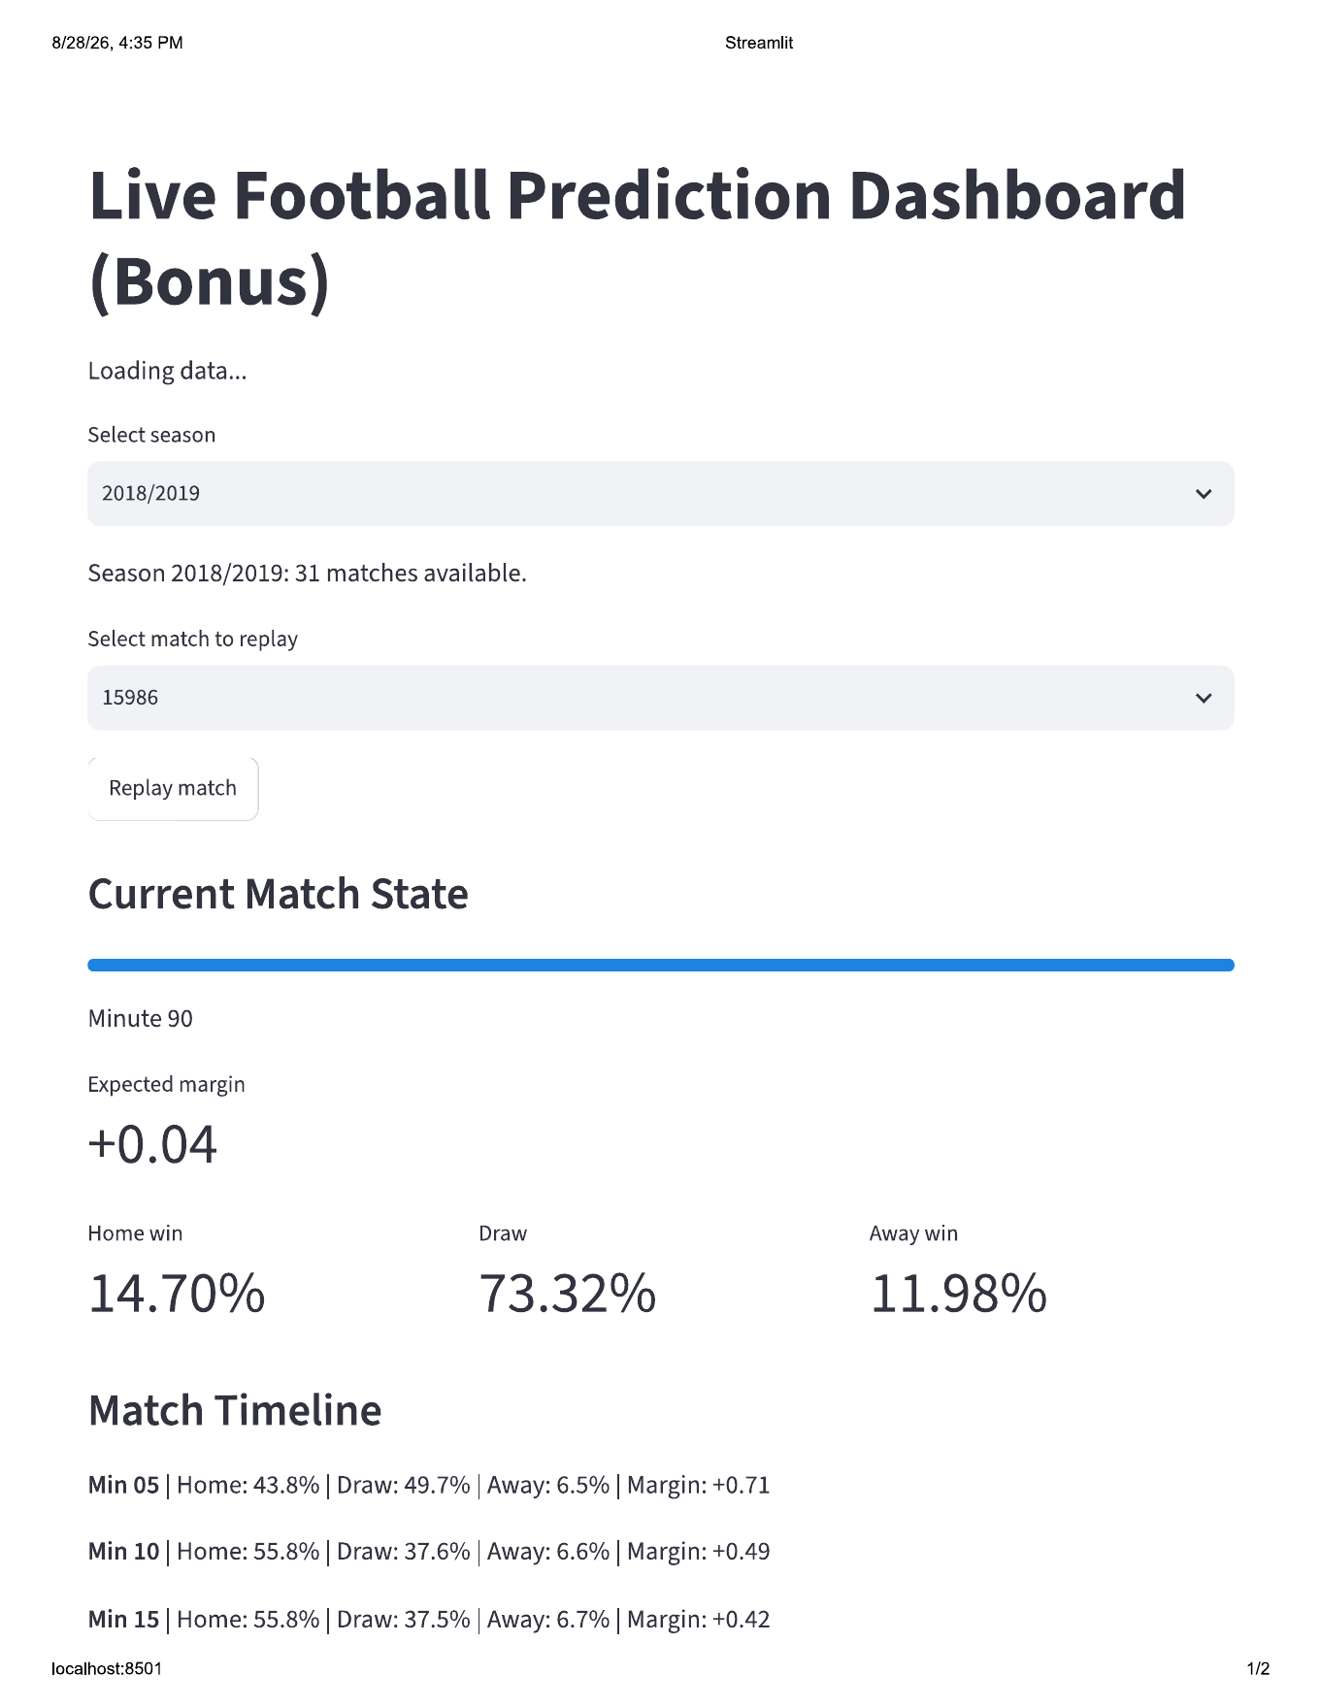
15 · BONUS
Live prediction service & dashboard
A replay interface demonstrates the in-play pipeline end to end.
FastAPI service
Loads trained models and exposes live prediction logic for a match/snapshot.
Streamlit replay
Replays a held-out match in 5-minute increments and updates H/D/A probabilities + expected margin.
What the screenshot proves
The supplied artifacts show the interface and a complete replay. They do not prove latency compliance.
Do not overclaim
Existing bonus output: Streamlit live football prediction dashboard.
No saved successful latency benchmark → do not claim the <200 ms target was met.
Notes:
The bonus artifact shows a working-looking Streamlit replay, including updated probabilities and margin at successive 5-minute states. The code includes latency benchmarking, but the provided outputs do not include a successful latency benchmark, so do not claim the under-200-millisecond requirement.

Slide 17
16 · LIMITATIONS
What is validated — and what is not
This slide is your strongest defense against overclaiming.
VALIDATED IN THIS RUN
NOT YET VALIDATED
End-to-end pipeline runs on held-out future seasons.
Pre-match and time-t leakage assertions pass.
Performance is measured on three chronological splits.
Probability metrics, calibration and SHAP artifacts are produced.
Generalization to full La Liga, other teams, leagues or eras.
A valid model-vs-bookmaker comparison in the saved run.
A universal “64% accuracy” independent of season.
Stable calibration under every small-sample season.
#1 limitation
#2 limitation
#3 limitation
First outer training split has only 17 modeling matches.
Dataset is Barcelona-centered, not a full-league sample.
Odds tagging is 0% and must be fixed before market claims.
Notes:
Internal validity is supported by chronological testing and leakage assertions. External validity is limited: small sample, Barcelona-centered data, and missing odds tags. For stronger validation, expand to full-league seasons and use a growing-window design, for example train 2017/18 through 2019/20 and test 2020/21.

Slide 18
17 · DEFENSE Q&A
Likely examiner questions · part 1
Keep these answers short, scoped and defensible.
Q · What features did you use?
Q · What market features did you add?
Pre-match: rolling form, goals/points, shots/xG, passing, pressure, territory, set pieces, defensive actions/cards, efficiency, rest, venue rates, momentum and home-away differences. Live: score, man advantage, cumulative events, recent 5-minute rates and pre-match prior.
odds_tagged and de-vigged market_p_H / market_p_D / market_p_A. Saved tagging coverage is 0%, so they are not valid evidence and no market comparison is claimed.
Q · What did you do for validation?
Q · How do you know the model is good?
Three outer season-ahead tests: 2017/18→2018/19, 2018/19→2019/20, 2019/20→2020/21. Tuning/calibration happen on training only; all snapshots of one match stay together.
Not from accuracy alone: future-season tests + dummy baseline + RPS/Log Loss/Brier/ECE + balanced accuracy/F1 + reliability diagrams + SHAP failure analysis.
A useful sentence to memorize
“A valid football forecast is not just the correct class; it is a well-calibrated probability distribution that generalizes to future matches without leakage.”
Notes:
Practice these answers as 20–30 second responses. Start with the headline, then one supporting detail. Do not drown the examiner in feature names or model names unless asked for more.

Slide 19
18 · DEFENSE Q&A
Likely examiner questions · part 2
The most important issue is attaching every number to its test data.
Q · These accuracy numbers belong to which data?
Q · If one year is 64%, why would another year also be 64%?
La Liga StatsBomb Open Data subset for 2017/18–2020/21, centered on Barcelona matches. Example: 63.6% GBM accuracy is specifically the held-out 2020/21 subset of 33 modeling matches after training on 2019/20.
It should NOT be assumed. The same SVC produced 51.6%, 70.0% and 60.6% accuracy on three different future seasons. The variation is temporal distribution shift.
Q · Are the results validate-able?
Q · What would you improve next?
Internally yes for the held-out seasons under the implemented leakage rules. External validity is still limited by small sample size, Barcelona-centered coverage and missing market odds.
1) Fix odds date/team alias tagging. 2) Expand to full-league / multiple-league seasons. 3) Use growing-window temporal validation. 4) Strengthen live features and re-test per match phase.
Never say
“Our model has 64% accuracy.” Say: “On test season X, after training on season Y, model Z achieved 64% on N held-out matches.”
Notes:
This is the exact answer to the examiner’s likely validation challenge. The number is always conditional on the test season and sample. Internal validity means the pipeline can be checked and rerun on held-out seasons without leakage. External validity requires broader data.

Slide 20
19 · CONCLUSION
What we can defend confidently
The project is strongest when the claims stay within the evidence.
1 · Pipeline
2 · Validation
3 · Results
Raw StatsBomb JSON → integrated tables → separate pre-match and in-play feature pipelines → chronological evaluation.
Three future-season tests, match-level snapshot grouping, explicit time-t leakage assertions and training-only resampling.
Useful predictive signal exists, but performance moves by season; probability quality and calibration must accompany accuracy.
Most defensible headline
“Our implementation demonstrates a reproducible leakage-aware football forecasting pipeline with measurable future-season predictive signal. It does not yet establish universal league-wide performance or a market-beating model.”
NOSRATI · YAZDANI
Instructor: Sattar Hashemi
THANK YOU
Notes:
Closing: The main achievement is a complete, leakage-aware, reproducible pipeline with three model tasks and real future-season evaluation. The main limitations are also clear: small Barcelona-centered sample and zero successful odds tags in the saved run. That honesty makes the validation argument stronger, not weaker.

Slide 21
APPENDIX
References & reproducibility
Backup slide for methodology questions.
StatsBomb / Hudl StatsBomb — StatsBomb Open Data.
Football-Data.co.uk — historical football results and betting odds data.
Tan, Y. S., Singh, C., Nasseri, K., et al. — Fast Interpretable Greedy-Tree Sums (FIGS), 2022 preprint.
Lundberg, S. M. & Lee, S. I. — A Unified Approach to Interpreting Model Predictions (SHAP).
Chen, T. & Guestrin, C. — XGBoost: A Scalable Tree Boosting System.
Ke, G. et al. — LightGBM: A Highly Efficient Gradient Boosting Decision Tree.
Course project specification — Forecasting Competitive Football: Pre-Match & In-Play Prediction from Raw Event Data.
Reproducibility
Paper sign-off caveat
Random seed = 42. Archive includes source, exported predictions/results, SHAP/calibration figures, bonus models and console logs.
Exact TA-approved P1/P2 paper bibliography and sign-off metadata are not present in the supplied archive; verify against the papers used in class.
Notes:
Use only if asked about citations or reproducibility. The exact course-approved paper references should be checked against your class paper choices because the uploaded archive does not contain the approval/sign-off PDFs.

