Slide 1

Generative Adversarial Networks

Slide 2
Deep Learning
GANs - Generative Adversarial Networks were invented in 2014 by Ian Goodfellow et al. and uses two networks competing against each other to generate data.
GANs are often described as a counterfeiter versus a detective, let’s see how they work.

Slide 3
Deep Learning
Generator
Recieves random noise ( Gaussian distribution)
Outputs data (often an image)

Slide 4
Deep Learning
Discriminator
Takes a data set consisting of real images from the real data set and fake images from the generator.
Attempt to classify real vs fake images (always binary classification)

Slide 5
Deep Learning
NOISE

Slide 6
Deep Learning
NOISE
Generator

Slide 7
Deep Learning
NOISE
Generator
The generator goal is to create images that fool the discriminator

Slide 8
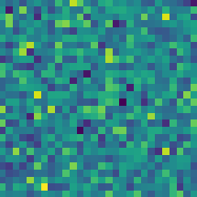
Deep Learning
NOISE
Generator
The generator goal is to create images that fool the discriminator

Slide 9
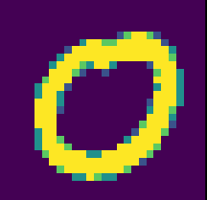
Deep Learning
NOISE
Generator
Real Data

Slide 10
Deep Learning
NOISE
Generator
Discriminator
Real Data

Slide 11
Deep Learning
Real or Fake
NOISE
Generator
Discriminator
Real Data

Slide 12
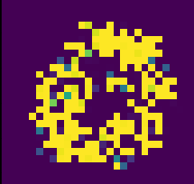
Deep Learning
Real or Fake
NOISE
Generator
Discriminator
Real Data

Slide 13
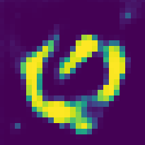
Deep Learning
Real or Fake
NOISE
Generator
Discriminator
Real Data

Slide 14
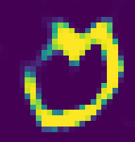
Deep Learning
Real or Fake
NOISE
Generator
Discriminator
Real Data

Slide 15
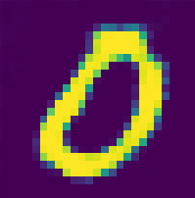
Deep Learning
Real or Fake
NOISE
Generator
Discriminator
Real Data

Slide 16
Deep Learning
Training Phases
Phase 1 - Train Discriminator
Phase 2 - Train Generator

Slide 17
Deep Learning
Phase 1: Discriminator
Real images (labeled 1) are combined with fake images from generator (labeled 0).
Discriminator trains to distinguish real from fake (with backpropagation only on discriminator weights)

Slide 18
Deep Learning
Phase 2: Generator
Produce fake images with generator.
Feed only these fake images to the generator with all labels set as real (1).
This causes the generator to attempt to produce images the discriminator believes to be real.

Slide 19
Deep Learning
Phase 2: Generator
Because we feed in fake images all with labeled 1, we only perform backpropagation on the generator weights in this step.

Slide 20
Deep Learning
Keep in mind, the generator never gets to see the actual real images!
It generates convincing images only based off gradients flowing back through the discriminator.

Slide 21
Deep Learning
Also keep in mind, the discriminator is also improving as training phases continuing, meaning the generated images will also need to get better and better.

Slide 22
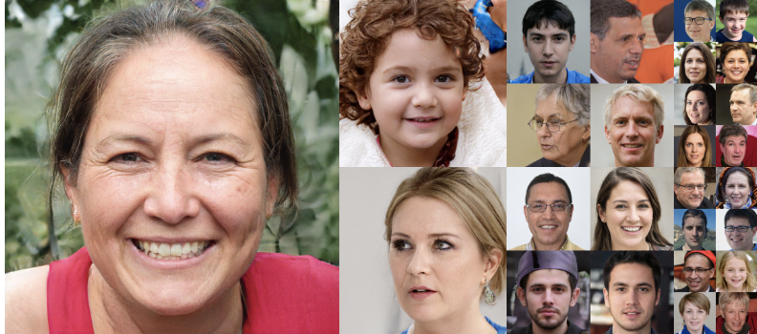
Deep Learning
Face GAN Performance from NVIDIA

Slide 23
Deep Learning
Difficulties with GANs
Training Resources
Mode Collapse
Instability

Slide 24
Deep Learning
Training Resources
Since GANs are most often used for image based data, they require GPUs for reasonable training time.
Fortunately, Google Colab has GPUs available for free!

Slide 25
Deep Learning
Mode Collapse
Often the generator will figure out a few images (or a single image) that can fool the discriminator, and eventually “collapses” to only produce that image.

Slide 26
Deep Learning
Mode Collapse
In theory it would be preferable to have a variety of images, such as multiple numbers or multiple faces, but GANs can quickly collapse to only produce a single number or face, regardless of input noise.

Slide 27
Deep Learning
Mode Collapse
DCGANs (Deep Convolutional GANs) are better for avoiding mode collapse.
Researchers have also experimented with “mini-batch discrimination”, essentially punishing generated batches of images that are all too similar.

Slide 28
Deep Learning
Instability
It can be difficult to ascertain performance and appropriate training epochs since the generated images are always truly “fake”.

Slide 29
Deep Learning
Instability
Due to the design of a GAN, the generator and discriminator are constantly at odds, leading to oscillation between performance between the two.

Slide 30
Deep Learning
Instability
Experimenting with hyperparameters such as layers, neurons, activation functions, learning rates, etc… is usually required for complex images.

Slide 31
Deep Learning
Final Thoughts
GANs are a very popular area of research!
Make sure to do a quick search on Google Scholar for the latest research papers on this topic!

Slide 32
Let’s get started!

Slide 33
GANs
Part 1 - Data

Slide 34
GANs Part 2
Generator and Discriminator

Slide 35
GANs Part 3
Training Batches

Slide 36
DCGANs

Slide 37
Deep Learning
Deep Convolutional GANs use Convolutional Layers to attempt to build GANs better suited for image data.
Let’s take a quick look at how the models would change for a DCGAN approach!

