Slide 1
Group Recommendations
DATA.ML.360-2023-2024-1-TAU Assignment III

Slide 2

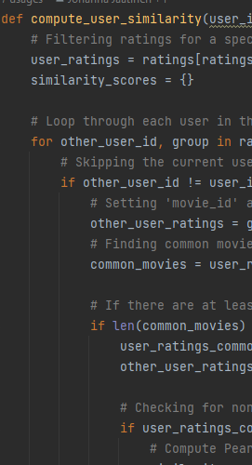
compute_user_similarity
For a given user_id, filter ratings and set 'movie_id' as the index.
Loop through each user in the dataset, excluding the current user.
Find common movies with the current user, considering at least 5 common movies.
Compute the Pearson correlation coefficient for users with common movies.
Store the similarity scores in a dictionary and return it.

Slide 3
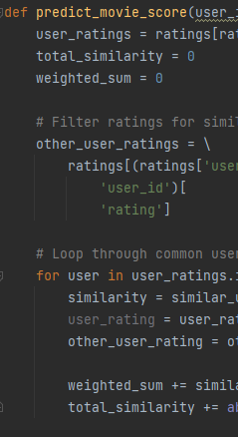
predict_movie_score
For a given user_id and movie_id, filter user ratings and set 'movie_id' as the index.
Calculate the weighted sum of ratings from similar users who have rated the specified movie.
Predict the movie score by dividing the weighted sum by the total similarity.
Return the predicted movie score, rounding it to three decimal places.

Slide 4
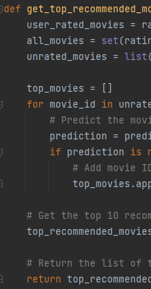
get_top_recommended_movies
For a given user_id and a dictionary of similar_users, find movies not rated by the user.
Predict the scores for unrated movies using the predict_movie_score function.
Return the top 10 recommended movies sorted by predicted scores in descending order.

Slide 5
calculate_dynamic_weights_least_misery
Step 1: Initialize mean_least_misery_scores dictionary to store mean least misery scores for each user.
Step 2: Check if there are previous_recommendations: - If yes, calculate least misery scores for each user based on their ratings for the movies.
- Use the predict_movie_score function for unrated movies.
- Calculate mean least misery scores for each user.
Step 3: If no previous_recommendations, initialize weights with equal values.
Step 4: Calculate dynamic weights using the formula:
Dynamic Weight = 1 / (1+coefficientxmean least misery score)
Step 5: Normalize dynamic weights to ensure they sum to 1.

