Slide 1
Group Recommendations
DATA.ML.360-2023-2024-1-TAU Assignment II

Slide 2

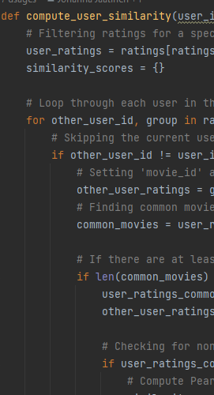
compute_user_similarity
For a given user_id, filter ratings and set 'movie_id' as the index.
Loop through each user in the dataset, excluding the current user.
Find common movies with the current user, considering at least 5 common movies.
Compute the Pearson correlation coefficient for users with common movies.
Store the similarity scores in a dictionary and return it.

Slide 3
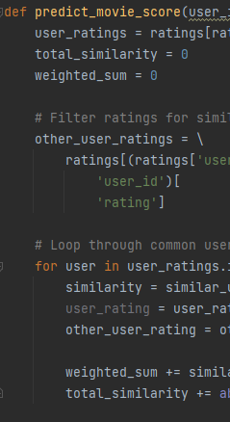
predict_movie_score
For a given user_id and movie_id, filter user ratings and set 'movie_id' as the index.
Calculate the weighted sum of ratings from similar users who have rated the specified movie.
Predict the movie score by dividing the weighted sum by the total similarity.
Return the predicted movie score, rounding it to three decimal places.
If user has already rated the movie, use the rating as is.

Slide 4
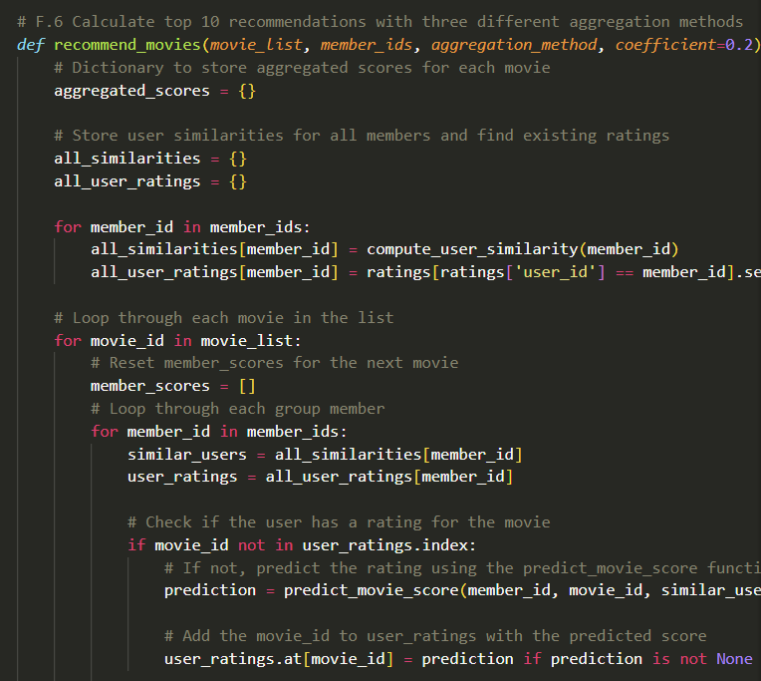
recommend_movies
Calculate top 10 recommended movies for a given group of users
Choose from three different aggregation methods
Takes existing ratings from each user and predicts the rest
Calculates aggregated scores for each movie and returns the top 10 best matches for the group

Slide 5
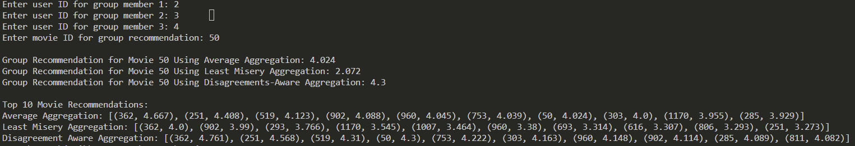
group_recommendation_disagreements
Calculate individual predictions for each user in the group using predict_movie_score.
If no predictions are available, return None.
Calculate the standard deviation of ratings across all users and the weighted average disagreements.
Display group recommendations and the top 10 movies using disagreements-aware aggregation.

