Slide 1
Explanations for Why-not Questions
DATA.ML.360-2023-2024-1-TAU Assignment IV

Slide 2

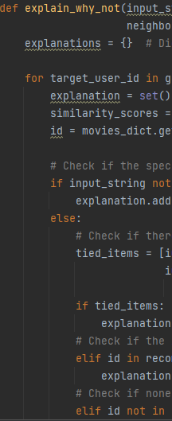
Explain_why_not
This method addresses the question of why a specific item is not recommended to a group of users.
Components include input strings, user questions, rating scores, recommendation lists, and peer information.
The primary goal is to provide more informative explanations for non-recommended items and why they were not included

Slide 3
Explain_why_not call
Prompt user for a movie name using input_string.
Store the entered movie name in input_string.
Create an empty dictionary, explanations_dict, to store user explanations.
Iterate through each user in the group using for user_id in group_members.
Collect peer rating scores for movies in peers_rating_scores.
Obtain user recommendations using user_recommendations.
Utilize functions (compute_user_similarity and get_top_recommended_movies) for collaborative filtering.

Slide 4
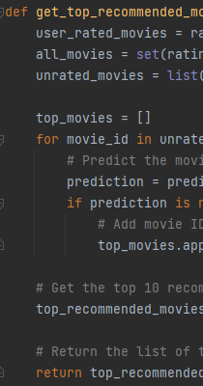
Explain_why_not
Create an empty dictionary explanations to store explanations for each group member.
Calculate similarity scores between the target_user_id and other users using the compute_user_similarity function.
If user has already rated the movie, add the explanation “User has already rated (input_string)”
If there is a tie with another item in the recommendation list based on rating scores, add the explanation "Tied relevance scores" to the set.
If the item is in the recommendation list and its position is within the range of the first two times the neighborhood_size, add the explanation "Position in list (neighborhood_size)" to the set.

Slide 5
Explain_why_not_group
Create an empty dictionary explanations to store explanations for the group
Find similar users for the group members to help establish a framework of peers
If there are insufficient number of most similar peers, add explanation “Insufficient most similar peers for Category”
If there are insufficient overall peers, add explanation “Insufficient overall similar peers”
If there are no peer ratings, add explanation “No peer ratings for the items in Category”

Slide 6
If none of the users in the system have rated the item, add the explanation "No ratings for the item" to the set.
If any of the peers of the target user have rated the item, loop through the peers and add explanations for each peer including their ID, rating for the item, and similarity score.
If the number of most similar peers who have rated the item is less than numPI, add the explanation "Insufficient most similar peers" to the set.
If the total number of peers is less than numP, add the explanation "Insufficient overall similar peers" to the set.
If none of the peers have rated the item, loop through all users and add explanations for each user who hasn't rated the item.
Store the set of explanations for the current target_user_id in the explanations dictionary.
After iterating through all group members, return the explanations dictionary containing explanations for each user in the group.

