Slide 1

J Cooper’s Legal Practice, how can I help?
Need some legal advice for my business
Sure, let me start by taking some details…

Slide 2
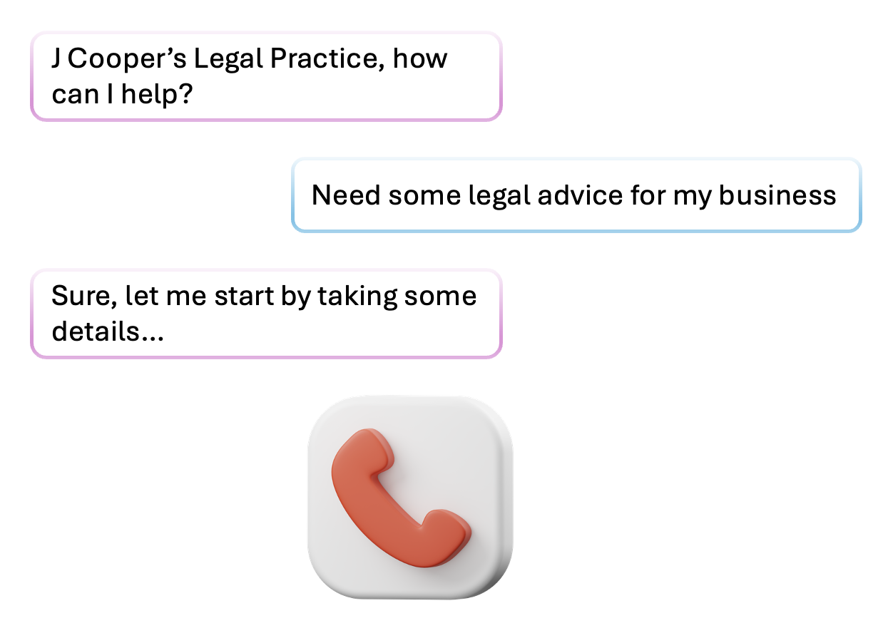

Slide 3
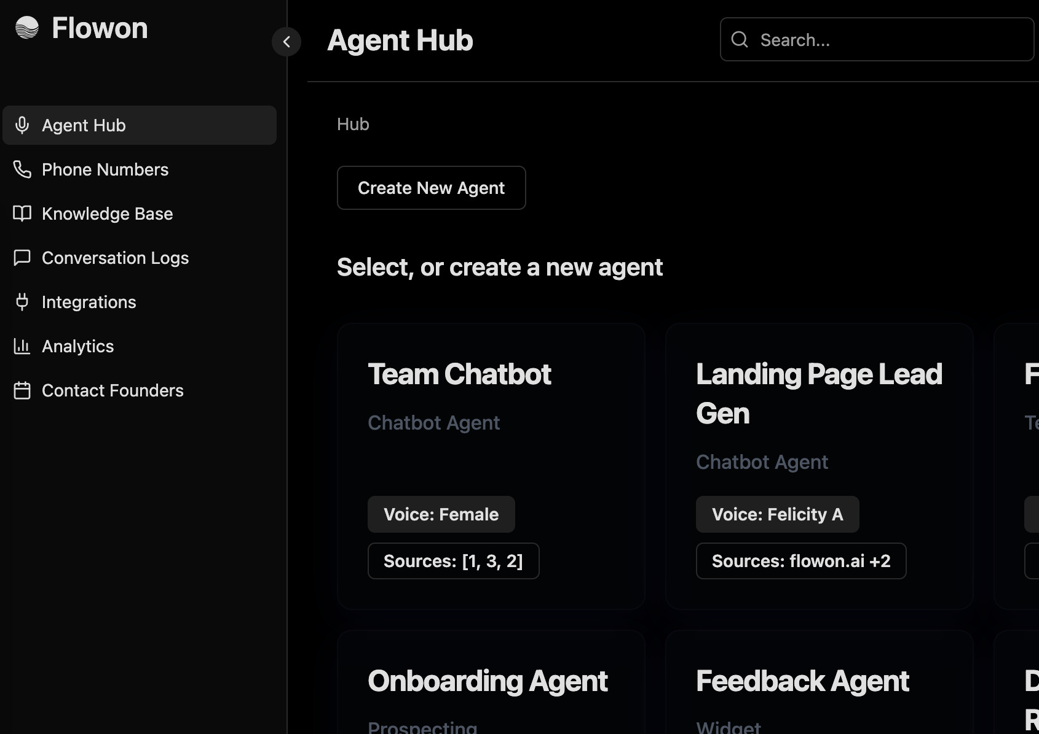

Slide 4
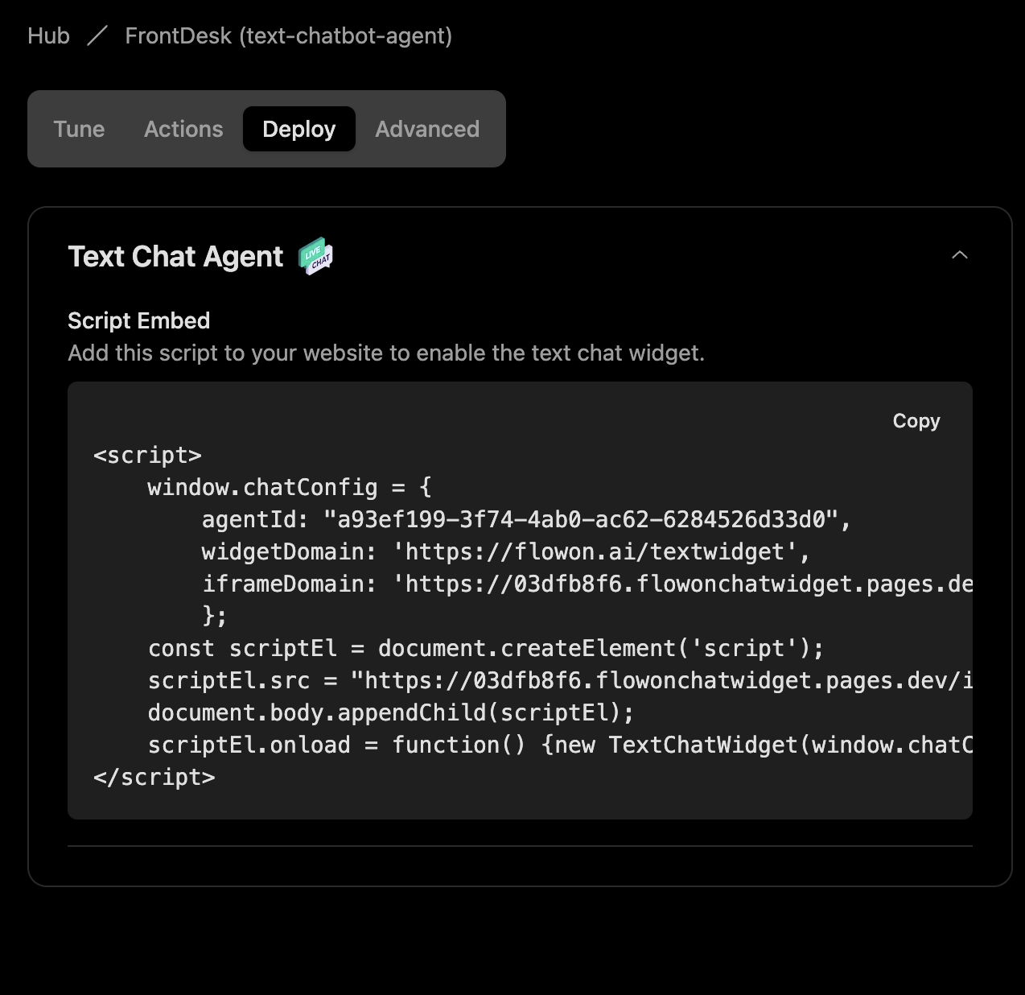

Slide 5
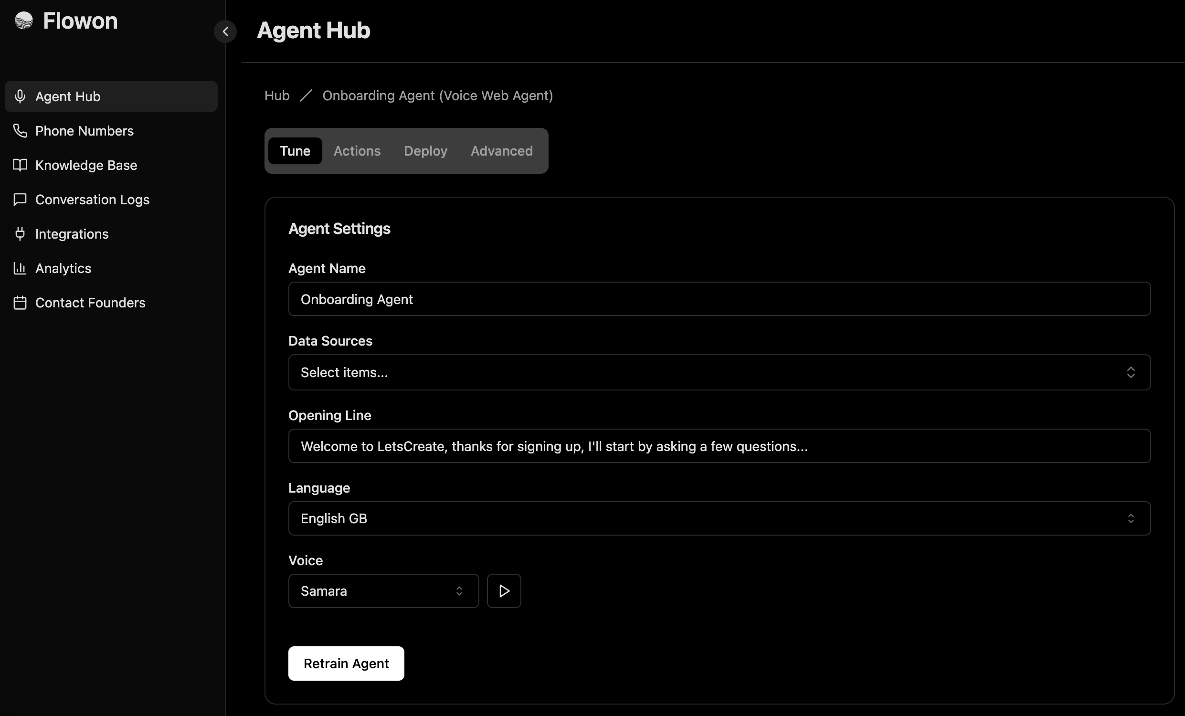

Slide 6
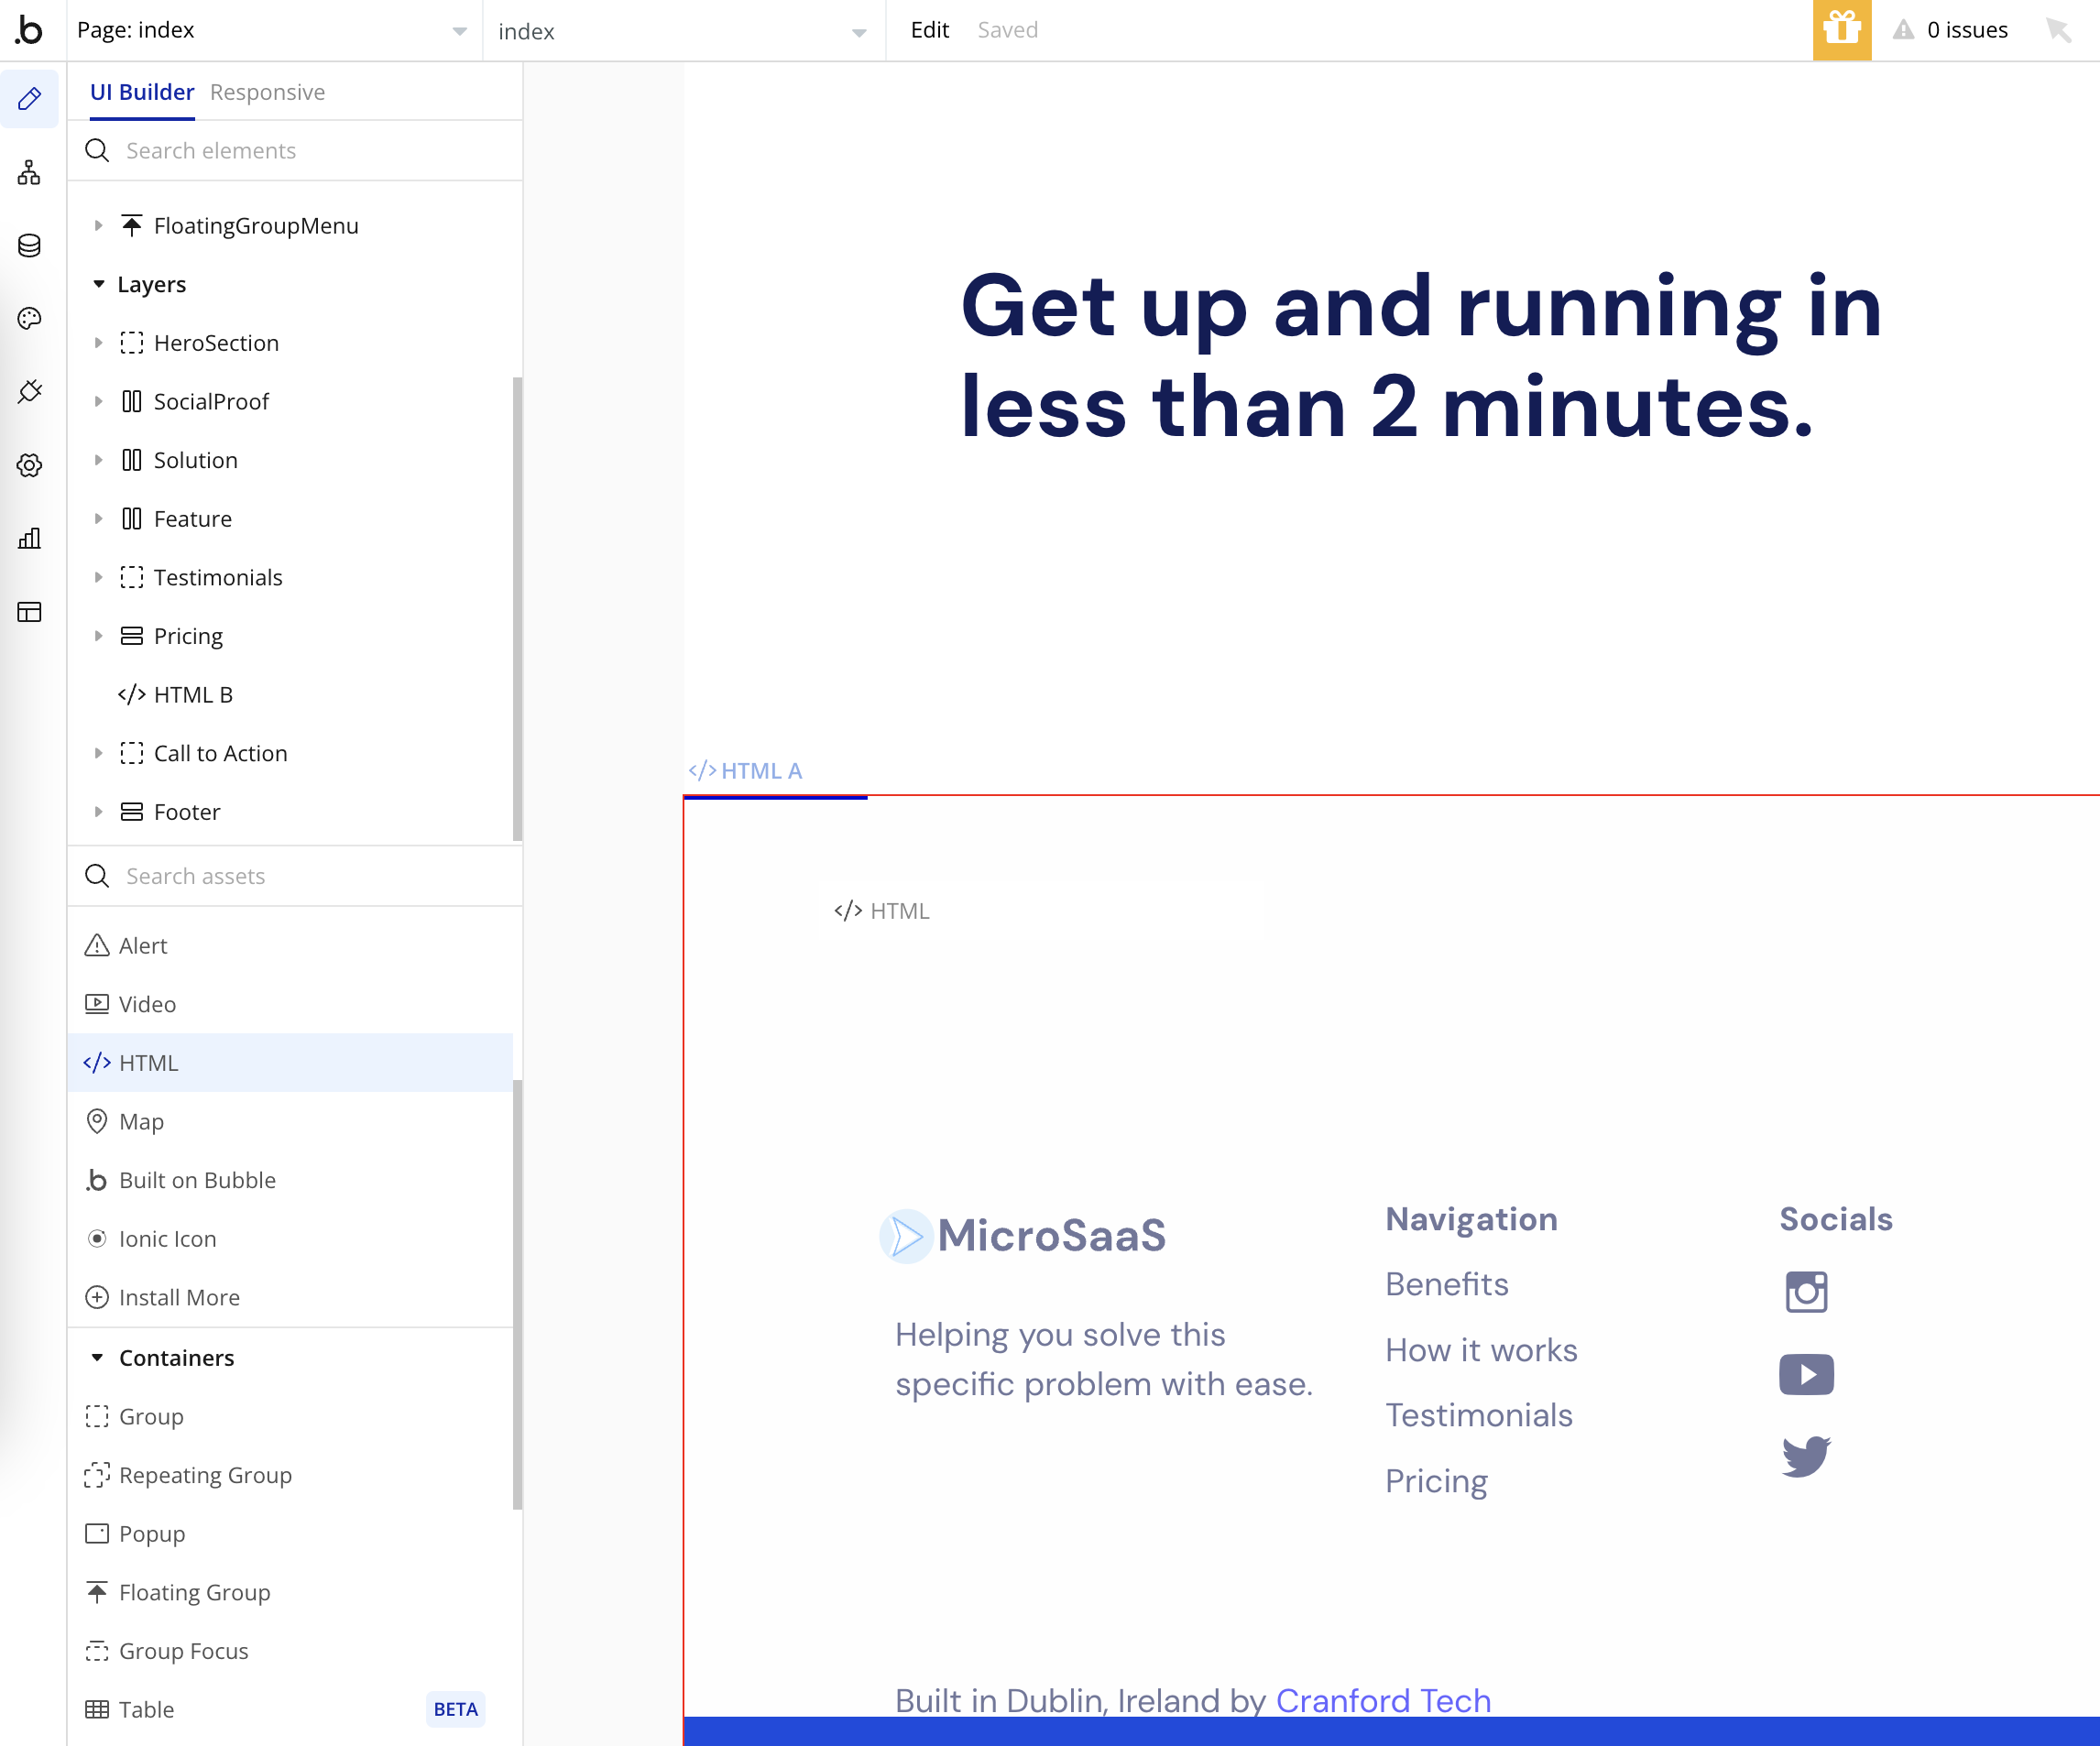
2
1

Slide 7
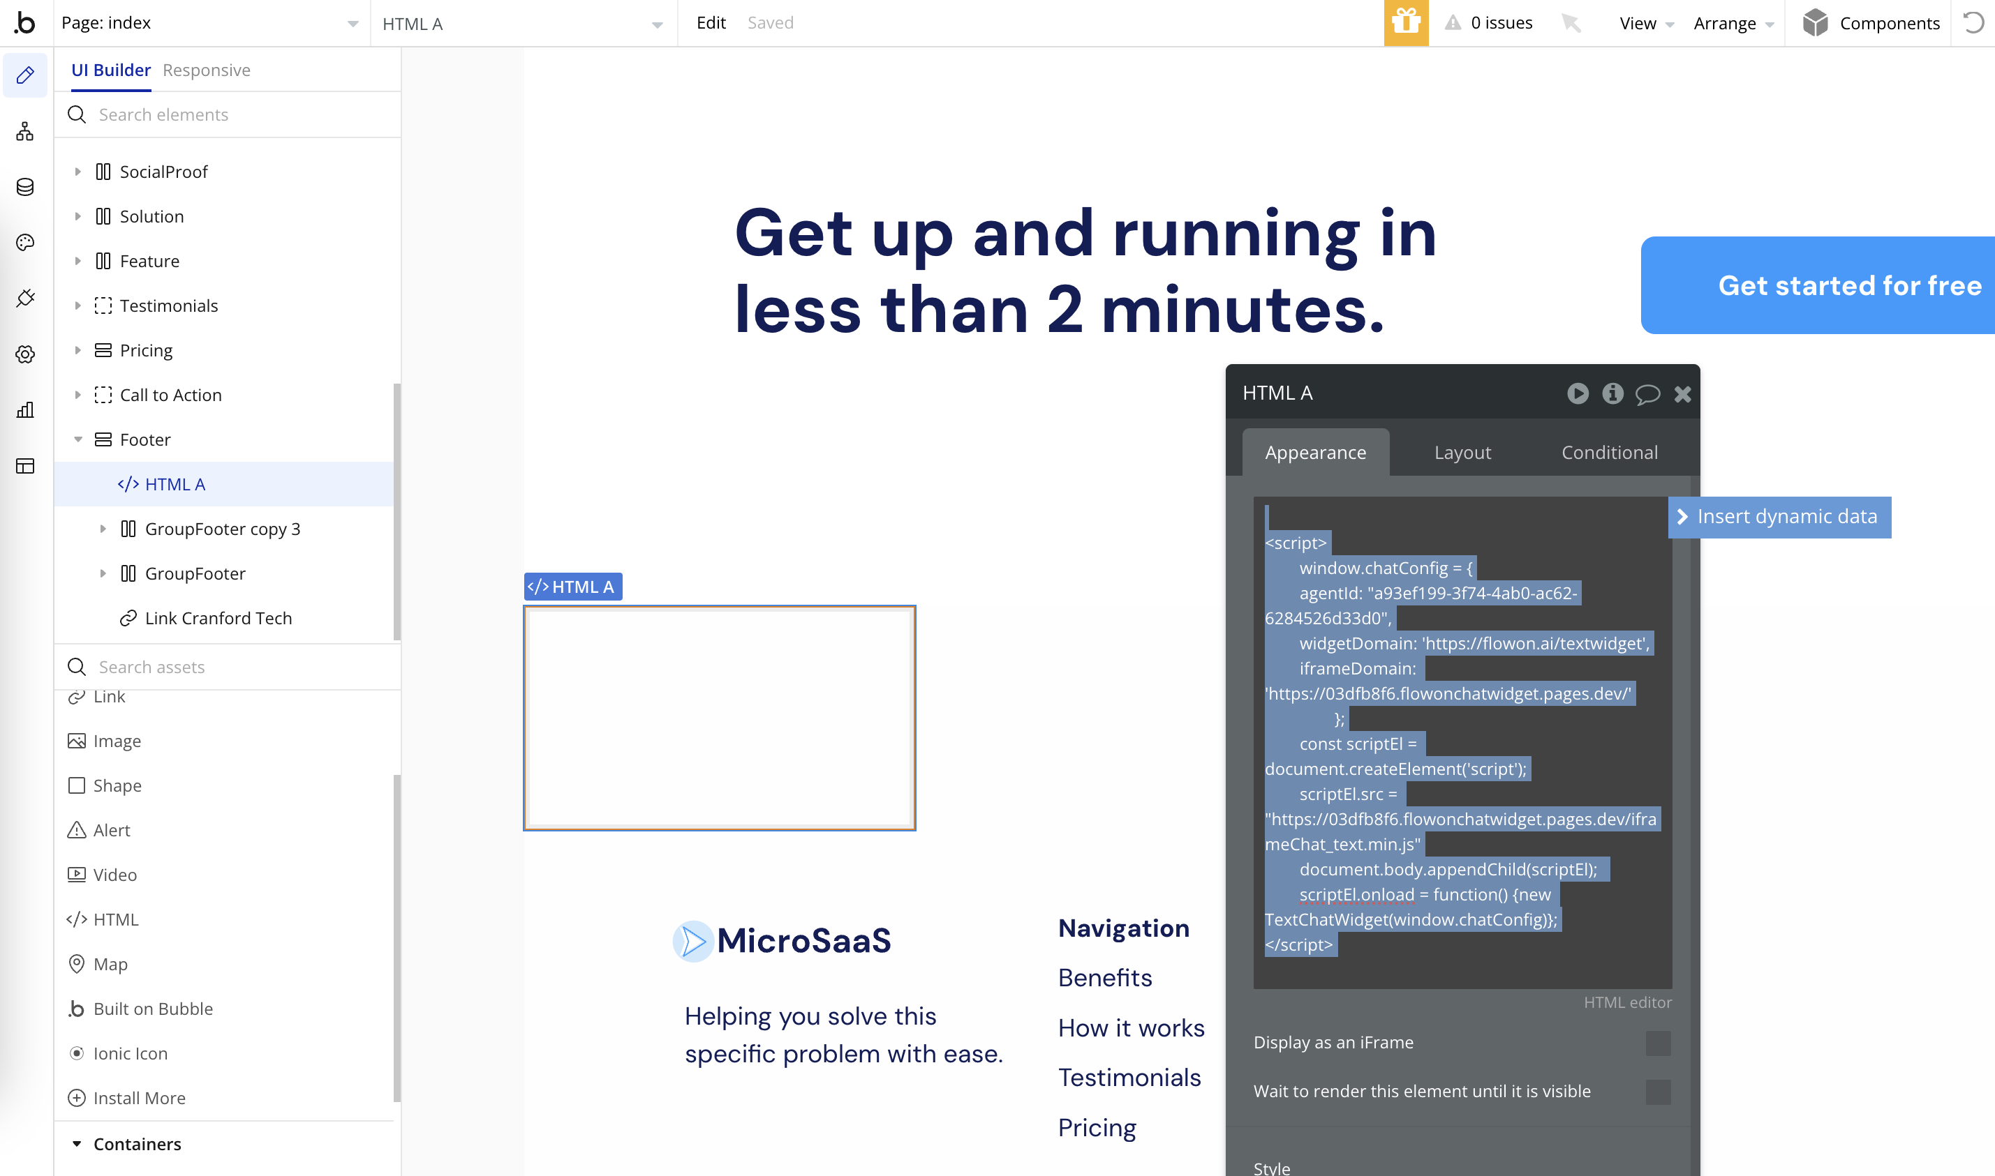

Slide 8
