Slide 1
Portuguese Vinho Verde Psychochemical Data Analysis
Professor Mª Rosário Oliveira
Multivariate Analysis
2019/ 2020
Maria Almeida | Nuno Rosinha | Sebastião Almeida | Sebastião Cerqueira
97136
34290
97115
97108

Slide 2
Dataset
Features
Fixed Acidity
Volatile Acidity
Citric Acid
Residual Sugar
Chlorides
Free Sulfur Dioxide
Total Sulfur Dioxide
Density
pH
Sulphates
Alcohol
Alcohol
Quality

Slide 3
Univariate Analysis: Red Wine
 | Fixed Acidity | Volatile Acidity | Citric Acid | Residual Sugar | Chlorides | Free Sulfur Dioxide
Mean | 8,320 | 0,530 | 0,271 | 2,539 | 0,088 | 15,870
Median | 7,900 | 0,527 | 0,260 | 2,200 | 0,079 | 14,000
Min. | 4,600 | 0,120 | 0,000 | 0,900 | 0,012 | 1,000
Max. | 15,900 | 1,580 | 1,000 | 15,500 | 0,611 | 72,000
Var. | 3,031 | 0,032 | 0,038 | 1,988 | 0,002 | 109,400
 | Total Sulfur Dioxide | Density | pH | Sulphates | Alcohol | Quality
Mean | 46,470 | 0,997 | 3,311 | 0,658 | 10,420 | 5,636
Median | 38,000 | 0,997 | 3,310 | 0,620 | 10,200 | 6,000
Min. | 6,000 | 0,990 | 2,740 | 0,330 | 8,400 | 6,000
Max. | 289,000 | 1,000 | 4,010 | 2,000 | 14,900 | 8,000
Var. | 1082,000 | 0,000 | 0,024 | 0,029 | 1,135 | 0,652

Slide 4
Univariate Analysis: White Wine
 | Fixed Acidity | Volatile Acidity | Citric Acid | Residual Sugar | Chlorides | Free Sulfur Dioxide
Mean | 6,855 | 0,278 | 0,334 | 6,391 | 0,046 | 35,310
Median | 6,800 | 0,260 | 0,320 | 5,200 | 0,043 | 34,000
Min. | 3,800 | 0,080 | 0,000 | 0,600 | 0,009 | 2,000
Max. | 14,200 | 1,100 | 1,660 | 65,800 | 0,346 | 289,000
Var. | 0,712 | 0,010 | 0,015 | 25,726 | 0,000 | 289,243
 | Total Sulfur Dioxide | Density | pH | Sulphates | Alcohol | Quality
Mean | 138,400 | 0,994 | 3,188 | 0,490 | 10,510 | 5,878
Median | 134,000 | 0,994 | 3,180 | 0,470 | 10,400 | 6,000
Min. | 9,000 | 0,987 | 2,720 | 0,220 | 8,000 | 3,000
Max. | 440,000 | 1,039 | 3,820 | 1,080 | 14,200 | 9,000
Var. | 1806,086 | 0,000 | 0,023 | 0,013 | 1,514 | 0,475

Slide 5
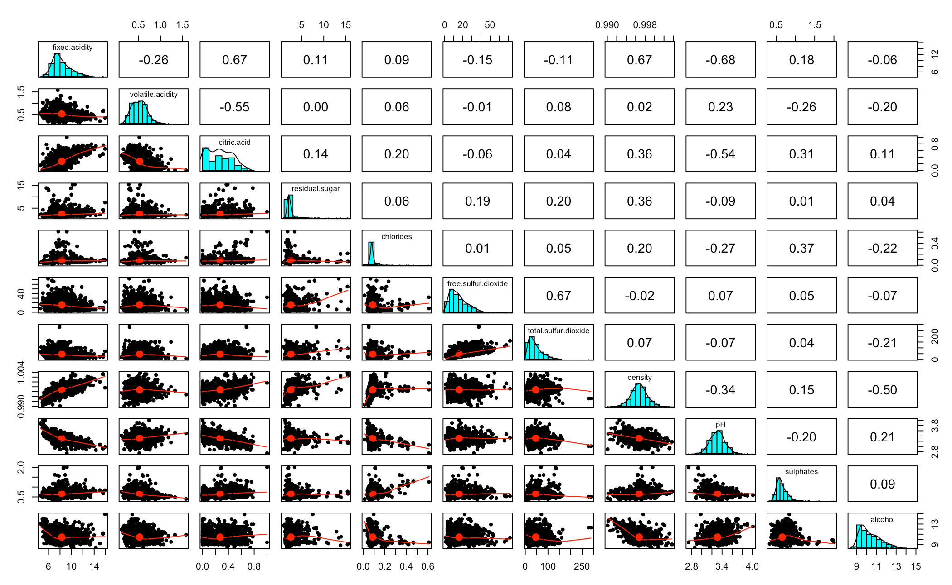
Overview: Red Wine

Slide 6
Overview: White Wine

Slide 7
Looking into ”Quality”
Red Wine
White Wine

Slide 8
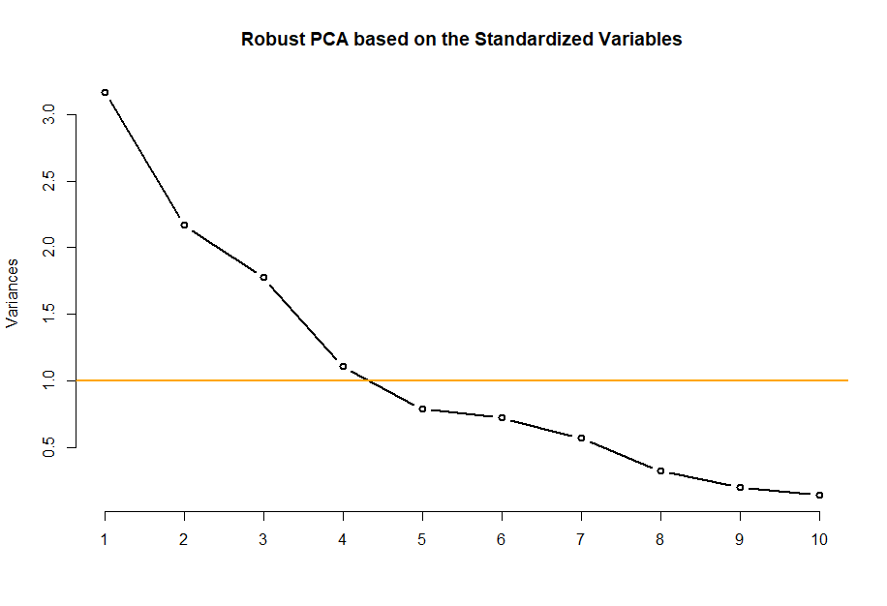
Principal Component Analysis: Red Wine
5 components explain 82% of variability

Slide 9
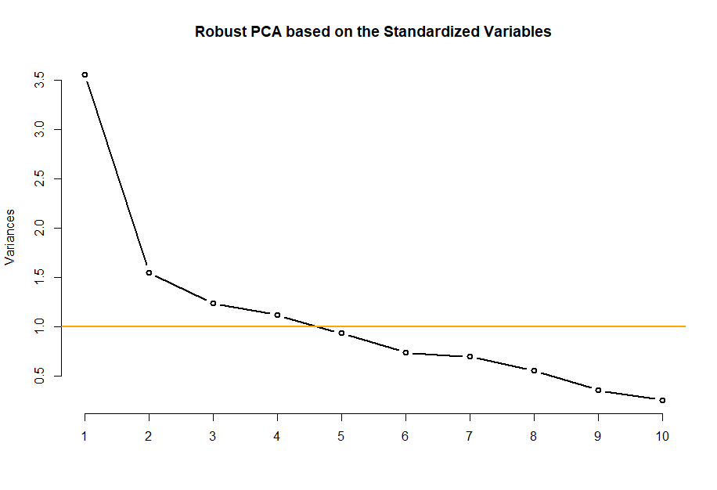
Principal Component Analysis: White Wine
5 components explain 76% of variability

Slide 10

Outlier Identification and Removal
Done class by class
Outlier identification on the multivariate dataset at once, instead of doing it in a univariate way for each variable
Using robust PCA’s for outliers identification, with a high cutting value (0.999), for a conservative and adequate approach to this issue
Hopefully, the cost of the loss of some observations, and, therefore, information, is offset by the improvement in the performance of the classifiers, which would translate to a better real-world application

Slide 11
Feature Selection
Red Wine
White Wine
Features by Relevance
Alcohol
Volatile Acidity
Sulphates
Total Sulfur Dioxide
Chlorides
Residual Sugar
pH
Density
Free Sulfur Dioxide
Citric Acid
Fixed Acidity
Features by Relevance
Alcohol
Volatile Acidity
Fixed Acidity
Chlorides
Sulphates
Free Sulfur Dioxide
Citric Acid
pH
Residual Sugar
Total Sulfur Dioxide
Density

Slide 12
Datasets for the Analysis
Original
With Classes Grouped
With Principal Components
After Outlier Removal
After Feature Selection

Slide 13
Support Vector Machine: Red Wine
Datasets/ Kernel | Linear | Polynomial | Radial | Sigmoid
Original | 0,569 | 0,581 | 0,640’ | 0,513
PCA | 0,573’’ | 0,473 | 0,492 | 0,438
3 Classes | 0,618 | 0,626 | 0,666 | 0,537
Outliers | 0,592 | 0,631 | 0,634 | 0,507
Feature Selection | 0,573 | 0,574 | 0,631’’’’ | 0,505
’Gamma = 1, Cost = 6 ’’ Cost = 9 ’’’ Gamma = 0.1, Cost = 6 ’’’’ Gamma = 0.1

Slide 14
Support Vector Machine: White Wine
Datasets/ Kernel | Linear | Polynomial | Radial | Sigmoid
Original | 0,522 | 0,538 | 0,648’ | 0,453
PCA | 0,449 | 0,449 | 0,447 | 0,407
3 Classes | 0,547 | 0,560 | 0,679’’ | 0,494
Outliers | 0,526 | 0,533 | 0,643’ | 0,445
Feature Selection | 0,515 | 0,519 | 0,629’’’ | 0,452
’Gamma = 1, Cost = 6 ’’ Gamma = 1, Cost = 11 ’’’ Gamma = 1, Cost = 7

Slide 15
Decision Tree & Random Forest: Red Wine
Datasets/ Classifier | Decision Tree | Random Forest
Original | 0,561 | 0,708
PCA | 0,489 | 0,628
3 Classes | 0,620 | 0,737
Outliers | 0,571 | 0,716
Feature Selection | 0,527 | 0,697
Alcohol
Sulphates
Sulphates
Sulphates

Slide 16
Decision Tree & Random Forest: White Wine
Datasets/ Classifier | Decision Tree | Random Forest
Original | 0,527 | 0,699
PCA | 0,442 | 0,621
3 Classes | 0,557 | 0,736
Outliers | 0,514 | 0,700
Feature Selection | 0,535 | 0,702
Alcohol
Volatile Acidity
Total Sulfur Dioxide

Slide 17
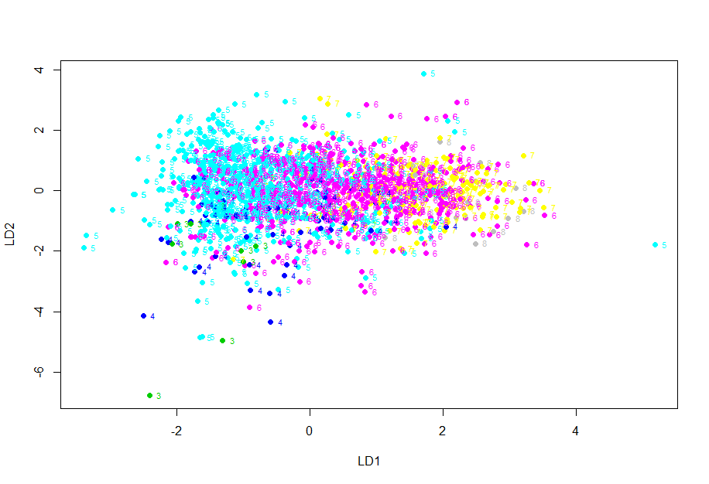
Linear Discriminant Analysis: Red Wine
Multivariate Analysis
17

Slide 18
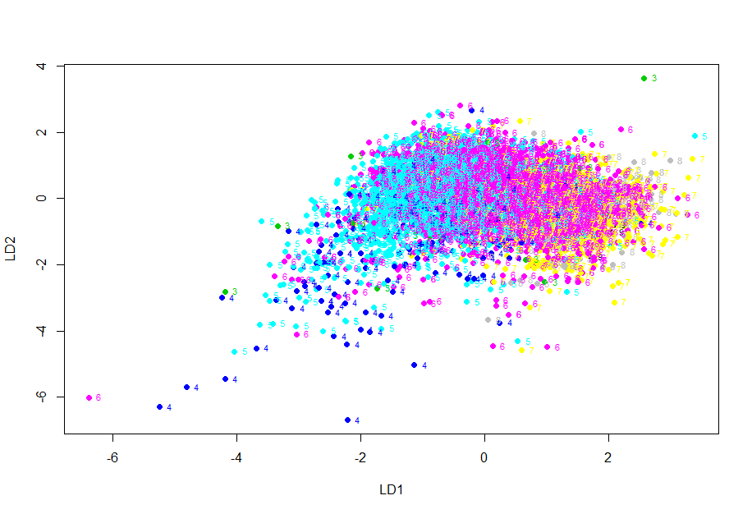
Linear Discriminant Analysis: White Wine
Multivariate Analysis
18

Slide 19
Clustering: Choosing the Algorithm
Red Wine
 | Hierarchical K-Means | K-Medoids
Original | 0,603 | 0,579
Outliers | 0,595 | 0,568
Feature Selection | 0,647 | 0,621
Average Silhouette Width
White Wine
 | Hierarchical K-Means | K-Medoids
Original | 0,506 | 0,506
Outliers | 0,507 | 0,508
Feature Selection | 0,578 | 0,563

Slide 20
Clustering: Hierarchical K-Means
Red Wine
 | Size | BSS | WSS | BSS/ TSS
Cluster 1 | 1192 | 1170116 | 251802 | 0,675
Cluster 2 | 407 |  | 312412
White Wine
 | Size | BSS | WSS | BSS/ TSS
Cluster 1 | 1784 | 865372 | 307029 | 0,606
Cluster 2 | 3114 |  | 255223

Slide 21
Clustering: Hierarchical K-Means
Summary Statistics for “Quality”
Red Wine
 | Cluster 1 | Custer 2
Min | 3,000 | 4,000
Max | 8,000 | 8,000
Median | 6,000 | 5,000
Mean | 5,723 | 5,381
White Wine
 | Cluster 1 | Custer 2
Min | 3,000 | 3,000
Max | 9,000 | 9,000
Median | 6,000 | 6,000
Mean | 5,839 | 5,900

Slide 22
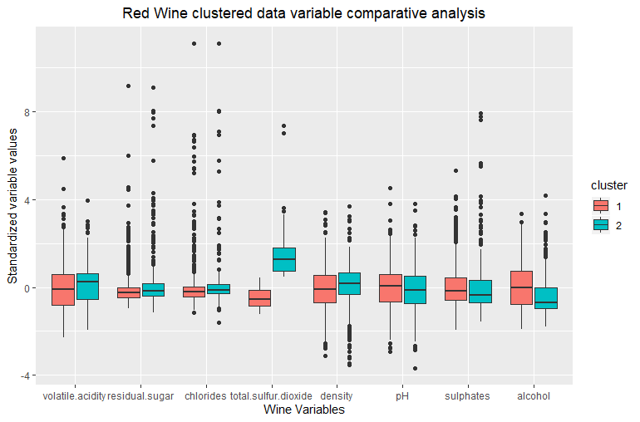
Clustering: Hierarchical K-Means

Slide 23
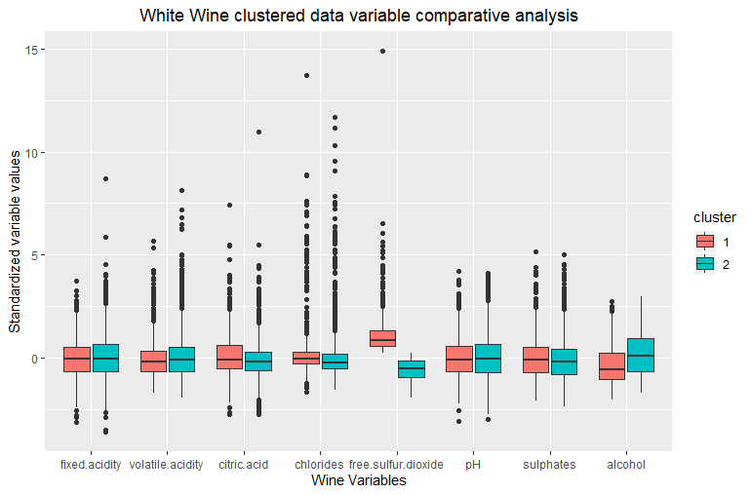
Clustering: Hierarchical K-Means

Slide 24
Applying the Clustering Results
Split the Dataset
Perform the Clustering Separately
70% for Training
30% for Testing
Red Wine
Classify
White Wine
Random Forest
Support Vector Machine
Accuracy: 0,987
Accuracy: 0,978

Slide 25
Conclusions & Suggestions
Able to predict quality with an accuracy surrounding 60%;
Most relevant features are Alcohol and Volatile Acidity;
Problem of having an ordinal label on the classification task;
Variables distinguishing between the different wines are related to the amount of sulfur;
Reached a good clustering solution through Hierarchical K-Means;
Increase the number of very bad and very good wines;
Experiment doing the supervised learning through a regression.

Slide 26
Thank You for Your Attention
Multivariate Analysis
2019/ 2020

