Slide 1


A CHINESE LEARNING APP

Slide 2

An educational purpose / distance learning
UI for all kinds of users of all ages
An accessible and easy to use app
CONCEPT IDEA
App Development (for IOS)
Implement computer vision and object detection
Imagery Data Base Gathering

Slide 3
A CHINESE LEARNING APP
Mashi Mashi (妈是) is an IOS (and possibly future Android) app which helps users learn how to correctly write Chinese characters by hand.
Using a database found on Kaggle of over 15 000 handwritten Chinese numbers, Mashi Mashi tells you if you properly write your Chinese characters.
一 | 二 | 三
四 | 五 | 六
七 | 八 | 九
十 | 零 | 百
千 | 万 | 亿

Slide 4



BEHIND THE APP
Learned and used XCode for the development of the IOS App with a Swift program in the background allowing for a smooth operation.
Python (3.9) Programming Language used to implement the computer vision part of the project.
Firebase used as a connection of the computer vision model which we wrote to the app.

Slide 5

COMPUTER VISION
Seeing is believing.
In seeking to replicate the human visual system, we allow for the automation of tasks that machines were once not able to do.
With this project, our team seeks to use the ImageAI Recognition and Detection AI to understand and implement this technology so that the program can return what it detects on the image submitted to our application.
This is all done in order to deliver an education service in which people of all ages may be delivered optimal language training.
ImageAI

Slide 6



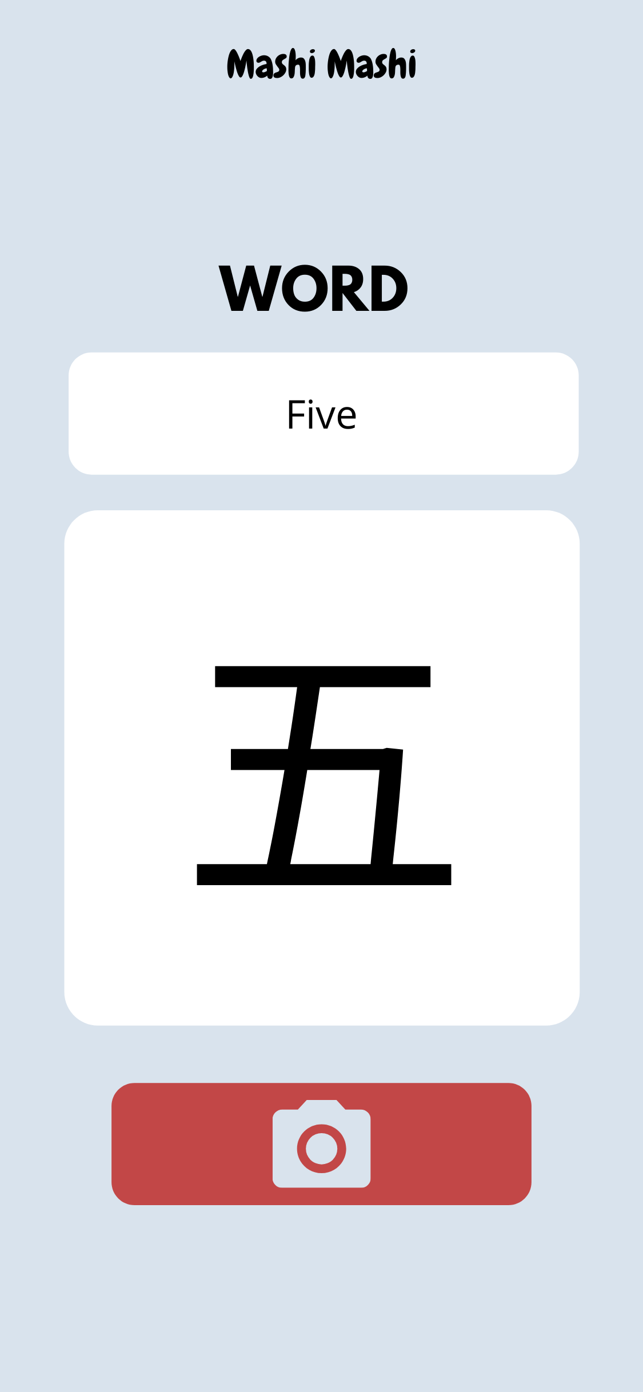
APP INTERFACE
Simple interface which even children could easily understand and use on their own.
Colours which are both enticing and soothing for a user experience which is engaging but not overwhelming.
Swift programming in the back end for an easy scalability of the app as well as improved performance and safety.

Slide 7
OUR ALGORITHM
Pull Variable
Push Variable
F I R E B A S E
Xcode
ImageAI
U. I.
Push picture
C. V.
Pull picture

Slide 8

CODE.JAM{2020}
“Digital By Default”. For us, this means being able to rely on digital devices (such as your phone) to do crucial tasks like learning without needing other people. Education has always been essential, it allows for the growth of society and the improvement of future generations. Education is necessary and when it is hindered because of a pandemic, we start to see the ways in which online learning is lacking. We want to improve an aspect of this through hacking.
Therefore, with an app which allows for checking your chinese character writing through computer vision, gone are the days where you need to pay for a class or a tutor to check your handwriting.
Everything becomes digital.

Slide 9
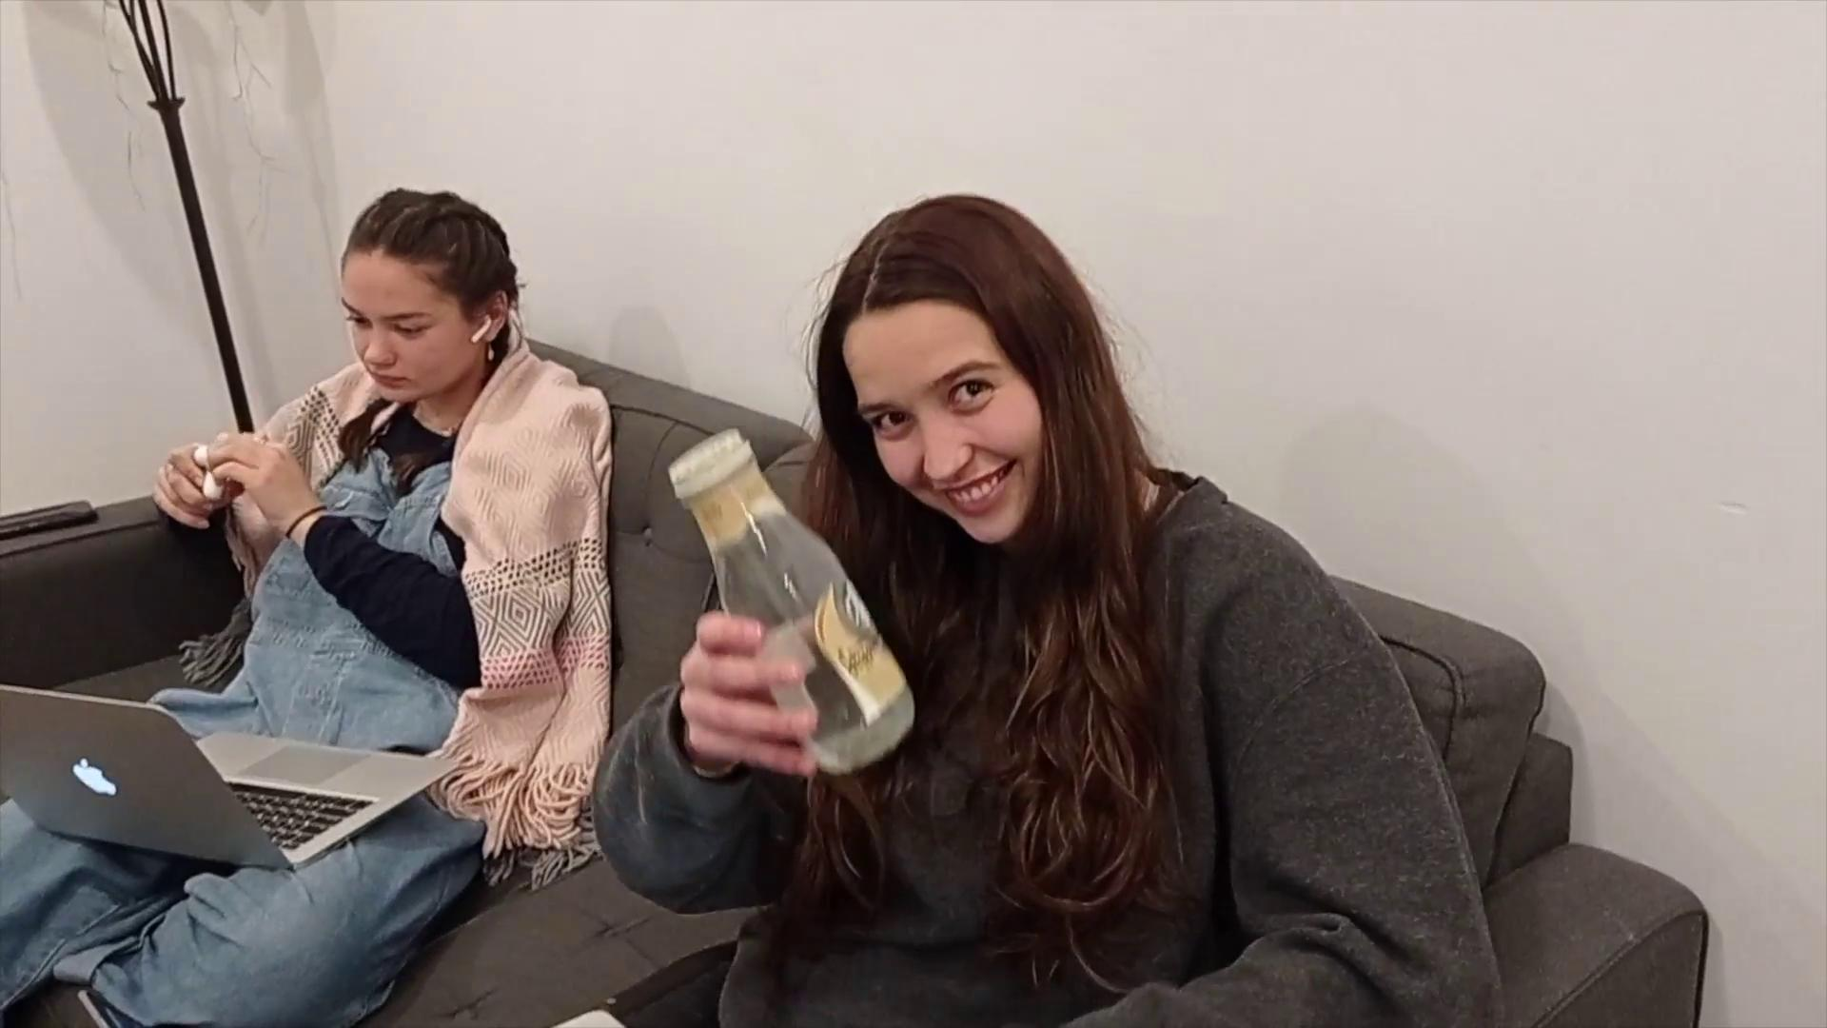
PROMO VIDEO

Slide 10

APP DEMO

Slide 11


LOOKING AHEAD...
Looking ahead we want to be able to further this project so that it can cater larger audiences and bigger needs.
Near Future
Bigger database ( more Chinese characters)
Implement a correction feature which indicates where your writing should be improved
Far Future Add more languages (Korean, Japanese, Arabic…)

Slide 12




MEET THE TEAM!
Jamie Folwell
B.A.Sc. in Cognitive Science (Comp Sci focus)
Victorien Garrigues
B.A. in Computer Science & Political Science
Loi Duong
B.A. in Computer Science & Mathematics
Mia Berthier
B.A.Sc. in Cognitive Science (Comp Sci focus)

