Slide 1
Python - Part 1
Syntax and Basic Functionality

Slide 2
Start Using Python
Log into ceclnx01
Type python
Done.
python3 will start python 3.3 (rather than 2.7)
Alternatively, running the program IDLE on the lab machines will start a GUI for Python interpreting
quit() will exit the interpreter

Slide 3
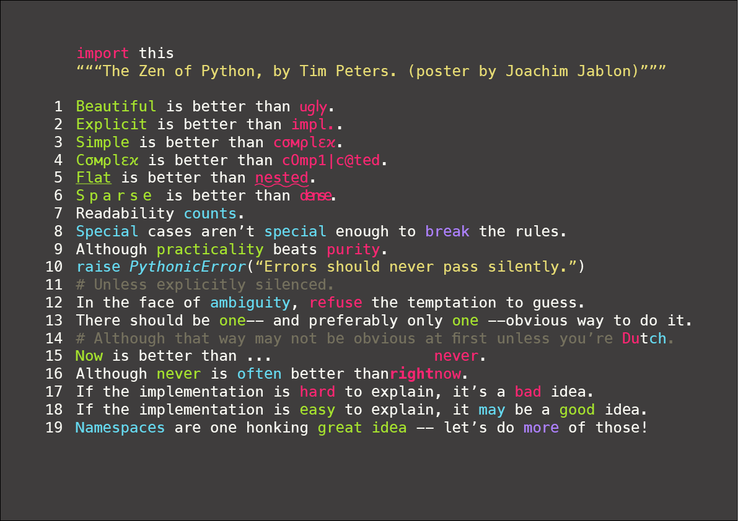

Slide 4
Paradigms
Object-oriented
Imperative and Functional Programming
Dynamic Typing
Automatic Memory Management

Slide 5
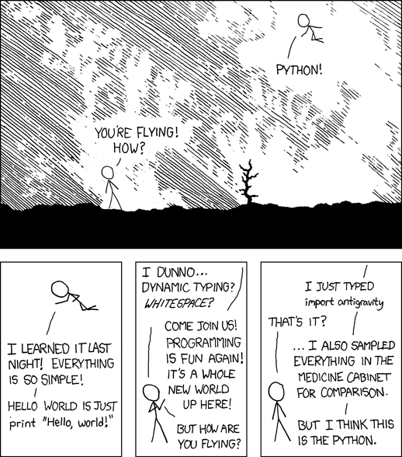
Advantages of Python
Free and Open Source
HUGE number of 3rd party libraries
Emphasizes readability, simplicity, and rapid development

Slide 6
Hello World
print ‘Hello, World!’
print(‘Hello, World!’) with python3
That’s it!

Slide 7
Math and Python
Familiar mathematical syntax
2+2
5*5
6/2
6/4
6/4.0
Simplified mathematical syntax (from Java)
5**3 ( versus Math.pow(5,3) )

Slide 8
More Math!
Complex Numbers
J or j
Must be preceded by a number
Ex: x = 5 + 1j
abs(x)
x.real
x.imag
NumPy and SciPy for even more advanced features
NumPy is very similar to MATLAB

Slide 9
Variables
Dynamically typed
No need to declare object type
x = 5
x = y = z = 3
x = ‘a’
Notes:
Cannot declare variable without initializing it.
Use None reserved word (roughly equivalent to null)
‘_’ refers to the value returned by the previous line (in interactive mode)

Slide 10
Data Structures
Sets, Lists, Dictionaries built-in much more intuitively
Create a list:
i = [5, 3, 7, 3]
Retrieve values
i[2]
Create a tuple:
T = (5, 3, 7, 3)
What’s different between a list and a tuple?
Tuples have defined sizes (cannot append new values). Like arrays in Java
Create a set:
s = {5, 3, 7, 3}
No indexing. Why not?
Create a dictionary:
d = { ‘a’ : 4 , ’b’ : 3 , ’c’ : 8 }
Retrieve value
d[‘a’]

Slide 11
Data Structures (cont’d)
Create empty structures:
List: w = []
Tuple: x = ()
Set: y = set()
Dict: z = dict()

Slide 12
Data Structures and Math
Lists []
+
sets {}
&
|
-
^

Slide 13
Strings
“Hello, World” or ‘Hello, World’
No differentiation between character and string
“ must match with “ and ‘ with ‘
“Hello, World’ – NO
“That’s it!” – Yes
‘He said, “Hello, World”’
Use \ to escape special characters
Ex: “\n” for new line

Slide 14
String Formatting
str.format()
Insert strings print “{0}, {1}, my name is {myName}”.format(‘Hello’, ↵ ‘World’, myName=‘Kyle’)
Format numbers print “Pi: {0:.3f}”.format(math.pi)
Format inserted string x = {‘John’:’123-555-1234’,’Stephanie’:’123-555-4321’} for name, phone in x.items(): print “{0:15} == {1:12}”.format(name,phone)

Slide 15
Booleans, For Loops, While Loops, and Reserved Words
Flow Control

Slide 16
Booleans
True and False
1 or 0
Standard ‘<‘, ‘>’, ‘==‘, ‘!=‘, ‘<=‘, ‘>=‘
No &&, ||, or !
Just ‘and’, ‘or’, and ‘not’
Ex: (5 < 6 and 4 >= 3) or not True

Slide 17
Loops
For Loops
While Loops
Collection based
Ex: x = [0,1,2,3,4] for i in x: print ‘hello’, i
Shortcut for i in xrange(5): print ‘hello’,i
Set start value for i in xrange(5,10): print ‘hello, i
Boolean based
Ex: x = 0 while x < 5: print x x += 1

Slide 18
Misc Helpful Things
Other Stuff

Slide 19
Tuples
x = (5,3,2,1)
Or just x = 5,3,2,1
Parentheses not necessary
Split a tuple into individual variables
a,b,c,d = x
Implication – One line – Multiple assignments
a,b,c,d,e = 1,2,3,4,5
Another implication – Swap variables
a,b = b,a

Slide 20
List Comprehensions
Task: Create list containing x2 for x = 1..10
Naïve Approach: squares = [] for x in xrange(10): squares.append(x**2)
List Comprehension Approach: squares = [x**2 for x in xrange(10)]
Other Example: osp = [(x,x**2) for x in xrange(10) if x%2 != 0]

Slide 21
More Lists
2D List (Matrices) Comprehension
matrix = [ range(1,5), range(5,9), range(9, 13)] [ [ row[i] for row in matrix ] for i in range(4) ]
Transposes a list
Repeat a list
[1,2,3,4,5]*4
[1]*100 is equivalent to MATLAB’s ones(100)
[0]*100 <=> MATLAB’s zeros(100)

Slide 22
Lists, Indices, and Sublists
Create a list x = range(10)
x[3]
Get sublist starting at an index (inclusive) x[3:]
Get sublist ending at an index (exclusive) x[:7]
Get sublist with defined start and end x[3:7]

Slide 23
Fun With Sets
Use ‘in’ keyword to check if a set contains a certain value
Ex: fruits = {‘apple’,’orange’,’banana’} ‘carrot’ in fruits
Create a set from a list someSet = set(someList)

Slide 24
Set Comprehensions
Task: Create a set of the letters in abracadabra not including a, b, or c
Naïve Approach: s = ‘abracadabra’ rv = set() for c in s: if c != ‘a’ and c != ‘b’ and c != ‘c’: rv.add(c)
Set Comprehensions rv = {x for x in ‘abracadabra’ if x not in ‘abc’}

Slide 25
Dictionaries
When key is a simple string – simple instantiation
Ex: d = dict(john=5, ben=10, howie=14, bill=3)
Dictionary Comprehensions
osp = {x: x**2 for x in xrange(10) if x % 2 != 0}
Convert list of sequences (size 2 tuples) to dict
Ex: l = [(1,2), (3,5), (6,10)] d = dict(l)

Slide 26
Bitwise Operations
|, &, ^ for bitwise or, and, xor
~ for complement ( equivalent to -x-1 )
<<, >> for bit shifting

Slide 27
Notes on Python 3
New standard (since 2008!)
Not backwards compatible
Technically new software should use Python3
Python 2 will lose support eventually
Support for some libraries is still in progress
Forces some projects to stay on Python2
Tools to ease conversion from 2 to 3 exist
Not perfect

