Slide 1

Fun Fact:
Python is not named for the snake
Rather, it is named for
Monty Python’s Flying Circus

Slide 2
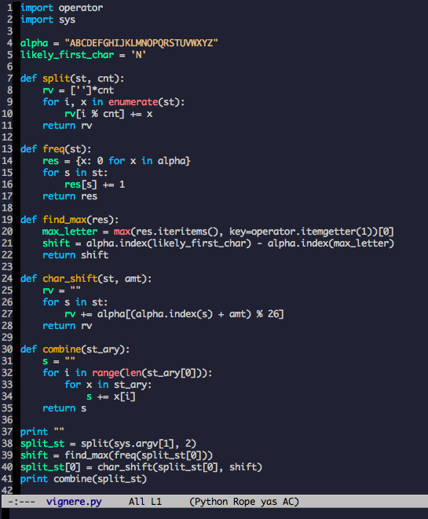
Review
Dynamic Variables
No need to specify variable type
Uses colons/whitespace for delimiting
Familiar math syntax
and/or/not rather than && / || / !

Slide 3
Connect to lnx01
Open Putty
Enable X11 forwarding (if you’re using Emacs)
Connect to ceclnx01.cec.miamioh.edu

Slide 4
Create Your First Python Module
A module is the name for a Python file (uses .py extension)
Open emacs/vim/nano with file test.py
emacs test.py > /dev/null 2>&1 &
vim test.py
nano test.py
Emacs is highly recommended

Slide 5
Hello World!
Type print “Hello, World!”
Return to shell
Enter python test.py

Slide 6
Create a Function
Return to Emacs/vim/nano
Insert a new line ABOVE the print statement
“def” declares a function
On the new line enter: def hello():
Go to next line and indent it
Should now read def hello(): print “Hello, World!”
Return to shell and run python test.py

Slide 7
Call a Function
Return to your editor
After the function definition, enter a new line hello()
Return to shell and run the program

Slide 8
Add Arguments to Your Function
Return to your hello function
Inside parentheses, enter greeting
Should now read
def hello(greeting):
Go to print statement line and change it to print greeting, “world”
Change call to hello(“Hello”)
Run the program

Slide 9
Add a Return
Go to your hello function
After the print statement, add return 0
Go to the line that calls hello()
Change it to print hello(“world”)

Slide 10
First Exercise!
Given an encrypted string, decrypt it
Uses a Caesar Cipher (w/ +7 as the key)
Remember that if x+7 goes past 26, it cycles back to the beginning
Decrypt the strings
OLSSVDVYSK
AOPZPZHUVAOLYZAYPUN

Slide 11
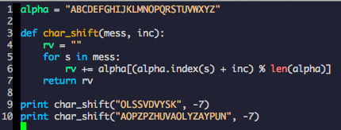
Answer

Slide 12
Additional Notes on Functions
You can nest functions
Default argument values
Java equivalent requires “Builder” design pattern
def stuff(volts, amps=.5, val=200): print volts * amps / val
Keyword arguments
thing(volts=3, amps=7, val=1500)
Pack/Unpack arguments
Lambda expression support

Slide 13
Classes
Using classes, inheritance, and methods

Slide 14
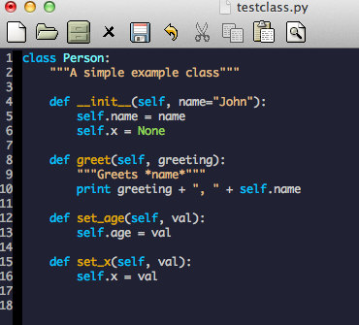
Example Class

Slide 15
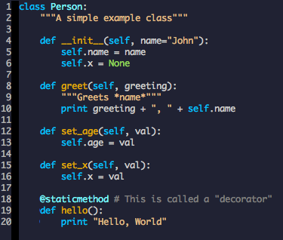
Static Methods

Slide 16
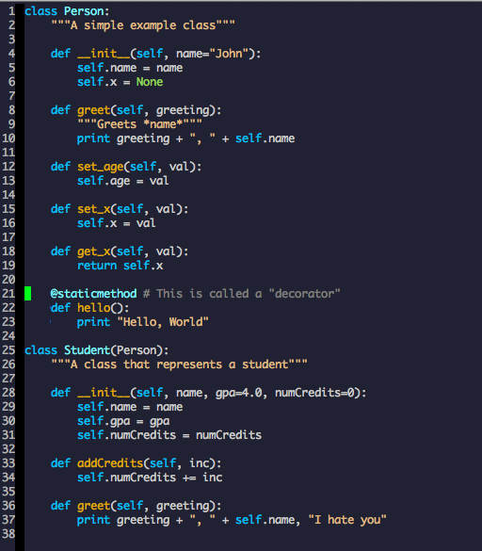
Inheritance

Slide 17
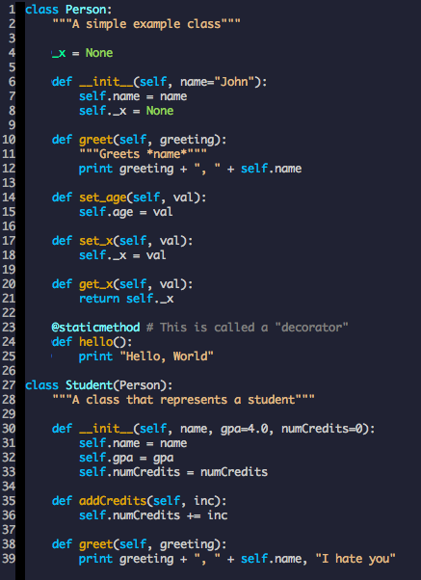
Private Variables
Use a single underscore ‘_’ to denote private variables
Ex: Line 4
There are not actually private variables
Simply denotes to programmers that they should not be used outside of the class

Slide 18
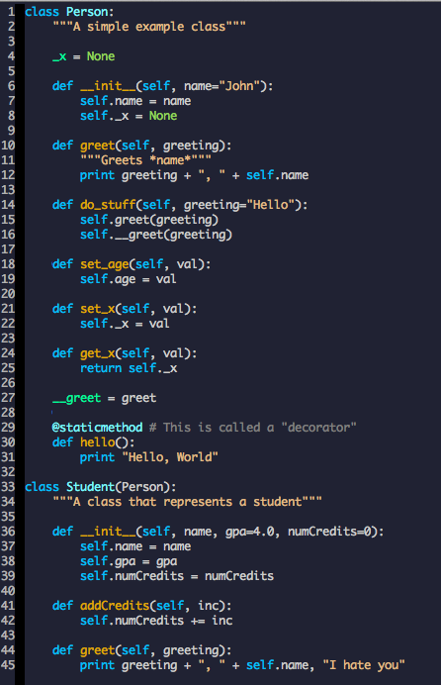
Name Mangling
Use two underscores ‘__’ to stop a variable from being unintentionally overridden
This is called name mangling
The variable can still be overridden
This simply converts the variable name to _classname__varname
=IF(B2="","",B2&"@miamioh.edu")

Slide 19
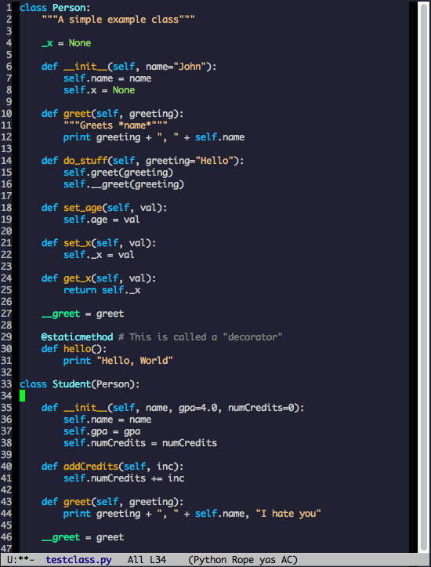
Exercise 2: Find the bug

Slide 20
Answer: Line 8 Missing underscore

Slide 21
Other Things to Note
Supports multiple inheritance
Can create an empty class definition with pass class Person: pass
Exceptions are classes
Can easily create an iterable
Generators

Slide 22
PEP 8
Widely accepted standard on Python style
Functions should be lower case with underscores (example_function() )
Classes should be camel-case (CamelCase)
4 spaces instead of tabs
Lines should not be more than 80 characters
No space immediately inside parentheses, brackets, or braces
No space immediately before colon, comma, semicolon, or parentheses
One space immediately after comma
Binary operators should have 1 space on either side

Slide 23
Notable 3rd Party Libraries
NumPy
MATLAB-like substitute
SciPy
Contains many algorithms for scientific purposes
Django
Powerful web application framework
Pygame
Supports many features necessary for 2D game development
Use Pyglet for 3D games

