Slide 1


It’s not just an insult from Harry Potter!

Slide 2
What is Git?
Distributed Version Control System (DVCS)
Compared to a Centralized Version Control System (CVCS)
Version control tracks changes to files
Extremely useful for software development
Allows backtracking to previous versions
Widely used on open source projects
Linux kernel
Django
jQuery
LibreOffice

Slide 3
History of Git 101
Linux was created in 1991 by Linus Torvalds
Used BitKeeper for source code management
BitKeeper is a proprietary DVCS that was free for Free and Open Source (FOSS) projects
BitKeeper withdrew free access to the Linux project due to issues with the terms of service
Linus created a new FOSS DVCS in 2005 called git (in 2 weeks)

Slide 4
Philosophy Behind Git
Distributed
Performance
Guaranteed code that goes in comes out identical
Open source was not a motivator
“I do open source because I think it’s the only right way to do software, but I will use the right tool for the job.” – Linus Torvalds, 2007

Slide 5
Why not SVN?
“If it’s not distributed, it’s not worth using”
– Linus Torvalds, 2007
Git repositories have a much smaller footprint compared to SVN
Mozilla switched from SVN to git – reduced size from 12 Gb to 400 Mb
Git is significantly faster than SVN
Commits are local
Branches are almost instant, even for large projects

Slide 6
Why not SVN? (cont’d)
Centralized means some people have commit access – some don’t
How do you determine who gets access?
Git assumes other developers are idiots*
All developers can make their own changes independently of each other
Developers can decide to pull changes from each other
* As explained by Linus Torvalds

Slide 7
Why not SVN? (still cont’d*)
All repositories are full backups
Complete with entire commit history
Theoretically, no repository is more important than any other
Branches are made almost instantly
Branches carry entire repository history
*Ya, there are that many reasons to not use SVN

Slide 8
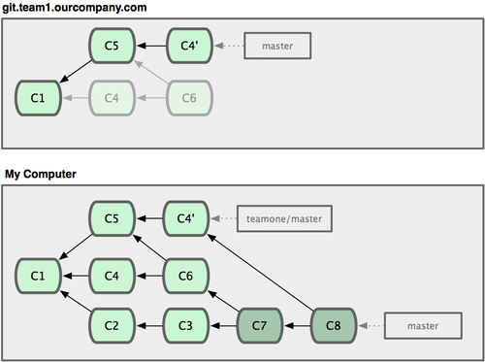
Typical Git Repository
Source: git-scm.com

Slide 9
Fork a Repository
Go to GitHub.com and create a new account
(Or sign in to your existing account)
Go to www.github.com/rogerskw/GitTutorial
Fork the repository
This creates your own copy of my repository
You have full access to modify all files

Slide 10
Get a Local Copy
Connect to ceclnx01.cec.miamioh.edu
Putty or ssh
Use this command git clone https://github.com/<user>/GitTutorial.git
Check the directory (ls –al)
You should see a directory called GitTutorial
Change to this directory (cd GitTutorial)
Look at the files (ls –hal)

Slide 11
Make Your First Commit
Open a file (vi githubfile.txt) and make some changes. Close the file
Look at what can be saved in a commit git status
View changes to the file by running git diff
Add the file to the “Staging Area” git add githubfile.txt
View the Staging Area git status
Commit the change with a message git commit –m ‘This is a useful explanation’

Slide 12
View Your Commit
Check your commits (and all commits to a repo) with git log
On large projects, this is inconvenient.
View most recent n commits with git log –n
EX: git log -2

Slide 13
Push Your Changes to Your GitHub Account
Putting changes online is vital for working with others
‘Push’ your changes to the cloud with git push origin master
Enter your login credentials
Your commit should now be viewable online

Slide 14
What just happened?
git push origin master
Push – tells git to send the changes to another repository
Origin – the name of the remote repository

Slide 15
Remote Repositories
Another copy of the repository in a different location
The copy on GitHub’s servers is a remote repository
View your repo’s remotes with git remote
When cloning a repo, git automatically uses the term ‘origin’ to map to it
Add/remove a new remote repo with git remote add/remove <name>

Slide 16
git push origin master
Master – the name of the branch

Slide 17
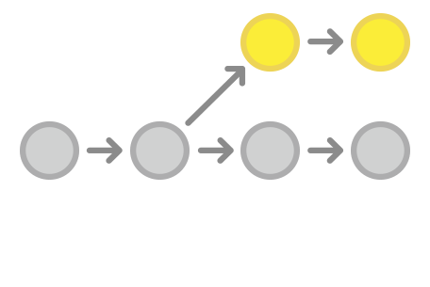
Branches
A git repo is set up like a tree
‘Branches’ are offshoots of the main repo
They create separate commit history

Slide 18
Branches (cont’d)
View your current branches git branch
Master is the default main branch
Master branch is typically reserved for “release-worthy” states
Some workflows differ
Create new branches for addressing new features, issues, or experimenting

Slide 19
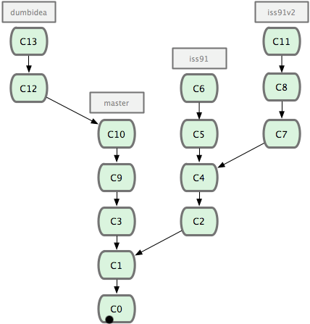
Branching & Issues in Git
Source: git-scm.com

Slide 20
Branches: Differences from SVN
SVN branches create entirely new files
Makes branching expensive
Can take up to several minutes to create a branch
Git branches create new delta logs
Creates a new file containing ~100 bytes per file
Almost instant
Branching in git is a regular part of a git workflow

Slide 21
Addressing a New Issue
Issue #1 : githubfile.txt must have some more text in it.
Create a new branch git branch iss1
View branches git branch
Switch to that branch git checkout iss1
Make some changes to githubfile.txt

Slide 22
Security Concern! Hotfix Necessary!
There is an issue with rogerskw.txt
It needs to begin with “Hello, World!” or the hackers can get in!
iss1 is not ready to be pushed to production
Commit changes in iss1
Switch back to master
Open up githubfile.txt and look at its contents
Create a new branch for the hotfix and switch to it git checkout –b hotfix

Slide 23
Push the Hotfix
Add ‘Hello, World!’ to the beginning of rogerskw.txt
Save and commit the change
Switch back to master
Merge the changes from hotfix to master git merge hotfix
Now push the fix to production (the GitHub repo)

Slide 24
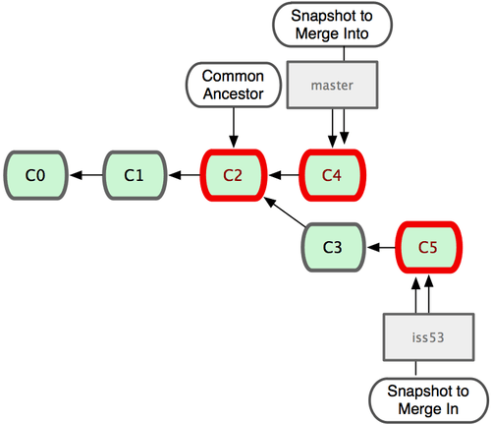
Merging in Git
Source: git-scm.com

Slide 25
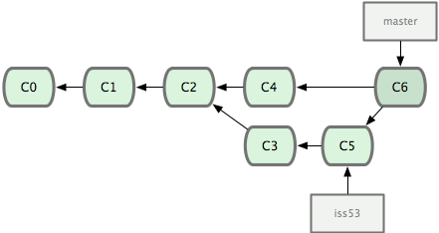
Merges in Git
Source: git-scm.com

Slide 26
Continue on with Issue 1
Make some changes to rogerskw.txt and githubfile.txt
Add and commit git add . && git commit –m ‘issue 1: asdf’
Switch back to master
Merge

Slide 27
Merge Issues
Often times files will not merge easily
This is where the developer needs to go through the code and find and fix inconsistencies
Open rogerskw.txt and look at the merge issues
Fix them (remember to not undo the security concern)
Push Issue 1 to production

Slide 28
Congratulations!
You understand the basics of working with git and GitHub
Go make some cool stuff!

