Slide 1
Collaborative Filtering and Implementation
李揚

Slide 2
Introduction
Bias and Collaborative Filtering
Matrix Factorization for Recommender System
Tools for Recommendation system

Slide 3
Goal
We want to make a recommendation system.
We will focus on one data set and try to teach different methods and see the pros and cons of each methods.

Slide 4

MovieLens

Slide 5

MovieLens

Slide 6
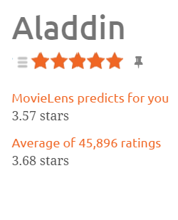
Look closer
You can rate the movies
MovieLens will predict your ratings
MovieLens will provide the information of ratings

Slide 7
Fact
As long as you get enough rating to MovieLens, it can make a good prediction for you.
We will teach how can MovieLens do it.☺

Slide 8
Data Set
MovieLens
80000 ratings in the training set and we want to predict the future 20000 ratings in the testing set.
There are 943 users
There are 1650 items

Slide 9


Reference

Slide 10
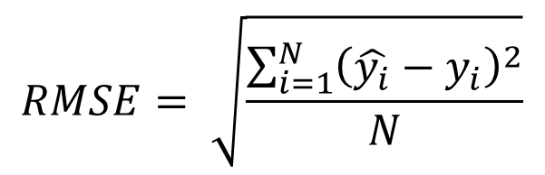
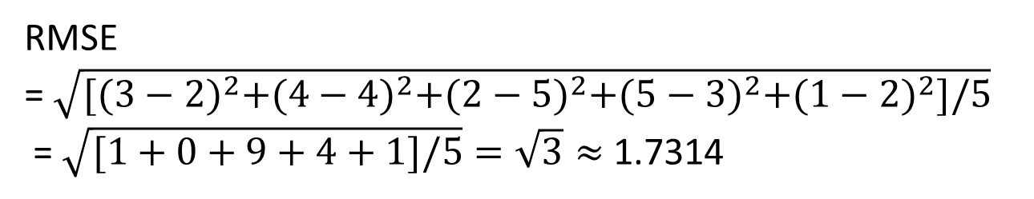
Recall the RMSE(Root Mean Square Error)
Answer | Prediction
3 | 2
4 | 4
2 | 5
5 | 3
1 | 2
$$RMSE= \sqrt{\frac{\sum_{i=1}^{N}{{\left(\hat{y_{i}}−y_{i}\right)}^{2}}}{N}}$$
RMSE
= $\sqrt{{[(3−2)}^{2}+{(4−4)}^{2}+{(2−5)}^{2}+{(5−3)}^{2}+{(1−2)}^{2}]/5}$
= $\sqrt{[1+0+9+4+1]/5}=\sqrt{3}≈$ 1.7314

Slide 11
Training and Testing RMSE
We will use our model to predict the ratings in the testing set and calculate the RMSE, and we call it testing RMSE
We will also use our model to predict the ratings in the training set and calculate the RMSE, and we call it training RMSE

Slide 12
Architecture of each experiment
Training Data
Final Result!!! ☺
The algorithm(model) we will develop
Evaluation on RMSE
Testing Data
prediction

Slide 13
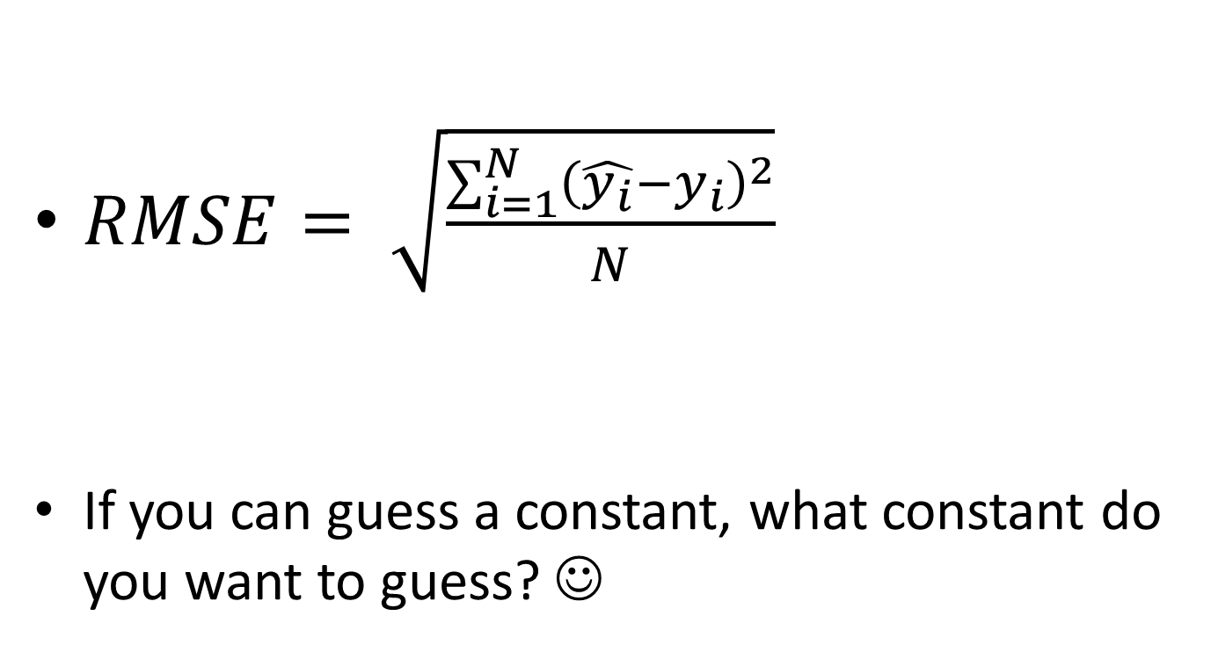
Our Evaluation (RMSE)
$RMSE= \sqrt{\frac{\sum_{i=1}^{N}{{\left(\hat{y_{i}}−y_{i}\right)}^{2}}}{N}}$
If you can guess a constant, what constant do you want to guess? ☺

Slide 14
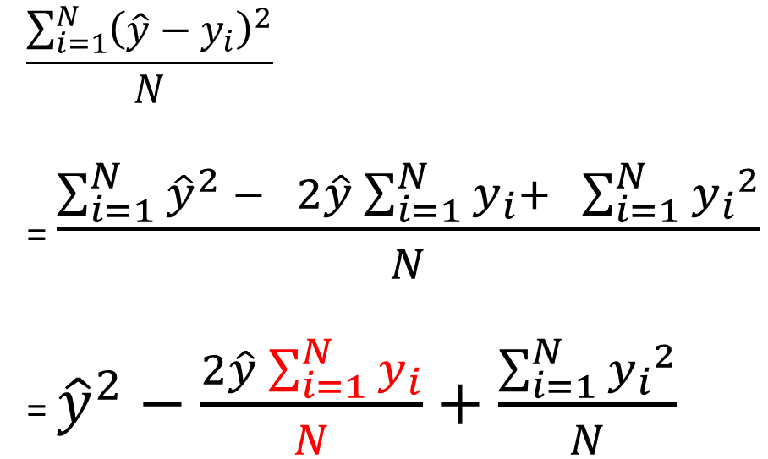
Let’s Find it-1
$$\frac{\sum_{i=1}^{N}{{\left(\hat{y}−y_{i}\right)}^{2}}}{N}$$
= $\frac{\sum_{i=1}^{N}{{\hat{y}}^{2}} − 2\hat{y}\sum_{i=1}^{N}{y_{i}}+ \sum_{i=1}^{N}{{y_{i}}^{2}}}{N}$
= ${\hat{y}}^{2}−\frac{2\hat{y}\sum_{i=1}^{N}{y_{i}}}{N}+\frac{\sum_{i=1}^{N}{{y_{i}}^{2}}}{N}$

Slide 15

Let’s Find it - 2
${\hat{y}}^{2}−2\hat{y}\overline{y}+\frac{\sum_{i=1}^{N}{{y_{i}}^{2}}}{N}$
= ${(\hat{y}−\overline{y})}^{2}+\frac{\sum_{i=1}^{N}{{y_{i}}^{2}}}{N}−{\overline{y}}^{2}$
RMSE = $\sqrt{{(\hat{y}−\overline{y})}^{2}+\frac{\sum_{i=1}^{N}{{y_{i}}^{2}}}{N}−{\overline{y}}^{2}}$

Slide 16
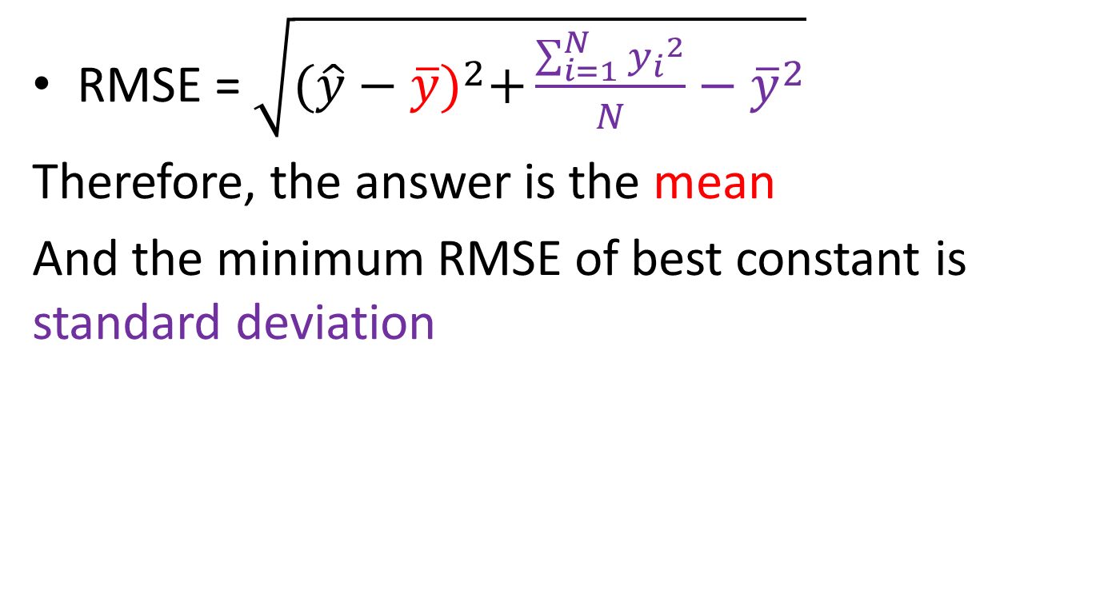
Get the Answer ☺
RMSE = $\sqrt{{(\hat{y}−\overline{y})}^{2}+\frac{\sum_{i=1}^{N}{{y_{i}}^{2}}}{N}−{\overline{y}}^{2}}$
Therefore, the answer is the mean
And the minimum RMSE of best constant is standard deviation

Slide 17
Architecture
Training Data
Final Result!!! ☺
The algorithm(model) we will develop
Evaluation on RMSE
Testing Data
prediction

Slide 18
Data Format
Training data
[user id] [item id] [ratings]
Testing data
[user id] [item id]
Prediction
[rating] // the permutation is correspond to //the testing data

Slide 19
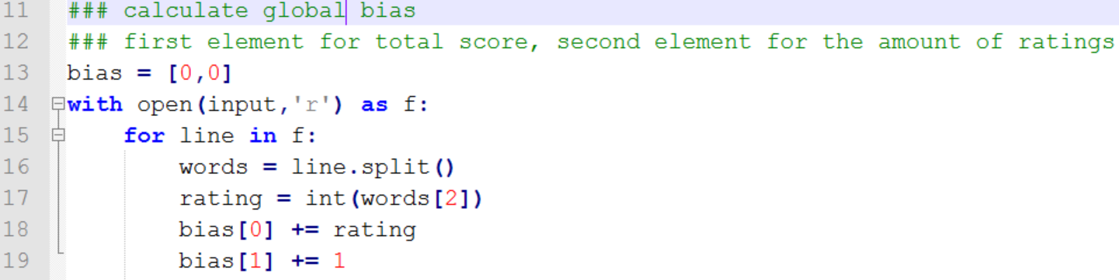
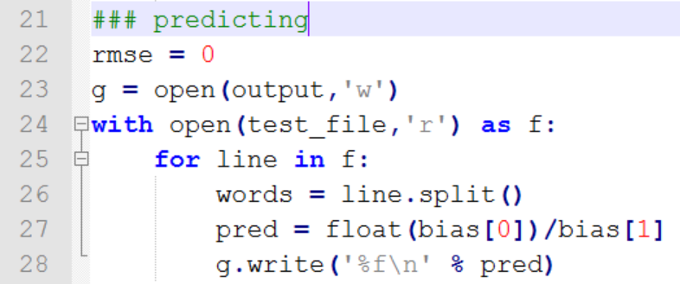
Global bias(mean) implementation

Slide 20
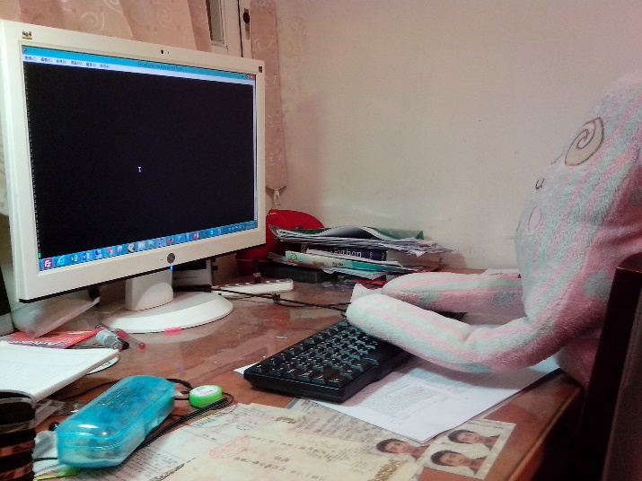
Run!!!
python global_bias.py global_bias.pred

Slide 21
Architecture
Training Data
Final Result!!! ☺
The algorithm(model) we will develop
Evaluation on RMSE
Testing Data
prediction

Slide 22
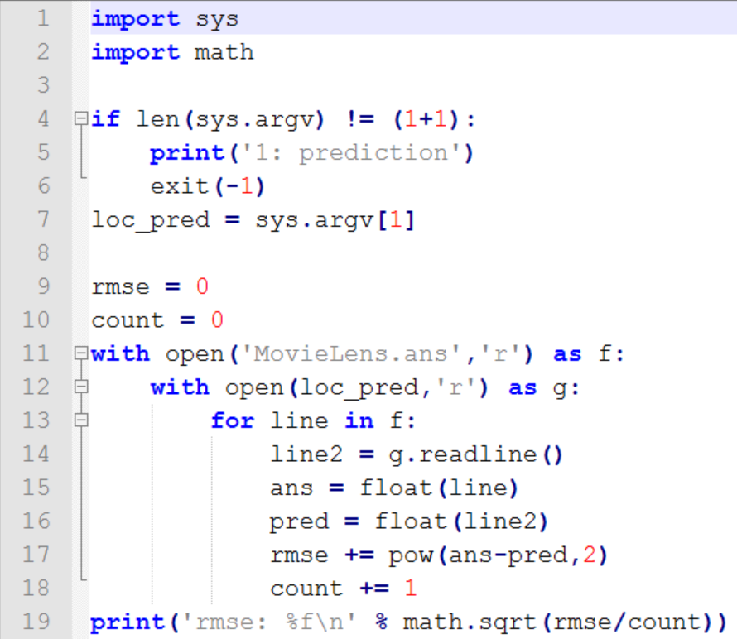
Evaluation

Slide 23
Run!!!
Python evaluate.py global_bias.pred

Slide 24
Global bias(mean) Result
Training RMSE: 1.119
(equal to standard deviation ☺)
Testing RMSE: 1.154

Slide 25
Conclusion
If we only guess a constant to minimize the training RMSE, the mean is the best solution, and the training RMSE is the standard deviation of the training set.
Therefore, if your evaluation is RMSE, the standard deviation is a good indicator to indicate how hard your question is.

Slide 26
Fun Time ☺
Question:
If we divide the ratings into 4 parts and calculate the mean separately…
Will the training RMSE increase or decrease?
What is the advantages and the disadvantages of this method?
mean1
mean2
mean3
mean4

Slide 27
Reasonable bias
User Bias
Mean of the user’s ratings
Item Bias
Mean of the Item’s ratings

Slide 28
Implementing user bias
You should finish the part that construct the user bias structure by reading the line in the training file one by one.
User_id
1
2
3
Total ratings | # ratings
Total ratings | # ratings
Total ratings | # ratings

Slide 29

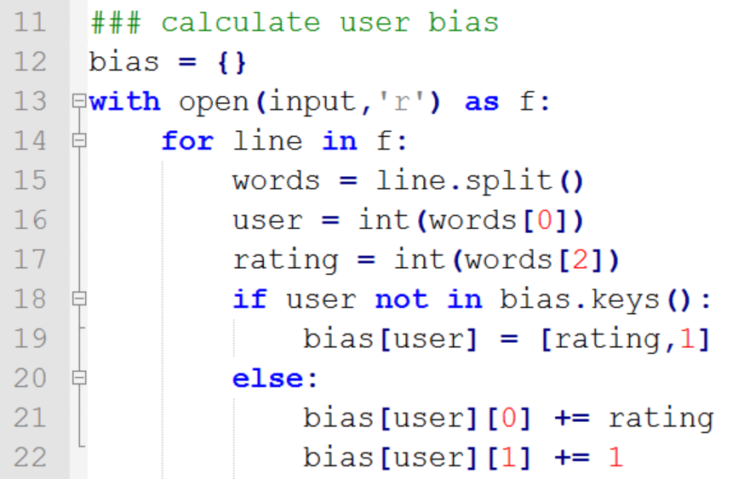
User Bias answer

Slide 30
Item Bias
Almost the same with user bias you can check the code in your folder.
And execute it:
Python item_bias.py item_bias.pred
Python evaluate.py item_bias.pred

Slide 31
Summary of the Result
Method | Training RMSE | Testing RMSE
Global Bias | 1.119 | 1.154
User Bias | 1.025 | 1.063
Item Bias | 0.996 | 1.032

Slide 32
Conclusion about the bias
We have known three reasonable basic baselines for a recommendation system that aims to optimize RMSE
Although it is simple, it is not so bad ☺
In the following slides, we want to exploit the other similar users or items to beat the three baselines

Slide 33
Fun Time ☺
Question:
Is it possible that training RMSE is bigger than testing RMSE?
If the testing RMSE is much bigger than training RMSE? What have happened?

Slide 34
If we there are only one person…
Lion King | Aladin | Mickey Mouse | One Piece
3 | 2 | 4 | ?
We can only user bias to solve the problems

Slide 35
However, there are some users with similar behaviors☺
User | Lion King | Aladin | Mickey Mouse | One Piece
User1 | 3 | 2 | 4 | ?
User2 | 3 | 2 | 4 | 5
User3 | 3 | 2 | 4 | 5

Slide 36
Collaborative Filtering
User Based Collaborative Filtering
Item Based Collaborative Filtering

Slide 37
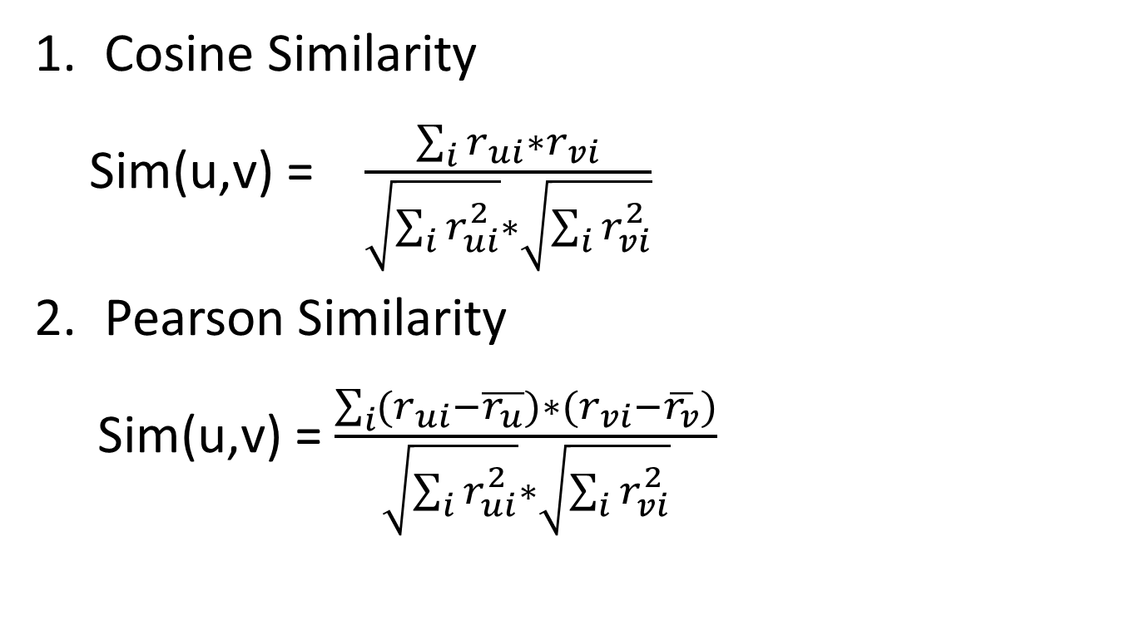
Similarity Meature
Cosine Similarity
Sim(u,v) = $\frac{\sum_{i}{r_{ui}∗r_{vi}}}{\sqrt{\sum_{i}{r_{ui}^{2}}}∗\sqrt{\sum_{i}{r_{vi}^{2}}}}$
Pearson Similarity
Sim(u,v) = $\frac{\sum_{i}{{(r}_{ui}−\overline{r_{u}})∗(r_{vi}−\overline{r_{v}})}}{\sqrt{\sum_{i}{r_{ui}^{2}}}∗\sqrt{\sum_{i}{r_{vi}^{2}}}}$

Slide 38
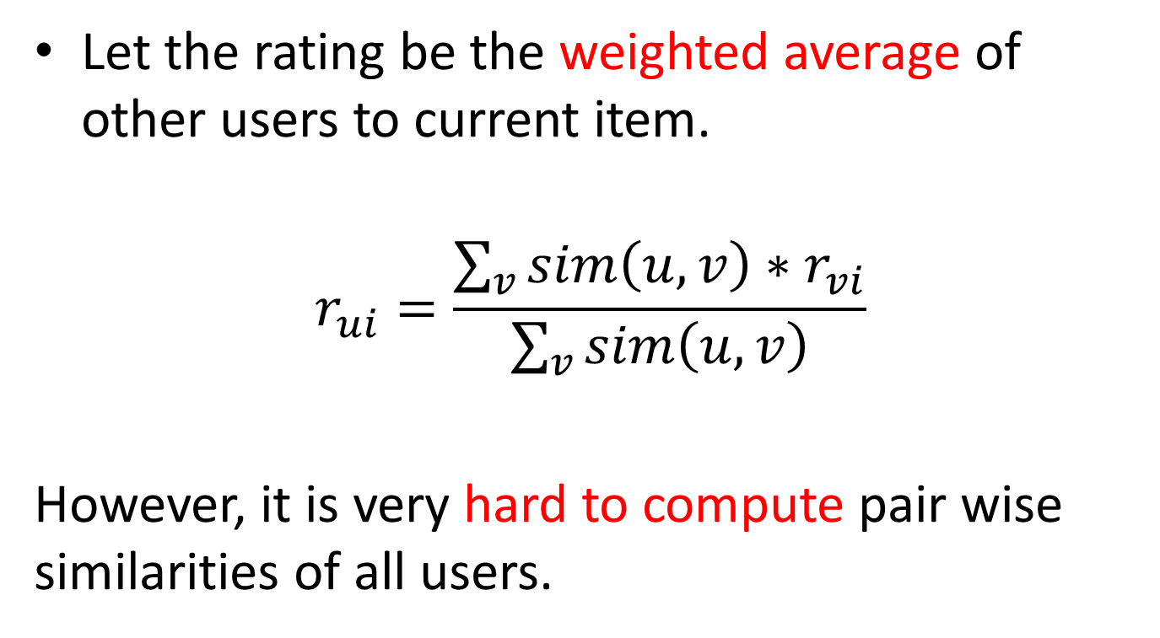
User based Collaborative filtering
Let the rating be the weighted average of other users to current item.
$$r_{ui}=\frac{\sum_{v}{sim\left(u,v\right)∗r_{vi}}}{\sum_{v}{sim\left(u,v\right)}}$$
However, it is very hard to compute pair wise similarities of all users.

Slide 39
Fact
We don’t need to compare all the users for the final predictions.
5 | 3 | 2 | ? | 2
2 | 3 | 4 | 2 | 3
? | ? | 2 | ? | 4
2 | 3 | ? | 5 | ?
? | ? | 4 | ? | ?

Slide 40
Implementation of Collaborative Filtering
For any given item, Construct the set contains the users rates this item.
Calculate the weighted average of the users will affect the prediction result.

Slide 41
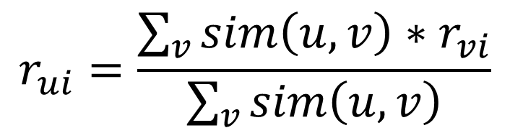
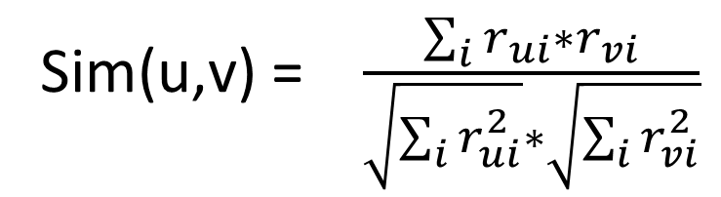
Implement Cosine Similarity Collaborative Filtering
Sim(u,v) = $\frac{\sum_{i}{r_{ui}∗r_{vi}}}{\sqrt{\sum_{i}{r_{ui}^{2}}}∗\sqrt{\sum_{i}{r_{vi}^{2}}}}$
Final
Score
$$r_{ui}=\frac{\sum_{v}{sim\left(u,v\right)∗r_{vi}}}{\sum_{v}{sim\left(u,v\right)}}$$
Total

Slide 42

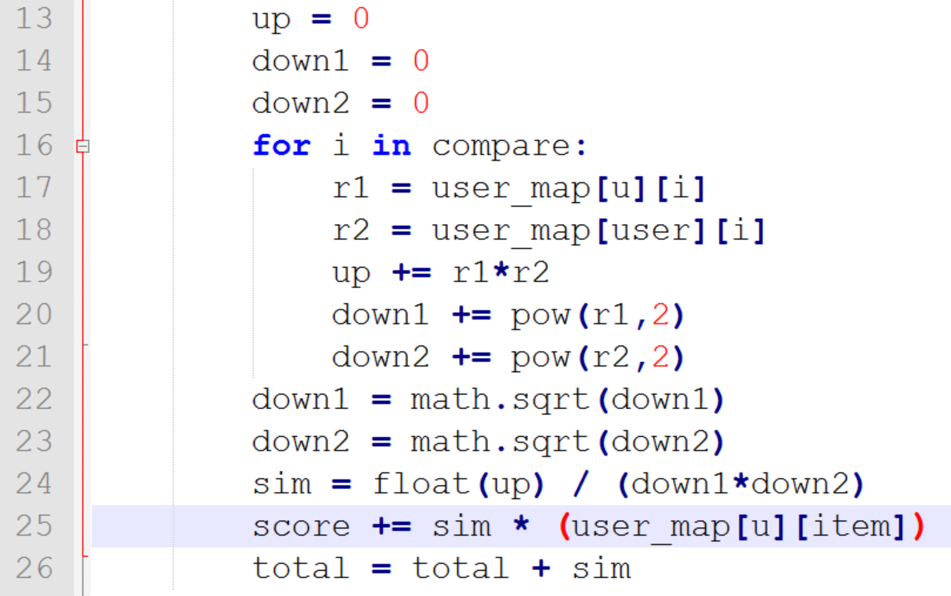
Sample Answer

Slide 43
Result
Method | Training RMSE | Testing RMSE
Cosine Similarity | 0.989 | 1.032

Slide 44
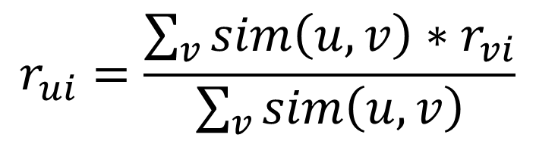
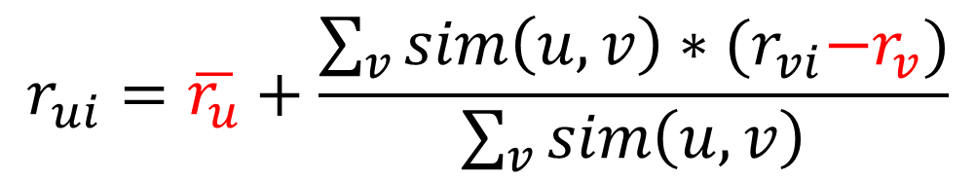
Collaborative filtering with bias
$$r_{ui}=\frac{\sum_{v}{sim\left(u,v\right)∗r_{vi}}}{\sum_{v}{sim\left(u,v\right)}}$$
$$r_{ui}=\overline{r_{u}}+\frac{\sum_{v}{sim\left(u,v\right)∗{(r}_{vi}−r_{v})}}{\sum_{v}{sim\left(u,v\right)}}$$

Slide 45

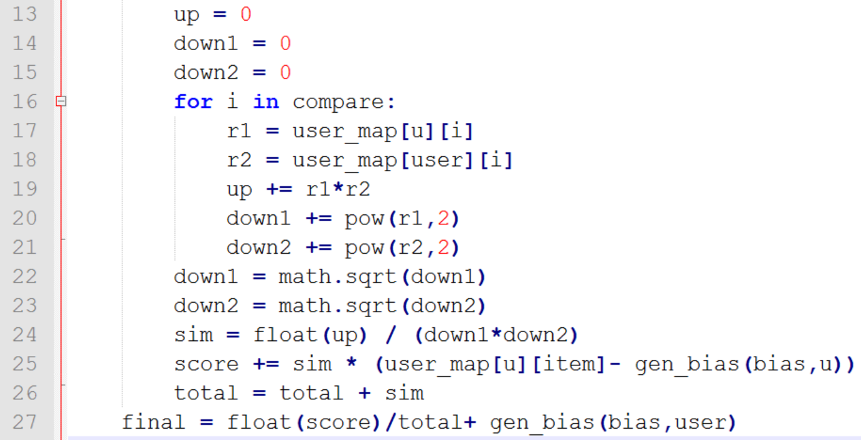
Sample Answer

Slide 46
Bias is very helpful☺
User based Collaborative Filtering using cosine similarity
Method | Training RMSE | Testing RMSE
With Bias | 0.920 | 0.976
Without Bias | 0.989 | 1.032
Item Based Collaborative Filtering Using Cosine Similarity
Method | Training RMSE | Testing RMSE
With Bias | 0.904 | 0.960
Without Bias | 1.018 | 1.067

Slide 47
Pros and Cons memory based Collaborative Filtering
Pros:
Simple(easy to understand)
Highly interpretable
Cons:
Slow

Slide 48
You can use bias to improve any models
Rating Matrix
Final Prediction
- bias
+ bias
Model
prediction
Predict Testing File

Slide 49
Summary of Results
Global Bias RMSE : 1.154
User Bias RMSE : 1.063
Item Bias RMSE : 1.032
User Based CF RMSE : 0.976
Item Based CF RMSE : 0.960

Slide 50
Take away notes
Standard Deviation is a good indicator of how hard the problem is
Implementation of collaborative filtering
Enhance the model by adding bias information

Slide 51
Fun Time☺
Why Collaborative Filtering Work? What characteristic does the data set have?

