Slide 1

CHECKPOINT 3
Adaptive
LLM
Router
Mian Abdullah
CSC498: Senior Seminar
Nov 12, 2026
Notes:
Checkpoint 3 of the Adaptive LLM Router. Checkpoint 2 routed with hand-written rules. Checkpoint 3 replaces the rules with a trained router, tests it on prompts it never saw, and compares it with the baselines and the rule router.

Slide 2
Today
01
From rules to a learned router
02
Benchmark matrix · 600 × 9
03
Choosing the router + user weights
04
Held-out results + plots
Then:
live demo
Notes:
Four parts, then the live demo: how the learned router works, the benchmark it learned from, how I chose the model and the user weights, and the results on held-out prompts.

Slide 3
Rules → learned router
Checkpoint 3 replaces the hand-written rule with a model trained on measured outcomes.
01
02
03
04
Prompt
Filters
Predict
Score
text + priority
hard requirements
P(success) per model
quality − cost − latency
Trained on 360 prompts. Tuned on 120. Tested once on 120 it never saw.
Logistic regression, exported as plain numbers. Every decision still returns one model and a reason.
Notes:
Every request still follows four steps. Hard requirements filter first. Then, instead of a rule, a trained model predicts how likely each model is to answer correctly, and a weighted score trades that off against expected cost and speed for the user's priority. The prompts were split before any model ran: 360 to train, 120 to tune, and 120 held out and read only once at the end.

Slide 4
CP3 • Benchmark matrix
600 prompts × 9 models: 200 GSM8K math · 200 MMLU-Pro questions · 200 HumanEval+ / MBPP+ coding
MODEL | ACCESS | MATH | QA | CODE | TOTAL / 600
Gemini 4 Argon | Paid | 193 | 185 | 185 | 563
Gemma 4 26B | Paid | 191 | 162 | 164 | 517
Nemotron 3 Ultra | Free | 182 | 159 | 170 | 511
DeepSeek V4 Flash | Paid | 182 | 158 | 168 | 508
gpt-oss-120b | Free | 191 | 154 | 150 | 495
Mercury 3 | Paid | 183 | 160 | 151 | 494
Llama 3.3 70B | Free | 187 | 153 | 153 | 493
Qwen 3.5 9B (laptop) | Local | 189 | 153 | 129 | 471
Qwen 3.8 27B | Free | 181 | 144 | 136 | 461
5,400
scored answers, every one saved
3
providers, one of them on my laptop
≈$3.50
total paid spend, under a $15 cap
Code runs in a no-network Docker sandbox. Every failed call counts as wrong.
Two more free models (Google AI Studio, NVIDIA NIM) were too unreliable to include: retested Oct 28 and Nov 3.
Notes:
A router can only learn from evidence, so I ran 600 benchmark prompts through nine models: paid, free, and one running locally on my laptop. That is 5,400 scored answers. Math and multiple-choice answers are checked automatically, and coding answers are run against hidden tests in a Docker container with no network. Failures count as wrong. The whole run cost about three and a half dollars.

Slide 5
Choosing the router
Validation split only. Lower log loss = better probability estimates.
LOGISTIC REGRESSION
GRADIENT-BOOSTED TREES
REFERENCE: TASK × MODEL
0.465
0.491
0.454
validation log loss
validation log loss
validation log loss
gap 0.077
gap 0.174
no prompt features
SELECTED
USER WEIGHTS
HONEST FINDING
4 presets tuned on validation. Lower cost and faster had to match always using the cheapest model there. Users can also set custom weights.
A simple per-task success rate predicts as well. With 360 training prompts, knowing which model is good at which task does most of the work.
Notes:
My proposal said to train logistic regression and gradient-boosted trees and keep the one that does better on validation without overfitting. Logistic regression won and overfits half as much, so it is the router. I also compared it with a simple table of each model's success rate per task. That table does just as well, which tells me most of the signal is which model is good at which task, not the wording of the prompt. Each priority's weights were tuned on the same validation prompts.

Slide 6
Held-out results
120 prompts it never saw · 40 math · 40 QA · 40 coding · read once
STRATEGY | CORRECT | COST | MEDIAN
Always cheapest (Gemma) | 103 | $0.018 | 5.1 s
Always strongest (Gemini) | 112 | $0.493 | 5.1 s
CP2 rule router | 105 | $0.186 | 3.5 s
Learned · higher quality | 112 | $0.421 | 5.4 s
Learned · lower cost | 103 | $0.0003 | 12.7 s
Learned · faster | 102 | $0.116 | 2.1 s
−15%
cost, same 112/120 as always using Gemini
−98%
cost, same 103/120 as always using Gemma
2.1 s
fastest median of every strategy
Each priority makes a different trade: quality matches the best model for less, cost matches the cheapest for almost nothing but runs slower.
120 prompts: a difference of 1–3 correct answers is within noise. Outcomes replayed from saved answers; no model called again.
Notes:
This is the comparison my proposal promised: the trained router against the two fixed baselines and the Checkpoint 2 rule router, on the same 120 held-out prompts. With the quality priority it gets 112, the same as always using Gemini, for about 15 percent less, because it sends the math questions to the cheaper Gemma. With the cost priority it matches the cheapest paid model for almost nothing by using free models, but it is slower. The faster priority has the quickest median of all. With 120 prompts, one to three answers is noise, so I treat these as evidence, not proof.

Slide 7
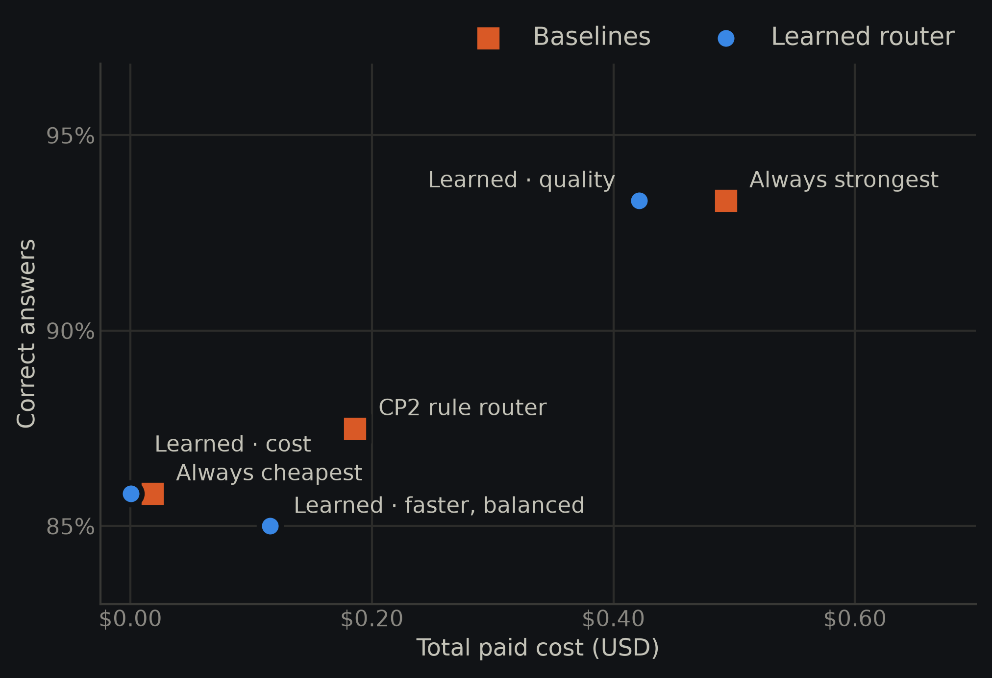
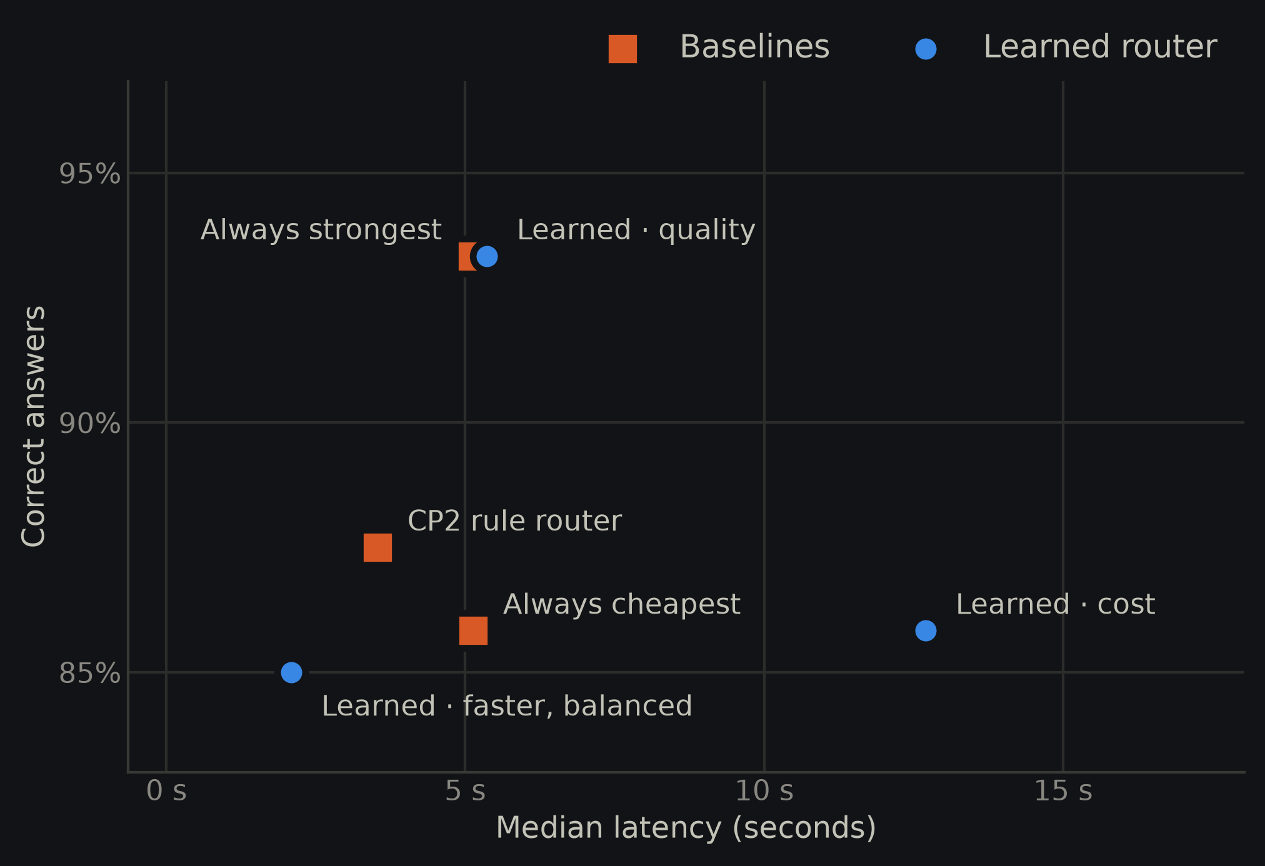
Comparison plots
Held-out test · all three task types together · per-task views in the app
Accuracy vs. cost
Accuracy vs. response time
Blue circles: learned router. Orange squares: baselines. Up and to the left is better.
Notes:
These are the comparison plots: accuracy against cost on the left and against response time on the right, for the held-out prompts. Blue circles are the learned router with each priority, orange squares are the baselines. Up and to the left is better. The quality point sits level with always-strongest but further left, and the cost point sits on top of always-cheapest at nearly zero cost. The app shows the same charts for math, questions, and code separately.

Slide 8
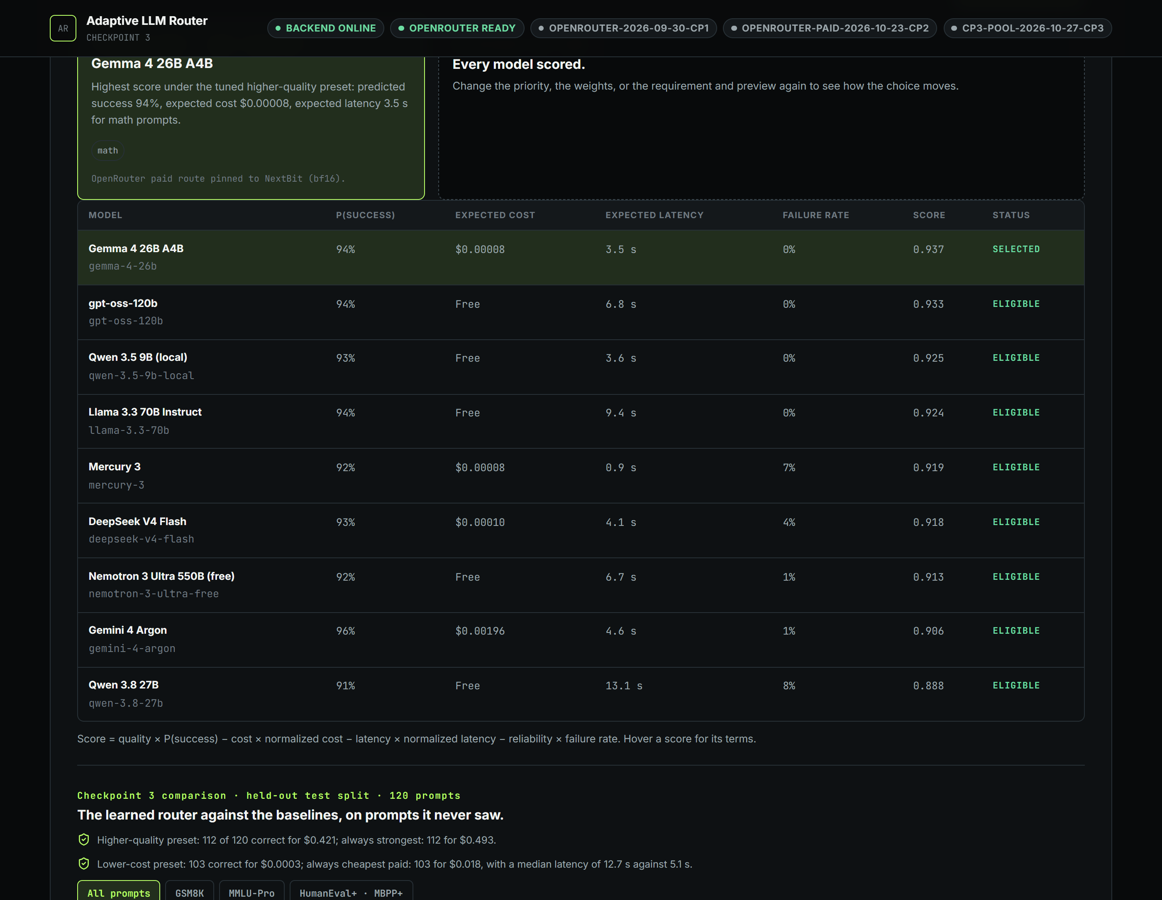
What shipped
By Nov 12, every Checkpoint 3 commitment runs in the app.
01
trained router on held-out prompts
02
vs. fixed + rule baselines
03
3 task types + comparison plots
04
priority presets + custom weights
LIVE DEMO
Notes:
This is the real Learned tab. For a math prompt with the quality priority, the router scores every model and picks Gemma: its predicted success is high and it costs a fraction of Gemini. Everything my proposal listed for Checkpoint 3 runs in the app: the trained router tested on held-out prompts, the comparison with the baselines and the rule router, all three task types with comparison plots, and priority presets with custom weights. I will show it live next.

Slide 9

What I learned
CHALLENGE
The learned router predicts no better than a per-task success table: with 360 training prompts, the wording of a prompt adds little.
RESPONSE
Reported it honestly; the gains come from cost- and speed-aware choices per task. Next for Checkpoint 4: the oracle comparison, under- and over-routing analysis, and robustness tests.
Questions?
Notes:
The main lesson was that a simple baseline matters: the learned router predicts no better than a per-task success table, so without that table I would have credited the prompt features for gains that really come from knowing which model is good at which task. The router is still useful, because it trades cost and speed per task. Next, for Checkpoint 4, I will compare it with an oracle that knows the right answer in advance, analyze where it under- or over-routes, and test how it reacts when prices or speeds change. Thank you, I am happy to take questions.

