Slide 1


CHECKPOINT 2
Adaptive LLM
Router
Mian Abdullah
CSC498: Senior Seminar
Oct 15, 2026

Slide 2








Today
01
What changed
02
Rule-based routing
03
Priority + requirement tests
04
Baseline evidence
Then:
live demo

Slide 3
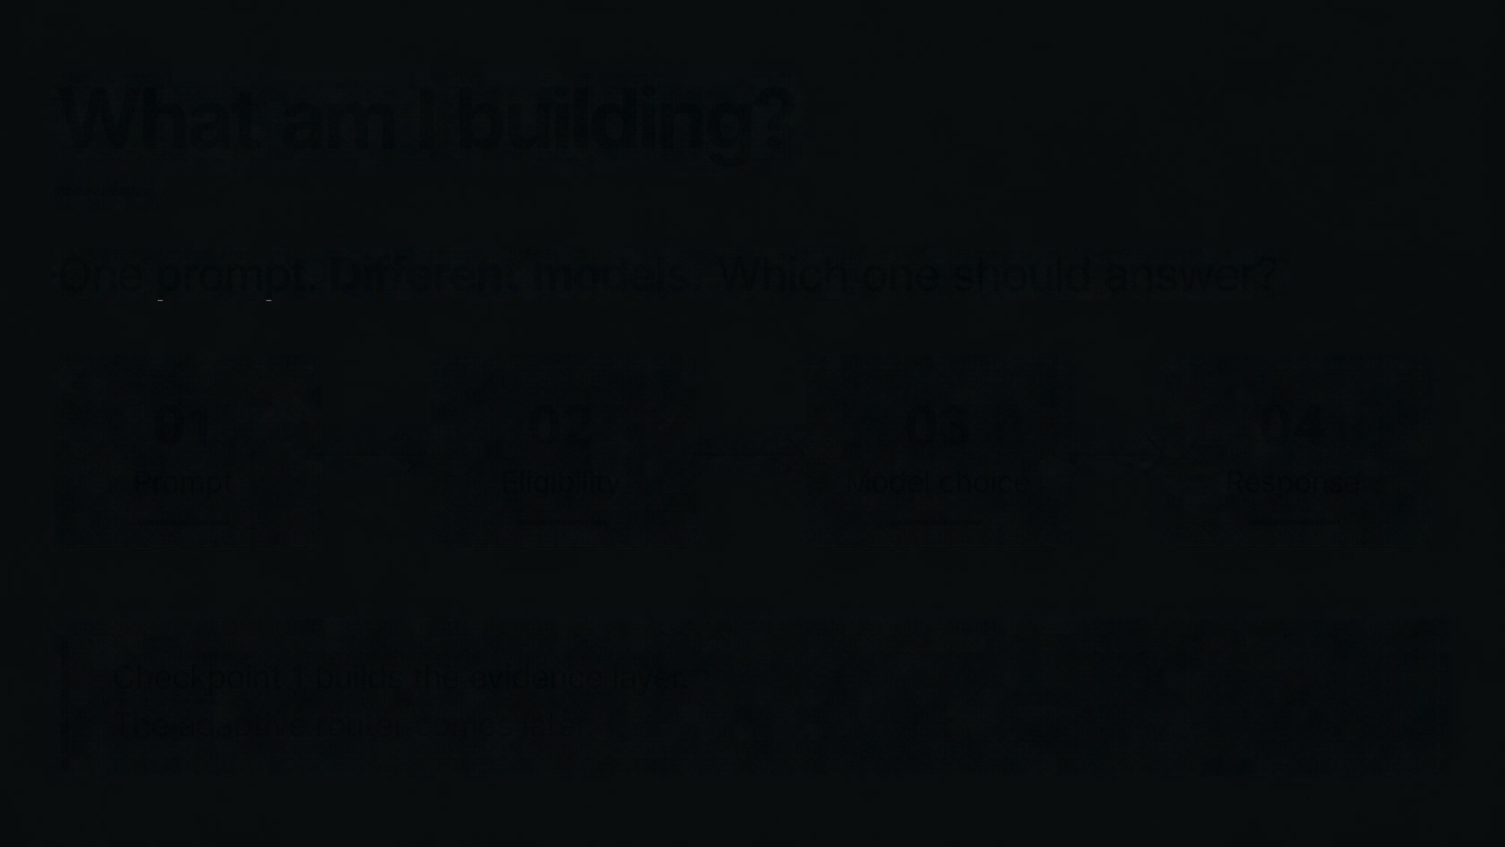









Evidence → decision
Checkpoint 2 adds transparent routing on top of the Checkpoint 1 evidence layer.
01
02
03
04
Prompt
Filters
Rule
Model
Deterministic first.
Every choice includes a reason.

Slide 4



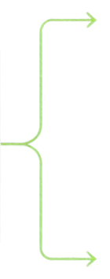





Rule routing · transparent decisions
Same prompt. Hard requirements first. User priority second.
A
B
GEMMA
NEMOTRON
Routing request
Context
262K
Context
1M
Baseline
cost
Baseline
best
GSM8K
3/12
GSM8K
8/12
Avail.
3/12
Avail.
12/12
Rule
speed
Rule
500K
LIVE DEMO
One selected model. Explicit rule version. Human-readable reason.

Slide 5







CP1
• Baseline evidence
Saved GSM8K matrix • 12 questions × 2 models = 24 canonical result cells
!
NEMOTRON
GEMMA
Failures stay visible.
All 12 cells count.
No silent substitute.
66.7% accuracy
25.0% accuracy
12
3
successful calls
successful calls
8
3
exact matches
LIVE DEMO:
exact matches
9
saved run
shared-pool
rate limits
+
strategy replay
mean
mean
20s
5.6s

Slide 6
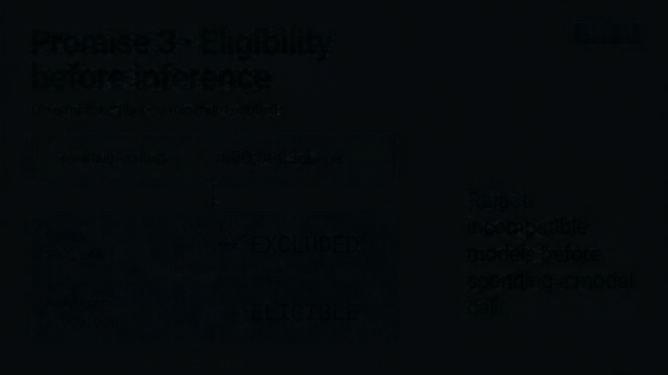







Policy tests • same prompt, different goals
LIVE DEMO
Priorities steer the choice only after hard filtering
Same prompt
One change
Selected model
Eligible set
Reason
No provider call.
Cost /
speed
GEMMA
Quality /
500K
NEMOTRON

Slide 7



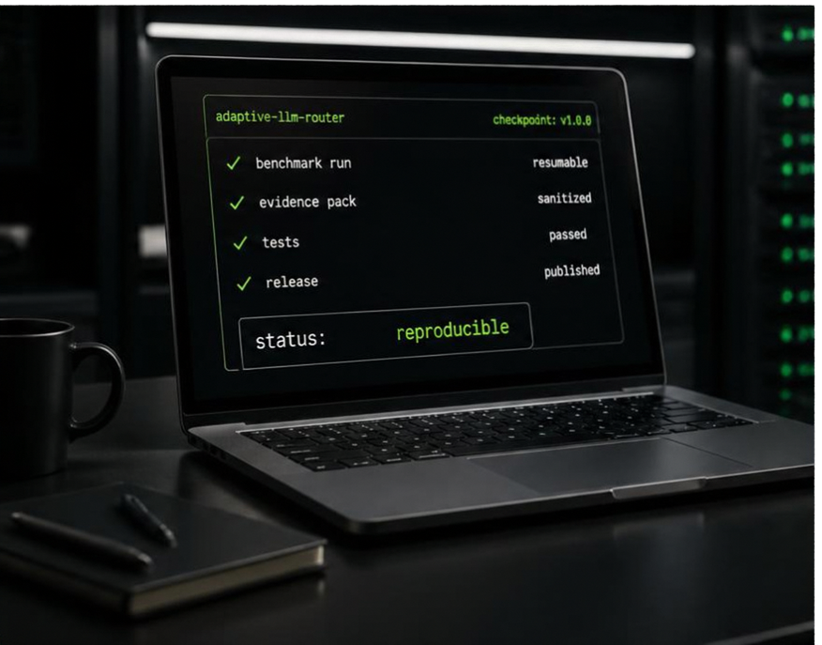
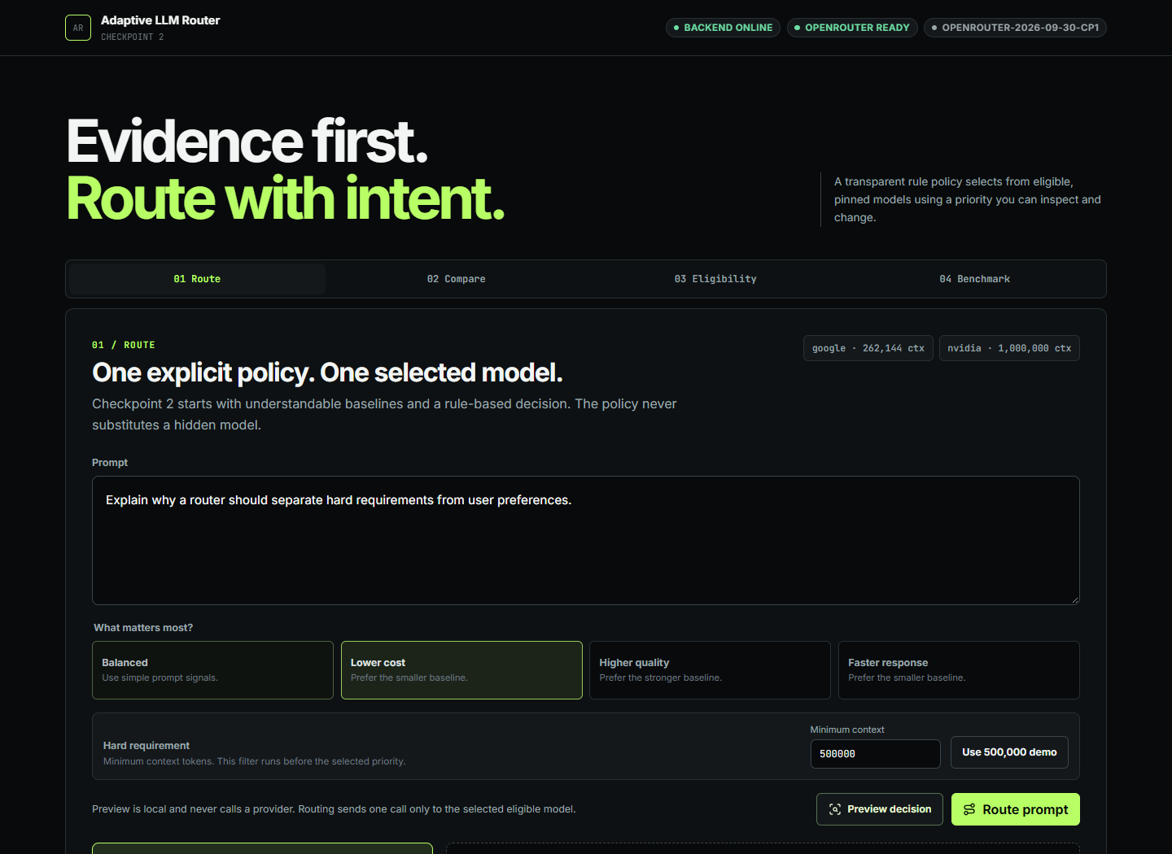




What shipped
By Oct 15, Checkpoint 2 can be demonstrated without spending provider calls.
01
fixed + rule baselines
02
priority + context controls
03
decision explanation view
04
saved-matrix dashboard

Slide 8







What I learned
What I learned
CHALLENGE
Free shared endpoints are noisy. A live provider call is not a reliable demo.
RESPONSE
Preview locally. Replay saved evidence. Keep real failures visible. Next: learned routing.
Questions?

