Slide 1
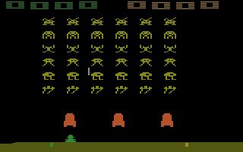
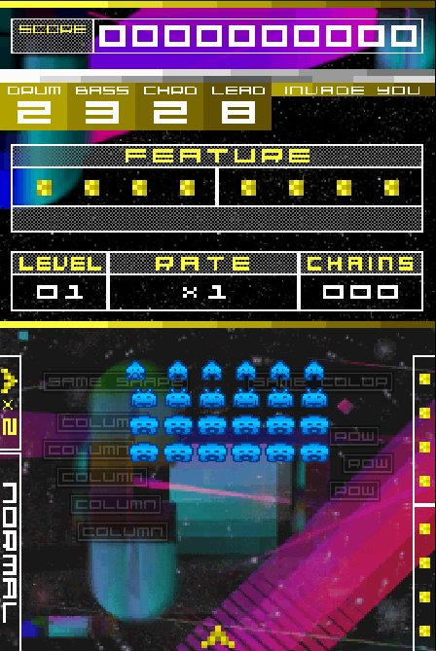
INVADERS, REVISITED
SPACE INVADERS (1978) vs SPACE INVADERS EXTREME (2008)
Dilan Mian · Retro Game Dev. / Topics in Digital Media · Ontario Tech University · Winter 2026
1978 , Atari 2600 port
2008 , Nintendo DS

Slide 2
THE TWO GAMES
SPACE INVADERS (1978)
SPACE INVADERS EXTREME (2008)
Developer: Tomohiro Nishikado · Publisher: Taito
Platform: Arcade (Atari 2600 port shown)
Hardware: Intel 8080 @ 2 MHz
Developer/Publisher: Taito / Square Enix
Platform: Nintendo DS (shown) & PSP
Audio: Zuntata in-house sound team
Nishikado, shmuplations.com (2000) · Square Enix press release, June 17, 2008 · KHInsider, AUDIO CLUSTER liner notes

Slide 3
DIFFICULTY & AUDIO
1978 - EMERGENT DIFFICULTY
The speed-up is a CPU artefact, not code. Fewer aliens = less rendering load = faster loop. The four-note audio loop tempo is mechanically coupled to alien count: it accelerates as the game does, functioning as a real-time threat readout.
2008 - AUTHORED DIFFICULTY
Five structured stages with boss encounters. Fever Mode and the ×10 Break multiplier let skilled players partially choose their own difficulty. Zuntata soundtrack: audio is reward and spectacle, not a game-state readout.
Speed increase: never programmed.
Intel 8080 renders faster
with fewer sprites on screen.
(Tom's Hardware, 2025)
KEY FINDING: Any remake that retains the 1978 audio aesthetic while disconnecting it from the mechanical loop produces nostalgia, not design fidelity.
ComputerArcheology.com · Tom's Hardware (2025) · Nishikado, One Million Power interview · Schartmann, Bloomsbury (2015)

Slide 4
FORMATION & HUD
DIMENSION | 1978 | 2008
Formation | Fixed 11×5 grid | Variable per wave (varies by level)
Bunkers | 4 (destructible) | None
HUD | Score + lives only | Dual-screen dashboard
Fire | 1 shot on screen | Rapid fire
Cover | Bunker management | Colour-chain logic
Fixed 11×5 grid, 55 aliens
990 pts total
Variable formations
Dual DS screens
BUNKERS:
The original's bunkers are the player's only spatial resource, a sub-game of cover management. Extreme removed them because colour-chain tracking requires an unobstructed field, and the dual-screen HUD leaves no cognitive room for bunker geometry. Both systems are correct. They are incompatible.
ComputerArcheology.com · shmups.wiki · Table Salt Games DS review (2008) · GameSpot PSP review (2008)

Slide 5
VISUAL LANGUAGE & KEY FINDINGS
1978: Restraint by constraint. Monochrome sprites, cellophane overlays, 224×256 CRT. Every visible element is directly actionable. (MoMA collection, 2013)
2008: Maximalism as counter-statement. Neon palette + particle effects celebrate 30 years of hardware capability. Classic sprites retained, context transformed.
CONSTRAINT FINDING
AUDIO FINDING
Nishikado did not choose simplicity, his hardware gave it to him. What he chose was to trust the emergent complexity that simplicity produced. The speed-up was never designed to create tension. It creates tension anyway.
The 1978 tempo-linked loop is irreplaceable in any remake that seeks to preserve its function, the function depends on the relationship between sound and hardware state. Extreme performs a different role: reward, not readout.
MoMA collection 701.2013 · Nishikado, shmuplations.com (2000) · Schartmann, Bloomsbury (2015) · Nintendo Life (2020)

Slide 6
ARTIFACT & CONCLUSION
LEVEL RE-LAYOUT STUDY
1978 ≠ SIMPLE
3 annotated draw.io mockups
It is emergently complex. Every tension arose from simple rules, not designed escalation.
A: BASELINE: Arcade-accurate 11×5 grid. Point-value gradient (10→30 pts) annotated. Bunker positions and UFO lane mapped.
B: HYBRID: Extreme's colour-class logic on the original's fixed grid. Creates strategic tension between descent control and power-up farming.
C: RHYTHM-AWARE: 55 aliens split into 4 clusters = 4 notes. A design fiction exploring authored vs. emergent audio coupling.
2008 ≠ COMPLEX
It is explicitly authored. Both casual and expert play are supported simultaneously through the same mechanics.
THE DESIGN LESSON: Constraints are not the enemy of design, they are often its engine.
Full analysis: Invaders, Revisited , Comparative Study Report, Mian (2026) · Ontario Tech University, Winter 2026

