Slide 1
Security Posture & Risk Assessment
ICT Capstone Project Presentation
Group: 8 Unit: COIT20265
Project Mentor: Azmat Ullah Term: 2025 Term 1
Students: Mian Fazal ur Rehman (12224256)
Theofill Jake Gepila Bautista (12243209)
Sushila Karmacharya (12205881)
Shihan Deshapriya (12231034)

Slide 2
Agenda
Introduction
Flowchart
Problem Statement
Project Aim
Identified problems
Solution Overview
Prototype Design & Execution
Technical Architecture Diagram
Cost-Benefit Analysis
Conclusion

Slide 3
Introduction
Premier Technology Solutions: Leading provider of IT services for hybrid work environments
Specialized in cloud solutions, cybersecurity, and infrastructure support.
Operating with multiple third-party vendors and remote employees.
Facing challenges due to rapid cloud adoption, increasing Shadow IT, and endpoint vulnerabilities
Committed to enhancing security posture while maintaining operational efficiency.

Slide 4
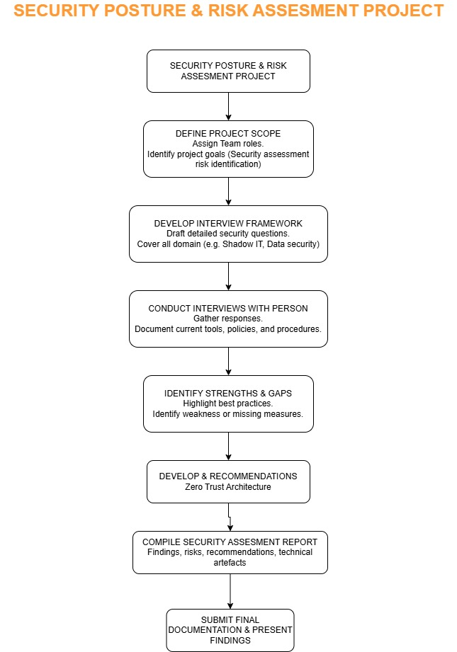
Flowchart

Slide 5
Problem Statement
Premier operates in a rapidly evolving cybersecurity environment.
Hybrid work, emerging threats, and third-party dependencies pose new risks.
Third-Party access risks.
Shadow IT proliferation causing data leakage.
Endpoint security gaps increasing vulnerability.

Slide 6
Project Aim
Design and validate a Zero Trust Architecture tailored to Premier’s environment.
Address key security risks through scalable, manageable controls.
Deliver measurable improvements in Shadow IT control, vendor access, and endpoint security.
Demonstrate business value through prototype and pilot phases.

Slide 7
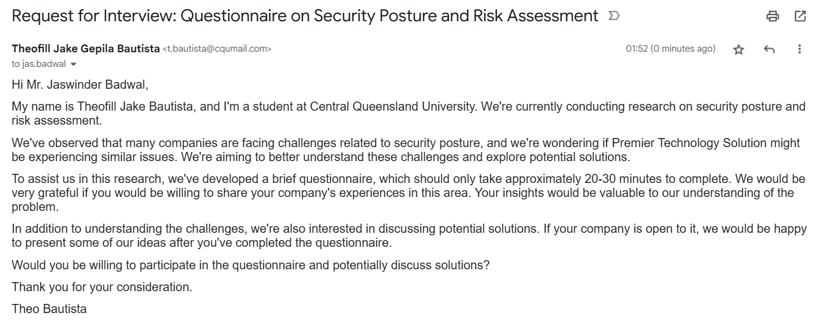
Email requested for the interview

Slide 8
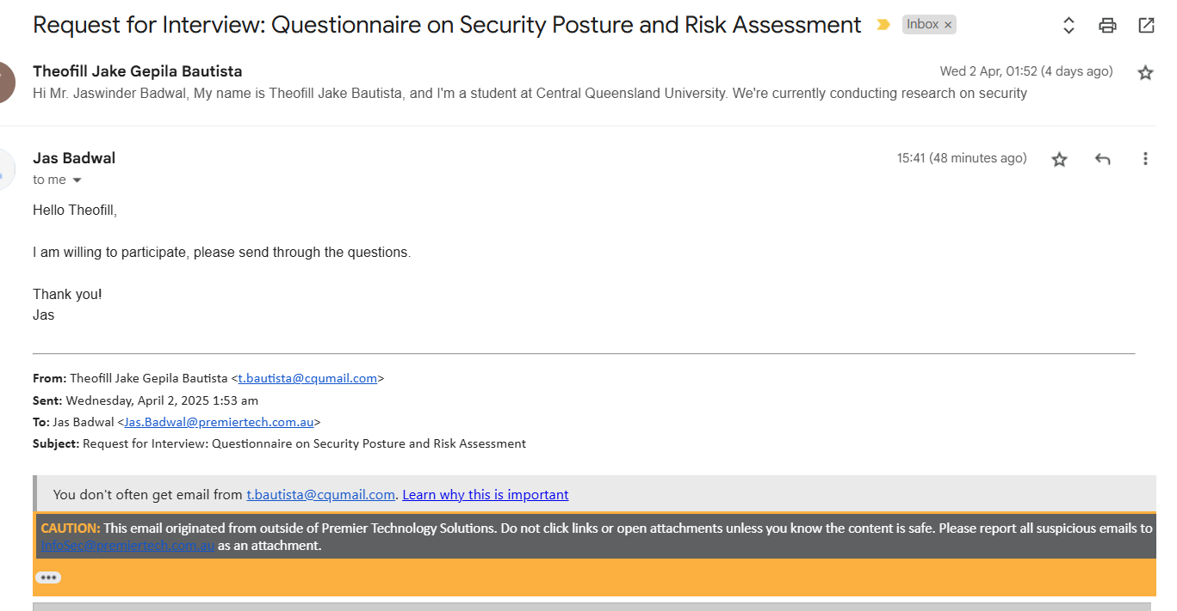
Response from the company

Slide 9
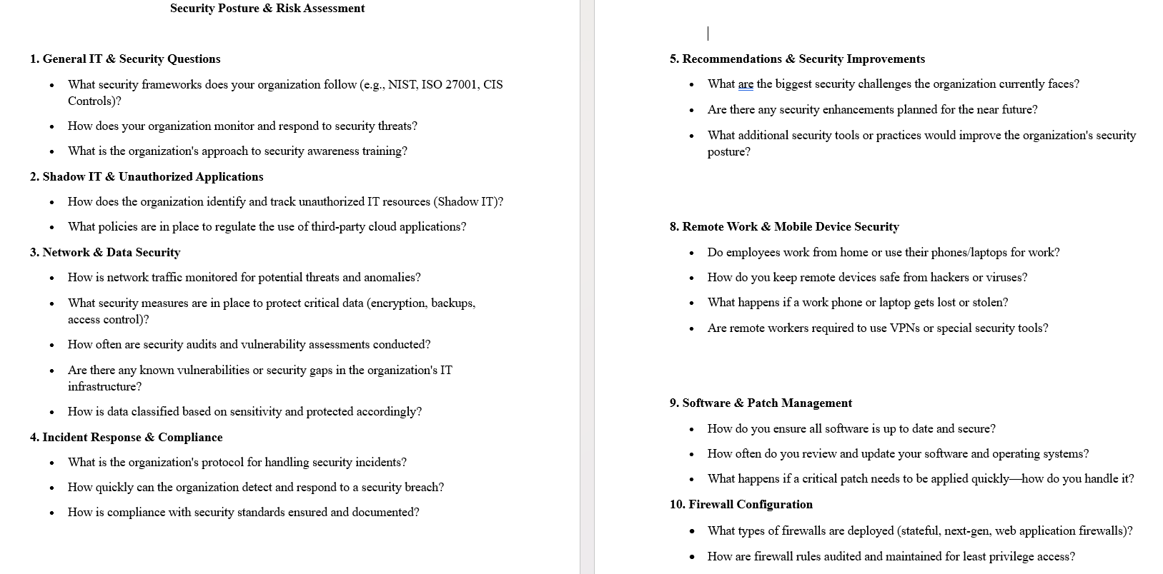
Interview Questions

Slide 10
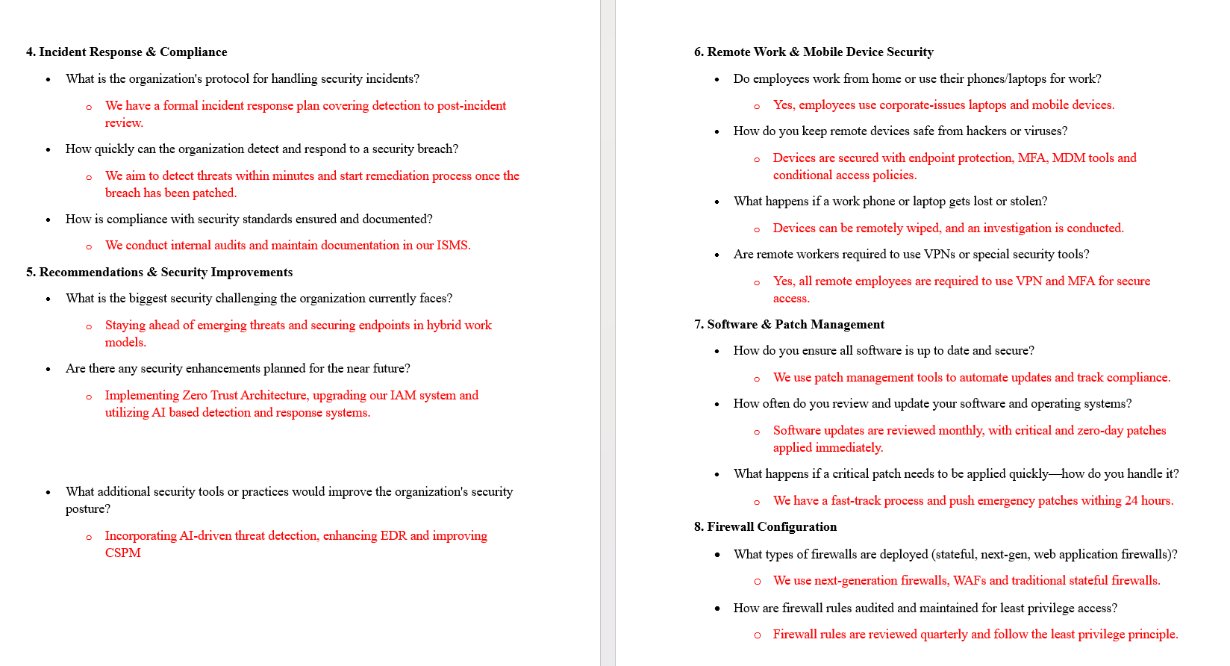
Answers

Slide 11
Identified Problems
Lack of Comprehensive Third-Party Risk Management
Reactive Approach to Shadow IT Management.
Gaps in Endpoint Security and Insider Threat Detection

Slide 12
Possible Solutions
Zero Trust Architecture (ZTA)
Perimeter-Based Security (Castle-and-Moat)
Defense in Depth Architecture
Cloud Security Architecture

Slide 13
Zero Trust Architecture (ZTA)
Principle: "Never trust, always verify"
Focus: Verify every request regardless of location
Use Case: Protect against insider threats, third-party risks.

Slide 14
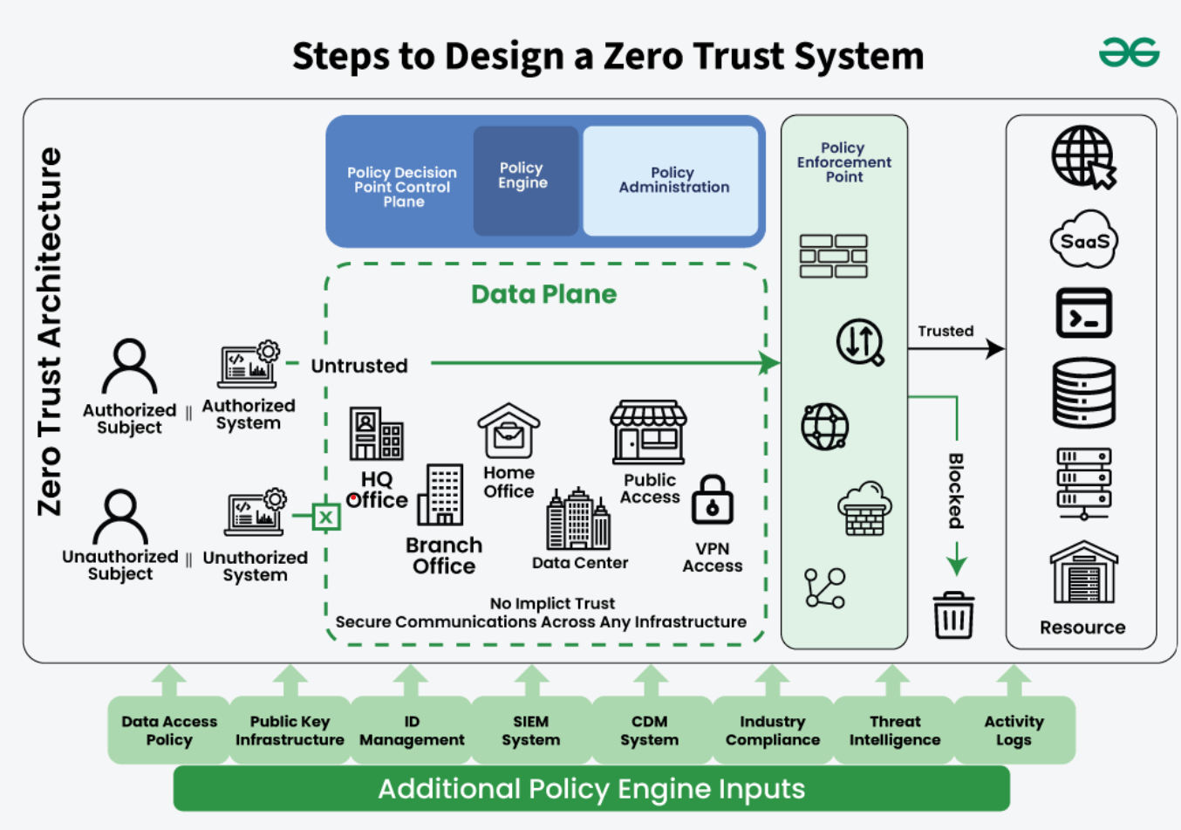
Zero Trust Architecture (ZTA)

Slide 15
Prototype Design Phase 1 – Shadow IT Management PoC
Blocking unauthorized cloud apps (e.g., personal Google Drive)
Enforcing SSO via Microsoft OneDrive
Encrypting sensitive data with AES-256
Automating app approval workflows with ServiceNow

Slide 16
Deliverables & Outcomes of Phase 1
Live demo: Blocking Shadow IT apps and seamless SSO
Encryption demo preventing unauthorized data access
80% faster app approval process through automation
Achieved 90% reduction in Shadow IT usage

Slide 17
Phase 2 - Third-Party Risk & Endpoint Security Pilot
Vendor access controls with MFA and restricted API usage
Deployment of ZTNA to replace VPNs on test devices
Device compliance validation with Microsoft Intune
Insider threat detection using Microsoft Sentinel UEBA

Slide 18
Deliverables & Outcomes of Phase 2
Vendor access logs demonstrating restricted and compliant access.
Improved security and performance metrics replacing VPNs with ZTNA.
Real-time alerts on anomalous user behavior.
100% vendor MFA compliance and 95% endpoint encryption compliance.

Slide 19
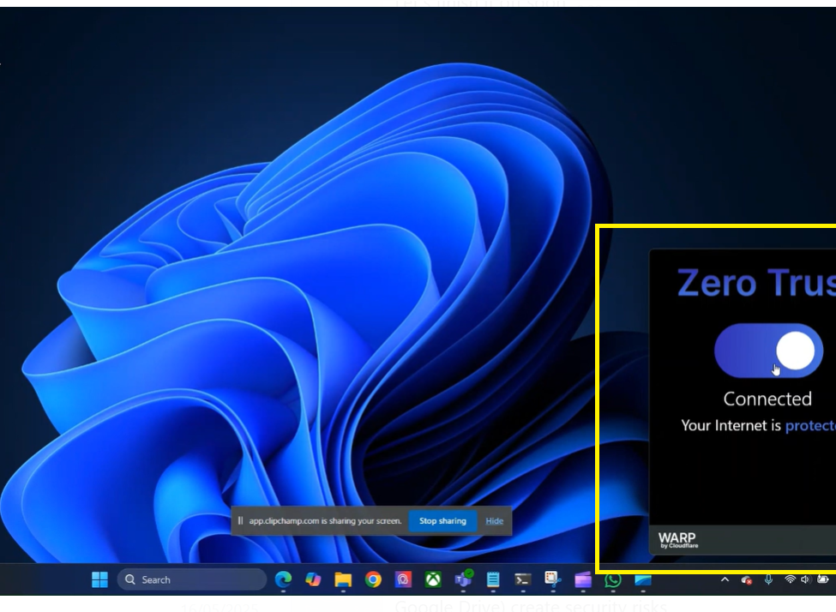
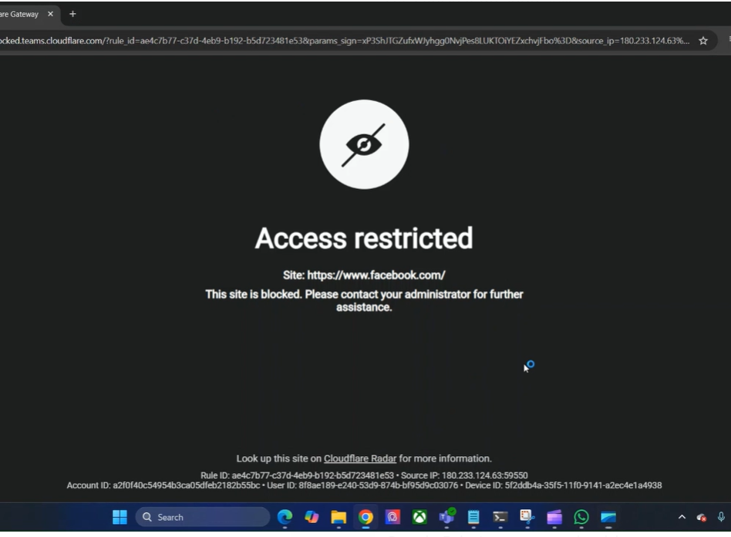
Screenshots

Slide 20
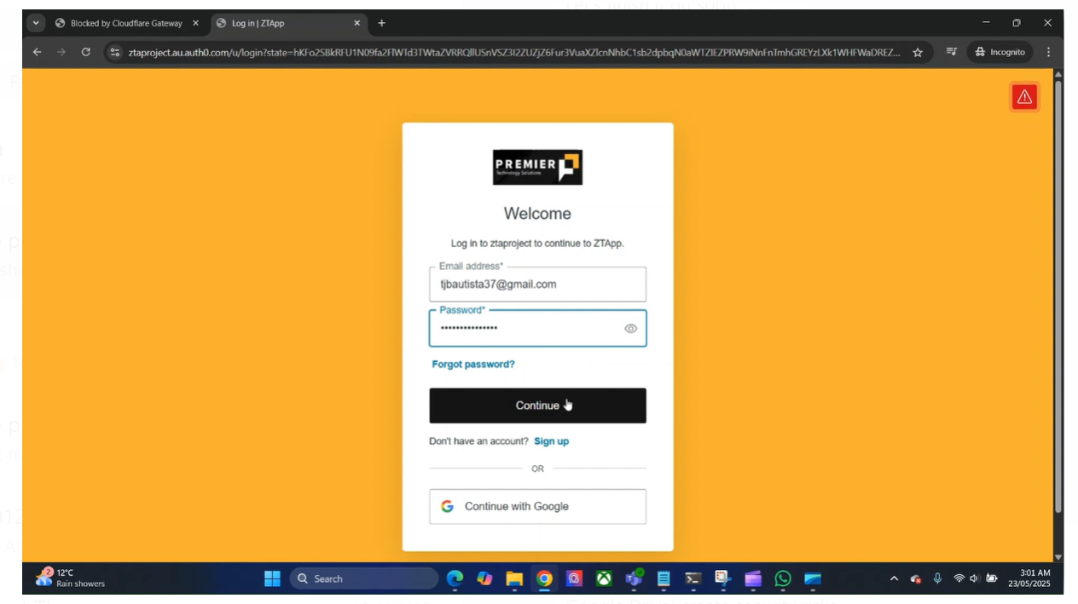
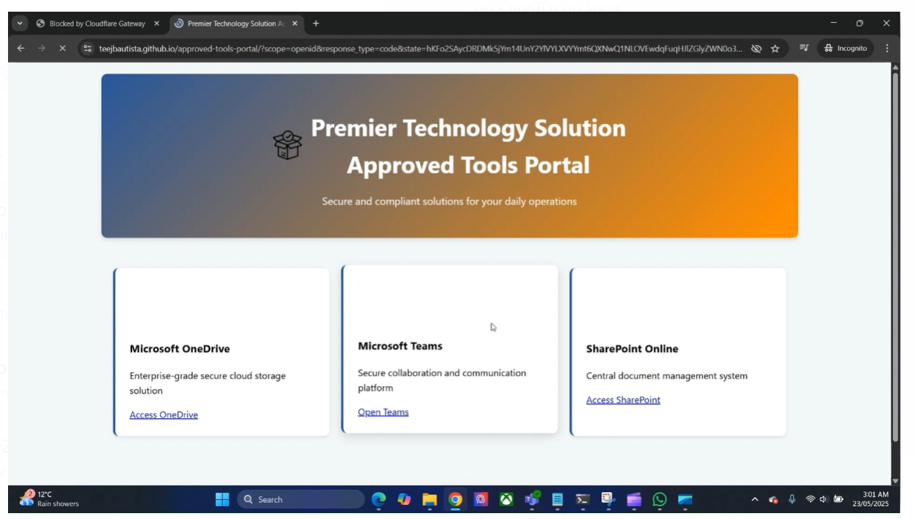
Screenshots

Slide 21
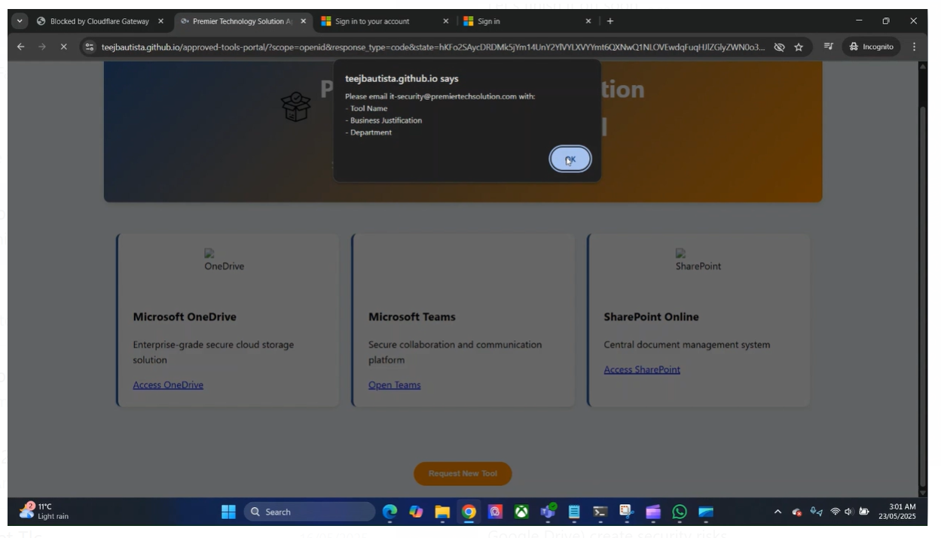
Screenshots

Slide 22
Cost-Benefit Analysis
Utilizes existing Microsoft ecosystem minimizing costs
Expected 40% reduction in breach response and downtime costs
Phased deployment reduces risk and operational disruption

Slide 23
Conclusion
Premier’s core security challenges - Shadow IT, third-party access risks, and endpoint vulnerabilities were clearly identified and addressed through a targeted Zero Trust approach.
The proposed Zero Trust Architecture (ZTA), built on Microsoft and Zscaler tools, offers a scalable and cost-effective security solution tailored to Premier’s hybrid work model.
The two-phase prototype focusing on Shadow IT management and third-party/endpoint security demonstrated results, including a 90% drop in app usage and full vendor MFA compliance.
The architecture leverages existing infrastructure, reducing new investments while delivering an estimated 40% cost savings in breach response and operational downtime.
With proven outcomes from the prototype, Premier is strategically positioned to fully adopt ZTA through a phased implementation roadmap enhancing long-term security and Compliances.

Slide 24
Harvard Style References
Rose, S., Borchert, O., Mitchell, S. and Connelly, S. (2020). Zero trust architecture. NIST Special Publication 800-207, [online] (800-207). doi: https://doi.org/10.6028/nist.sp.800-207.
Cisco (2019). What Is Shadow IT? [online] Cisco. Available at: https://www.cisco.com/c/en/us/products/security/what-is-shadow-it.html.
KPMG (2024). Insights. [online] KPMG. Available at: https://kpmg.com/xx/en/our-insights.html.
Microsoft (2024). Zero trust security. [online] www.microsoft.com. Available at: https://www.microsoft.com/en-us/security/business/zero-trust.
IBM (2024). Cost of a data breach report 2024. [online] IBM. Available at: https://www.ibm.com/reports/data-breach.

Slide 25
Harvard Style References
Verizon (2025). 2025 Data Breach Investigations Report. [online] Verizon Business. Available at: https://www.verizon.com/business/resources/reports/dbir/.
Crowdstrike (2024). CrowdStrike: Stop breaches. Drive business. [online] CrowdStrike.com. Available at: https://www.crowdstrike.com/en-us/.

Slide 26
THANK YOU ANY QUESTIONS ?

