Slide 1
Credit Payment Default Analysis

Slide 2
Business Objective
In early 2000s, the credit card issuers in Taiwan faced the cash and credit card debt crisis due to over-issued cash and credit cards to unqualified applicants in order to gain market share. Most cardholders, irrespective of their repayment ability, overused credit card for consumption and accumulated heavy credit and cash–card debts.
In this project, we are tasked with predicting if customers will default their next payment. This would give the credit issuers valuable information on risk of any additional default payment by the customer and what action they should take to minimize loss.

Slide 3
Analysis Plan
Raw CreditOne Dataset
Data Pre-Processing
EDA
Feature Engineering
Generate Report
Make Predictions & Evaluate Results
Building & Selecting Model
Three classification algorithms will be evaluated to determine the appropriate model.
Random Forest
Support Vector Machine
Decision Tree
The chosen model with then be used for make predictions.
Accuracy and Precision will be used to measure the model performance.

Slide 4
Data
This study reviewed the literature and used the following 23 variables as explanatory variables:
X1: Amount of the given credit (NT dollar) - it includes both the individual consumer credit and his/her family (supplementary) credit.
X2: Gender - 1 = male; 2 = female
X3: Education - 1 = graduate school; 2 = university; 3 = high school; 0, 4, 5, 6 = others
X4: Marital status - 1 = married; 2 = single; 3 = divorce; 0=others
X5: Age
X6-X11: History of past payment from April to September 2005 (in reverse chronological order)
-2: No consumption;
-1: Paid in full;
0: The use of revolving credit;
1-9 = payment delay for the corresponding number of months.
X12-X17: Amount of bill statement (NT dollar) from April to September 2005 (in reverse chronological order)
X18-X23: Amount of previous payment (NT dollar) from April to September 2005 (in reverse chronological order)
This research employed a binary variable, default payment (Yes = 1, No = 0), as the response variable. From the perspective of risk management, the result of predictive accuracy of the estimated probability of default will be more valuable than the binary result of classification - credible or not credible clients.

Slide 5
Data Pre-processing
X1: Amount of the given credit (NT dollar) - Divide data into the following groups:
0: <100k
1: 100k-190k
2: 200k-290k
3: 300k-190k
4: 400k+
X3: Education – Combine 0, 4, 5, 6 into one group (group 0) for others
X5: Age – divide age into the following groups:
0: <30
1: 30-39
2: 40-49
3: 50+

Slide 6
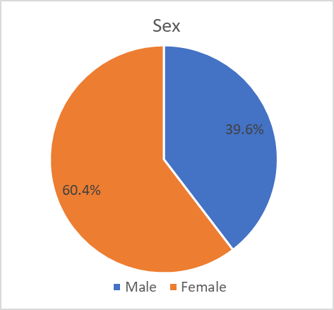
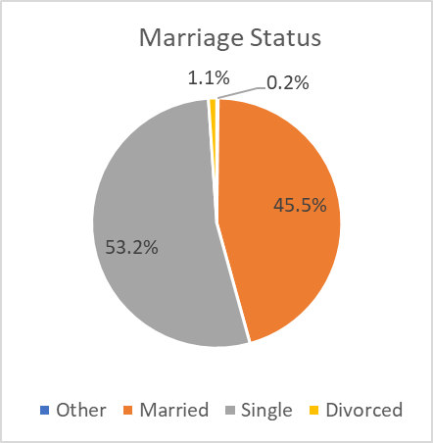
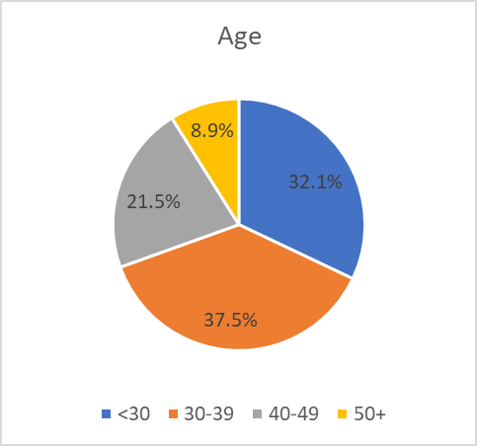
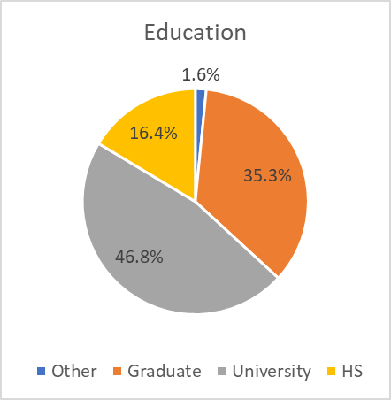
Preliminary Data Review - Demographic
60% of the customers are female
More than half of the customers are single. 45% are married.
70% of the customers are between the age of 20 & 40.
Less than 20% of the customers have less than university education.

Slide 7
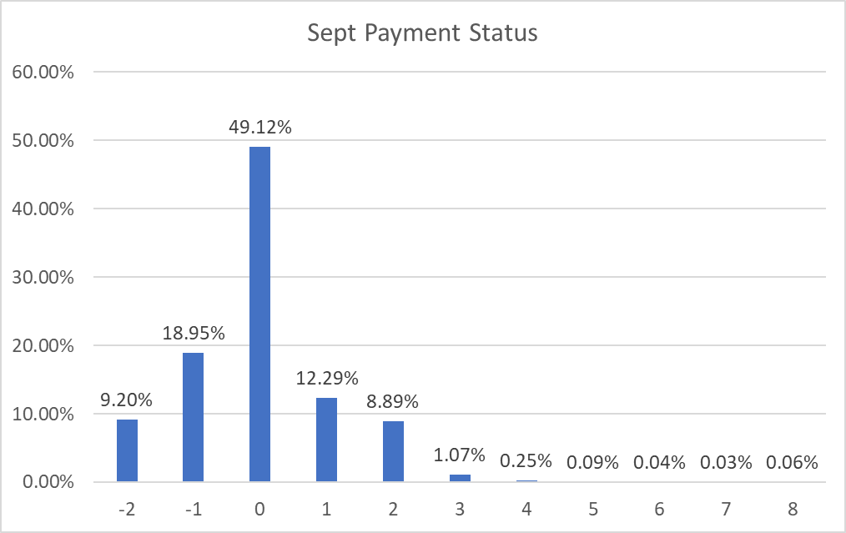
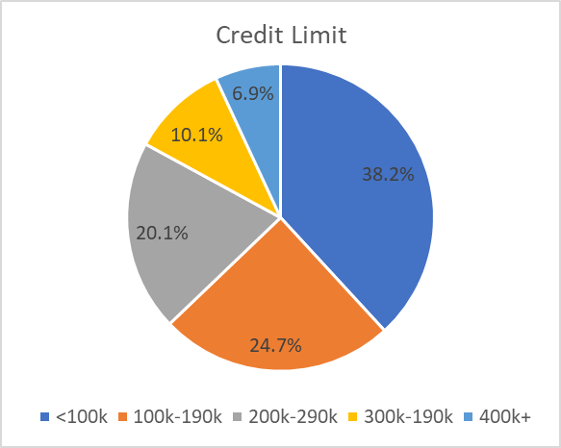
Preliminary Data Review
More than 60% of the customers have credit limit <200k NT dollars.
In September, almost half of the customers used revolving credit, 12% of the customers delayed payment for one month. 9% of the customers delayed payment for 2 months. 1.5% of the customers delayed payment for more than 2 months.

Slide 8
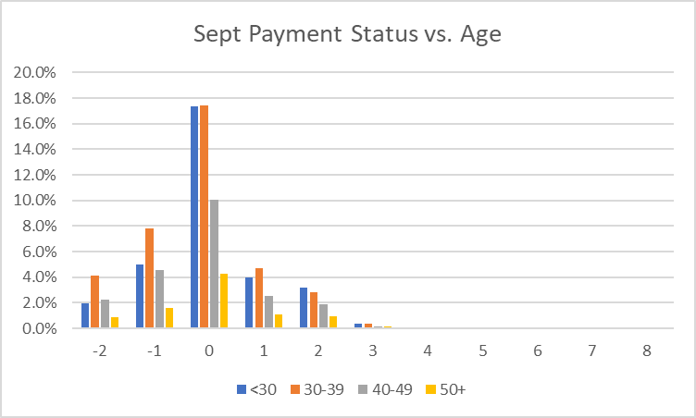
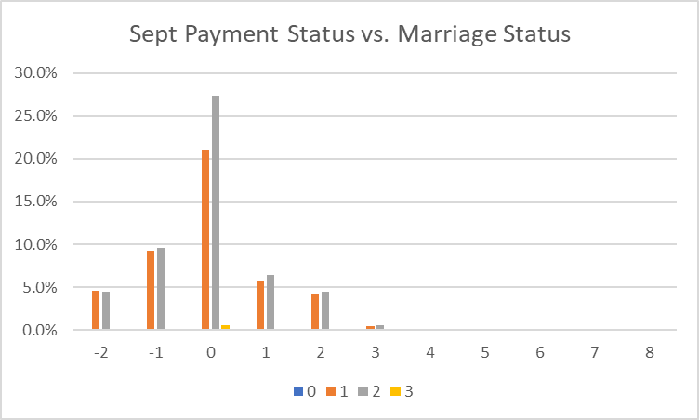
September Payment Review
<30 and 30-39 age groups have the highest percentage in September for using revolving credit.
30-39 age group has the highest percentage in paying the payment in full or having no consumption.
Single customers have the highest percentage in using revolving credit.

Slide 9
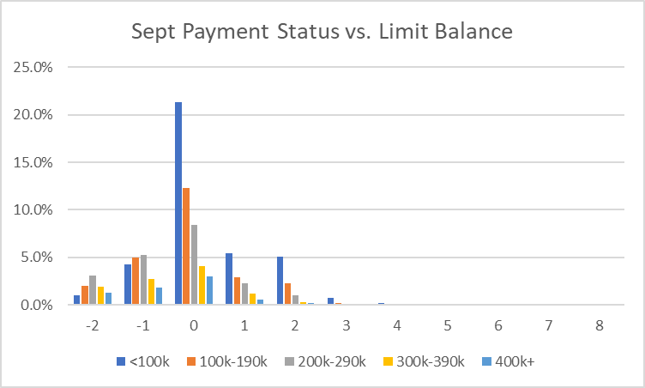
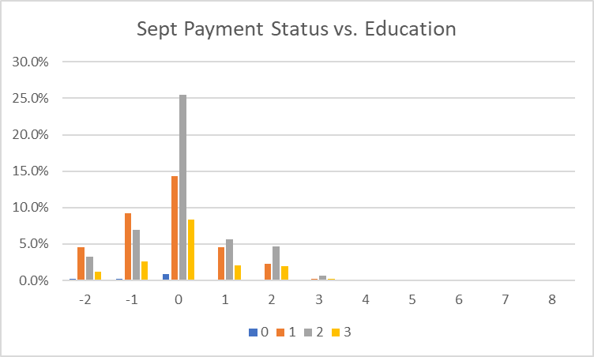
September Payment Review
Customers with <100k credit leads in using revolving credit and delay payments.
Customers with 100k-290k credit leads in no consumption and payment in full.
Customers with university education leads in using revolving credit and delay payments.
Customers with graduate education leads in no consumption and payment in full.

