Slide 1
Causal memory — round 1 frozen
Layer 1 (observed slots) · write → hold → regime-gated read · one recovered structure, used forward (selection) and backward (auditing)
Round-1 evidence, all frozen on disk:
E0 — gated-edge recovery (synthetic): SUPPORTED. Blind discovery misses every read edge; conditioning on the regime recovers them all.
P2 — graph-guided compact memory (MemoryArena, held-out IDs 111–120): PASS.
P3-A — hidden-driver auditing (MINJA + AgentPoison): SUPPORTED, with stated identification boundaries.
P3-B — online mitigation (both carriers): FAIL, kept as a negative.
This meeting is for what round 1 did not settle: the v0.2 formulation, samples per variable, the scaling simulation, and the venue.
2026-08-30 · frozen = criterion and split fixed before any output existed · exploratory vs confirmatory labels kept throughout

Slide 2
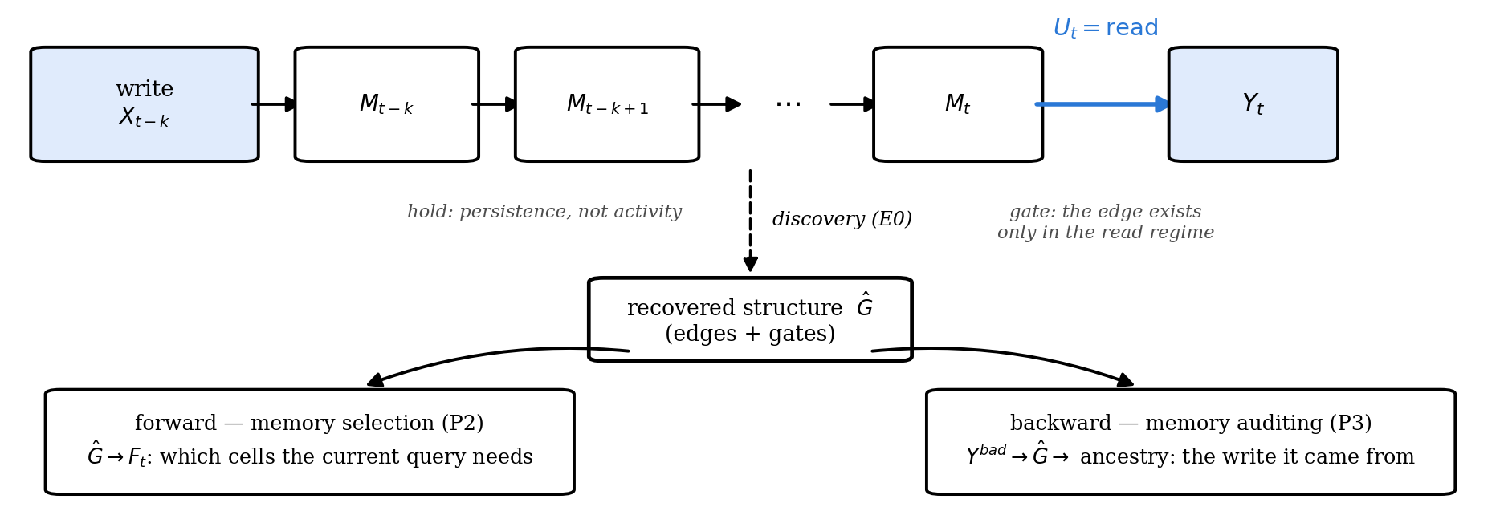
1 · the object
The object we converged on: memory = write → hold → regime-gated read
One structural object now explains all three parts: what discovery must recover (E0), what selection uses forward (P2), and what auditing traverses backward (P3-A).
No numbers on this page on purpose — the claim is the object: memory as a persistent, regime-gated temporal dependency.

Slide 3
2 · your questions, answered
Your 8/15 questions → what v0.2 fixes
Your 8/15 questions:
· what is a variable, at what granularity?
· what is a sample — how many per variable?
· how many variables can GRACE handle?
· what does the graph learn, and how does it act on memory?
· is the target trustworthiness or downstream benefit?
Now fixed in v0.2:
· t = interaction step; Xₜ = fixed-schema semantic slots with persistence Xₜ = vₜ if updated, else Xₜ₋₁ (Form A; vector-valued slots allowed — one of your three 8/15 definitions).
· Uₜ = read/write regime events; discovery input is (X, U), output Ĝ with per-edge gates.
· D = {τ⁽ⁿ⁾}: episodes are independent trials; effective samples counted per edge × lag × regime, never by concatenating short trajectories.
· forward: Ĝ → Fₜ, the memory frontier the current query needs; backward: Ĝ → the write ancestry of a bad output.
· both targets kept: downstream score is primary; graph/audit quality is the diagnostic axis.
All of this was fixed before round 1 ran. Two things it leaves open — the written-out SCM and scale — are the next two slides.
Granularity as a later design choice, vector-valued variables, repo + benchmark both — consistent with what you laid out on 8/15.

Slide 4
3 · SCM
The formulation, written out (Layer 1)
Variables and regime
Xₜ = (Xₜ¹, …, Xₜᵈ): semantic slots at interaction step t, all observed.
Uₜ ∈ {write, hold, read}: the regime event at t. Yₜ: the agent's output at t.
Structural equations
Xₜⁱ = fᵢ(Pa⁽⁰⁾(i) ⊂ Xₜ, Pa⁽¹⁾(i) ⊂ Xₜ₋₁, …, Pa⁽ᴷ⁾(i) ⊂ Xₜ₋ₖ; Uₜ; εₜⁱ)
hold (Form A): if slot i is not written at t, Xₜⁱ = Xₜ₋₁ⁱ — persistence is a deterministic copy, so the value survives while its edges stay dormant.
read: Yₜ = h(Xₜ restricted to its gated parents; εₜʸ) when Uₜ = read.
The object discovery must recover
Ĝ = {A⁽ᵏ⁾ᵢⱼ, gᵢⱼ(u)}: lag-k adjacency together with a per-edge gate saying in which regime the edge is active. A pooled estimator sees only the marginal edge; the gate is what E0 tests.
Discovery: Regime-GRACE
GRACE with the regime as an input to every edge score. ⟨FILL: exact form — gate gᵢⱼ(u) on the score, or per-regime parameters?⟩
Baselines on the same traces: blind PCMCI+ (regime ignored) · additive u-as-node (CD-NOD-style surrogate) · regime-subsampled.
Forward use (P2): the frontier
Fₜ = ancestors in Ĝ of the slots the current query reads, within K lags and under the current regime; memory is serialized from Fₜ only, under a fixed budget. ⟨CONFIRM: the query-ancestry rule P2 ran⟩
Backward use (P3): write ancestry
From a flagged output Yᵇᵃᵈ, traverse gated edges backward to the write step(s) that produced its parents.
Where Layer 2 enters
Everything above is observed. Layer 2 puts the same object over latent zₜ (thoughts / plans) generating Xₜ; “what the agent is thinking” lives there and is claimed nowhere in round 1.
Written in response to your 7/29 request for explicit within- and cross-step functions; the full v0.2 text is in the formulation doc.

Slide 5
4 · scale
Scale — your first question on 8/15
Where round 1 sits
E0 (synthetic): d = ⟨FILL⟩ variables · 3,000 steps per run · read regime on 5% of steps (150 / 3,000).
P2 (MemoryArena): ⟨FILL⟩ slots per schema · graph learned on IDs ≤ 110 · ⟨FILL⟩ episodes.
P3 (MINJA / AgentPoison): ⟨FILL⟩ variables (record and event channels) · MINJA: 243 rounds over 3 seeds.
Regime-GRACE ceiling: ~100 variables, inherited from GRACE (your 8/15 question). ⟨CONFIRM: unchanged for the regime version?⟩ The grouping fallback you proposed was ⟨FILL: needed / not needed⟩ in round 1.
What round 1 does not contain
The simulation you called mandatory on 8/21 — SCM/MLP-generated data with known ground truth, structure recovery scored — at the scale you asked for on 7/29 (thousands of variables). E0 shows the gating mechanism on ⟨FILL⟩ variables; scale is untested.
Proposal for round 2 (unrun — your sign-off first)
d ∈ {50, 200, 1,000, 5,000} · MLP mechanisms · sparse lag-k graphs with a regime-gated subset of edges · report SHD / F1 vs d for Regime-GRACE, blind PCMCI+ and additive u-as-node · grouping applied above the GRACE ceiling and reported as a separate curve.
This is decision 3 on the decisions slide.
Simulation design follows your 8/21 guidance: follow existing papers for the simulation part; coverage over depth for the two applied parts.

Slide 6
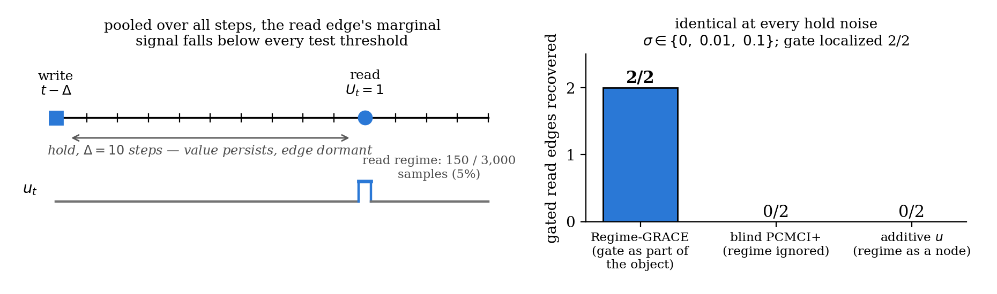
5 · E0 · synthetic, frozen
Part 1 — dormant memory edges vanish when regimes are pooled
Open in round 1: with 150 / 3,000 read samples this is also a power effect. Until a sample-size sweep for blind PCMCI+ exists, the claim is “required at practical sample sizes”. Additive u-as-node (a CD-NOD-style surrogate) scores 0/2 here and 2/3 on MINJA — ⟨FILL: why the difference⟩
Memory dependence is intermittent: the read regime is part of the structural object, so uₜ enters discovery as an input in its own right.
Δ = 10, σ ∈ {0, 0.01, 0.1} · E0 v0 sweep agrees: blind PCMCI+ read-recall 0.0 in all nine (Δ, σ) configs; other recalls 1.0 for every method.

Slide 7
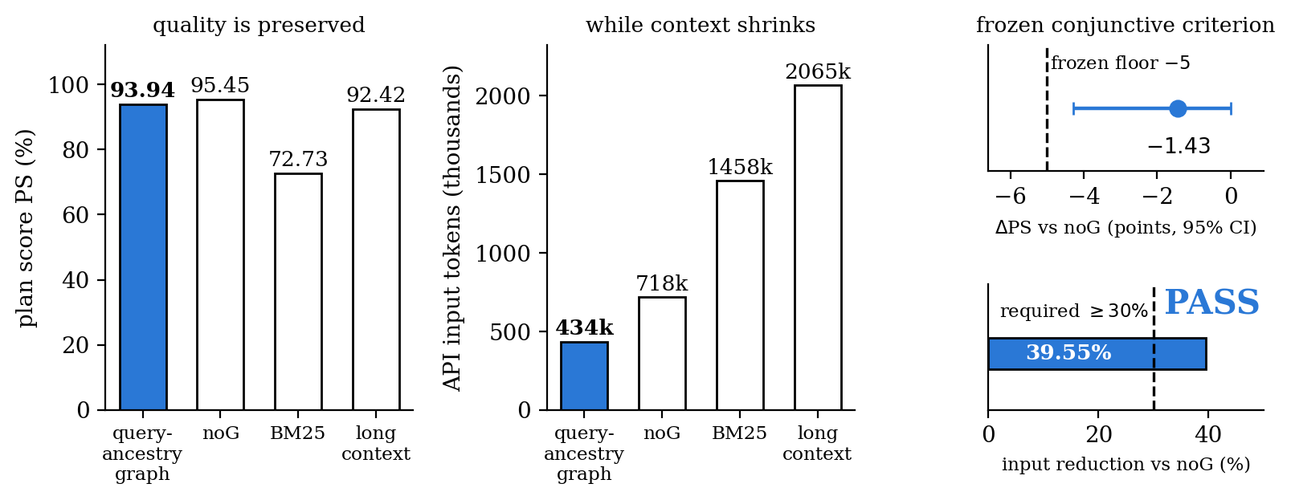
6 · P2 · held-out IDs 111–120
Part 2 — forward use: quality held at 40% less input (PASS)
Criterion frozen before any IDs 111–120 output existed: PS loss vs noG ≤ 5 points AND input reduction ≥ 30% — measured −1.43 (95% CI [−4.29, 0.00], W/T/L 0/9/1) and −39.55% → PASS. Vs baselines: +19.80 PS over BM25 at −70.2% input; +1.07 vs long context at −79.0% input.
Boundary: graph selection and compact serialization are bundled; the adjacency mask alone is not isolated.
Four arms share model / decoder / steps / tools · graph learned excluding IDs 111–120 · prior secondary FAIL (−14.7%, IDs 101–110) kept.

Slide 8
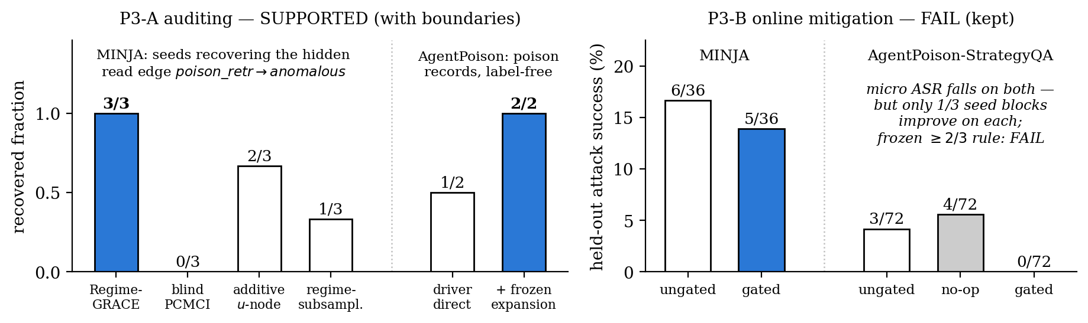
7 · P3 · frozen, both verdicts kept
Part 3 — backward use: auditing SUPPORTED, mitigation FAIL
Auditing: Regime-GRACE finds MINJA's hidden read edge in 3/3 seeds (gated 2/3) and provenance traces each back to its write round; AgentPoison's label-free driver recovers 2/2 poison records after the frozen cluster expansion (precision 100%). Mitigation: micro ASR falls on both carriers, yet each has only 1/3 seed blocks improving — the frozen ≥2/3 rule fails, twice.
Recovery ≠ mitigation. The negative result stays; neither claim overwrites the other.
Boundaries: poison_retr is oracle-tagged; lag-0 direction from retrieve-before-act instrumentation; AgentPoison recovery had no pre-registered PASS.

Slide 9
8 · decisions
What we need from you
1 · Formulation — is write → hold → regime-gated read, with frontier Fₜ, the object the paper is built on?
v0.2 makes it the source of truth (problem → primitive → samples → two uses → instantiations → evidence); the SCM slide is the written-out form.
2 · Samples per variable — does “episodes as independent trials, effective samples per edge × lag × regime” settle your 8/15 question?
No cross-episode lag stitching. The alternative is to make the amortized cross-episode estimator primary.
3 · Scale — run the d = 50 → 5,000 simulation as round 2 before writing, or is E0 plus grouping enough for the venue?
Round 1 has no SCM/MLP ground-truth simulation at scale (scale slide).
4 · Claim boundaries — how much unbundling / blinding before submission?
P2 bundles selection + serialization (a second-task ablation would isolate the mask); MINJA's recovery reads an oracle-tagged channel (fully label-free record discovery would remove it).
5 · P3-B — keep both frozen FAILs and stop, or run the drafted round 3?
The power audit shows 2/3 AgentPoison blocks on a 0-ASR floor, so the acceptance rule was unsatisfiable there; the round-3 draft fixes evaluability / exposure / noise and waits on your sign-off.
6 · Venue — you named a target deadline on 8/15; which one?
If ICLR 2027: papers due Sep 24 (abstracts Sep 19), about 3.5 weeks out ⟨CONFIRM on iclr.cc⟩. Otherwise: which deadline is round 2 designed around?
Only (3) and (5) would need new runs, and only with your approval. Round-1 and round-2 negatives stay pass=false regardless.

Slide 10
appendix · P2 audit trail
Appendix — how P2 went from PS = 0% to a frozen PASS
IDs 1–5 (original protocol): PS 0.00% on both graph arms — reproduced exactly in the pre-registered rerun (run B). Cause is the strict full-plan denominator (SPS 96.9% while one wrong slot fails the whole person), not a scorer or parse bug.
Failure audit: 31/37 persons failed only on slots the query never asked to change → deterministic query-target/base-inheritance decoder (no gold access, no evaluator in the loop).
Same IDs, exploratory: learned arm 100% PS online; learned−pure +18.69 points [+12.86, +28.33]. Labeled exploratory repair — developed after seeing the failures, so it never became a confirmatory claim.
IDs 101–110 (held-out): main judgement PASS — pure−BM25 +16.55 [+9.17, +25.24], W/T/L 8/2/0. But the graph/noG secondary condition FAILED: input −14.7% < the frozen 30%.
Diagnosis: context compression ≠ API input compression — shared system/tool schema and ReAct history dominate. → compact target-delta serialization (v3), frozen on dev IDs 101–103 only.
IDs 111–120 (new frozen round): −1.43 PS / −39.55% input → PASS (Part 2 slide).
All intermediate negatives preserved unchanged in results/ (no run overwritten, no ID or seed re-drawn) · e2e_scores*.json · e2e_failure_audit*.json

Slide 11
appendix · P3-A
Appendix — MINJA per-seed detail and identification boundaries
Replication (3 seeds, 243 rounds):
seed 0 · held-out ASR 6/12 · decisive cell 12/37 = 0.324 · edge found, gated
seed 1 · ASR 1/12 · 6/31 = 0.194 · found, gated
seed 2 · ASR 1/12 · 4/8 = 0.500 · found, not gated
aggregate · ASR 8/36 = 0.222, Wilson [0.117, 0.381] · decisive 22/76 = 0.289, Wilson [0.200, 0.400] · note-free control 0/77
(the 6/36 on the Part 3 slide is the P3-B round, a separate run) ⟨CONFIRM⟩
Discovery baselines (same traces):
blind PCMCI 0/3 · additive u-as-node 2/3 · regime-subsampled 1/3
seed-0 read coefficient: 0.77 in the read regime (p = 2.9e-6) vs 0.02 outside (p = 0.85)
Boundaries that ship with the claim:
· poison_retr is constructed from the record's is_poison tag — the recovered structure sits on an oracle-tagged event channel; fully-blind record discovery is claimed nowhere for MINJA.
· lag-0 orientation comes from the instrumented retrieve-before-act order.
· seed heterogeneity is real (test ASR 6/12 vs 1/12): the pathway is reproducible, its strength is seed-dependent.
· MemAudit reproduction scores CMIS macro AUC 0.866 / precision@k 0.874 — our claim is temporal ancestry and one-graph-two-uses; a detection-score win is claimed nowhere.
minja_replication_summary.json · minja_audit_report_{v2,seed1,seed2}.json · memaudit_baseline_v2.json (lexical overlap stands in for NLI)

Slide 12
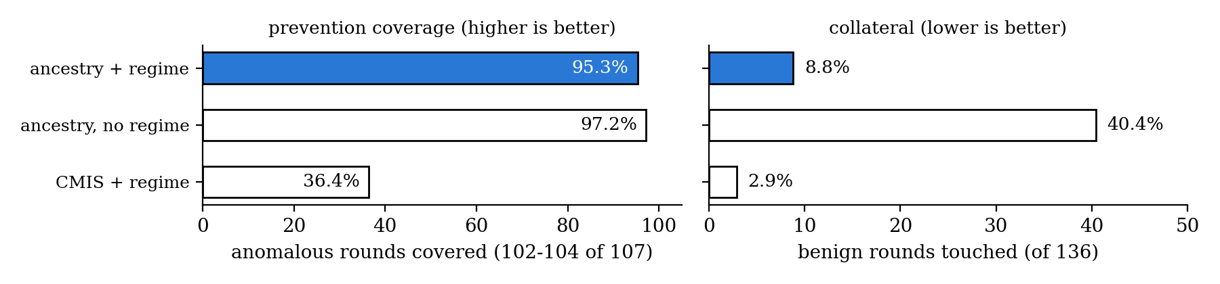
appendix · offline coverage
Appendix — regime gating matters operationally (replay-only)
Dropping the regime condition keeps coverage (+2 anomalous rounds) but touches 43 more benign rounds — collateral 8.8% → 40.4%. The score-based baseline with the same regime condition is precise but covers only 36.4%. “When is the edge active” is doing real selective work, matching Part 1's structural claim.
These are coverage counts on saved trajectories with no LLM re-invocation, so they are a policy-design signal; online prevention is the P3-B test, and it failed.
results/real/causal_gate_v2.json · three seeds, micro-pooled: 107 anomalous / 136 benign rounds.

Slide 13
appendix · P3-B
Appendix — why P3-B failed, and the drafted (unrun) round 3
Power audit (diagnostic only):
· AgentPoison: seed blocks 0 and 2 had ungated 0/24 — a 0-ASR floor. “≥2/3 blocks improve” was unsatisfiable with one evaluable block; conditional on evaluability the gate went 1/1, with 3 touched preventions and 0 reverse triggers. This FAIL is mostly the acceptance rule.
· MINJA: a genuine limitation. ~55% of memory records never surfaced in calibration retrieval (poison-recall cap 0.24–0.39), and untouched controls flip answers at the size of the measured effect — clean-gated changed 10/24 answers while deleting zero retrievals.
Round-3 draft (frozen only after sign-off):
· a-priori evaluability: a block counts only if ungated attacks ≥ 3; ≥ 3 evaluable blocks by construction, predicted from earlier rounds' ungated ASR only.
· exposure: longer calibration (≥ 40 eligible trigger rounds) + the frozen embedding-cluster expansion already validated on AgentPoison (recall 0.50 → 1.00).
· noise: primary endpoint becomes touched-only net prevention vs a pre-registered flip-rate floor from round 2; block ASR is secondary.
· round-2 verdicts stay pass=false no matter what round 3 finds.
results/real/p3b_power_audit.json · docs/p3b-round3-preregistration-draft-2026-08-30.md — DRAFT, unrun; decision (5) on the decisions slide.

