Slide 1
Causal Memory
Round 1 results · 2026-08-30
Memory = write → hold → regime-gated read (Layer 1, observed)
One learned graph, two uses: forward memory selection · backward auditing
E0 simulation — gated-edge recovery: supported
P2 MemoryArena — compact memory: PASS (frozen criterion)
P3-A auditing — supported, with boundaries
P3-B online mitigation — FAIL (kept)
Today: v0.2 formulation · samples definition · scaling simulation · venue
Notes:
Round 1 is complete and frozen: two supported claims, one PASS, one kept negative. The meeting decides the four open items; the last slide turns them into six questions.

Slide 2
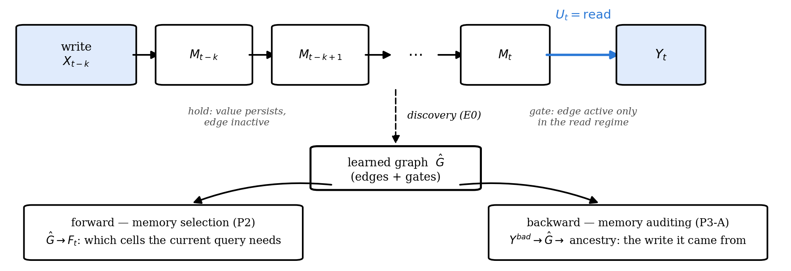
the object
Memory = write → hold → regime-gated read
The same learned graph selects memory for the current query (forward) and traces a bad output to the write that caused it (backward).
Notes:
The one-picture story. E0 shows the graph is recoverable, P2 uses it forward, P3-A uses it backward. This is the 8/21 'one structure, two payoffs' framing.

Slide 3
formulation
Your 8/15 questions → v0.2
Your questions:
· how many variables can GRACE handle?
· what is a variable? what granularity?
· what is a sample? how many per variable?
· what does the graph learn / how does it act on memory?
· trustworthiness or downstream benefit?
v0.2:
· t = interaction step; Xₜ = semantic slots; unwritten slots persist (Xₜ = Xₜ₋₁)
· Uₜ = read/write regime; discovery input (X, U) → graph + per-edge gates
· sample = one episode (independent trial); effective samples counted per edge × lag × regime
· forward: graph → what memory to keep; backward: graph → ancestry of a bad output
· downstream score primary; trustworthiness = second use of the same graph
Scale and the written-out SCM: next two slides.
Notes:
Variable definition uses one of the three options she listed (vector slots allowed); she left the choice open, so this is for sign-off — decisions 1 and 2.

Slide 4
SCM & method
The formulation (Layer 1)
Xₜ = (Xₜ¹ … Xₜᵈ): semantic slots, observed · Uₜ ∈ {write, hold, read} · Yₜ: output
xⱼ(t) = Σᵢ Σₗ₌₀…ᴷ [ aᵢⱼₗ · gᵢⱼₗ(uₜ) ] · xᵢ(t−l) + εⱼ(t)
l = 0: within-step · l ≥ 1: cross-step · hold: unwritten slot copies itself
The gate multiplies the coefficient. A linear-additive uₜ-node only shifts the mean, so it misses gated edges. (A CD-NOD-style nonparametric surrogate could detect them; our round-1 baselines are linear.)
Estimator — fit each regime separately; edge = significant in any regime; gated = coefficients differ ≥ 4×. Ran as GRACE-per-regime (P2) and per-regime ridge + FDR (E0, MINJA).
Layer 2 = the same object over latent state (“what the agent is thinking”). Round 1 is entirely Layer 1.
Notes:
The functions she asked for on 7/29: within-step (l=0) and cross-step (l>=1) in one equation. If she raises CD-NOD: agree — our additive arms are linear, the nonparametric surrogate is the fair comparison and is in the round-2 simulation.

Slide 5
your first 8/15 question
Scale
Round 1 is small: E0 8 variables · P2 7 slots · MINJA 6 event channels — all far under GRACE's ~100-variable ceiling; grouping never needed.
GRACE ran P2's slot graph; per-regime ridge ran E0 and MINJA. The ceiling belongs to the GRACE path.
Missing: the simulation you called mandatory — SCM/MLP data, known ground truth, SHD/F1, up to ~5,000 dims.
Round-2 proposal (runs on your sign-off):
d ∈ {50, 200, 1,000, 5,000} · MLP mechanisms · gated edge subset
Regime-GRACE vs blind PCMCI+ vs linear-additive u vs CD-NOD-style
grouping above the ceiling, reported as its own curve
Notes:
Her first 8/15 question. Be precise: the ~100 ceiling is GRACE's and GRACE only ran P2's slot graph; ridge ran E0/MINJA and is bounded by samples per regime, not variables. The mandatory scaling sim does not exist yet — decision 3.

Slide 6
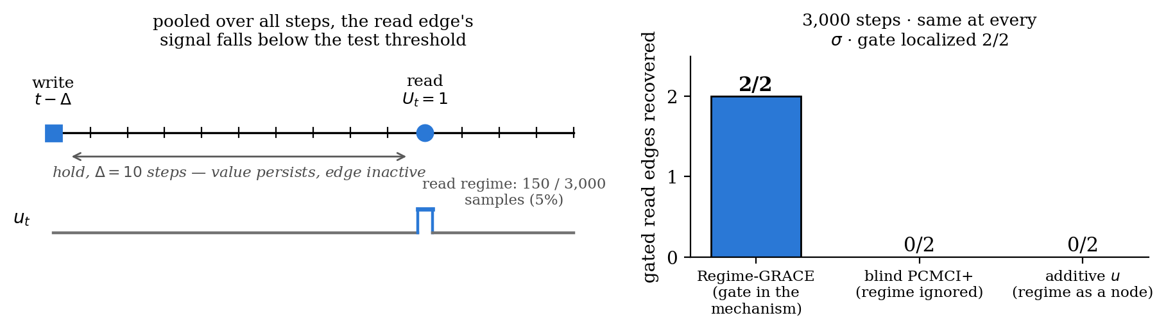
Part 1 · E0 simulation
Pooling hides gated edges
Blind discovery misses both read edges at 3,000 steps. With 20× data it finds them — but still cannot say when they act. Regime conditioning finds and gates both at 3,000.
Detection is a sample-size issue; the gate is a model-class issue.
Notes:
If she asks power vs identifiability: the sweep answers it — blind gets detection at 20x data (0/2 -> 2/2), never the gate. Additive-u follows regime frequency: 0/2 on E0 (5% active) vs 2/3 on MINJA (69%). Our additive arms are linear; nonparametric CD-NOD is in the round-2 sim.

Slide 7
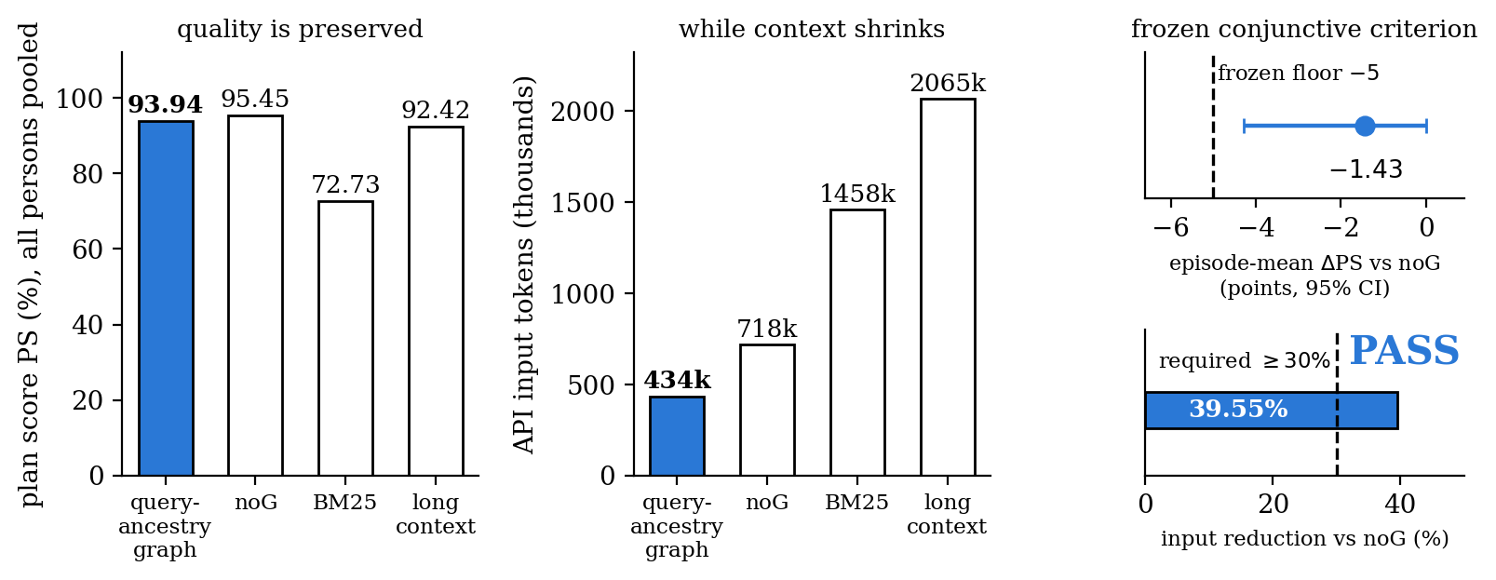
Part 2 · MemoryArena, held-out IDs
Same graph, forward: compact memory (PASS)
Frozen criterion: PS loss ≤ 5 points and input reduction ≥ 30% vs noG → measured −1.43 and −39.55% → PASS. vs BM25: +19.8 PS at −70% input.
Boundary: graph selection and compact serialization are bundled.
Notes:
Bars pool all persons; the frozen criterion uses episode-mean deltas (−1.43 vs pooled −1.52 — episodes differ in person count). Unbundling selection from serialization is decision 4.

Slide 8
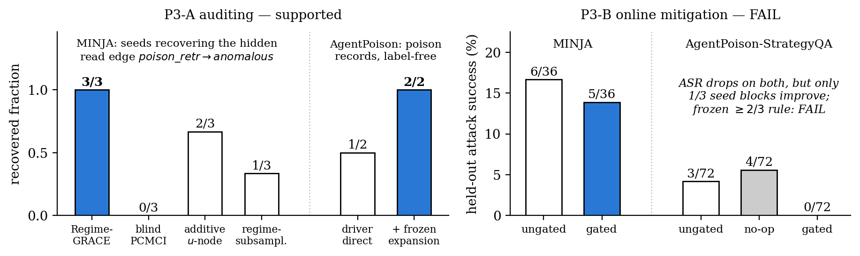
Part 3 · safety
Same graph, backward: auditing works, online defense does not
Auditing: the hidden read edge recovered in 3/3 seeds and traced to its write round (MINJA); 2/2 poison records recovered label-free (AgentPoison).
Online deletion gate: ASR drops on both carriers, but only 1/3 seed blocks improve → FAIL, kept.
One-line caveats: MINJA's event channel is oracle-tagged; AgentPoison recovery had no pre-registered PASS.
Notes:
Keep the halves separate: auditing (her 8/21 trustworthiness pitch) is supported; mitigation failed its frozen rule twice. The 6/36 here is the mitigation round's own ungated arm; the replication round measured 8/36 (appendix). Power audit says the AgentPoison FAIL is mostly the acceptance rule — decision 5.

Slide 9
decisions
What we need from you
1 · Formulation — build the paper on write → hold → regime-gated read?
2 · Samples — does per-edge × lag × regime counting settle the sample question?
3 · Scale — run the d = 50 → 5,000 simulation as round 2?
4 · Boundaries — how much unbundling before submission? (P2 bundle · MINJA oracle tag)
5 · P3-B — keep the FAILs and stop, or run the drafted round 3? (2/3 blocks had zero attacks to prevent)
6 · Venue — which deadline? ICLR 2027: abstract Sep 18 / paper Sep 25.
Only 3 and 5 need new runs.
Notes:
1-2 close the formulation. 3 and 5 are the only new-compute items. 4 sets the writing bar. If she confirms ICLR 2027, Sep 18/25 makes 3 and 5 this week's decisions. Round-3 draft is written and waits for sign-off; round-2 negatives stay pass=false regardless.

Slide 10
appendix · P2 audit trail
Appendix — P2: from PS = 0% to a frozen PASS
IDs 1–5 (original protocol): PS 0.00% on both graph arms — reproduced exactly in the pre-registered rerun. Cause: the strict full-plan denominator (SPS 96.9% while one wrong slot fails the whole person); scorer and parsing verified clean.
Failure audit: 31/37 persons failed only on slots the query never asked to change → deterministic query-target/base-inheritance decoder (no gold access, no evaluator in the loop).
Same IDs, exploratory: learned arm 100% PS online; learned−pure +18.69 points [+12.86, +28.33]. Labeled exploratory repair — developed after seeing the failures, so it stayed outside the confirmatory record.
IDs 101–110 (held-out): main judgement PASS — pure−BM25 +16.55 [+9.17, +25.24], W/T/L 8/2/0. The graph/noG secondary condition FAILED: input −14.7% against the frozen 30%.
Diagnosis: context compression outpaced API-input compression (shared system/tool schema and ReAct history dominate) → compact target-delta serialization v3, frozen on dev IDs 101–103 only.
IDs 111–120 (new frozen round): −1.43 PS / −39.55% input → PASS.
All intermediate negatives preserved unchanged in results/ · e2e_scores*.json · e2e_failure_audit*.json · e2e_scores_holdout_101_110.json · p2_compact_v3/round_summary.json
Notes:
The audit trail if she asks how a 0% became a PASS: reproduce the zero, audit the failures, freeze a decoder fix, fail the input criterion once, diagnose, freeze v3, pass on fresh held-out IDs.

Slide 11
appendix · P3-A
Appendix — MINJA per-seed detail and boundaries
Replication (3 seeds, 243 rounds):
seed 0 · held-out ASR 6/12 · decisive cell 12/37 = 0.324 · edge found, gated
seed 1 · ASR 1/12 · 6/31 = 0.194 · found, gated
seed 2 · ASR 1/12 · 4/8 = 0.500 · found, without gate flag
aggregate · ASR 8/36 = 0.222, Wilson [0.117, 0.381] · decisive 22/76 = 0.289 [0.200, 0.400] · note-free control 0/77
(the 6/36 on the Part 3 slide is the later P3-B mitigation round's own ungated arm — a separate run from this 8/36)
Discovery baselines (same traces):
blind PCMCI 0/3 · additive u-as-node 2/3 · regime-subsampled 1/3 · seed-0 read coefficient 0.77 in-regime (p = 2.9e-6) vs 0.02 outside (p = 0.85)
Boundaries on the claim:
· poison_retr is built from the record's is_poison tag: the recovered structure sits on an oracle-tagged event channel, and MINJA record discovery stays outside the claim.
· lag-0 orientation comes from the instrumented retrieve-before-act order.
· seed heterogeneity is real (test ASR 6/12 vs 1/12): the pathway reproduces, its strength is seed-dependent.
· MemAudit reproduction scores CMIS macro AUC 0.866 / precision@k 0.874; our claim is temporal ancestry plus one-graph-two-uses.
minja_replication_summary.json · minja_audit_report_{v2,seed1,seed2}.json · memaudit_baseline_v2.json (lexical overlap stands in for NLI)
Notes:
Per-seed backup. The additive-u 2/3 here vs 0/2 on E0 is regime frequency (trigger active 69% of MINJA rounds vs 5% on E0). The boundaries column keeps P3-A at Layer 1.

Slide 12
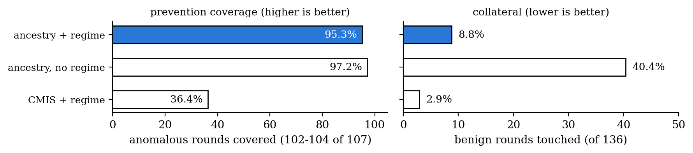
appendix · offline coverage
Appendix — the regime condition in the replay gate
Dropping the regime condition keeps coverage (+2 anomalous rounds) while touching 43 more benign rounds — collateral 8.8% → 40.4%. The score-based baseline with the same regime condition is precise but covers only 36.4%.
Coverage counts on saved trajectories, zero LLM re-invocation — a policy-design signal. The online test of the same idea is P3-B, which failed.
results/real/causal_gate_v2.json · three seeds, micro-pooled: 107 anomalous / 136 benign rounds
Notes:
The gate's operational value without overclaiming: replay-only coverage, clearly separated from the failed online test.

Slide 13
appendix · P3-B
Appendix — why P3-B failed; the drafted round 3
Power audit (diagnostic only):
· AgentPoison: seed blocks 0 and 2 had ungated 0/24 — zero attacks to prevent, so “≥2/3 blocks improve” was unsatisfiable with one evaluable block. Conditional on evaluability the gate went 1/1, with 3 touched preventions and 0 reverse triggers: this FAIL is mostly the acceptance rule.
· MINJA: a genuine limitation. ~55% of memory records never surfaced in calibration retrieval (poison-recall cap 0.24–0.39), and untouched controls flip answers at the size of the measured effect — clean-gated changed 10/24 answers while deleting zero retrievals.
Round-3 draft (freezes only after sign-off):
· a-priori evaluability: a block counts only with ungated attacks ≥ 3; ≥ 3 evaluable blocks by construction, predicted from earlier rounds' ungated ASR only.
· exposure: longer calibration (≥ 40 eligible trigger rounds) + the frozen embedding-cluster expansion already validated on AgentPoison (recall 0.50 → 1.00).
· noise: primary endpoint becomes touched-only net prevention against a pre-registered flip-rate floor from round 2; block ASR turns secondary.
· round-2 verdicts stay pass=false whatever round 3 finds.
results/real/p3b_power_audit.json · docs/p3b-round3-preregistration-draft-2026-08-30.md · results/diagnostics/e0_blind_power_sweep.json
Notes:
Backup for decision 5. The carriers failed for different reasons: AgentPoison's rule was unsatisfiable; MINJA's limits are exposure and call noise, both measured. The draft fixes each with a frozen rule.

