Slide 1
Causal Memory
Memory = write → hold → regime-gated read (Layer 1, observed)
One learned graph, two uses: forward memory selection · backward auditing
E0 simulation — gated-edge recovery: supported
P2 MemoryArena — compact memory
P3-A auditing — supported, with boundaries
Today: v0.2 formulation · samples definition · scaling simulation · venue

Slide 2
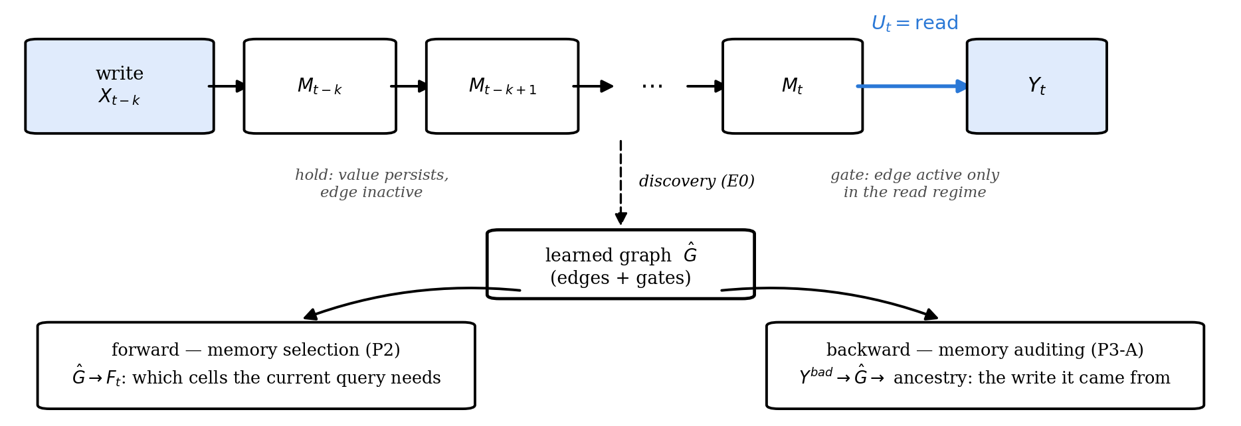
Memory = write → hold → regime-gated read
The same learned graph selects memory for the current query (forward) and traces a bad output to the write that caused it (backward).
Notes:
E0 shows the graph is recoverable, P2 uses it forward, P3-A uses it backward.

Slide 3
SCM & method
The formulation (Layer 1)
Xₜ = (Xₜ¹ … Xₜᵈ): semantic slots, observed · Uₜ ∈ {write, hold, read} · Yₜ: output
xⱼ(t) = Σᵢ Σₗ₌₀…ᴷ [aᵢⱼₗ · gᵢⱼₗ(uₜ)] · xᵢ(t−l) + εⱼ(t)
l = 0: within-step · l ≥ 1: cross-step · hold: unwritten slot copies itself
The gate multiplies the coefficient. A linear-additive uₜ-node only shifts the mean, so it misses gated edges. (A CD-NOD-style nonparametric surrogate could detect them; our round-1 baselines are linear.)
Estimator — fit each regime separately; edge = significant in any regime; gated = coefficients differ ≥ 4×. Ran as GRACE-per-regime (P2) and per-regime ridge + FDR (E0, MINJA).
Layer 2 = the same object over latent state (“what the agent is thinking”). Round 1 is entirely Layer 1.
Notes:
The functions she asked for on 7/29: within-step (l=0) and cross-step (l>=1) in one equation. If she raises CD-NOD: agree — our additive arms are linear, the nonparametric surrogate is the fair comparison and is in the round-2 simulation.

Slide 4
your first 8/15 question
Scale
Round 1 is small: E0 8 variables · P2 7 slots · MINJA 6 event channels — all far under GRACE's ~100-variable ceiling; grouping never needed.
GRACE ran P2's slot graph; per-regime ridge ran E0 and MINJA. The ceiling belongs to the GRACE path.
Missing: the simulation you called mandatory — SCM/MLP data, known ground truth, SHD/F1, up to ~5,000 dims.
Round-2 proposal (runs on your sign-off):
d ∈ {50, 200, 1,000, 5,000} · MLP mechanisms · gated edge subset
Regime-GRACE vs blind PCMCI+ vs linear-additive u vs CD-NOD-style
grouping above the ceiling, reported as its own curve
Notes:
the ~100 ceiling is GRACE's and GRACE only ran P2's slot graph; ridge ran E0/MINJA and is bounded by samples per regime, not variables.

Slide 5
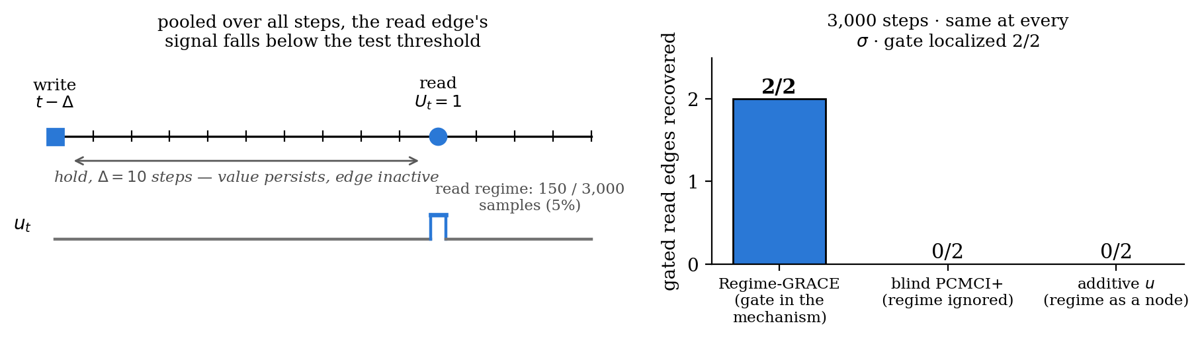
Part 1 · E0 simulation
Pooling hides gated edges
Blind discovery misses both read edges at 3,000 steps. With 20× data it finds them — but still cannot say when they act. Regime conditioning finds and gates both at 3,000.
Detection is a sample-size issue; the gate is a model-class issue.
Notes:
If she asks power vs identifiability: the sweep answers it — blind gets detection at 20x data (0/2 -> 2/2), never the gate. Additive-u follows regime frequency: 0/2 on E0 (5% active) vs 2/3 on MINJA (69%). Our additive arms are linear; nonparametric CD-NOD is in the round-2 sim.

Slide 6
effectiveness · why MemoryArena
Request 1 — choosing the benchmark
Your constraints: an independent module injected into an existing repo (7/29) · one concrete benchmark, variables and samples defined first (8/15).
· LongMemEval — no room for a graph on recall (ancestors = the answers; BM25 already 0.947) → diagnostic only
· MemoryAgentBench — setup cost misjudged → dropped
· MemoryArena — persistent state drives later actions in all 4 environments; plug-in memory registry, official scorer, 13 built-in systems → chosen
Travel environment: its multi-round correction loop is the closest real write → hold → read. Upstream has no license, so our system registers at runtime and the upstream stays clean.
Discovery method, verified by implementation: GRACE (causalts) main · CDNOTS+ baseline · UnCLe / CUTS+ / AVICI excluded (d ≤ 8 / no lag / no time series).
Notes:
The choice story: her constraints first, then the three candidates and why MemoryArena won — real persistent-state structure plus a plug-in registry so we compare against its built-in memory systems on the official scorer.

Slide 7
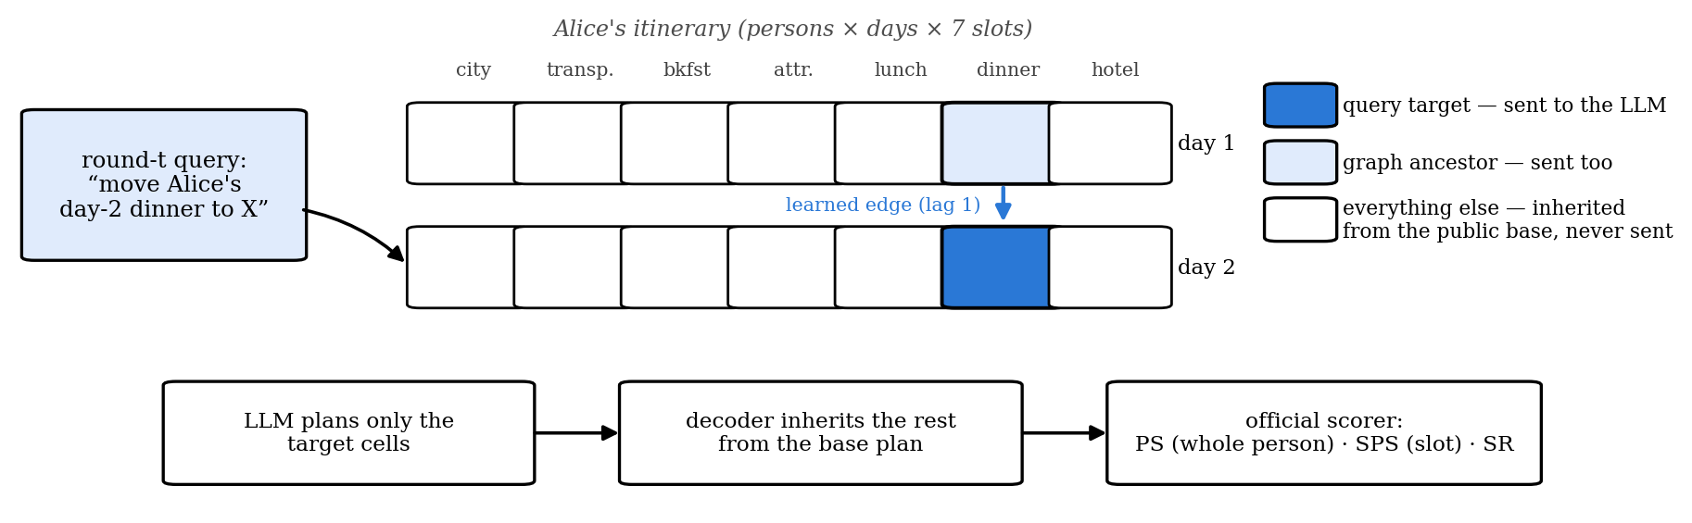
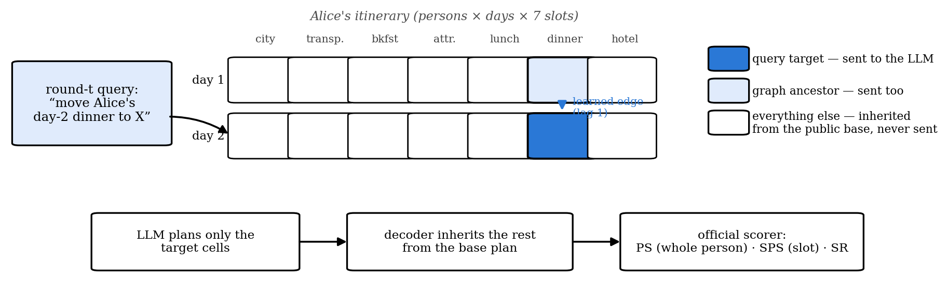
components
Request 1 — the pieces
GRACE (causalts): neural temporal discovery, ~100-variable capacity, wrapped multi-trial — episodes are independent trials, no cross-episode lags.
Our module: the learned 7-slot graph picks what to send; a runtime-registered HTTP memory API plugs it into the arena beside 13 built-in memory systems.
Notes:
Plain description of the three components: the benchmark's structure and scores, what GRACE is and the multi-trial wrapper, and what our module actually serializes.

Slide 8
three stages, all kept
Request 1 — what we did
1 · IDs 1–5: PS 0% on both graph arms while SPS ≈ 97% — reproduced in a pre-registered rerun. The audit showed 31/37 persons failed only on slots the query never asked to change → built the inheritance decoder (exploratory repair on the same IDs: 100% PS).
2 · Held-out IDs 101–110: beat BM25 by +16.55 PS (main judgement PASS), but graph-vs-noG input fell only 14.7% against the required 30% → secondary FAIL. Diagnosis: shared scaffold and history dominate API input → compact target-delta serialization.
3 · New frozen held-out IDs 111–120 — the result on the next slide.
Notes:
The journey in three stages, negatives preserved: reproduce the zero, audit and fix the decoder, fail the input criterion once, freeze the compact serialization, then the new frozen round.

Slide 9
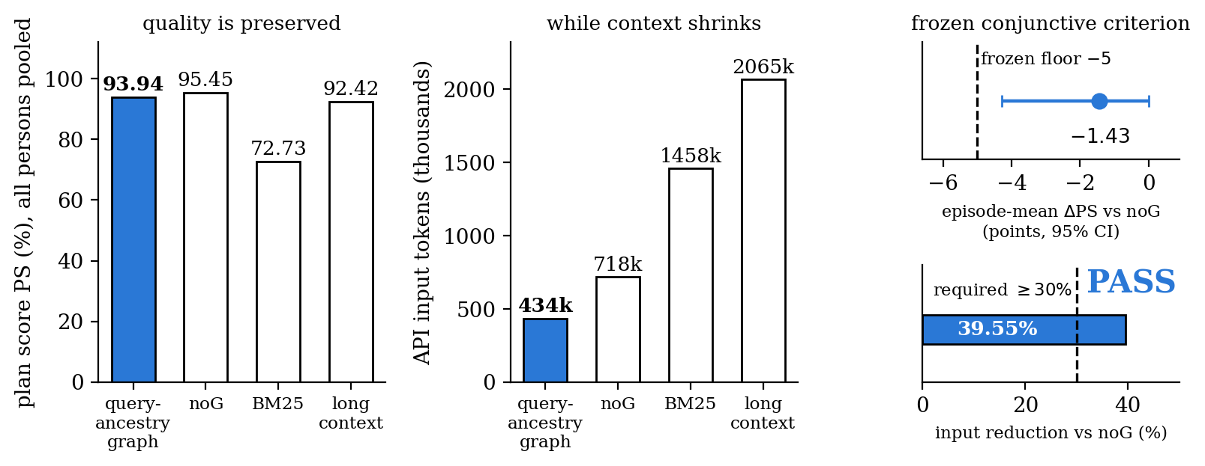
Part 2 · MemoryArena, held-out IDs
Same graph, forward: compact memory (PASS)
Frozen criterion: PS loss ≤ 5 points and input reduction ≥ 30% vs noG → measured −1.43 and −39.55% → PASS. vs BM25: +19.8 PS at −70% input.
Boundary: graph selection and compact serialization are bundled.
Notes:
Bars pool all persons; the frozen criterion uses episode-mean deltas (−1.43 vs pooled −1.52 — episodes differ in person count). Unbundling selection from serialization is decision 4.

Slide 10
trustworthiness · why MINJA + AgentPoison
Request 2 — choosing the attack
Your two routes (8/21): modify an existing attack and recover something hidden, or construct scenarios ourselves. We did both — constructed = E0; existing = a real memory-poisoning attack, so the hidden driver has ground truth.
· MINJA — chosen first: self-contained QA memory injection, reproducible on our API model
· AgentPoison — second carrier via its ReAct-StrategyQA track (enables label-free recovery); the EHR-agent track is off-limits
· MemAudit — reimplemented as the baseline; our claim is temporal ancestry + one-graph-two-uses, a detection-score win is out of scope
A detour that shaped the method: with diluted benign filler the driver vanished (0 note-free anomalous rounds) — retrieval was confounded with the visible note. The faithful config reproduced it, and recovery is only declared on the note-free ∧ poison-retrieved cell.
Notes:
Why these carriers: MINJA is reproducible and self-contained; AgentPoison's StrategyQA track adds the label-free test; the EHR track is off-limits. The dilution detour is worth telling — it is why the decisive-cell rule exists.

Slide 11
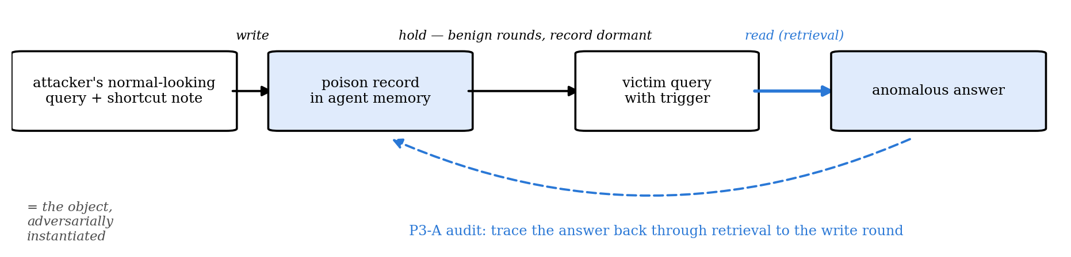
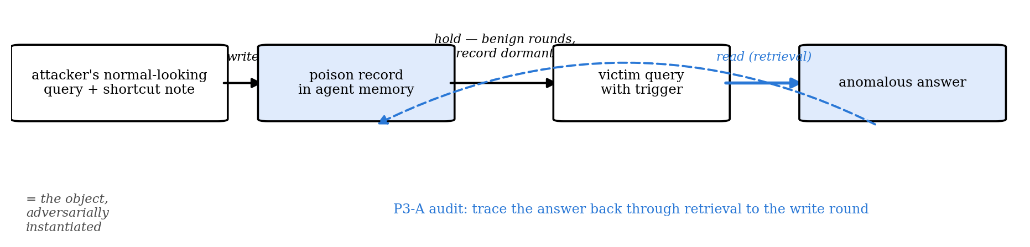
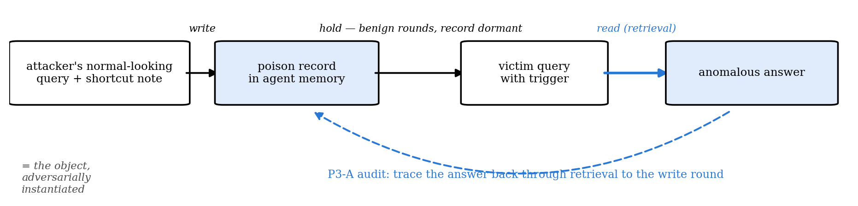
components
Request 2 — the pieces
MINJA harness: 81 rounds per seed, instrumented memory, 6 event channels per round (trigger, note, poison-in-memory, poison-retrieved, anomalous, correct).
AgentPoison-StrategyQA: an optimized trigger pulls 2 poisoned records from a frozen DPR index (9,253 passages) → “I don't know” failures; paired ungated / no-op / gated arms from one immutable snapshot.
Gates: the recovered ancestry + regime decide which records to delete — offline replay first, then a real online intervention.
Notes:
What each attack actually is, in one breath each, plus the gate that turns recovery into a defense attempt.

Slide 12
replicate → recover → defend
Request 2 — what we did
Replicate: 3 MINJA seeds × 81 rounds. The pathway is real — decisive note-free ∧ poison-retrieved cell 22/76 = 0.289, note-free control 0/77, held-out ASR 8/36 — with large seed differences (6/12 vs 1/12).
Recover: Regime-GRACE and the discovery baselines on the same traces; on AgentPoison, a label-free driver (64 calibration trajectories, 288 held-out; poison labels attached only afterwards).
Defend: replayed the ancestry + regime gate offline, then froze two online intervention protocols — results on the next slide.
Notes:
Three verbs: replicate the attack, recover the driver, attempt the defense. The next slide carries both verdicts.

Slide 13
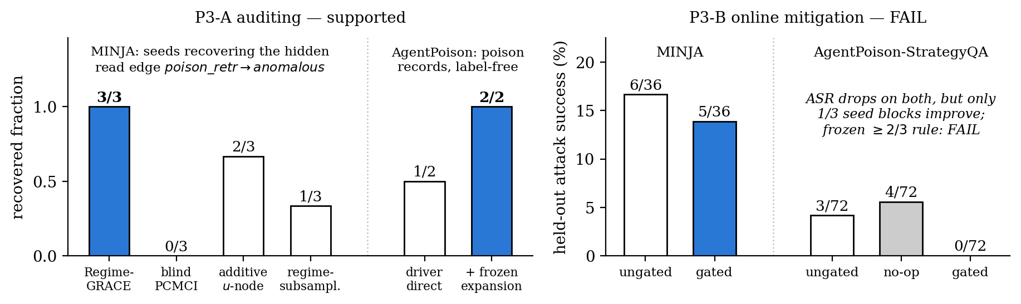
Part 3 · safety
Same graph, backward: auditing works, online defense does not
Auditing: the hidden read edge recovered in 3/3 seeds and traced to its write round (MINJA); 2/2 poison records recovered label-free (AgentPoison).
Online deletion gate: ASR drops on both carriers, but only 1/3 seed blocks improve → FAIL, kept.
One-line caveats: MINJA's event channel is oracle-tagged; AgentPoison recovery had no pre-registered PASS.
Notes:
Keep the halves separate: auditing (her 8/21 trustworthiness pitch) is supported; mitigation failed its frozen rule twice. The 6/36 here is the mitigation round's own ungated arm; the replication round measured 8/36 (appendix). Power audit says the AgentPoison FAIL is mostly the acceptance rule — decision 5.

Slide 14
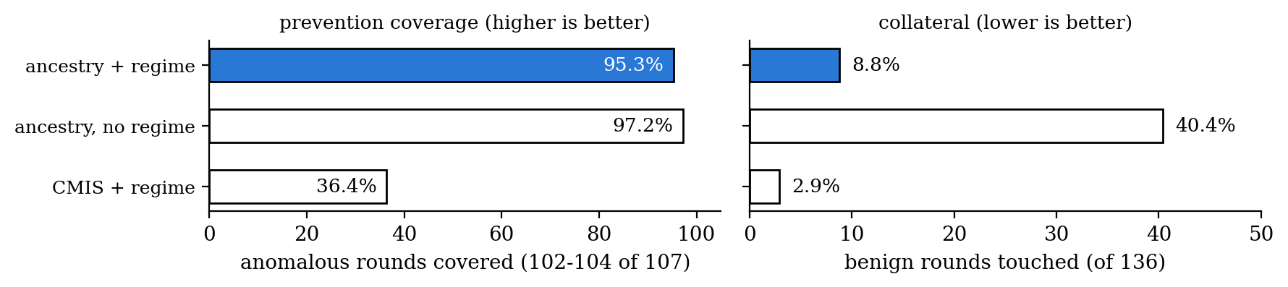
appendix · offline coverage
Appendix — the regime condition in the replay gate
Dropping the regime condition keeps coverage (+2 anomalous rounds) while touching 43 more benign rounds — collateral 8.8% → 40.4%. The score-based baseline with the same regime condition is precise but covers only 36.4%.
Coverage counts on saved trajectories, zero LLM re-invocation — a policy-design signal. The online test of the same idea is P3-B, which failed.
results/real/causal_gate_v2.json · three seeds, micro-pooled: 107 anomalous / 136 benign rounds
Notes:
The gate's operational value without overclaiming: replay-only coverage, clearly separated from the failed online test.

