Slide 1
Causal Memory
Memory = write → hold → regime-gated read (Layer 1, observed)

Slide 2
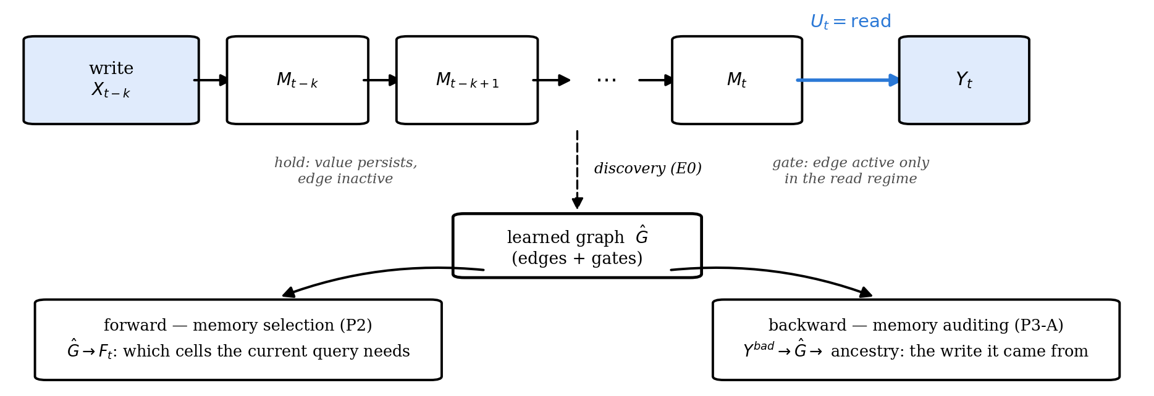
formulation: what is written, held, and later read
The same learned graph selects memory for the current query (forward) and traces a bad output to the write that caused it (backward).
Notes:
Write: A slot or record enters memory. Hold:The value persists across rounds. Read:The agent retrieves memory before acting.

Slide 3
The formulation (Layer 1)
Xₜ = (Xₜ¹ … Xₜᵈ): semantic slots, observed, Uₜ ∈ {write, hold, read}, Yₜ: output
xⱼ(t) = Σᵢ Σₗ₌₀…ᴷ [aᵢⱼₗ · gᵢⱼₗ(uₜ)] · xᵢ(t−l) + εⱼ(t)
Temporal dependencies. (l=0) captures dependencies within the same interaction step, while (l≥ 1) captures effects carried across steps. During hold, an unwritten memory slot simply persists.
Regime-dependent edges. The gate gᵢⱼₗ(uₜ) allows the same dependency to be active during write, hold, or read, rather than assuming one fixed graph across all interactions.
learn these dependencies over observable semantic states
Notes:
represent memory as observable semantic state evolving over time. The key assumption is that a dependency may only become active under a particular operation, so instead of learning one pooled graph, we estimate the structure separately by regime and identify edges whose strength changes sharply across regimes

Slide 4
The formulation (Layer 1)
How do we recover the graph?
split traces by write / hold / read;
estimate dependencies within each regime;
combine significant edges;
compare edge strengths across regimes to identify gated dependencies.

Slide 5
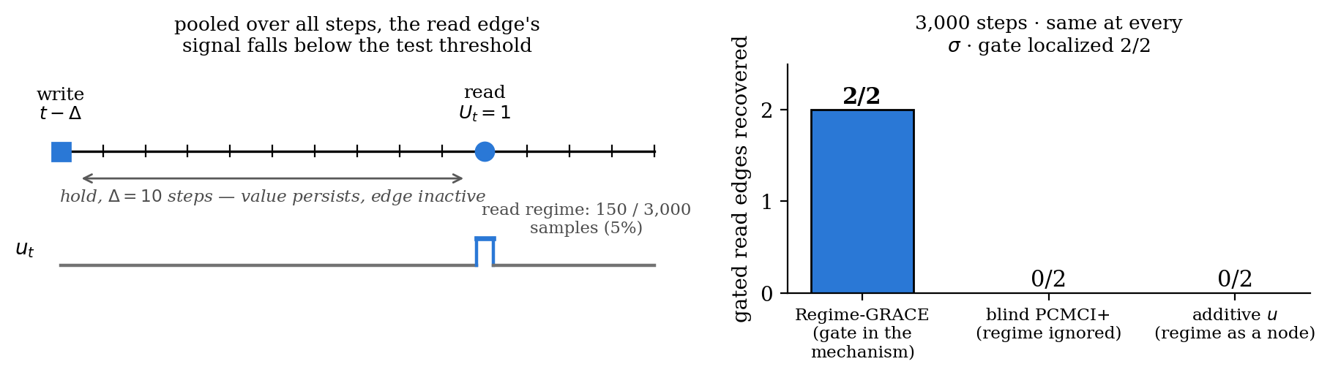
Conditioning on write / hold / read reveals dependencies that pooling misses
Blind discovery misses both read edges at 3,000 steps. With 20× data it finds them, but still cannot say when they act. Regime conditioning finds and gates both at 3,000.
Standard temporal causal discovery assumes time-invariant edges, but memory effects often activate only when read. Our regime-conditioned formulation recovers when such causal edges become active.

Slide 6
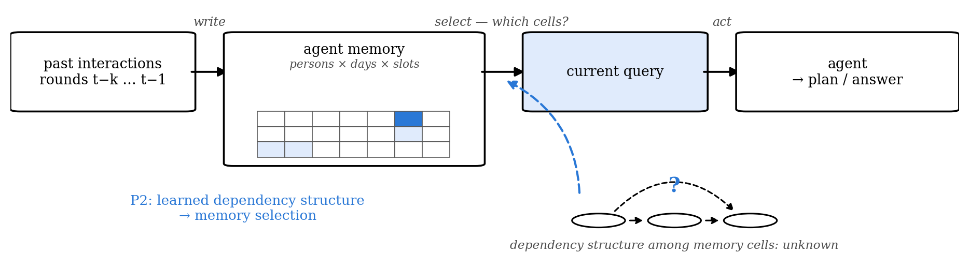
Can learned temporal structure make agent memory useful?
Memory holds many cells written over past interactions, and the current decision needs only some of them. Can a learned dependency structure tell the agent what to remember for the current decision?
Notes:
Forward use of the same learned graph from the formulation slide. In MemoryArena travel the memory is persons × days × 7 itinerary slots written round by round, and the agent must emit a complete itinerary every round, so every slot is a target whose ancestors must survive selection. This is Requirement 1 from 8/21: effectiveness on a real benchmark or agentic codebase, one or two representative setups.

Slide 7
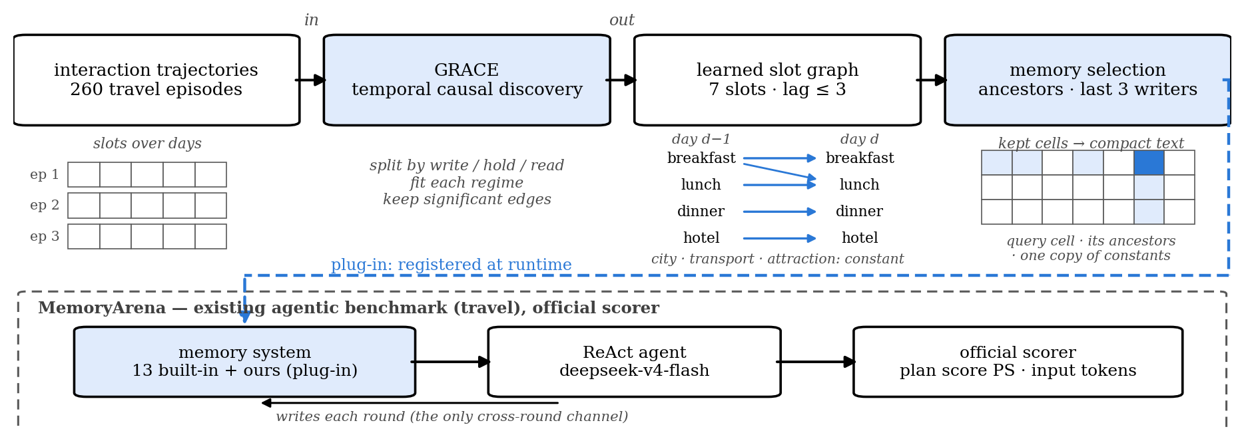
GRACE as a memory module in MemoryArena
GRACE learns temporal dependencies among the seven itinerary slots from past trajectories, and the learned ancestors decide which memory cells the current query needs. MemoryArena is an existing agentic benchmark in which stored memory is the only cross-round channel; our system registers as one more plug-in memory and is scored by the official scorer.
Notes:
GRACE (causalts) runs on per-regime multi-trial subsamples; the artifact of record is learned from the 260 episodes outside the held-out IDs (7 slot types × lag ≤ 3). Learned edges: breakfast, lunch, dinner and accommodation depend on their own earlier values at lags 1–3, and lunch on breakfast at lag 3; city, transportation and attraction are constant within a trip, so one retained copy reconstructs every round. Selection = ancestor slot types of the query's targets, the last max-lag writers, one copy of constants; then the compact target-delta serialization frozen on dev IDs 101–103. MemoryArena: persistent state drives later actions, memory is the only cross-round channel, a plug-in registry puts our system beside 13 built-in memory systems on the official scorer; upstream has no license, so we register at runtime and never vendor. Agent: ReAct on deepseek-v4-flash, 12 max steps, shared decoder, env and tools across all arms. Discovery alternatives verified by implementation: CDNOTS+ as baseline; UnCLe, CUTS+, AVICI excluded.

Slide 8
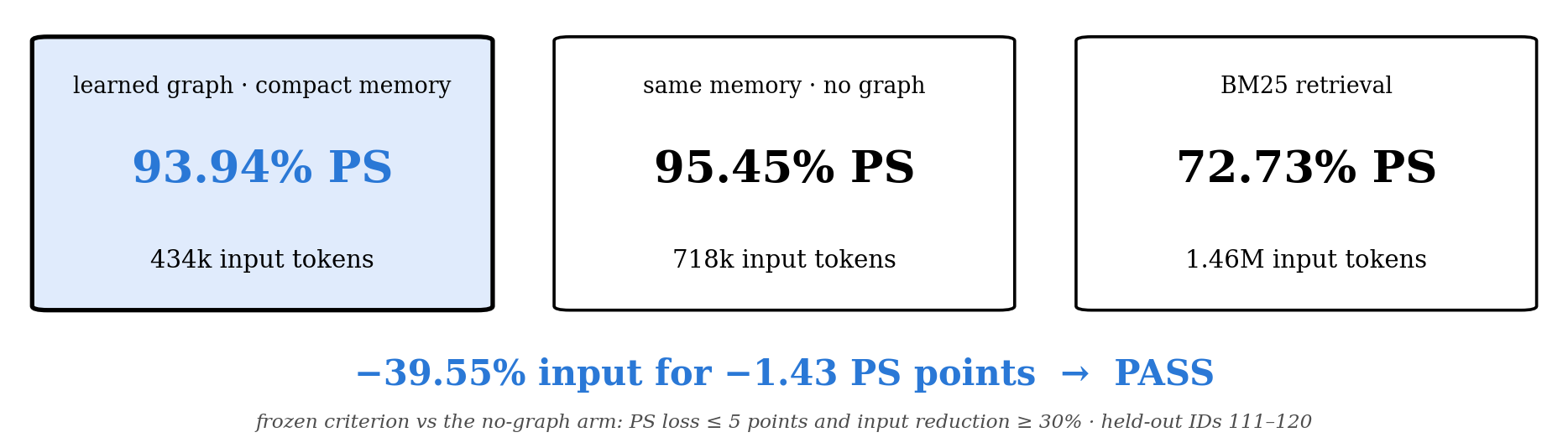
The learned graph works as a memory-selection structure
On MemoryArena Travel, the learned graph works as a memory-selection structure and passes the frozen effectiveness criterion.
Notes:
Held-out IDs 111–120; the graph was learned without them; four arms share model, decoder, steps and tools. Long context (not on the slide): 92.42% PS at 2.06M input tokens. Paired episode-mean PS: graph minus no-graph −1.43 [−4.29, 0.00], W/T/L 0/9/1; graph minus BM25 +19.80 [+10.04, +29.70]; graph minus long context +1.07 [−4.29, +7.50]. Frozen criterion: PS loss ≤ 5 points and input reduction ≥ 30% versus the no-graph arm → PASS. Boundary: graph selection and compact serialization are bundled in this arm. Earlier stages, all kept: IDs 1–5 gave PS 0% on both graph arms (strict full-plan denominator; 31/37 persons failed only on slots the query never asked to change) → the inheritance decoder; IDs 101–110 passed the main judgement against BM25 (+16.55) but cut input by only 14.7% against the frozen 30% → compact serialization → this round.

Slide 9
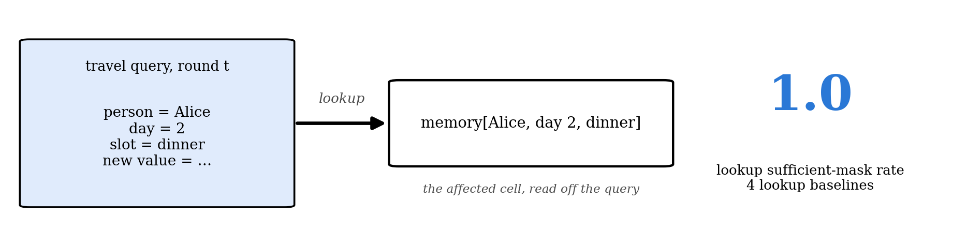
But Travel did not require discovering the dependency
The PASS shows useful structured memory and compression, but the query itself already reveals which cells matter.
Notes:
The 9/3 audit. Travel queries name person, day and slot, so memory[(person, day, slot)] = new value already reads every affected cell: four lookup baselines reach a propagation sufficient-mask rate of 1.0. So the PASS shows that structured storage and compression work; it cannot show that learned structure is needed. Two further points: the inheritance decoder tests constrained editing rather than propagation, and selection and serialization are bundled, so the token reduction is not attributable to the graph alone. The utility result stands; what is missing is attribution, so the next experiment hides the dependency.

Slide 10
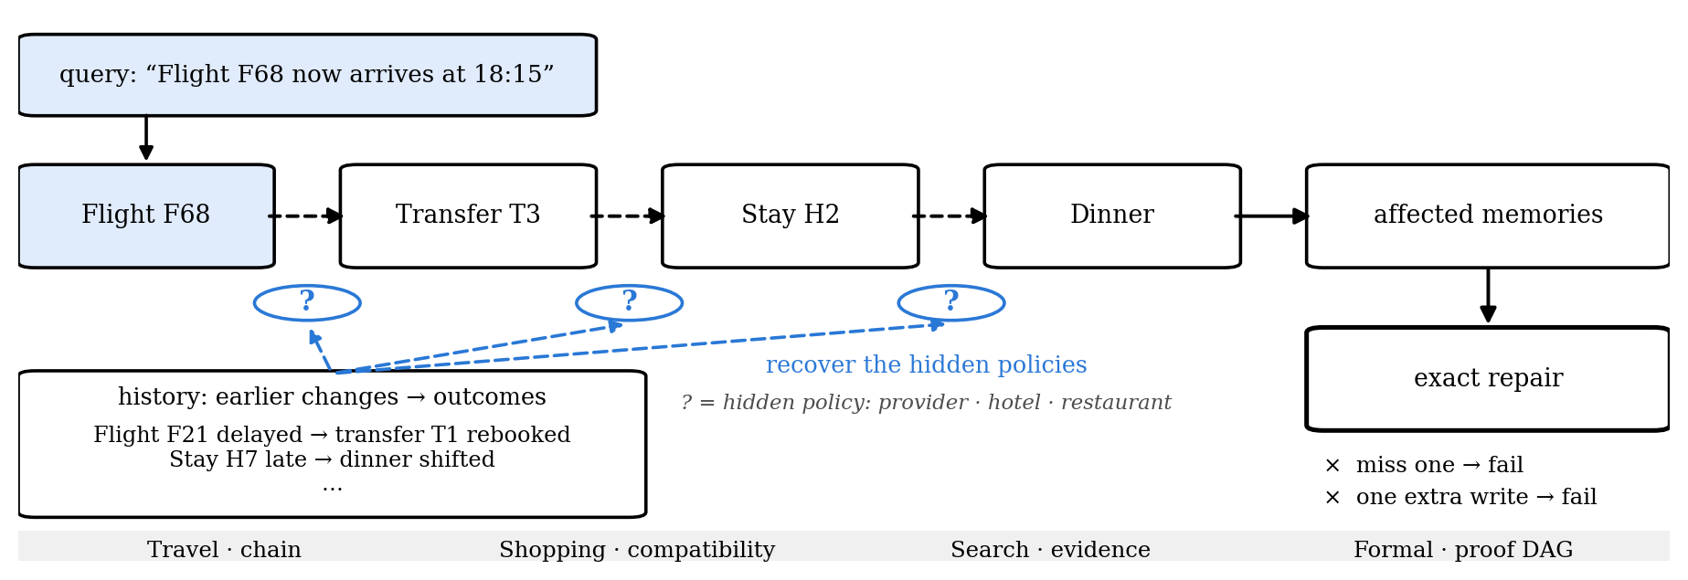
Hide the dependency and require exact repair
The query names only what changed; the dependencies must be inferred from earlier outcomes.
Notes:
Hidden Mechanism v3. An episode is (history, pre-state, intervention, oracle actions, post-state, receipt); methods see only history, pre-state and intervention. The query names the source object and its new value and nothing else (gate C1). The answer is a set of non-idempotent transactions {op, object_id, expected_revision, payload}: each write bumps the revision, consumes a change token, charges a fee and drops the price lock even when it rewrites the same value, and a stale expected_revision is illegal. Score: executable exact success = all transactions legal, post-state equals the oracle's, receipt equals the oracle's; so a missed repair and an extra write both fail (one extra idempotent write fails 180/180). Every hidden parameter is recoverable from one earlier outcome witness, never from a policy statement; the generator keeps adding earlier interventions until every parameter the oracle consults is recoverable, then adds distractor witnesses for other entities. Travel: provider auto-rebook and buffer, hotel late cutoff, restaurant shift-or-cancel, bundle linkage. Shopping: compatibility, promotion strictness, budget (v3.2 starts promotions and accessories at random so the initial state does not leak the policies). Search: trust weight per source class, de-duplication, unresolved-child policy. Formal: section shadowing, per-lemma sensitivity along a proof DAG. An eight-check zero-API gate ran on dev seeds before any test or API output.

Slide 11
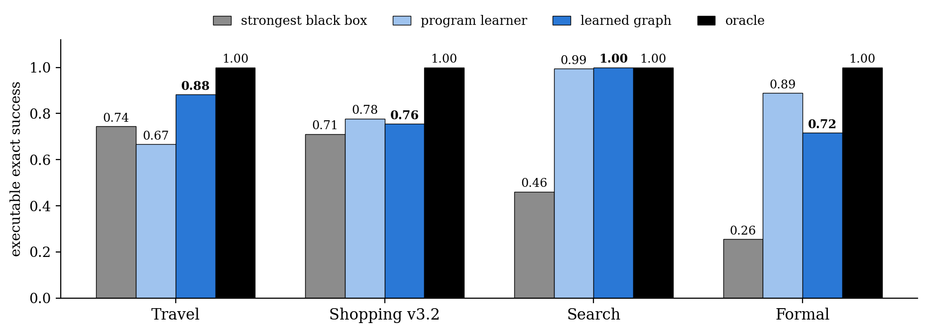
When dependencies are hidden, learned relational structure matters
The learned graph beats the strongest black-box predictor in all four environments. Its clearest advantage is Travel, where effects compose over multiple hops.
Notes:
Fresh test seeds 20–22, train 200 / eval 60 per seed, mean of three, executable exact success. Lookups, kNN and the conservative superset stay at or below 0.46 in every environment; both oracles reach 1.0. The strongest black box is the GNN with history-parsed estimates in all four. Program learner (regularised) 0.67 / 0.78 / 0.99 / 0.89; learned graph 0.88 / 0.76 / 1.00 / 0.72 on Travel / Shopping v3.2 / Search / Formal. If asked about Formal: yes, this is an important boundary. The explicit graph form is not necessary everywhere; what the data support is learned relational structure with policies read from history, and the graph's exclusive lead is the multi-hop numeric chain. LLM runtime (appendix): at about 64 episodes per cell (API rounds 3–4), graph selection with witness closure cuts input by 70–74% at an exact-success cost of 0.10–0.19 on deepseek-v4-flash; non-inferiority at the −0.10 margin is not met, and the LLM stays far below the deterministic executor.

Slide 12
Setting
 | Deterministic replication | LLM runtime
LLM | — | DeepSeek-v4-flash, T=0
Tasks | Travel · Shopping v3.2 · Search · Formal | Travel · Search
Data | train 200 / test 60 per seed, seeds 20–22 | 20 test episodes per cell (rounds 1–2); ≈ 64 per cell (rounds 3–4)
Methods | 5 killers · 4 black boxes · program learner · learned graph · 2 oracles | 5 selections × 2 serializations; round 4 adds witness closure
Metric | executable exact success | executable exact success, input tokens
Gate | 8 checks on dev seeds 0–2 before any output | same gate; API only where it passed
Cost | CPU only | 4 rounds, $32.1
Notes:
Backup: the exact settings behind the two results slides.

Slide 13
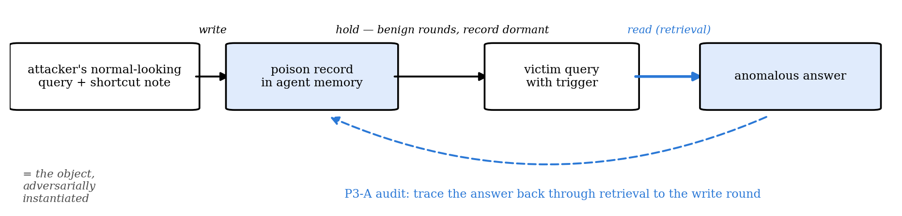
Memory poisoning gives us a hidden driver to recover
A poisoned memory record is written during a normal-looking interaction, stays dormant, and later gets retrieved by a trigger to produce a bad answer. The audit task is to trace the bad answer back to the retrieved record and its original write round.
Notes:
trustworthy part

Slide 14
Test auditing on two memory-based agents
LLM: DeepSeek-v4-flash.
The two experiments vary the memory and retrieval mechanism
MINJA
An attacker plants a shortcut note into the agent’s memory through normal interactions. Later queries retrieve memories using Levenshtein top-3 retrieval, allowing us to observe the full write → hold → read → output pathway. (a QA agent on one MMLU subject. )
We run 3 seeds × 81 rounds.
AgentPoison-StrategyQA
The frozen DPR index contains 9,253 passages, including two poisoned records. For each ReAct search, the agent retrieves the single top-ranked passage (DPR top-1); a trigger may cause one of the poisoned records to surface.
During auditing, poison labels are hidden and revealed only afterwards for evaluation.
Notes:
MemAudit is used as a detection baseline, MINJA tests full temporal ancestry, AgentPoison tests label-free record attribution under a different retrieval mechanism.

Slide 15
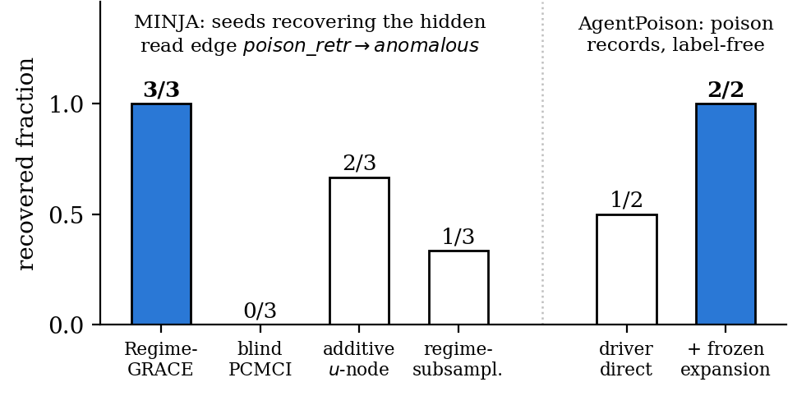
Results
MINJA:
The hidden poison-retrieved → anomalous dependency is recovered in 3/3 seeds.
Because the memory is instrumented from the time it is written, we can trace the anomalous answer through retrieval back to the original write round.
AgentPoison :
Direct temporal attribution identifies 1/2 poisoned records without using poison labels.
A pre-frozen (k=2) embedding-cluster expansion recovers 2/2.
Notes:
MINJA establishes full provenance
We can recover the dependency that drove the bad answer and trace it back through retrieval to the memory’s original write round.
AgentPoison establishes label-free attribution
The same auditing idea identifies poisoned records in a frozen retrieval index without exposing poison labels during recovery.

Slide 16
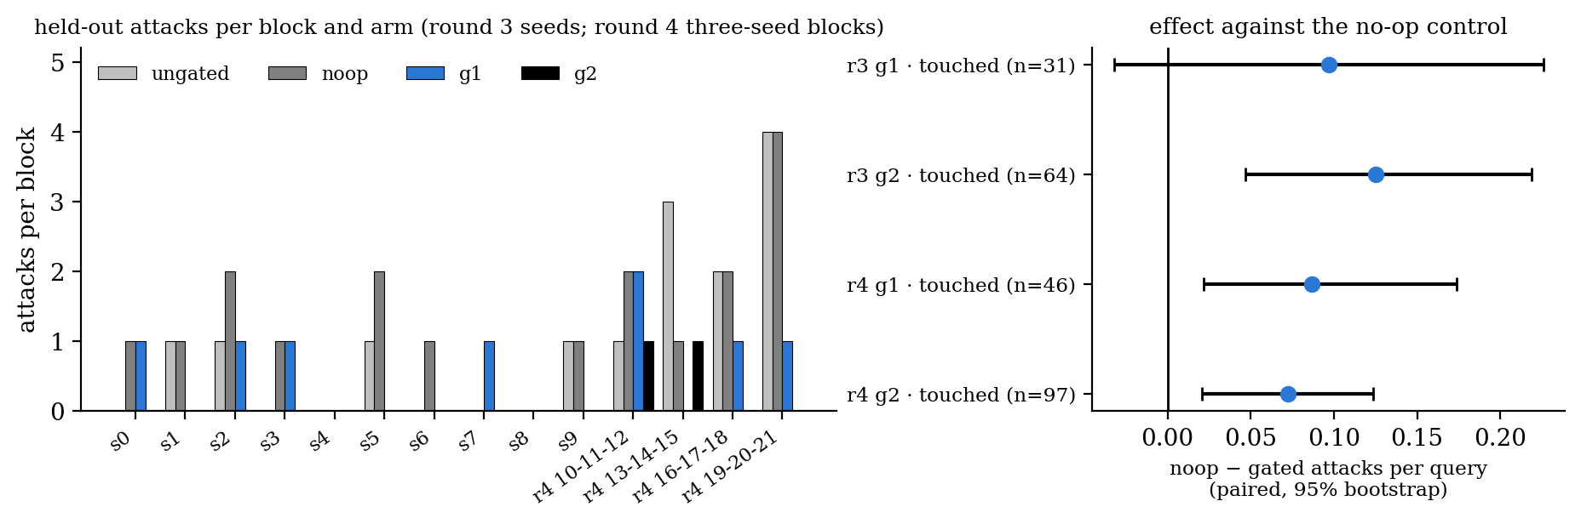
Results: online mitigation, rounds 3 and 4
MINJA, four arms from one frozen memory: ungated, no-op (noise control), g1 = implicated records plus every record written on the same question stem, g2 = g1 plus quarantine of unvetted records in the trigger regime.
Round 3 (ten 12-round blocks): attack rate ungated 0.03, no-op 0.07, g1 0.03, g2 0.00; paired effect against no-op on touched queries g1 +0.10 [-0.03, +0.23], n = 31, g2 +0.12 [+0.05, +0.22], n = 64; frozen judgement g1 FAIL, g2 FAIL: no block reached the evaluability floor at this base rate.
Round 4 (fresh seeds, four three-seed blocks): ungated 0.07, no-op 0.06, g1 0.03, g2 0.01; g1 +0.09 [+0.02, +0.17], n = 46, g2 +0.07 [+0.02, +0.12], n = 97; evaluable blocks 4 of 4; frozen judgement g1 PASS, g2 PASS.
Notes:
The no-op arm is the noise control: same memory, same pipeline, nothing deleted. The paired difference against it is the effect of the deletion policy itself. AgentPoison round 3 is blocked here by network access to the dev split and the encoder.

Slide 17
Setting
 | MINJA-QA | AgentPoison
LLM | DeepSeek-v4-flash | DeepSeek-v4-flash
Decoding | T=0.5, top-p=1 | T=0, top-p=1
Agent | QA + episodic memory | 7-step ReAct
Retrieval | Levenshtein top-3 | DPR top-1
Memory | online written memory | frozen 9,253-passage index
Audit evidence | 3 × 81 rounds | 64 calibration + held-out trajectories
Main purpose | full write→read provenance | label-free record attribution

Slide 18
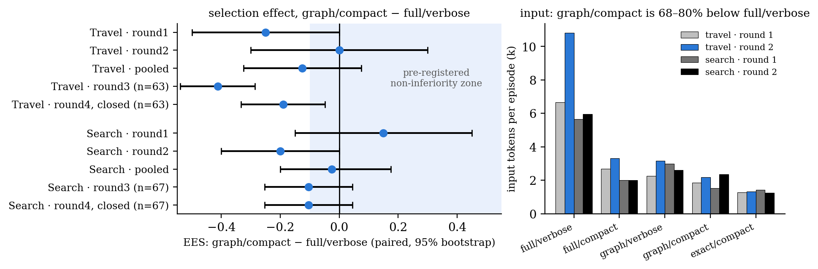
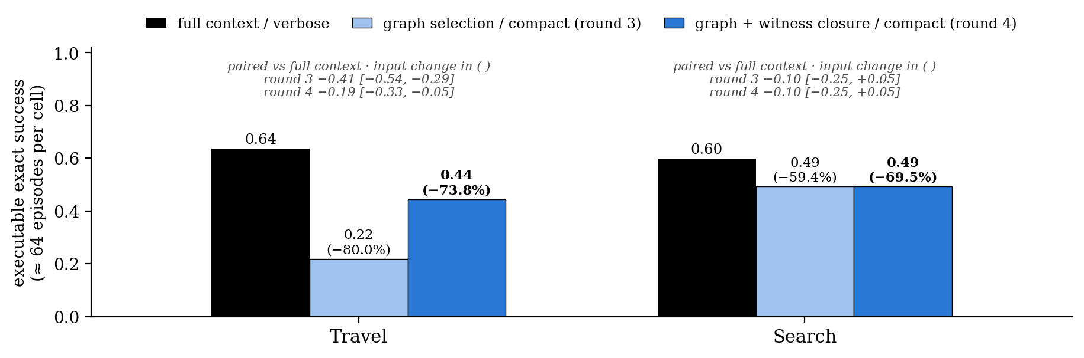
Appendix — the LLM runtime: selection × serialization
Selection × serialization; 20 episodes per cell in rounds 1–2, 63–69 per main cell in rounds 3–4:
Graph selection needs 70–80% less input than the full context in every round. At 20 episodes per cell the two rounds gave opposite verdicts; at 64 the picture is stable.
Round 4 (graph selection closed over the objects its witnesses name): Travel 0.44 against full context 0.63, paired -0.19 [-0.33, -0.05]; Search 0.49 against 0.60, -0.10 [-0.25, +0.04]. The closure recovered half of Travel's gap; the rest is the runtime's use of a minimal evidence set. The best LLM cell stays far below the deterministic graph.
Notes:
Backup for the P2 result slide. Rounds 1–2 (20 episodes per cell) were inconclusive: the paired intervals crossed zero and the pre-registered point rule flipped between rounds. Round 3 re-ran the four main cells with prompt v2 at 80 episodes per cell and hit its pre-declared $12 cap at 527 cells (63–69 per cell). Round 4 ($6.41, pre-registered) closed the graph selection: the graph's reads plus the objects its witness records name and their neighbours, because in 33 of 38 failing Travel episodes the witness records named objects absent from the selected state. The closure recovered half of Travel's gap (+0.234 [+0.094, +0.359] over the open selection). Verdict at this sample size: graph selection cuts input by 70–74% at an exact-success cost of 0.10–0.19; non-inferiority at −0.10 is not met. The deterministic graph reaches 0.86 (Travel) and 0.99 (Search) on the same tasks, so the runtime is the bottleneck. Total P2 API spend across four rounds: $32.1.

