Slide 1
Causal Memory
Memory = write → hold → regime-gated read (Layer 1, observed)

Slide 2
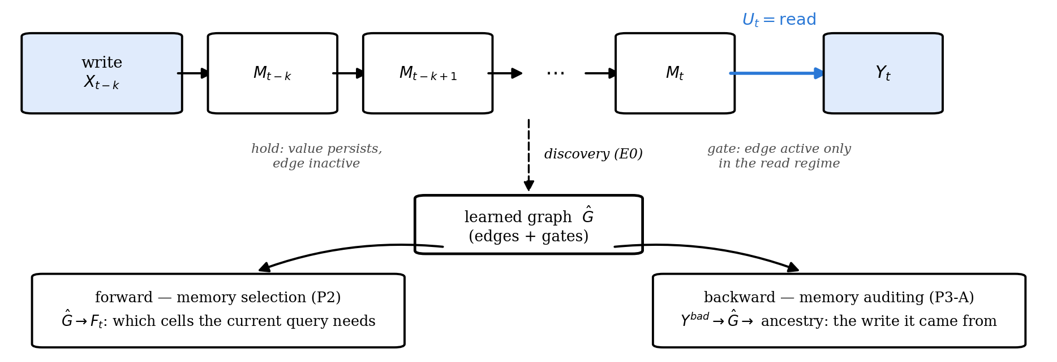
formulation: what is written, held, and later read
The same learned graph selects memory for the current query (forward) and traces a bad output to the write that caused it (backward).
Notes:
Write: A slot or record enters memory. Hold:The value persists across rounds. Read:The agent retrieves memory before acting.

Slide 3
The formulation (Layer 1)
Xₜ = (Xₜ¹ … Xₜᵈ): semantic slots, observed, Uₜ ∈ {write, hold, read}, Yₜ: output
xⱼ(t) = Σᵢ Σₗ₌₀…ᴷ [aᵢⱼₗ · gᵢⱼₗ(uₜ)] · xᵢ(t−l) + εⱼ(t)
Temporal dependencies. (l=0) captures dependencies within the same interaction step, while (l≥ 1) captures effects carried across steps. During hold, an unwritten memory slot simply persists.
Regime-dependent edges. The gate gᵢⱼₗ(uₜ) allows the same dependency to be active during write, hold, or read, rather than assuming one fixed graph across all interactions.
learn these dependencies over observable semantic states
Notes:
represent memory as observable semantic state evolving over time. The key assumption is that a dependency may only become active under a particular operation, so instead of learning one pooled graph, we estimate the structure separately by regime and identify edges whose strength changes sharply across regimes

Slide 4
The formulation (Layer 1)
How do we recover the graph?
split traces by write / hold / read;
estimate dependencies within each regime;
combine significant edges;
compare edge strengths across regimes to identify gated dependencies.

Slide 5
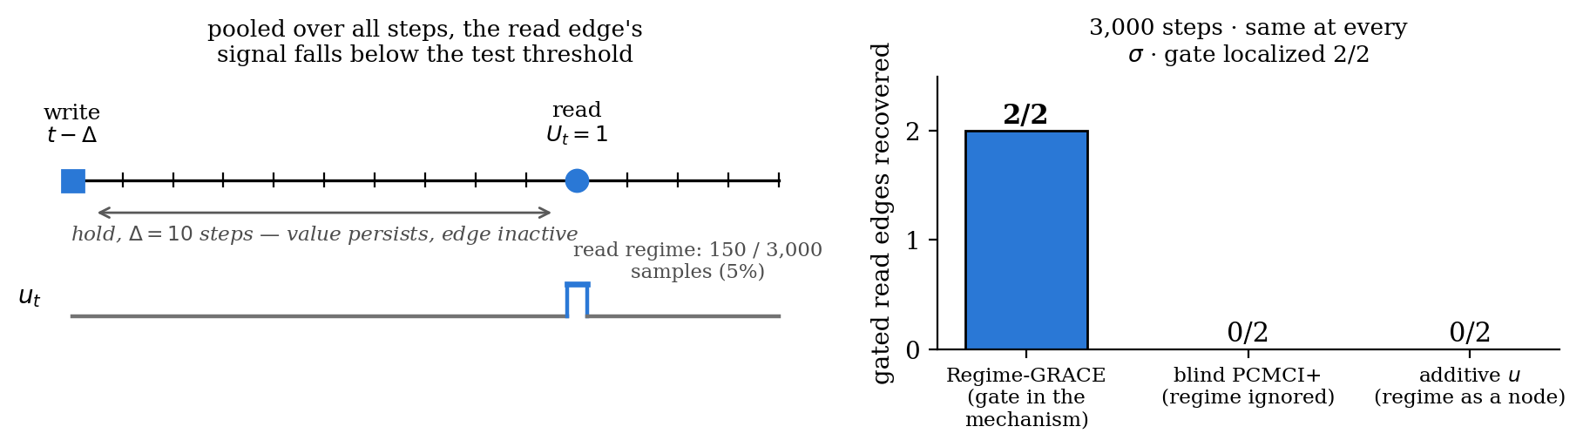
Conditioning on write / hold / read reveals dependencies that pooling misses
Blind discovery misses both read edges at 3,000 steps. With 20× data it finds them, but still cannot say when they act. Regime conditioning finds and gates both at 3,000.
Standard temporal causal discovery assumes time-invariant edges, but memory effects often activate only when read. Our regime-conditioned formulation recovers when such causal edges become active.

Slide 6
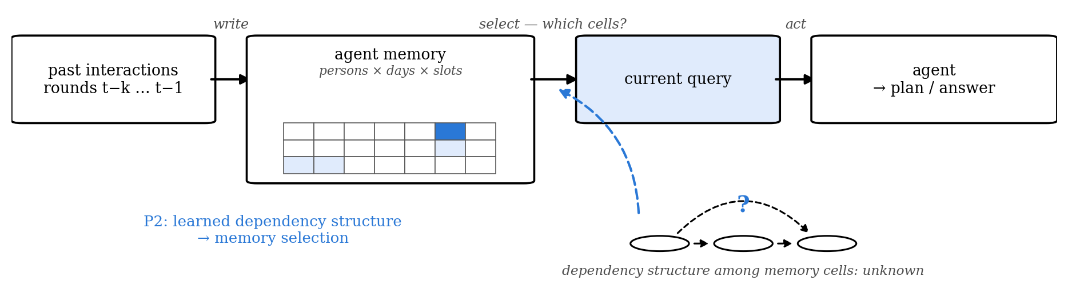
Can learned temporal structure make agent memory useful?
Memory holds many cells written over past interactions, and the current decision needs only some of them. Can a learned dependency structure tell the agent what to remember for the current decision?
Notes:
Forward use of the same learned graph from the formulation slide. In MemoryArena travel the memory is persons × days × 7 itinerary slots written round by round, and the agent must emit a complete itinerary every round, so every slot is a target whose ancestors must survive selection. This is Requirement 1 from 8/21: effectiveness on a real benchmark or agentic codebase, one or two representative setups.

Slide 7
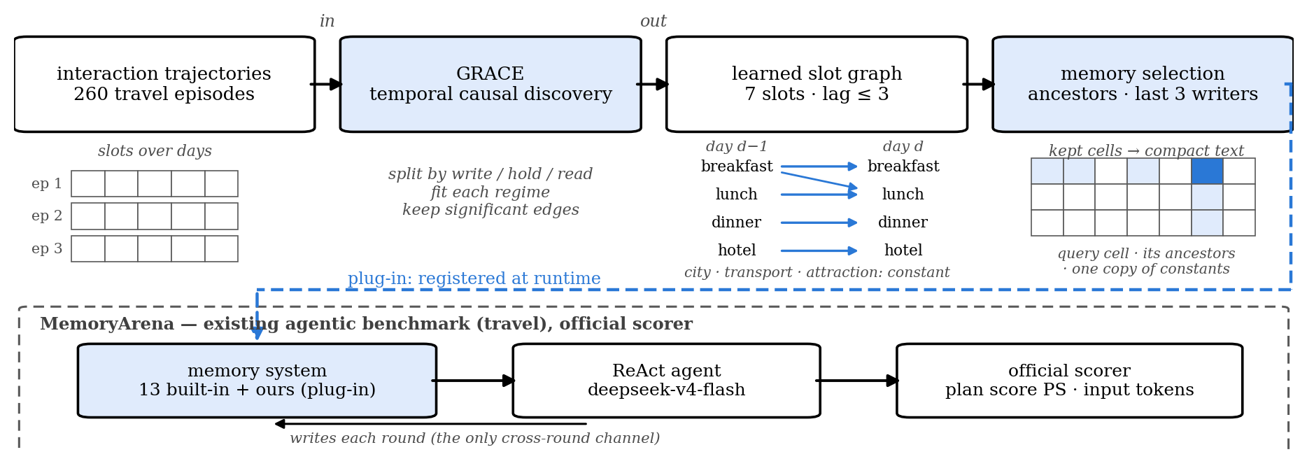
GRACE as a memory module in MemoryArena
GRACE learns temporal dependencies among the seven itinerary slots from past trajectories, and the learned ancestors decide which memory cells the current query needs. MemoryArena is an existing agentic benchmark in which stored memory is the only cross-round channel; our system registers as one more plug-in memory and is scored by the official scorer.
Notes:
GRACE (causalts) runs on per-regime multi-trial subsamples; the artifact of record is learned from the 260 episodes outside the held-out IDs (7 slot types × lag ≤ 3). Learned edges: breakfast, lunch, dinner and accommodation depend on their own earlier values at lags 1–3, and lunch on breakfast at lag 3; city, transportation and attraction are constant within a trip, so one retained copy reconstructs every round. Selection = ancestor slot types of the query's targets, the last max-lag writers, one copy of constants; then the compact target-delta serialization frozen on dev IDs 101–103. MemoryArena: persistent state drives later actions, memory is the only cross-round channel, a plug-in registry puts our system beside 13 built-in memory systems on the official scorer; upstream has no license, so we register at runtime and never vendor. Agent: ReAct on deepseek-v4-flash, 12 max steps, shared decoder, env and tools across all arms. Discovery alternatives verified by implementation: CDNOTS+ as baseline; UnCLe, CUTS+, AVICI excluded.

Slide 8
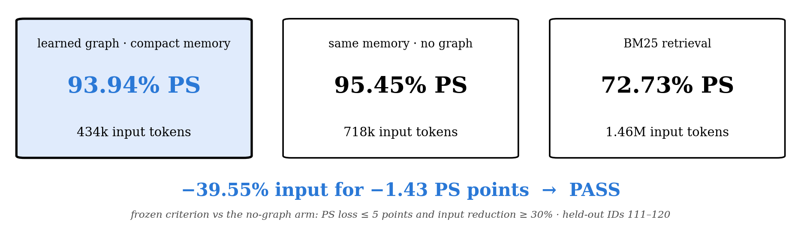
The learned graph works as a memory-selection structure
On MemoryArena Travel, the learned graph works as a memory-selection structure and passes the frozen effectiveness criterion.
Notes:
Held-out IDs 111–120; the graph was learned without them; four arms share model, decoder, steps and tools. Long context (not on the slide): 92.42% PS at 2.06M input tokens. Paired episode-mean PS: graph minus no-graph −1.43 [−4.29, 0.00], W/T/L 0/9/1; graph minus BM25 +19.80 [+10.04, +29.70]; graph minus long context +1.07 [−4.29, +7.50]. Frozen criterion: PS loss ≤ 5 points and input reduction ≥ 30% versus the no-graph arm → PASS. Boundary: graph selection and compact serialization are bundled in this arm. Earlier stages, all kept: IDs 1–5 gave PS 0% on both graph arms (strict full-plan denominator; 31/37 persons failed only on slots the query never asked to change) → the inheritance decoder; IDs 101–110 passed the main judgement against BM25 (+16.55) but cut input by only 14.7% against the frozen 30% → compact serialization → this round.

Slide 9
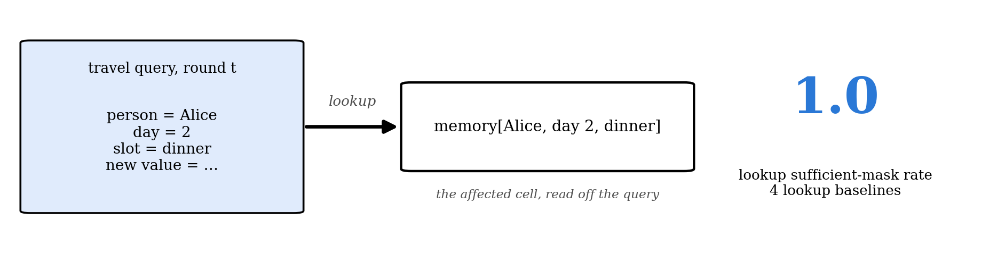
But Travel did not require discovering the dependency
The PASS shows useful structured memory and compression, but the query itself already reveals which cells matter.
Notes:
The 9/3 audit. Travel queries name person, day and slot, so memory[(person, day, slot)] = new value already reads every affected cell: four lookup baselines reach a propagation sufficient-mask rate of 1.0. So the PASS shows that structured storage and compression work; it cannot show that learned structure is needed. Two further points: the inheritance decoder tests constrained editing rather than propagation, and selection and serialization are bundled, so the token reduction is not attributable to the graph alone. The utility result stands; what is missing is attribution, so the next experiment hides the dependency.

Slide 10
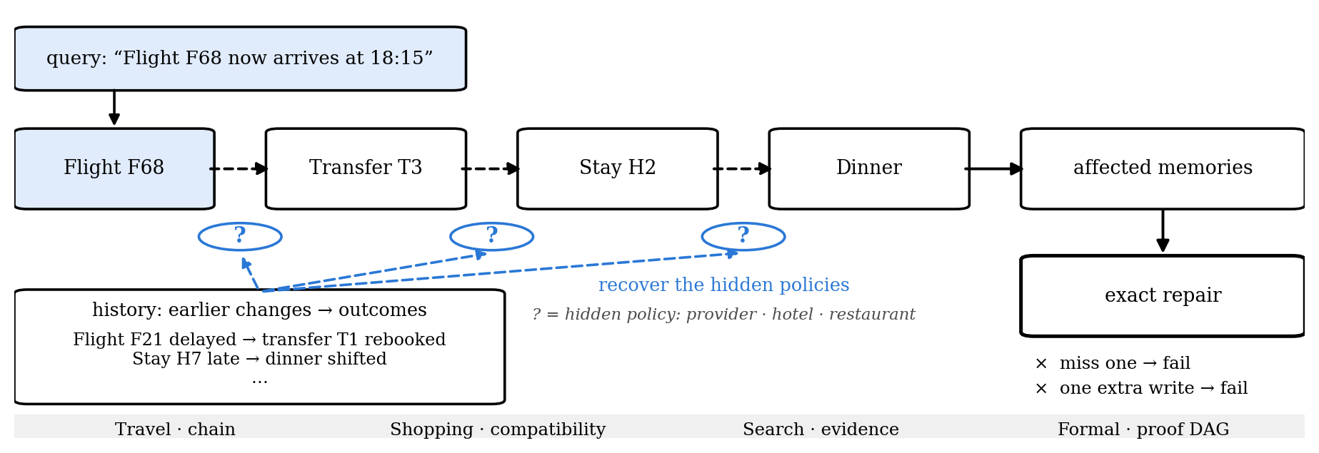
Hide the dependency and require exact repair
The query names only what changed; the dependencies must be inferred from earlier outcomes.
Notes:
Hidden Mechanism v3. An episode is (history, pre-state, intervention, oracle actions, post-state, receipt); methods see only history, pre-state and intervention. The query names the source object and its new value and nothing else (gate C1). The answer is a set of non-idempotent transactions {op, object_id, expected_revision, payload}: each write bumps the revision, consumes a change token, charges a fee and drops the price lock even when it rewrites the same value, and a stale expected_revision is illegal. Score: executable exact success = all transactions legal, post-state equals the oracle's, receipt equals the oracle's; so a missed repair and an extra write both fail (one extra idempotent write fails 180/180). Every hidden parameter is recoverable from one earlier outcome witness, never from a policy statement; the generator keeps adding earlier interventions until every parameter the oracle consults is recoverable, then adds distractor witnesses for other entities. Travel: provider auto-rebook and buffer, hotel late cutoff, restaurant shift-or-cancel, bundle linkage. Shopping: compatibility, promotion strictness, budget (v3.2 starts promotions and accessories at random so the initial state does not leak the policies). Search: trust weight per source class, de-duplication, unresolved-child policy. Formal: section shadowing, per-lemma sensitivity along a proof DAG. An eight-check zero-API gate ran on dev seeds before any test or API output.

Slide 11
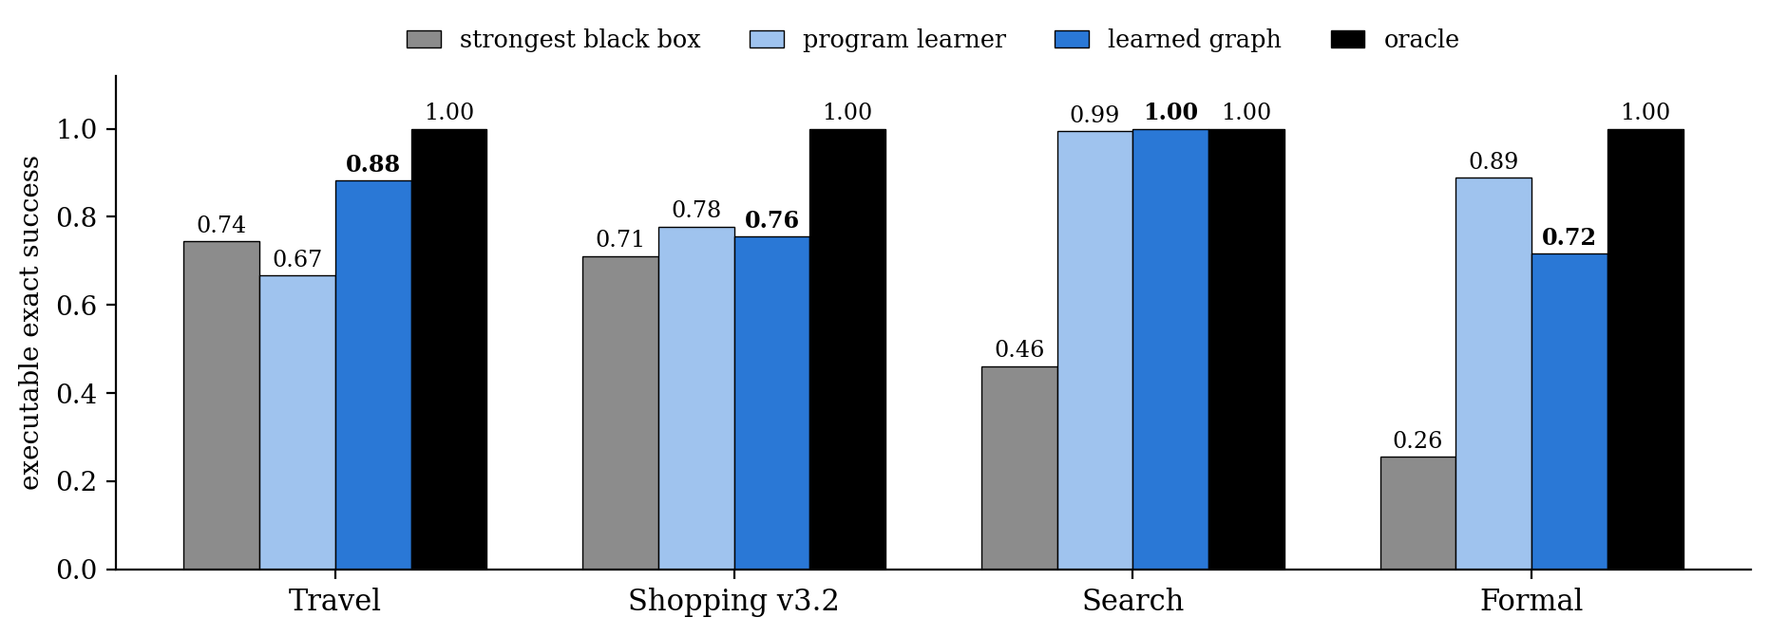
When dependencies are hidden, learned relational structure matters
The learned graph beats the strongest black-box predictor in all four environments. Its clearest advantage is Travel, where effects compose over multiple hops.
Notes:
Fresh test seeds 20–22, train 200 / eval 60 per seed, mean of three, executable exact success. Lookups, kNN and the conservative superset stay at or below 0.46 in every environment; both oracles reach 1.0. The strongest black box is the GNN with history-parsed estimates in all four. Program learner (regularised) 0.67 / 0.78 / 0.99 / 0.89; learned graph 0.88 / 0.76 / 1.00 / 0.72 on Travel / Shopping v3.2 / Search / Formal. If asked about Formal: yes, this is an important boundary. The explicit graph form is not necessary everywhere; what the data support is learned relational structure with policies read from history, and the graph's exclusive lead is the multi-hop numeric chain. LLM runtime (appendix): at about 64 episodes per cell (API rounds 3–4), graph selection with witness closure cuts input by 70–74% at an exact-success cost of 0.10–0.19 on deepseek-v4-flash; non-inferiority at the −0.10 margin is not met, and the LLM stays far below the deterministic executor.

Slide 12
Setting
 | Deterministic replication | LLM runtime
LLM | — | DeepSeek-v4-flash, T=0
Tasks | Travel · Shopping v3.2 · Search · Formal | Travel · Search
Data | train 200 / test 60 per seed, seeds 20–22 | 20 test episodes per cell (rounds 1–2); ≈ 64 per cell (rounds 3–4)
Methods | 5 killers · 4 black boxes · program learner · learned graph · 2 oracles | 5 selections × 2 serializations; round 4 adds witness closure
Metric | executable exact success | executable exact success, input tokens
Gate | 8 checks on dev seeds 0–2 before any output | same gate; API only where it passed
Cost | CPU only | 4 rounds, $32.1
Notes:
Backup: the exact settings behind the two results slides.

Slide 13
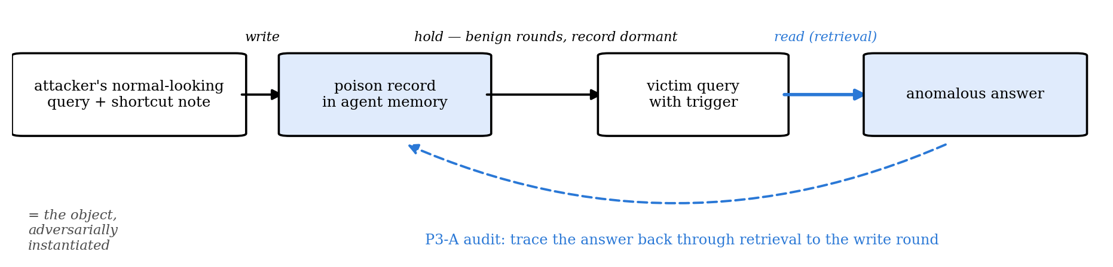
Memory poisoning gives us a hidden driver to recover
A poisoned memory record is written during a normal-looking interaction, stays dormant, and later gets retrieved by a trigger to produce a bad answer. The audit task is to trace the bad answer back to the retrieved record and its original write round.
Notes:
trustworthy part

Slide 14
Test auditing on two memory-based agents
LLM: DeepSeek-v4-flash.
The two experiments vary the memory and retrieval mechanism
MINJA
An attacker plants a shortcut note into the agent’s memory through normal interactions. Later queries retrieve memories using Levenshtein top-3 retrieval, allowing us to observe the full write → hold → read → output pathway. (a QA agent on one MMLU subject. )
We run 3 seeds × 81 rounds.
AgentPoison-StrategyQA
The frozen DPR index contains 9,253 passages, including two poisoned records. For each ReAct search, the agent retrieves the single top-ranked passage (DPR top-1); a trigger may cause one of the poisoned records to surface.
During auditing, poison labels are hidden and revealed only afterwards for evaluation.
Notes:
MemAudit is used as a detection baseline, MINJA tests full temporal ancestry, AgentPoison tests label-free record attribution under a different retrieval mechanism.

Slide 15
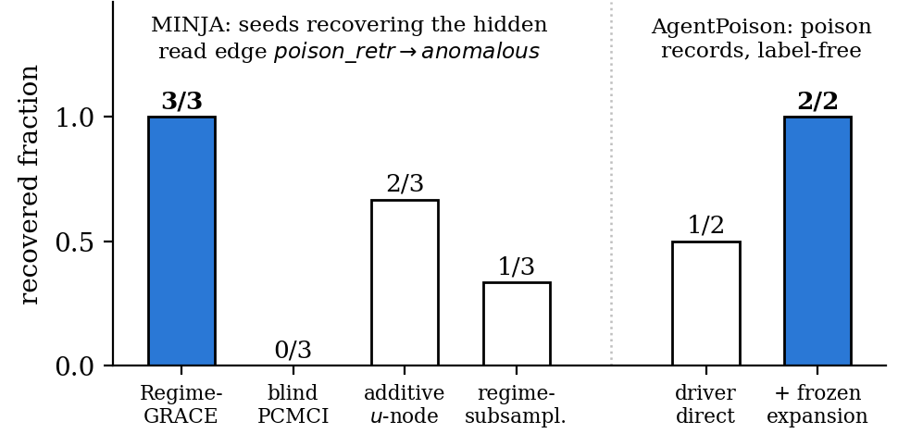
Results
MINJA:
The hidden poison-retrieved → anomalous dependency is recovered in 3/3 seeds.
Because the memory is instrumented from the time it is written, we can trace the anomalous answer through retrieval back to the original write round.
AgentPoison :
Direct temporal attribution identifies 1/2 poisoned records without using poison labels.
A pre-frozen (k=2) embedding-cluster expansion recovers 2/2.
Notes:
MINJA establishes full provenance
We can recover the dependency that drove the bad answer and trace it back through retrieval to the memory’s original write round.
AgentPoison establishes label-free attribution
The same auditing idea identifies poisoned records in a frozen retrieval index without exposing poison labels during recovery.

Slide 16
Test online mitigation with a no-op control
LLM: DeepSeek-v4-flash, the MINJA carrier from the auditing experiment.
The gate turns the recovered ancestry into a deletion policy and is tested on new LLM calls
Calibration
Earlier rounds are scored without poison labels: a record is implicated when it was retrieved in trigger rounds that ended in an anomalous answer. Round 2 deleted only those records, and about half of the memory was never retrieved during calibration, so unscored poison records survived.
Two deletion policies
g1 adds every record written on the same question stem as an implicated one (the attack appends escalating notes to one stem). g2 adds a quarantine: in the trigger regime, records that calibration never vetted are withheld as well.
Four arms from one frozen memory
Each held-out query is answered by the ungated memory, by a no-op arm with an empty deletion set, by g1 and by g2, in a fixed random order. The no-op arm is the noise control: independent calls flip answers on their own, so every effect is measured paired against it. Round 3: ten seeds × 12 rounds. Round 4: fresh seeds 10–21 in four three-seed blocks, frozen before its first call; a block counts when its gate-free arms hold at least three attacks.
Notes:
Same shape as the auditing setup slide. The one idea to land: the effect is measured against a no-op arm on the same frozen memory, because paired LLM calls flip answers without any intervention (the ungated and no-op arms disagree on 6-9% of rounds). Round 4's block design was frozen after an interim look at five round-3 seeds and is disclosed in the protocol.

Slide 17
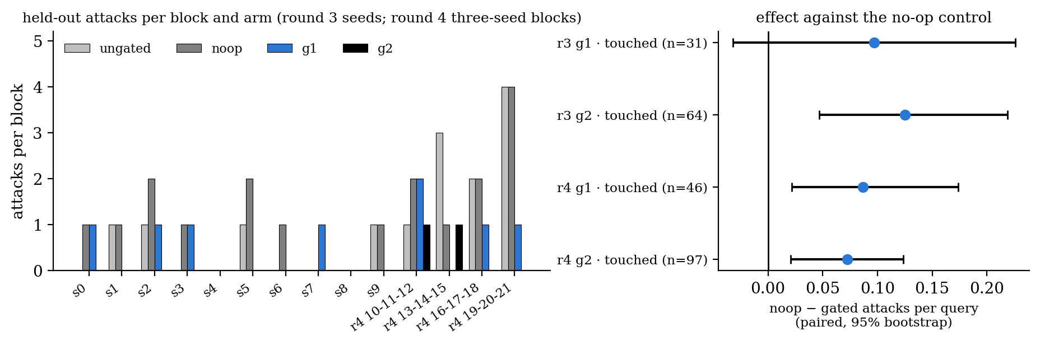
Deleting the recovered ancestry and its same-stem records mitigates the attack
On fresh seeds the gate removes about half of the attacks (g1) to four fifths (g2) that the same memory produces under the no-op control, with no loss of normal-answer accuracy, and passes the pre-registered judgement in 3 of 4 blocks for each policy.
Notes:
Round 3 (ten 12-round blocks): attacks per 120 rounds ungated 4, no-op 9, g1 4, g2 0; accuracy g2 0.89; paired against no-op on touched queries g1 +0.097 [-0.032, +0.226], n = 31, g2 +0.125 [+0.047, +0.219], n = 64; frozen judgement FAIL for both because the base attack rate (3-8%) leaves no 12-round block above the evaluability floor. Round 4 (seeds 10-21, four three-seed blocks, all evaluable): attacks per 144 rounds ungated 10, no-op 9, g1 4, g2 2; accuracy 0.83 / 0.80 / 0.85 / 0.87; g1 +0.087 [+0.022, +0.174], n = 46, g2 +0.072 [+0.021, +0.124], n = 97; 3 of 4 blocks improve under each -> PASS for both. Pooled 22 seeds (descriptive): g1 +0.091 [+0.026, +0.169], n = 77, g2 +0.093 [+0.050, +0.143], n = 161. Boundaries: one carrier and one model; the attack is rare against this model, so absolute effects are small; mitigation evidence does not upgrade P3-A's recovery evidence; rounds 2 and 3 stay recorded as FAIL. AgentPoison round 3 is blocked here (no network path to the dev split or the DPR encoder).

Slide 18
Setting
 | MINJA-QA | AgentPoison
LLM | DeepSeek-v4-flash | DeepSeek-v4-flash
Decoding | T=0.5, top-p=1 | T=0, top-p=1
Agent | QA + episodic memory | 7-step ReAct
Retrieval | Levenshtein top-3 | DPR top-1
Memory | online written memory | frozen 9,253-passage index
Audit evidence | 3 × 81 rounds | 64 calibration + held-out trajectories
Main purpose | full write→read provenance | label-free record attribution

Slide 19
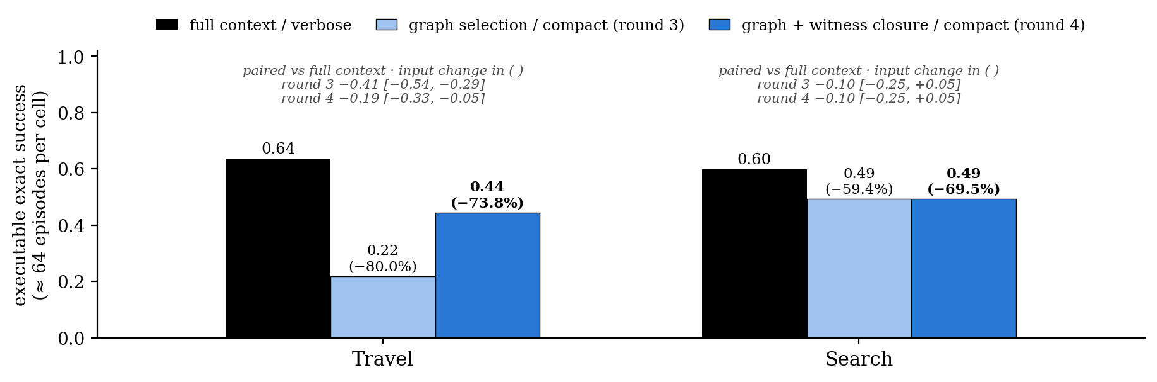
Appendix — the LLM runtime: selection × serialization
At about 64 episodes per cell, graph selection with witness closure cuts LLM input by 70–74% at an exact-success cost of 0.10–0.19 on deepseek-v4-flash; non-inferiority at the −0.10 margin is not met. The LLM stays far below the deterministic graph on the same tasks.
Notes:
Backup for the P2 result slide. Rounds 1–2 (20 episodes per cell) were inconclusive: the paired intervals crossed zero and the pre-registered point rule flipped between rounds. Round 3 re-ran the four main cells with prompt v2 at 80 episodes per cell and hit its pre-declared $12 cap at 527 cells (63–69 per cell). Round 4 ($6.41, pre-registered) closed the graph selection: the graph's reads plus the objects its witness records name and their neighbours, because in 33 of 38 failing Travel episodes the witness records named objects absent from the selected state. The closure recovered half of Travel's gap (+0.234 [+0.094, +0.359] over the open selection). Verdict at this sample size: graph selection cuts input by 70–74% at an exact-success cost of 0.10–0.19; non-inferiority at −0.10 is not met. The deterministic graph reaches 0.86 (Travel) and 0.99 (Search) on the same tasks, so the runtime is the bottleneck. Total P2 API spend across four rounds: $32.1.

Slide 20
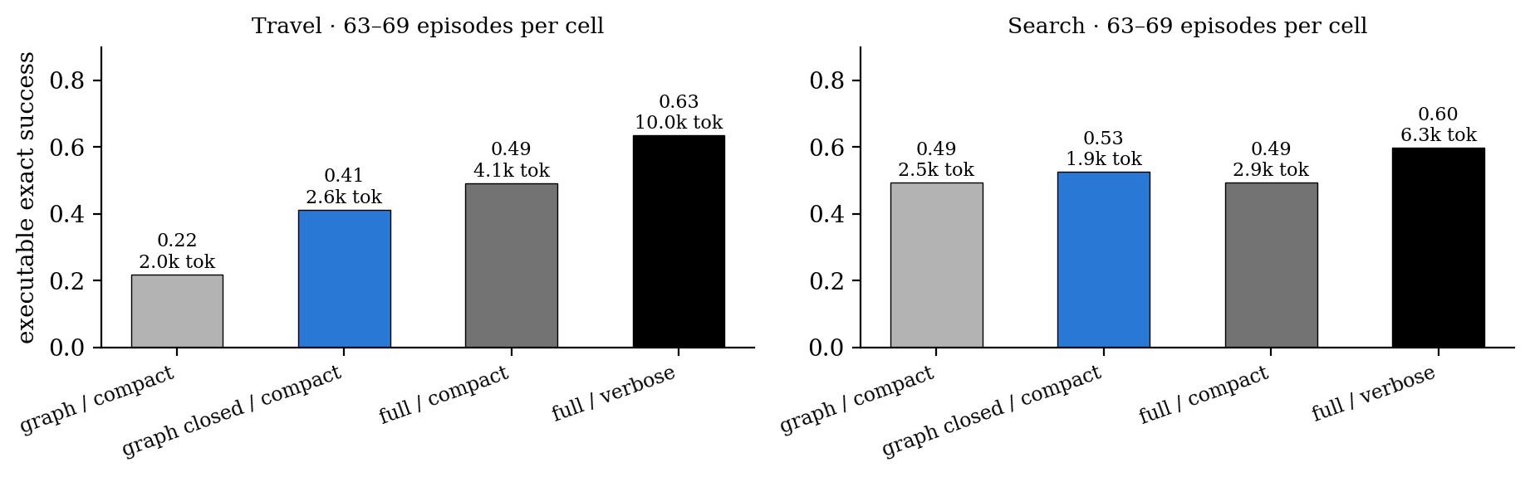
Appendix — the LLM needs the objects its witnesses name
In 33 of 38 failing Travel episodes the graph's witness records named objects the selection had dropped, so the model saw a transfer move without the transfer's provider. Adding those objects and their neighbours recovers half of the gap (+0.23) at a quarter of the full input; the remainder is the runtime's use of a minimal evidence set.
Notes:
Round 3 vs round 4, 63-69 episodes per cell, paired per episode. Travel: graph/compact 0.219, graph_closed/compact 0.444, full/verbose 0.635; paired closed - full -0.190 [-0.333, -0.048]; closure gain over the open selection +0.234 [+0.094, +0.359]. Search: closed 0.493 vs full 0.597, -0.104 [-0.254, +0.045]; the closure changed nothing there. The deterministic executor always sees the full state, which is why the graph reaches 0.86 / 0.99 on the same episodes: the read-recall metric counted witness records, and the LLM also needs the objects those records refer to.

Slide 21
Appendix — what we can write, and the decisions
Can write
· memory as write → hold → regime-gated read; regime conditioning recovers gated edges that pooling misses (E0)
· a learned slot graph selects memory on MemoryArena at −39.55% input with PS held (frozen PASS)
· the v3 benchmark isolates hidden structure on an executable endpoint: lookups, kNN and superset fail, both oracles complete it
· learned relational structure with history-parsed policies completes repair (0.72–1.00); the graph form leads on Travel
· graph selection cuts LLM input by 70–74% at a measured exact-success cost of 0.10–0.19
· the recovered ancestry is recoverable on MINJA (3/3 seeds) and, with same-stem expansion, mitigates the attack online (round 4 PASS)
Cannot write
· that the causal-graph form is necessary in all four tasks (Formal favours the per-object learner)
· that the LLM runtime already exploits the learned structure, or that graph selection is non-inferior at −0.10
· mitigation beyond one carrier and one model; rounds 2 and 3 stay FAIL in the record
Decisions
1 · formulation and claim 2 · Shopping v3.2 as the version of record 3 · report the LLM cost or buy a stronger runtime
4 · Formal gap: solve or report 5 · mitigation enters the paper with its boundaries? 6 · scale simulation 7 · ICLR 2027 (Sep 18 / 25)
Notes:
Backup for the spoken decisions. Read the two lists straight; the decisions are the same seven as in the script.

