Slide 1
Can self-evolution move beyond the initial direct-sampling frontier?
Qwen3-4B · verifier-free SqueezeEvolve (no tests in generation) · 1,093 non-saturated codeforces · oracle = full hidden tests
Three pass@K quantities we keep separate:
1. current/evolving-population pass@K — oracle of the CURRENT candidate set; selection can never exceed it; we make NO claim against it.
2. initial direct-sampling pass@K — the base model's first K samples; THIS is the frontier we test.
3. compute-matched direct-sampling frontier pass@(N×T) — the same total budget spent on naive sampling; the “more than just sampling?” baseline.
Claim under test: evolution reaches solutions that compute-matched independent sampling essentially never reaches; gains sit at the difficulty boundary; we fold them back into the same model (self-evolution, no teacher).

Slide 2
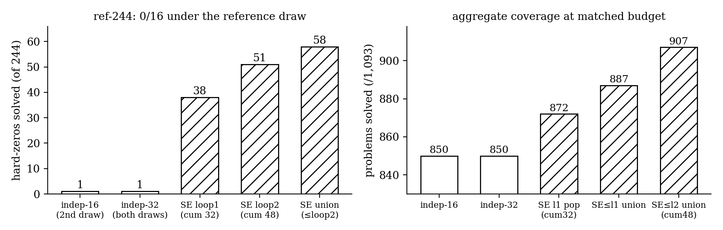
Frontier movement — evolution vs compute-matched sampling (verified)
A 2nd independent 16-draw adds ~NOTHING (850→850 coverage; 1/244 hard-zeros; the two draws agree on 243/244) — independent sampling saturates by ~16 samples. SE at the SAME 32-sample budget solves 38 hard-zeros (51 by loop2, 58 = 23.8% cumulative).
Honest caveats: pop-8 cross-check at matched-16: SE 1,384 vs BoN 1,373 (+28/−17) — modest aggregate edge; independent-48 baseline missing (loop2 not compute-matched yet); partial loop3 = net −1 (saturating); 7 loop1 solves eroded at loop2 (union keeps them).

Slide 3
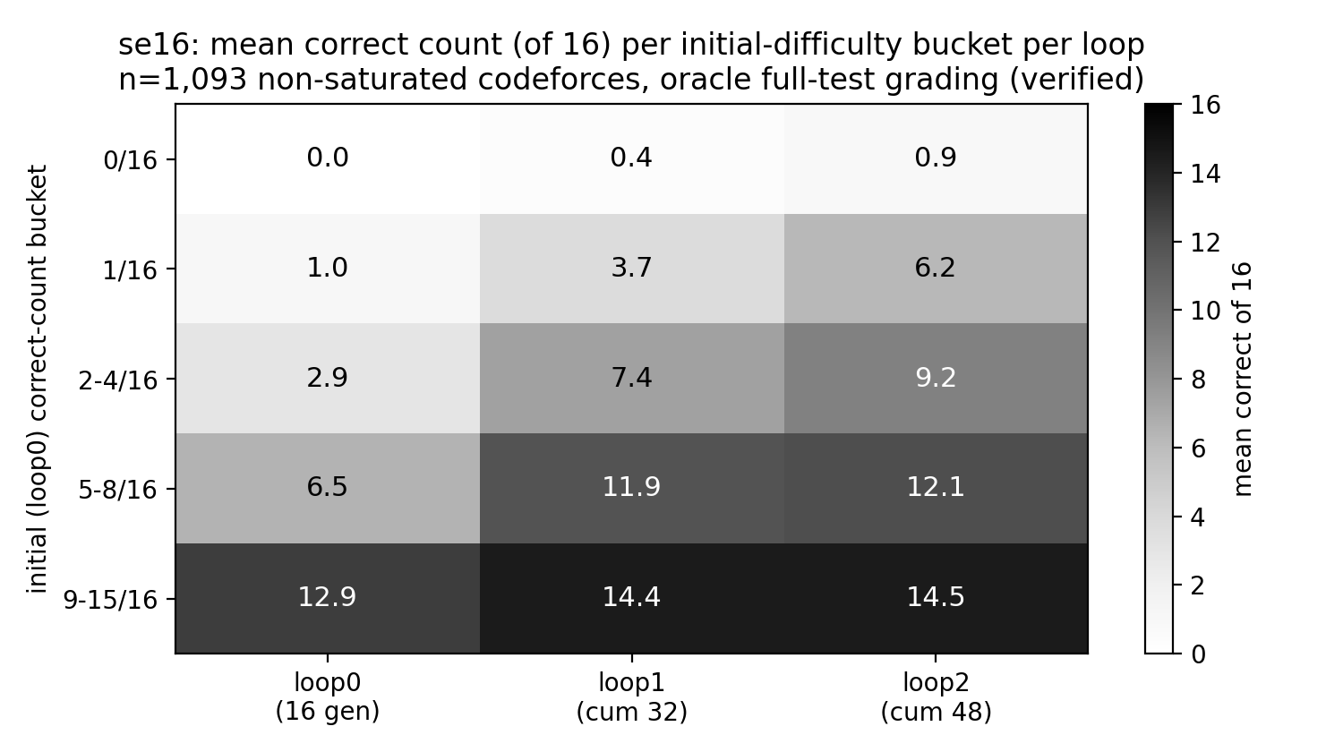
Where gains concentrate — boundary buckets & stopping rules
stopping rule (offline sim) | saved | frontier kept | coverage
full 2-loop run | 0% | 58/58 | 907
freeze 9-15 bucket only | 48% | 58/58 | 907
pure boundary (drop 0-bucket too) | 70% | 1/58 | 850
stop-when-dry (no new uniques) | 11% | 38/58 | 887
Boundary buckets (1, 2-4) gain most per loop; 9-15 plateaus at loop1 and its UNIQUE density falls at loop2 (duplicates).
The 0-bucket is thin but carries THE ENTIRE frontier — curricula must keep hard-zero exploration.
(Descriptive simulation on collected loops; no curriculum experiment run yet.)

Slide 4
Folding back into weights — SFT pilots (held-out LCBv6, raw generation)
arm (LoRA, empty-think/code-only) | data | pass@1 | pass@4 | pass@16 | cap-hit
base (untrained) | — | 0.413 | 0.482 | 0.527 | 44%
loop0 · best-per-problem | 804 | 0.436 | 0.534 | 0.595 | 24%
loop1 (SE) · best-per-problem | 872 | 0.437 | 0.528 | 0.588 | 26%
loop0 · all-unique | 3,889 | 0.410 | 0.504 | 0.565 | 26%
loop1 (SE) · all-unique | 9,025 | 0.397 | 0.494 | 0.557 | 19%
real-CoT · best | 371 | 0.203 | 0.260 | 0.290 | 77%
Durable (weight-level): oracle-verified best-per-problem beats base at EVERY k; SE-source ≈ independent-source at matched selection (Δ 0.001) in this small cross-platform pilot — SE's 68 extra covered problems can't show up here by construction.
Selection vs durable, kept separate: test-time selection is worth up to +0.10–0.24 pass@1 on codeforces pools (needs a strong judge: gpt-oss V1 0.80/0.81 ≈ oracle 0.83/0.86; the 4B can't verify itself — SVD below random). Durable SFT lift so far: +0.023.
Negatives verified: all-unique dumping ≤ base @pass@1; real-CoT collapses (78% hit the 40,960-token cap); final-only 0.131. Next: boundary-set RL (Setlur: verifier-free trace-cloning is suboptimal).

Slide 5
Questions for Sewon
1. Boundary curriculum: informative band carries the RL gradient, but the 0-bucket carries the frontier (drop it → lose 57/58 solves). Principled budget split between boundary exploitation and hard-zero exploration?
2. Stopping rule: freeze problems at ≥9/16 estimated density? Test-free version would use gpt-oss SVD density estimates (r≈0.65, over-claim ≤3) — defensible?
3. SFT vs RL for fold-back: given the SE-vs-independent SFT null at matched selection, is boundary-set GRPO the cleaner test of evolution-data value?
4. Final-answer vs evolution-chain EFT: manifests ready (final-correct 9.1k · chain 136 · pref-pairs 2k), but the SE client logs no parent→child lineage — is per-loop state-chain supervision a valid proxy, or re-run generation with lineage logging?
5. Weak self-verifier vs strong judge: 4B self-verification is below random (AUC≈0.41); a 120B judge ≈ oracle. Is judge-in-the-loop honest for a self-evolution story if disclosed?
6. Sample-efficient RL when rollouts are expensive: beyond compute-matched frontier movement, what evidence would convince an RL audience that evolution+verification extracts more signal per rollout?

