Slide 1
Can self-evolution move beyond the initial direct-sampling frontier?
Qwen3-4B · verifier-free SqueezeEvolve (no tests in generation) · 1,093 non-saturated codeforces · oracle = full hidden tests
Three pass@K quantities we keep separate:
1. current/evolving-population pass@K — oracle of the CURRENT candidate set; selection can never exceed it; we make NO claim against it.
2. initial direct-sampling pass@K — the base model's first K samples; THIS is the frontier we test.
3. compute-matched direct-sampling frontier pass@(N×T) — the same total budget spent on naive sampling; the “more than just sampling?” baseline.
Claim under test: evolution reaches solutions that compute-matched independent sampling essentially never reaches; gains sit at the difficulty boundary; we fold them back into the same model (self-evolution, no teacher).

Slide 2
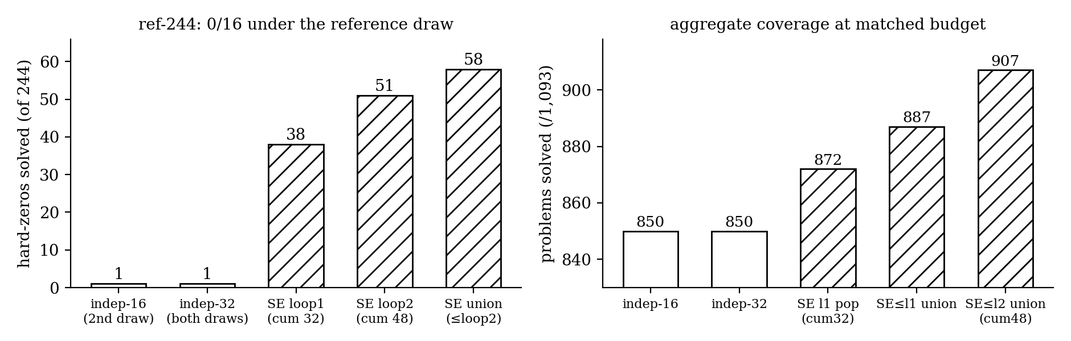
Frontier movement — evolution vs compute-matched sampling (verified)
A 2nd independent 16-draw adds ~NOTHING (850→850 coverage; 1/244 hard-zeros; the two draws agree on 243/244) — independent sampling saturates by ~16 samples. SE at the SAME 32-sample budget solves 38 hard-zeros (51 by loop2, 58 = 23.8% cumulative).
Honest caveats: pop-8 cross-check at matched-16: SE 1,384 vs BoN 1,373 (+28/−17) — modest aggregate edge; independent-48 baseline missing (loop2 not compute-matched yet); partial loop3 = net −1 (saturating); 7 loop1 solves eroded at loop2 (union keeps them).

Slide 3
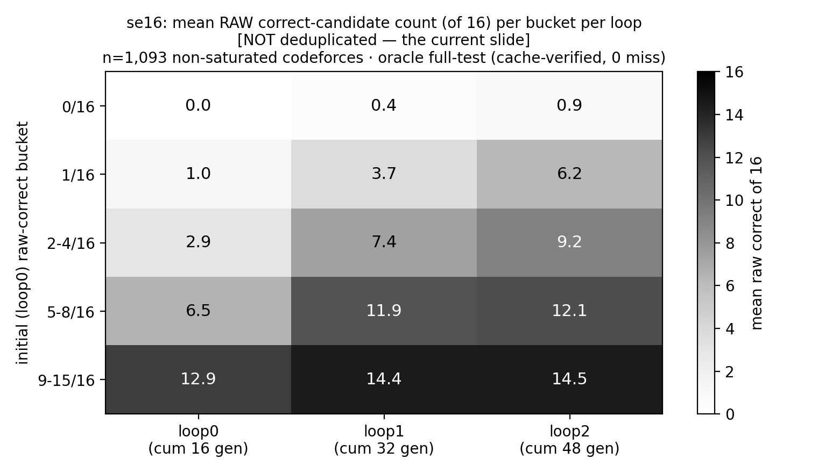
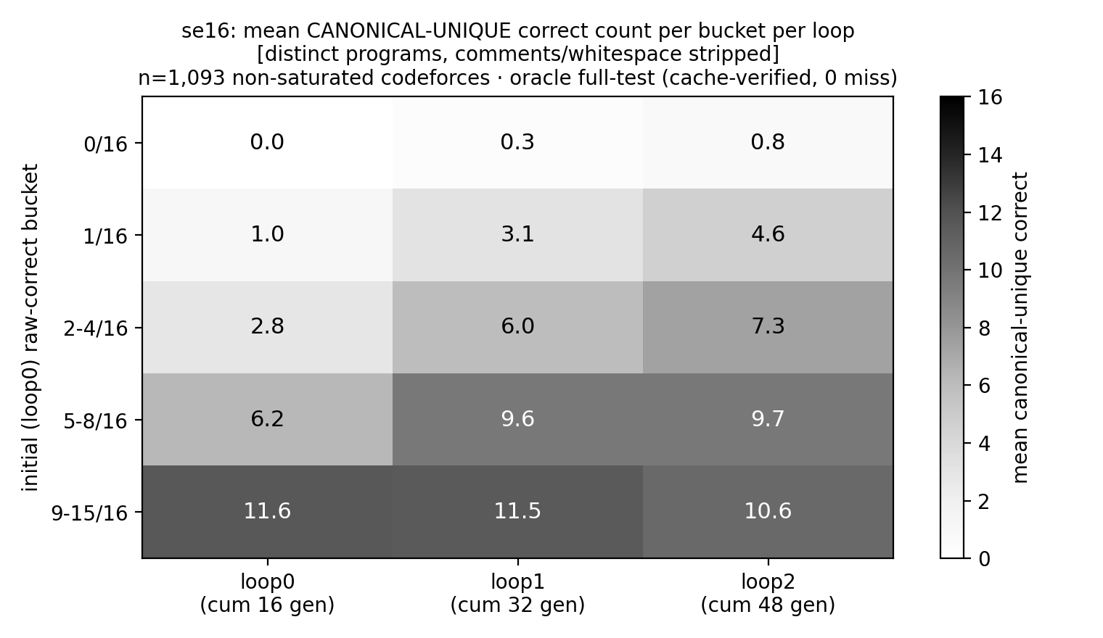
Where gains concentrate — raw density vs unique-correct diversity
RAW correct-candidate density (current slide)
CANONICAL unique-correct density (deduplicated)
Stopping-rule sim (offline)
stopping rule | saved | kept | cov
full 2-loop run | 0% | 58/58 | 907
freeze 9–15 only | 48% | 58/58 | 907
pure boundary (drop 0-bucket) | 70% | 1/58 | 850
stop-when-dry | 11% | 38/58 | 887
Raw density ≠ unique diversity. Dedup confirms hard/boundary gains are genuine, while easy-bucket gains are mostly copy amplification.
Duplication grows modestly 1.10→1.25→1.33. Easy 9–15 raw rises but canonical-unique falls 11.6→11.5→10.6. Hard/boundary buckets gain genuine unique-correct programs. 0-bucket frontier is robust: 57 ever-solved; not copy amplification.
(Oracle full-test dedup; canonical = comments/whitespace stripped, names & structure kept — conservative, can only over-count uniqueness. Source: unique_correct_audit.)
Freeze the near-saturated 9–15 bucket after loop0 → 48% of evolution compute saved, ZERO frontier lost (its extra “gains” are duplicates).

Slide 4
Folding back into weights — SFT pilots (held-out LCBv6, raw generation)
arm (LoRA, empty-think/code-only) | data | pass@1 | pass@4 | pass@16 | cap-hit
base (untrained) | — | 0.413 | 0.482 | 0.527 | 44%
loop0 · best-per-problem | 804 | 0.436 | 0.534 | 0.595 | 24%
loop1 (SE) · best-per-problem | 872 | 0.437 | 0.528 | 0.588 | 26%
loop0 · all-unique | 3,889 | 0.410 | 0.504 | 0.565 | 26%
loop1 (SE) · all-unique | 9,025 | 0.397 | 0.494 | 0.557 | 19%
real-CoT · best | 371 | 0.203 | 0.260 | 0.290 | 77%
Durable (weight-level): oracle-verified best-per-problem beats base at EVERY k; SE-source ≈ independent-source at matched selection (Δ 0.001) in this small cross-platform pilot — SE's 68 extra covered problems can't show up here by construction.
Selection vs durable, kept separate: test-time selection is worth up to +0.10–0.24 pass@1 on codeforces pools (needs a strong judge: gpt-oss V1 0.80/0.81 ≈ oracle 0.83/0.86; the 4B can't verify itself — SVD below random). Durable SFT lift so far: +0.023.
Negatives verified: all-unique dumping ≤ base @pass@1; real-CoT collapses (78% hit the 40,960-token cap); final-only 0.131. Next: boundary-set RL (Setlur: verifier-free trace-cloning is suboptimal).

Slide 5
EFT: process-level fold-back works, but via a stronger teacher
EFT evidence | What they found | Relevance to us
Teacher-generated trajectories | OpenEvolve + Qwen3.5-397B-A17B teacher mutation operator; students are 2B–9B Finch models | Useful but teacher-dependent; not frontier-compatible
Held-out gain | +10.22% avg over 22 held-out tasks | Evolution trajectories can become reusable capability
Many-task scaling | 15→355 training tasks gives +14.1% held-out improvement | Scale / task diversity likely matters
Filtered positives matter | Imp-only helps; Imp+NC+Reg can hurt | Matches our all-unique / CoT negative results
Test-time RL after EFT | Finch + test-time RL reaches SOTA on two circle-packing tasks and beats base on Erdős | Motivates boundary-set RL after fold-back
Takeaway: EFT shows evolution-process data can improve held-out discovery ability — but it relies on a much stronger (~400B) teacher to generate the trajectories.
Our target: same-model self-evolution → verification → fold back into the SAME model (no teacher).

Slide 6
Questions for Sewon
1. Boundary curriculum: informative band carries the RL gradient, but the 0-bucket carries the frontier (drop it → lose 57/58 solves). Principled budget split between boundary exploitation and hard-zero exploration?
2. Stopping rule: freeze problems at ≥9/16 estimated density? Test-free version would use gpt-oss SVD density estimates (r≈0.65, over-claim ≤3) — defensible?
3. SFT vs RL for fold-back: given the SE-vs-independent SFT null at matched selection, is boundary-set GRPO the cleaner test of evolution-data value?
4. Final-answer vs evolution-chain EFT: manifests ready (final-correct 9.1k · chain 136 · pref-pairs 2k), but the SE client logs no parent→child lineage — is per-loop state-chain supervision a valid proxy, or re-run generation with lineage logging?
5. Weak self-verifier vs strong judge: 4B self-verification is below random (AUC≈0.41); a 120B judge ≈ oracle. Is judge-in-the-loop honest for a self-evolution story if disclosed?
6. Sample-efficient RL when rollouts are expensive: beyond compute-matched frontier movement, what evidence would convince an RL audience that evolution+verification extracts more signal per rollout?

