Slide 1

Professor Oak’s Pokémon Love Calculator
A Love App
By Angus, Declan, Jeff, Nobu & Tom

Slide 2

Elevator Pitch

Slide 3

Concept - Description
User types their name and the name of their love interest into the boxes on the home page
When user clicks calculate, the site runs an API to determine how compatible the user’s name is with that of their interest.
This compatibility will then be compared to a Pokémon, giving the user a fun and profoundly accurate description of how a relationship with this person would be!

Slide 4

Concept
Motivation for development:
A love compatibility search that incorporates Pokémon for fun.
Allows users to discover the compatibility of their name with a potential
match, then compare their score with a Pokémon and a description.
Saves 10 highest and lowest scores recorded on the app.
Engaging and fun user interface.
User story:
As a single person and lover of Pokémon: I want to search the compatibility of my name with that of a potential partner. I would then like the potential relationship rated in relation to a Pokémon I know. I would also like to know some of the most and least compatible names. This is so I can have fun investigating my compatibility with different people, and have a laugh at the same time.

Slide 5

Process
Technologies used
HTML
CSS: Bootstrap, FontAwesome
JavaScript: JQuery, Node
Other API’s: Pokémon API, Name match API

Slide 6

Process – Breakdown of tasks & roles
Angus
A
B
C
Declan
A
B
C
D
Jeff
A
B
C
Nobu
HTML Layout
CSS
C
Tom
A
B
C

Slide 7

Process
Challenges
A
B
C
Successes
Visually appealing interface
Effective search functionality to achieve goals
Strong mobile display & usability.
Strong and active collaboration & teamwork.

Slide 8

Demo

Slide 9
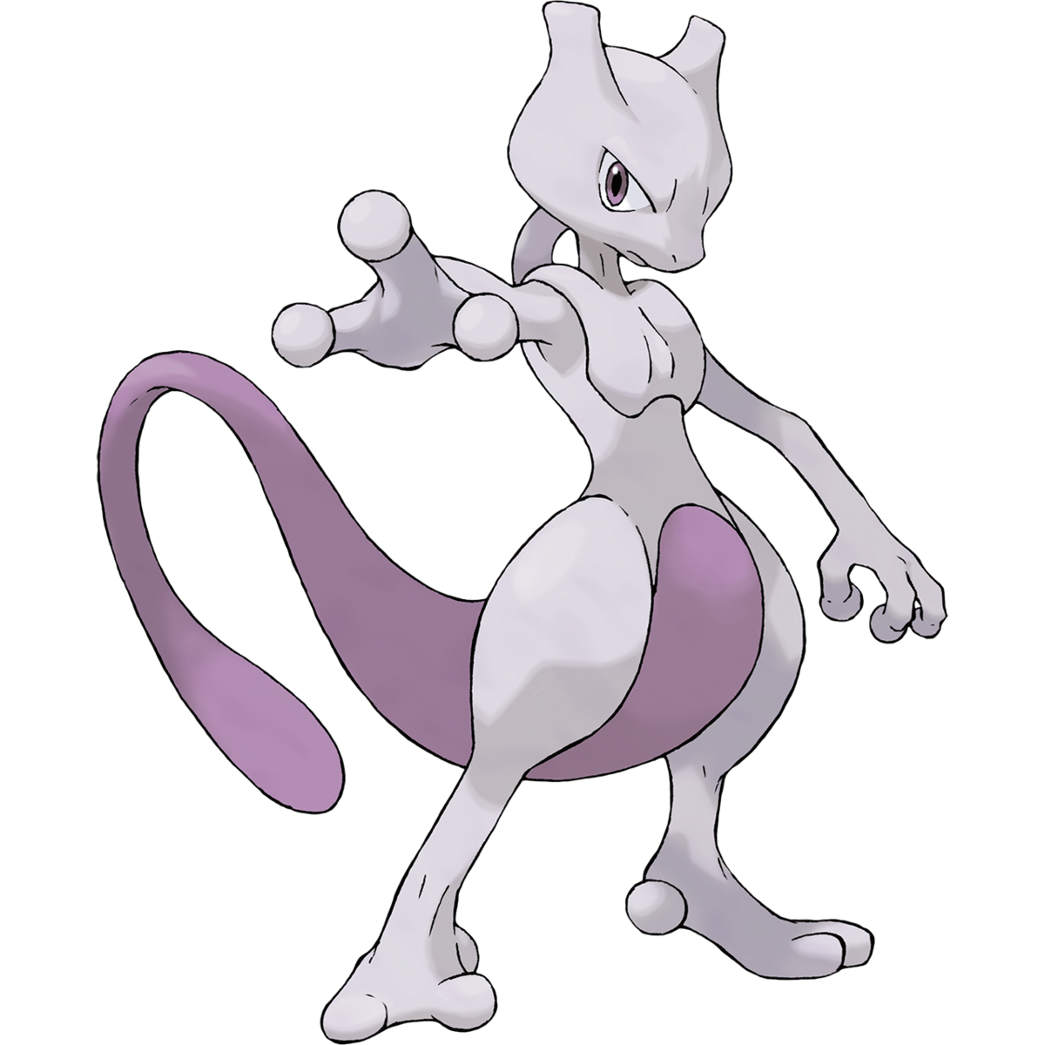
Directions for Future Development
Link into Dating App tech to match with compatible people nearby.
User compares 2 potential matches by simulating Pokémon battle.
A
• B
Notes:
The app can be extended to include a search for other users in their town to find partners with love of Pokémon. Would incorporate dating app technology.
The app might also let users make the Pokémon from 2 recent searches battle, to see which may be best for them.

Slide 10

Links
Deployed: https://thomasmaglaris.github.io/Project-2/
GitHub Repo: https://github.com/thomasmaglaris/Project-2

