Slide 1
Bypassing the keyfile of Hpmbcalc 4.22
Project 2 for cs265
Li Miao
05/05/2015

Slide 2
Tools
ollydbg
explorer suite
dUP2(diablo2oo2's Universal Patcher )
Resource Hacker
PEID

Slide 3
Target
Hpmbcalc 4.22 (hexprobe multibyte calculator)
http://www.hexprobe.com/hpmbcalc/download.htm

Slide 4
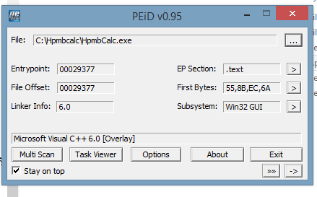
Step1:determine if it is packed or not

Slide 5
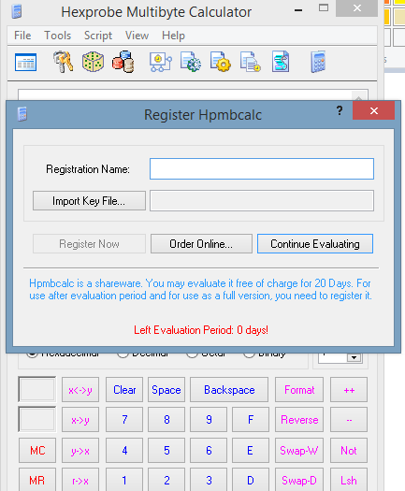
Step2:Explore The App
Run the app.

Slide 6
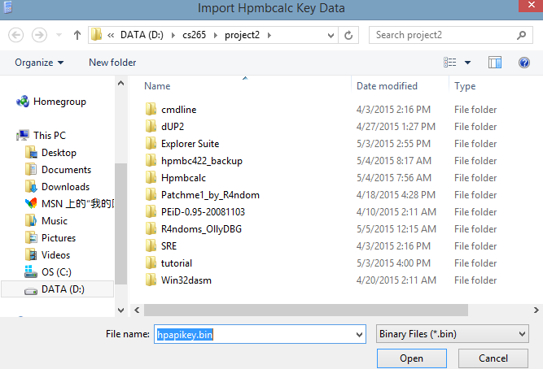

Slide 7
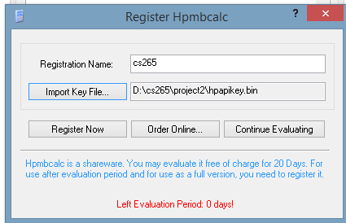

Slide 8
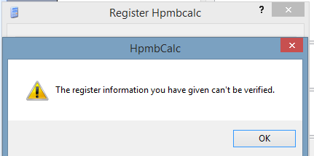

Slide 9
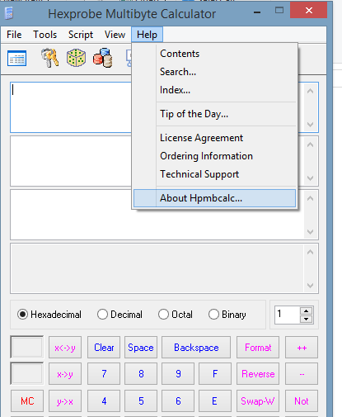

Slide 10
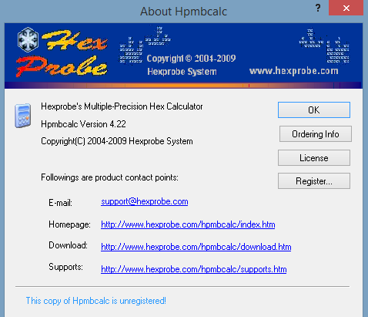

Slide 11
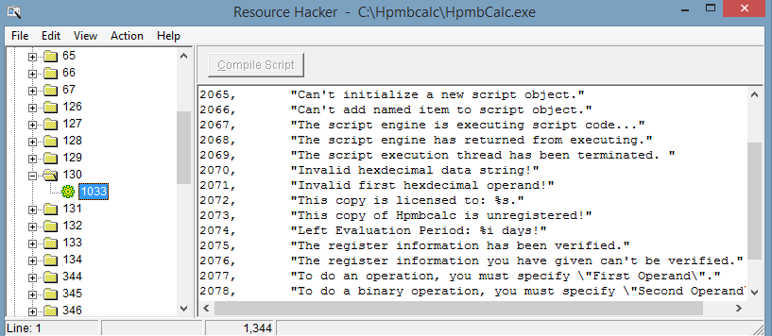
Step3:look for the patch.

Slide 12
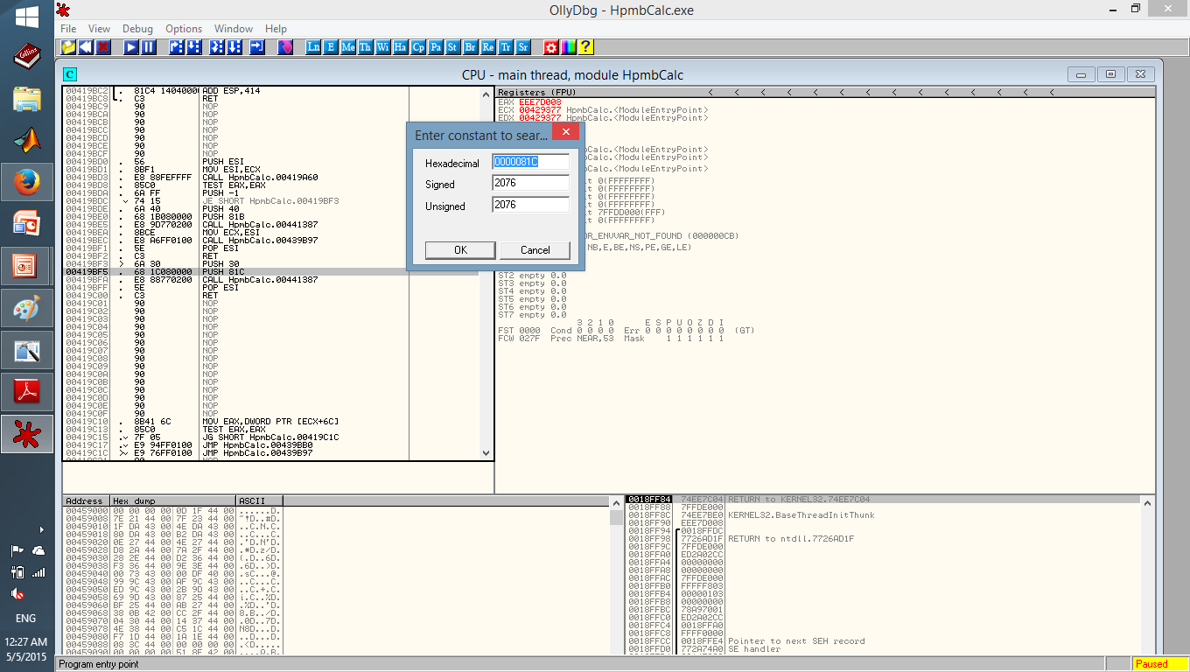

Slide 13
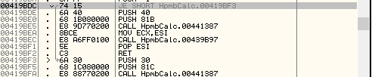

Slide 15
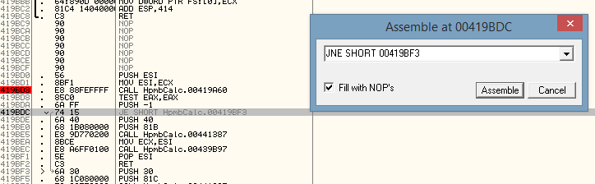

Slide 16
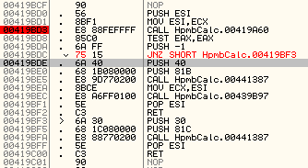

Slide 17
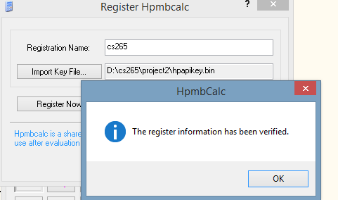

Slide 18
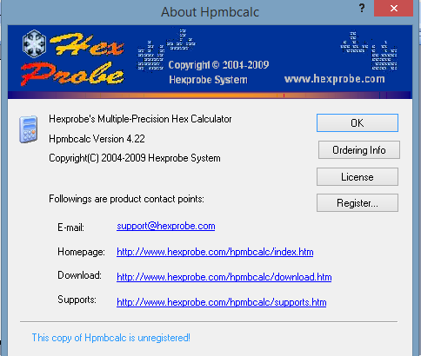

Slide 19
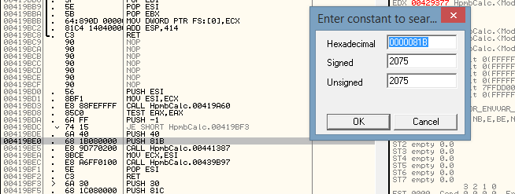

Slide 20
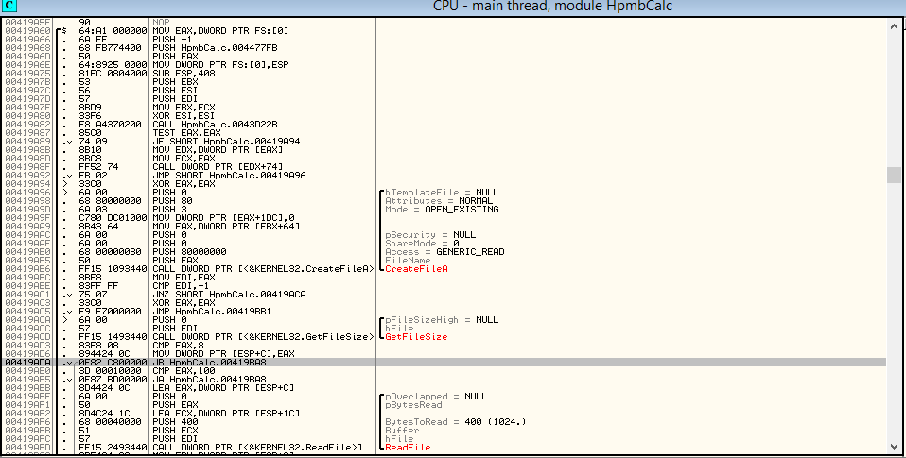

Slide 21
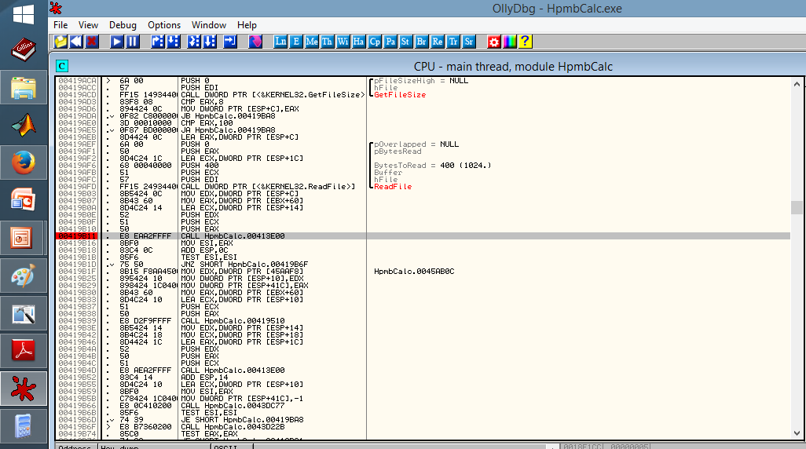

Slide 22
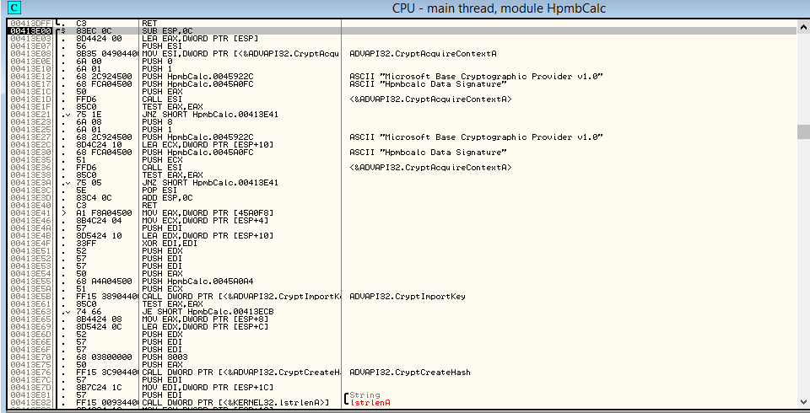

Slide 23
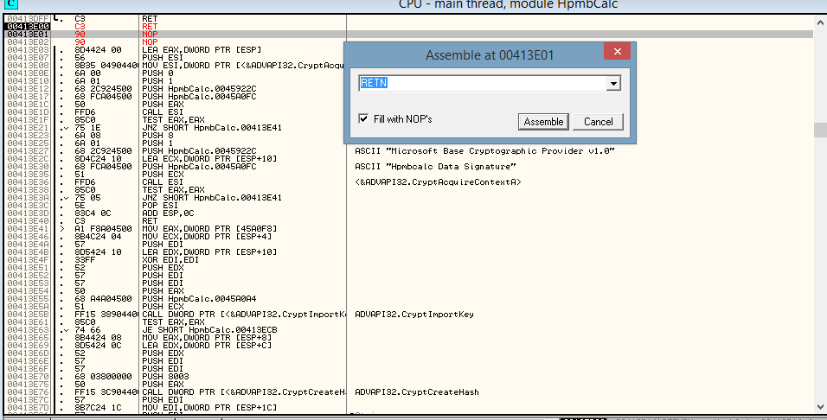

Slide 24
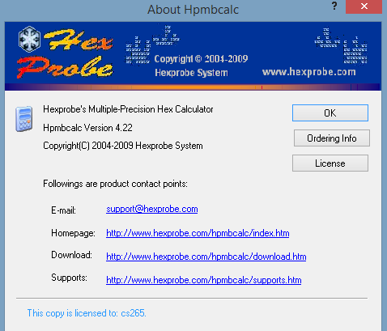

Slide 25
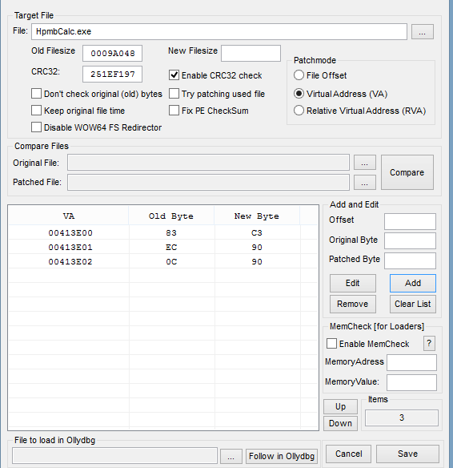
Step4_1:Make loader

Slide 26
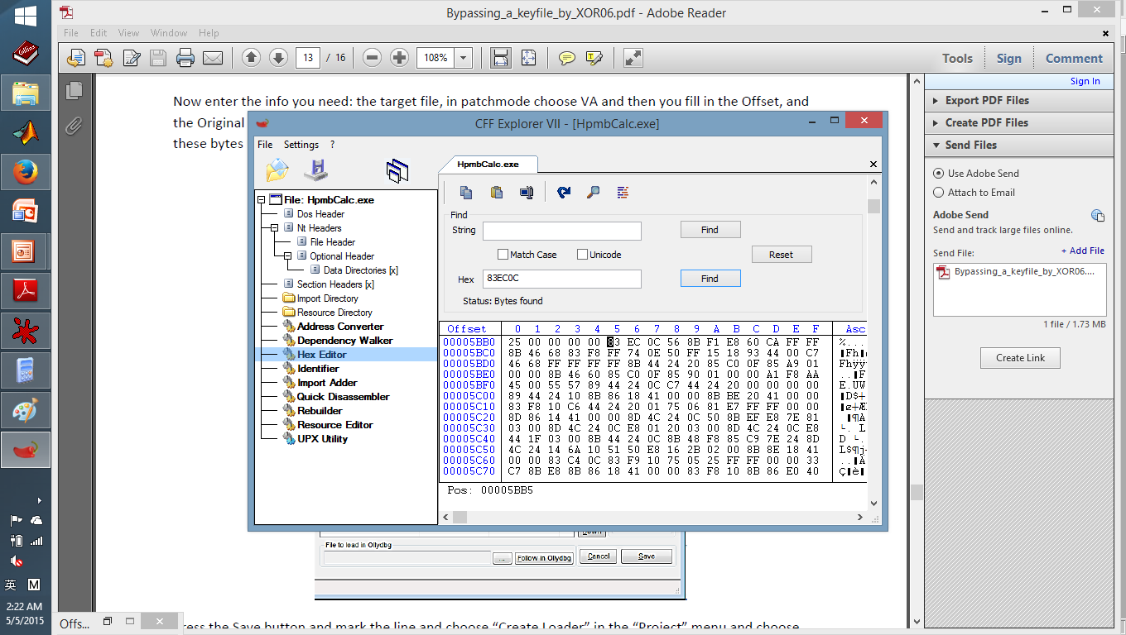
Step4_2:Make patch

Slide 27
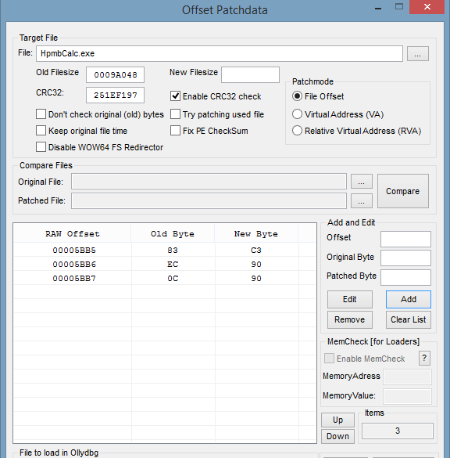
Make patch

Slide 28
Show loader/patch

Slide 29
Thanks

