Slide 1
Exact solutions to the nonlinear dynamics of learning in deep linear neural networks
Chung Hyun Kim, Rebecca Miao
Oct, 3rd 2019

Slide 2
Introduction
The analytical understanding of the rich dynamic of deep learning remain elusive, for example
What determines the time scales over which deep learning unfolds?
How does training speed retard with depth?
Under what conditions will greedy unsupervised pretraining speed up learning?
…
Today’s Agenda
General learning dynamics of shallow linear network (Rebecca)
Deeper multilayer dynamics (Rebecca)
Finding good weight initializations (Chung)
Extension to nonlinear networks (Rebecca)

Slide 3
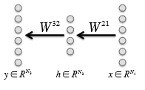

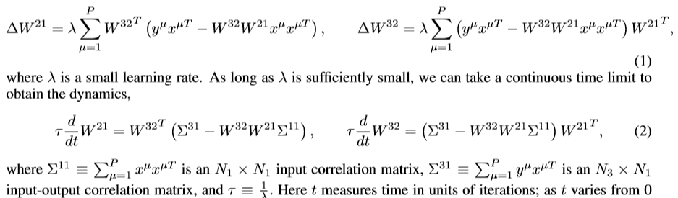


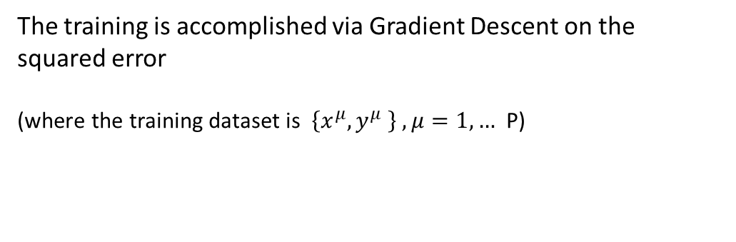
Part 1: General learning dynamics
The training is accomplished via Gradient Descent on the squared error
(where the training dataset is $\left\{x^{μ},y^{μ} \right\} , μ=1, …$ P)
This gradient descent yields the batch learning rule:
Notes:
Network has three layers…explains
How does the training perform
Introduce the batch learning rules and function (1) and function (2)
Despite the linearity of linearity of the network, functions (2) shows nonlinear learning dynamics
11 is N1 * N1 input correlation matrix
31 is nx*n1 input output correlation matrix

Slide 4
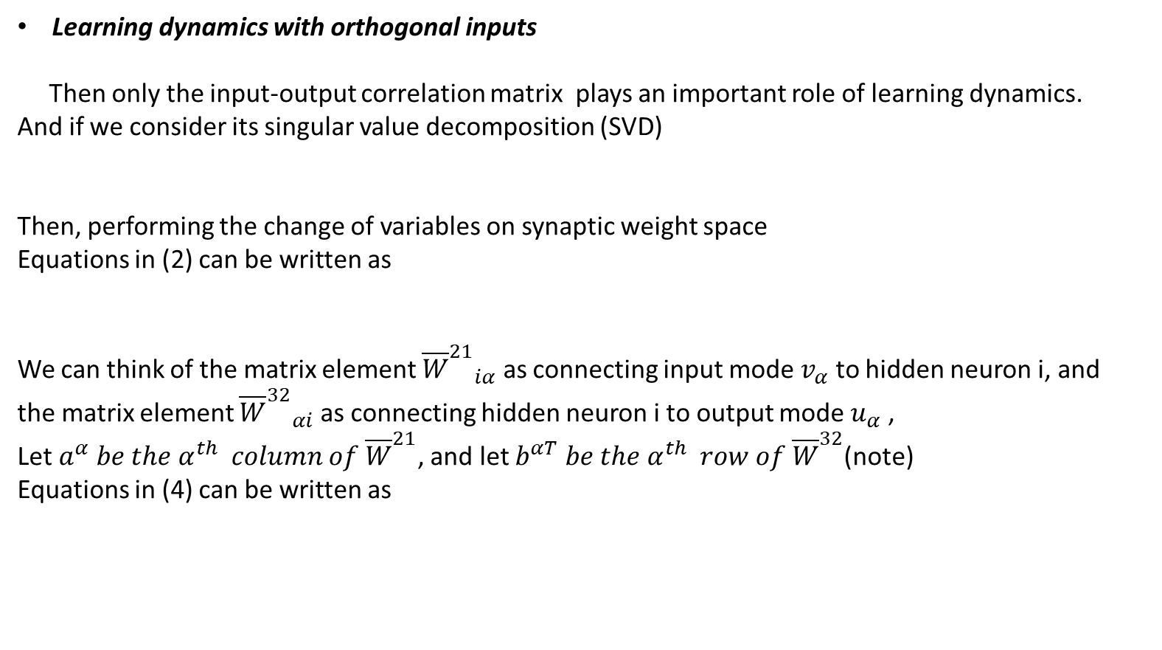
Part 1: General learning dynamics
Learning dynamics with orthogonal inputs
Then only the input-output correlation matrix plays an important role of learning dynamics. And if we consider its singular value decomposition (SVD)
Then, performing the change of variables on synaptic weight space
Equations in (2) can be written as
We can think of the matrix element ${{\overline{W}}^{21}}_{iα}$ as connecting input mode $v_{α}$ to hidden neuron i, and the matrix element ${{\overline{W}}^{32}}_{αi}$ as connecting hidden neuron i to output mode $u_{α}$ ,
Let $a^{α} be the α^{th} column of {\overline{W}}^{21}$, and let $b^{αT} be the α^{th} row of {\overline{W}}^{32}$(note)
Equations in (4) can be written as
These dynamics arise from gradient descent on the energy function:
Notes:
To simplify the analysis,
(FUNCTION3)Here V 11 is an N1 ×N1 orthogonal matrix whose columns contain input-analyzing singular vectors vα that reﬂect independent modes of variation in the input, U33 is an N3 × N3 orthogonal matrix whose columns contain output-analyzing singular vectors uα that reﬂect independent modes of variation in the output, and S31 is an N3 ×N1 matrix whose only nonzero elements are on the diagonal; these elements are the singular values sα,α = 1,...,N1 ordered so that s1 ≥ s2 ≥···≥ sN1.
(FUNCTIION4) To gain intuition for these equations, note that while the matrix elements of W21 and W32 connected neurons in one layer to neurons in the next layer
(Function 5)
Intuitively, aα is a column vector of N2 synaptic weights presynaptic to the hidden layer coming from input mode α, and bα is a column vector of
N2 synaptic weights postsynaptic to the hidden layer going to output mode α
(Function 6)
Consider,
From the first terms in (5) & (6), the connectivity modes from the two layers, $a^{α} and b^{α}$ associated with the same input-output mode of strength $s^{α}$, drive each other to larger magnitudes and point in to similar directions in hidden units.
The second terms show the competition between connectivity modes in the first and second layers associated with different input modes. This yields repulsive force between all distinct pairs of first and second layer connectivity modes, driving the network to a decoupled regime in which the different connectivity modes become orthogonal.

Slide 5
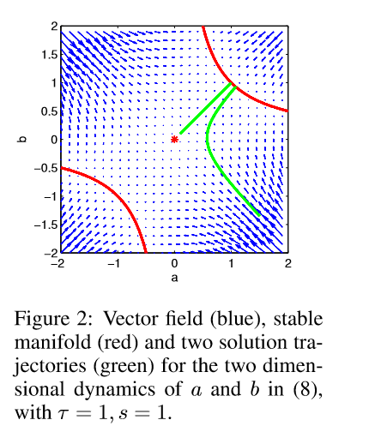

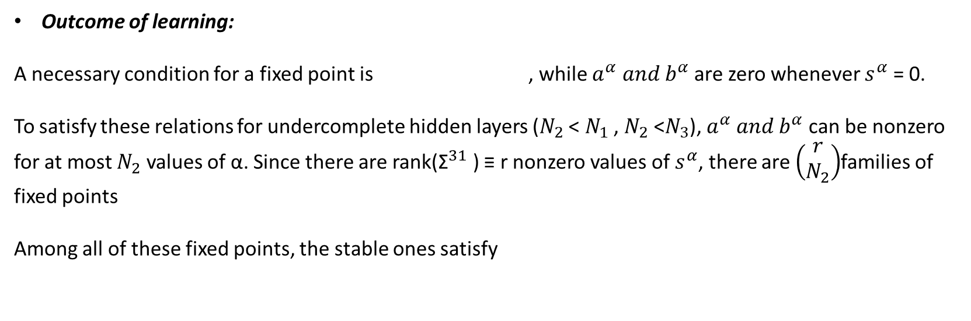
Part 1: General learning dynamics
Outcome of learning:
A necessary condition for a fixed point is , while $a^{α} and b^{α}$ are zero whenever $s^{α}$ = 0.
To satisfy these relations for undercomplete hidden layers ($N_{2}$ < $N_{1}$ , $N_{2}$ <$N_{3}$), $a^{α} and b^{α}$ can be nonzero for at most $N_{2}$ values of α. Since there are rank(${\text{Σ}}^{31}$) ≡ r nonzero values of $s^{α}$, there are $\left(\begin{matrix}r \\ N_{2}\end{matrix}\right)$families of fixed points
Among all of these fixed points, the stable ones satisfy
Notes:
Gradient descent learning for linear networks has a fixed point structure. A necessary//
….
Those fixed point only contains saddle points and global local minimia.
For example, the chart
How long does it take to reach the global min point.

Slide 6
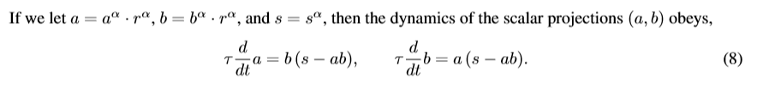

Part 1: General learning dynamics
The time of learning
Special class for initial conditions
$r^{α}$is a fixed collection of $N_{2}$ vectors that form an orthonormal basis for synaptic connections from an input or output mode onto the same set of hidden units
For function (5) and (6), the dot products are equal to 0 because the different active modes are orthogonal to each other.
These equations can by solved by noting that they arise from gradient descent on the error,
Notes:
(all other connectivity modes $a^{α} and b^{α}$ = 0)
This implies that the product ab monotonically approaches the ﬁxed point s from its initial value. Moreover, E(a,b) satisﬁes a symmetry under the one parameter family of scaling transformations a → λa, b → b /λ.

Slide 7
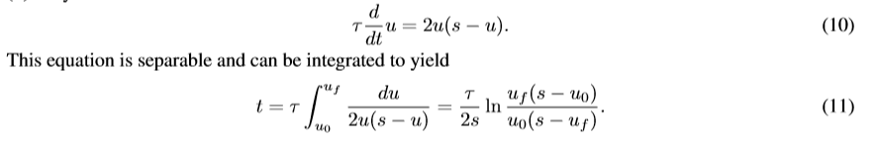

Part 1: General learning dynamics
The time of learning
Special class for initial conditions
(all other connectivity modes $a^{α} and b^{α}$ = 0)
We can then track the dynamics of u ≡ ab, which from (8)
Assume t is the time for u to travel from $μ_{o} to{ μ}_{f}.$If we assume $μ_{o}= ε, then t=O(\frac{τ}{s})$
Notes:
(function 11)
Here t is the time it takes for u to travel from u0 to uf. If we assume a small initial condition u0 = e , and ask when uf is within e of the ﬁxed point ,then the learning timescale in the lim e → 0 is t = O(τ/s) (with a weak logarithmic dependence on the cutoff). This yields a key result: the time scale of learning of each input-output mode α of the correlation matrix Σ31 is inversely proportional to the correlation strength sα of the mode. Thus the stronger an input-output relationship, the quicker it is learned.
Tau =1/lamda

Slide 8




Part 2: Deeper multiplayer dynamics
The shallow linear network is the minimal example of a multilayer net.
Track the dynamics of $u= \prod_{i=1}^{N_{l}−1}{a_{i}}$
As $N_{l}$ goes to infinity,
Equation (16) can be integrated to obtain

Slide 9
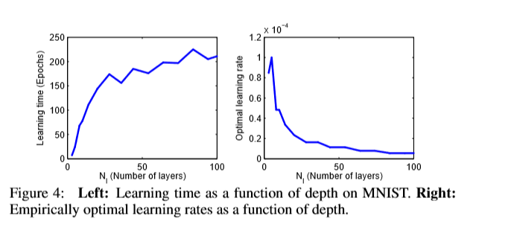
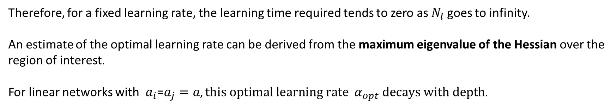
Part 2: Deeper multiplayer dynamics
Therefore, for a fixed learning rate, the learning time required tends to zero as $N_{l}$ goes to infinity.
An estimate of the optimal learning rate can be derived from the maximum eigenvalue of the Hessian over the region of interest.
For linear networks with $a_{i}$=$a_{j}=a, this optimal learning rate α_{opt} decays with depth.$
With the optimal learning rate, the difference between learning times for an shallow net and a infinite net is
Notes:
This result depends on the continuous time formulation, however. Any implementation will operate in discrete time and must choose a ﬁnite learning rate that yields stable dynamics.
An estimate of the optimal learning rate can be derived from the maximum eigenvalue of the Hessian over the region of interest.
S31 is an N3 ×N1 matrix whose only nonzero elements are on the diagonal; these elements are the singular values sα,α = 1,...,N1 ordered so that s1 ≥ s2 ≥···≥ sN1.
Conclusion. As we mentioned, in order to achieve (kind of) depth independent learning time, the initial weight matters

Slide 10
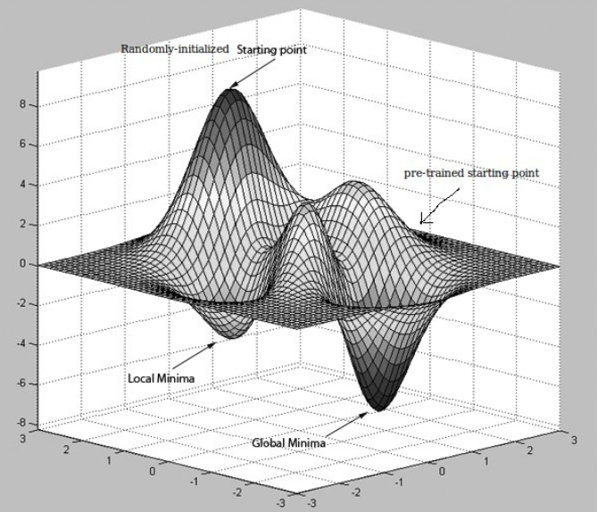
What conditions on weight matrices will produce depth-independent learn time?

Slide 11
3 different weight initializations explored:
Initialization Methods | Learn time scale
Layerwise unsupervised pretraining | Scale linearly with depth
Random weights | Scale exponentially with depth
Orthogonal weights | Depth independent, ~ should be similar to pretraining?

Slide 12
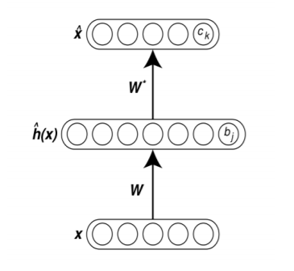
Greedy layer-wise pretraining
Breakthrough discovery in training deep neural network to counter the vanishing gradient problem
Speeds up and improves generalization performance of standard gradient descent
Author’s procedure: use autoencoders to 1) train the network to produce its input as its output and then 2) finetune the on the ultimate input-output task of interest
W != W* to avoid
learning the identity matrix

Slide 13
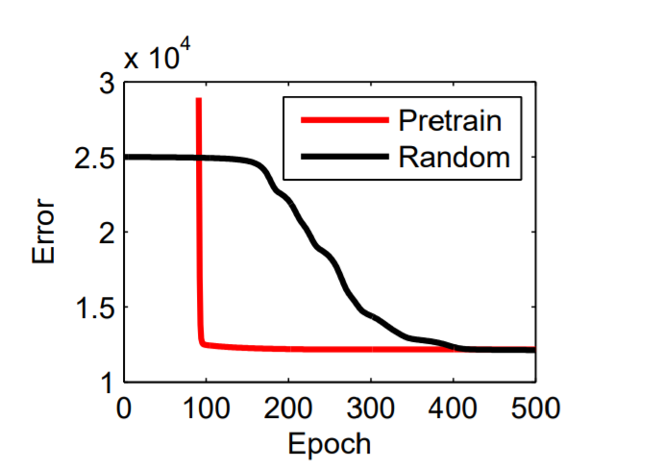
It works well…
Why?
Autoencoder is essentially performing PCA on the input-input correlation matrix and setting each weight matrix to be orthogonal
~hidden layer should separate factors of variation in the input
Learning curves on MNIST for a five layer linear network starting from random Gaussian vs pretrained weights
Notes:
**** I’m still not sure– the paper seems to say the autoencoder’s approximation of input-input correlation matrix is basically PCA, where the eiganvalues are close to identiy matrix ~stable. But I’m still struggling to understand the author’s statement on page 9 “the right singular vectors of the ultimate input-output task of interest V11 must be similar to the principal components of the input data Q”

Slide 14
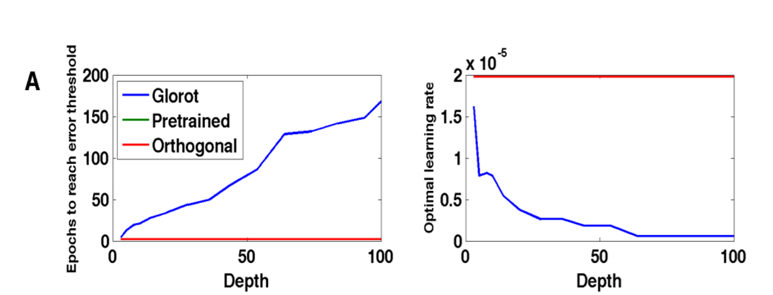
Weights: scaled i.i.d uniform vs orthogonal matrix
Learning time on MNIST as a function of depth for different initial conditions on weights
Pretrained and orthogonal are on top of each other
Notes:
A Left: Learning time (on MNIST using the same architecture and parameters as in Fig. 4) as a function of depth for different initial conditions on weights (scaled i.i.d. uniform weights chosen to preserve the norm of propagated gradients as proposed in [13] (blue), greedy unsupervised pre-training (green) and random orthogonal matrices (red). The red curve lies on top of the green curve. Middle: Optimal learning rates as a function of depth for different weight initilizations. Right: The eigenvalue spectrum, in the complex plane, of a random 100 by 100 orthogonal matrix.

Slide 15
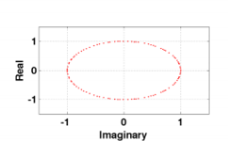
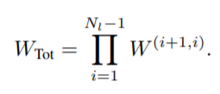
Why do random orthogonal weight metrices train faster than random Gaussian weight matrices?
Has to do with the way the 2 matrices evolve over repeat matrix multiplications, and this can be studied by looking at their singular values and eiganvalues.
Consider the product of matrices across all hidden N layers, representing the total end to end propagation of activity across a deep linear network
The product of random orthogonal matrices are more stable than the product of random Gaussian matrices
Eiganvalues of
a random
100 x 100 orthogonal
matrix

Slide 16
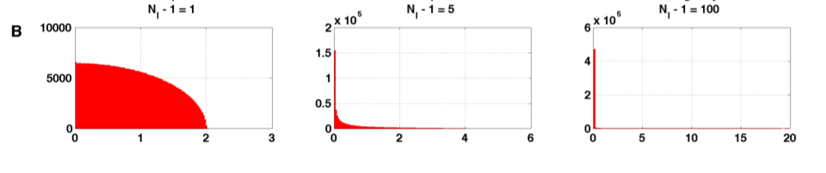
Under random orthogonal initializations, WTot is itself an orthogonal matrix and has all singular values equal to 1.
Under Guassian initializations, there is no complete theoretical characterization of singular value distribution of WTot.
Histograms of singular values of the products of N-1 independent random Gussian matrices, as a function of different depths. They develop highly kurtotic (tailedness) nature as the depth increases. Most of the singular values becoming vanishingly small while a long tail of very large singular values remains.
Notes:
This has an effect of strongly amplifying the projection of an error vector onto a very small subset of singular vectors and attenuating the error vector in all other directions. The projection of error vectors onto a high dimensional subspace corresponding to small singular values would be very weak, yielding vanishingly small gradient signals corresponding to these directions in early years.
Caption: Histograms of the singular values of products of Nl −1 independent random Gaussian N by N matrices whose elements themselves are chosen i.i.d. from a zero mean Gaussian with standard deviation 1/ √ N. In all cases, N = 1000, and histograms are taken over 500 realizations of such random product matrices, yielding a total 5 · 105 singular values in each histogram.

Slide 17
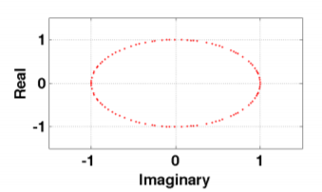
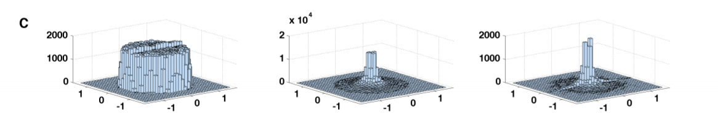
Same with eiganvalues
Eiganvalues of a random 100 x 100 orthogonal matrix
1 layer
5 layers
100 layers
Histograms of eiganalues of the products of N-1 independent random Gussian matrices, as a function of different depths.
The bin containing the origin was removed from the second and third graphs as it contains 32% and 94% of the eiganvalues respectively; shows that as depth increases, the eiganvalues concentrate around 0

Slide 18
Takeaways
Discrepancy in learning time between the scaled Gauissian and orthogonal/pretraining is modest for the depth of around 6, but magnified at larger depths.
True even in nonlinear network(?)
In recurrent networks, an infinitely deep feed-forward networks with tied weights, a very promising approach is a modification to the training objective that partially promotes dynamical isometry for the set of gradients currently being back-propagated.
Notes:
Isometry – a distance preserving transformation between metric spaces

Slide 19


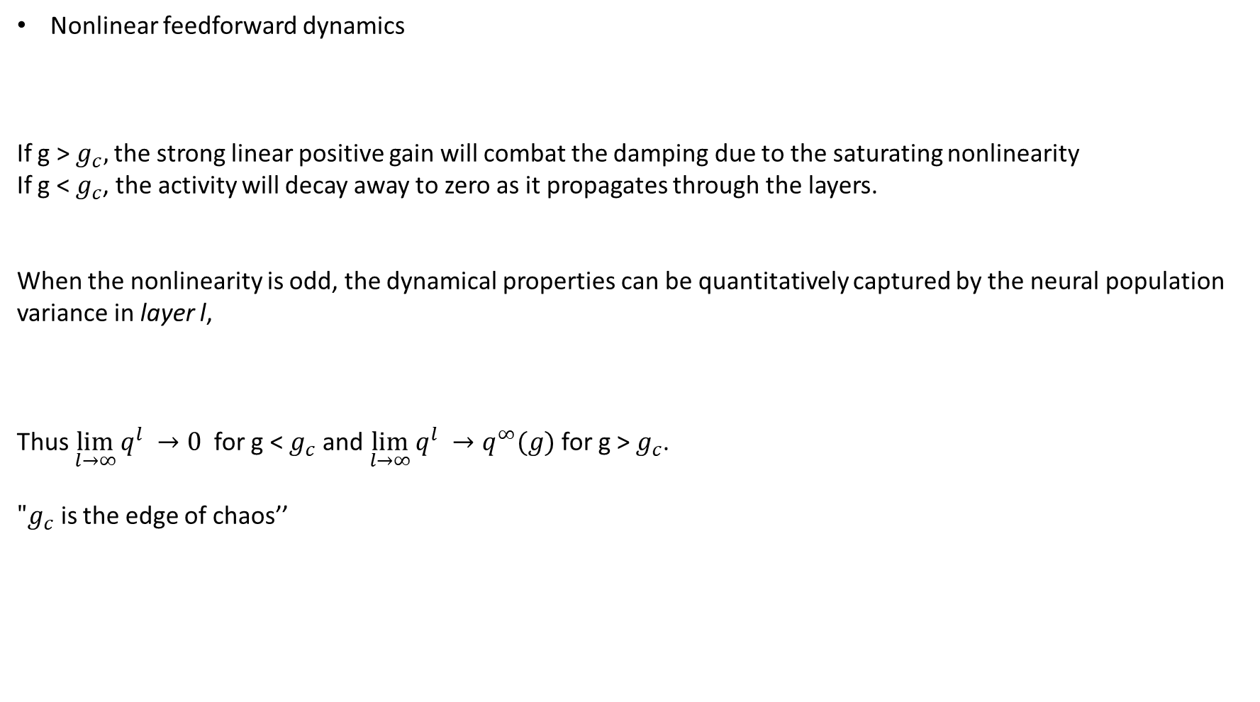
Part 4: Extension to Nonlinear Network
Nonlinear feedforward dynamics
If g > $g_{c},$the strong linear positive gain will combat the damping due to the saturating nonlinearity
If g < $g_{c}$, the activity will decay away to zero as it propagates through the layers.
When the nonlinearity is odd, the dynamical properties can be quantitatively captured by the neural population variance in layer l,
Thus $\lim_{l→∞}{q^{l} →0}$ for g < $g_{c}$ and $\lim_{l→∞}{q^{l} →q^{∞}(g)}$for g > $g_{c}$.
${"g}_{c}$ is the edge of chaos’’
Notes:
Where xl i denotes the activity of neuron i in layer l, W(l+1,l) ij is a random orthogonal connectivity matrix from layer l to l + 1, g is a scalar gain factor, and φ(x) –phi is any nonlinearity that saturates as x →±∞.
g>gc might over fit
q is variance

Slide 20

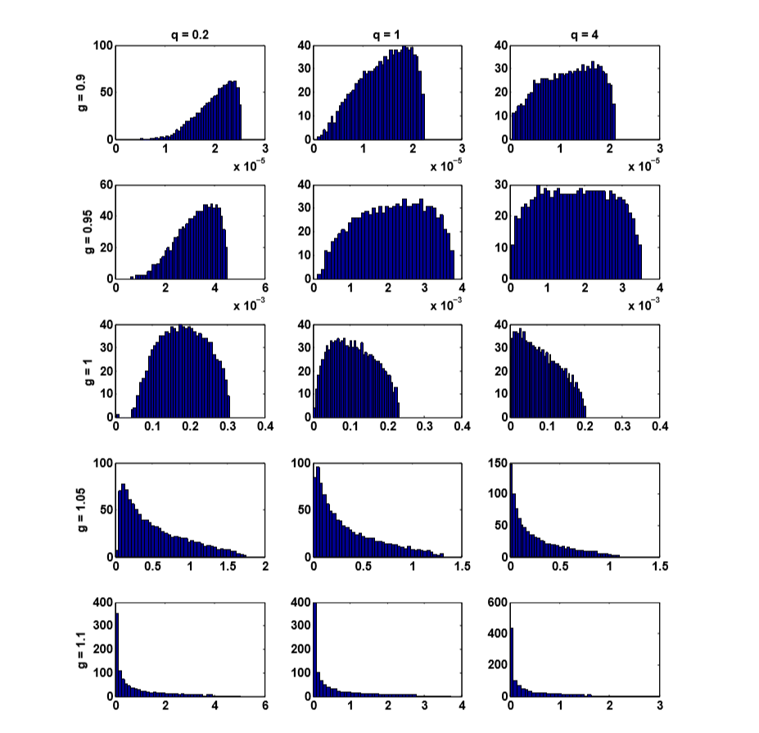
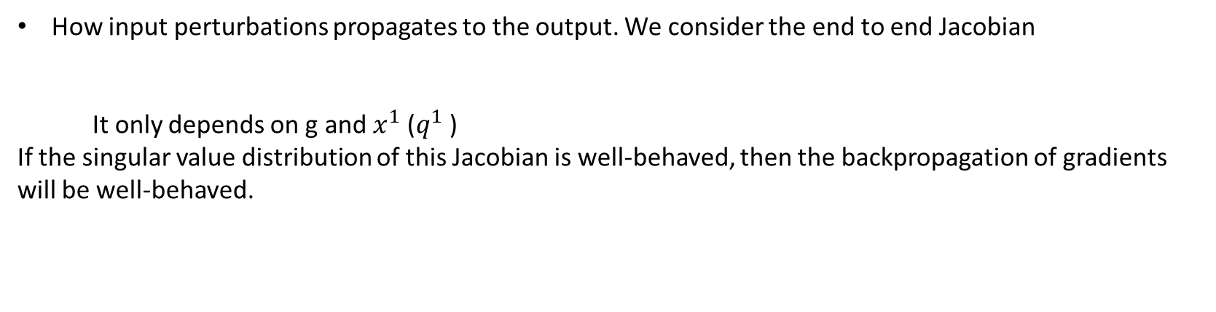
Part 4: Extension to Nonlinear Network
How input perturbations propagates to the output. We consider the end to end Jacobian
It only depends on g and $x^{1}$($q^{1}$)
If the singular value distribution of this Jacobian is well-behaved, then the backpropagation of gradients will be well-behaved.
The singular value spectrum is more robust to perturbations that increase g from 1 relative to those that decrease g, so just beyond the edge of orthogonal chaos may be a good regime for learning in deep nonlinear networks.
Notes:
If the singular value distribution of this Jacobian is well-behaved (few extremely large or small singular values), then the backpropagation of gradients will be well-behaved.
For the chart, the gc= 1
If g <1, the linear dampening over many layers yields extremely small singular values
If g >1, the combination of positive linear amplification and saturation nonlinear dampening yields an anisotropic distribution of singular values.
If g=1, the distribution is concentrated in a range and reflects approximate dynamical isometry. Also, it remains valid as the q1 is increased far beyond 1, where tanh function enters nonlinear regime.

