Slide 1
Understanding the nonlinear dynamics of learning in deep linear neural networks
Chung Hyun Kim, Rebecca Miao

Slide 2

Intro
The analytical understanding of the rich dynamic of deep learning remain elusive, for example
What determines the time scales over which deep learning unfolds?
How does training speed retard with depth?
Under what conditions will greedy unsupervised pretraining speed up learning?
…
Agenda
General learning dynamics of shallow linear network (Rebecca)
Deeper multiplayer dynamics (Rebecca)
Finding good weight initializations (Chung)
Extension to nonlinear networks (Rebecca)
Notes:
Deep linear network compared to a shallow one does not gain expressive power from depth and will underfit and perform poorly on complex real work problems.
But it will exhibit highly nonlinear learning dynamics , which will change with increasing depth. (can be used to learn the nonlinear dynamic for deep networkds)

Slide 3
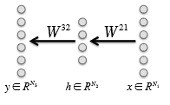


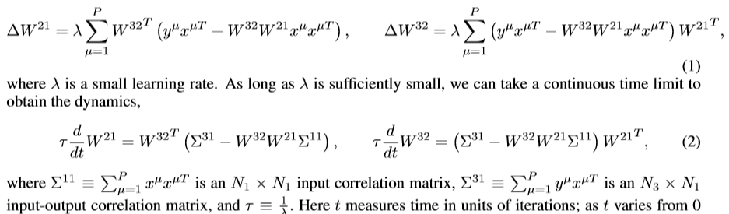


General learning dynamics
Gradient descent via squared error
Where the training dataset is
P is the number of training samples
This gradient descent yields the batch learning rule:
Notes:
T means the # of iterations. Despite the linearity of linearity of the network, functions (2) shows nonlinear learning dynmics
11 is N1 * N1 input correlation matrix
31 is nx*n1 input output correlation matrix

Slide 4
General learning dynamics
Further simplify the analysis by focusing on the case of orthogonal inputs, where
Then only the input-output correlation matrix plays an important role of learning dynamics.
These dynamics arise from gradient descent on the energy function:
First term, drive the same input connectivity modes
Second term, show the competition between connectivity modes in the first and second layers associated with different input modes.

Slide 5
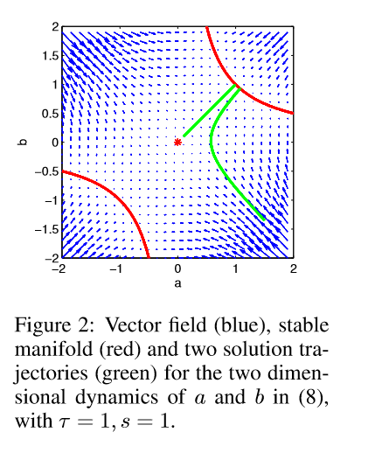

General learning dynamics
Outcome of learning:
A necessary condition for a fixed point is , while aα and bα are zero whenever sα = 0.
To satisfy these relations for undercomplete hidden layers (N2 < N1,N2 < N3), aα and bα can be nonzero for at most N2 values of α. Since there are rank(Σ31) ≡ r nonzero values of sα, there are C(r, N2) families of fixed points
Among all of these fixed points, one only is stable. Which satisfy

Slide 6
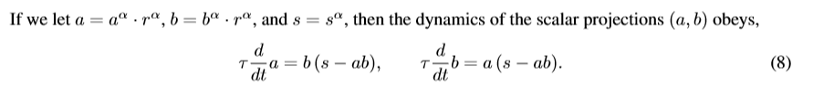
General learning dynamics
The time of learning
Special class for initial conditions
(all other connectivity modes a alpha and b alpha = 0)
r alpha is a fixed collection of N2 vectors that form an orthonormal basis for synaptic connections from an input or output mode onto the same set of hidden units
For function 5 and 6, the dot products are equal to 0 because the different active modes are orthogonal to each other.
These equations can by solved by noting that they arise from gradient descent on the error,
This implies that the product ab monotonically approaches the ﬁxed point s from its initial value. Moreover, E(a,b) satisﬁes a symmetry under the one parameter family of scaling transformations a → λa, b → b λ.

Slide 7
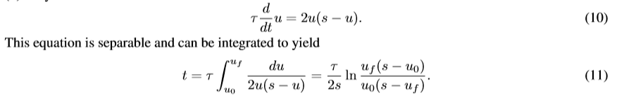
We can then track the dynamics of u ≡ ab, which from (8)
Notes:
Here t is the time it takes for u to travel from u0 to uf. If we assume a small initial condition u0 = , and ask when uf is within of the ﬁxed point s, i.e. uf = s−, then the learning timescale in the limit → 0 is t = τ/sln(s/) = O(τ/s) (with a weak logarithmic dependence on the cutoff). This yields a key result: thetimescaleoflearningofeachinput-outputmode α ofthecorrelationmatrix Σ31 isinverselyproportional to the correlation strength sα of the mode. Thus the stronger an input-output relationship, the quicker it is learned.

Slide 8


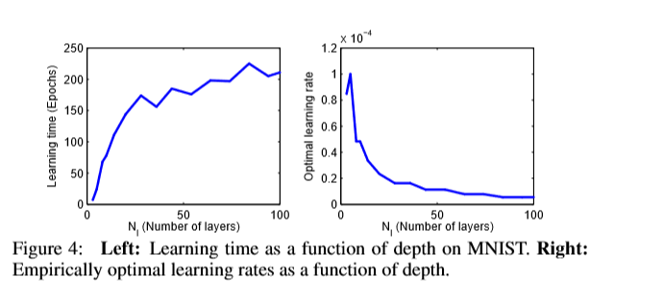
Deeper multiplayer dynamics
The shallow linear network is the minimal example of a multilayer net.

Slide 9
Extension to Nonlinear network

Slide 10
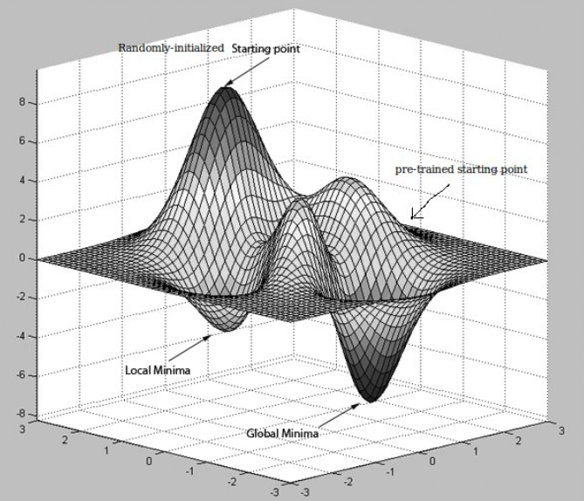
What conditions on weight matrices can produce depth-independent learn time?

Slide 11
3 useful insights from analysis of deep linear networks:
Decoupling of modes in hidden layers
Orthogonality
Mode strength
Notes:
I still need to think about what to say on these three topics…

Slide 12
Exploration of 3 different weight initializations:
Greedy layer-wise unsupervised pretraining
Random Gaussian distribution
Orthogonal matrix

Slide 13
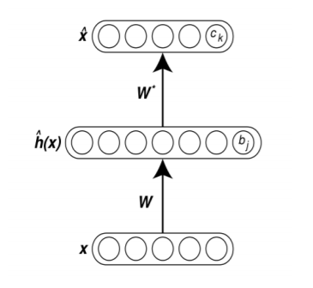
Greedy layer-wise pretraining
Breakthrough discovery in training deep neural network to counter the vanishing gradient problem
Speeds up and improves generalization performance of standard gradient descent
Author’s procedure: use autoencoders to 1) train the network to produce its input as its output and then 2) finetune the on the ultimate input-output task of interest
W != W* to avoid
learning the identity matrix

Slide 14
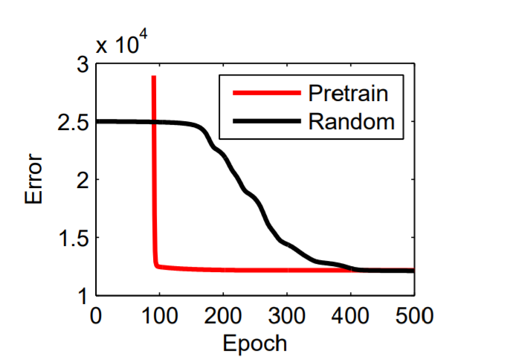
It works well…
Why?
****
Learning curves on MNIST for a five layer linear network starting from random Gaussian vs pretrained weights
Notes:
**** I’m still not sure– the paper seems to say the autoencoder’s approximation of input-input correlation matrix is basically PCA, where the eiganvalues are close to identiy matrix ~stable. But I’m still struggling to understand the author’s statement on page 9 “the right singular vectors of the ultimate input-output task of interest V11 must be similar to the principal components of the input data Q”

Slide 15
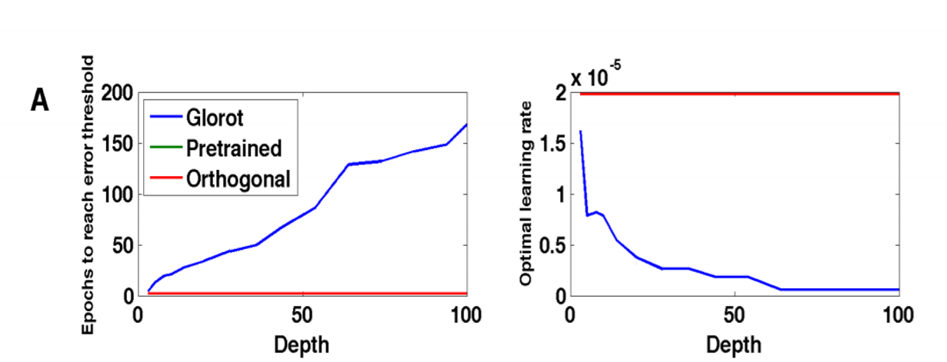
Weights i.i.d from Gaussian vs orthogonal matrix

Slide 16
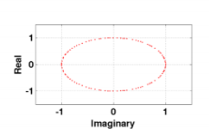
Initial Weights i.i.d from Gaussian vs orthogonal matrix
Orthogonal matrices have eiganvalues whose absolute value is 1
Eiganvalues indicate system stability over time (via matrix multiplications). Values < 1 will attenuate over time and values >1 will explode over time, making gradient descent vanish or become highly fluctuating respectively
By contrast, author shows the product of weight matrices with initial weights picked i.i.d from a Gaussian distribution concentrate closer to the origin as depth increases (vanishing gradient?)

