Slide 1
Ocumet: Comparison of FPF between Control and ODD, NAION groups
Publication Figures
Miaomiao Yu
16 Nov 2022

Slide 2
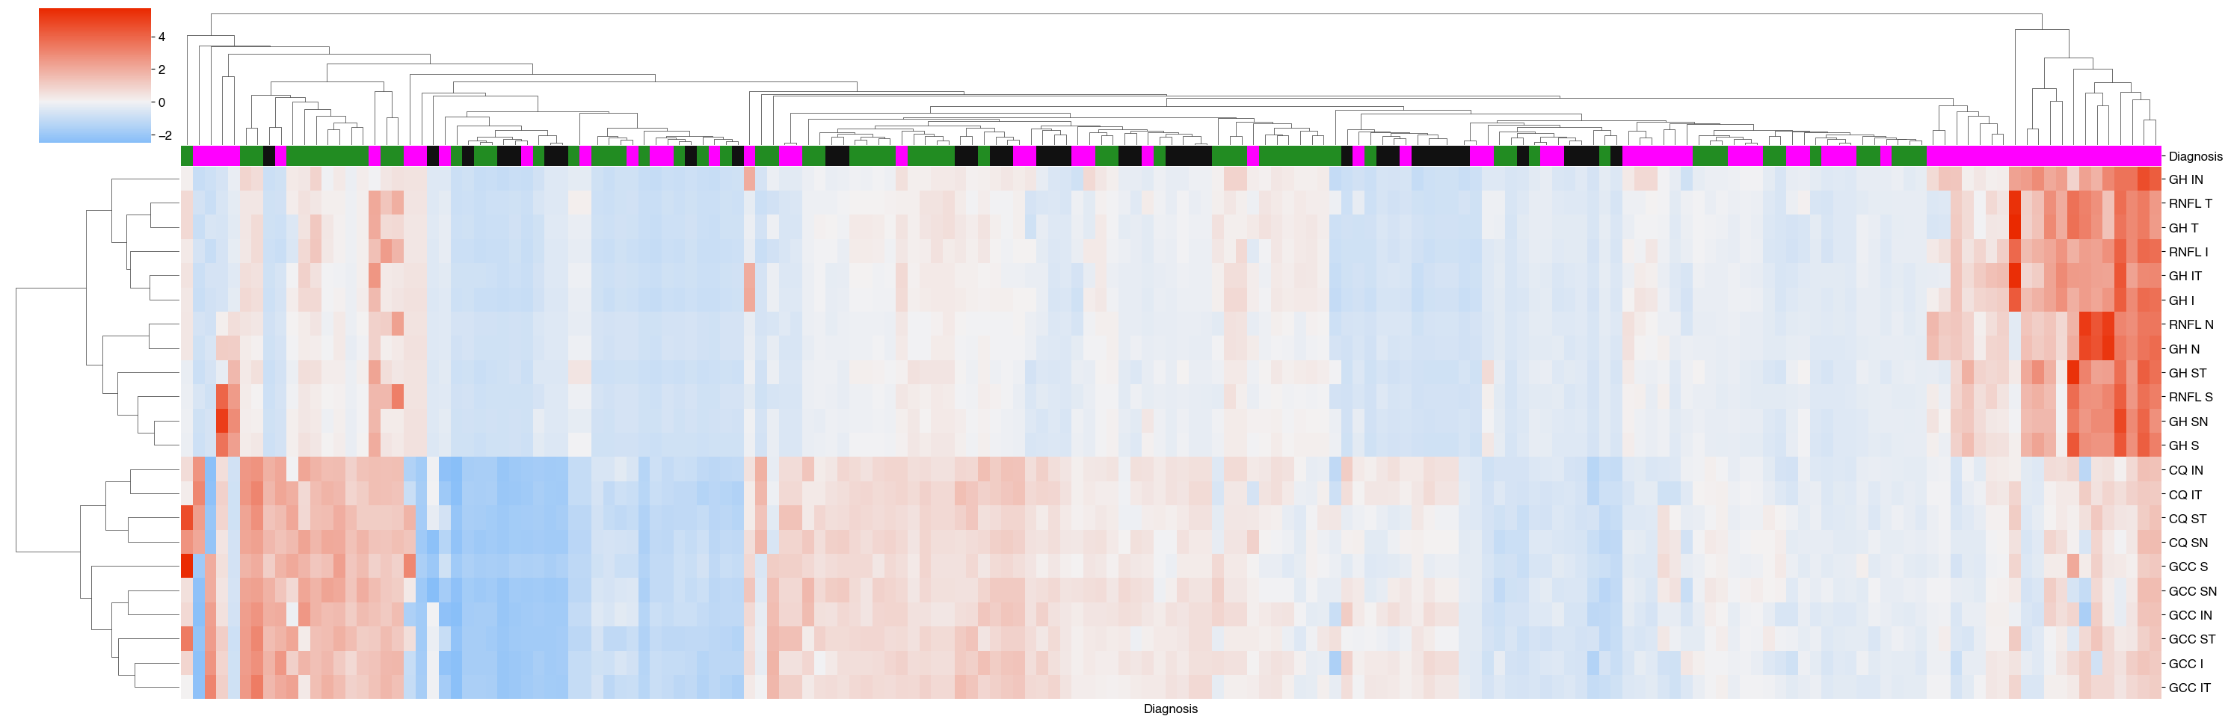
Figure 1. Clustermap of FPF values measured within conventional OCT or OCTA sections for different patient groups (black = Controls, green = NAION, magenta = ODD). FPF values are standardized to the distribution of Control group. The figure shows a clear distinction between FPF values found in disc and macular regions, with a cluster of ODD patients showing much higher FPF values than other patient groups.

Slide 3
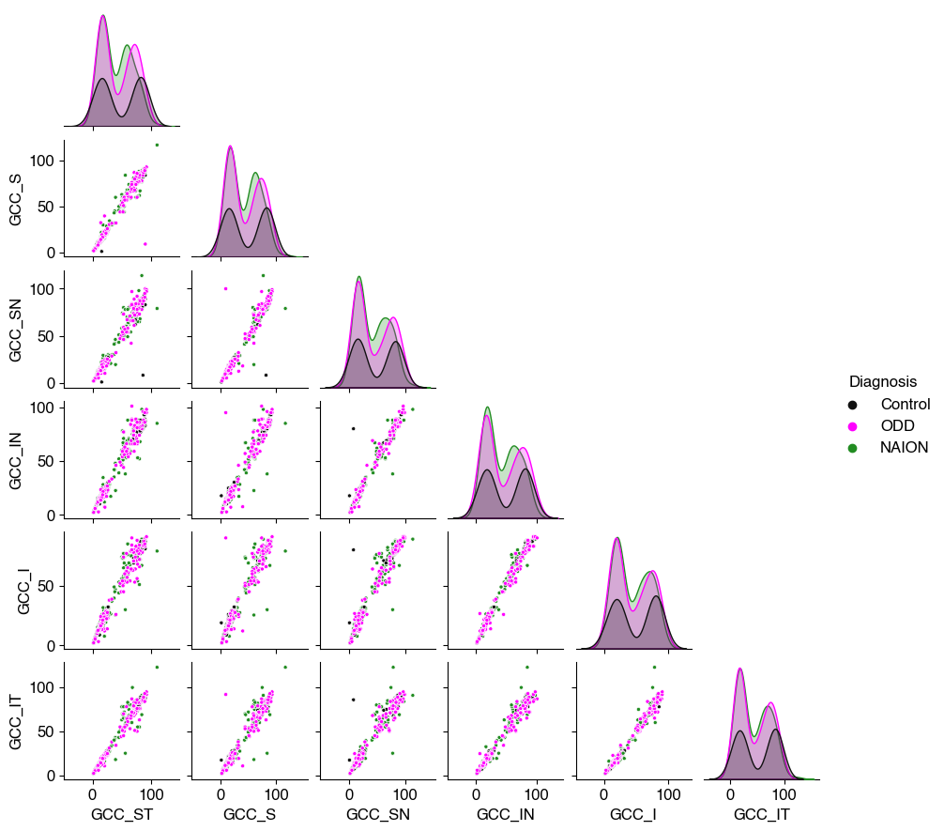
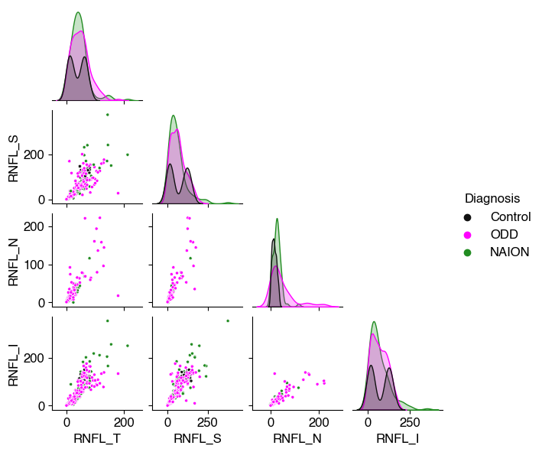
Figure 2. Pair plots of OCT values and FPF values for each RNFL quadrant and GCC sector. The figures indicate high correlation between the two measurements. (No stats yet, sorry). Colors indicate patient group.

Slide 4
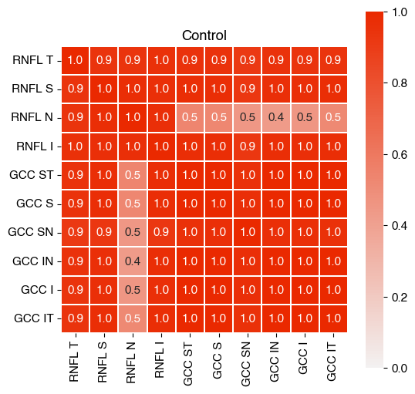
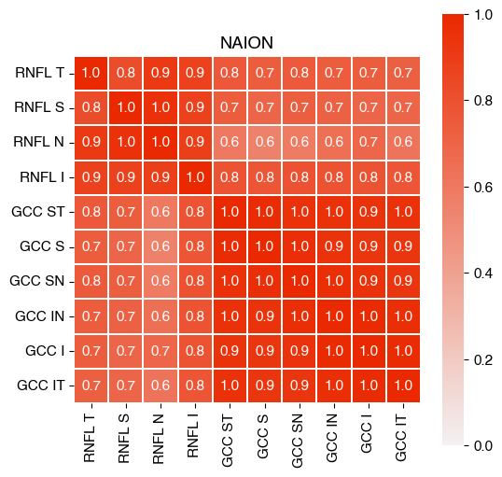
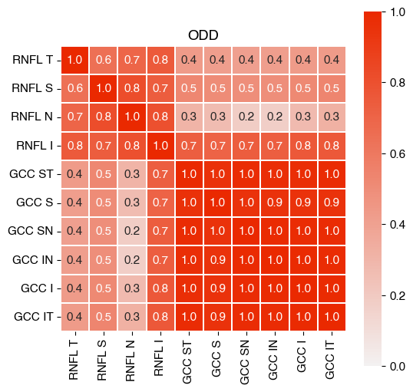

Slide 5
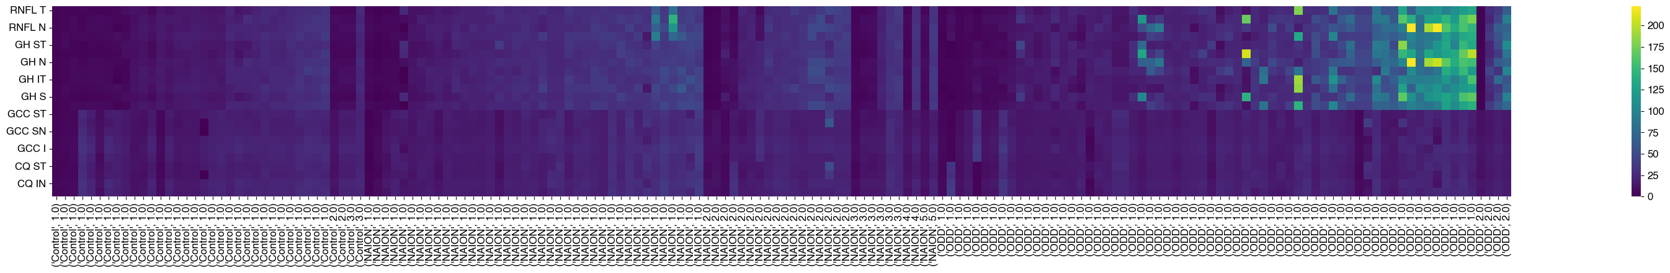
Time
Figure 3. Heatmap for FPF values across visit numbers and patient group.

Slide 6
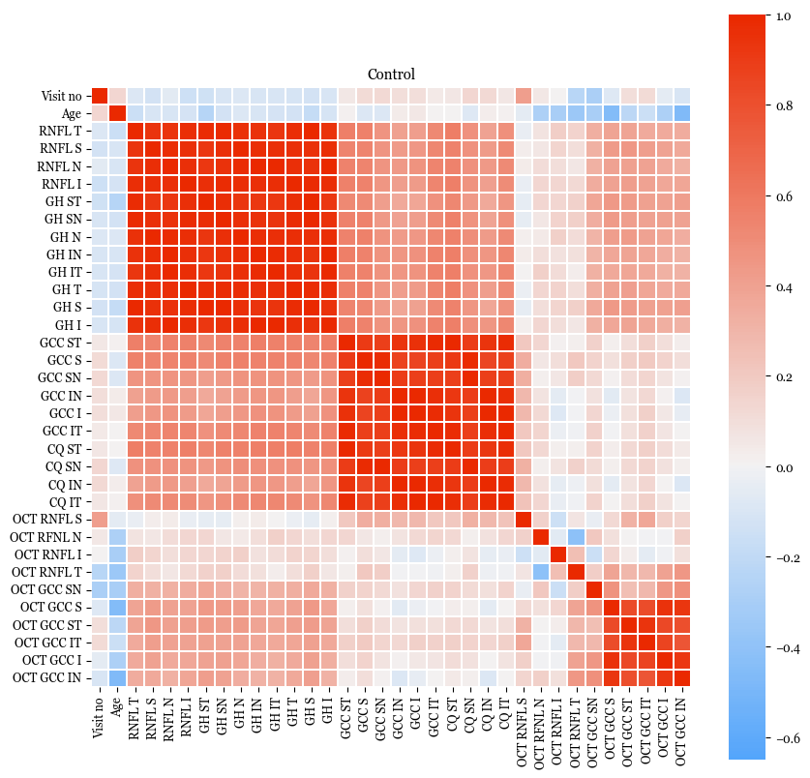
Heatmap of correlation values across all FPF and OCT values.

Slide 7
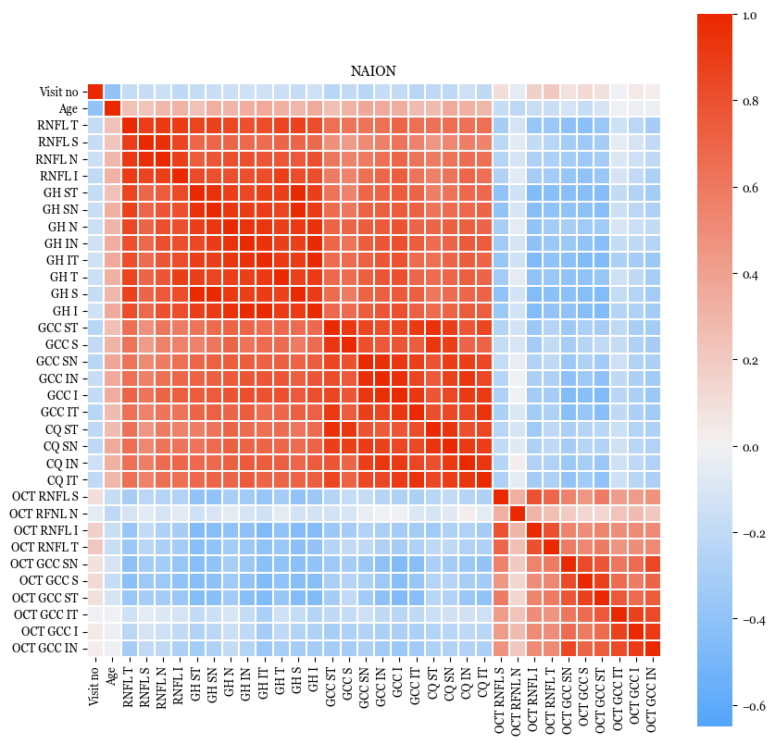
Heatmap of correlation values across all FPF and OCT values.

Slide 8
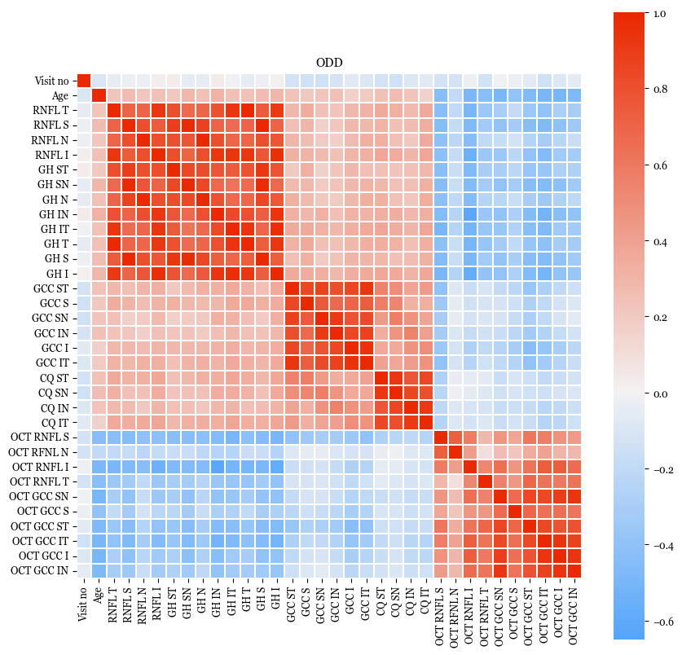
Heatmap of correlation values across all FPF and OCT values.

