Slide 1
SOFTWARE Engineering PM REVIEW
G2 TEAM 2

Slide 2
content
Functionalities
Schedule
Metrics
Roles & Responsibilities
Pair Programming Rotation Plan

Slide 3
Functionalities
G2 TEAM2 COLOR: BLUE
Login
Bootstrap
Basic App Usage Report
Top-k App Usage Report
Smartphone Overuse Report
Dual Interfaces (Web UI and Web Services)

Slide 4
JSP MODEL 1
Browser
3. Connects & retrieves data
1. HTTP Request
JSP
(View + Controller)
2. Invokes method (CRUD)
DataManager
(Model)
4. Instantiates object (for select)
Database
6. HTTP Response
Java Class
(Model)
5. Retrieves data

Slide 5
Schedule
Milestone2
30Sep PM review
Milestone4
27Oct
Supervisor meeting3
Read Requirements, Assignment of Roles and Task, Use cases
Login Debugging, Bootstrap,
App Usage Report
Web UI and Web Service
Testing before UAT
Milestone5
3Nov UAT
27Aug
to 10Sep
9Oct
to 22Oct
11Sep
to 24Sep
25Sep
to 8Oct
23Oct
to 5Nov
6Nov
to 18Nov
ITERATION
1
2
3
4
5
6
Start
Buffer Time
End
SD, LD, Class diagrams, Login (Test Case + Coding)
Top-k, Smartphone Overuse Report
Final code sharing, deployment, testing and Presentation Preparation
Milestone1
22Sep
Supervisor meeting1
Milestone3
13Oct
Supervisor meeting2
Milestone6
18Nov
Final presentation

Slide 6
Schedule
INTERNAL MEETING
DESIGN
DEVELOPMENT
LOCAL TEST
INTEGRATION & TESTING
DEPLOYMENT & TESTING
END OF ITERATION

Slide 7
Iteration 1: ▼ | PM: Claudie
Design
Read requirements | Claudie
Assignment of Roles and Tasks | Claudie
Write Use case scenario | Claudie
Draw Use case diagrams | Claudie

Slide 8
Iteration 2: ▼ | PM: Claudie
Internal Meeting | Claudie
Design
Draw all the SDs | PM in charge and we discuss and draw diagrams together as a team
Class diagram
Logical diagram
Feature Design
Update Use Case diagrams/SD/Class Diagrams | Claudie
Test Case Design | Fuyan
Development
Coding of Login (JAVA Class) | De Wang, Claudie
Coding of Login (UI, Authentication) | Gao Shuang, Miao Qiong
Coding of Login (Database connection) | Miao Qiong
End of Iteration | Claudie

Slide 9
Iteration 3: ▼ | PM: DEWANG
Internal Meeting | DEWANG
Feature Design
Update Use Case diagrams/SD/Class Diagrams | Fuyan,Miaoqiong
Test Case Design for bootstrap | Claudie, Gaoshuang
Test Case Design for App usage Report | Fuyan, DEWANG
Development
bootstrap | Pair programming
App usage report
Local Test
Testing & debugging (login) | Claudie, Fuyan
Testing & debugging (bootstrap) | Gao Shuang, Miao Qiong
Testing & debugging (app usage report) | DEWANG, Claudie
Integration
Integrating with earlier functionalities | De Wang, Fu Yan
Testing & Debugging | Miaoqiong, Claudie

Slide 10
Deployment
Deploy function to OpenShift | De Wang
Testing & Debugging on OpenShift | Gao Shuang
End of Iteration
Code-sharing | DEWANG
Metric collection and Mitigation | DEWANG
Update next iteration schedule | DEWANG
PM Handover | DEWANG

Slide 11
Iteration 4: ▼ | PM: Gao Shuang
Feature Design
Update Use Case diagrams/SD/Class Diagrams for Top-k and Smartphone Overuse Report | Gao Shuang
Test Case Design (Top-k Usage Report) | Claudie, Dewang
Test Case Design (Smartphone Overuse Report) | Miaoqiong, Fu Yan
Development
Coding for Top-k Usage Report | Miaoqiong, Fu Yan
Coding for Smartphone Overuse Report | Claudie, Dewang
Local Test
Testing & Debugging for Top-k Usage Report | Miaoqiong, Fu Yan
Testing & Debugging for Smartphone Overuse Report | Claudie, Dewang

Slide 12
Integration
Integrating Top-k Usage Report with earlier functionalities | Miaoqiong, Fu Yan
Integrating Smartphone Overuse Report with earlier functionalities | Claudie, Dewang
Testing & Debugging | Fu Yan, Miaoqiong
Deployment
Deploy Top-k Usage Report to OpenShift | Fu Yan, Miaoqiong
Deploy Smartphone Overuse Report to OpenShift | Claudie, Gao Shuang
Testing & Debugging on OpenShift | Gao Shuang
End of Iteration
Code-sharing | Gao Shuang
Metric collection and Mitigation | Gao Shuang
Update next iteration schedule | Gao Shuang
PM Handover | Gao Shuang

Slide 13
Iteration 5: ▼ | PM: FU YAN
Design
Update Use Case diagrams/SD/Class Diagrams for Dual Intereface | Fu Yan
Test Case Design (Dual Interface) | Fu Yan, Gao Shuang
Development
Coding for Dual Interface | De Wang, Claudie
Local Test
Testing & Debugging for Dual Interface | Miaoqiong, Fu Yan
Integration
Integrating with earlier functionalities | Gao Shuang, Claudie
Test
Testing & Debugging | Miaoqiong, De Wang
Deployment
Deploy function to OpenShift | Claudie
Testing & Debugging on OpenShift | Miaoqiong, Gaoshuang

Slide 14
End of Iteration
Code-sharing | Fu Yan
Metric collection and Mitigation | Fu Yan
Update next iteration schedule | Fu Yan
PM Handover | Fu Yan

Slide 15
Iteration 6: ▼ | PM: Miao Qiong
Update and finalise all diagrams | Claudie, Gao Shuang
Prepare slides | Fu Yan, De Wang
Code-sharing | Miaoqiong
Presentation Rehearsal | Miaoqiong

Slide 16
Critical path
Any delay on a activity on the critical path impacts the completion date
Code-sharing and handover
Project preparation
Assign roles and tasks
Technical document
Login function
1Day
1Day
7Days
4Days
1Day
1Days
4Days
Common Validations
File-specific validations
Update SD and design test case
App usage Report function
UI and unzip files
Upload data and add additional
3Days
1Day
1Days
3Days

Slide 17
8Days
topK usage report function
Local testing
Integration and Deployment
Code-sharing and handover
3Days
Smartphone overuse function
1Day
1Day
5Days
Integration and Deployment
Integration and Deployment
Finalize and buffer time
Code-sharing and handover
Dual interface
2Days
1Day
3Days
2Days
9Days
6Days
Final testing & debugging
Final testing
Prepare slides
Rehearsal
Code-sharing and handover
Update and finalize technical documents
3Days
3Day
3Day
1Day
3Days
Any delay on a activity on the critical path impacts the completion date

Slide 18
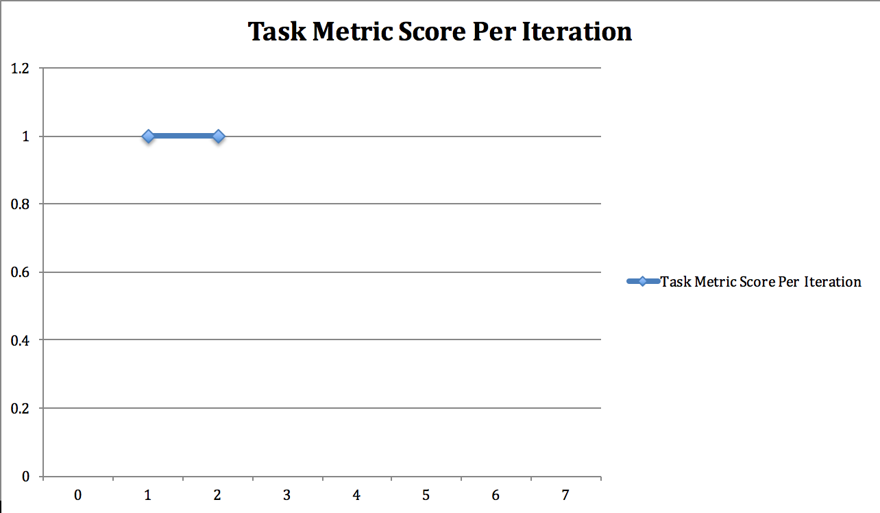
Metrics-task metrics
Actual tasks/ Estimated tasks completed
Mitigation plan:
We finished all the tasks in iteration1 and iteration2
90 < Percentage <= 110
Our estimates are fairly accurate, and we are roughly on track

Slide 19
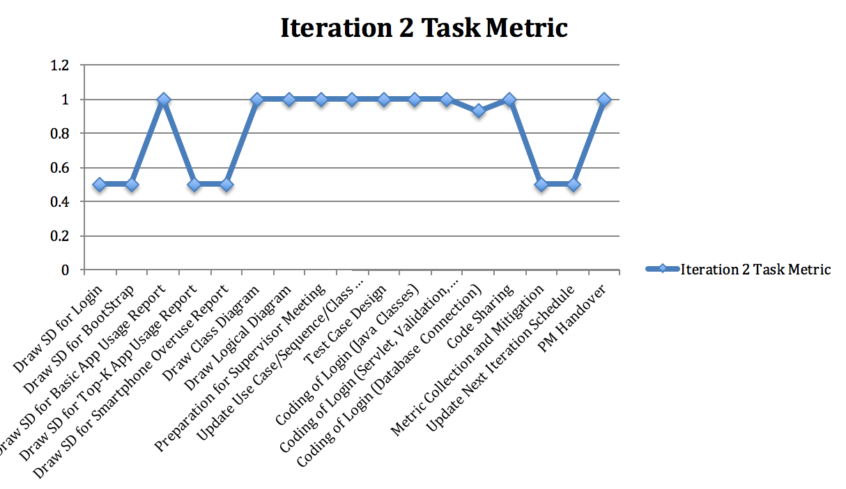
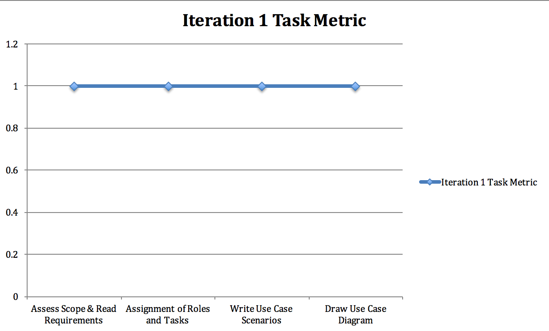

Slide 20
Bug metrics
Iteration | Files Affected | Description | Severity
3 | authenticate.jsp | Authentication returns false for all cases | low
3 | UserDAO.java | Cannot load data | high
3 | login.jsp | Error messages cannot be printed out | low

Slide 21
Formula: 1 x num (low) + 5 x num (high) + 10 x num (critical)
7 points
Points in Iteration | Action
Points < 10 | Use the planned debugging time in the iteration.
Points >= 10 | Stop current development and resolve the bug immediately. Project Manager reschedules the project.

Slide 22
Pair programming metrics
Formula: Estimated PP hours/ actual PP hours (per task)
Task | Plan | Actual | Score | Action
Login Database Connection | 1 | 0.93 | 1.07 | No action required.
Login Testing & Debugging | 1 | 1.13 | 0.88 | No action required.
Unzip file | 1 | 3.2 | 0.31 | Re-estimate the tasks in the coming iteration(s) and update the schedule document. Review possible pairing & estimation issues.
Common validation | 3 | 3.17 | 0.95 | No action required.

Slide 23
Score(%) | Action
PPM < 50 | Re-estimate the tasks in the coming iteration(s) and update the schedule document. Review possible pairing & estimation issues.
50 < PPM <= 150 | No action required.
150 < PPM | Re-estimate the tasks in the coming iteration(s) ) and update the schedule document. Review possible pairing & estimation issues.
Notes:
This is a hide page

Slide 24
Roles & Responsibilities
ITERATION | PROJECT MANAGER | Milestone
1 | Claudie
2 | Claudie | 1
3 | DeWang | 2
4 | Gao Shuang | 3
5 | Fu Yan | 4,5
6 | MiaoQiong | 6

Slide 25
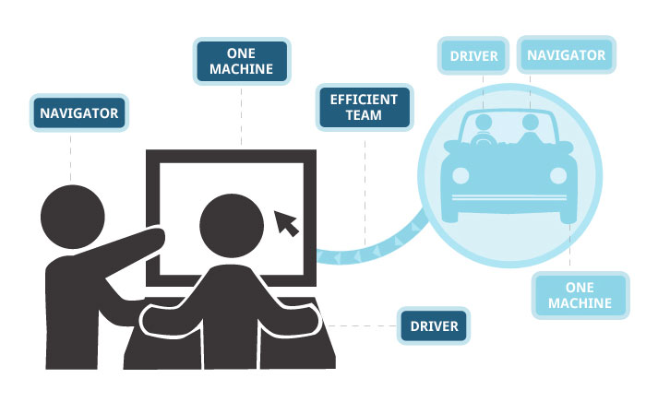
Pair programming rotation plan
STRONG - WEAK
RANDOM PAIRING

Slide 26
Functionality |  | Rotation
Bootstrap | Unzip files Common validations for all data files/File-specific Validation Upload data, read csv and add additional data, bootstrap | Miaoqiong & Dewang Gaoshuang & Fuyan Claudie & Dewang
App Usage Report | Usage time/Usage time + demographics App category Diurnal pattern of app usage time | Claudie & Gaoshuang Miaoqiong & Fuyan Gaoshuang & Dewang
Top-k App Usage Report | - | Claudie & Dewang
Smartphone Overuse Report | - | Miaoqiong & Fuyan
Dual Interfaces (Web UI and Web Services) | - | Miaoqiong & Dewang Claudie & Gaoshuang

Slide 27
Q & A

Slide 28
Thank you SE ALL THE BEST : )

