Slide 1
Software Engineering Supervisor Meeting 2
G2 TEAM 2

Slide 2
Agenda
Project progression
Challenges
Responsibility
Metrics

Slide 3
Project Progression
Iteration 1 | PM: Claudie
Design | Assign to
Read requirement | Chaudie
Assignment of roles and tasks | Chaudie
Write use case scenario | Chaudie
Draw use case diagrams | Chaudie

Slide 4
Project Progression
Iteration 2 | PM: Claudie
Internal Meeting | Claudie
Design
Sequence Diagram | PM in charge and we discuss and draw diagrams together as a team
Class diagram
Logical diagram
Feature Design
Update Use Case diagrams/SD/Class Diagrams | Claudie
Login Test Case Design | Fu Yan
Development
Coding of Login (JAVA Class) | De Wang, Claudie
Coding of Login (UI, Authentication) | Gao Shuang, Miao Qiong
Coding of Login (Database connection) | Gao Shuang, Miao Qiong
End of Iteration | Claudie

Slide 5
Project Progression
Iteration 3 | PM: Dewang
Internal Meeting | Dewang
Feature Design
Update Use Case diagrams/SD/Class Diagrams | Fu Yan,Miaoqiong
Test Case Design for bootstrap | Claudie, Gaoshuang
Test Case Design for App usage Report | Fu Yan, Dewang
Development
Bootstrap (Validation) | Gao Shuang, Fu Yan
Bootstrap (Unzip) | Miaoqiong, Dewang
Bootstrap (Upload data) | Miaoqiong, Dewang
Bootstrap (Read csv and additional data) | Fu Yan, Claudie
App usage report (by app category) | Claudie, Fu Yan
App usage report (by usage time category) | Claudie, Dewang
App usage report (by usage time category and demographics) | Claudie, Dewang
App usage report (Diurnal pattern) | Claudie, Dewang

Slide 6
Project Progression
Iteration 3 | PM: Dewang
Local Test
Testing & debugging (login) | Gao Shuang. Miaoqiong
Testing & debugging (bootstrap) | Claudie, Miao Qiong
Testing & debugging (app usage report) | Dewang, Claudie
Integration
Integrating with earlier functionalities | Dewang, Fu Yan
Testing & Debugging (after integrating) | Miaoqiong, Claudie
Deployment
Deploy function to OpenShift | Dewang
Testing & Debugging on OpenShift | Gao Shuang
End of Iteration
Code-sharing | Dewang
Metric collection and Mitigation | Dewang
Update next iteration schedule | Dewang, Gao Shuang
PM Handover | Dewang, Gao Shuang

Slide 7
Project Progression
Iteration 4 | PM: Gao Shuang
Internal Meeting | Gao Shuang
Feature Design
Update Use Case diagrams/SD/Class Diagrams for Top-k and Smartphone Overuse Report | Gao Shuang
Test Case Design (Top-k Usage Report) | Claudie, Dewang
Test Case Design (Smartphone Overuse Report) | Miaoqiong, Fu Yan
Development
Coding for Top-k Usage Report | Miaoqiong, Fu Yan
Coding for Smartphone Overuse Report | Claudie, Dewang
Local Test
Testing & debugging (app usage report) | Dewang, Gao Shuang
Testing & Debugging for Top-k Usage Report | Miaoqiong, Fu Yan
Testing & Debugging for Smartphone Overuse Report | Claudie, Dewang

Slide 8
Project Progression
Iteration 4 | PM: Gao Shuang
Integration
Integrating with earlier functionalities | Miao Qiong, Fu Yan
Testing & Debugging (after integrating) | Gao Shuang, Dewang
Optimize bootstrap performance | Miaoqiong, Fu Yan
Integrating Top-k Usage Report with earlier functionalities | Miaoqiong, Fu Yan
Integrating Smartphone Overuse Report with earlier functionalities | Claudie, Dewang
Testing & Debugging | Fu Yan, Miaoqiong
Deployment
Deploy function to OpenShift | Dewang
Testing & Debugging on OpenShift | Gao Shuang, Dewang
Deploy Top-k Usage Report to OpenShift | Fu Yan, Miaoqiong
Deploy Smartphone Overuse Report to OpenShift | Claudie, Gao Shuang
Testing & Debugging on OpenShift | Gao Shuang

Slide 9
Project Progression
Iteration 4 | PM: Gao Shuang
End of Iteration
Code-sharing | Gao Shuang
Metric collection and Mitigation | Gao Shuang
Update next iteration schedule | Gao Shuang
PM Handover | Gao Shuang

Slide 10
Project Progression -- Deviation
Iteration 1 and 2 end without extension
Iteration 3:
1. 5 tasks are not done: due to time boxing, we move the 5 tasks to the next iteration which is iteration 4
2. Bootstrap poor performance: we add a new task “optimize bootstrap performance”

Slide 11
Project Progression -- Milestone
Top-k App Usage Report
Week 9
Supervisor Meeting 2
Week 11
Supervisor Meeting 3
Smartphone Overuse Report

Slide 12

Challenges -- Bootstrap
Bootstrap/ add additional data:
- Optimizing performance now

Slide 13
Current Responsibility
Had being/ is now PM thus more tasks
Name | Count tasks | Main Functions Assign
Claudie | 19 | Basic App Usage Report
Dewang | 20 | Basic App Usage Report
Gao Shuang | 17 | Login, Basic App Usage Report(UI)
Fu Yan | 12 | Bootstrap
Miaoqiong | 13 | Login, Bootstrap

Slide 14
Current Metrics -- Task Metrics
Iteration | Plan | Actual | Score | Action
1 | 4 | 4 | 1
2 | 17 | 17 | 1
3 | 21 | 16 | 0.77 | Re-estimate the tasks for the future iterations. Deduct the number of days behind schedule from buffer days. If there is no more buffer day, decide which functionalities to be pushed to the next iteration.

Slide 15
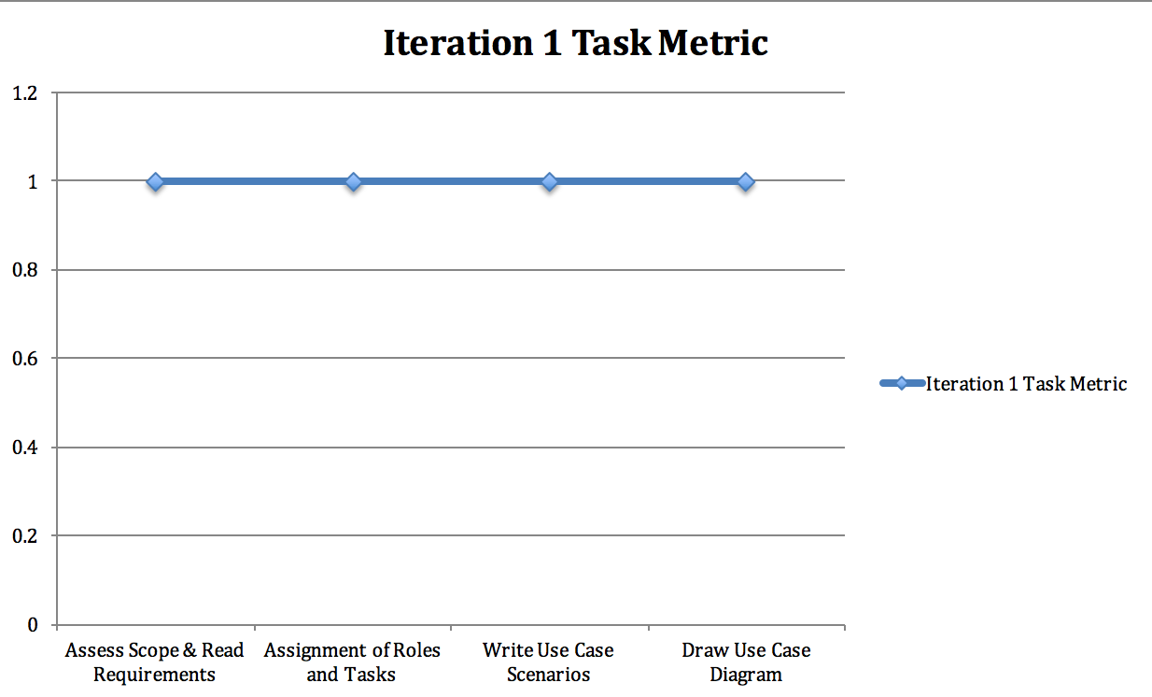
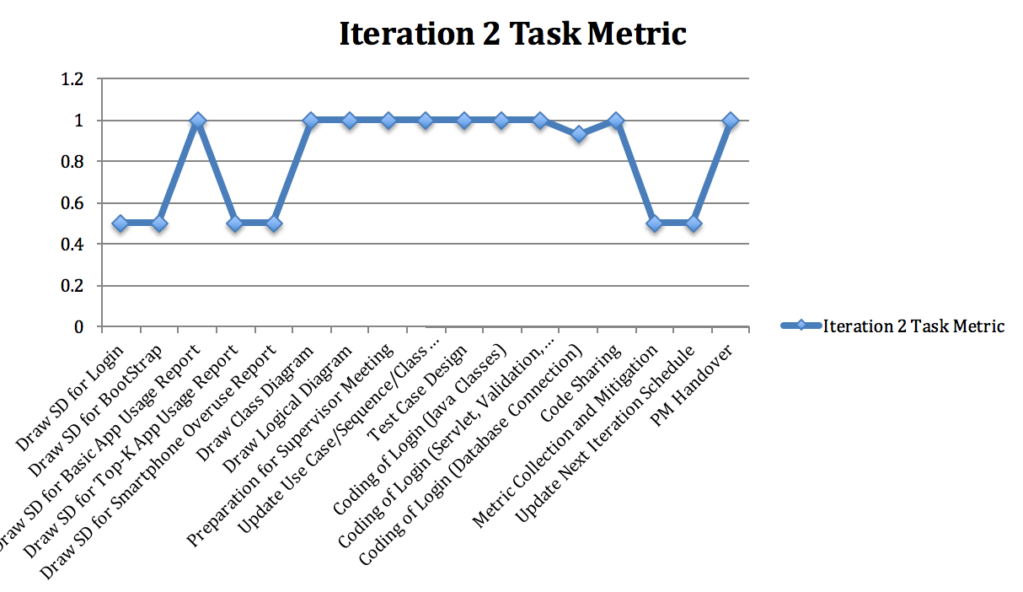

Slide 17
Current Metrics -- Bug Metrics
Iteration | Files Affected | Description | Severity | Solved
3 | authenticate.jsp | Authentication returns false for all cases | low | Solved
3 | UserDAO.java | Cannot load data | high | Solved
3 | login.jsp | Error messages cannot be printed out | low | Solved
3 | appusageDao | retrieve from database, nothing return | low | Solved
3 | processBasicAppUsage.java | display wrong percentage | low | Solved
3 | processBasicAppUsage.java | incorrect user categoried (intense as mild) | low | Solved
3 | adminDisplay.jsp | Errror message cannot be printed when no file is chosen by user. | low | Solved
3 | BootstrapValidation.java | Check app.csv duplicate row. Did not add header into arraylist to check for duplicated records. | low | Solved
3 | BootstrapValidation.java | Check invalid appid. Could not for alphabetical data. | low | Solved
3 | BootstrapValidation.java | Check duplicated rows. After boolean is "false", did not put "break;" | low | Solved
3 | BootstrapValidation.java | "if" condition for checking duplicated rows does not work properly. "&&" "||" | low | Solved

Slide 18
Current Metrics -- Bug Metrics
Iteration | Files Affected | Description | Severity | Solved
3 | BootstrapValidation.java | Duplicated rows, after checking could not add correct rows into arraylist | high | Solved
3 | BootstrapValidation.java | Line Number could not be displayed properly | low | Solved
3 | Bootstrap.java and adminDisplay.jsp | Error messages cannot be forward to adminDisplay | low | Solved
3 | adminDisplay.jsp | Could not direct to servlet from adminDisplay.jsp | high | Solved
3 | BootstrapValidation.java | Error Message displayed as "Ling number" | low | Solved
3 | BoostrapValidation.java | Email validation could not check for "xxx2014@school.smu.edu.sg" | low | Solved
3 | BootstrapValidation.java | Duplicated rows, after checking could not add correct rows into arraylist | high | Solved
3 | BootstrapValidation.java | Could not check for invalid date format (YYYY-MM-DD) | high | Solved
3 | adminDisplay.jsp | Could not filter not other file types and display error message. | high | Solved
3 | adminDisplay.jsp | Could not stop operation if the zip file contains non-csv files | low | Unsolved
3 | adminDisplay.jsp BootstrapServlet.java | Upload file repository created in C drive, project clean build could not clear the C drive repository | high | Solved

Slide 19
Current Metrics -- Bug Metrics
Iteration | Files Affected | Description | Severity | Solved
3 | Update.jsp UpdateServlet.java | Did not create another file directory for file unzip | low | Solved
3 | DAOs | Upload to data base could not load finish (takes too long) | critical | Solved
3 | ConnectionManager.java | Could not upload Chinese / Japanese / Korean characters onto SQL DB. It appears as codes. | high | Solved
3 | BootstrapServlet.java | Error when used request dispatched and response.sendRedirect() | low | Solved
67 Points Formula: 1 x 17 (low) + 5 x 8 (high) + 10 x 1 (critical)
Points in Iteration | Action
Points < 10 | Use the planned debugging time in the iteration.
Points >= 10 | Stop current development and resolve the bug immediately. Project Manager reschedules the project.

Slide 20
Current Metrics -- Bug Metrics
Iteration | Files Affected | Description | Severity | Solved
4 | Project JAR Library | Library and JAR files could not be loaded in Openshift | critical | Solved
4 | Openshift data directory | Could not find Openshift data directory and file directory cannot be found with slash '\\" | high | Solved
4 | processDiuranl,java/ processBasicAppUsage.java/processAppCagegory | can not getparameter from jsp page | low | Solved
4 | processBasicAppUsage.java | JDK version incompatible | low | Solved
4 | processAppCategory.java | JDK version incompatible | low | Solved
4 | processDiurnal.java | JDK version incompatible | low | Solved
4 | processDiurnalandAppcategory.java | user want to generate app report, but direct to diurnal page | low | Solved

Slide 21
Current Metrics -- Bug Metrics
Iteration | Files Affected | Description | Severity | Solved
4 | all the basic app UI page | user didn’t enter any information, NullpointerException | low | Unsolved
4 | processDiurnal.java | display result not accurate | low | Unsolved
4 | processDiuranl,java/processBasicAppUsage.java/processAppCagegory | incorrect user of sendRedirect | low | Solved
23 Points Formula: 1 x 8 (low) + 5 x 1 (high) + 10 x 1 (critical)
Points in Iteration | Action
Points < 10 | Use the planned debugging time in the iteration.
Points >= 10 | Stop current development and resolve the bug immediately. Project Manager reschedules the project.

Slide 22
Current Metrics – Pair Programming Metrics
Formula: Estimated PP hours/ actual PP hours (per task)
Task | Plan | Actual | Score | Action
Login Database Connection | 1 | 0.93 | 1.07 | No action required.
Login Testing & Debugging | 1 | 1.13 | 0.88 | No action required.
Unzip file | 1 | 3.2 | 0.31 | Re-estimate the tasks in the coming iteration(s) and update the schedule document. Review possible pairing & estimation issues.
Common validation | 3 | 3.17 | 0.95 | No action required.

Slide 23
Current Metrics – Pair Programming Metrics
Task | Plan | Actual | Score | Action
Upload data | 1 | 2.48 | 0.4 | Re-estimate the tasks in the coming iteration(s) and update the schedule document. Review possible pairing & estimation issues.
Read csv and add additional data | 2 | 2.7 | 0.74 | No action required.
Basic app usage report breakdown by usage time/usage time + demographics | 6.25 | 7.78 | 0.8 | No action required.
Basic app usage report breakdown by app category | 5 | 7.25 | 0.69 | No action required.
Diurnal pattern of app usage | 3.5 | 6.12 | 0.57 | No action required.
Testing & Debugging for login | 1 | 1.13 | 0.88 | No action required.
Testing & debugging for bootstrap | 5.5 | 11 | 0.5 | No action required.
Testing & debugging for app usage report | 2 | 2.18 | 0.92 | No action required.

Slide 24
- END -

