Slide 1
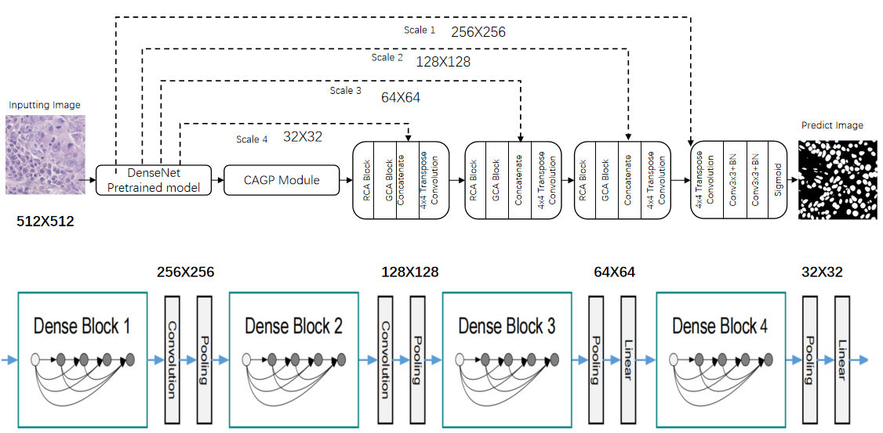
3、Research Approach
Encoder
Decoder Module
Decoder
Fig. 3.1 Structure of GC-UNet.
Notes:
The DenseNet block is used to replace the original U-Net encoder block.
The Context-Aware Gating Pooling (CAGP) module enhances the extraction of higher-level semantic feature maps.
The decoder Module contains RCA (Residual Context Attention) blocks and GCA (Global Context Attention) blocks,
and skip connections are used to transfer original features from each encoder to each decoder.

Slide 2
3、Research Approach
Encoder
Fig. 3.2 The DenseNet block is used to replace the original U-Net encoder block.
Notes:
DenseNet blocks are used to replace the original U-Net encoder .
This encoder has a deep DenseNet with 4 dense blocks. The feature map size is then changed by convolution and pooling.

Slide 3
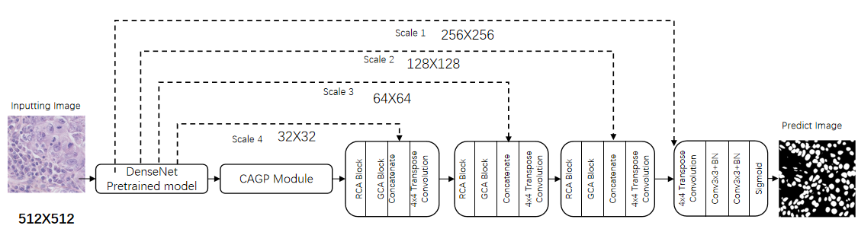
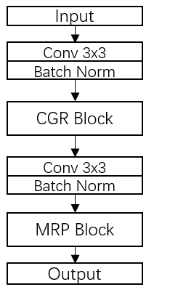
3、Research Approach
CAPG (Context-Aware Gating Pooling) module contains Context Gating Residual (CGR) block and Multipath Residual Pooling (MRP) block, enabling outstanding multi-scale feature extraction.
Fig. 3.3. The architecture of CAPG module.
Notes:
CAPG (Context-Aware Gating Pooling) module contains Context Gating Residual (CGR) block and Multipath Residual Pooling (MRP) block,
enabling outstanding multi-scale feature extraction.
Cancerous cells vary in size and shape.
I propose the Context Gating Residual (CGR) block and Multipath Residual Pooling (MRP) block to address this problem.

Slide 4
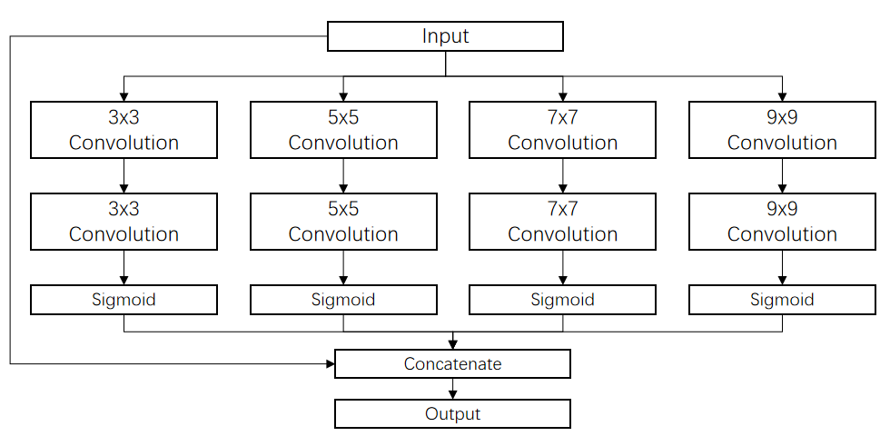
3、Research Approach
Fig. 3.5. The architecture of Context Gating Residual (CGR) block.
Notes:
The functions of the Context Gating Residual (CGR) block are as follows:
1.In favor of multi-scale feature extraction. 2.Residual connections make the network easier to train. 3.Improving context awareness. 4.The two-layer multi-scale convolutional neural network expands the receptive field.

Slide 5
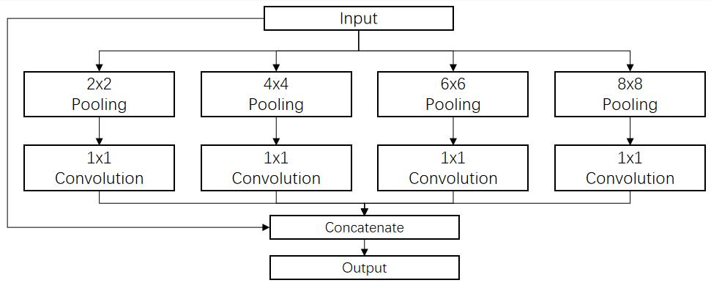
3、Research Approach
Fig. 3.10. The architecture of Multipath Residual Pooling (MRP) block.
MRP gather context information with four different-size pooling kernels.
Features are fed into 1×1 convolution to reduce the dimension of feature maps.
The features are concatenated with original features.
The architecture originates from "spatial pyramid pooling".
Gu Z, Cheng J, Fu H, et al. Ce-net: Context encoder network for 2d medical image segmentation[J]. IEEE transactions on medical imaging, 2019, 38(10): 2281-2292.
Notes:
MRP gather context information with four different-size pooling kernels.
Features are fed into 1×1 convolution to reduce the dimension of feature maps.
The features are concatenated with original features.
The architecture originates from "spatial pyramid pooling".

Slide 6
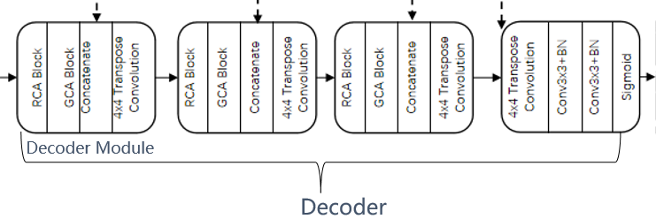
3、Research Approach
Decoder
Fig. 3.13. Architecture of feature decoder.
Feature decoder includes 3 decoder modules,a RCA Block, a GCA Block, a 4×4 transposed convolution, two 3×3 convolutions with batch normalization (BN), and a sigmoid activation function.
Notes:
Feature decoder includes 3 decoder modules,a RCA Block, a GCA Block, a 4×4 transposed convolution, two 3×3 convolutions with batch normalization (BN), and a sigmoid activation function

Slide 7
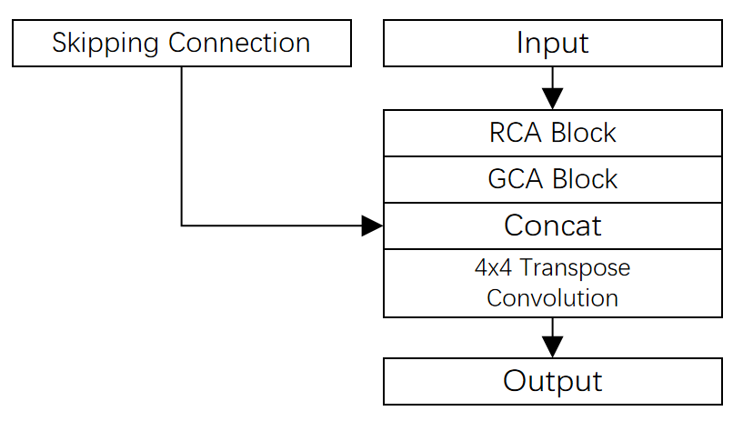
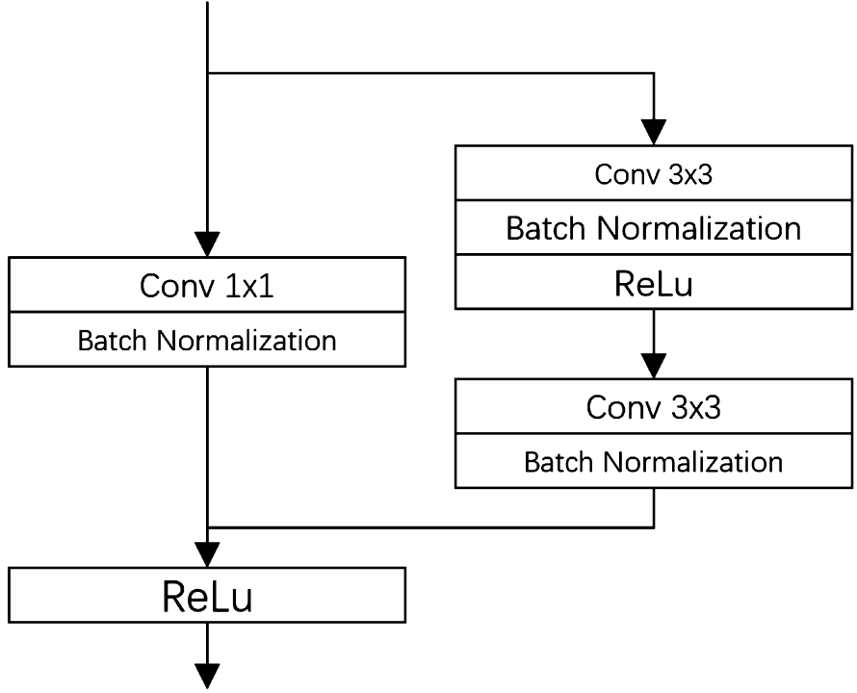
3、Research Approach
Decoder Module
Fig. 3.12. Decoder Module.
Fig. 3.13. Architecture of Residual Context Attention (RCA) block.
Residual Context Attention (RCA) block includes two 3×3convolutions, each followed by a batch normalization. The 1x1 convolution can enhance the expression ability of features, promote the network to learn and extract complex features more effectively, and ensure accuracy.
Notes:
Feature decoder module includes a RCA Block, a GCA Block, a 4×4 transposed convolution, and skipping connection with input features. Residual Context Attention (RCA) block includes two 3×3convolutions, each followed by a batch normalization. The 1x1 convolution can enhance the expression ability of features, promote the network to learn and extract complex features more effectively, and ensure accuracy.

Slide 8
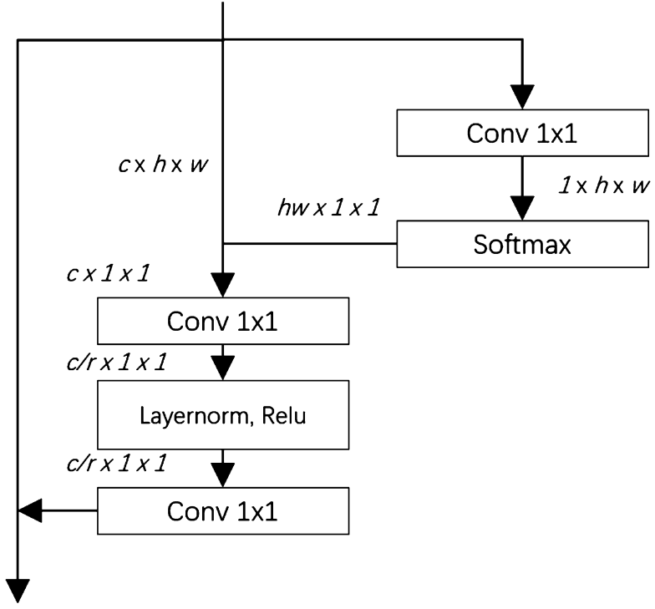
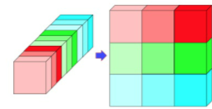
3、Research Approach
Decoder
Fig. 3.13. Architecture of Global Context Attention (GCA) block.
GCA block is used to fine-tune the weight of each feature to make the network focus on key elements and filter out irrelevant elements.
G. Yang, J. Huang, Y. He, Y. Chen, T. Wang, C. Jin, P. Sengphachanh, GCP-net: a gating context-aware pooling network for cervical cell nuclei segmentation, Mob. Inf. Syst. 2022 (2022).
Notes:
GCA block is used to fine-tune the weight of each feature to make the network focus on key elements.

Slide 9

4 Experiments and Discussion
Notes:
Next，Experiments and Discussion

Slide 10
Evaluation metrics
These Evaluation metrics include the Aggregated Jaccard Index , the Dice coefficient , and the panoptic quality.
Table 2 Datasets and their attributes.
Dataset | # of Images | Image Size | Division
MoNuSeg | 30 | 1000x1000 | 16/14
CoNSeP | 41 | 1000x1000 | 27/14
CPM-17 | 40 | 500x500 | 32/8
TCGA | 30 | 1000x1000 | 15/15
TNBC | 50 | 500x500 | 30/20
Notes:
Table 2 shows datasets and their attributes

Slide 11
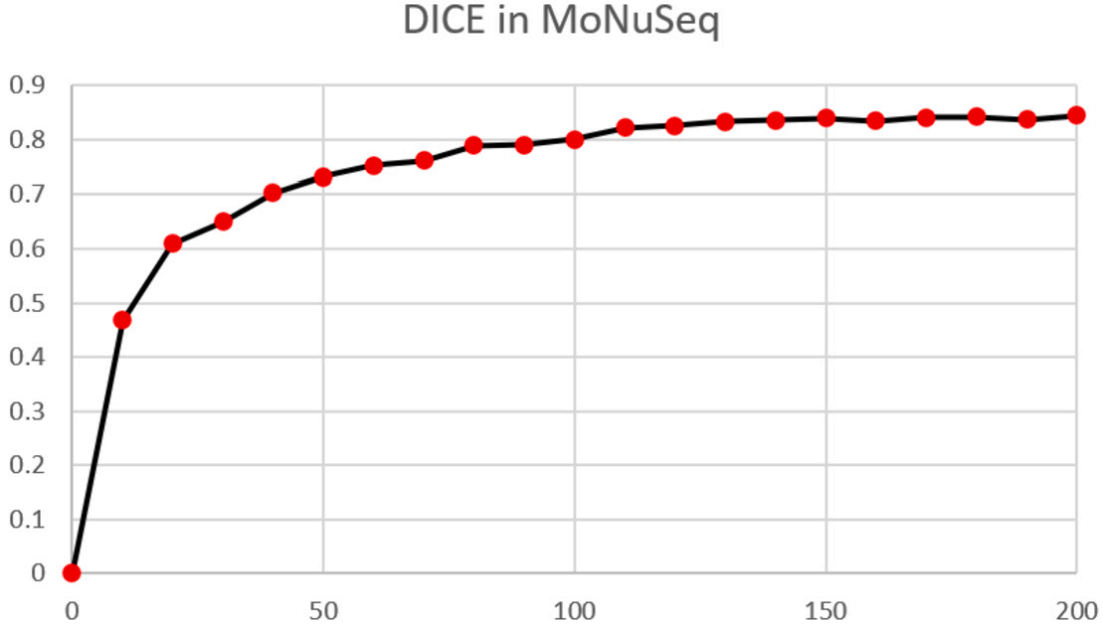
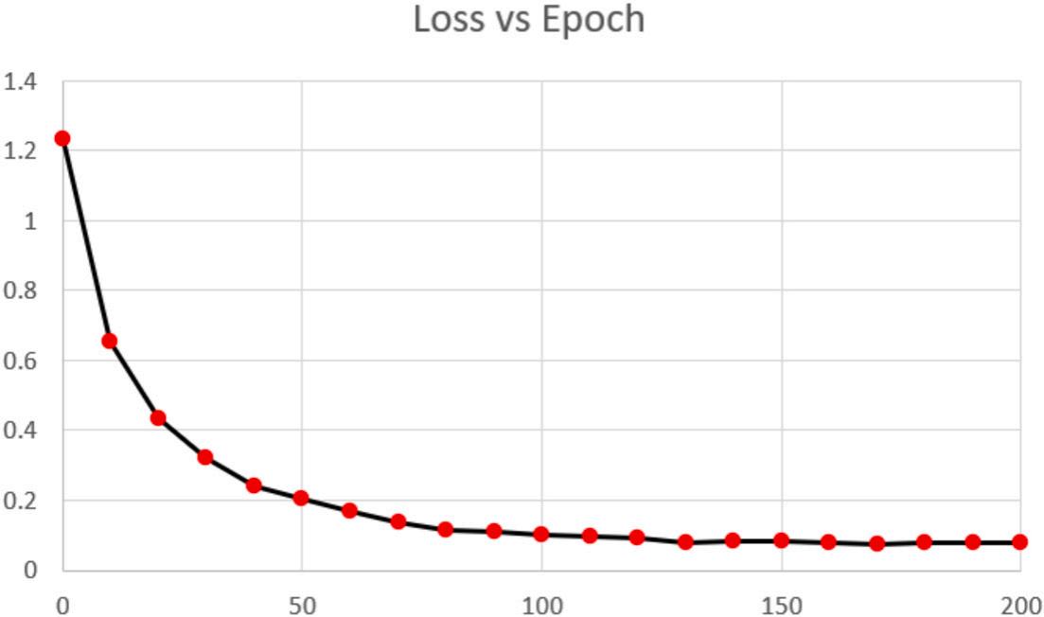
Fig. 4.1. Accuracy vs Training Epoch.
Fig. 4.2. Loss vs Training Epoch.
200 epochs, learning rate 0.0001 batch size of 8
The model's accuracy consistently increased from 0 at the initial epoch to 0.845 by the 200th epoch, signifying the model's ability to better predict the nuclei segmentation in biomedical images.
As the epochs progressed, the model continued to minimize the loss, achieving a loss of 0.102 by the 100th epoch. At the final 200th epoch, the loss had been further reduced to 0.078.
Notes:
The model's accuracy consistently increased from 0 at the initial epoch to 0.845 by the 200th epoch.
At the final 200th epoch, the loss had been further reduced to 0.078.

Slide 12
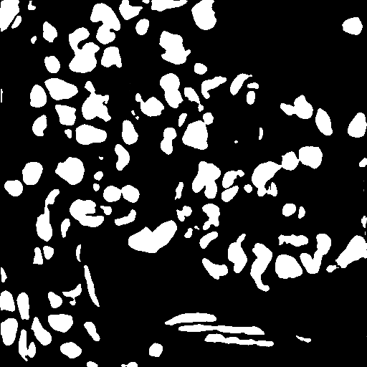
Fig. 4.3. The left is inputting image, the right is the result label map.

