Slide 1
Patient
Patient ID
Patient Last Name
Equipment
Rental Rate ID
Equipment ID
Referral
Equipment Description
Patient Health Authority
Patient Postal Code
Equipment Category
Rental Length Week
Rental Status
Delivery Date
Equipment ID
Patient First Name
Patient City
Rental Length Month
Return Date
Extension Due Date
Rental
Referral Case ID
Referral Date
Referral Professional
Referral Health Authority
Referral Site
Referral Source
Rental ID
Referral Case ID
Referral Priority
Is Palliative
Is Long Term
Overdue Rental Action Taken
Equipment Rental Rate
Payment Frequency
Payment Frequency
Rental Rate
Delivery Rate
Delivery Fee ID
Rate
Delivery Zone
Equipment ID
Installation Fee
Is Delivery
Is installation
Patient ID
Equipment ID
Unit Count

Slide 2
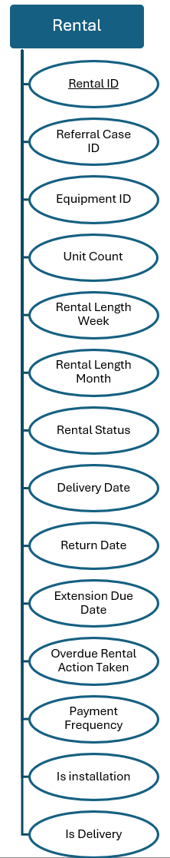
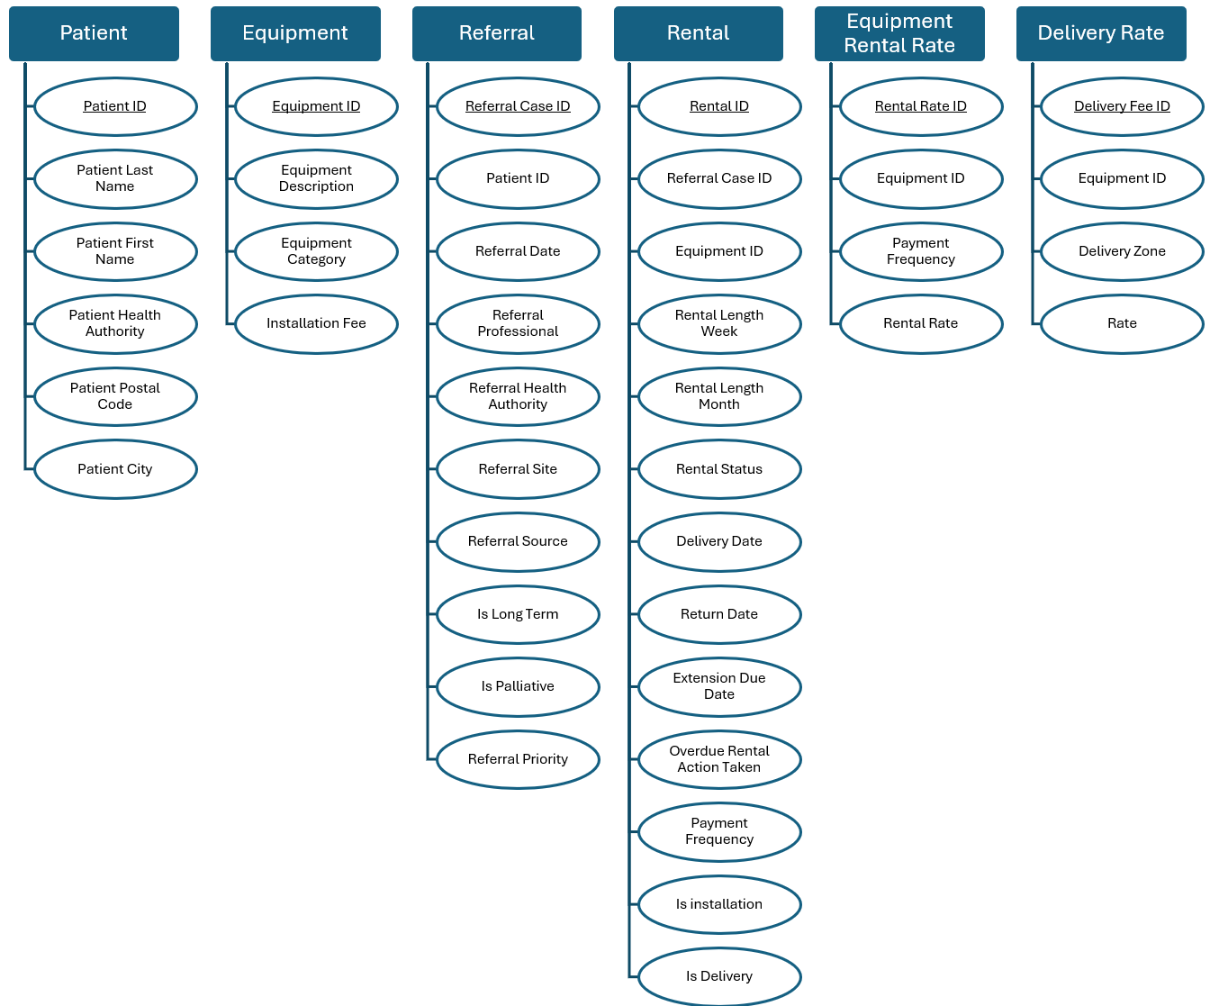
Refer
Start
Contain
have

