Slide 1
Patient
Patient ID
Patient Last Name
Equipment
Rental Rate ID
Equipment ID
Referral
Equipment Description
Patient Health Authority
Patient Postal Code
Equipment Category
Rental Length Week
Rental Status
Delivery Date
Equipment ID
Patient First Name
Patient City
Rental Length Month
Return Date
Extension Due Date
Rental
Referral Case ID
Referral Date
Referral Professional
Referral Health Authority
Referral Site
Referral Source
Rental ID
Referral Case ID
Referral Priority
Is Palliative
Is Long Term
Overdue Rental Action Taken
Equipment Rental Rate
Payment Frequency
Payment Frequency
Rental Rate
Delivery Rate
Delivery Fee ID
Rate
Delivery Zone
Equipment ID
Installation Fee
Is Delivery
Is installation
Patient ID
Equipment ID
Unit Count

Slide 2
Patient
Patient ID
Patient Last Name
Equipment
Rental Rate ID
Equipment ID
Referral
Equipment Description
Patient Health Authority
Patient Postal Code
Equipment Category
Rental Length Week
Rental Status
Delivery Date
Equipment ID
Patient First Name
Patient City
Rental Length Month
Return Date
Extension Due Date
Rental
Referral Case ID
Referral Date
Referral Professional
Referral Health Authority
Referral Site
Referral Source
Referral Priority
Is Palliative
Is Long Term
Overdue Rental Action Taken
Equipment Rental Rate
Payment Frequency
Payment Frequency
Rental Rate
Delivery Rate
Delivery Fee ID
Rate
Delivery Zone
Equipment ID
Installation Fee
Is Delivery
Is installation
Patient ID
Equipment ID
Unit Count
Patient ID

Slide 3
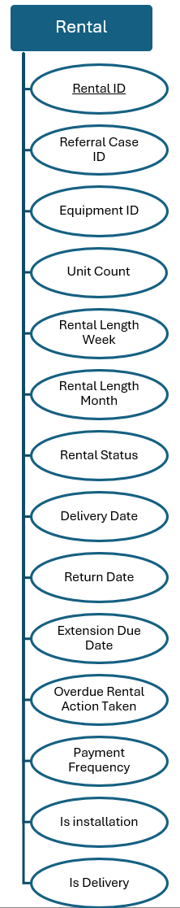
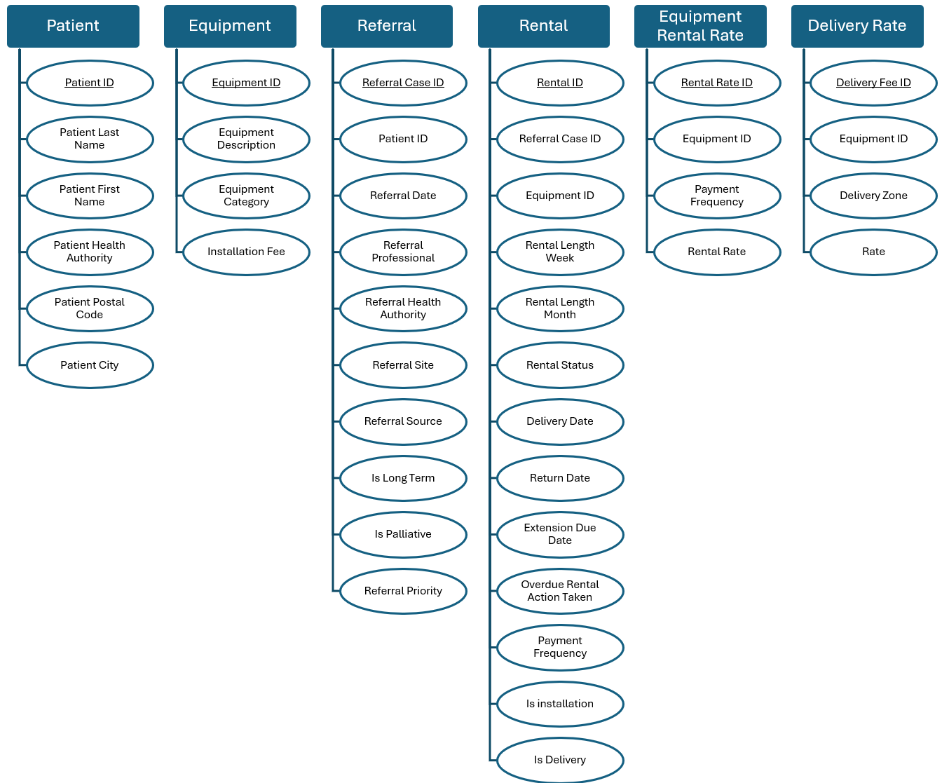
Refer
Start
Contain
have

Slide 4
Refer
rent
have

Slide 5
Refer
Referral ID
Referer
Patient
Patient ID
Patient Last Name
Patient Health Authority
Patient Postal Code
Patient First Name
Patient City
Equipment
Equipment Description
Equipment Category
Equipment ID
Installation Fee
Refer
Referral Case ID
Referral Date
Referral Professional
Referral Health Authority
Referral Site
Referral Source
Referral Priority
Is Palliative
Is Long Term
Patient ID
Rental Length Week
Rental Status
Delivery Date
Rental Length Month
Return Date
Extension Due Date
Rent
Rental ID
Referral Case ID
Overdue Rental Action Taken
Payment Frequency
Is Delivery
Is installation
Equipment ID
Unit Count
Have
Rental Rate ID
Equipment ID
Rental Rate
Payment Frequency
Rental Rate
Delivery Rate
Delivery Fee ID
Rate
Delivery Zone
Equipment ID

Slide 6
Refer
Start
Contain
have

Slide 7
Patient
Rent
Delivery zone
deliver
Patient ID
Referrer
Referral Case ID
Zone ID
Delivery Zone
Zone ID
Patient Last name
Equipment ID
Referrer ID
Equipment ID
Patient First name
Refer
Payment Frequency ID
Equipment
Referrer
Delivery Rate
Patient Postal Code
Zone ID
Equipment ID
Referral Case ID
Delivery Date
Live at
Equipment Description
Referrer ID
Referral Site
Return Date
Equipment Category
Patient postal code
Patient ID
Extension Due Date
Referral HA site
Installation Fee
Rental Rate
Patient Postal Code
Referral HA site
Overdue Rental Action Taken
Payment frequency
Referral HA
Referral Date
Unit Count
Frequency ID
Patient City
Referral Source
Payment Frequency ID
Is long-term
Rental Length Month
Equipment ID
Patient HA
Payment
Frequency
Rental Length Week
Rental Rate
Is Palliative
Rental Status
Priority
Is installation

Slide 8
Patient
Rent
Delivery zone
deliver
Patient ID
Referrer
Referral Case ID
Zone ID
Delivery Zone
Zone ID
Patient Last name
Equipment ID
Referrer ID
Equipment ID
Patient First name
Refer
Payment Frequency
Equipment
Referrer
Delivery Rate
Patient Postal Code
Zone
Equipment ID
Referral Case ID
Delivery Date
Live at
Equipment Description
Referrer ID
Referral Site
Return Date
Equipment Category
Patient postal code
Patient ID
Extension Due Date
Referral HA site
Installation Fee
Rental Rate
Patient Postal Code
Referral HA site
Overdue Rental Action Taken
Payment frequency
Referral HA
Referral Date
Unit Count
Frequency ID
Patient City
Referral Source
Payment Frequency ID
Is long-term
Rental Length Month
Equipment ID
Patient HA
Payment
Frequency
Rental Length Week
Rental Rate
Is Palliative
Rental Status
Priority
Is installation

Slide 9
Rent
Deliver
n,1
Delivery zone
Referrer
Referral Case ID
Zone ID
Zone ID
n,1
1,n
Referrer ID
1,n
1,n
Equipment ID
Equipment ID
Delivery Zone
Referrer
Payment Frequency
Equipment
Refer
Delivery Rate
n,1
Patient
n,1
Live at
1,n
Zone
1,n
Equipment ID
n,1
Rental Rate
n,1
Payment frequency
Referral Site
Referrer ID
Patient ID
Delivery Date
Equipment Description
Patient postal code
Patient ID
Patient Last name
Return Date
Equipment Category
Frequency ID
Referral HA site
Frequency ID
Patient Postal Code
Patient First name
Extension Due Date
Installation Fee
Equipment ID
Referral HA
Referral HA site
Payment
Frequency
Patient City
Patient Postal Code
Overdue Rental Action Taken
Referral Source
Referral Date
Rental Rate
Patient HA
Unit Count
Is long-term
Rental Length Month
Is Palliative
Rental Length Week
Priority
Rental Status
Is installation

Slide 10
1,n
Refer
1,n
Rent
n,1
1,n
n,1
Referrer
n,1
Patient
Equipment
Deliver
Delivery zone
Referrer ID
Patient ID
Referral Case ID
Equipment ID
Zone ID
Zone ID
Referrer ID
Patient Last name
Equipment ID
Equipment Description
Equipment ID
Delivery Zone
Referrer
Patient ID
Patient First name
Payment Frequency
Equipment Category
Delivery Rate
1,n
Referral HA site
Referral Site
Patient Postal Code
Zone
Installation Fee
Referral Date
n,1
1,n
Referral HA site
Live at
Delivery Date
Is long-term
Rental Rate
n,1
Payment frequency
Referral HA
n,1
Return Date
Is Palliative
Patient postal code
Extension Due Date
Frequency ID
Frequency ID
Referral Source
Priority
Equipment ID
Patient Postal Code
Overdue Rental Action Taken
Payment
Frequency
Patient City
Unit Count
Rental Rate
Patient HA
Rental Length Month
Rental Length Week
Rental Status
Is installation

Slide 11
1,n
Refer
1,n
Rent
n,1
1,n
Deliver
n,1
Referrer
Equipment
Delivery zone
Referrer ID
Referral Case ID
Equipment ID
Zone ID
Zone ID
Referral case ID
1,n
Referrer ID
Equipment ID
Equipment Description
Equipment ID
Delivery Zone
Referrer
Referral Site
Payment Frequency
Equipment Category
Delivery Rate
Patient ID
Zone
Installation Fee
Site id
Site id
1,n
1,n
Delivery Date
Referral HA site
Referral Date
Rental Rate
n,1
Payment frequency
Return Date
Referral HA
Is long-term
Extension Due Date
Frequency ID
Frequency ID
Referral Source
Is Palliative
Overdue Rental Action Taken
Equipment ID
Payment
Frequency
Patient
Dim postal code
Priority
n,1
Unit Count
Rental Rate
Patient ID
Patient Postal Code
Rental Length Month
Patient Last name
Patient City
Rental Length Week
Patient First name
Patient HA
Rental Status
Patient Postal Code
Is installation

