Slide 1
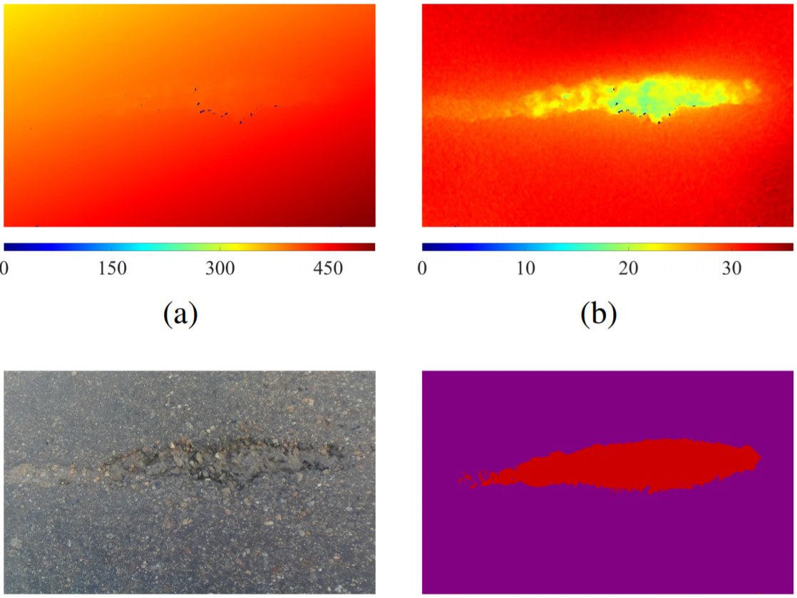
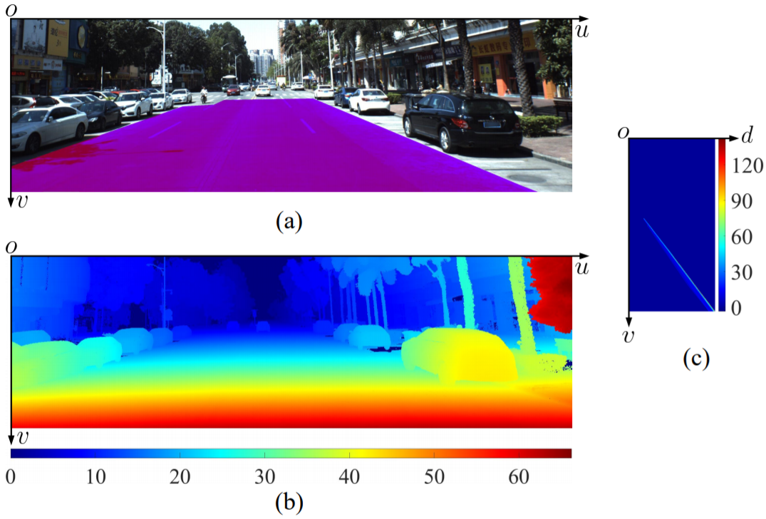
RGB Image
Disparity Image
Transformed Disparity Image
V-Disparity Map
Disparity Image
RGB Image
Detected Damaged Road Area

