Slide 1

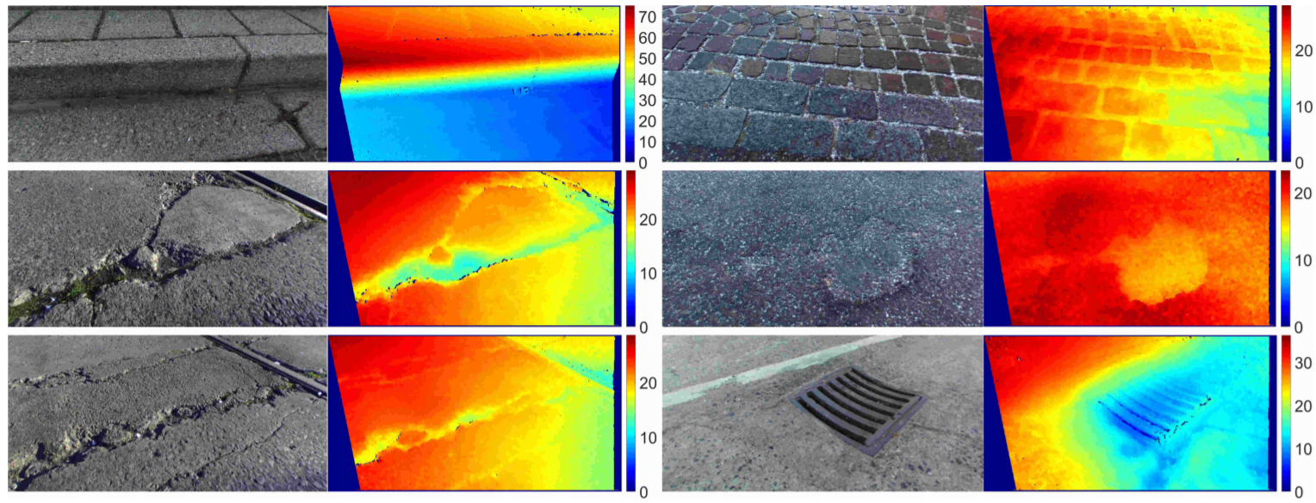
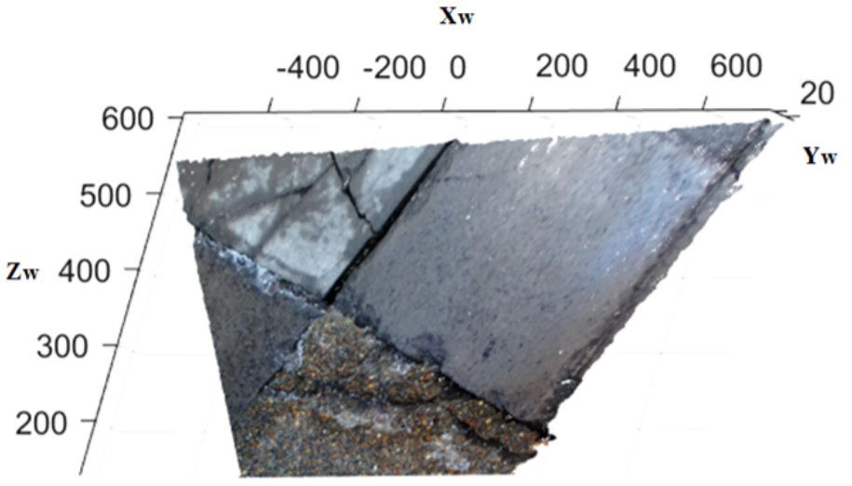
Block Diagram
RGB Images + Disparity Images
Reconstructed 3D Road Surface

