Slide 1
BLOCKCHAIN
A Distributed Ledger
At the heart of a blockchain network is a distributed ledger that records all the transactions that take place on the network.
A blockchain ledger is often described as decentralized because it is replicated across many network participants, each of whom collaborate in its maintenance.
the information recorded to a blockchain is append-only, using cryptographic techniques that guarantee that once a transaction has been added to the ledger it cannot be modified. This property of “immutability” makes it simple to determine the provenance of information because participants can be sure information has not been changed after the fact. It’s why blockchains are sometimes described as systems of proof.
Smart Contracts
Consensus
The process of keeping the ledger transactions synchronized across the network — to ensure that ledgers update only when transactions are approved by the appropriate participants, and that when ledgers do update, they update with the same transactions in the same order — is called consensus.
Blockchain as a shared, replicated transaction system which is updated via smart contracts and kept consistently synchronized through a collaborative process called consensus.

Slide 2
Why is a Blockchain useful?
Today’s Systems of Record
Modern technology has taken this process from stone tablets and paper folders to hard drives and cloud platforms, but the underlying structure is the same. Unified systems for managing the identity of network participants do not exist, establishing provenance is so laborious it takes days to clear securities transactions (the world volume of which is numbered in the many trillions of dollars), contracts must be signed and executed manually, and every database in the system contains unique information and therefore represents a single point of failure.
The Blockchain Difference
This is a blockchain network, wherein every participant has their own replicated copy of the ledger. In addition to ledger information being shared, the processes which update the ledger are also shared. Unlike today’s systems, where a participant’s private programs are used to update their private ledgers, a blockchain system has shared programs to update sharedledgers.
With the ability to coordinate their business network through a shared ledger, blockchain networks can reduce the time, cost, and risk associated with private information and processing while improving trust and visibility.

Slide 3
Blockchain is an immutable transaction ledger, maintained within a distributed network of peer nodes. These nodes each maintain a copy of the ledger by applying transactions that have been validated by a consensus protocol, grouped into blocks that include a hash that bind each block to the preceding block.
The first and most widely recognized application of blockchain - Bitcoin cryptocurrency
Ethereum - adding smart contracts to create a platform for distributed applications.
Bitcoin and Ethereum - public permissionless blockchain technology: public networks, open to anyone, where participants interact anonymously.
For enterprise use, we need to consider the following requirements:
Participants must be identified/identifiable
Networks need to be permissioned
High transaction throughout performance
Low latency of transaction confirmation
Privacy and confidentiality of transactions and data pertaining to business transactions
hard requirement, such as in the case of financial transactions where Know-Your-Customer (KYC) and Anti-Money Laundering (AML) regulations must be followed.

Slide 4
Hyperledger Fabric?
Where Hyperledger Fabric breaks from some other blockchain systems is that it is private and permissioned. Rather than an open permissionless system that allows unknown identities to participate in the network (requiring protocols like “proof of work” to validate transactions and secure the network), the members of a Hyperledger Fabric network enroll through a trusted Membership Service Provider (MSP).
Hyperledger Fabric also offers several pluggable options. Ledger data can be stored in multiple formats, consensus mechanisms can be swapped in and out, and different MSPs are supported.
Hyperledger Fabric also offers the ability to create channels, allowing a group of participants to create a separate ledger of transactions. This is an especially important option for networks where some participants might be competitors and not want every transaction they make — a special price they’re offering to some participants and not others, for example — known to every participant. If two participants form a channel, then those participants — and no others — have copies of the ledger for that channel.
Shared Ledger
Hyperledger Fabric has a ledger subsystem comprising two components: the world state and the transaction log. Each participant has a copy of the ledger to every Hyperledger Fabric network they belong to.
The world state component describes the state of the ledger at a given point in time. It’s the database of the ledger.
The transaction log component records all transactions which have resulted in the current value of the world state; it’s the update history for the world state.
The ledger, then, is a combination of the world state database and the transaction log history.
The ledger has a replaceable data store for the world state. By default, this is a LevelDB key-value store database. The transaction log does not need to be pluggable. It simply records the before and after values of the ledger database being used by the blockchain network.
Smart Contracts
Hyperledger Fabric smart contracts are written in chaincode and are invoked by an application external to the blockchain when that application needs to interact with the ledger. In most cases, chaincode interacts only with the database component of the ledger, the world state (querying it, for example), and not the transaction log.
Chaincode can be implemented in several programming languages. Currently, Go and Node are supported.
Privacy
Hyperledger Fabric supports networks where privacy (using channels) is a key operational requirement as well as networks that are comparatively open.
Consensus
Hyperledger Fabric has been designed to allow network starters to choose a consensus mechanism that best represents the relationships that exist between participants. As with privacy, there is a spectrum of needs; from networks that are highly structured in their relationships to those that are more peer-to-peer.
Hyperledger Fabric consensus mechanisms, which currently include SOLO and Kafka.

Slide 5
Smart Contracts
A smart contract - “chaincode”, functions as a trusted distributed application that gains its security/trust from the blockchain and the underlying consensus among the peers. It is the business logic of a blockchain application.
Most existing smart-contract capable blockchain platforms follow an order-execute architecture in which the consensus protocol:
validates and orders transactions then propagates them to all peer nodes,
each peer then executes the transactions sequentially.
Further, since all transactions are executed sequentially by all nodes, performance and scale is limited.

Slide 6
NEW ARCHITECTURE FOR TRANSACTIONS : EXECUTE-ORDER-VALIDATE
execute a transaction and check its correctness, thereby endorsing it,
order transactions via a (pluggable) consensus protocol, and
validate transactions against an application-specific endorsement policy before committing them to the ledger
In Fabric, an application-specific endorsement policy specifies which peer nodes, or how many of them, need to vouch for the correct execution of a given smart contract.

Slide 7
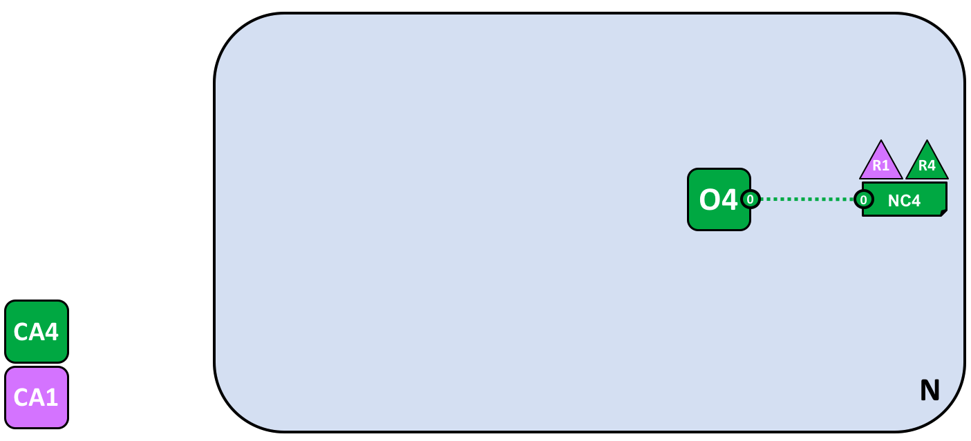
1- Creating the Network
The network is formed when an orderer is started. In our example network, N, the ordering service comprising a single node, O4, is configured according to a network configuration NC4, which gives administrative rights to organization R4. At the network level, Certificate Authority CA4 is used to dispense identities to the administrators and network nodes of the R4 organization.
Certificate Authorities
You can also see a Certificate Authority, CA4, which is used to issue certificates to administrators and network nodes. CA4 plays a key role in our network because it dispenses X.509 certificates that can be used to identify components as belonging to organization R4. Certificates issued by CAs can also be used to sign transactions to indicate that an organization endorses the transaction result – a precondition of it being accepted onto the ledger. Let’s examine these two aspects of a CA in a little more detail.
MSP
The mapping of certificates to member organizations is achieved by via a structure called aMembership Services Provider (MSP). Network configuration NC4 uses a named MSP to identify the properties of certificates dispensed by CA4 which associate certificate holders with organization R4. X.509 certificates are used in client applicationtransaction proposals and smart contract transaction responses to digitally sign transactions. Subsequently the network nodes who host copies of the ledger verify that transaction signatures are valid before accepting transactions onto the ledger.

Slide 8
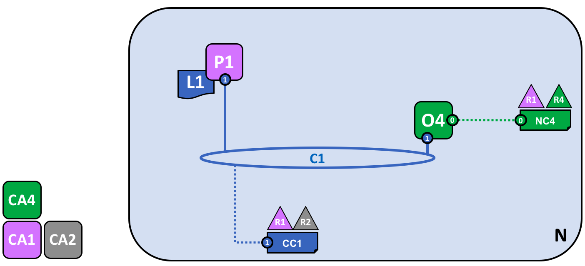
2-Creating a channel for a consortium
A channel is a primary communications mechanism by which the members of a consortium can communicate with each other.
Channels are useful because they provide a mechanism for private communications and private data between the members of a consortium. Channels provide privacy from other channels, and from the network.

Slide 9
3- Peers and Ledgers`
Peer nodes are the network components where copies of the blockchain ledger are hosted, for others to access. We can think of L1 as being physically hosted on P1, but logically hosted on the channel C1.
A key part of a P1’s configuration is an X.509 identity issued by CA1 which associates P1 with organization R1. Once P1 is started, it can join channel C1 using the orderer O4. When O4 receives this join request, it uses the channel configuration CC1 to determine P1’s permissions on this channel.

Slide 10
4- Applications and Smart Contract chaincode
In our example, client application A1 is associated with organization R1; and although it is outside the Fabric blockchain network, it is connected to it via the channel C1.
all access is managed via a special program called a smart contract chaincode, S5. Think of S5 as defining all the common access patterns to the ledger; S5 provides a well-defined set of ways by which the ledger L1 can be queried or updated. In short, client application A1 has to go through smart contract S5 to get to ledger L1!
Smart contract chaincodes can be created by application developers in each organization to implement a business process shared by the consortium members. Smart contracts are used to help generate transactions which can be subsequently distributed to the every node in the network.
Installing a smart contract
After a smart contract S5 has been developed, an administrator in organization R1 must installit onto peer node P1, P1 can see the implementation logic of S5 – the program code that it uses to access the ledger L1.
When an organization has multiple peers in a channel, it can choose the peers upon which it installs smart contracts; it does not need to install a smart contract on every peer.
Instantiating a smart contract
However, just because P1 has installed S5, the other components connected to channel C1 are unaware of it; it must first be instantiated on channel C1. In our example, which only has a single peer node P1, an administrator in organization R1 must instantiate S5 on channel C1 using P1. Note that although every component on the channel can now access S5, they are not able to see its program logic. This remains private to those nodes who have installed it;
Endorsement policy
The most important piece of additional information supplied at instantiation is an endorsement policy. It describes which organizations must approve transactions before they will be accepted by other organizations onto their copy of the ledger. In our sample network, transactions can be only be accepted onto ledger L1 if R1 or R2 endorse them.
The act of instantiation places the endorsement policy in channel configuration CC1; it enables it to be accessed by any member of the channel.
Invoking a smart contract
Once a smart contract has been installed on a peer node and instantiated on a channel it can be invoked by a client application. Client applications do this by sending transaction proposals to peers owned by the organizations specified by the smart contract endorsement policy. The transaction proposal serves as input to the smart contract, which uses it to generate an endorsed transaction response, which is returned by the peer node to the client application.

Slide 11
Types of peers
Committing peer. Every peer node in a channel is a committing peer. It receives blocks of generated transactions, which are subsequently validated before they are committed to the peer node’s copy of the ledger as an append operation.
Endorsing peer. Every peer with a smart contract can be an endorsing peer if it has a smart contract installed. However, to actually be an endorsing peer, the smart contract on the peer must be used by a client application to generate a digitally signed transaction response. The term endorsing peer is an explicit reference to this fact.
An endorsement policy for a smart contract identifies the organizations whose peer should digitally sign a generated transaction before it can be accepted onto a committing peer’s copy of the ledger.
These are the two major types of peer; there are two other roles a peer can adopt:
Leader peer. When an organization has multiple peers in a channel, a leader peer is a node which takes responsibility for distributing transactions from the orderer to the other committing peers in the organization. A peer can choose to participate in static or dynamic leadership selection.
It is helpful, therefore to think of two sets of peers from leadership perspective – those that have static leader selection, and those with dynamic leader selection. For the static set, zero or more peers can be configured as leaders. For the dynamic set, one peer will be elected leader by the set. Moreover, in the dynamic set, if a leader peer fails, then the remaining peers will re-elect a leader.
It means that an organization’s peers can have one or more leaders connected to the ordering service. This can help to improve resilience and scalability in large networks which process high volumes of transactions.
Anchor peer. If a peer needs to communicate with a peer in another organization, then it can use one of the anchor peers defined in the channel configuration for that organization. An organization can have zero or more anchor peers defined for it, and an anchor peer can help with many different cross-organization communication scenarios.
Note that a peer can be a committing peer, endorsing peer, leader peer and anchor peer all at the same time! Only the anchor peer is optional – for all practical purposes there will always be a leader peer and at least one endorsing peer and at least one committing peer.

Slide 12
Here’s a quick summary of the network components we’ve discussed:
Ledger. One per channel. Comprised of the Blockchain and the World state
Smart contract (aka chaincode)
Peer nodes
Ordering service
Channel
Certificate Authority

Slide 13
NODES
Nodes are the communication entities of the blockchain. A “node” is only a logical function in the sense that multiple nodes of different types can run on the same physical server. What counts is how nodes are grouped in “trust domains” and associated to logical entities that control them.
There are three types of nodes:
Client or submitting-client: a client that submits an actual transaction-invocation to the endorsers, and broadcasts transaction-proposals to the ordering service.
Peer: a node that commits transactions and maintains the state and a copy of the ledger (see Sec, 1.2). Besides, peers can have a special endorser role.
Ordering-service-node or orderer: a node running the communication service that implements a delivery guarantee, such as atomic or total order broadcast.

