Slide 1

Airlines stocks comparison
Southwest, American, Delta, United Airlines
Author: Mia Fryer
Notes:
Curious clients

Slide 2
Agenda
Questions | Factors
Which airlines to invest in | Risk evaluation
When to enter and sell | Trend indicators: Bollinger bands and Moving Average

Slide 3
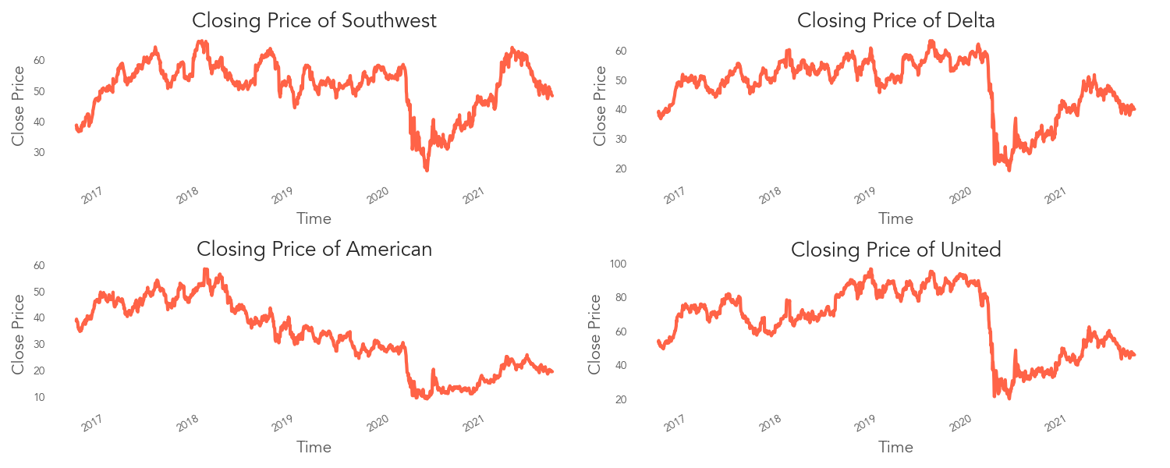
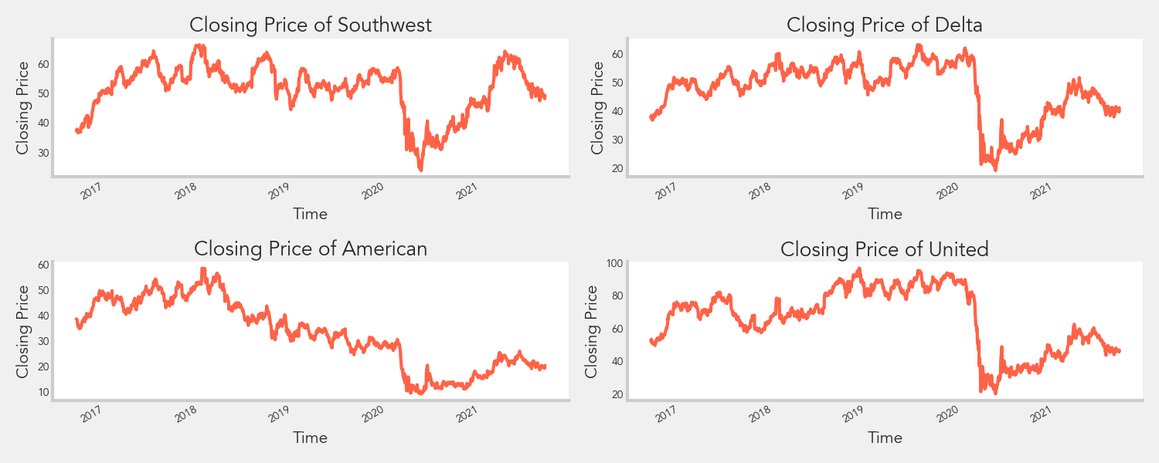
Overview
Notes:
Based on just looking at the closing price, it is hard to decide which airlines to invest since the overall trends seem to be similar where there is a drop around the beginning of last year due to covid

Slide 4
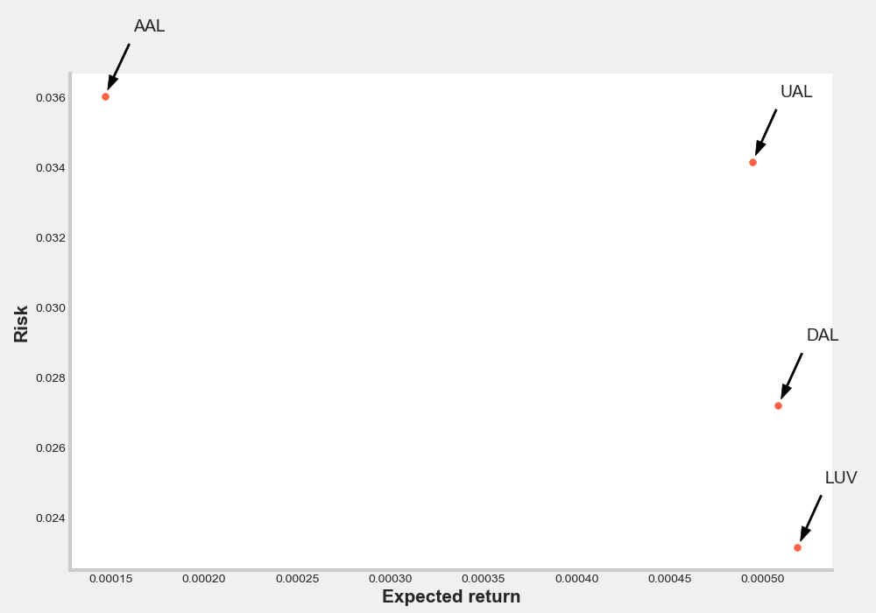
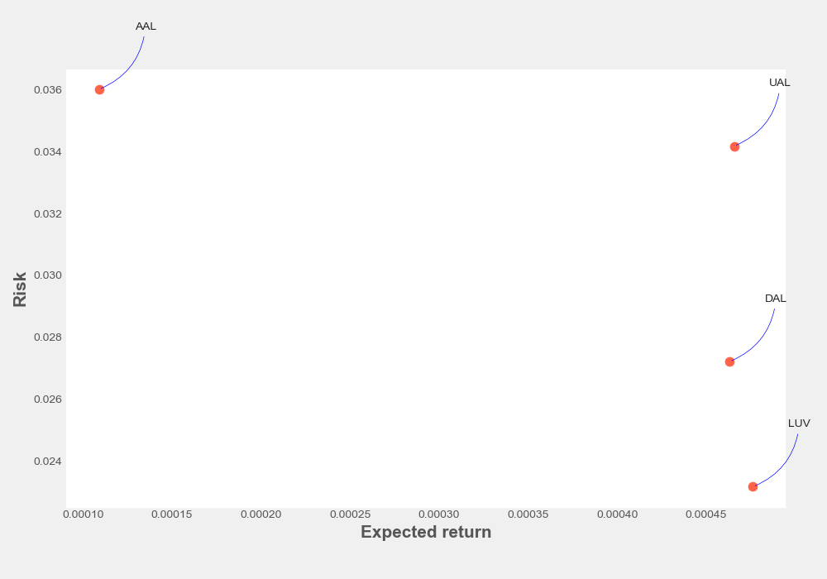
Risk Evaluation
Notes:
An easy evaluation is to compare risk and expected return based on the daily percent change and you can see that southwest airlines is the best option with higher expected return and lowest risk

Slide 5
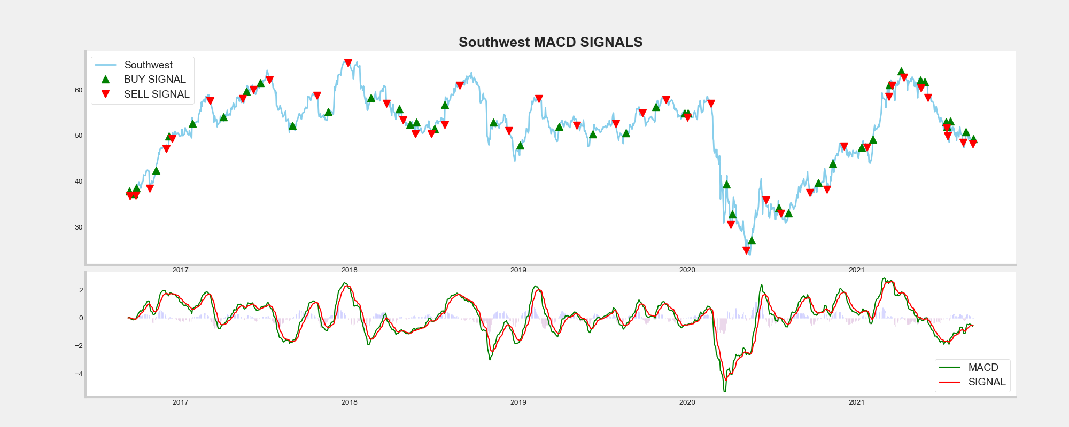

Moving average convergence divergence (MACD)
Notes:
Here are some common indicators to decide when to enter and exist.
moving average convergence and divergence is the difference between short term (12 period) and long term(26 period) exponential moving average and compared to the 9 period exponential moving average as the signal line. When the difference goes above the signal line, that is an indication of an upward trend to buy. As there is an increase in the rate of price change for the short term period and the trend is further validated by comparing to a even more recent moving average- the signal line. The reverse is true for a downward trend to take the short position.

Slide 6
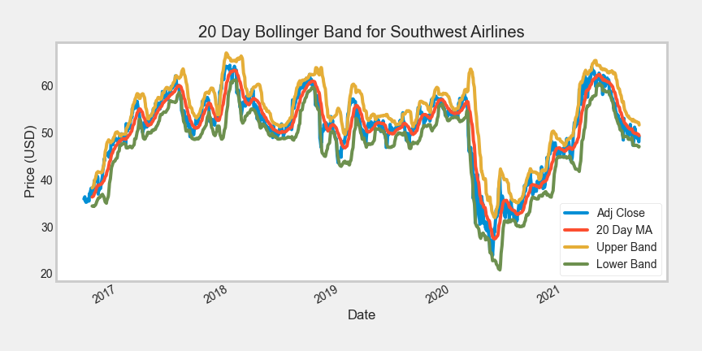
Bollinger bands
Notes:
Bollinger bands are a type of statistical chart to indicate the price volatility over time. When the band width widens, volatility increases as an indication that any existing trend may be ending. Also if the price drops below the lower band, it is an indidcation of the stock being oversold and might be for a correction.

Slide 7
Thank you!
Find me on
https://github.com/miazfryer
https://www.linkedin.com/in/miafryer/
What would you invest in?

