Slide 1

Airlines stocks comparison
Southwest, American, Delta, United Airlines
Author: Mia Fryer
Notes:
Curious clients

Slide 2
Agenda
Questions | Factors
Which airlines to invest in | Risk evaluation
When to enter and sell | Trend indicators: Bollinger bands and Moving Average

Slide 3
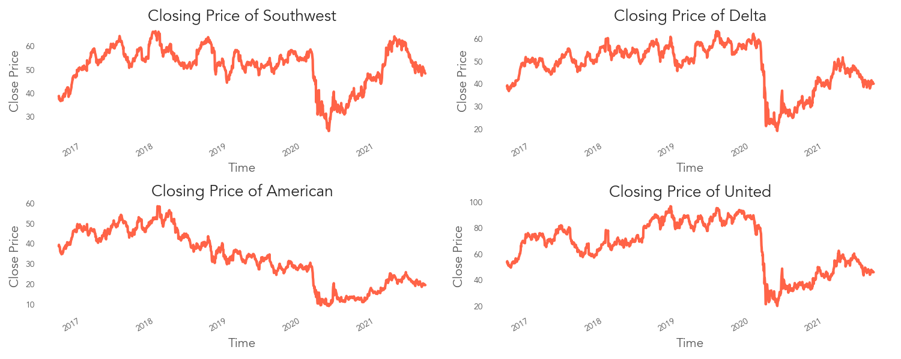
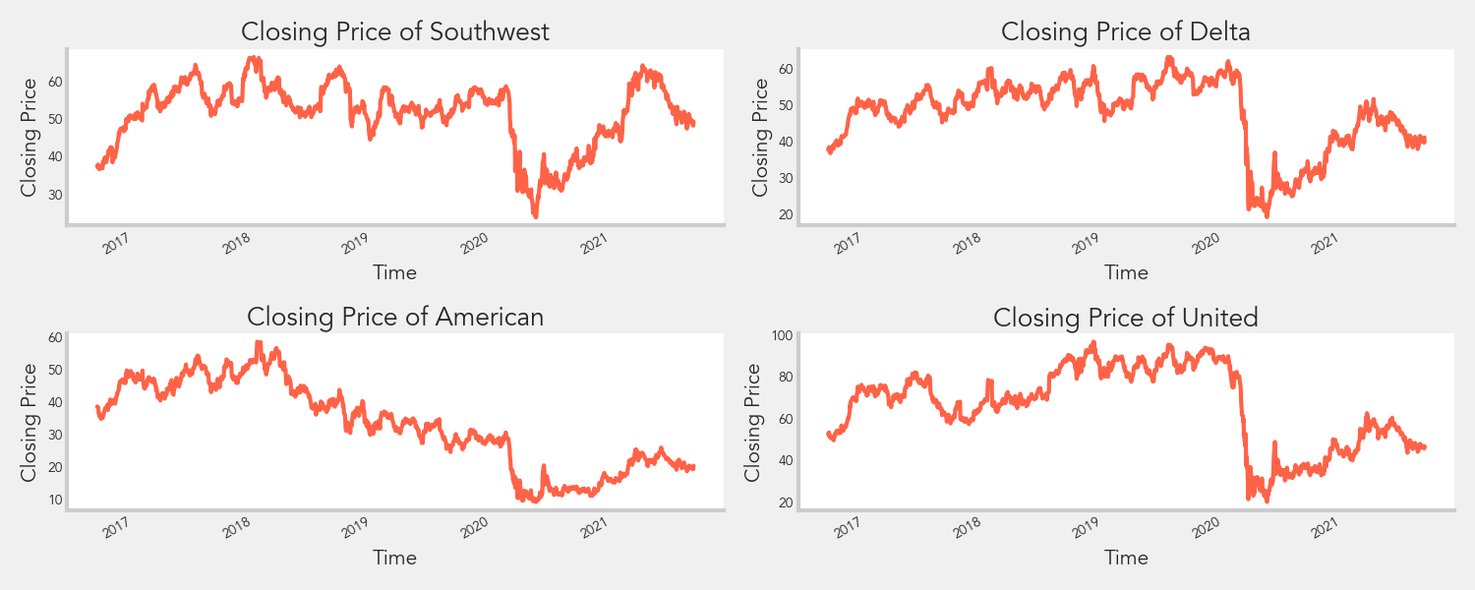
Overview
Notes:
Based on just looking at the closing price, it is hard to decide which airlines to invest in since the overall trends seem to be similar where there is a drop around the beginning of last year due to COVID.

Slide 4
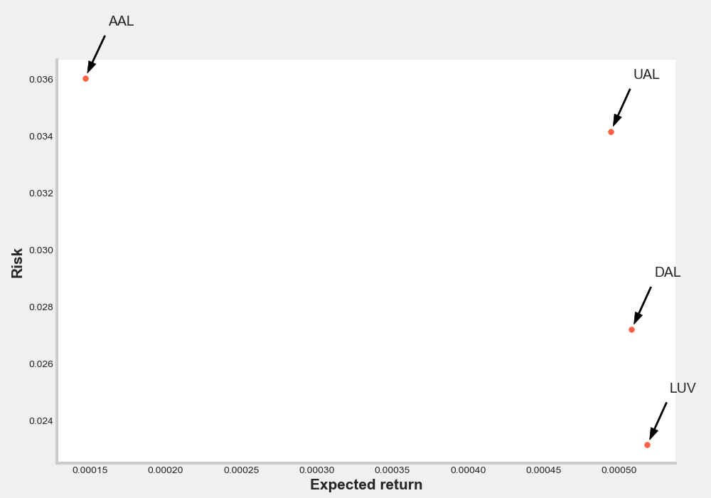
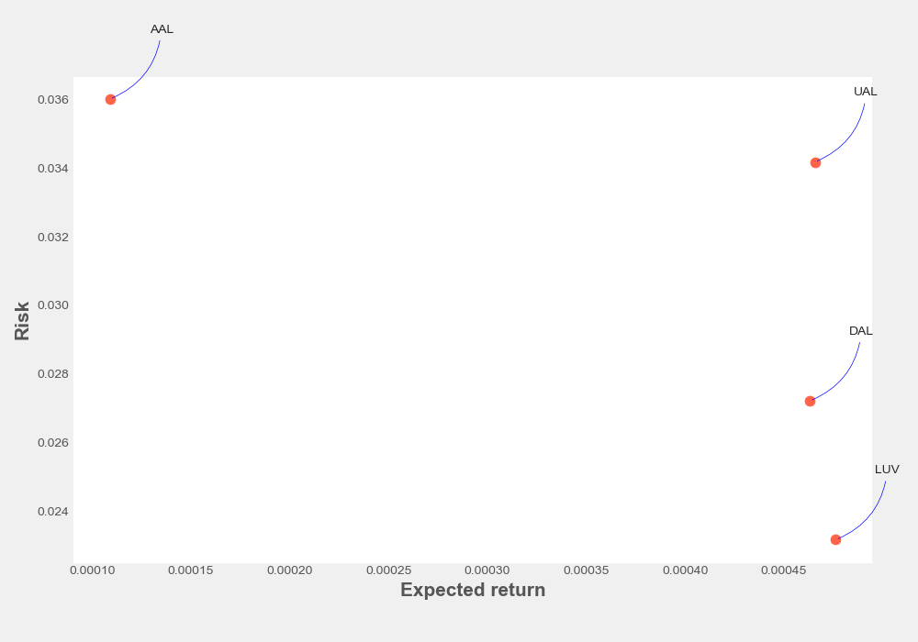
Risk Evaluation
Notes:
An easy evaluation is to compare risk and expected return based on the daily percent change, and from this, you can see that southwest airlines is the best option with a higher expected return and lowest risk.

Slide 5
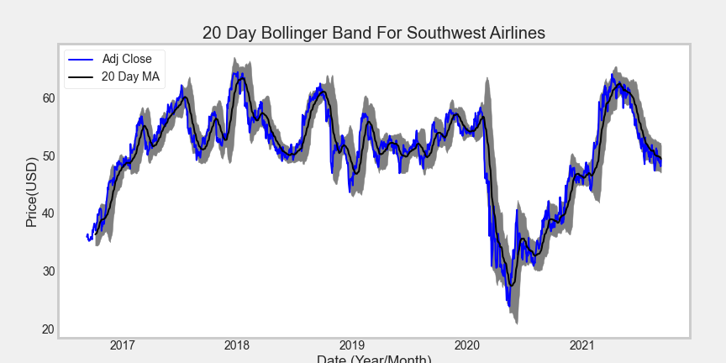
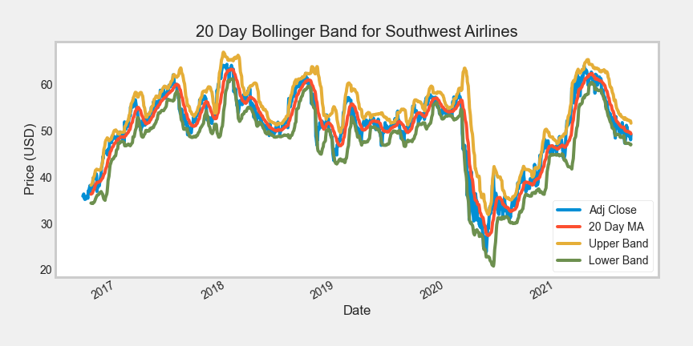
Bollinger bands
Notes:
Bollinger bands are a type of statistical chart to indicate the price volatility over time. When the bandwidth widens, volatility increases as an indication that any existing trend may be ending. Also, if the price drops below the lower band, it indicates the stock is oversold, and there might be a correction.

Slide 6
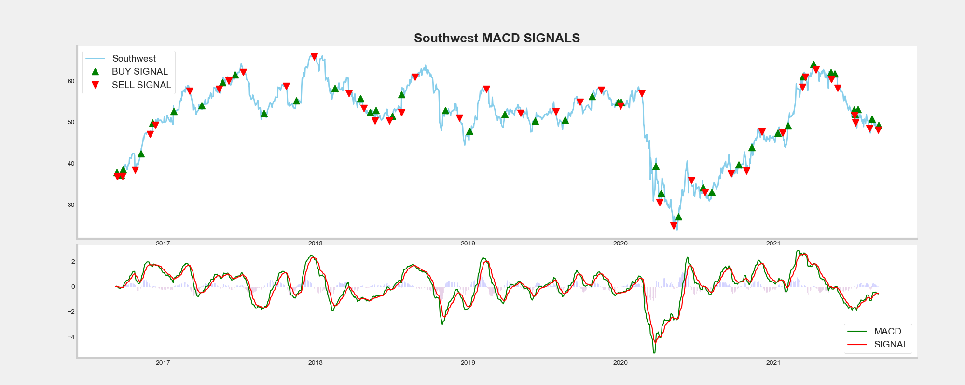

Moving average convergence divergence (MACD)
Notes:
Here are some common indicators to decide when to enter and exit.
Moving average convergence and divergence is the difference between the short term (12-period) and long term(26-period) exponential moving average compared to the 9-period exponential moving average as the signal line. When the difference goes above the signal line, that indicates an upward trend to buy. As there is an increase in the rate of price change for the short-term period, the trend is further validated by comparing to an even more recent moving average- the signal line. The reverse is valid for a downward direction to take a short position.

Slide 7
Return
Profit gained from the MACD strategy by investing $100k in Southwest : $84237.82
percentage of the MACD strategy : 84.0%
Notes:
This is assuming if you buy and sell at all the point for all the stock purchases
First find Macd return by calculating the difference between stock price per day and multiply by 1(buy)or 0 (sell or do nothing)
Calculated using 10k/the first closing price to find number of shares purchased then multiple number of stocks by the macd return then sum it up to get the total return

Slide 8
Thank you!
Find me on
https://github.com/miazfryer
https://www.linkedin.com/in/miafryer/
What would you invest in?

