Slide 1

Airline stock Prices comparison
Southwest, American, Delta, United Airlines

Slide 2
Agenda
Overview
Solution
Evaluation

Slide 3
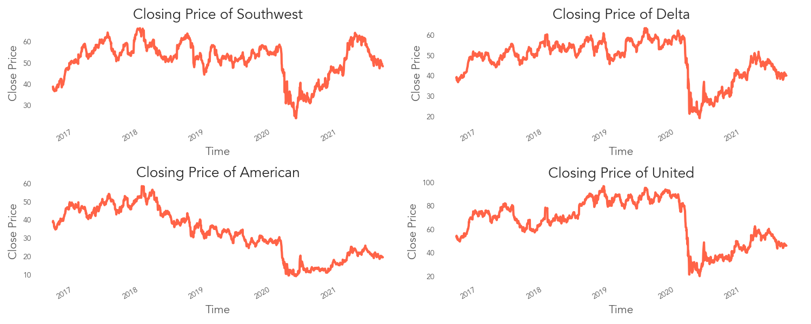
Overview

Slide 4
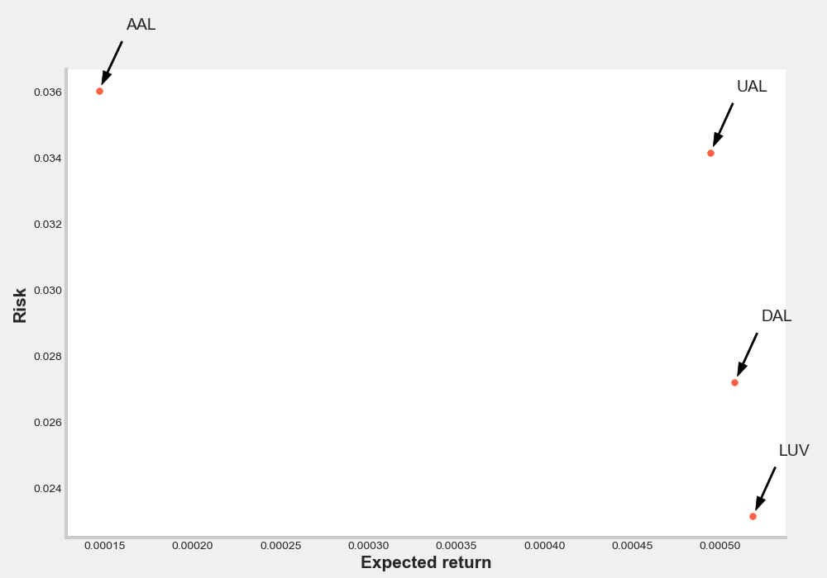
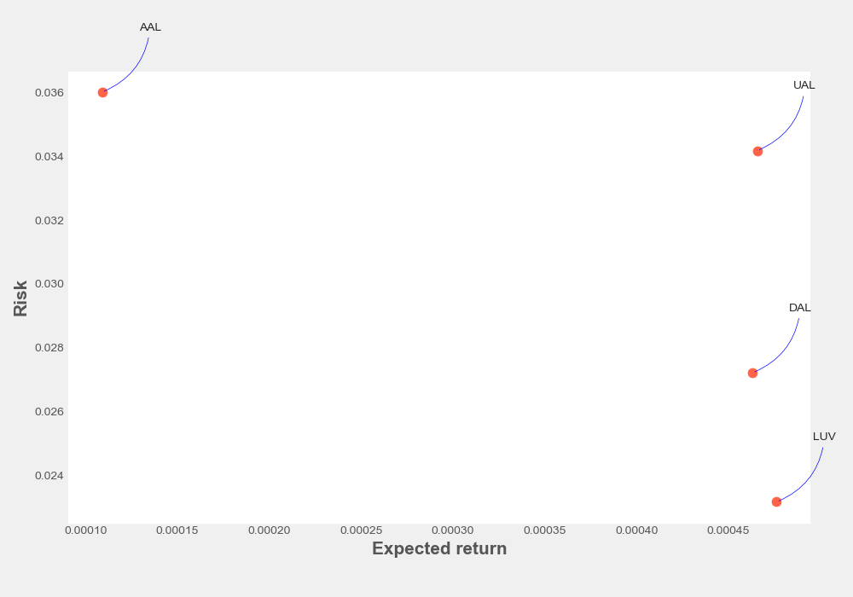
Risk Evaluation

Slide 5
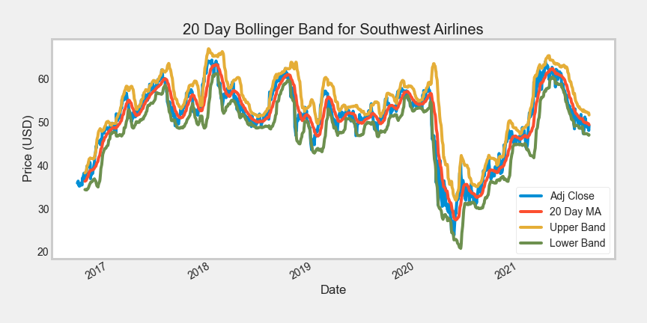
Bollinger bands

Slide 6
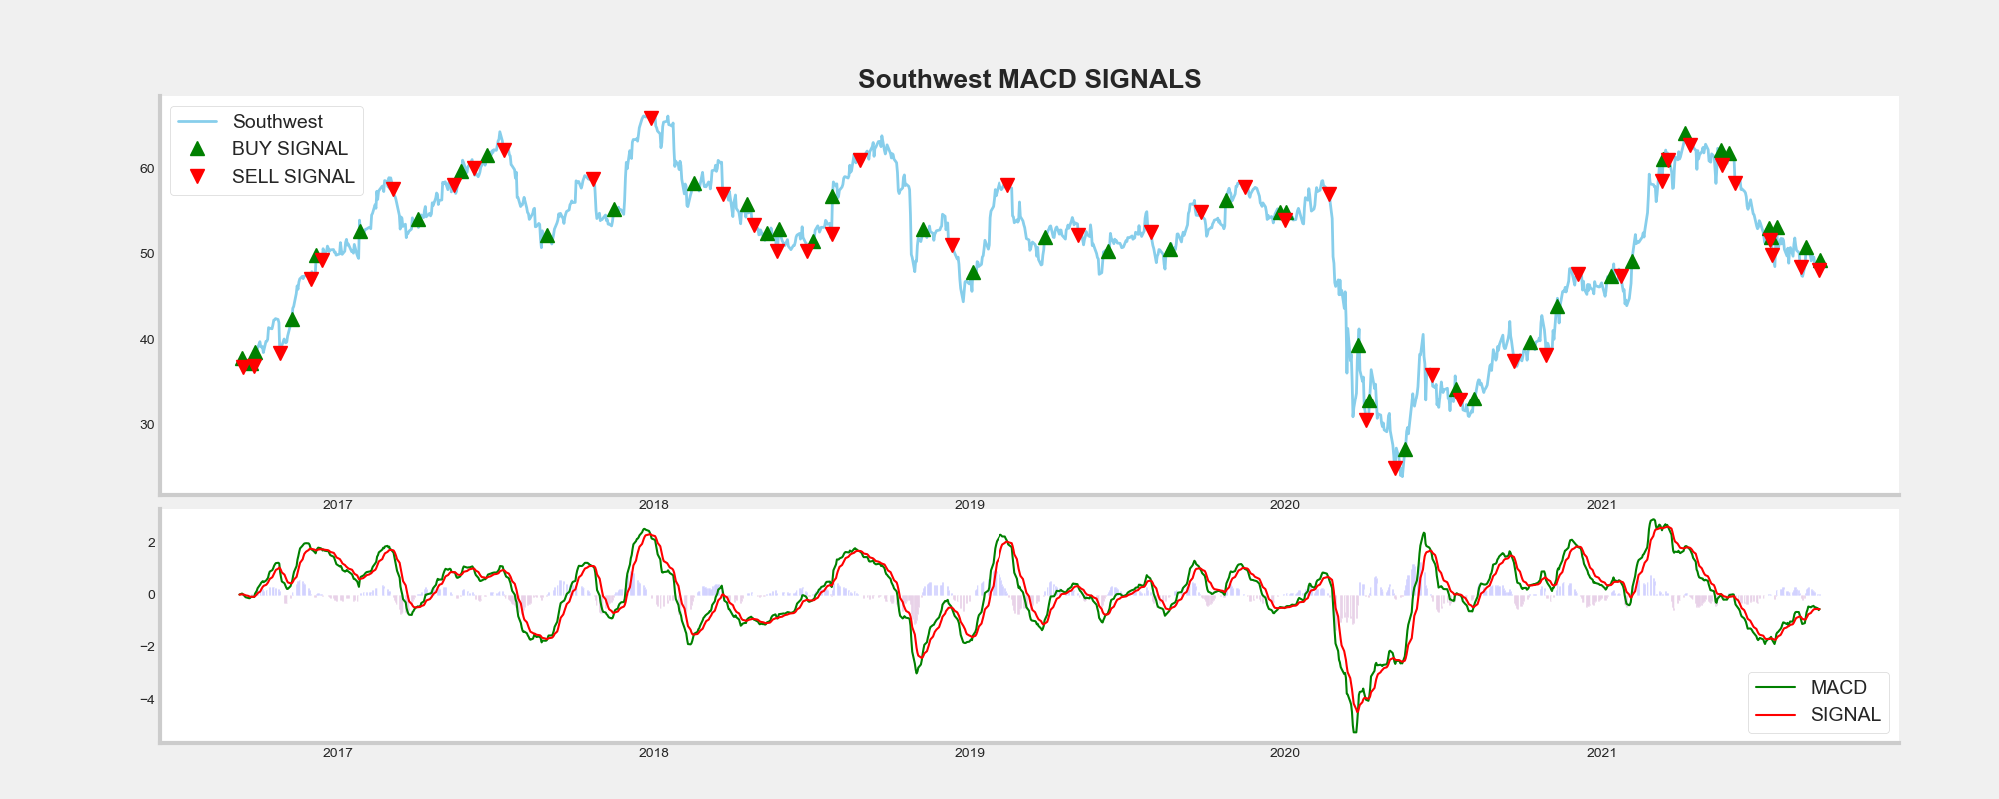

Moving average convergence divergence (MACD)

Slide 7
Thank you!
Find me on
https://github.com/miazfryer
https://www.linkedin.com/in/miafryer/
What would you invest in?

