Slide 1

Airlines stocks
Southwest, American, Delta, United Airlines
Author: Mia Fryer
Notes:
Curious clients

Slide 2
Agenda
Questions | Factors
Which airlines to invest in | Risk evaluation
When to buy and sell | Analysis tools using Bollinger bands and Moving Average

Slide 3
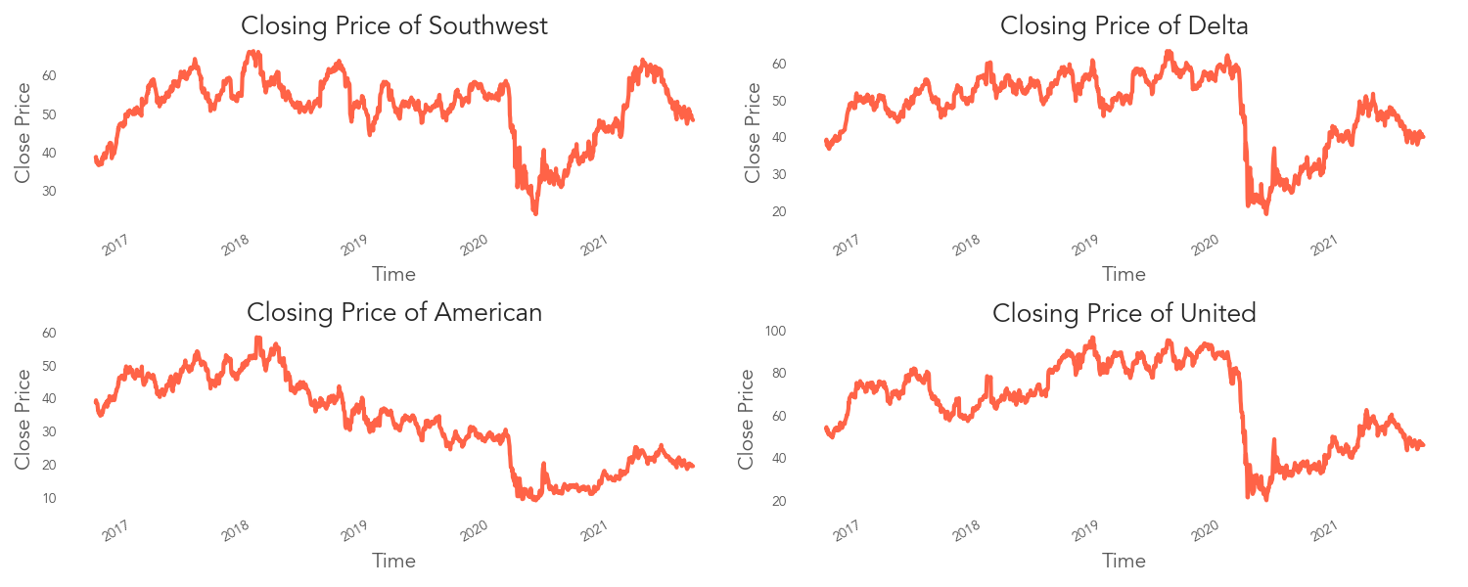
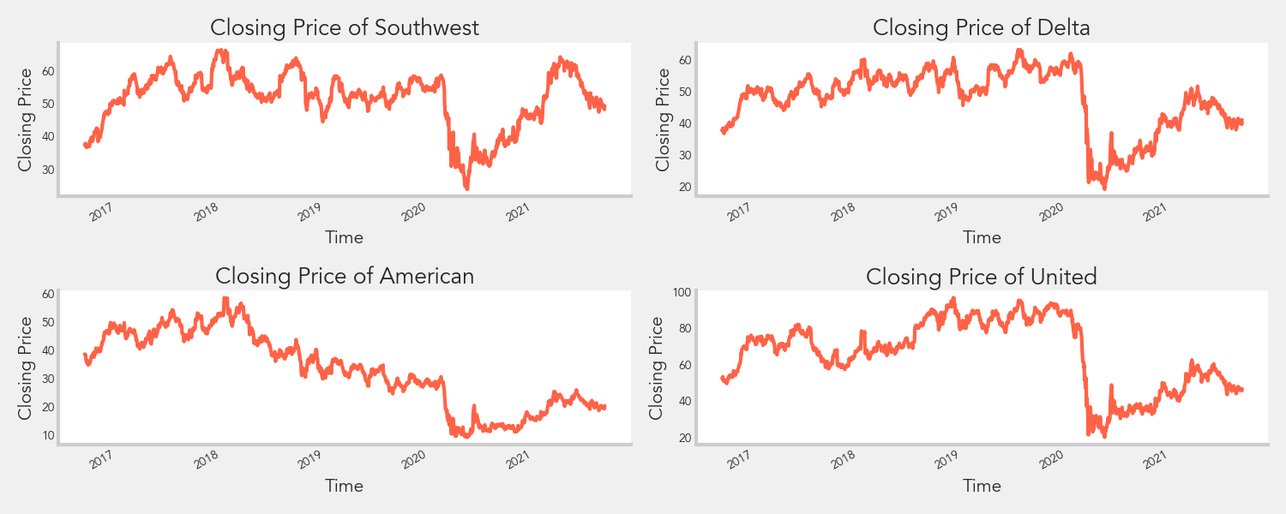
Overview
Notes:
Based on just looking at the closing price, it is hard to decide which airlines to invest in since the
overall trends seem to be similar where there is a drop around the beginning of last year due to COVID.

Slide 4
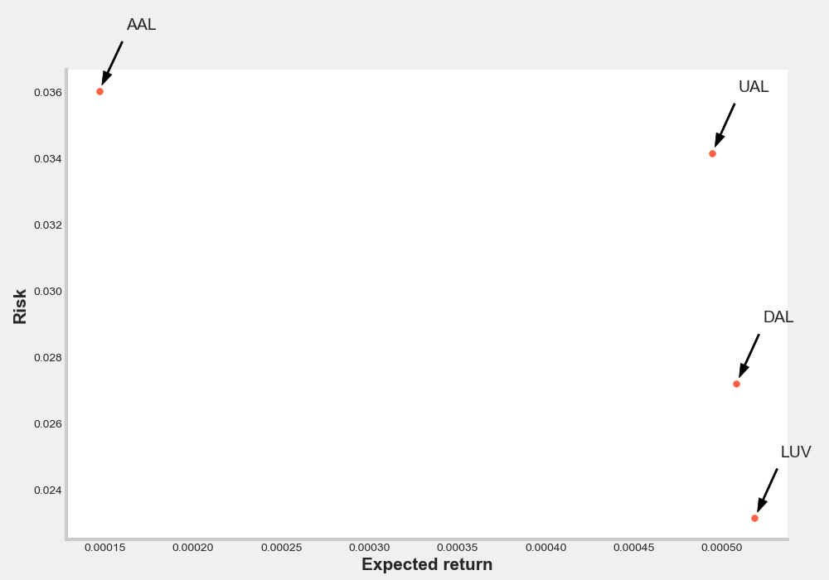
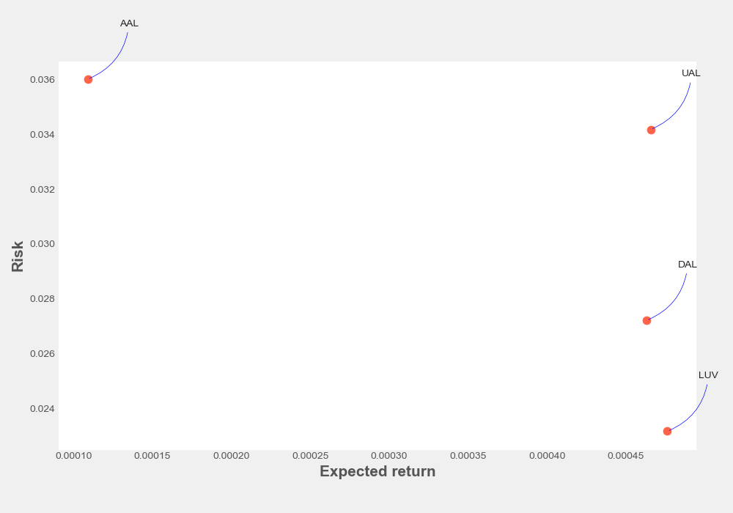
Risk Evaluation
Notes:
An easy evaluation is to compare risk and expected return based on the daily percent change,
and from this, you can see that southwest airlines is the best option with a higher expected return and lowest risk.

Slide 5
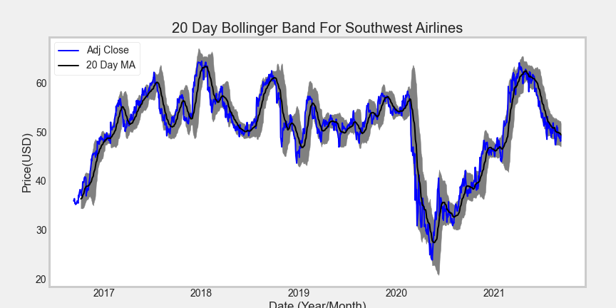
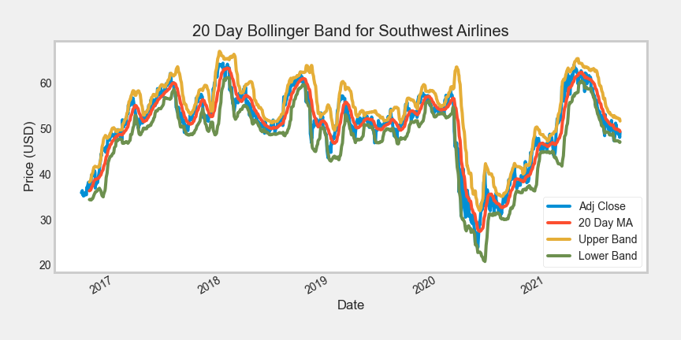
Bollinger bands
Notes:
Here are some other analysis tools to facilitate decision making for when to enter and exist. Bollinger bands are a type of statistical chart to indicate the price volatility over time.
When the bandwidth widens, volatility increases as an indication that any existing trend may be ending.
Also, if the price drops below the lower band, it indicates the stock is oversold, and there might be a correction.

Slide 6
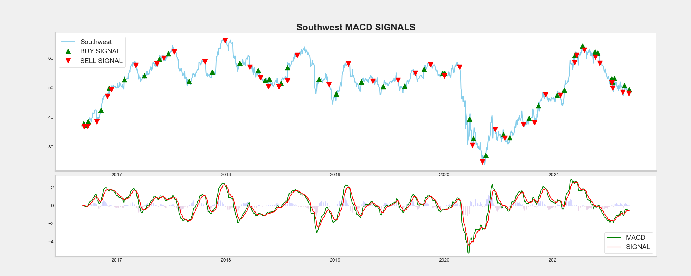

Moving average convergence divergence (MACD)
Notes:
Moving average convergence and divergence is the difference between the short term (12-period)
and long term(26-period) exponential moving average compared to the 9-period exponential moving
average as the signal line.
When the green line is above zero, it means that there is an increase in the rate of price change for the short-term period,
and if the difference also goes above the signal line, the trend is further validated by comparing to an even more recent moving average- the signal line.
that indicates an upward trend to buy.
The reverse is valid for a downward direction to take a short position.

Slide 7
Return
Profit gained from the MACD strategy by investing $100k in Southwest : $84237.82
Return on investment using MACD strategy : 84.0%
Notes:
Following the moving average strategy, assuming if you buy and sell at all the point for all the stock purchases, you have a 84% return on investment
First find the return using the moving average by calculating the difference between stock price per day and multiply by 1(buy)or 0 (sell or do nothing)
Calculated using 10k/the first closing price to find number of shares purchased then
multiple number of stocks by the macd return then sum it up to get the total return

Slide 8
Thank you!
Find me on
https://github.com/miazfryer
https://www.linkedin.com/in/miafryer/
What would you invest in?

