Slide 1

Airbnb New User Destination
LlanfairPG
Olivia, Nicola, Miguel, Manu, Alun

Slide 2
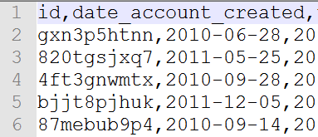
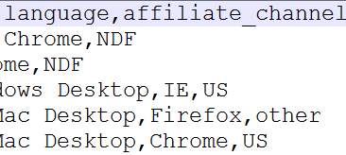
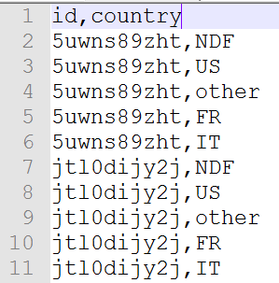
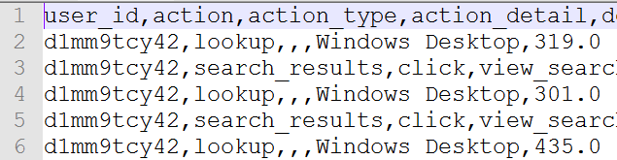
Competition and Dataset
New users
First booking
Predict from 10 possible destinations (out of 190+)
User Profile
Train
Test
Sessions
Submission sample

Slide 3
Feature Engineering
Data
Feature Engineering
Evaluation
FE Process
Model
New Features

Slide 5
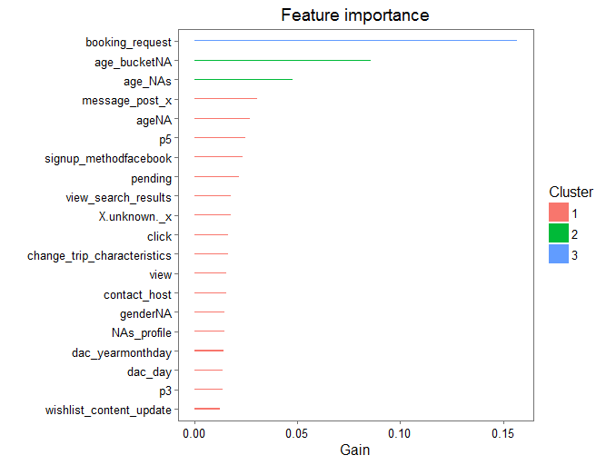
XGBoosting
XGB is a very fast implementation of gradient boosting. Decision tree ensemble.
There are many parameters to the model, cross validation was done to optimise these.

Slide 6
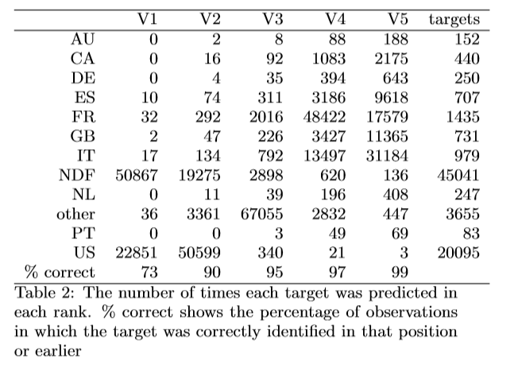
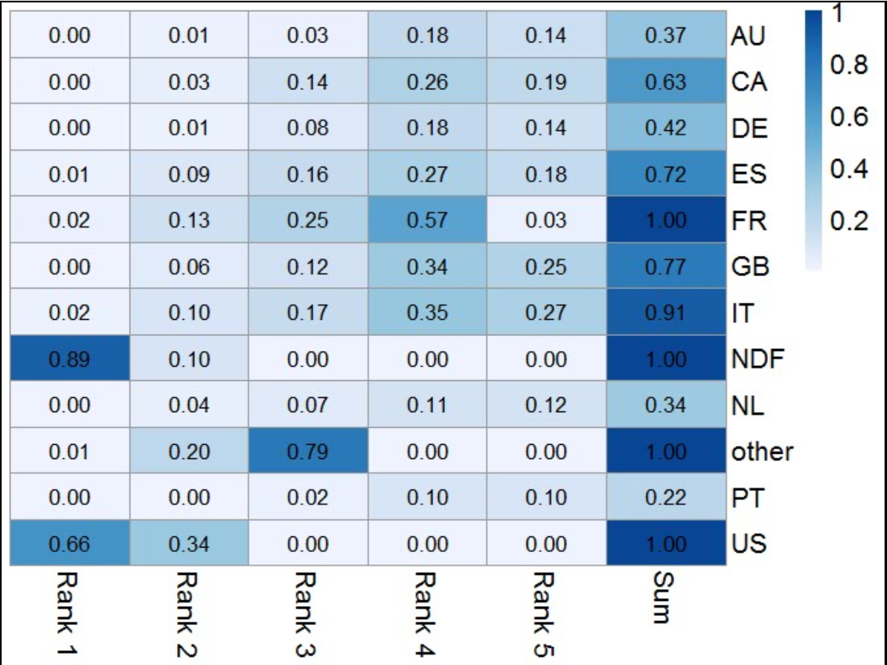
XGBoosting

Slide 7
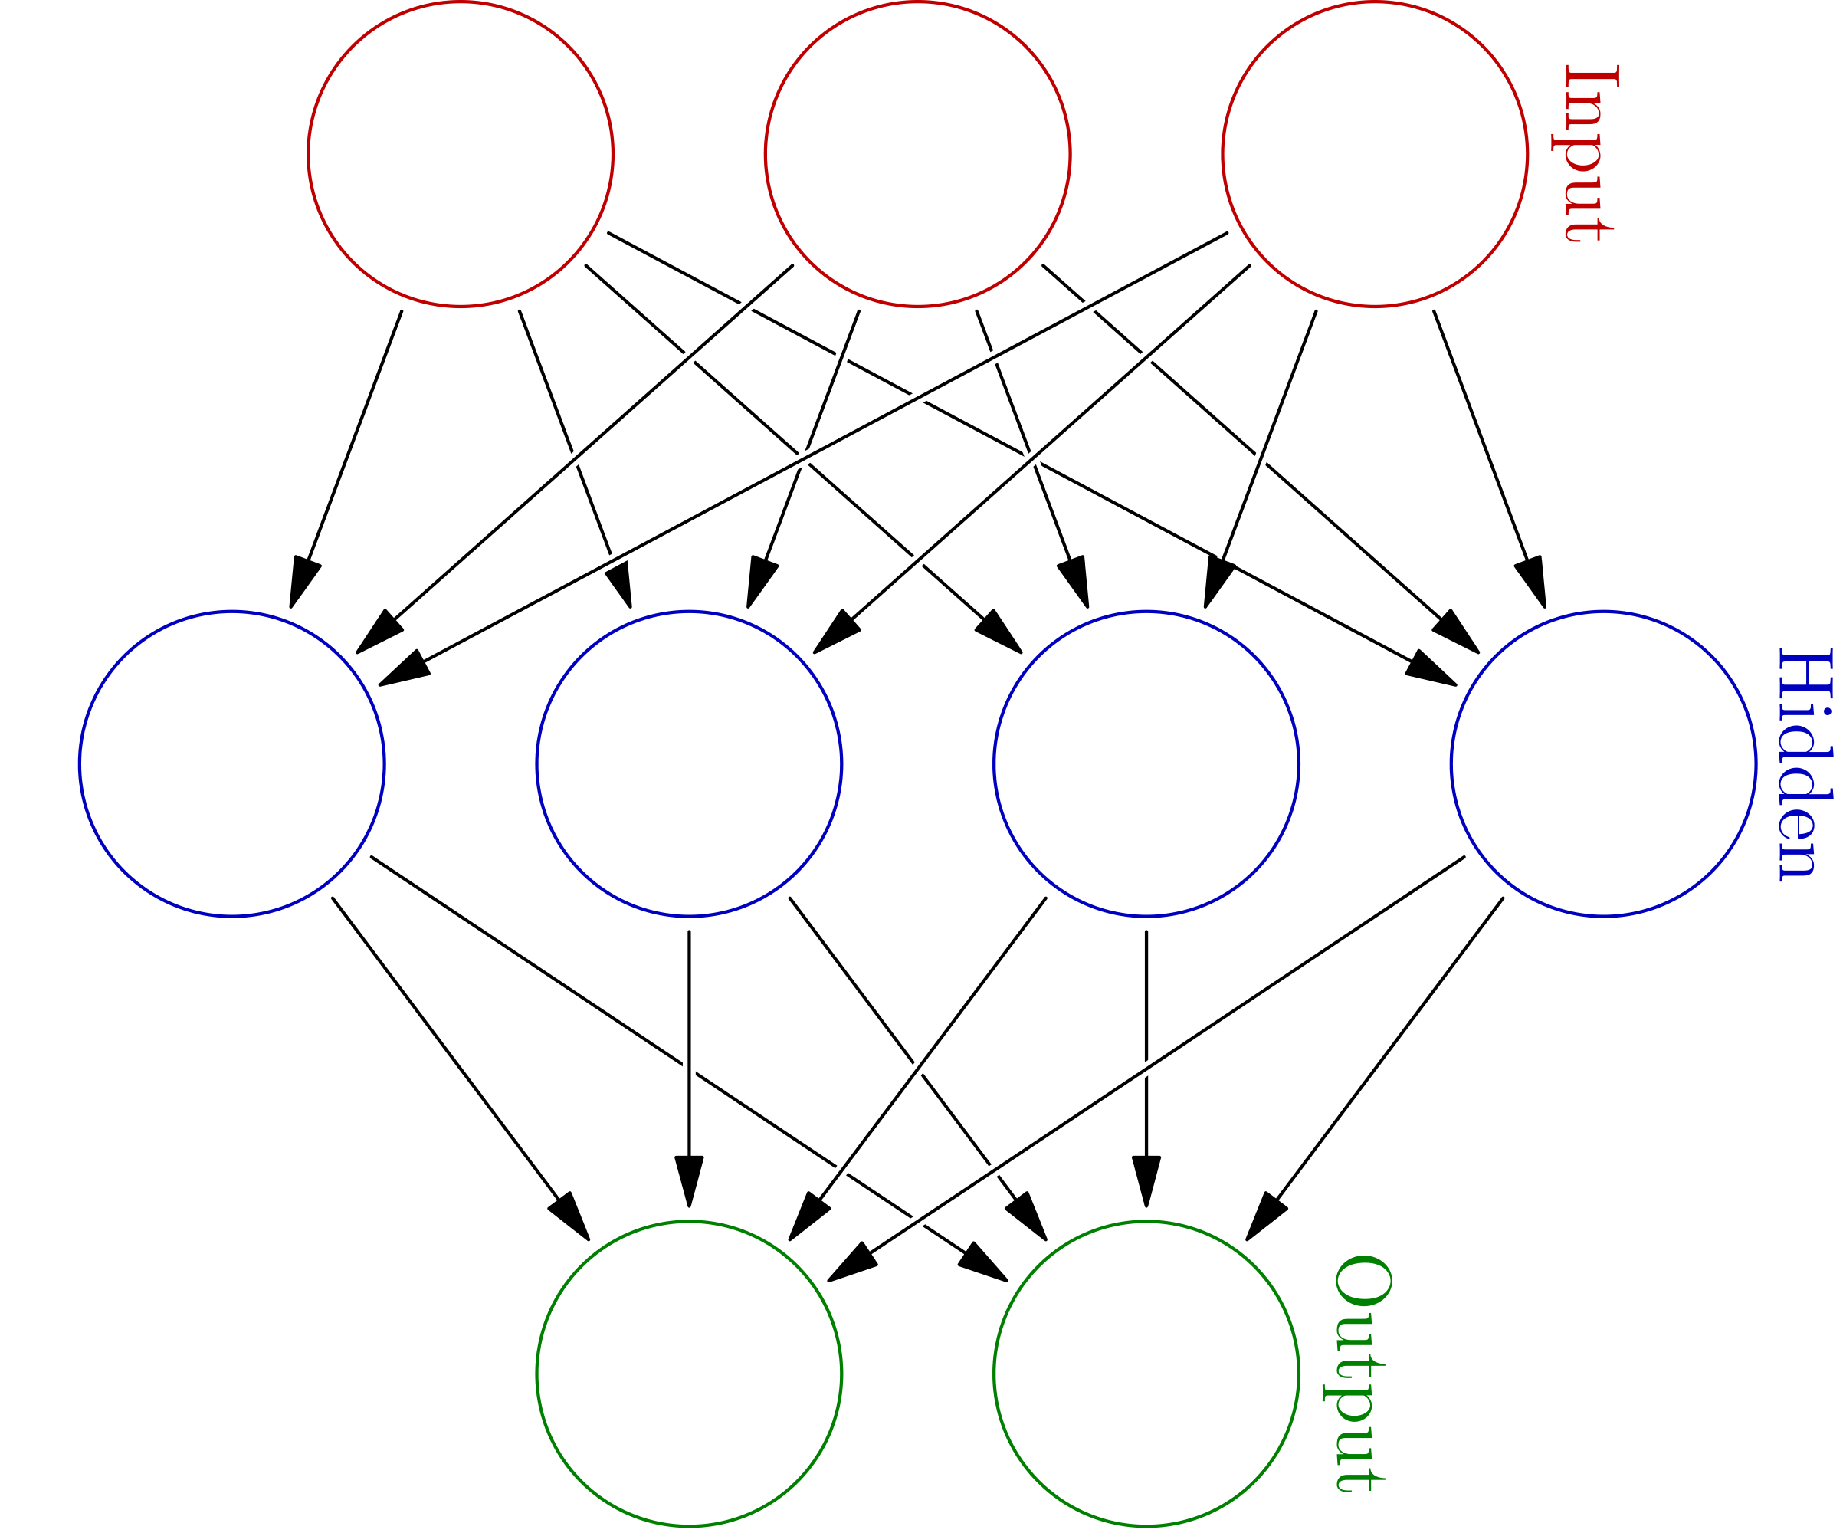
Artificial Neural Network

Slide 8
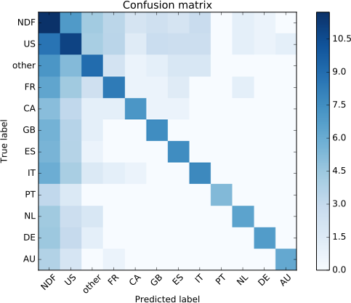
Random Forests
Log scale

Slide 9
Comparisons
 | NDCG
XGBoost | 0.8777
Neural Network | 0.8513
Random Forest | 0.8622
All NDF | 0.6841
NDF and US | 0.8307
XGBoost benchmark (basic feature engineering) | 0.8655
Null | 0.6854

Slide 10
Conclusions
Learners do not have confidence outside of the null hypothesis
Sessions data adds accuracy (two of the models)
Date fields have high importance
NA values in the age field has high importance in all models.

