Slide 1

Lab Book 1.0. Waveguides
Student: Marco Ibáñez Véliz

Slide 2
Instructions General
SCRIPTS
From GitHub →
Fork the repo: https://github.com/cccanvas-upv/cifoin-lab1.git
Clone the repo using VSCode
Run the Jupyter Notebook:
WAVEGUIDES_Student.ipynb
W (width)
W (width)
Core
Core
h_core
h
(height)
Cladding
Cladding
Slab
h_slab
deep waveguide
shallow waveguide

Slide 3
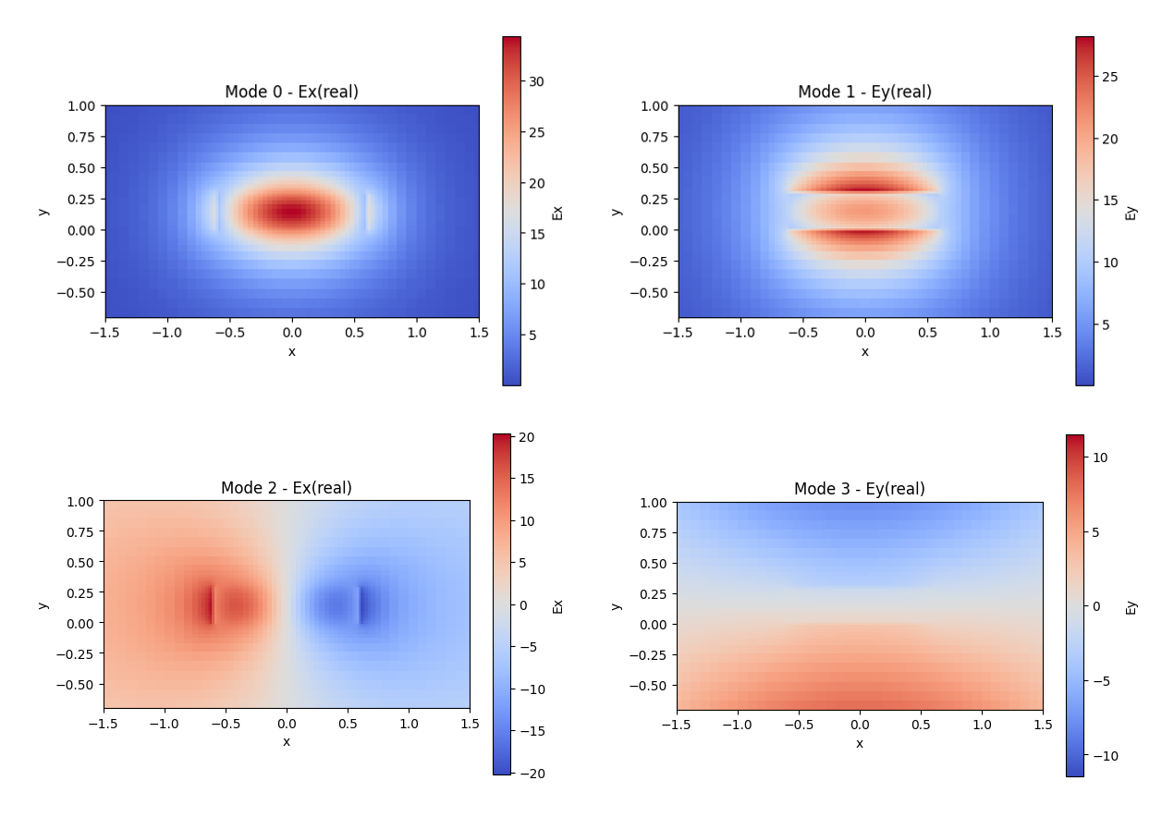
Learning outcome #1 – Effective index of a waveguide
Deep SiNx waveguide
w = 1.2 um, h = 300 nm, lambda = 1.55 um
Core: SiNx, cladding: SiO2
Mode 0: quasi-TE, neff = 1.605248
Mode 1: quasi-TM, neff = 1.528298
Mode 2: higher-order quasi-TE, neff = 1.450730
Mode 3: higher-order quasi-TM, neff = 1.433258
All guided modes stay above the SiO2 index, so the solutions are physically consistent.
Mode profiles at lambda = 1.55 um. Quasi-TE branches: modes 0 and 2. Quasi-TM branches: modes 1 and 3.

Slide 4
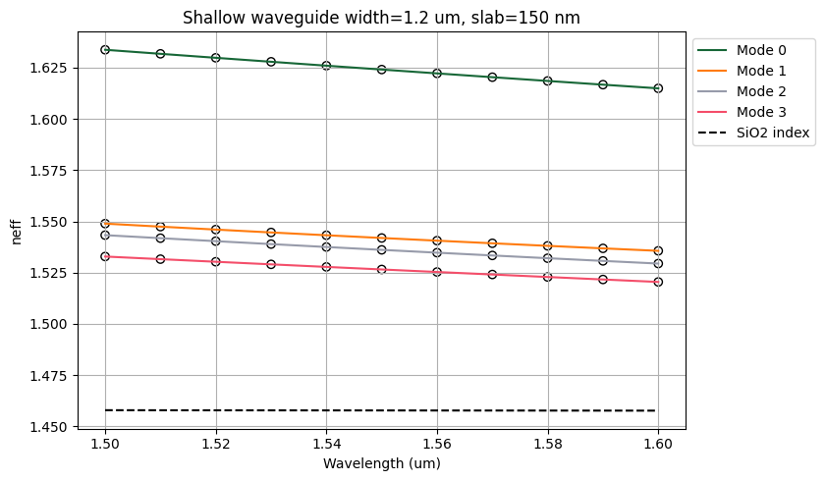
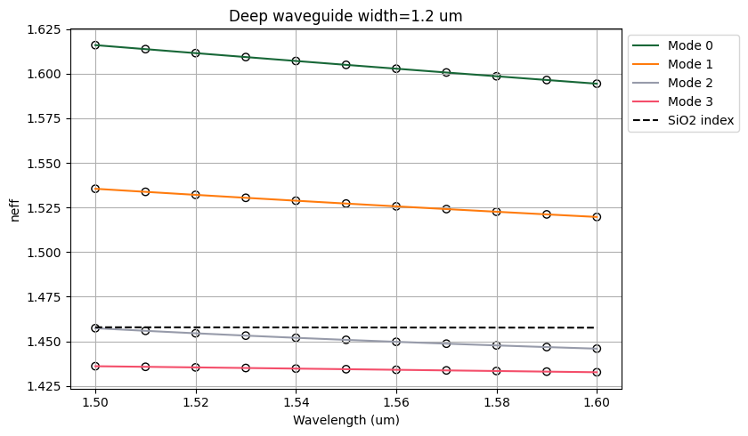
Learning outcome #2 – Wavelength behavior Wavelength 1.5-1.6 µm (step 0.01 µm) – width 1.2 µm
Both waveguides show a monotonic decrease of neff when wavelength increases from 1.50 to 1.60 um.
The 150 nm slab shifts the dominant branches upward: TE0 goes from 1.6337 to 1.6149 in the shallow guide, versus 1.6160 to 1.5944 in the deep guide.
The shallow geometry also packs the modes more closely together, so polarization mixing is stronger than in the deep rib.

Slide 5
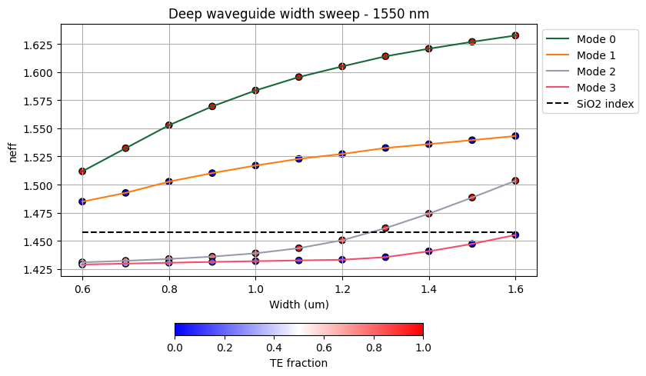
Learning outcome #3 – Width dependence Width 0.6 - 1.6 µm (step 0.1 µm) – Wavelength 1.55 µm
Increasing width raises modal confinement and moves the fundamental branch from neff = 1.5117 at 0.6 um to 1.6324 at 1.6 um.
Mode 1 is already guided at the narrowest widths, while additional branches appear around 1.2 um (mode 2) and 1.6 um (mode 3).
The color scale confirms the expected polarization pattern: modes 0 and 2 are TE-like, whereas modes 1 and 3 are TM-like.

Slide 6
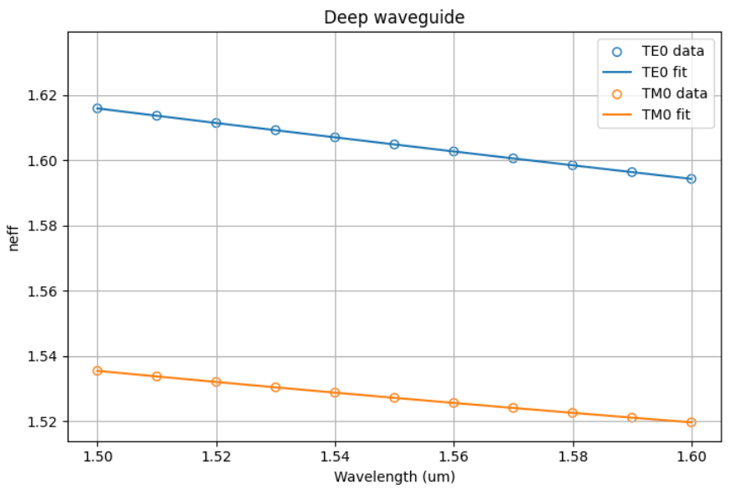
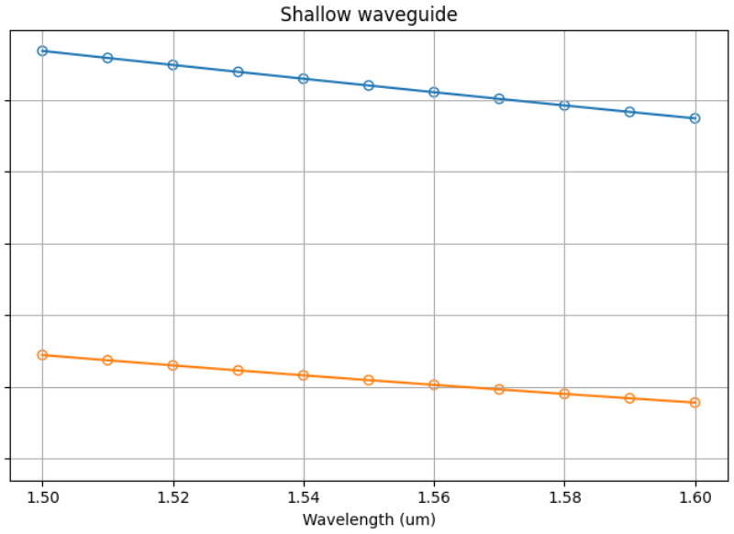
Learning outcome #4 – Waveguide compact model - Find the compact models of the following waveguides: Deep waveguide, h=300nm, w=1.2um - Shallow waveguide, core h=300nm, slab h=150 nm, w = 1.2um
The compact model accurately describes the wavelength dependence of the fundamental TE and TM modes in both waveguides. In both structures, the effective index decreases smoothly as the wavelength increases, and the fitted curves match the simulated data well. The shallow waveguide shows slightly higher effective index values, while the deep waveguide maintains a slightly larger group index. In all cases, dispersion remains very small and negative, confirming a weak dependence on wavelength in the studied range.

Slide 7
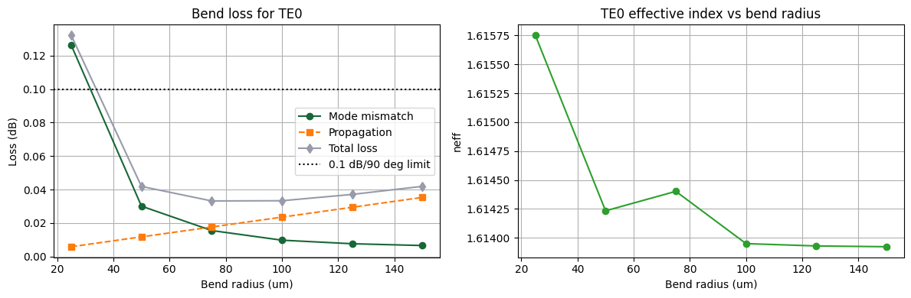
Learning outcome #5 – Bend waveguide radius vs. loss – deep Find neff_TE0 for wvl 1.55 µm, width 1.2 µm for R=25,50,75,100, 125,150 µm
Mode-mismatch dominates the smallest radius and pushes the 25 um bend above the 0.1 dB/90 deg target.
The first simulated safe radius is 50 um, with a total loss of 0.0419 dB/90 deg.
The minimum loss in the sweep appears around 75-100 um, where total loss stays near 0.033-0.034 dB/90 deg and neff_TE0 is almost constant.

Slide 8

Thank you

