Slide 1

Lab Book 4.0 Layout
Student: Marco Ibáñez Véliz, Hugo Beltrán Sanz

Slide 2
Instructions General
SCRIPTS
From GitHub →
Fork the repo: https://github.com/pascualmunoz/cifoin-lab4.git
Clone the repo using VSCode
Open folder / repo in VSCode
Open terminal: uv sync
Run the Jupyter Notebook:
LAYOUT_STUDENT.ipynb
Points
LO1: 3 points
LO2: 3 points
LO3: 1 points
LO4: 3 points

Slide 3
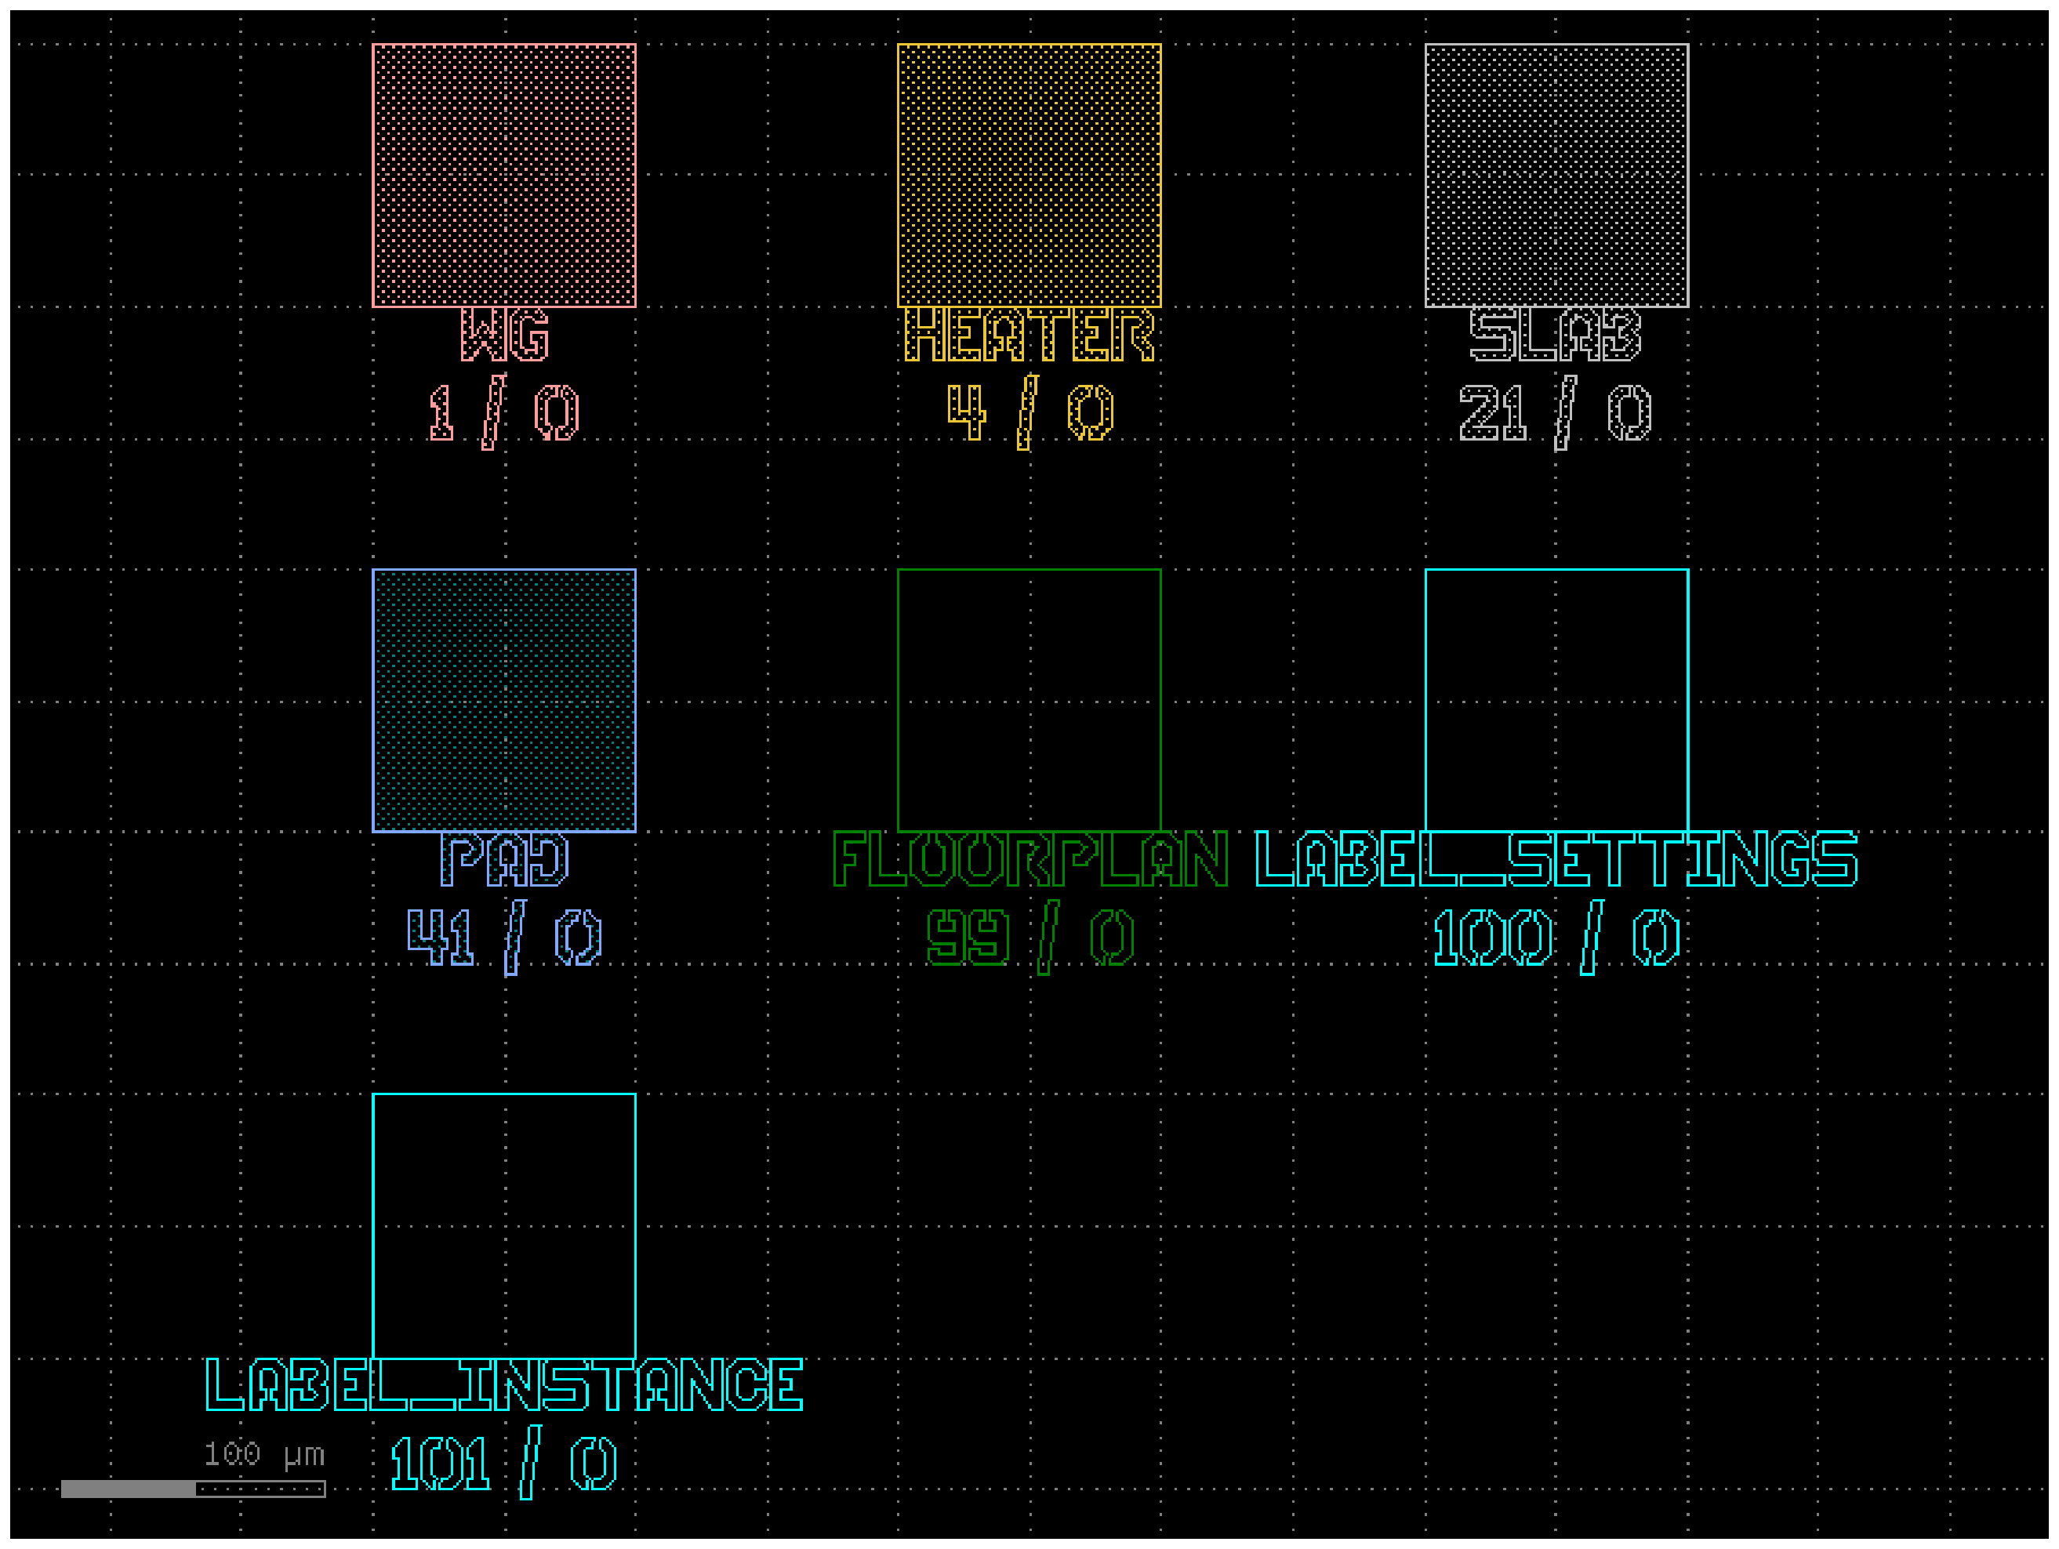
Learning outcome #1a - Notebook section 1. Technology
from upvfab.sin300.cband import PDK, cells
LAYER_VIEWS = PDK.layer_views
c = LAYER_VIEWS.preview_layerset()
c.plot()
PDK layer check used in the notebook. Passive devices use WG=(1,0); SLAB, HEATER, PAD and FLOORPLAN are kept as separate process layers.

Slide 4
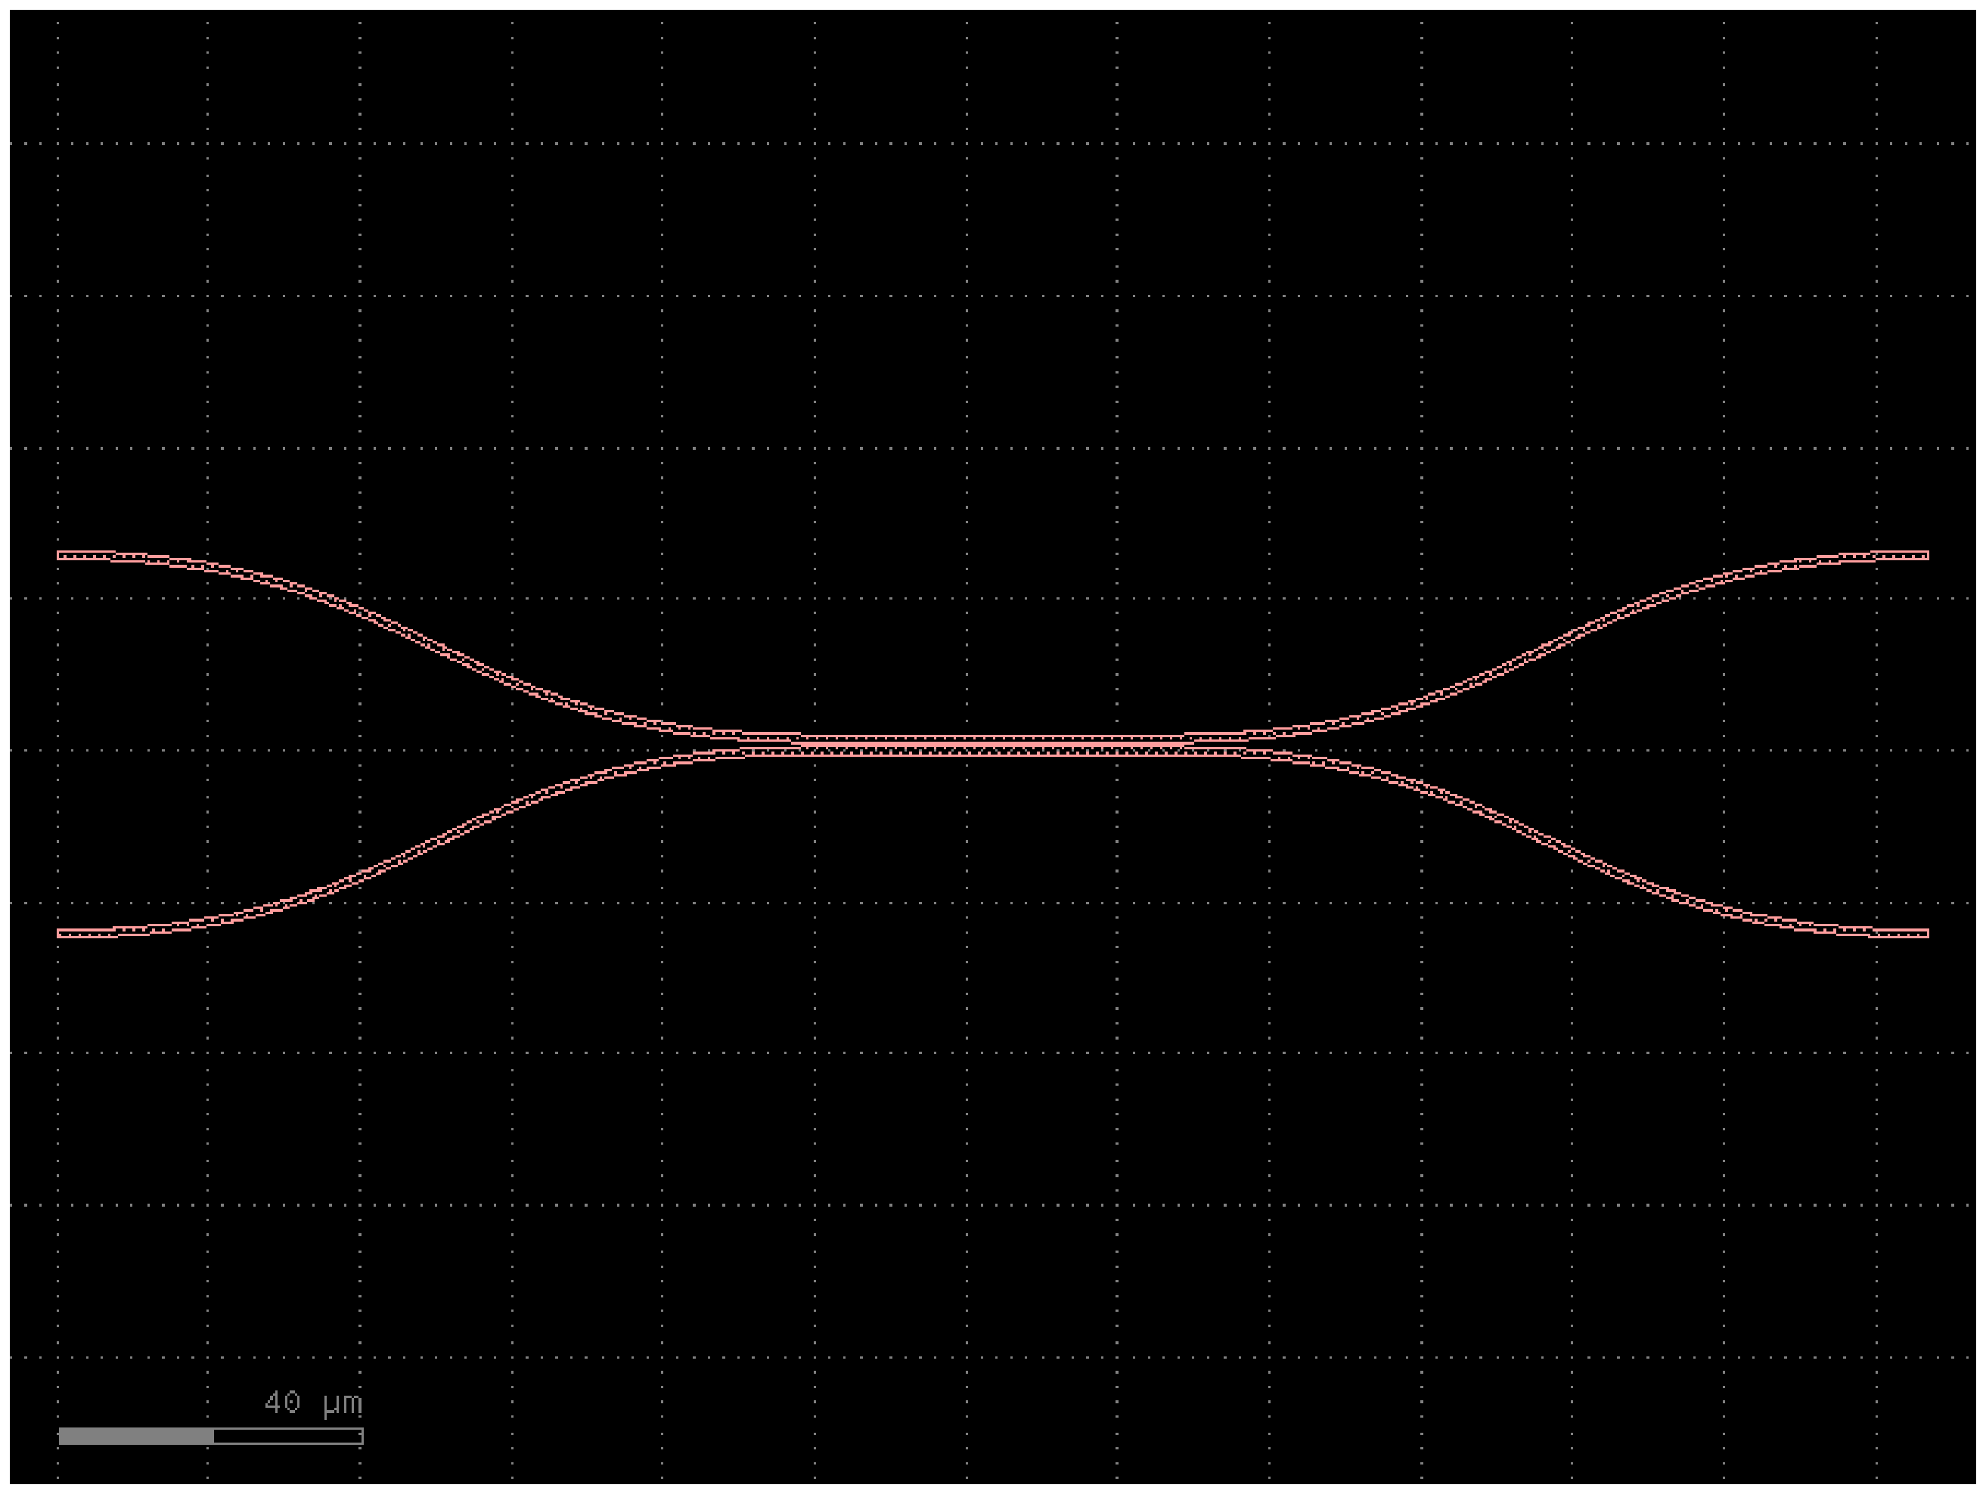
Learning outcome #1b - Directional coupler layout instance
dc = cells.coupler(**LAB2_DC_DESIGN)
dc.plot()
Lab 2 directional coupler instance: gap = 0.6 um and 50:50 interaction length = 47.014 um.

Slide 5
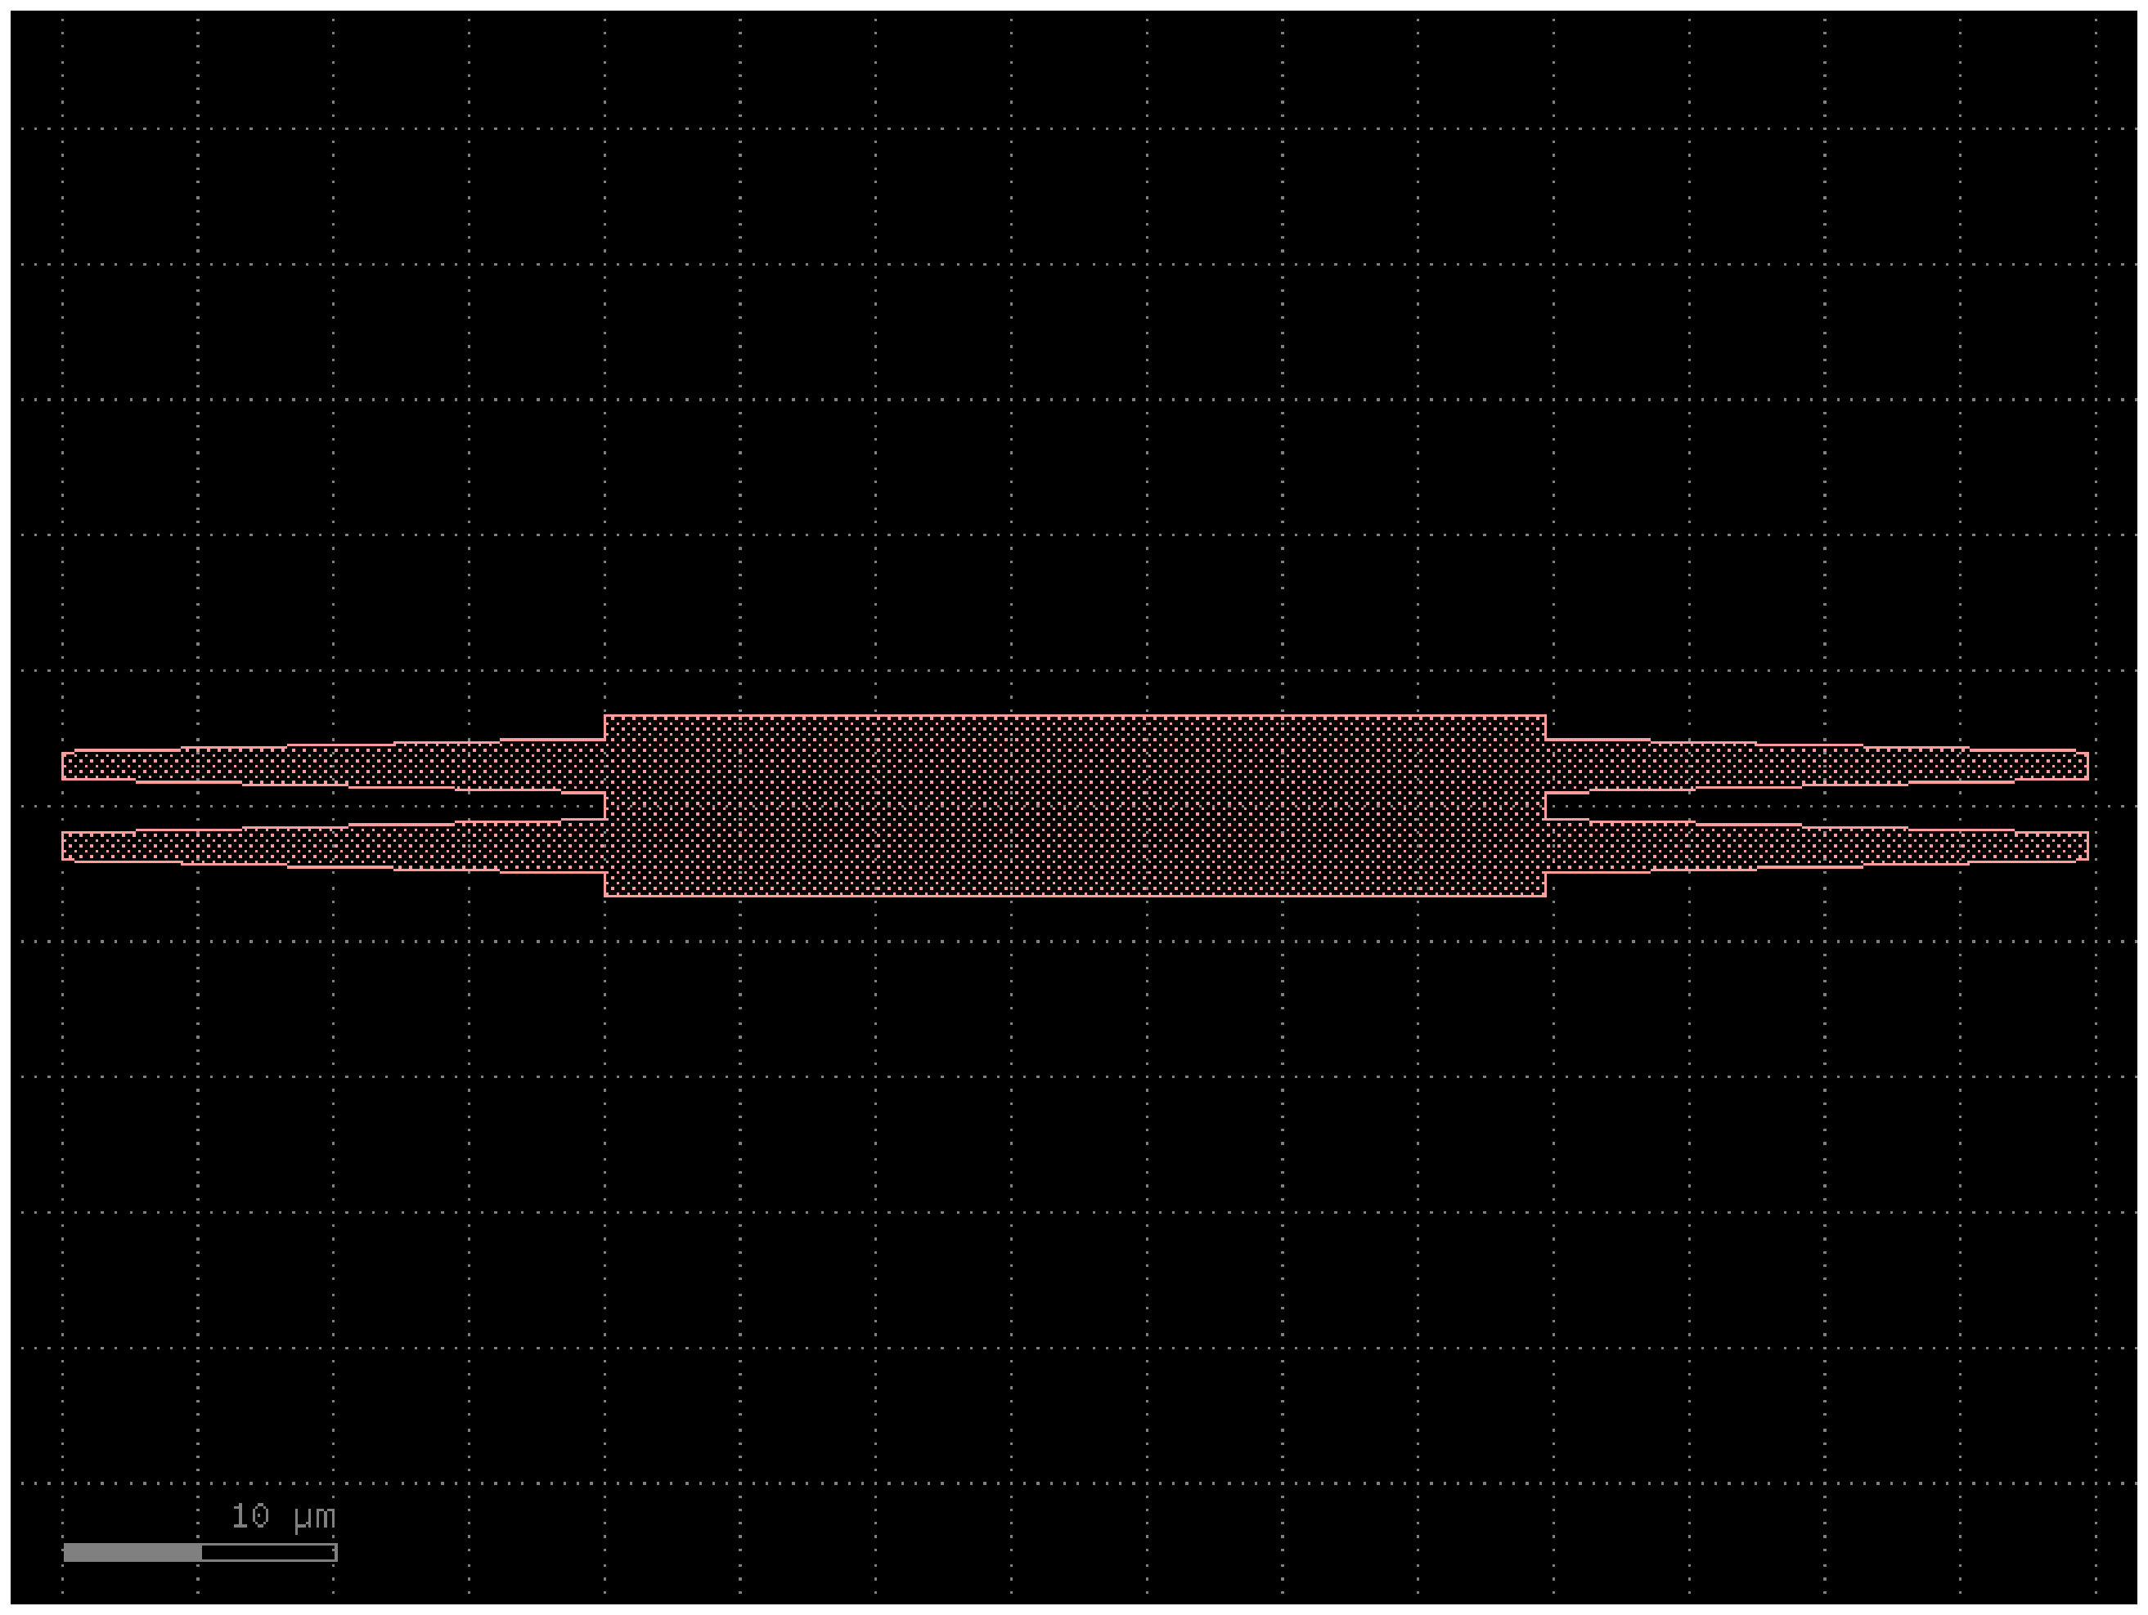
Learning outcome #1b - MMI 2x2 layout instance
mmi = cells.mmi2x2(**LAB2_MMI2X2_DESIGN)
mmi.plot()
Lab 2 MMI instance: W_MMI = 6.6 um, L_MMI = 34.718 um, width_taper = 2.0 um and gap_mmi = 1.0 um.

Slide 6
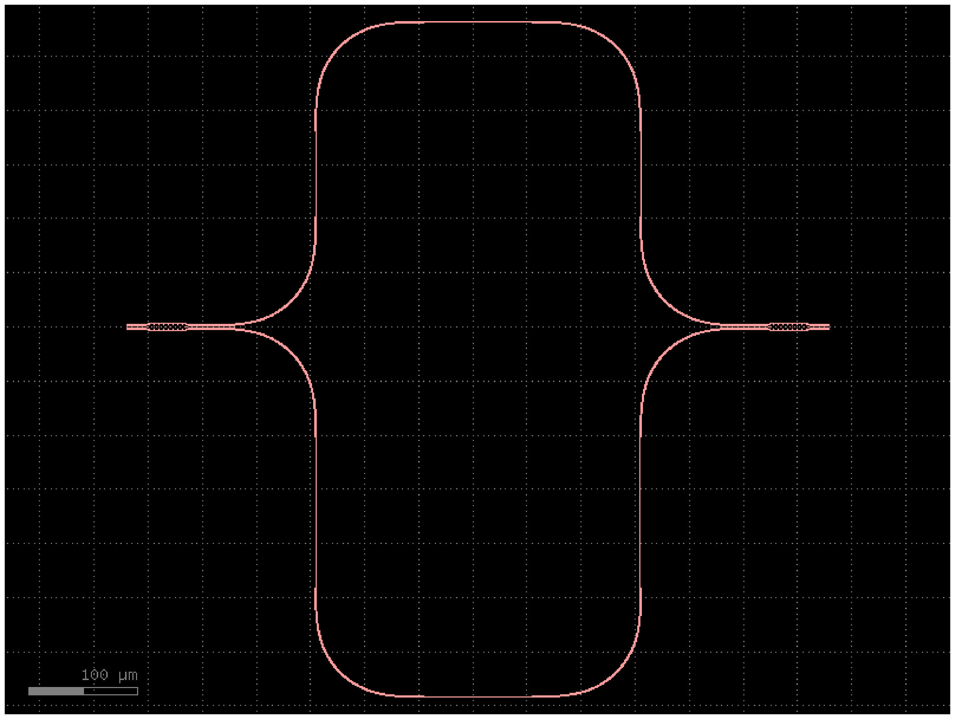
Learning outcome #1b - MZI layout instance
mzi = lab3_unbalanced_mzi(
delta_length=LAB3_MZI_DESIGN["delta_length"]
)
mzi.plot()
Lab 3 MZI instance using the Lab 2 MMI as splitter and combiner. The arm imbalance is 120.13 um.

Slide 7
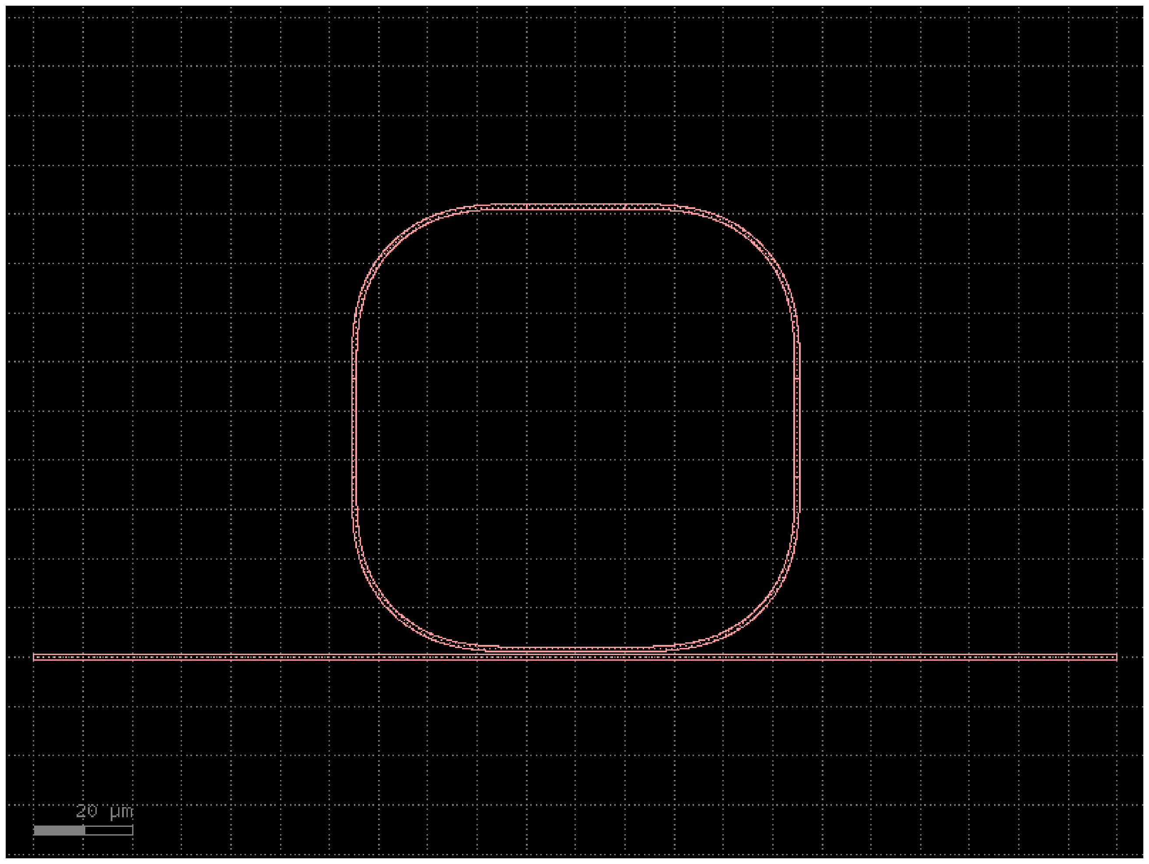
Learning outcome #1b - Ring resonator layout instance
ring = lab3_allpass_ring_layout(**LAB3_RING_LAYOUT_DESIGN)
ring.plot()
Lab 3 ring instance mapped to the PDK-safe layout values: radius = 35 um, length_x = 20 um, length_y = 20 um and gap = 0.6 um.

Slide 8
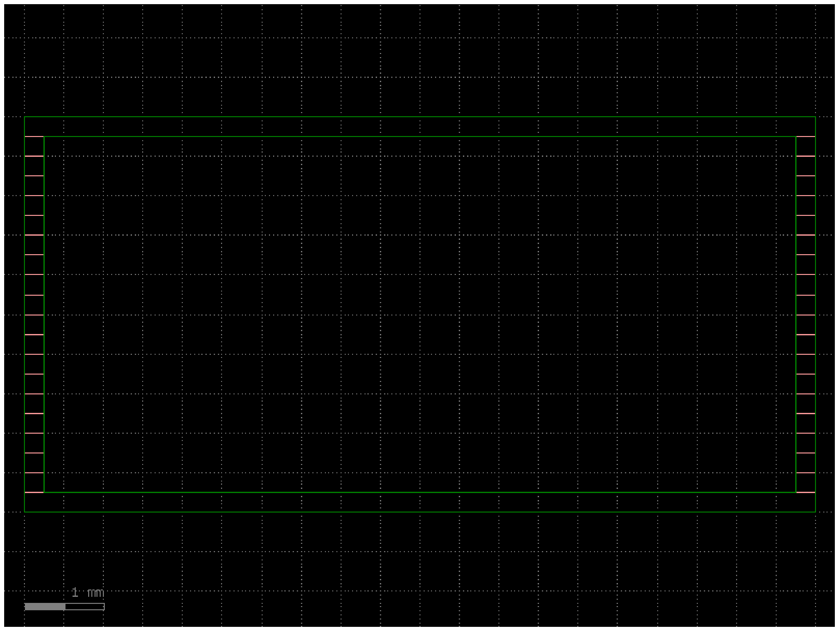
Learning outcome #2a - Die as reusable cell
@gf.cell
def lab4_die_with_ios(die_width=5000, die_length=10000,
border=250, io_spacing=250):
c = gf.Component()
n_ios = int((die_width - 2 * border) // io_spacing) + 1
for i in range(n_ios):
left = c.add_ref(gf.components.straight(length=250,
cross_section="strip"))
right = c.add_ref(gf.components.straight(length=250,
cross_section="strip"))
c.add_port(name=f"W{i:02d}", port=left["o2"])
c.add_port(name=f"E{i:02d}", port=right["o2"])
return c
The die cell creates a 5 mm x 10 mm FLOORPLAN frame and 19 optical I/Os per side at 250 um pitch.

Slide 9
Learning outcome #2a - Directional coupler as cell
@gf.cell
def lab2_directional_coupler_50_50(length=47.014, gap=0.6):
return cells.coupler(length=length, gap=gap)

Slide 10
Learning outcome #2a - MMI 2x2 as cell
@gf.cell
def lab2_mmi2x2_50_50(width_mmi=6.6, length_mmi=34.718,
width_taper=2.0, gap_mmi=1.0):
return cells.mmi2x2(
width_mmi=width_mmi,
length_mmi=length_mmi,
width_taper=width_taper,
gap_mmi=gap_mmi,
cross_section="strip",
)

Slide 11
Learning outcome #2a - MZI as cell
@gf.cell
def lab3_unbalanced_mzi(delta_length=120.13, length_y=80):
mmi = lab2_mmi2x2_50_50()
return gf.components.mzi(
delta_length=delta_length,
splitter=mmi,
combiner=mmi,
port_e1_splitter="o3",
port_e0_splitter="o4",
port_e1_combiner="o3",
port_e0_combiner="o4",
)

Slide 12
Learning outcome #2a - Ring as cell
@gf.cell
def lab3_allpass_ring_layout(radius=35, length_x=20,
length_y=20, gap=0.6):
return cells.ring_single(
radius=radius,
length_x=length_x,
length_y=length_y,
gap=gap,
cross_section="strip",
)

Slide 13
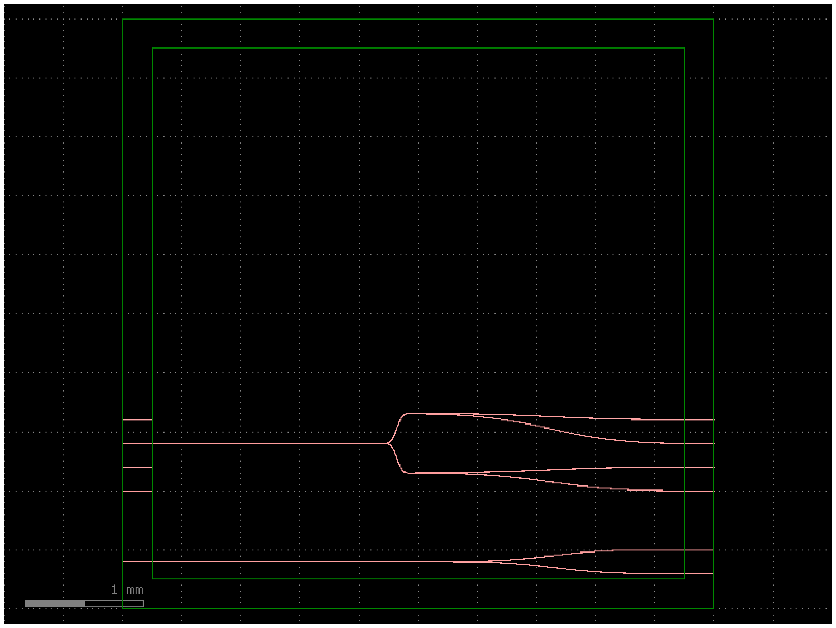
Learning outcome #3 - Notebook section 3. Complete layout
Read and describe 4 code blocks in section 3
Python code block 1: creates the main component, die frame and first MMI routing.
Python code block 2: tests a flat 1x4 MMI tree with three 1x2 MMIs.
Python code block 3: converts the MMI tree into a reusable @gf.cell.
Python code block 4: adds I/O arrays and routes the tree to the die waveguides.

Slide 14
Learning outcome #4 - Unbalanced MZI
@gf.cell
def lab4_unbalanced_mzi(delta_length=120.13, length_y=80):
mmi = lab2_mmi2x2_50_50()
return gf.components.mzi(
delta_length=delta_length,
splitter=mmi,
combiner=mmi,
port_e1_splitter="o3",
port_e0_splitter="o4",
port_e1_combiner="o3",
port_e0_combiner="o4",
)
Unbalanced MZI using the Lab 2 2x2 50:50 MMI; delta_length is the design parameter.

Slide 15
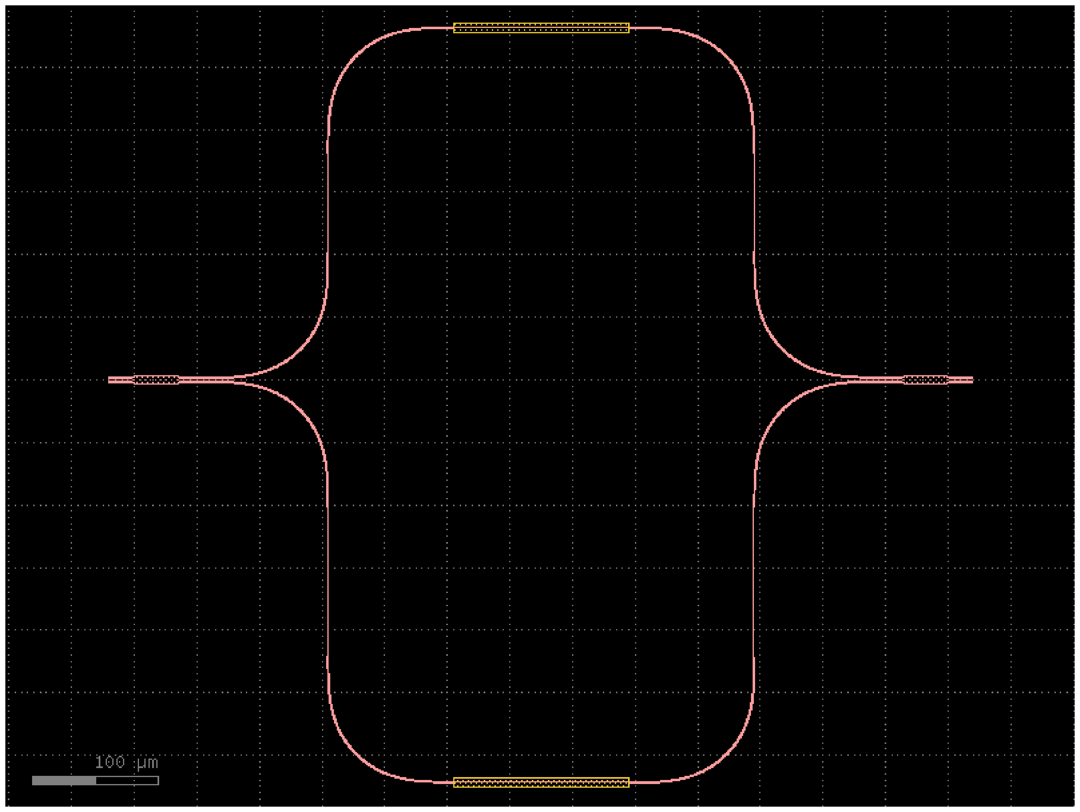
Learning outcome #4 - MZI with thermal tuners
@gf.cell
def lab4_thermal_mzi(delta_length=120.13, length_y=80):
mmi = lab2_mmi2x2_50_50()
return gf.components.mzi(
delta_length=delta_length,
splitter=mmi,
combiner=mmi,
cross_section_x_top="strip_heater_metal",
cross_section_x_bot="strip_heater_metal",
port_e1_splitter="o3",
port_e0_splitter="o4",
port_e1_combiner="o3",
port_e0_combiner="o4",
)
Thermal version of the MZI: both horizontal arms use the PDK heater-metal cross-section.

Slide 16
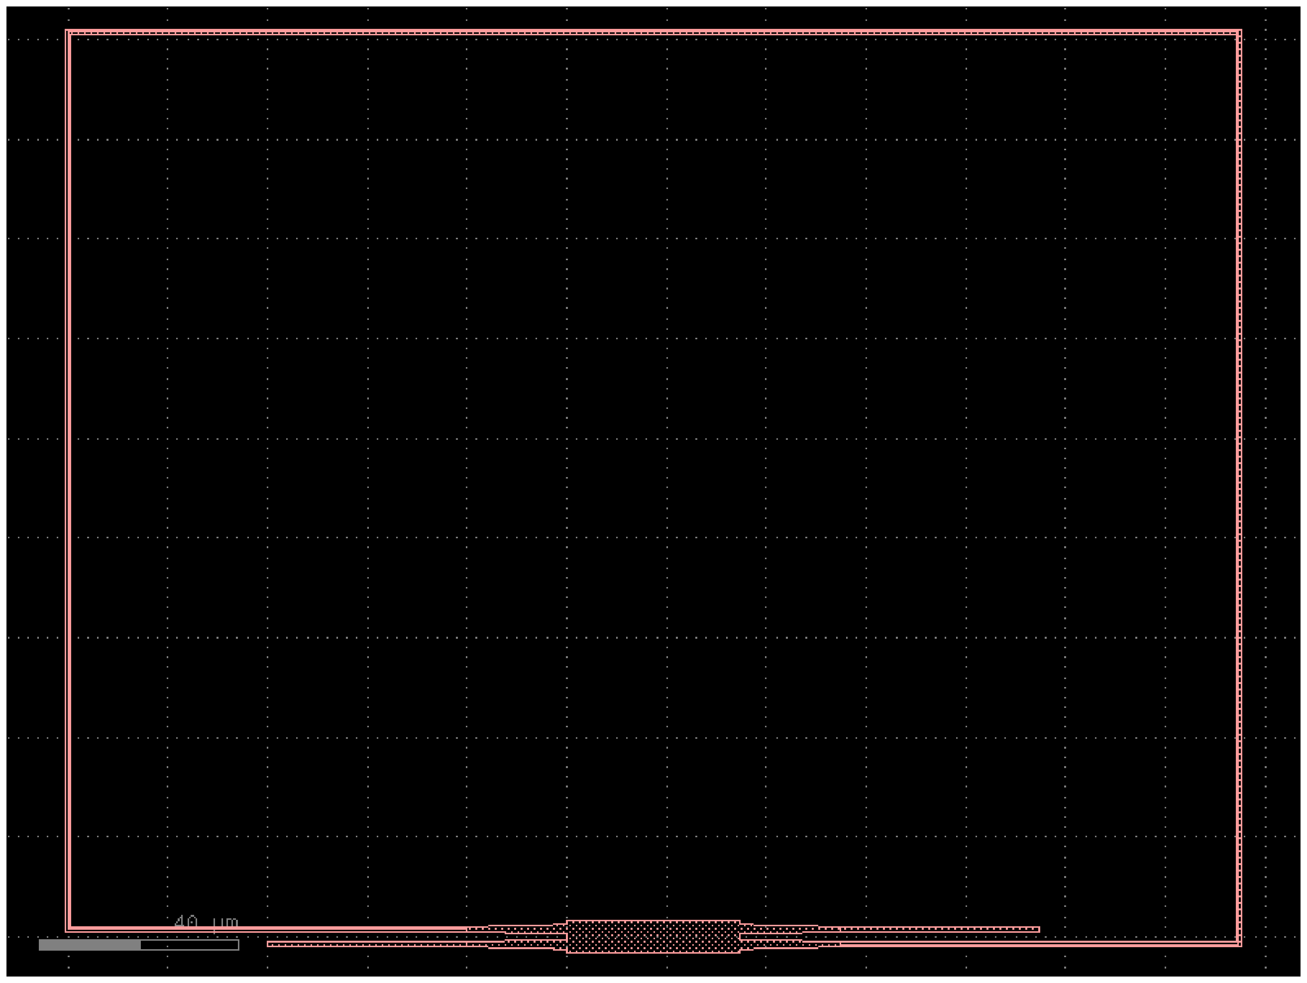
Learning outcome #4 - All-pass ring with MMI
@gf.cell
def lab4_mmi_allpass_ring(extra_length=0, thermal=False):
c = gf.Component()
mmi = c.add_ref(lab2_mmi2x2_50_50())
loop_xs = "strip_heater_metal" if thermal else "strip"
p_start = mmi["o4"]
p_stop = mmi["o2"]
x0, y0 = p_start.center
x1, y1 = p_stop.center
waypoints = [(x0 + 80, y0), (x0 + 80, y0 + 180),
(x1 - 80, y0 + 180), (x1 - 80, y1)]
gf.routing.route_single(c, p_start, p_stop,
waypoints=waypoints, cross_section=loop_xs)
return c
All-pass ring based on one 2x2 MMI; extra_length changes the feedback-loop perimeter.

Slide 17
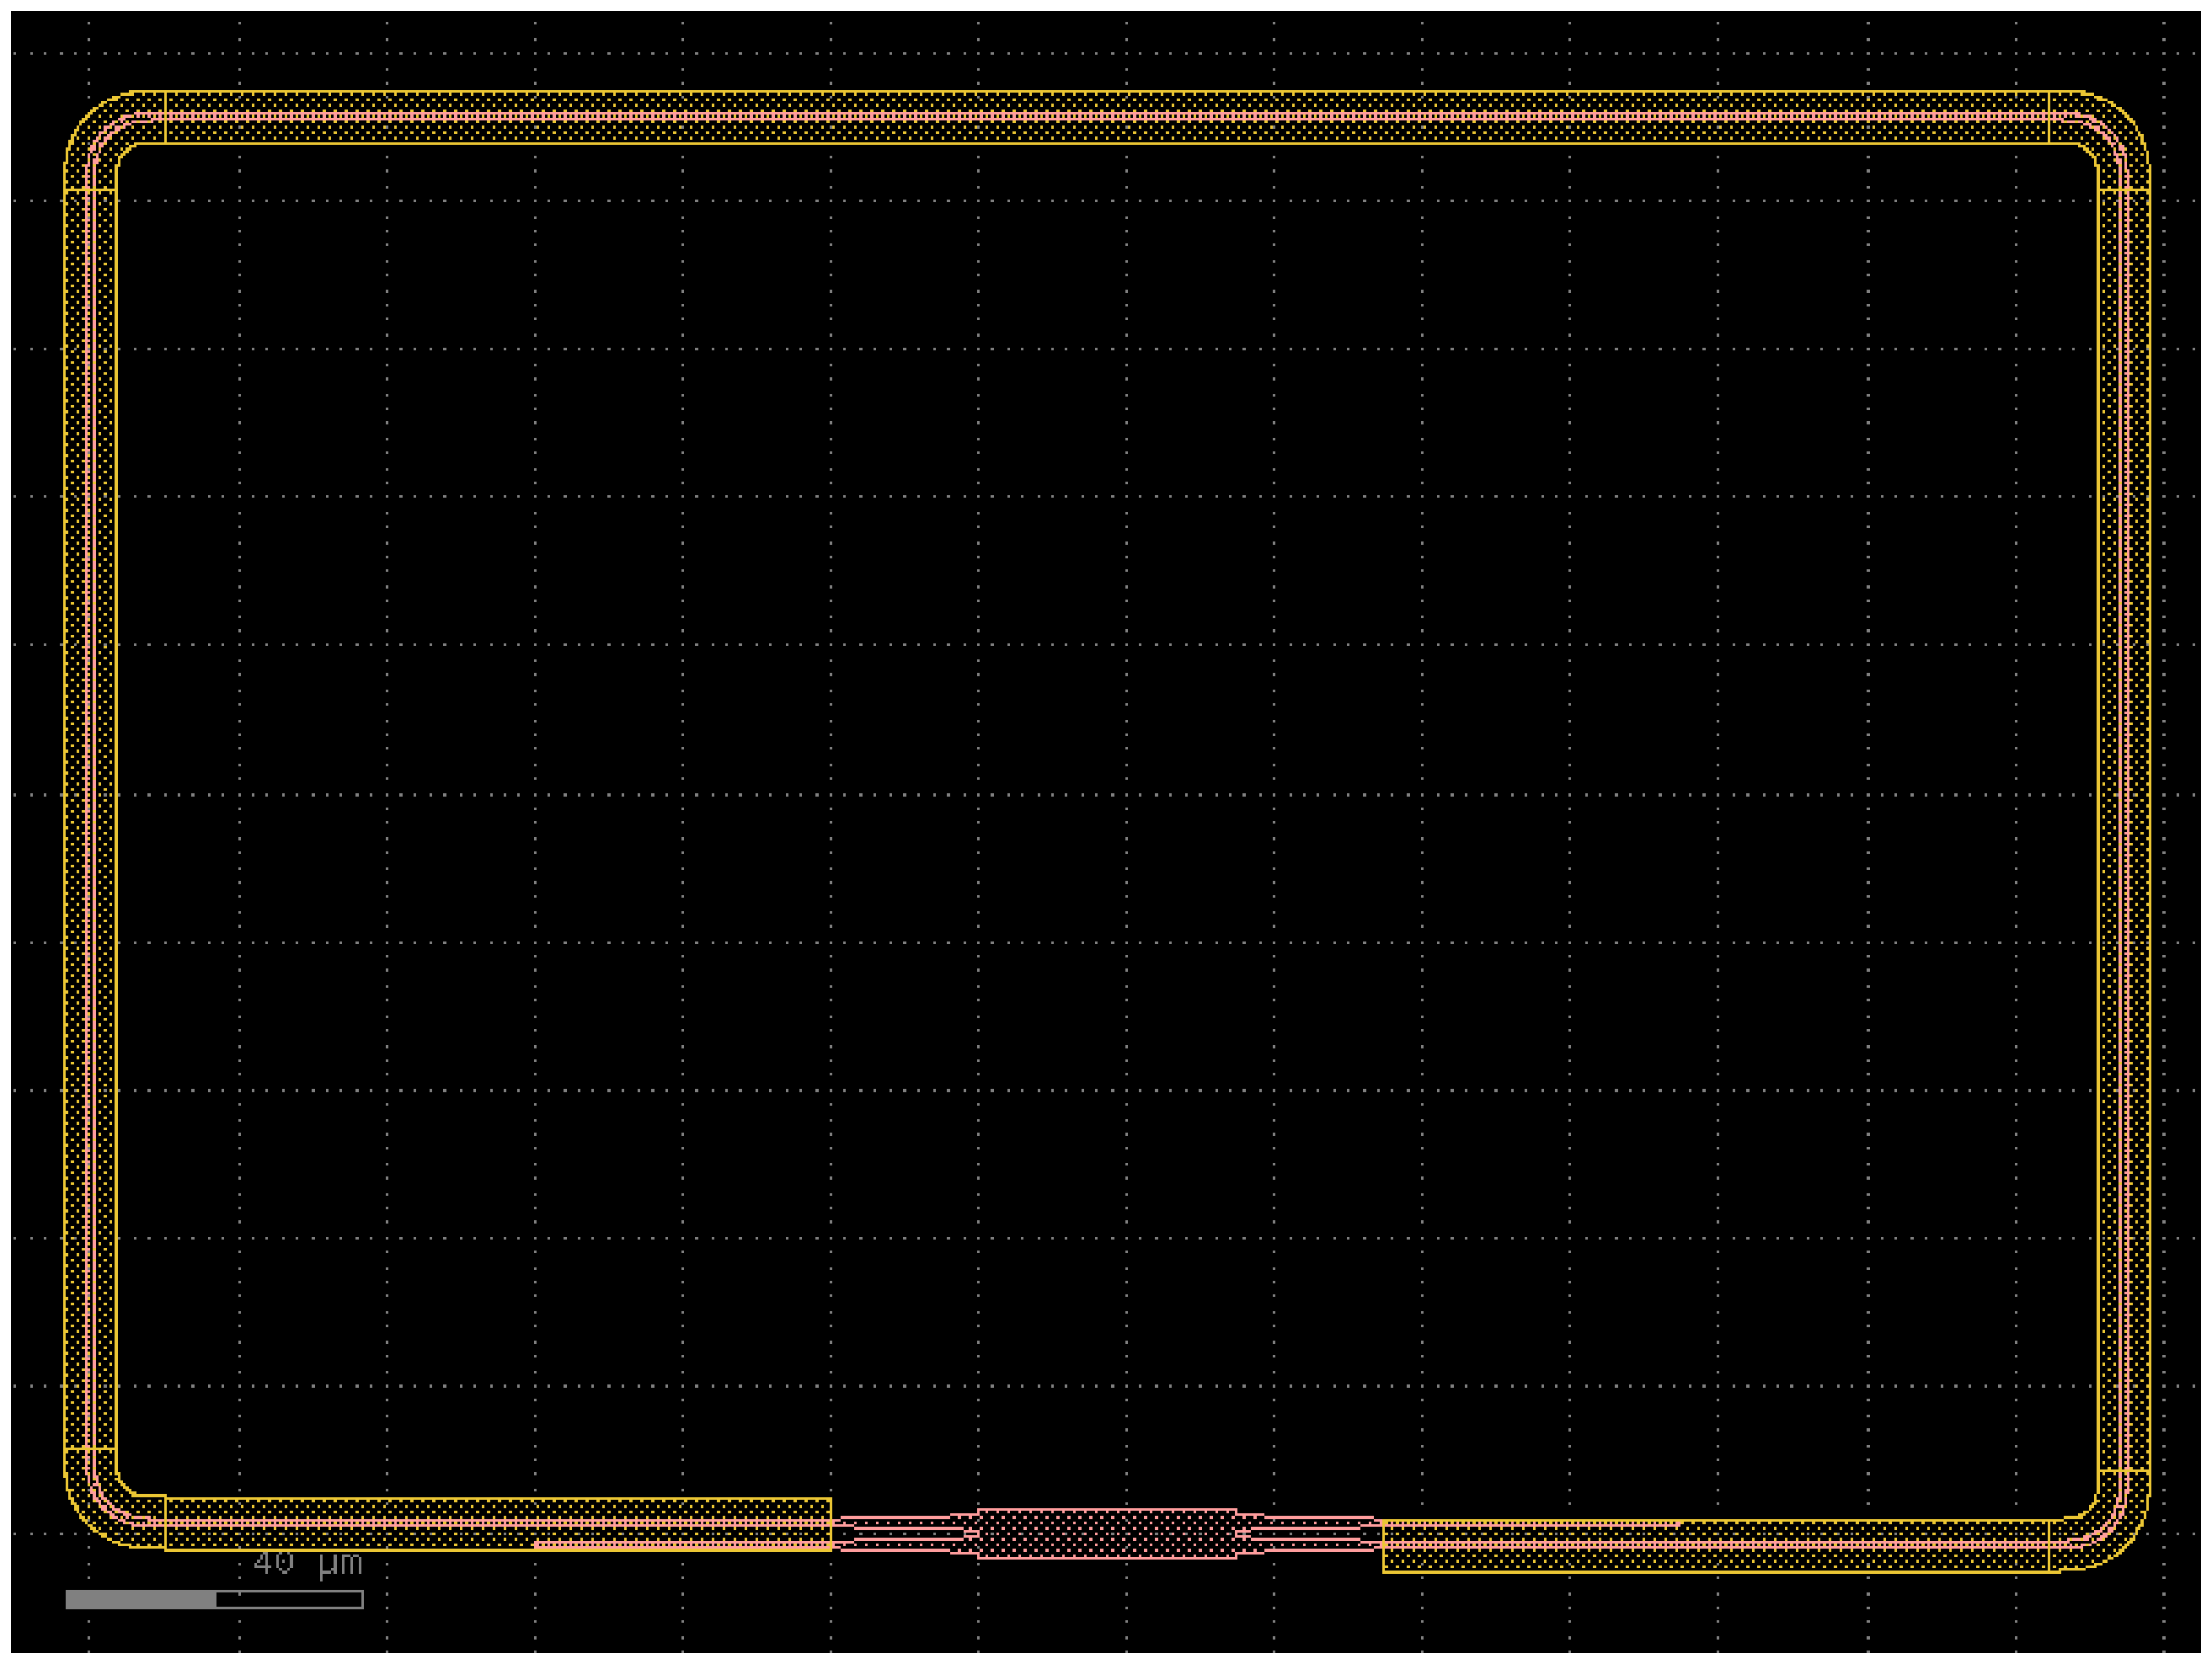
Learning outcome #4 - Thermal all-pass ring
@gf.cell
def lab4_thermal_mmi_allpass_ring(extra_length=0, loop_height=180):
return lab4_mmi_allpass_ring(
extra_length=extra_length,
loop_height=loop_height,
thermal=True,
)
Thermal ring wrapper: same MMI ring, but the loop is routed with heater metal.

Slide 18
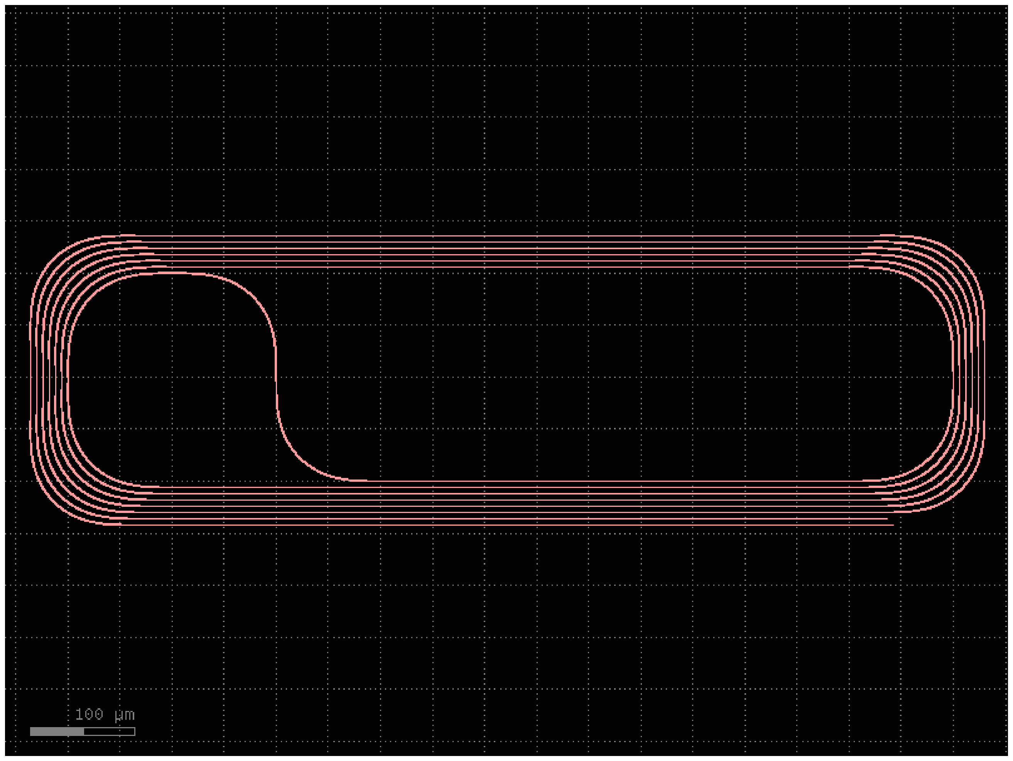
Learning outcome #4 - Spiral component
@gf.cell
def lab4_spiral_delay(length=500, n_loops=6, spacing=6):
return cells.spiral(
length=length,
n_loops=n_loops,
spacing=spacing,
cross_section="strip",
)
Spiral delay component based on the existing PDK/GDSFactory spiral cell.

Slide 19
Learning outcome #4 - Die with I/O array
die_with_ios = lab4_die_with_ios()
print(die_with_ios.info["n_ios_per_side"])
print(len(die_with_ios.ports))
die_with_ios.plot()
Result: 19 optical I/Os per side and 38 accessible optical ports in total.

Slide 20
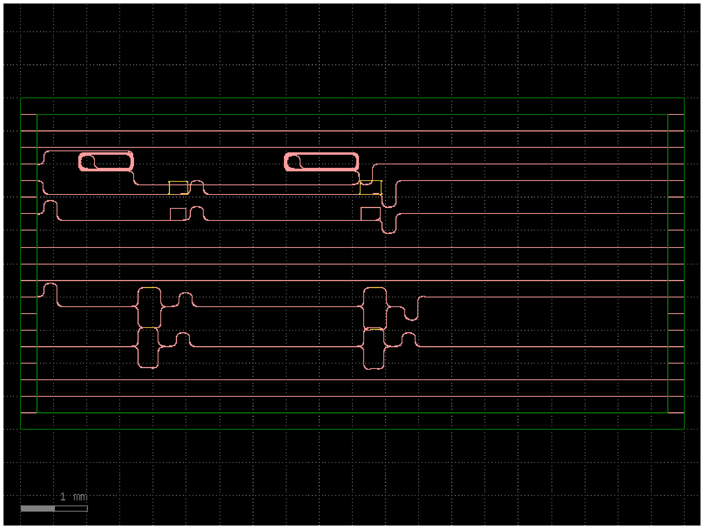
Learning outcome #4 - Complete die floorplan
lab4_complete = lab4_complete_floorplan()
print("Straight rows:", [0, 1, 2, 8, 9, 10, 16, 17, 18])
print("Device chain rows:", [4, 7, 12, 14, 15])
lab4_complete.write_gds("lab4_complete_floorplan.gds")
Final validation: 3 sets of 3 straight waveguides plus two instances of each created component, routed to die I/Os.

Slide 21

Thank you

