Slide 1

Hackathon 2024
Trend Prediction from Social Media
Exploring the Impact, Methodologies, and Predictions
Presented by

Slide 2
Trend Prediction from Social Media
Problem Statement:
Analyze social media data using LLMs to identify trending topics over a short period. Predict how political trends might evolve in the next few weeks.
Scope:
Short-term trends, utilizing a dataset comprising 14 days of tweets to generate predictive insights

Slide 3
LLMs Were Used for Various Analyses for Elections
Gujral et al. [1] examined social media's political impact using LLMs for nuanced election predictions based on Twitter data
Williams et al. [2] found that LLMs can generate convincing election disinformation, raising concerns about their misuse in political contexts
Yu et al. [3] introduced a framework utilizing LLMs to predict election outcomes, validated with real-world and synthetic voter data.
[1] Can LLMs Help Predict Elections? (Counter) Evidence from the World's Largest Democracy
[2] Large language models can consistently generate high-quality content for election disinformation operations.
[3] Will Trump Win in 2024? Predicting the US Presidential Election via Multi-step Reasoning with Large Language Models. Predicting the US Presidential Election via Multi-step Reasoning with Large Language Models

Slide 4
United States Political Tweets:
Twitter timeline of most prominent American politicians
Link: https://www.kaggle.com/datasets/tunguz/united-states-political-tweets/data?select=pence_timeline.json
Our dataset contained 4 JSON files with tweets from the following US politicians
Joe Biden
Donald Trump
Kamala Harris
Mike Pence

Slide 5
Sample biden_timeline.json
0:{24 items
"created_at":string"Thu Oct 22 00:30:00 +0000 2020"
"id":float1319073483943407600
"id_str":string"1319073483943407617"
"text":string"Folks, if you plan to vote by mail and haven’t requested your ballot yet, it’s important that you do so as soon as… https://t.co/LlS8JP7Nj4"
"truncated":booltrue
"entities":{...}4 items
"source":string"<a href="https://studio.twitter.com" rel="nofollow">Twitter Media Studio</a>"
"in_reply_to_status_id":NULL
"in_reply_to_status_id_str":NULL
"in_reply_to_user_id":NULL
"in_reply_to_user_id_str":NULL
"in_reply_to_screen_name":NULL
"user":{...}42 items
"geo":NULL
"coordinates":NULL
"place":NULL
"contributors":NULL
"is_quote_status":boolfalse
"retweet_count":int1181
"favorite_count":int4677
"favorited":boolfalse
"retweeted":boolfalse
"possibly_sensitive":boolfalse
"lang":string"en"
}

Slide 6
Data Preprocessing & Methodology
JSON dataset
Python object
Pandas DataFrame
New columns (text, created_at, retweet_count, favorite_count) added
Remove stop words, newline characters, URLs, non-ASCII characters
-1.0: Negative
0: Neutral
1.0: Positive
Dataset with sentiment polarity (-1.0 to 1.0)
TextBlob
library
Sentences & Words
0: Objective Statements
1: Subjective Statements
Dataset with sentiment subjectivity (0 to 1)
Based on keywords such as “election” and “children
Categorized tweets
Prophet
library
Forecasted Data

Slide 7







Tools and Technologies

Slide 8
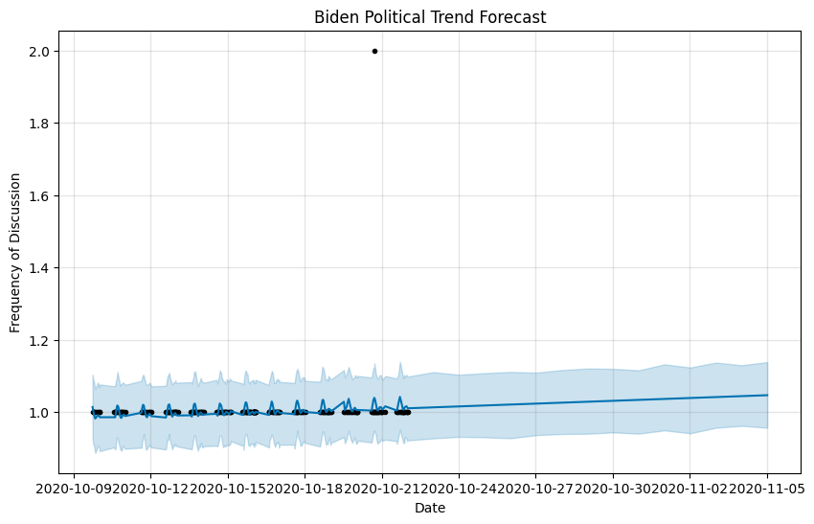
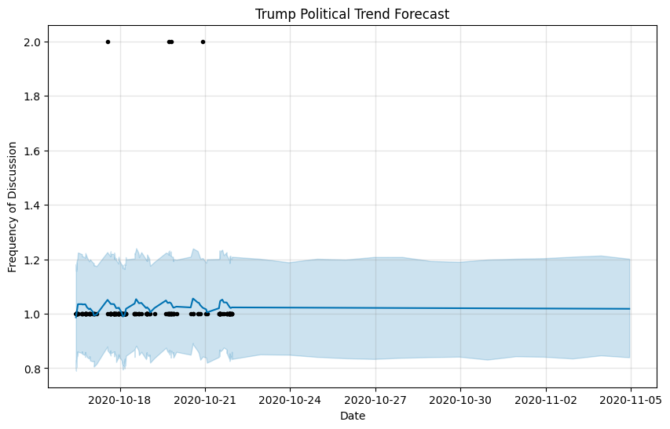
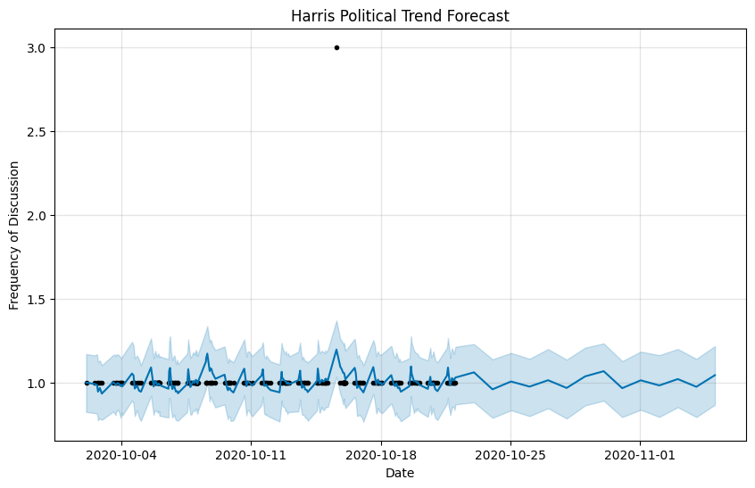
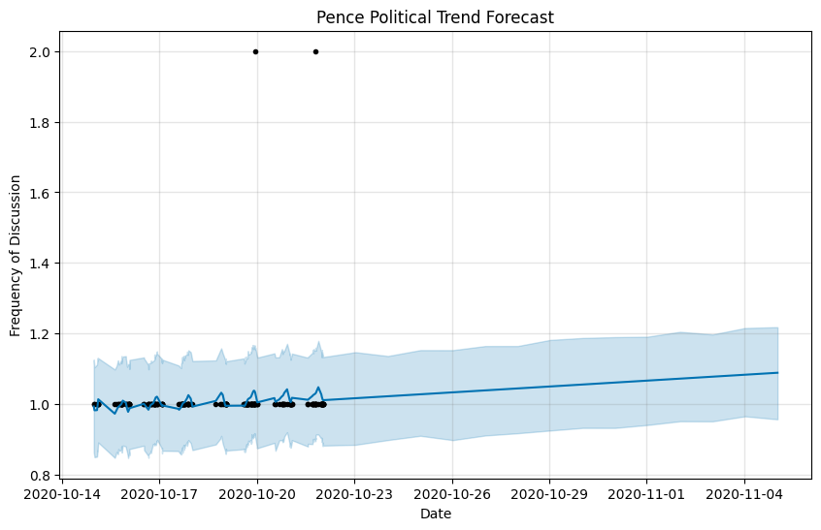
Political Trend Forecast
Presidential Candidate
Vice Presidential Candidates

Slide 9
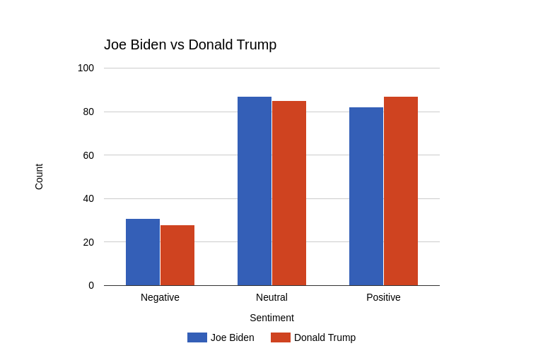
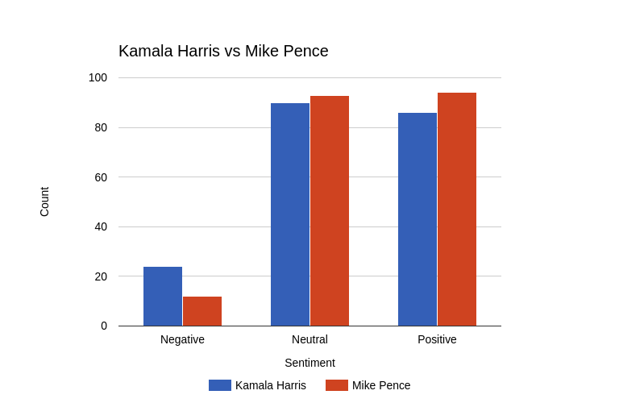
Sentiment Count Comparison

Slide 10
Key Takeaways
Analyzed political trends using 14 days of social media data and LLMs for predictive insights.
Public opinion shifts offer crucial insights for political strategies and public relations.
LLMs reveal trends but face challenges with bias, noise, and misinformation.
Used Kaggle data from 2020 candidates, processing it for sentiment and engagement metrics with Prophet.
Predicted steady interest in Biden, rising engagement for Pence, stable interest in Trump, and fluctuating trends for Harris.
Findings show strong momentum for Biden and Pence, with variable sentiment for Harris.
Future improvements: multi-platform data, extended timelines, real-time updates, and refined sentiment analysis.

