Slide 1
Arwi: Case study of Arabic, Syriac and Diacritical Unicode characters
M.I. Seyed Mohamed Buhari
Department of Computer Science,
Faculty of Science,
Universiti Brunei Darussalam,
Brunei Darussalam
Email: mibuhari@gmail.com mibuhari@fos.ubd.edu.bn

Slide 2
Arwi – An Introduction
Called as Arabu-Tamil or Arabic-Tamil Script
Used by Muslims of Tamil Nadu (in India) and Sri Lanka
Used to write their religious texts as well as communication letters
Writing Tamil language using Arabic style of Script
Like Malay language written in Jawi Script
Notes:
Arwi (also called as Arabu-Tamil or Arabic-Tamil) Script was widely used by Muslims of Tamil Nadu (in India) and Sri Lanka to write their religious texts as well as communication letters. Arwi Script is writing Tamil language using Arabic style of scripts. This is similar to writing Malay language both in English and Jawi Script. Actually, Tamil language is written in Tamil Script, which is of left-to-right pattern. Arwi is written using Arabic script with an addition of certain diacritics and characters, which is of right-to-left pattern.

Slide 3
Tamil Script
Historical information: 100 BC
  http://www.xs4all.nl/~wjsn/tekst/taalschriften.htm#QXQ
Based on Brahmi Script
  Like Devanagari, Malayalam, Telugu, etc.
Left-to-right writing
Uses 65 characters and variants
  Uses combinations of them also
Uses HTML codes 2944 to 3071
  Unicode (U+0B80 – U+0BFF)
Ref: http://www.xs4all.nl/~wjsn/tamil.htm
Notes:
Spoken in Tamil Nadu, Malaysia, Singapore, etc.

Slide 4
Arabic Script
Belongs to Semitic Language family
  Recorded back to thousands of years
Right-to-left writing
  Like Persian, Urdu
Contains 28 characters and 6 vowels
Character representation:
  Initial, Middle and final forms
Diacritical marks: Damma (/u/), Fatha (/a/), Kasrah (/i/)
Has influence on many other languages
Notes:
Official language in most countries in Middle-East and North Africa.

Slide 5
Arwi Script
Outcome of cultural relations between Arabs and Tamil-speaking Muslims of Tamil Nadu
Spread to Sri Lanka, Malaysia, Thailand, etc
Based on Arabic Script
  Addition (13 in number)
Right-to-left writing
Used to write variety of Islamic books
  Belief, Law, Sufism, Medicine, etc
http://en.wikipedia.org/wiki/Arwi_language

Slide 6
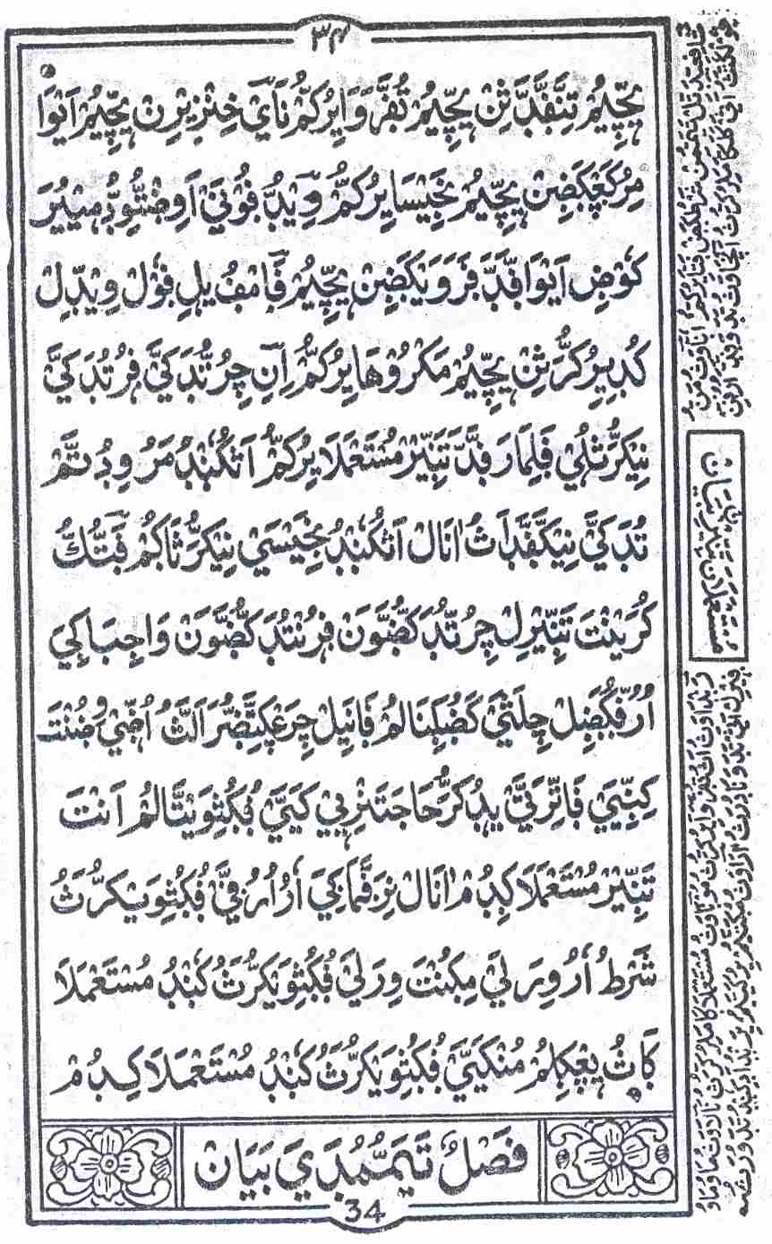
Arwi Script
Arwi script – A sample page from the book titled “Sumthu Subyan”

Slide 7
Arwi Script
Achievement of this script:
  Has provided necessary information (both religious and society)
People still use certain Arwi words, which were borrowed from Arabic
  Example (to note a very few):
    Amma (Mother) is used as Umma (Ummun from Arabic)
    Raahat, Kithaab, Mowth, etc.
Notes:
Arwi Script has helped the Muslim community to learn write Arabic text faster, which is the language of the Holy Quran.

Slide 8
Status of Arwi Script
Arwi is still used in certain Islamic schools (madrashas) in Tamil Nadu
Some famous books are preserved in libraries
Lack of printing facility has affected the further usage of this script
  Few books written in Arwi have been translated into Tamil Script
  This shows the importance of those texts to the public
As per the knowledge of the author, no ARWI font exists

Slide 9
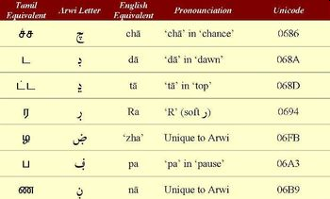
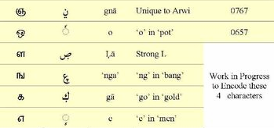
Status of Arwi Script - Wikipedia
Notes:
Ref.: http://en.wikipedia.org/wiki/Arwi_language
Famous books by great scholars like Imaam Shaafi (Radiallahu Anhu - May Allah be pleased with him) and Imaam Abu Hanifa (May Allah be pleased with him) have been translated into Arabic-Tamil. Authors also indicate that decline of Arwi has caused a steady decline in the education of the women in the latter half of the 20th century. Characters mentioned as work in progress are handled in our work.

Slide 10
Related Works
Wikipedia indicates that Arwi was taught in Indonesia, Thailand, Malaysia, Myanmar and Pakistan
Tschacher[1] notes about the use of Arwi for poem writing
Shuayb Alim[2] indicates that Arwi was used by Malaysians in their daily life
Few authors quote the use of Arwi in Sri Lanka
Notes:
1. Tschacher. T., "How to die before dying? Sharia and Sufism in a 19th century Arabic-Tamil Poem", Panel 38, 18th European Conference on Modern South Asian Studies , at Lund, Sweden, 6 – 9 July 2004. http://www.sasnet.lu.se/panelabstracts/38.html
2. Shuayb Alim, "Arabic, Arwi and Persian in Sarandib and Tamil Nadu", Madras, 1993.

Slide 11
Related Works
Reasons for decline of usage of Arwi as quoted [2,3]:
  Lack of printing facilities
  Use of Urdu as the teaching medium in many Muslim schools in Tamil Nadu
Nuhman[4] quotes about discussion of having Tamil as one of the official languages in Sri Lanka. Multiple Arabic characters are present for one Tamil character
Notes:
3. http://www.armu.com/armu/works/archives/12dec1998/amc1.html [Accessed on: 22nd April 2008]
4. Nuhman MA, "Sri Lankan Muslims: Ethnic Identity within Cultural Diversity", International Centre For Ethnic Studies, Colombo, Sri Lanka, 2007.
Nuhman [7] quotes about the bill on whether to make Sinhala as the only official language. In that discussion, some speakers have quoted that Arwi used as a writing script by Muslims is Tamil language. Those speakers were stating the importance of making Tamil as one of the official languages. Nuhman [7] refers to the issues of understanding Arwi scripts by people who understand Arabic and those who understand Tamil. People who understand Arabic can read Arwi but can't understand and those who know Tamil and not Arabic can't read but if someone reads for them they can understand Arwi. Author describes about the use of Arabic script for languages like Malayalam and Bengali.

Slide 12
Related Works
Nuhman[4] indicates:
  Arabic: 28 characters and 6 vowels
  Tamil: 30 letters (12 vowels and 18 consonants); Also has 216 syllabic symbols apart from basic vowels and consonants
  Joining of drastically different languages was handled
Mohan [5] quotes the presence of many literary works in Arwi
Notes:
Nuhman[4] indicates that there were 200 published and around 2000 unpublished literary works written in Arwi. Thus, two drastically different languages where combined to form a scripting language Arwi instead of developing a brand new language. Author concludes by saying that we could use any writing script to write any other languages with some modifications except for those languages like Chinese which uses ideograph.
5. Mohan V., "Muslims of Sri Lanka", Aalekh Publishers, Jaipur, India, 1985.

Slide 13
Arwi Books
Religious Rules
  Maani (The Treasure) - Maapillai Lebbe Alim @ Seyed Mohamed Ibnu Ahamed Lebbe (May Allah be pleased with him) (1816 – 1898) from Kayalpattinam, Tamil Nadu, India
  Sumthu Subyaan
Poems:
  Adabumalai (About Morale and Discipline)
  Thakkasuruth (About Rules for Prayer)
Notes:
Note: Shamu Sihabudeen Appa has written many poets (including Adabumalai and Thakkasuruth) in Arwi. Mapillai Lebbe Alim has written many books in Arwi.

Slide 14
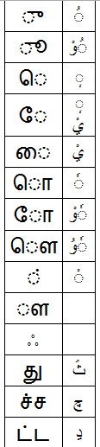
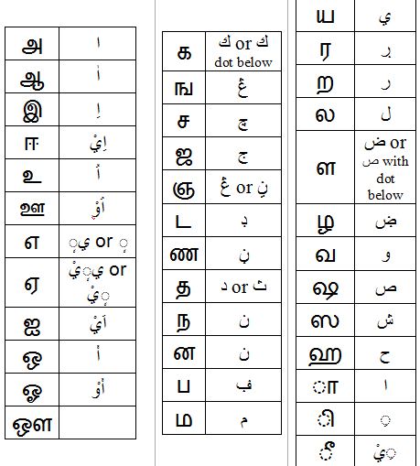
Tamil and Arwi Alphabets – A Comparison

Slide 15
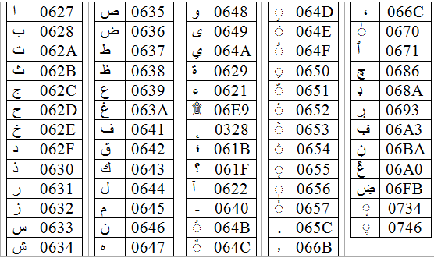
Arwi Script – Available Unicode Equivalents

Slide 16


Arwi Script – Available Unicode Equivalents
Dot below 0643 (Kaf) is also needed
Number representation in Arabic: (U+0661 – U+0669)
Number representation in Arabic: (U+06F1 – U+06F9)
Notes:
Arabic Numerals are not exactly followed in Arwi. There is slight difference between them with regards to numerals 4, 5 and 6. Sometimes, even the numeral 7 is expressed slightly different (something like the English character ‘L’).

Slide 17
Arwi Script – Available Unicode Equivalents
Note that we have used Unicode characters from:
  Arabic (U+0600 – U+06FF)
  Syriac (U+0700 – U+074F)
  Combinational Diacritical Marks (U+0300 – U+036F)
  Additionally, we did have a look at Forms-A and Forms-B. But, none of them was used.
    Arabic Presentation Forms-A (U+FE70 – U+FEFF)
    Arabic Presentation Forms-B (U+FB50 – U+FDFF)

Slide 18
Font Development
Issues to be considered:
  Needs to consider cursive nature, joining, diacritical characters and forms of the characters
  Cater all kinds of Operating system and Editing Software
    Rendering issues of different editing tools
  Have to consider the development of keymap which is closely related to Arabic keymap

Slide 19
Font Development
Two Approaches:
  Development of a web page where people can type in Tamil Script directly or type in English but the characters will be changed to Arwi Script
    Constrained on the fonts available on the user’s PC.
  Development of a new font
    Need to install and cater for different operating systems
    User has to learn to type using the new Arwi Keymap.

Slide 20
JavaScript based Arwi Typing Webpage
Install necessary fonts
  Windows: Install Complex script and right-to-left languages
  Linux: Generally BD (Bidirectional) or Multilingual Support is there by default
Features
  Uses JavaScript (Client-Side)
  Works on Windows and Linux
  Users who know typing in Tamil can type in Tamil directly.
Notes:
http://en.wikipedia.org/wiki/Help:Multilingual_support_(Indic)
At first, to enable type in Arabic or Arwi Font, Install files for complex script and right-to-left languages (including Thai) option must be enabled on the users' PC. This is done using Regional and Language Settings in Control Panel.

Slide 21
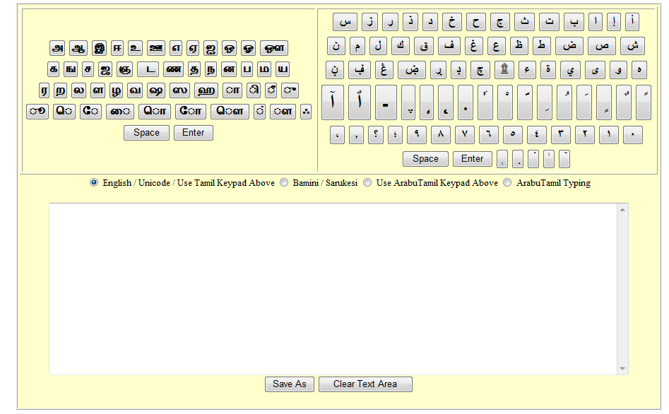
JavaScript based Arwi Typing Webpage
Virtual Keypad
Expected Webpage
Notes:
This software is made using JavaScript and thus does not require any server side support. You could just get the whole code and run on any machine. This runs both on Windows and Linux machines. This software provides options for users to mix both Tamil and Arwi scripts even though that is not the normal method of writing in Arwi Script. When users types in Arwi, the character alignment becomes right-to-left.

Slide 22
JavaScript based Arwi Typing Webpage
Tamil keymap vary based on:
  If we use certain fonts like Bamini or Sarukesi
  If we use Unicode fonts like Latha font
JavaScript based Webpage permits both the keymap options using the radio button for selection
Users who are not aware of Tamil typing, can use the virtual keypad provided.
Arwi can also be typed using virtual keypad. No need for Arwi keymap setup on the PC

Slide 23
JavaScript based Arwi Typing Webpage
Scripting changes from left-to-right to right-to-left once user decides to go to Arwi typing
Issues faced:
  Windows Vista: Webpage works as expected on Internet Explorer (Version: 7.0.6000.16386) and Firefox (Version: 2.0.0.13)
  Windows XP:
    Internet Explorer (6.0.2900.2180.xpsp_sp2_rtm.040803-2158)
    Problem displaying: 0656 (Arabic Subscript Alef), 0657 (Arabic Inverted Damma), 065C (Arabic Vowel Sign Dot Below), 0328 (Combining Ogonek)

Slide 24
JavaScript based Arwi Typing Webpage
Windows XP:
  Upgraded Internet Explorer to 7.0.5730.13 version:
    Same problems persist
  Firefox 2.0.0.13
    0656, 0657 and 0328 did not appear properly on the virtual keypad
    0746 (Syriac three dots below) and 0734 (Syriac Zqapha below) did not join with the previous character and appeared separately
    General diacritical marks which belong to Arabic Script (Like Fathah, Damma, etc) needed increase in size, to appear properly in Virtual keypad
Notes:
After finding that few characters don’t appear properly on Windows XP, we did check for the presence of the Unicode character in Windows XP and compare that with Windows Vista. This is done using Charmap with Advanced view. We did select Unicode subrange in "Group by" option and selected Combining Diacritical Marks and Arabic to verify for the presence of the Unicode characters. We could conclude that few characters were not present in Windows XP and thus could not be displayed.

Slide 25
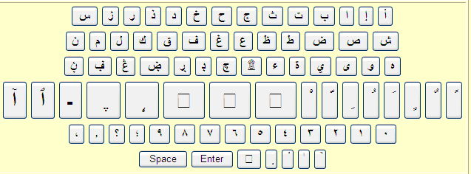
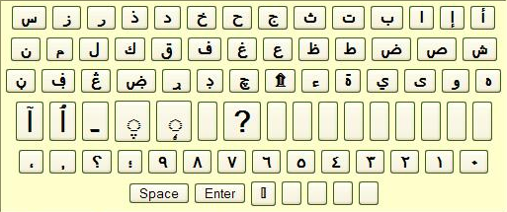
JavaScript based Arwi Typing Webpage
Joining of Syriac character was done using Unicode character 0640 (hyphen), 200D (Zero Width Joiner) and 070F (Syriac Abbreviation Mark):
    document.write('<INPUT type="button" style="font-size: 30; font-weight:bold" name="\u0746" value=" \u0746 " onclick=AppendCharacter("\u0640\u200d\u070f\u0746")>');
Internet Explorer – Win XP
Firefox 2.0.0.16 – Win XP
Notes:
Internet Explorer (Version: 6.0.2900.2180.xpsp_sp2_rtm.040803-2158) does not display few characters like those with Unicode numbers 0656 (Arabic Subscript Alef), 0657 (Arabic Inverted Damma), 065C (Arabic Vowel Sign Dot Below), 0328 (Combining Ogonek, part of Combining Diacritical Marks) properly. Even after upgrading the Internet Explorer to 7.0.5730.13 version, same problems persist.
We did download the Arial Font from the Internet (Arial32.exe) and used it with Windows XP. After doing this, Unicode character 0328 did work fine but did not appear properly in the display.

Slide 26
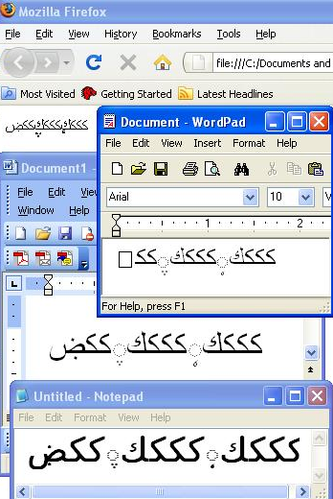
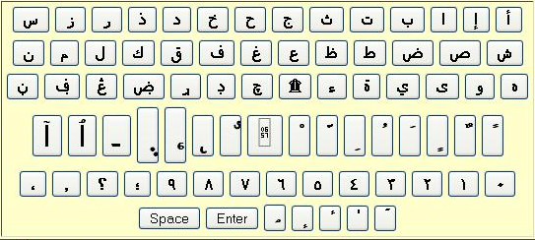
JavaScript based Arwi Typing Webpage
In Mozilla Firefox 3, the Arabic HTML appears better expect for U+0657 character. Also, Syrian characters need not include \u0640\u200d\u070f to join properly
Firefox 3.0.1 – Win XP

Slide 27
JavaScript based Arwi Typing Webpage
SuSe 10.2 (Firefox 2.0.0.6):
  Appearance issues
    Did not appear properly on the virtual keypad, but worked fine while typing:
  Characters that did not work
    0657 and 0328 appeared as a separate character and did not join with the previous character
    Unicode characters like 06E9, 065C, 0734 and 0746 did not appear properly in virtual keypad

Slide 28
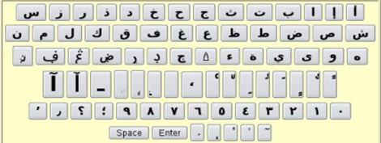
JavaScript based Arwi Typing Webpage
In SuSe 10.2, with Firefox 3.0.1, Webpage worked fine. There is no need for U+0640, U+200D and U+070F
Further Analysis:
  Windows Vista has more Unicode characters compared to Windows XP
    Can be verified using Charmap
  Presence or usage of Syriac and few other combinational diacritical marks have problems appearing on the virtual keypad and also in the text
Firefox 3.0.1 – OpenSuSe 10.2

Slide 29
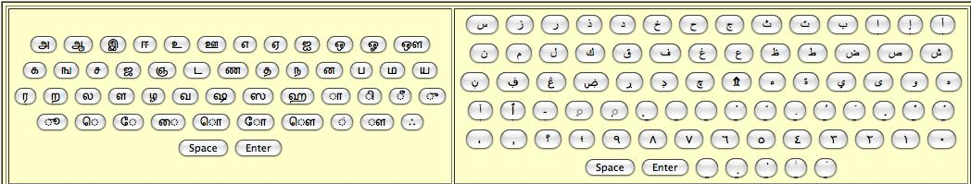
JavaScript based Arwi Typing Webpage
In Safari Version 3.1.2 (525.21) on Windows XP:
  All the characters seem to work fine both on the virtual keypad display and when used.

Slide 30
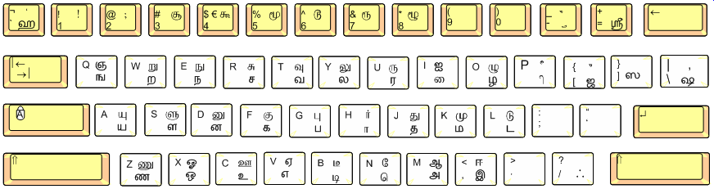
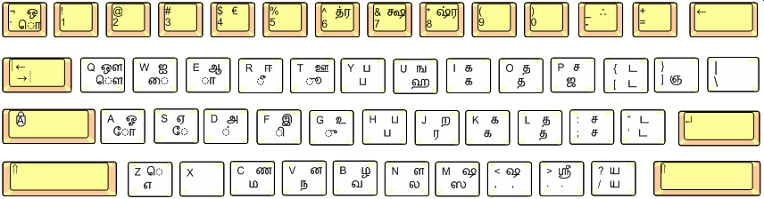
Tamil Keyboard - Comparison
Tamil – Latha – Unicode
Tamil – Bamini OR Sarukesi – Non-Unicode
Notes:
Differences in Keypad for Unicode and non-unicode based Tamil font has been a concern for those who wish to type in Tamil. Those who have learnt Tamil using Typewriter find it difficult to move on to Unicode based Tamil Fonts. There exists certain software that could convert text from one font to another, just make sure that the rendering works fine.

Slide 31
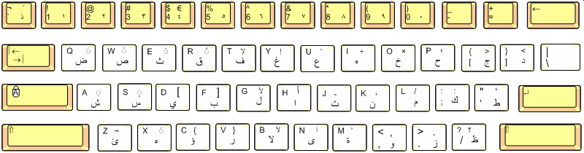
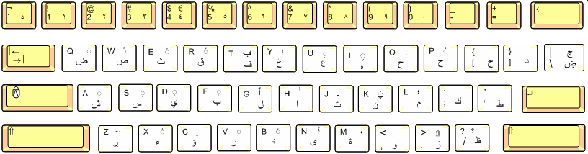
Arabic Keyboard - Proposed Arwi
Arabic Keyboard
Arwi Keyboard
Notes:
We have designed the keypad for Arwi to be similar to that of Arabic, so as to make it easier for those who already knew Arabic Typing. If a user does not know how to type in Tamil or Arwi, he could use the keypad provided in the software.

Slide 32
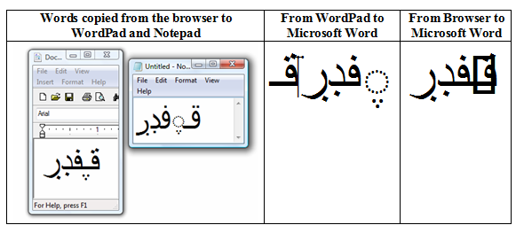
Font Rendering – Editor Tools
Rendering of Arabic, Tamil and Arwi characters vary between Notepad, WordPad, Microsoft Word, OpenOffice.org tools, etc
Table shows characters typed with Webpage and copied and pasted in different editors

Slide 33
Font Rendering – Editor Tools
Editor Tool Issues:
  Authors in [6] describe about rendering problems for Unicode characters in various Indian Languages (including Tamil). They also quote that the Zero Width Non Joiner (ZWNJ) are permitted by Wordpad but not by Notepad.
  Zero Width Joiner (ZWJ) is rendered properly by Wordpad but not by Notepad
    U+200D (Keep words closer and make then join)
  Wordpad 6.0 seems to render Arwi better than Notepad 6.0, Microsoft Word 2003 and OpenOffice.org Writer 2.1
Notes:
6. http://acharya.iitm.ac.in/multi_sys/unicode/render/ren_07.php [Accessed on: 23rd April 2008]

Slide 34
Font Rendering – Issues
Characters coupled with characters such as the zero width joiner, zero width non-joiner etc., can cause serious headaches to the text processing applications if the displayed text was composed using these codes [7]
Zero width glyphs are very important for Indian language fonts [7]
Notes:
7. http://acharya.iitm.ac.in

Slide 35
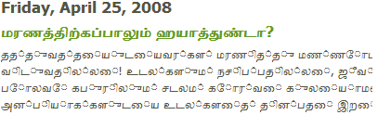
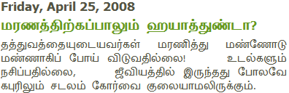
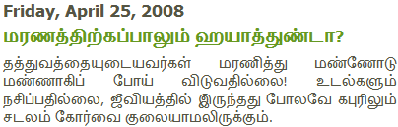
Font Rendering – Issues
Example showing how Tamil website (Unicode) appears in different browsers [8]
Internet Explorer 7
Mozilla Firefox 2.0.0.16
Mozilla Firefox 3.0.1
Notes:
8. http://zeyarath.blogspot.com

Slide 36
Font Development - fontforge
Operating System used: SuSe 10.2
FontForge (2008032 – 2 Mar 2008) software is used to develop Arwi font
DejaVuSans font was used as the base font
After appropriate changes Arwi font was generated as TTF font and tested on Linux and Windows platform with various Editor Tools.
Notes:
Users can make HTML pages using ARWI font by including the tag <font face="arwi">

Slide 37
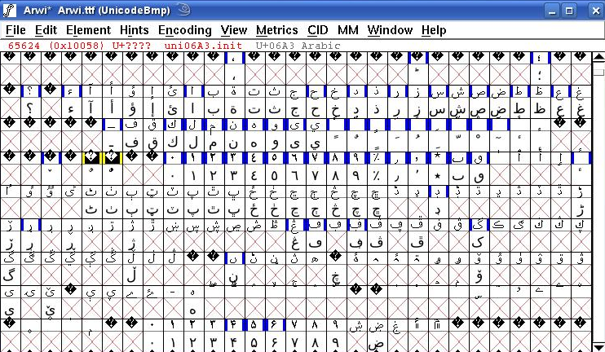
fontforge – Characters Added
We have added new characters needed for Arwi font to the DejaVuSans Unicode font
For each character, we need to have medi, init and final forms
Notes:
DejaVuSans.ttf font present in the /usr/share/fonts/truetype folder was selected as the base font. Installation of fontforge software on SuSe machine was straight forward with rpm (rpm –ivf fontforge-i386.rpm). In fontforge, when we open the DejaVuSans font, we could see that each character is shown as two cells. The cell on the top indicates the character and the bottom cell indicates the drawing or representation of the character.
To add new glyphs to the given font, we need to add slot and proceed to enter the glyph and then link this glyph to the base character. This is done as below: Encoding → Add Encoding Slots (Indicate the number of glyphs you want to add)
Select each one of the newly added slot and do the following:
Element → Glyph Info: For a Glyph (Unicode Name: uni06A1.init; Unicode Value: -1)
For a base character (Unicode Name: uni06A1; Unicode Value: U+06a1)
Then click 'Set From Name' (in Glyph Info) and click 'Ok'.
For each and every glyph created, we need to click File → Generate Fonts → Save as True type. Note: User rights are to be considered when saving the fonts in the respective folders.
Make sure that the glyph is added to the substitutions option in the main or base Unicode font.
After doing the above, if we wish to see the impact on OpenOffice.org Writer, we need to close OpenOffice.org Writer and re-open it. Also, make sure the keymap entry is removed and added again (if there needs to be a change in the keymap).

Slide 38
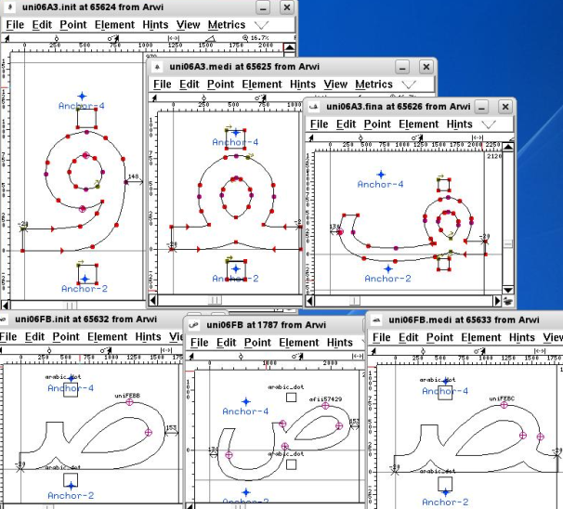
fontforge – Characters Added
Example of Initial, Middle, and Final Forms
Notes:
The name of the font can be changed using Font Info under Element menu in fontforge software. To generate the font, use Generate Fonts option under File menu and then select TTF type. It was noted that we need to close the fontforge before having the font to be available for typing in any editor software.
For each character, we have substitutions like the initial, middle and final one. We need to link the substitution glyph with the original base character. This is done using Element → Glyph Info → Substitutions. Select the appropriate substitution like 'init' or 'medi' or 'fina' and link to the newly created glyph.
'medi': Medical forms in Arabic Lookup 8 subtable
'fina': Terminal forms in Arabic Lookup 9 subtable
'init': Initial forms in Arabic Lookup 10 subtable

Slide 39
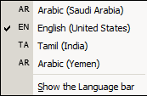
Keyboard Layout Setup - Windows
When someone wishes to type using Arwi language, he needs to add Arwi language to the language bar
Software used: Keyboard Layout Manager
No Arwi layout exists
Arabic(Yemen) used for testing
Notes:
From the glyph, we can see to which base character it is linked using: Element → Show Dependent → Substitutions.

Slide 40
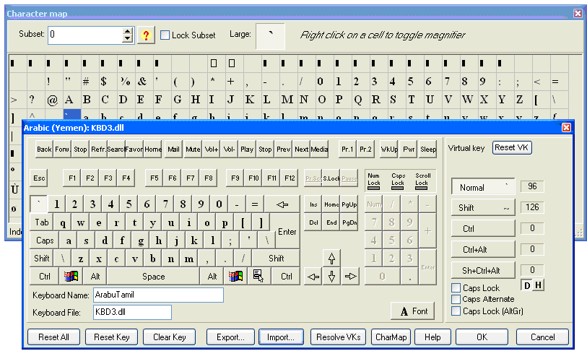
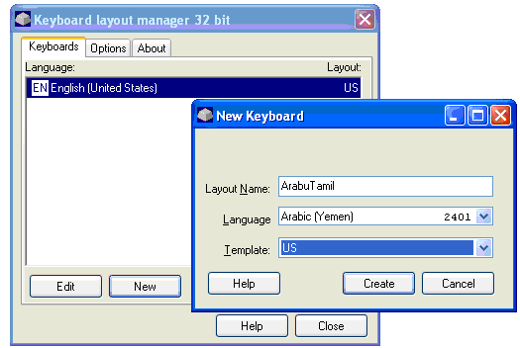
Keyboard Layout Setup - Windows
Select the appropriate Unicode character according to the Arwi Keyboard setup required
Notes:
Using the Keyboard Layout Manager software, we provide the users with the Keyboard Layout file, which is named as ArabuTamil.klm2000. To install the given ArabuTamil keypad on to any Windows machine, users need to use the Keyboard Layout Manager Software. Install the software and open the software. Then, click New under Keyboards and in the layout type "ArabuTamil" and select any language that you are not using or not planning to use (we have selected Arabic(Yemen)). Then click on Create. Once, the Option is created, select the ArabuTamil option and click Edit. Click on Import and select the ArabuTamil.klm2000 file given. Then, click Open followed by OK twice. Finally, you need to Confirm changes. Then, in your language bar, you will find the necessary ArabuTamil (as Arabic(Yemen)) option present. Now that you can type ArabuTamil in any editor software by selecting ArabuTamil in the language bar.

Slide 41
Keyboard Layout – Windows - Issues
Diacritics alignment was a problem when the character from Syriac was used with Arabic and Arabic supplements
Syriac Qushshaya (U+0741 – dot above) and Syriac Rukkakha (U+0742 – dot below) can be used with only specific Syriac letters [9]
Difference in alignment between Opera, Mozilla Firefox and Internet Explorer
Notes:
9. The Unicode Standard - Chapter 8

Slide 42
Keyboard Layout – Linux
Check for language support
  locale -a
To make the font as default font, add these line to your profile (~/.profile)
  export LANG=en_US.UTF-8
  export LANG=ar_SA.UTF-8
  To make change into effect, press Ctrl+Alt+Backspace (login again)
Notes:
In order to verify whether Unicode is enabled on the machine, locale command was used. You could use locale –a and find out what are the languages that are supported by the machine. To change the locale settings for your account, open the ~/.profile file present in your home folder and add the line
export LANG=en_US.UTF-8
If you wish to make the default font to be an Arabic font, you could change the LANG option as to something like ar_SA.UTF-8, which stands for the Unicode of Arabic (Saudi Arabia). Setting the LANG option to ar_SA.UTF-8 seems to make the Firefox browser turn to Arabic language in SuSe 10.2. In order to make the change in profile to take effect, we need to login again. This could be done by clicking Ctrl+Alt+BackSpace.

Slide 43
Keyboard Layout – vim - Linux
Vim keymaps are present at:
  /usr/share/vim/current/keymap
  Keymap exists for Unicode and non-Unicode.
  Arabic Unicode: arabic_utf-8.vim
Creating Arwi Keymap
  Arwi is related to Arabic so a copy of Arabic Unicode was made
  New file is named as: arwi_utf-8.vim
  This file maps characters of keyboard with hexadecimal and decimal representation of Unicode characters
Notes:
The necessary keymaps for vim is present in /usr/share/vim/current/keymap folder. For each language, you could find keymap for both Unicode and non-Unicode characters. The Unicode keymap for Arabic language is arabic_utf-8.vim.
In order to write our own keymap, we could copy the arabic_utf-8.vim file into arwi_utf-8.vim. The contents of this file indicate the link between the characters of the keyboard with that of the hexadecimal and decimal representation of Unicode characters. You could provide a comment to indicate what each character means.

Slide 44
Keyboard Layout – vim - Linux
let b:keymap_name = "arwi"
loadkeymap
q <char-0x0636> " (1590) - DAD
w <char-0x0635> " (1589) - SAD
The character 'q' (Lowercase) is mapped to Arabic Dad which is represented in hexadecimal and decimal as 0x0636 and 1590 respectively
Once the keymap is ready, you could type in the vim using the statement as set keymap=arwi, after pressing Esc+:

Slide 45
Keyboard Layout – Input Locale - Linux
Input locales:
  Personal Settings (Configure Desktop) → Regional & Accessibility → Keyboard Layout
  Select the language from Available layout and click Add
Creating new Arwi Keymap
  Go to xkb folder in either /usr/share/X11 or /etc/X11 or /usr/X11R6/lib/X11 folder
  Add an entry (anywhere) under the ! layout section of the base.lst file, which is present in /usr/share/X11/xkb/rules folder
Notes:
Note: We have used /usr/share/X11/xkb folder.
If you want enable the language bar in the task bar of the desktop, you need to do the following steps:
Click Personal Settings (Configure Desktop).
Select Regional & Accessibility.
Select Keyboard Layout.
Select the language that you want to present on the language bar from the Available Layout and click Add >>.
With these steps, you can click on the language bar and type in different languages. But, this will work only for those languages from which the keymap is already available. For this work, we wish to design a new Keymap for the Arwi script.

Slide 46
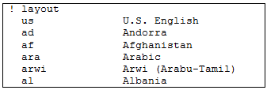
Keyboard Layout – Input Locale - Linux
The base.lst file is listed alphabetically on the Keyboard Layout (Regional & Accessibility)
Add the entry for the Arwi script in the base.xml file which is present in /usr/share/X11/xkb/rules folder. Copy the Arabic one and change <name>, <shortDescription> & <description> tags
Notes:
In order to design a new keymap, we need to go to the /usr/share/X11/xkb or /etc/X11/xkb or /usr/X11R6/lib/X11/xkb folder. Different Linux variants have different folders for the xkb. We then need to add an entry under the ! layout section of the base.lst file, which is present in /usr/share/X11/xkb/rules folder.
The next step is to add the entry for the Arwi script in the base.xml file which is present in /usr/share/X11/xkb/rules folder.

Slide 47
Keyboard Layout – Input Locale - Linux
The keymap needs to be added to /usr/share/X11/xkb/symbols folder
Copy the existing ara (Arabic) to arwi (Arwi)
AE stands for 1234 row in keyboard
AD stands for QWERT row in keyboard
AC stands for ASDF row in keyboard
AB stands for ZXCV row in keyboard
  AB01 stands for ‘z’ character
  AB02 stands for ‘x’ character and so on
  TLDE stands for ‘~’ character
Notes:
Then, we have to make the actual keymap available in the /usr/share/X11/xkb/symbols folder. After the reserved keyword "key" we use some representation to indicate each rows of the keyboard. AE stands for the row with numbers 1, 2, 3,… . AE01 indicates the first key, which is the number 1 key. AE02 indicates the second key, which the number 2 key and so on. AD stands for the row starting as QWERT. AD01 represents the key "q". AC stands for the row starting as ASDF. AC01 represents the key "a". AB stands for the row starting as ZXCV. AB01 represents the key "z". In the keymap, the lowercase representation and uppercase representation are separated by a comma.

Slide 48

Keyboard Layout – Linux
After changing keymap file (in /usr/share/X11/xkb/symbols):
  Remove keymap from the layout
  Add again from Available layout (Regional & Accessibility) and click Apply
Notes:
Whenever we make a change to the keymap file (present in the /usr/share/X11/xkb/symbols folder), we need to remove the keymap from the layout and add then again from the Available layout and click Apply. Then, only these changes will come to effect.

Slide 49
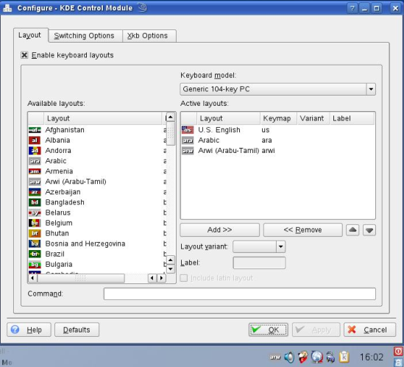
Keyboard Layout – Linux
Keymap can be temporarily enabled using anyone of the commands (Example, arwi keymap):
  setxkbmap –symbols 'arwi'
  setxkbmap –symbols arwi
  setxkbmap –layout 'arwi'
  setxkbmap –layout arwi

Slide 50
Issues Faced – Rendering Differences
OpenType capable text rendering engines:
  OpenOffice.org and SIL's XeTeX use IBM's International Components for Unicode (ICU)
  QT4 has its own engine based on HarfBuzz
  GTK+ uses Pango which is using HarfBuzz internally
  New TeX engine LuaTeX has its own OpenType engine
  Microsoft has its Uniscribe engine
  Adobe has a hybrid Apple Advanced Typography (AAT)-OpenType engine used on Mac OS X.
  Conclusion: One engine shared between GTK/QT4; another in OpenOffice.org; Microsoft has its own.

Slide 51
Issues Faced
Further, new diacritical characters were added
Joining problems of the diacritical character to the previous character was noted
Testing was done using:
  SuSe 10.2: Did not display properly
    OpenOffice.org 2.0.4 build 2.0.4.7
    Opcion Font Viewer 1.1.1
  Ubuntu 7.04: Did not display properly
  Ubuntu 8.04:
    OpenOffice.org 2.4.0, GTK+ Editor, gedit, kate, Opcion Font Viewer – Worked fine
    QT Editor – Diacritics not placed properly

Slide 52
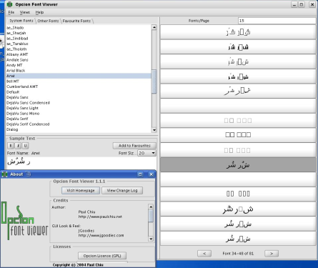
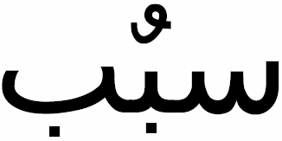

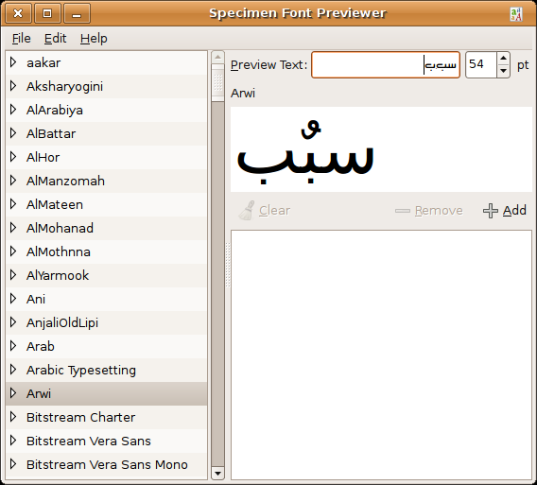
Issues Faced
Simple test was done by copying the existing diacritical character at a different position and testing with different tools
PDF by XeTeX & ConTeXt
Specimen Font Previewer

Slide 53
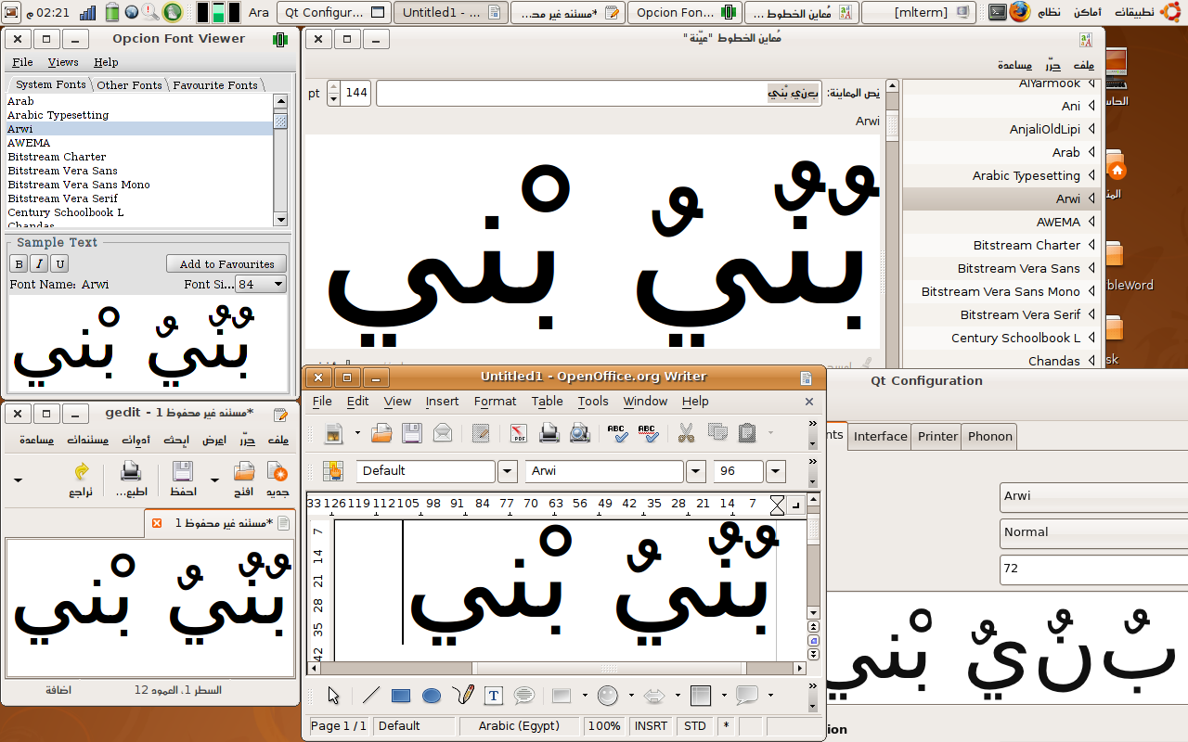
Issues Faced
Testing on Ubuntu 8.04
Notes:
Acknowledgements: Author wishes to acknowledge the help offered by Mr. Mohammed Khaled [www.eglug.org].

Slide 54
Characters that needs to be added
Make sure that the initial, final and middle glyphs of these Characters are present:
  0686, 068A, 068D, 0693, 0694, 06A3, 06B9, 06BA, 06A0, 06FB, 0767
Diacritical Marks that should be verified:
  0653, 0656, 0657, 0670, 0746
  0734 needs to be checked if it is just the mirror of 0657
Character that needs to be added:
  0643 WITH A DOT BELOW
  0635 WITH A DOT BELOW
  Number 7: Similar to the English character “L”

Slide 55
Further References
http://www.arabeyes.org/download/download/3rd/arabic.xkb
http://www.vim.org/htmldoc/arabic.html
http://countrystudies.us/sri-lanka/38.htm [Accessed on: 22nd April 2008]
http://www.armu.com/armu/works/archives/12dec1998/amc1.html [Accessed on: 22nd April 2008]
Tschacher, Arwi (Arabic-Tamil) – An Introduction [Accessed on: 23rd April 2008], http://web.archive.org/web/20040822180630/www.fas.nus.edu.sg/journal/kolam/vols/kolam5&6/1AOldLit/Arwi.htm
http://www.klm32.com/ [Accessed on: 22nd April 2008]
http://acharya.iitm.ac.in/multi_sys/unicode/render/ren_07.php [Accessed on: 23rd April 2008]

Slide 56
Conclusion
This work has tried to address the issue of lack of font for Arwi Script
Need to work closely with researchers in Unicode area to bring Arwi as part of Unicode characters

Slide 57
Arwi: Case study of Arabic, Syriac and Diacritical Unicode characters
Thank You
Questions are most welcome
Notes:
Acknowledgements: Author wishes to acknowledge the help offered by Dr. Jaidi, Mr. Mohammed Khaled, Dr. Hussain Miya, Mr. Shah Nawas, Ms. Daphne, Ms. Rosyzie, Mr. Hong, Mr. Arif, Ms. Rosnah and Mr. Ashraf.

Slide 58
Further Information
While using Unicode characters, developers are advised not to mix characters from different ranges. This is because there will be rendering issues.
  In our case, mixing of Syriac with Arabic characters should be avoided.
Character representation in Unicode.
  Previously, Arabic was considered as a special type where all the forms (media, init, final and isolated) were included in the Unicode. For other languages, it was left to the font to handle it.
  But presently, Unicode does not contain character forms of all languages including Arabic.
With regards to Slide 14
  A question was raised about the alphabetic sequence of Arwi script. This is needed to sort a given text in Arwi script.
  The same issue of ordering of characters in Arwi Script was raised with regards to slide 21.
For the Javascript based Arwi Typing
  It was suggested to use images onto the virtual keypad.
  Presence of additional information about each character would help the user know more about the script.
  When clicked, the actual text should appear.

Slide 59
Further Information
Many keypads do exist for Tamil (Slide 30)
Mapping Arwi keypad close to Tamil or Arabic Script was a concern raised.
  It is because People who know Tamil might not know Arabic typing.
  Generally, English typing is known to many among Tamil speaking public than Arabic or Tamil typing.
Proper appearance of Tamil characters in Firefox 3 (Slide 35)
  Firefox 3 uses Uniscribe rendering engine, which is from Microsoft.
The misplacement of damma as shown in slides 52 and 53 was discussed.
  This is due to the difference in rendering engine. KDE uses Pango, which did not do the rendering properly.
  It should be noted that certain rendering engines consider certain Unicode numbers to be rendered appropriately. Thus, if damma is copied and used at different location, it might not be rendered properly.

Slide 60
Further Information
While writing Unicode character proposal
  References should be given to printed text and thus Wikipedia or other Internet based sites can not be considered.
  Additions of character forms or glyphs is possible only with Arabic language and not with other languages.
In Arabic, all the forms (medi, init, final, isolated) called as glyph, have the same code point.
It was also said that Arial Unicode MS is one font which is not frequently updated. Also, fonts vary between Microsoft XP and Microsoft Vista.
The default position of U+0651 ARABIC SHADDA as a glyph, is above the base character, whereas for U+064D ARABIC KASRATAN is placed below the base character, as a glyph. However, computer fonts often follow an approach that originated in metal typesetting and combine the kasratan with shadda in a ligature above the text.

Slide 61
Further Information
Arabic Presentation Forms A
  Fonts will often include only a subset of these glyphs, and they may also include glyphs outside of this set.
  These glyphs are generally not accessible and are used only by rendering engines
Arabic Presentation Forms B
  They are included here for compatibility with preexisting standards and legacy implementations that use these forms as characters. They can be replaced by letters from the Arabic block (U+0600 … U+06FF).
  Implementations can handle contextual glyph shaping by rendering rules when accessing glyphs from fonts, rather than by encoding contextual shapes as characters.

Slide 62
Further Information
Do we need to propose a form of a specific character in Unicode? Is it part of the Unicode description or it handled by the fonts themselves?
  You do not need to propose the various initial/medial/final forms, only
  the nominal form is required. However, we need to know about joining behavior, so it is useful to know which forms exist for specific characters. Show all the different shapes for each letter in your proposal.
  The forms are normally rendered as needed by the fonts or rendering software. Handled by the fonts and the software that shows the text.
  Please see chapter 8 of the standard.
If a similar character is present in two scripts (like in Arabic and Syriac) can we share the character or is it necessary to add the same character to both the Scripts?
  Sometimes you can share the character. It depends on what it is. Often
  alphabetic letters are *not* shared, but punctuation and symbols can
  usually be shared.
  For Arwi, you should totally forget about Syriac. If it's not in the
  Arabic blocks, Unicode needs to encode it.

Slide 63
Further Information
How is the italic, bold, and character size handled?
  That is outside the scope of character encoding, and is handled by
  application software, etc.
Regarding Collation, is uppercase and lowercase considered the same or is it related to each script individually?
  It depends on the script. Arabic does not have case forms.
Is Arabic vowels like damma or fatha are called as diacritics or not?
  Yes, they are. Please see chapter 8. Go here:
  http://www.unicode.org/versions/Unicode5.1.0/ and look for Chapter 8 PDF.
If we join 0644 and 0627, we get "Lam-Alef"? Is it a surrogate pair? Is it considered as separate character and how is this handled?
  It is a ligature, handled by fonts.

Slide 64
Further Information
How is the joining of characters to form the words "Allah" or "Sallalahu Alaihiwassalam" done in Arabic?
  In fonts. There are some ligatures that were encoded for compatibility many years ago, but they are not normally used.
Page 259 of Unicode standard 5.0 states that U+0654 of Arabic can be shared between Arabic and Syriac. Are there any specific characters or diacritics in Syriac which could be shared with Arabic?
  Not that I know of.
  No. Syriac characters are for Syriac only.
In Page 273, Table 8-2 states about the representation of number 7 like English letter "L". Where is this character represented? Is it handled by the font?
  The code to be used is U+06F7. There are two ways to show the L-like shape: You can either have a font for Arwi that has that shape at location U+06F7, or you can have a font that specifies different forms of 7 for different languages written in Arabic and a piece of software that supports language-specific glyphs.

Slide 65
Further Information
If I propose few characters that are required for Arwi, should I provide the TTY font myself?
  Yes, that would be best, at least as a guide for us. Probably later,
  someone here would design a group of compatible glyphs to harmonize with the Arabic fonts that we use in printing the standard.
  Yes, we need a TTF font, but you don't necessarily need to create all the glyphs, put them in the proper place, or create OpenType tables. We mostly care about the glyph.

Slide 66
Further Information - Punycode
If the domain name of a website has non-English based unicode characters, these characters ought to be converted into ASCII Compatible Encoding (ACE), also known as ‘Punycode”
Encoding procedure: "bücher" is encoded as "bcher-kva".
Separation of ASCII characters
  First all basic (ASCII) characters in the string are copied directly from input to output skipping over other characters (e.g. "bücher" -> "bcher").
  If and only if there was one or more basic characters copied an ascii hyphen is added to the output next (e.g. "bücher" -> "bcher-") .
Encoding of non-ASCII character insertions as code numbers
  The decoder is a state machine with two state variables i and n. i is an index into the string ranging from zero (representing a potential insertion at the start) to the current length of the extended string (representing a potential insertion at the end).
  i starts at zero while n starts at 128 (the first non-ASCII code point). The state progression is monotonic. A state change either increments i or if i is at its maximum resets i to zero and increments n. At each state change either the code point denoted by "n" is inserted or it is not inserted.

Slide 67
Further Information - Punycode
  The code numbers generated by the encoder encode how many possibilities the decoder should skip before an insertion is made. "ü" has code point 252. So before we get to the possibility of inserting ü in position one it is necessary to skip over six potential insertions of each of the 124 preceding non-ASCII code points and one possible insertion (at position zero) of code point 252. That is why it is necessary to tell the decoder to skip a total of (6*124)+1=745 possible insertions before getting to the one required.
Re-encoding of code numbers as ASCII sequences
Punycode uses generalized variable length integers to represent these values. For example, this is how "kva" is used to represent the code number 745:
A number system with little-endian ordering is used which allows variable-length codes without separate delimiters: a digit lower than a threshold value marks that it is the most-significant digit, hence the end of the number. The threshold value depends on the position in the number and also on previous insertions, to increase efficiency. Correspondingly the weights of the digits (like the third digit from the right in ordinary numbers having a weight 100) varies.

Slide 68
Further Information - Punycode
In this case a "number system" with 36 "digits" is used, with the case-insensitive 'a' through 'z' equal to the numbers 0 through 25, and '0' through '9' equal to 26 through 35. Thus "kva", corresponds to "10 21 0". The second digit has a weight of 35 instead of 36 because for three-digit numbers the first (least significant) digit is in the range b-9, "a" would mark the end of the number. Therefore "kva" represents the number 10 + 35 × 21 = 745.
For the insertion of a second special character in "bücher", the first possibility is "büücher" with code "bcher-kvaa", the second "bücüher" with code "bcher-kvab", etc. After "bücherü" with code "bcher-kvae" comes "ýbücher" with code "bcher-kvaf", etc.
  Compare an ASCII 'punycoded' URL http://xn--tdali-d8a8w.lv/ that includes the Unicode representation of the Latvian "u with a macron", and "n with cedilla", instead of the unmarked base characters: http://tūdaliņ.lv.
  http://www.xn--theshmogroup-bgk.com/
  http://www.theshmoogroup.com/

Slide 69
Further Information
How to detect the encoding in a given text?
Word break API in Java (BreakIterator)
How about collation sequence on the given database? Is collation supported by php?
Timezone information [olson ids or tzinfo]
Issues with regard to using numbers or ? Or ! Or comma in RTL and LTR languages.
On webpages:
  &rlm;
  bdo dir = “ltr”
In Word: if you type 41 and press Alt+x, it changes 41 to ‘A’
Compare: REST (Ajax, Web 2.0) and Web Services
ImageBundle: Its impact on http traffic?
Javascript: Localeinfo.getCurrentLocale().isRTL()
NSLocale: NSNumberFormatter or NSDateFormatter

Slide 70
Further Information
a

