Slide 1
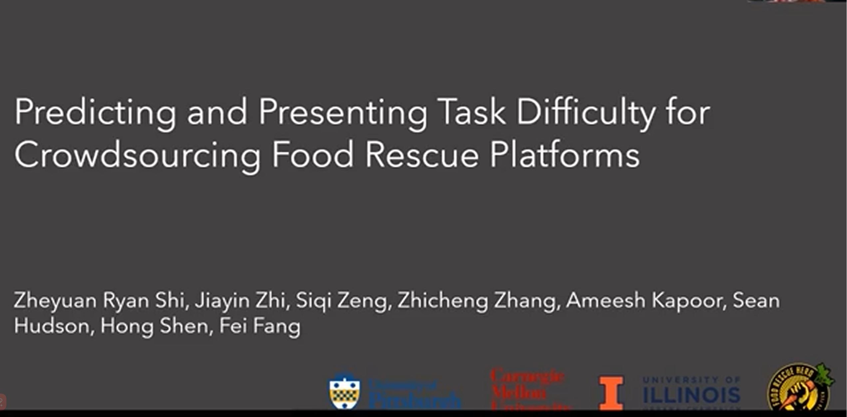
Notes:
“I’m going to talk about an AI research project I’m doing with my Assistant Professor on predicting and presenting test difficulty for crowdsourcing food rescue platforms this Spring term. My name is MYC, and my Assistant Professor is Dr. Ryan Shi at the University of Pittsburgh. This work is in collaboration with partners from Carnegie Mellon University, UIUC, and Food Rescue Hero.”

Slide 2
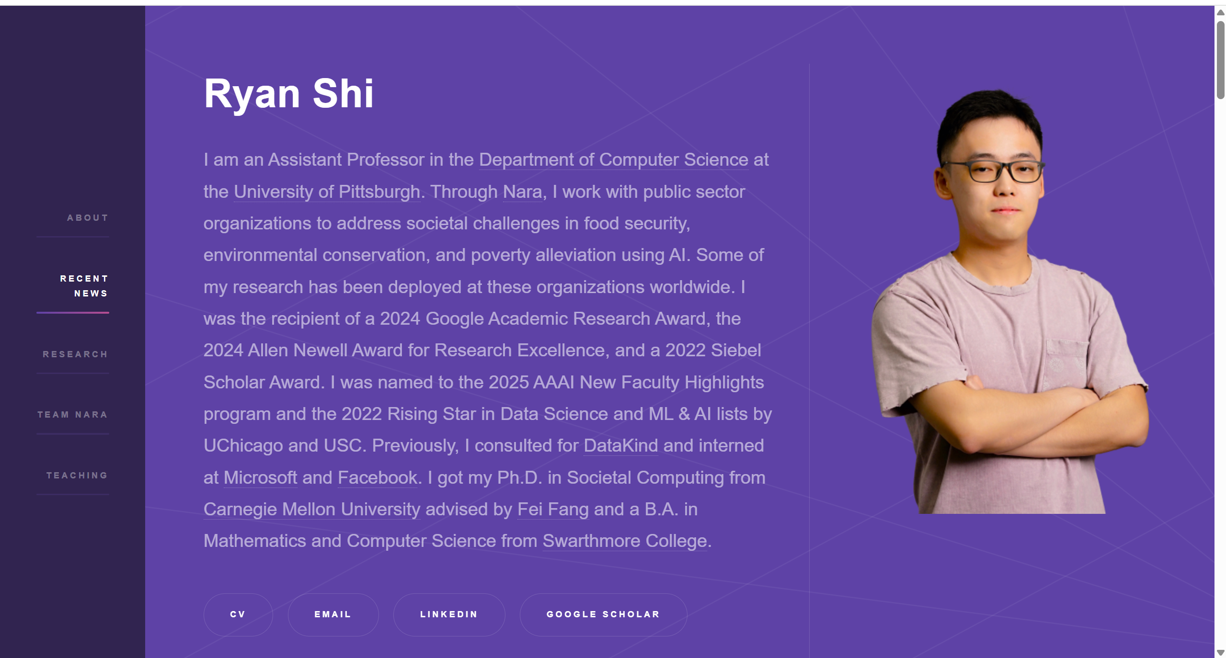
Notes:
Here’s my Doctor Ryan’s website.

Slide 3
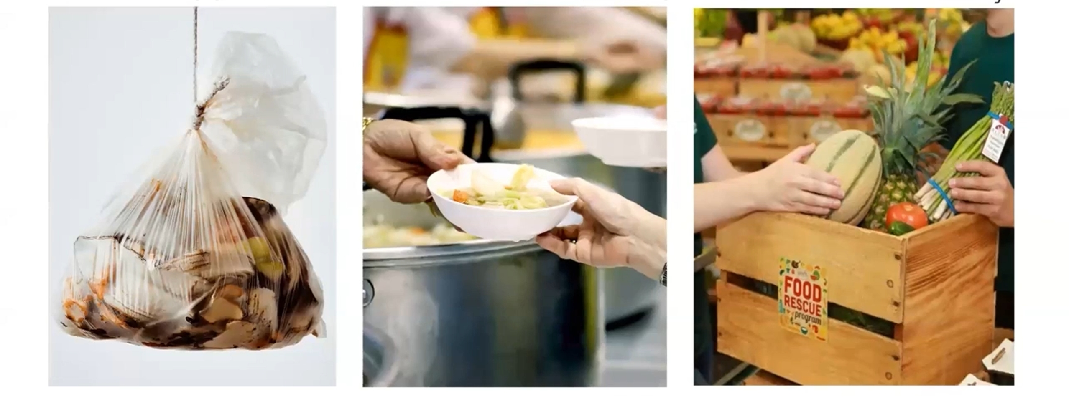
Background
Two main problems:
Food waste
Food insecurity
Notes:
Let’s start with our research background. Food waste and food insecurity are 2 important problems that unfortunately coexist in many parts of world.

Slide 4
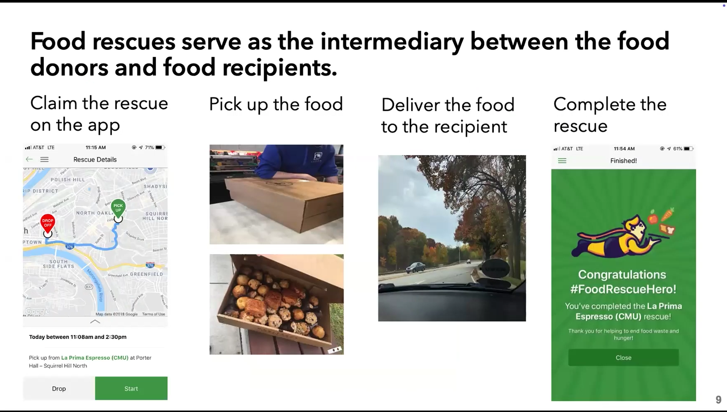
Notes:
And Food rescue organizations match donated food with the recipients who need it. Once a donation is paired with a recipient, it’s posted for volunteers on the app. Every volunteer has the app installed and receives a push notification about new rescue trips. If they choose to take one, the app shows them exactly where to pick up and deliver the food. That’s how these organizations operate on a daily basis

Slide 5
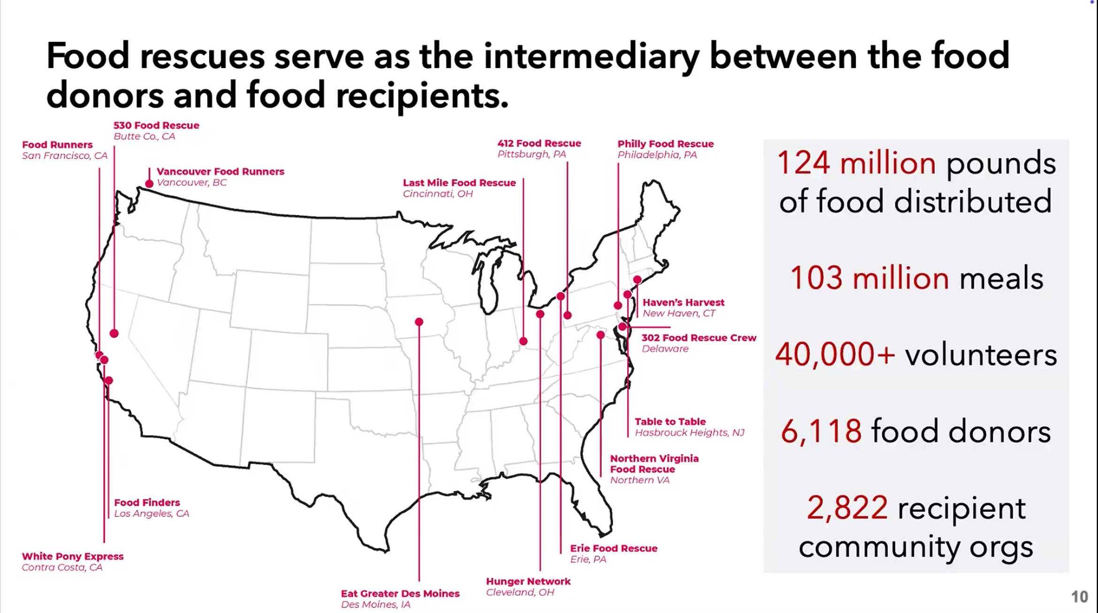
Notes:
The specific group we’re working with is called 402 Food Rescue, headquartered in Pittsburgh. However, they extend far beyond a single city—many similar food rescue organizations across various states rely on their software platform. In total, around 20 other groups use it, and there are above 40,000 volunteers delivering food from thousands of donors to numerous recipient organizations.

Slide 6

Research question
Notes:
The platform needs a robust volunteer base, but volunteers are not employees. A negative initial experience—for instance, a confusing pickup location or an overly long trip—can make someone quit early. These platforms want to keep volunteers engaged by identifying easy rescues for newer helpers, and designating harder ones to more experienced volunteers. That brings us to our research question: how to improve volunteer engagement and retention on such crowdsourcing volunteering platforms?

Slide 7
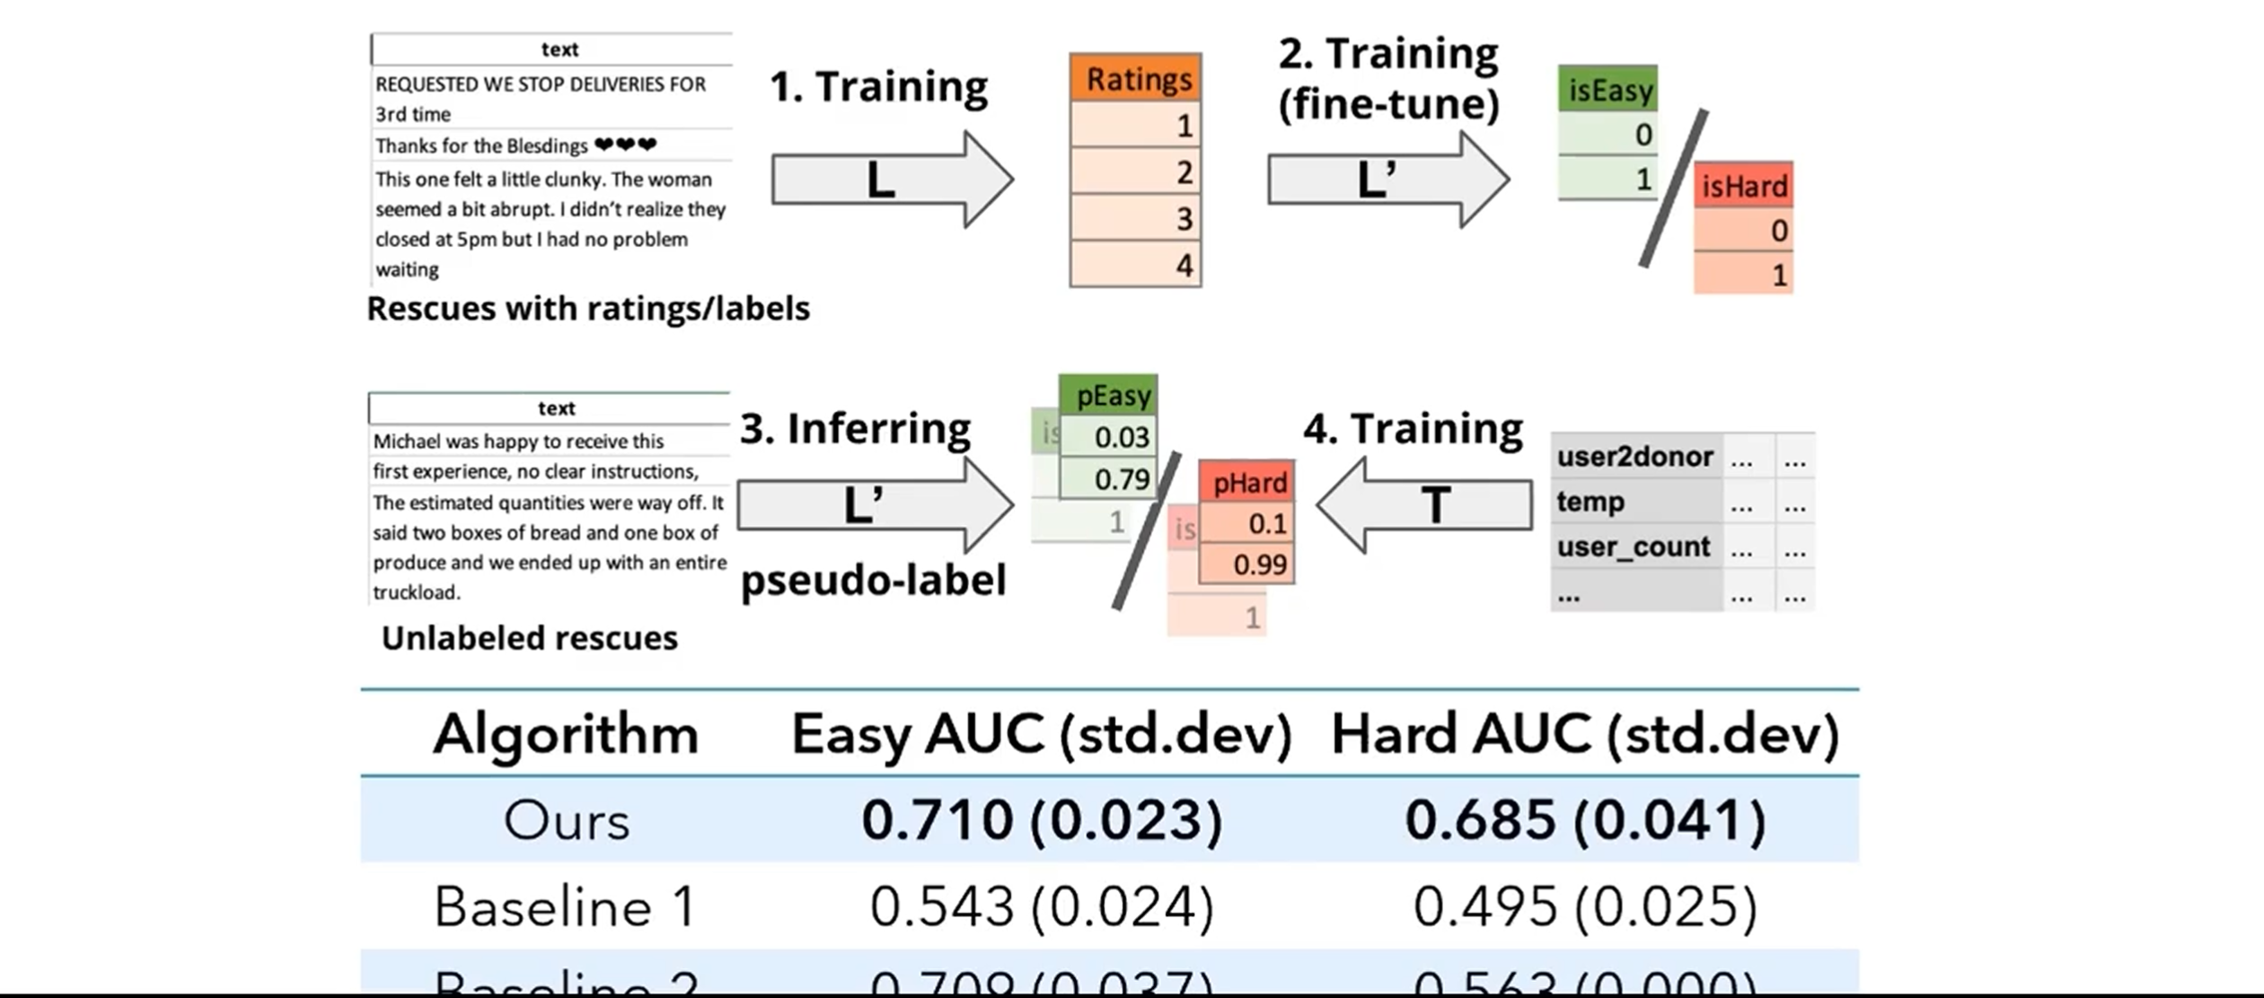
Can we predict whether a task would be easy/hard for volunteer?
hybrid model for prediction
bert-based language model for optimization
Notes:
Centering our study around this challenge, we make the following three contributions: first we developed a hybrid model to predict the difficulty level of each outcoming food rescue, we assembled a food rescue difficulty data set with expert labels from food Rescue Hero . As manual labels, they are too expensive, so we develop a bert-based language model to generate pseudo-label to optimize the training dataset. Our final model can identify easy rescue with 0.71 AUC and hard one with 0.685 AUC, significantly outperforming the baseline.

Slide 8
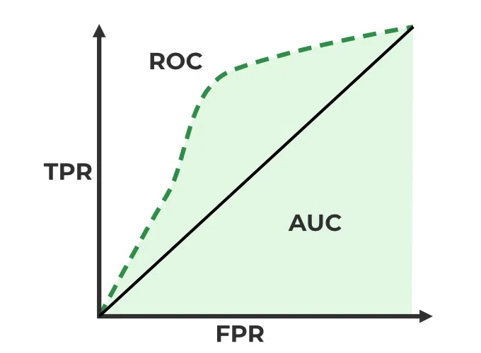
AUC?
Single‐number summary (ranging between 0.0 and 1.0) of how well a model distinguishes between two classes
AUC of 1.0: the model ranks all actual positives above all actual negatives
AUC of 0.5: it is no better than random guessing.
Notes:
Basically, AUC is a single‐number summary (ranging between 0.0 and 1.0) of how well a model distinguishes between two classes (e.g., “easy” vs. “hard” tasks). An AUC of 1.0 means the model ranks all actual positives above all actual negatives (perfect separation). An AUC of 0.5 means it is no better than random guessing.

Slide 9
Can we predict whether a task would be easy/hard for volunteer?
hybrid model for prediction
bert-based language model for optimization
identify easy rescue with 0.71 AUC
and hard one with 0.685 AUC
Notes:
Centering our study around this challenge, we make the following three contributions: first we developed a hybrid model to predict the difficulty level of each outcoming food rescue, we assembled a food rescue difficulty data set with expert labels from food Rescue Hero . As manual labels, they are too expensive, so we develop a bert-based language model to generate pseudo-label to optimize the training dataset. Our final model can identify easy rescue with 0.71 AUC and hard one with 0.685 AUC, significantly outperforming the baseline.

Slide 10



Task
Code Debugging & Preparation
Ensured successful compilation and runtime
Cleaned and verified numeric/geographic features
Model Training & Evaluation
Trained multiple tabular models (e.g., Random Forest, LightGBM)
Generated predictions and performed time-based analysis
Compared performances to find a best-fit model for real-world use
Deployment in AWS
Integrated the chosen model’s output into AWS environment
Validated end-to-end functionality
Notes:
Because I have been involved in this research project this spring semester, it has not been long, I've just completed some lighted tasks that Doctor Ryan gives to me so far.
First, I debugged our existing code to ensure everything could compile and run smoothly. This included fixing library incompatibilities, refining data preprocessing steps, and confirming that both numeric and geographic features were properly ingested. By doing this, I made sure the foundation for model training was solid.
Next, I moved on to model development and comparison. I experimented with several tabular models and then I fine-tuned their parameters using cross-validation. I incorporated time-based analysis to observe how each model’s predictions changed or trended over time. Ultimately, we wanted to identify which model had the most reliable performance not only in terms of accuracy or AUC scores, but also in terms of efficiency and stability.
And next step has not done by me yet. I will complete this task in the next period of time.
For this step, I will pinpoint the best model, I then integrated it into our AWS environment so it could be used in practice. I should also test it thoroughly to confirm everything was running correctly and securely in AWS

Slide 11
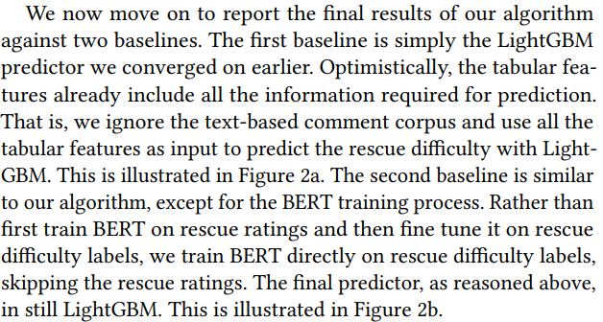
Baseline1, Baseline2 and Final Algorithm
Baseline 1 – Tabular Only
No BERT used
Trained only on gold-labeled tabular features
No pseudo-labels generated
Baseline 2 – Simple BERT + Pseudo-labels
Fine-tuned BERT on "easy/hard" labels
Generated pseudo-labels from text
Combined with tabular data for training
Final Algorithm – Full BERT with Rating Pre-training
Pre-trained BERT on volunteer ratings
Fine-tuned on difficulty
Combined text + tabular with best results
Notes:
"Here's a quick summary of the three modeling approaches we tested.
First, Baseline 1 is the simplest—it uses only the tabular data, no text, no BERT, just straightforward models like LightGBM.
Baseline 2 adds a layer of intelligence. It fine-tunes BERT on a small set of labeled data to generate pseudo-labels, then Combined those with the tabular features.
And finally, our Final Algorithm is the most complete. We first pre-train BERT on volunteer rating data, then fine-tune it on rescue difficulty. We combine these pseudo-labels with the tabular data and get the best performance
This progression shows how each layer of added information improves prediction."

Slide 12
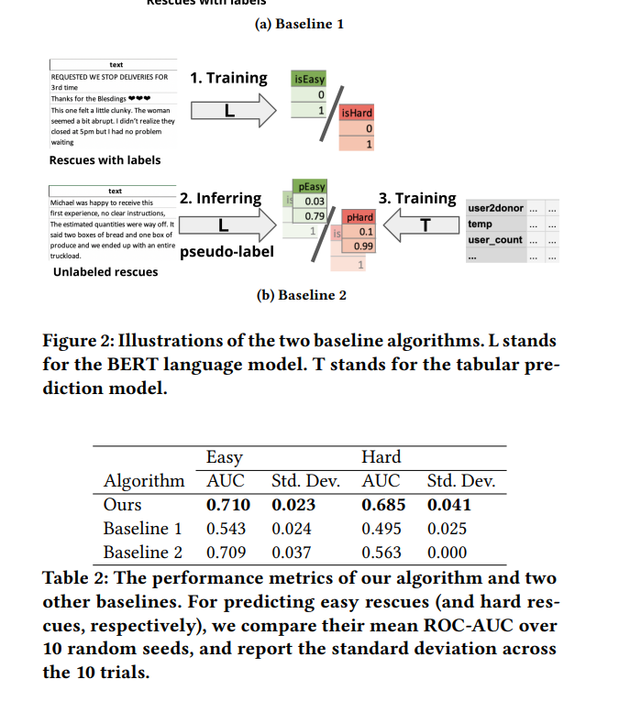
About details
Shortcoming of baseline1:
Only tabular features are not sufficient for prediction
comment text corpus and the pseudo-label generation are indeed helpful.
Shortcoming of baseline2:
First training BERT on rescue ratings indeed makes sense.
Far more (about 100x more) data points with ratings than with difficulty labels in the dataset
Notes:
For Baseline 1, the main issue is that it relies only on tabular features, which just aren’t enough on their own to make accurate predictions. Once we include comment text and generate pseudo-labels from BERT, we see clear performance improvement.
With Baseline 2, it skips an important step—pre-training BERT on the rescue ratings. That turns out to be a missed opportunity, because we actually have way more data points with ratings than with difficulty labels—nearly 100 times more.
The table below backs this up. You can see that our final model outperforms both baselines, especially on the hard examples, where Baseline 1 only gets an AUC of 0.495, while ours reaches 0.685."

Slide 13



Takeaway
Stay in regular contact with your professor to stay aligned.
Don’t hesitate to ask questions—engagement matters.
Remote work is convenient but may reduce active involvement.
Hands-on research helps fill gaps in theoretical knowledge.
Notes:
Here are some takeaways from my research experience. Firstly, I need to make sure that our progress is in line with that of the professors. If we are unfortunately unable to keep up with the progress of the professors, then we should contact them immediately/ Next, always feel comfortable asking questions. But before you do, try to spend a little time thinking about it yourself. This helps you strengthen your own problem-solving and coding abilities. Third, our research work, including meetings is all remote. My courses are heavy this semester, so remote work is very friendly for me, but remote work does not really motivate me to do my work well. I think I am the kind of person who relies on a suitable and strong working environment to have good work efficiency. So, if possible, I hope that my future internship or research experience can be personal. Finally, scientific research practice can greatly make up for the shortcomings of the knowledge learned and even bring me more knowledge that I don’t know.

Slide 14

1.Good Experience
2. 2 direction: Software Engineering/ ML
3. Hesitation(Need more time to decide)
Summary

Slide 15

Reference
Shi, Ryan Z. Ryan Z. Shi – Homepage. https://ryanzshi.github.io/. Accessed 3 Apr. 2025.
Wang, Tony, et al. "How Hard Is It to Find a Needle in a Haystack? A Study of Model-Based Food Rescue." Proceedings of the ACM Web Conference 2024, 2024, https://doi.org/10.1145/3589334.3648155. Accessed 3 Apr. 2025.

Slide 16


