Slide 1

Eyetracking experiment The processing of subject and object relative clauses in German
Department of Computational Linguistics
Department of Computational Linguistics
Micaela Ribeiro Vieira, Nadja Näf

Slide 2
Outline (TEMPORARY!!!!!!)
Department of Computational Linguistics
Purpose and research questions of the experiment
Experimental design
Stimuli
Latin square design
Statistics
Region of interest and dependent variables
Window design
Data recording
Breaks

Slide 3
Purpose and research questions of the experiment
Department of Computational Linguistics
Department of Computational Linguistics
Purpose:
In this experiment, eyetracking is used to investigate visual-word processing of relative clauses in German
We plan on recruiting 20 participants
The participants are adult L1 German speakers between 18 and 50 years of age
Research questions:
Are subject-relative clauses easier to process than object relative clauses?
Is this effect further affected if the relative pronouns show no distinguished declination?

Slide 4
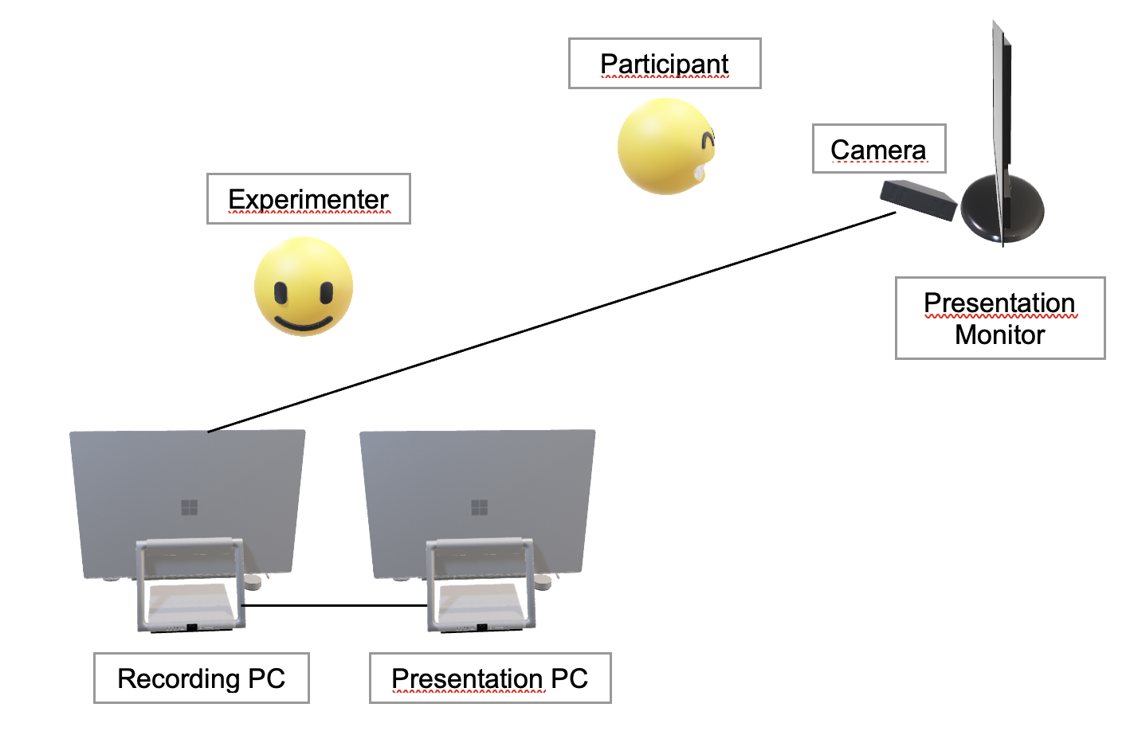
Experimental design
Department of Computational Linguistics
Department of Computational Linguistics
The participant and the experimenter are in the same room without windows
The participant’s head will be stabilized with the chin- and forehead rest that the Eyelink Portable Duo eye tracker provides
The distance between eye and optical camera is 50 cm
The Eyelink Portable Duo eye tracker is placed just in front of the monitor, which is at a distance of around 75 cm of the participant
The sampling rate used is 1000Hz
The instructions will be given orally by the experimenter to the participant

Slide 5
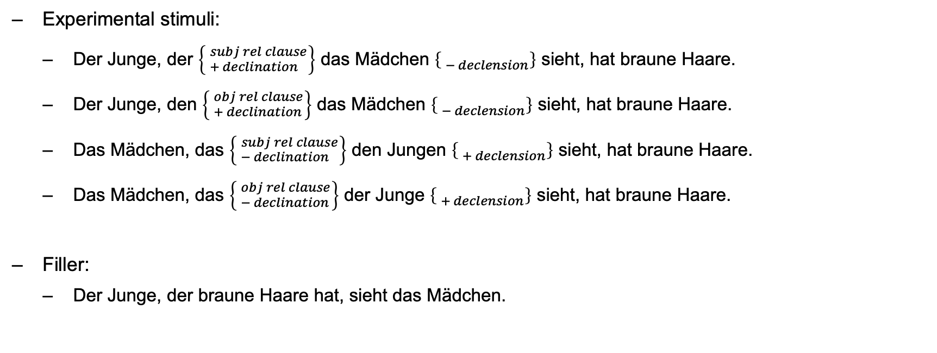
Stimuli
Department of Computational Linguistics
Department of Computational Linguistics
Experimental stimuli:
Der Junge, der $\left\{ _{+ declination}^{subj rel clause}\right\}$ das Mädchen $\left\{ _{− declension}^{ }\right\}$ sieht, hat braune Haare.
Der Junge, den $\left\{ _{+ declination}^{obj rel clause}\right\}$ das Mädchen $\left\{ _{− declension}^{ }\right\}$ sieht, hat braune Haare.
Das Mädchen, das $\left\{ _{− declination}^{subj rel clause}\right\}$ den Jungen $\left\{ _{+ declension}^{ }\right\}$ sieht, hat braune Haare.
Das Mädchen, das $\left\{ _{− declination}^{obj rel clause}\right\}$ der Junge $\left\{ _{+ declension}^{ }\right\}$ sieht, hat braune Haare.
Filler:
Der Junge, der braune Haare hat, sieht das Mädchen.

Slide 6
Latin square design: 2x2 fully-crossed design
Department of Computational Linguistics
Department of Computational Linguistics
Factor I: relative clause type {subject clause, object clause} Factor II: gender of relative pronoun {male, female}
All factors will be arranged into a 2x2 fully crossed within-subjects, within-items factorial design
Relabeling all possible combinations of factor levels as conditions:
a. subject relative clause, male
b. subject relative clause, female
c. object relative clause, male
d. object relative clause, female
See generate_lists.py for the latin square implementation

