Slide 1
Witricity
Presented by Team A
Caleb, Christy, Jerry, Keith & Micah

Slide 2
What Is Witricity

Slide 3
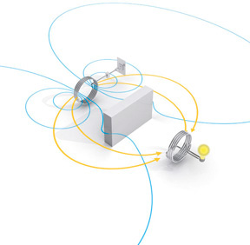
How Does It Work
Resonant magnetic coupling
Magnetic Resonators
Magnetic near field
Efficient energy transfer over impressively long distances.

Slide 4
How It’s Used
Power Light Fixtures
Powering Small Appliances
Powering Mobile Phone
Charging batteries

Slide 5
Why Use It?

Slide 6
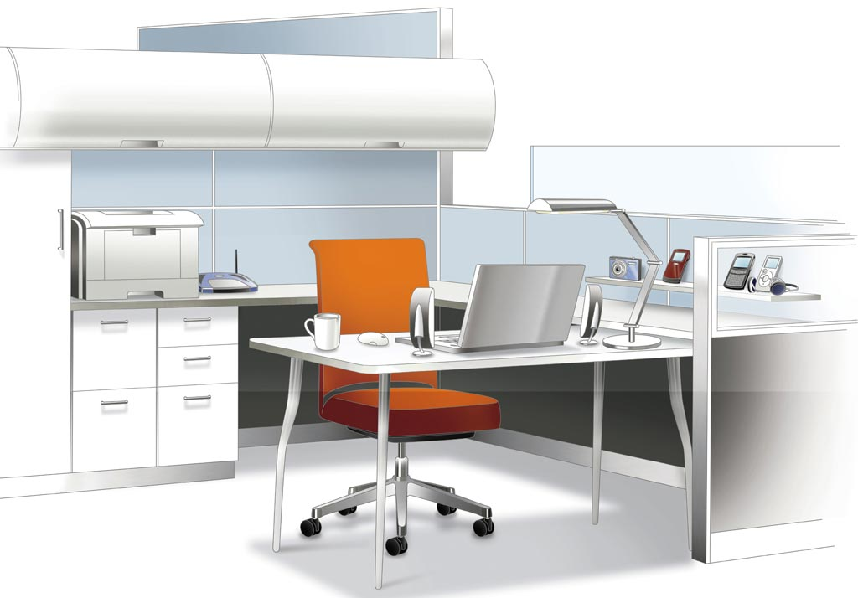
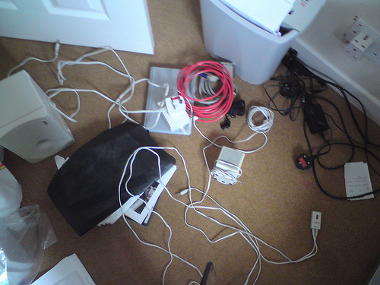
How Safe Is It?
Medical devices interaction
Biological effects
Other hazards

